Slide 1
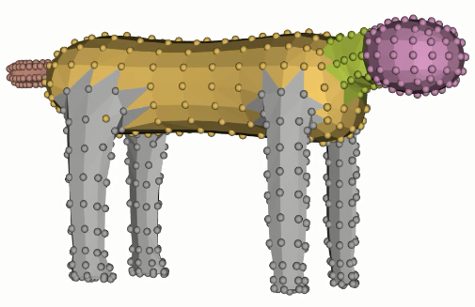


$R_{i}^{f}=\exp{r_{head}^{f}}$ 0-dof pvpf
3-dof per frame
$R_{i}^{f}=\exp{r_{neck}^{f}}$ 0-dof pvpf
3-dof per frame
$R_{i}^{f}=\exp{γ_{i}^{f} r_{leg}}$ 1-dof pvpf
2-dof global
2-dof pvpf
4-dof global ($r_{body}^{1,2}$)
$R_{i}^{f}=\exp{r_{i}^{f}}$ 3-dof pvpf
$$R_{i}^{f}=\prod_{k=1}^{2}{\exp{γ_{i,k}^{f}r_{body}^{k}}}$$
pvpf: “per vertex, per frame”

Slide 2
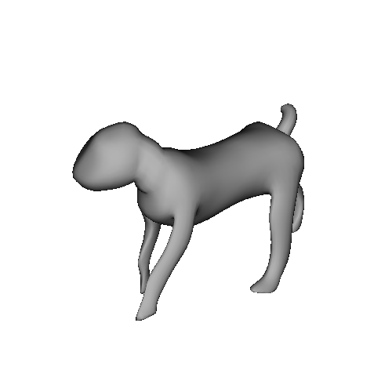
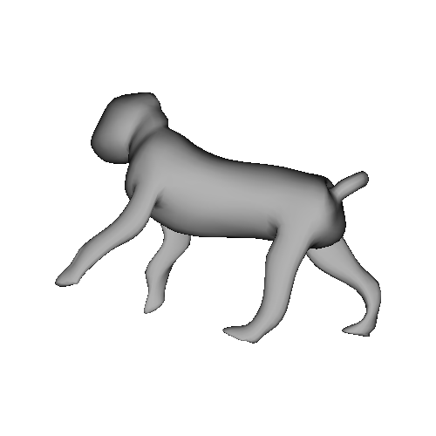
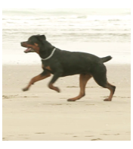
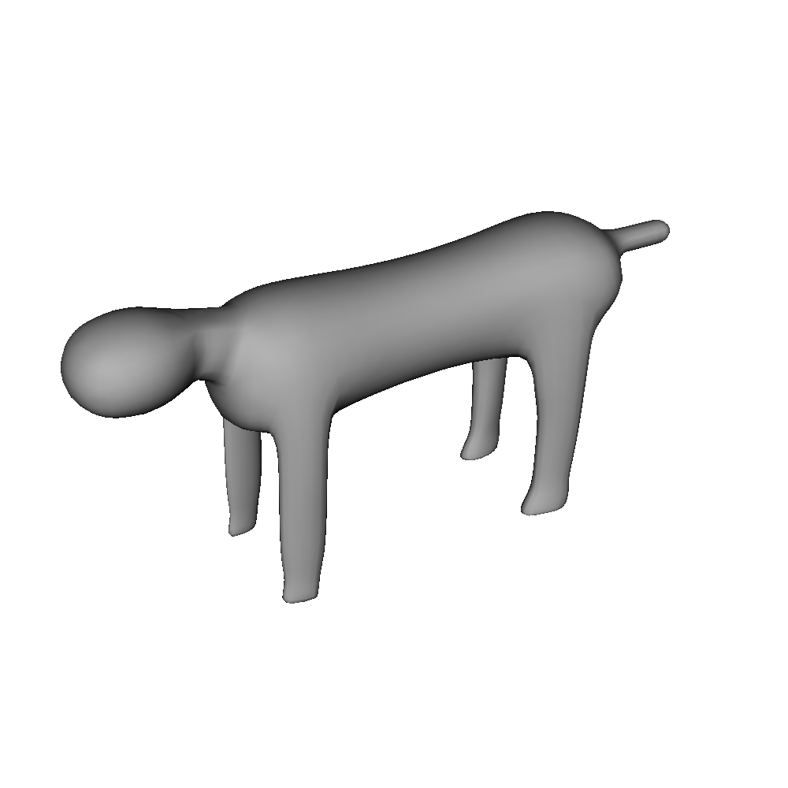
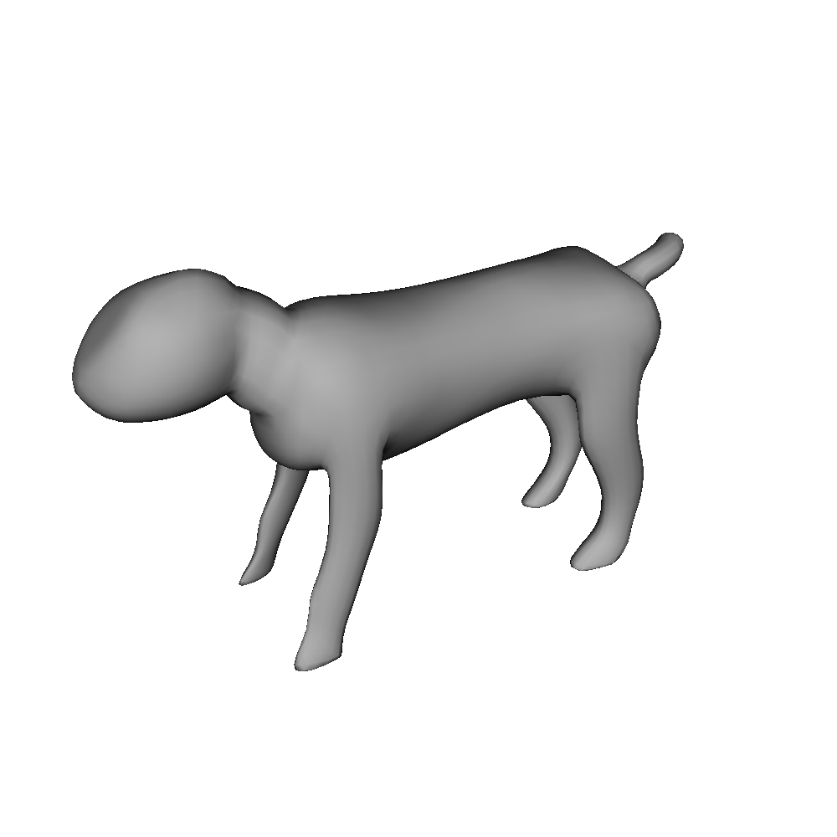
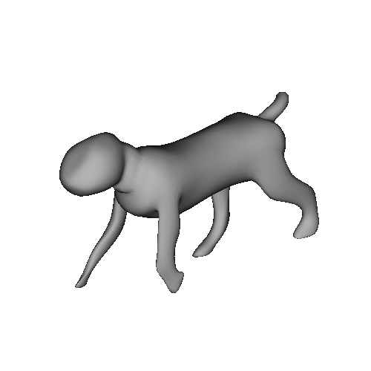
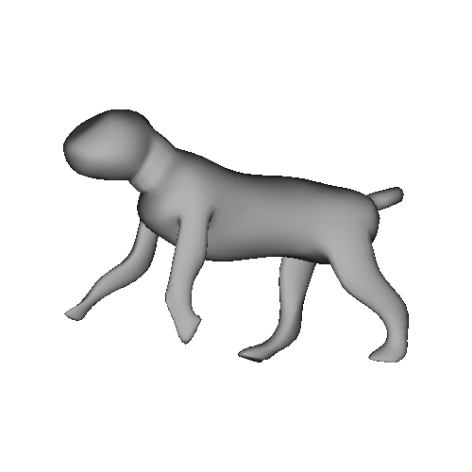
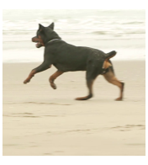
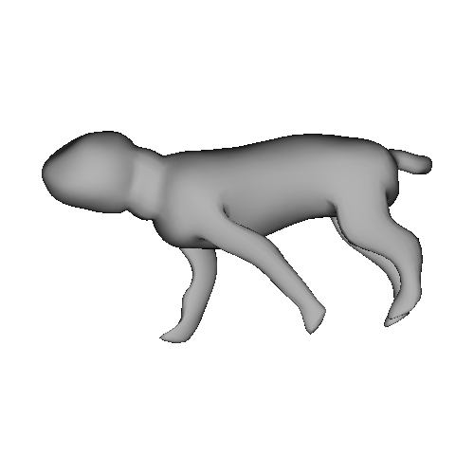
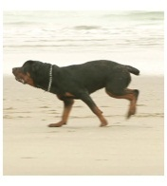
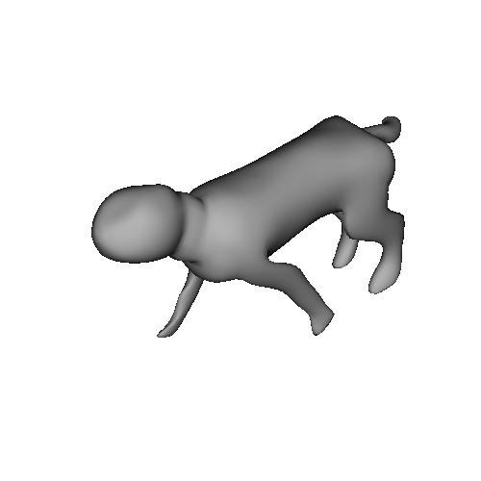
















$$𝒬_{t−1}$$
$$𝒢_{t−1}$$
$$𝒲_{t−1}$$
$$𝒱_{t−1}^{}$$
ARAP
$$𝒬_{t}$$
$$𝒢_{t}$$
$$𝒲_{t}$$
$$𝒱_{t}^{}$$
$$ℛ_{core}$$
$$𝒱_{template}$$
$$𝒱_{core}$$
template
mesh
ARAP
rotations
core
mesh
ARAP
$$𝒬_{t+1}$$
$$𝒢_{t+1}$$
$$𝒲_{t+1}$$
$$𝒱_{t+1}^{}$$
Hinted ARAP rotations, parameterized by $γ_{i,t}$
frame
poses
instance
meshes
silhouette
preimages
image
constraints

Slide 3
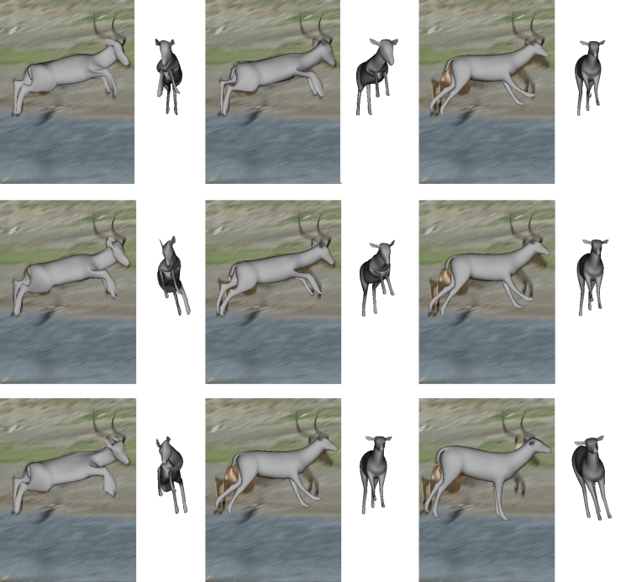








$$w_{instance−core}→$$
$$0.01$$
$$1$$
$$100$$
$$w_{core−template}→$$
$$0.01$$
$$1$$
$$100$$

