Slide 1
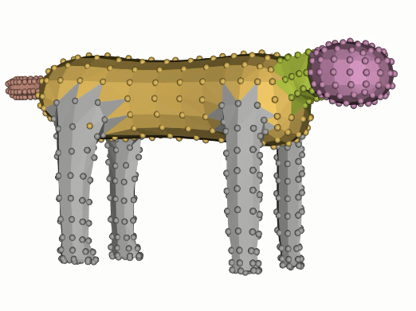
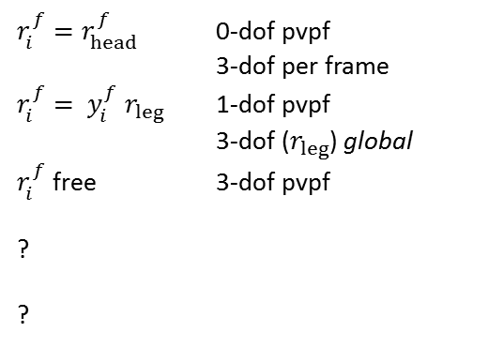
$r_{i}^{f}=r_{head}^{f}$ 0-dof pvpf
3-dof per frame
$r_{i}^{f}= y_{i}^{f} r_{leg}$ 1-dof pvpf
3-dof ($r_{leg}$) global
$r_{i}^{f}$ free 3-dof pvpf
?
?
pvpf: per vertex, per frame

