Slide 1

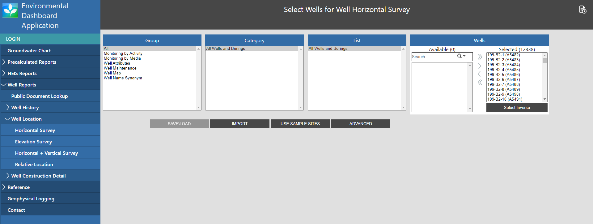
Well locations are retrieved from the Environmental Dashboard Application (EDA):
https://ehs.hanford.gov/eda/#/eda/Report/SearchCriteriaSelect?reportId=50&typeId=1
2) Click here to run report
1) Click here to select all wells available

Slide 2
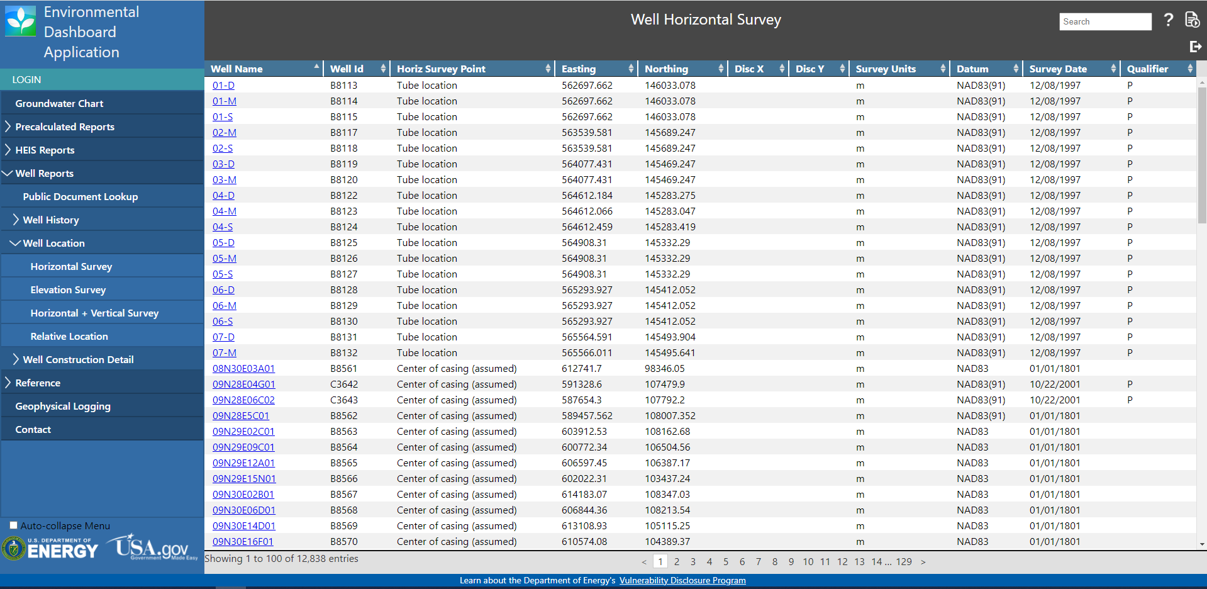
Once you click run report a new page will load showing the horizontal data for all available wells. These records can be exported as a .xlsx file which contain Easting (x) and Northing (y) coordinates.
Click here to export report

