Slide 1
Blockchain platform for issuing and verifying Higher Education diplomas
Student: Dorin-Liviu Heroi
Thesis advisor: Alexandra Cernian

Slide 2
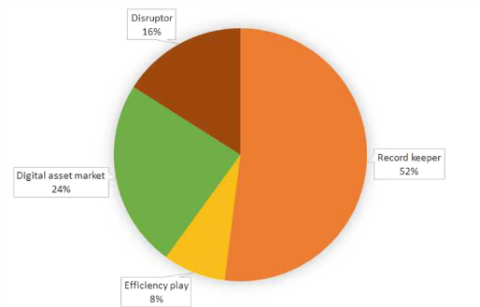
Motivation
The “Why?” of the project:
Popularity of blockchain
Potential of development of blockchain(due to novelty)
Small number of projects in this specific field
Usage of a different type of blockchain
A different approach with diploma storage(IPFS)
The share of applications within the educational domain classified into four blockchain initiatives

Slide 3
Hyperledger fabric & IPFS
Hyperledger Fabric:
Scarce use may bring more importance to the project by discovering new challenges
New opportunities and advantages as oposed to a public blockchain such as: lower costs, trusted network (permissioned architecture)
As very detail of blockchain can change for the better, the more customizable and modular it is, the better (Hyperledeger uses popular languages, modular architecture)
IPFS:
Not used in other projects
Possibility of diploma retrieval if student loses it
Privacy solution of encrypting diplomas

Slide 4
Implementation requirements
None but authorized departments from the accepted institutions are allowed to issue diplomas
Diplomas should be confidential on chain
Processes of issuance and verification should not imply any technical skill
The possibility of revoking issued documents
Diplomas should be issued in a digital format

Slide 5
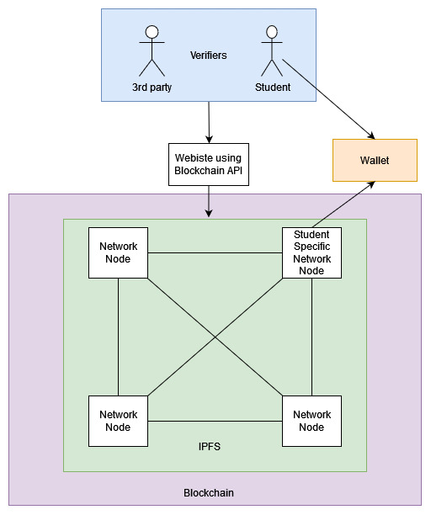

Slide 6
Development plan
Semester 2&3:
Familiarize and develop the Hyperledger fabric blockchain with the afore specified requirements
Familiarize and develop the IPFS network for diploma storage with the afore specified requirements
Create an easy method with which students can generate their wallets
Create and polish the API so that the interaction between an application (such as a website) and the blockchain and IPFS network is facilitated
Semester 4:
- Polishing of the overall project and final tests

