Slide 1
Gender Recognition by Voice
Vaibhavi Awghate

Slide 2
About the data..
Data was collected from https://www.kaggle.com/primaryobjects/voicegender.
Initially, the author had .wav files.
Used WarbleR package of R to get the acoustic properties of a person.
Final dataset had 20 attributes and a target variable.

Slide 3
Methodology
Data Analysis
Data Preprocessing
Data modeling
Evaluation

Slide 4
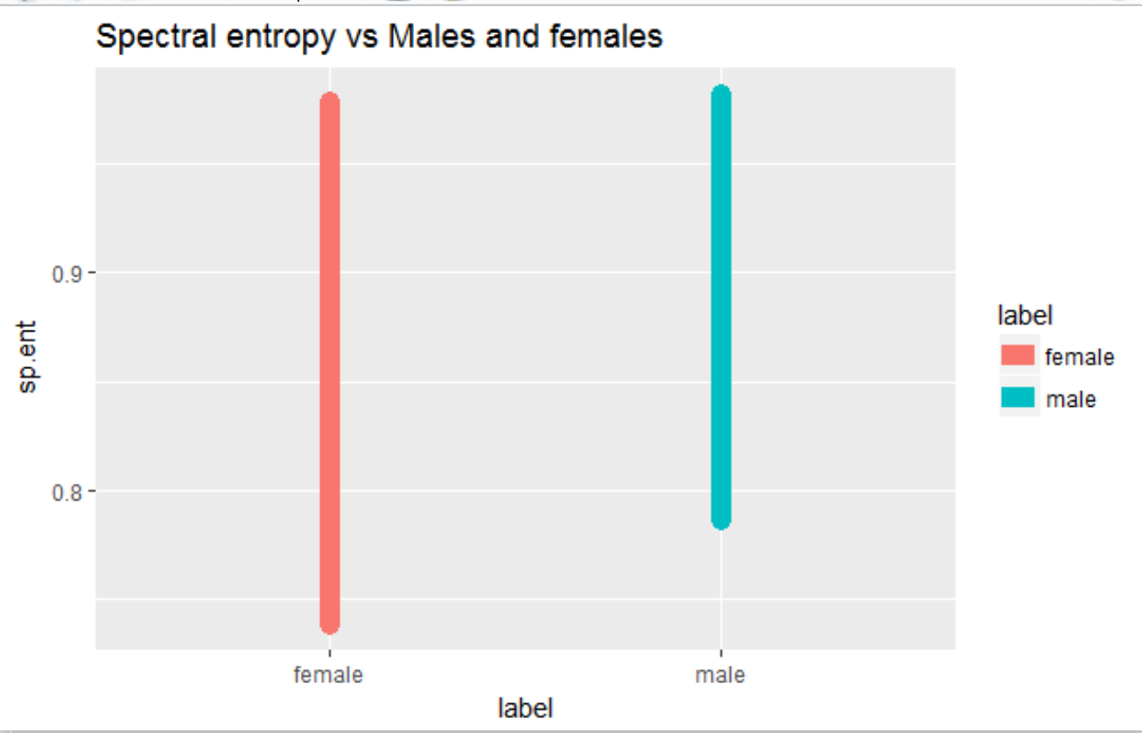
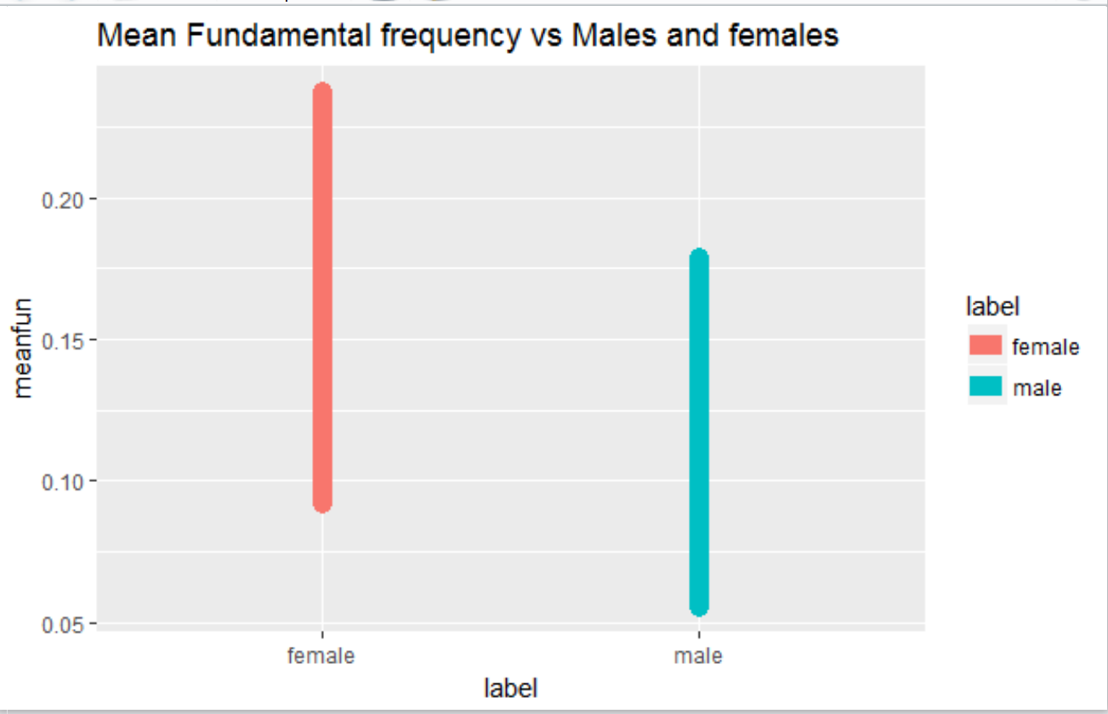
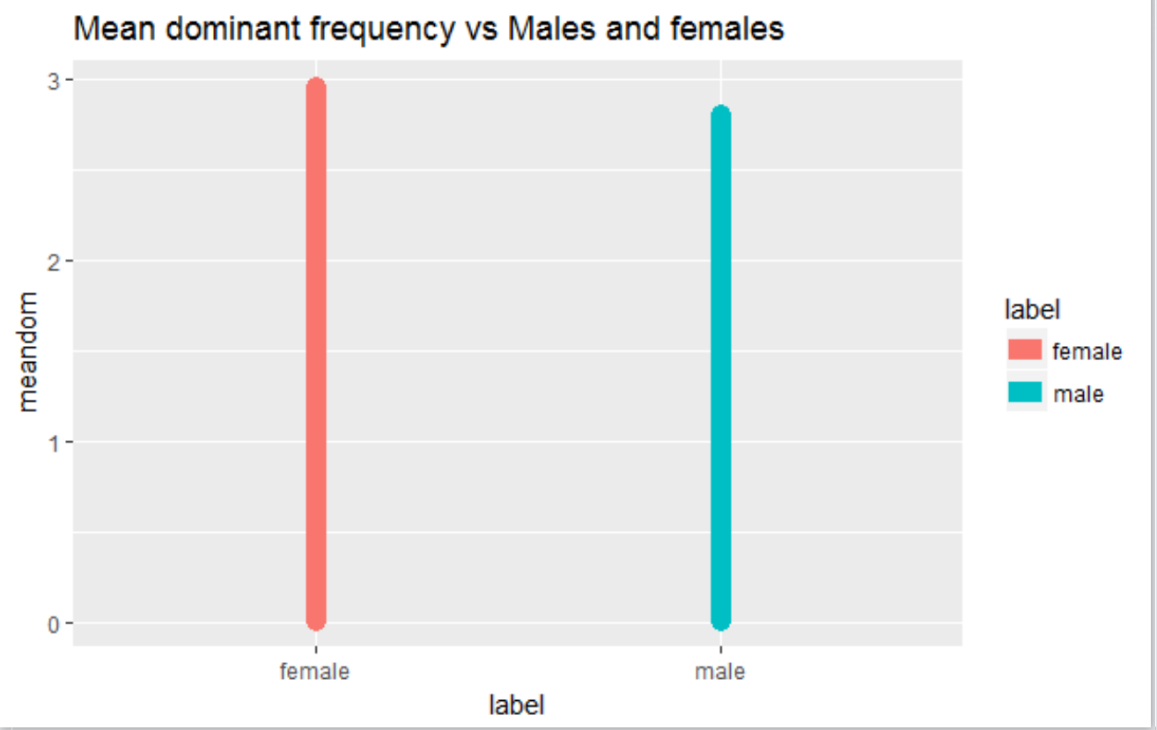
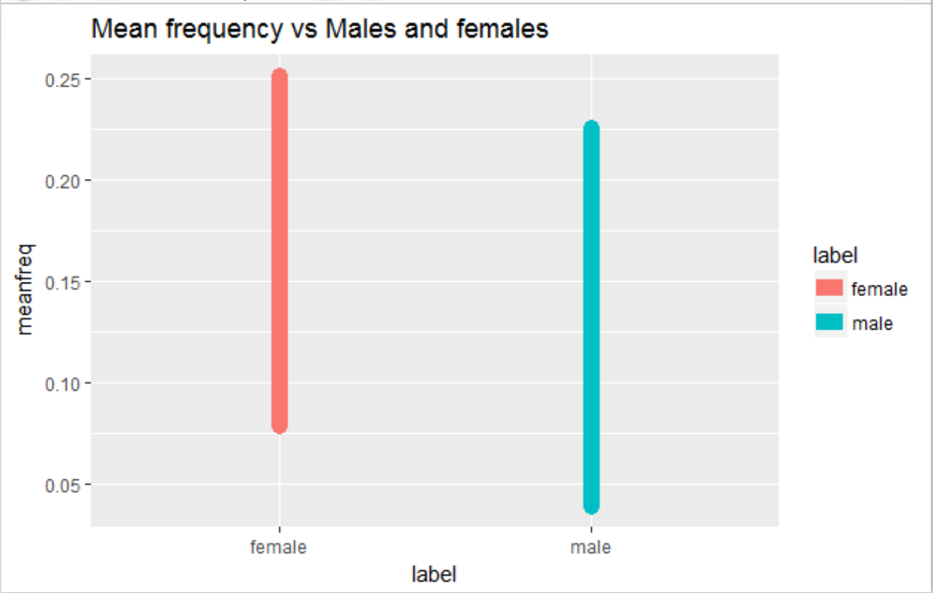
Data Analysis

Slide 5
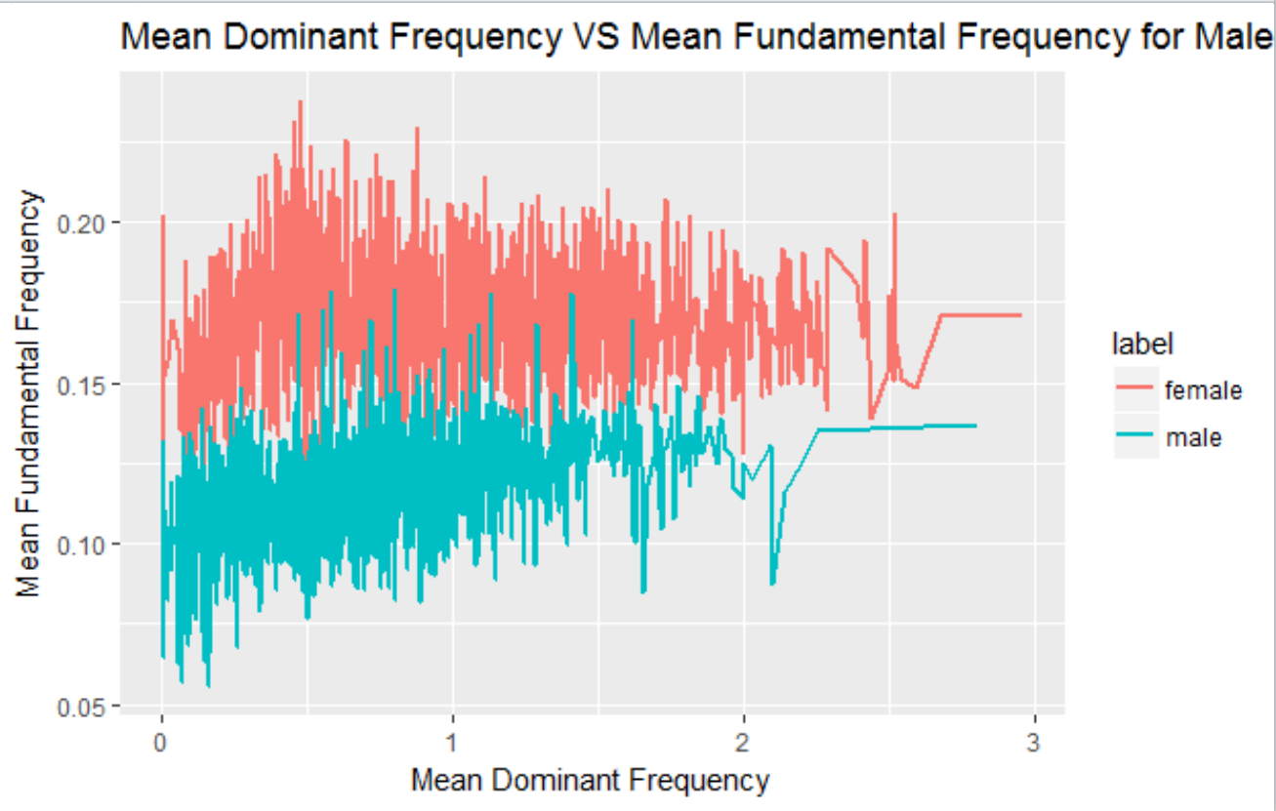
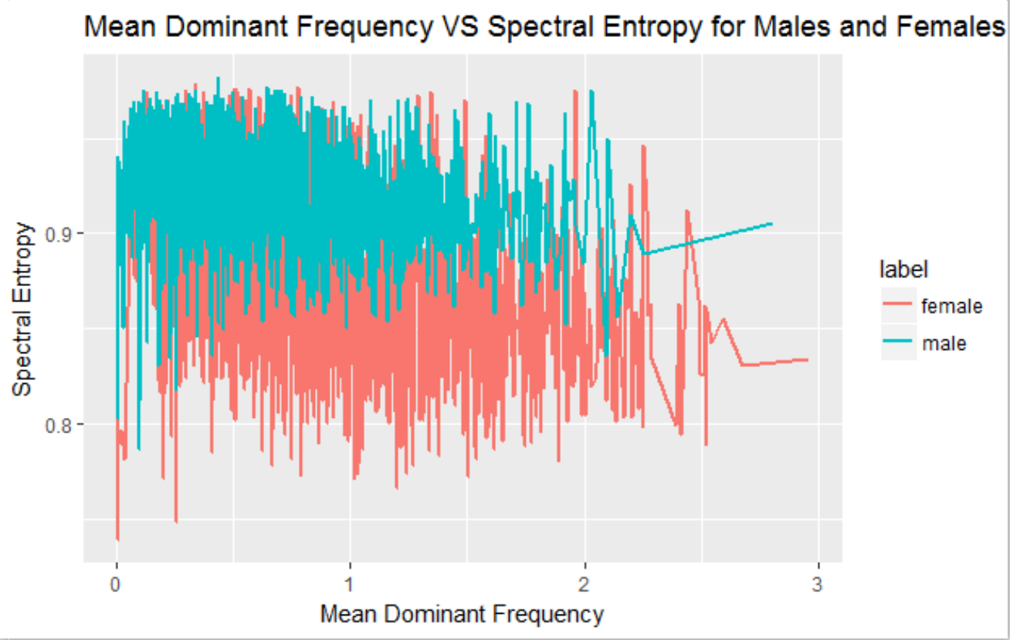
Data Analysis

Slide 6
Methodology
Data Analysis
Data Preprocessing
Data modeling
Evaluation

Slide 7
Data Preprocessing
Used Principal Components Analysis (PCA) for dimensionality reduction.
Reduced 20 dimensions to 10 dimensions.
Resulted in increased speed, but decreased accuracy.

Slide 8
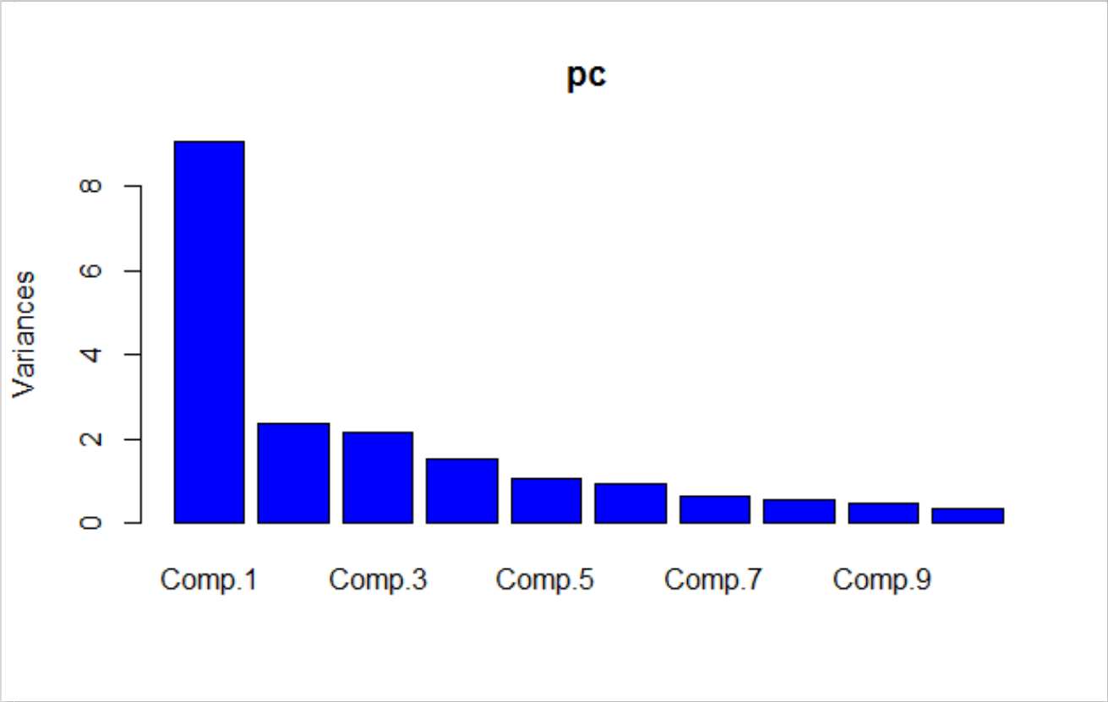
Data Preprocessing

Slide 9
Methodology
Data Analysis
Data Preprocessing
Data modeling
Evaluation

Slide 10
Data Modeling
Used five different classification algorithms.
OneR Rule
CART
J48
Naïve Bayes
Random Forest
Applied classification algorithms both on processed and unprocessed data.
Generated confusion matrix to evaluate each of the classifier.

Slide 11
Methodology
Data Analysis
Data Preprocessing
Data modeling
Evaluation

Slide 12
Accuracy Comparison
Classifiers | Accuracy before PCA | Accuracy after PCA
OneR rule | 95.17 | 76.59
CART | 97.37 | 91.48
J48 | 97.37 | 94.53
Naïve Bayes | 88.96 | 94.21
Random Forest | 98.32 | 97.16

Slide 13
Time Comparison
Classifiers | Before PCA | After PCA
OneR | 0.35 | 0.09
CART | 0..33 | 0.29
J48 | 0.73 | 0.23
Naïve Bayes | 0.06 | 0.01
Random Forest | 3.63 | 3.28

Slide 14
Thank You!!

