Slide 1
YARD SCHEDULER APPLICATION
A modern approach to solve hump yard scheduling
Thomas Anthone, Chris Recinos, Anna Rue, Adam Halley

Slide 2
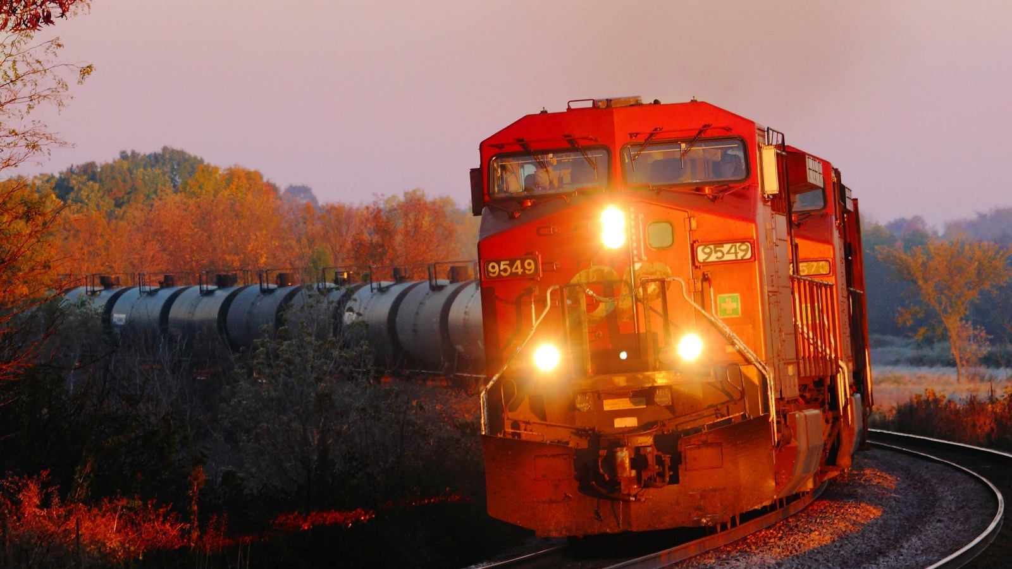
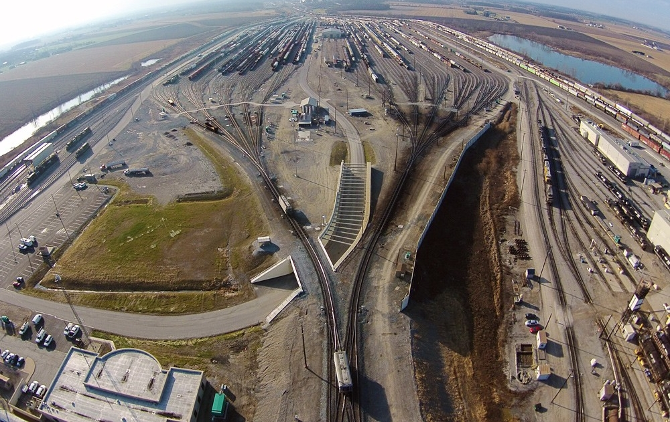
How to Use this File
Hump Yard Operation
Large Scale Maintenance
Train Routing
Load Shifts
As a design guide.
The following slides provide a number of examples and useful information regarding the design and use of this template.
As a starting point.
Edit the sample slides in this deck, replacing the existing data with your own.
As a PowerPoint template.
Save this deck as a POTX file to make it available every time you create a new presentation.

Slide 3


Application Purpose
The purpose of of this application is to simplify hump operations for all terminal managers. (DTO, MYO, MTO, DYO, Sup, Yard Master, etc.)
The Application will work alongside terminal automation hardware/software.
Designed for continued optimization and cross functional integration.

Slide 4
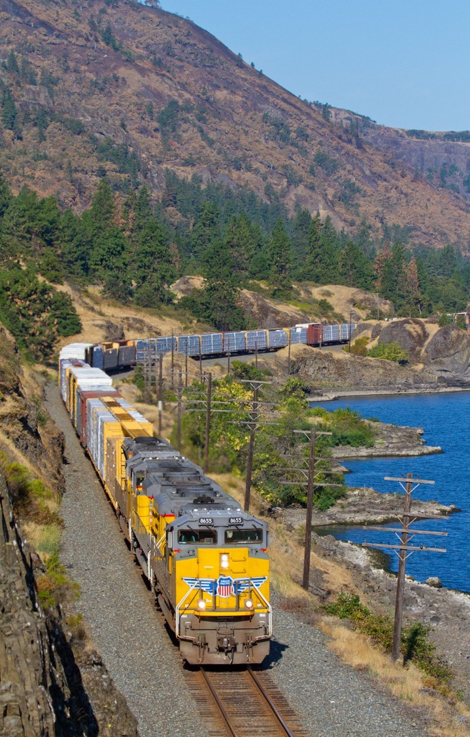
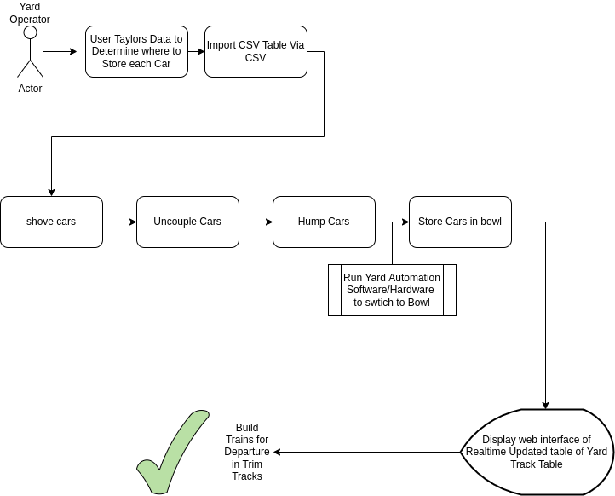
Project Work Flow Diagram

Slide 5
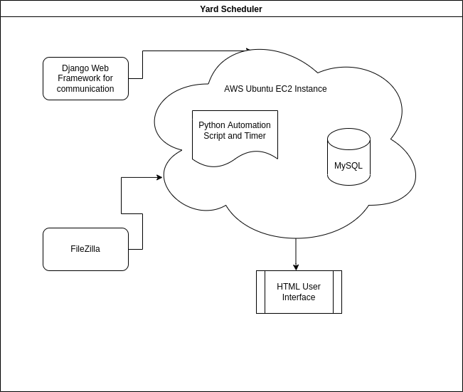

Simple Diagram

Slide 6





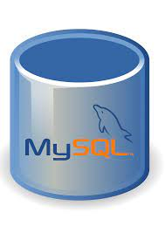
Tools Used
Django
Django Rest Framework
MYSQL
Python 3.11
Jet Brains YouTrack
NGINX Server
EC2 AWS Instance
Git/Github

Slide 7
Demo

Slide 8
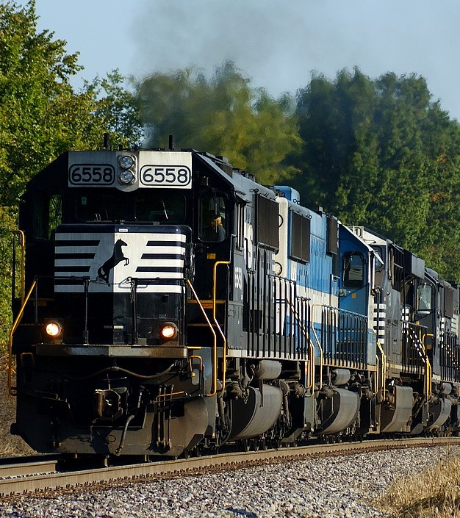
Moving Forward
Rest framework allows for customized integration
Optimize Hump Logic
Work on trim track/ outbound scheduling
Work on integration with proprietary servers (i.e. Apache Tomcat)

Slide 9
Questions
Adam Halley – ahalley@unomaha.edu
Anna Rue – arue@unomaha.edu

