Slide 1
Programming Fundamentals for Android
Utilize Data
January 21, 2016

Slide 2
Corresponding Text
Learn Java for Android Development, pp. 1-11, 37-70

Slide 3
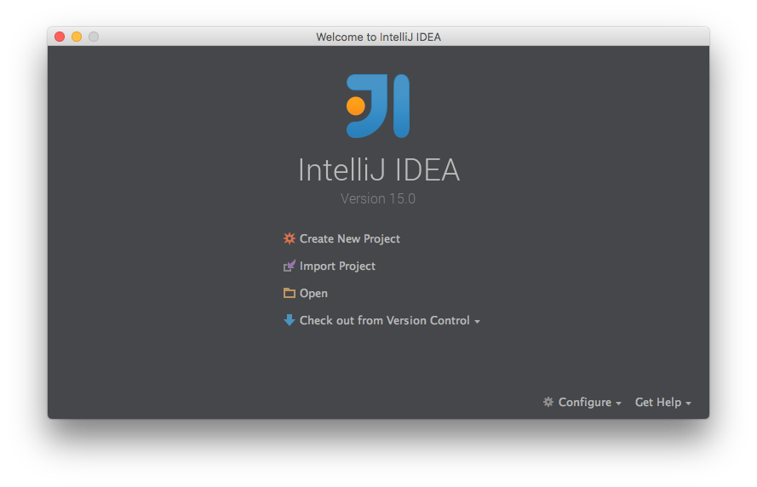
IntelliJ IDEA Java IDE
IntelliJ is a Java integrated development environment (IDE)
Available at https://www.jetbrains.com/idea/download
Requires the Java development kit (JDK) available at https://www.oracle.com/technetwork/java/javase/downloads

Slide 4
Our First Java Program
package com.myname.week_01;
public class Main {
public static void main(String[] args) {
System.out.println("Hello, World!");
}
}
We’ll often use System.out.println() to display data at the console.

Slide 5
Variables and Data Types
A variable is a named location in the computer’s memory use to store a value.
A data type is a classification of data items and specifies possible values.

Slide 6
Primitive Data Types
Data Type | Description
boolean | two possible values: true and false
char | a single Unicode character such as "A", "z", "5", or "%" with integer value between 0 and 65,535
byte | an integer value between -128 and 127, uses 8 bits of memory
short | an integer value between -32,786 and 32,767, uses 16 bits of memory
int | an integer value between -2,147,483,648 and 2,147,483,647, uses 32 bits of memory
long | an integer value between -9,223,372,036,854,775,808 and 9,223,372,036,854,775,807, uses 64 bits of memory
float | a 32-bit value used to represent numbers with fractional parts
double | a 64-bit value used to represent numbers with fractional parts

Slide 7
Reference Data Types
A variable with a reference type stores a reference, a memory address, to the location in memory that stores the value associated with the variable.
Compare this to a primitive type which stores the value directly.
An example of a reference type is the String type. A string is a sequence of characters.

Slide 8
Creating Variables and Storing Values
Variable names can be any collection of letters, digits, “_”, or “$” as long as the name doesn’t begin with a digit.
Variables must be declared before they can be used. To declare a variable, we must specify both a type and a name.
float temperature;
int zipCode;
boolean isRaining;
String cityName;
We can declare several variables of the same type at once.
float temperature, humidity, pressure;

Slide 9
Arrays
We can use a single variable to store multiple values of a certain type.
Array types are reference types that allow us to store values in equal-sized, contiguous locations in memory.
Individual values in an array are known as elements.
Brackets, [ and ], are used in array declarations.
Examples:
int[] dailyHighs;
String cityNames[];
Usually see brackets next to type except when delcaring multiple variables.
float currentTemperature, forecastHighs[], forecastLows[];

Slide 10
Expressions
An expression is a combination of literals, variable names, method calls, and operators.
A literal is an value expressed verbatim like the integer 123 or the string “hello”.
There are several kinds of literals: a single character, a string, an integer, a floating-point value, a boolean value, and null (used to indicate that a reference value doesn’t refer to an object).
Data Type | Literal Examples
char | '1', 'A', '?'
String | "Hello", "Goodbye"
int | 1, -20, 1234
double | 1, 2.0, 0.828, -123.92929
boolean | true, false

Slide 11
Expressions
A simple expression is an individual literal, variable name, or method call.
A compound expression is a sequence of simple expressions and operators.
An operator is a symbolic instruction used to transform data, the operands, into another value.

Slide 12
Arithmetic Operators
Operator | Symbol | Description
Addition/String Concatenation | + | Returns the sum of two numeric operands or the concatenation of strings
Division | / | Returns the quotient of two numeric operands
Multiplication | * | Returns the product of two numeric operands
Subtraction | - | Returns the difference of two numeric operands
Unary Plus | + | Returns the numeric operand
Unary Minus | - | Returns the arithmetic negative of operand
Increment | ++ | Add one to the operand, prefix and postfix operator
Decrement | -- | Subtract one from the operand, prefix and postfix operator

Slide 13
Other Operators
Operator | Symbol | Description
Array Index | [ ] | Given variable[index], where index is an integer, return or store the value in variable's storage at index
Assignment | = | Given variable = operand, store operand in variable
Compound Assignment | +=, -=, *=, /= | Given variable operator operand, perform the operation using the existing value of variable and operand, store the result in variable
Comparison | ==, <, <=, >, >= | Given operand1 operator operand2, compare both operands, return true or false depending on the comparison; includes equality, less than, less than or equal to, greater than, greater than or equal to
Object Creation | new | Given new identifier[integer size], allocate a one-dimensional array of values with type identifier

Slide 14
Examples

Slide 15
GitHub
We’ll be using GitHub to share our work and to submit assignments.
Built on Git, a version control system used to track changes.
Four distinct parts: the working directory, the staging area, the local repository, and a remote repository.
For an overview of Git, see https://try.github.io.
Sign up for a GitHub account at https://github.com.
We can work with GitHub directly from IntelliJ.

Slide 16
First Project
Project 1 should make use of topics covered during weeks one though three.
Create a program that allows a user to add, remove, edit, and list to-do items by presenting the user with a menu similar to the following:
Please choose an option:
(1) Add a task.
(2) Remove a task.
(3) Update a task.
(4) List all tasks.
(0) Exit.
If the user chooses to add a task, the program should prompt for a description of the task and add it to the collection of tasks.
If the user chooses to remove a task, the program should ask the user which item to remove and remove it from the collection of tasks.
If the user chooses to update a task, the program should ask which task will be updated and for a new description of the task.
The program should loop until the user chooses to exit.
The program should include methods dedicated to adding, removing, and updating tasks.

Slide 17
Exercise
Write a program that stores a city name as a string, the city's zip code as an integer, and the high temperature for the next five days in an array. The program should calculate the average high temperature for the next five days and store the value in a variable. Finally, the program should display the city name, the zip code, and the average high temperature.
The average of a collection of values is the sum of all the values divided by the number of values.
For example, if the city is Columbus; the zip code is 43215; and the high temperatures for the next five days are 32, 25, 27, 40, and 45, the output of the program might be:
City: Columbus
Zip Code: 43215
Average High Temperature 33.8
When computing the average high temperature, was the value stored as an integer value or a floating-point value? What happens to the computed average with either data type?
Be sure to commit your code and push it to GitHub.

