Slide 1
Programming Fundamentals for Android
Week 4: Collection Types
February 11, 2016

Slide 2
Reminders
Project 1 due today
Project 2 available today
Weekly exercises and projects submitted using GitHub URLs

Slide 3
Corresponding Text
Learn Java for Android Development, pp. 305-318, 404-425, 448-456

Slide 4
Collaboration on GitHub
Forks and Pull Requests

Slide 5
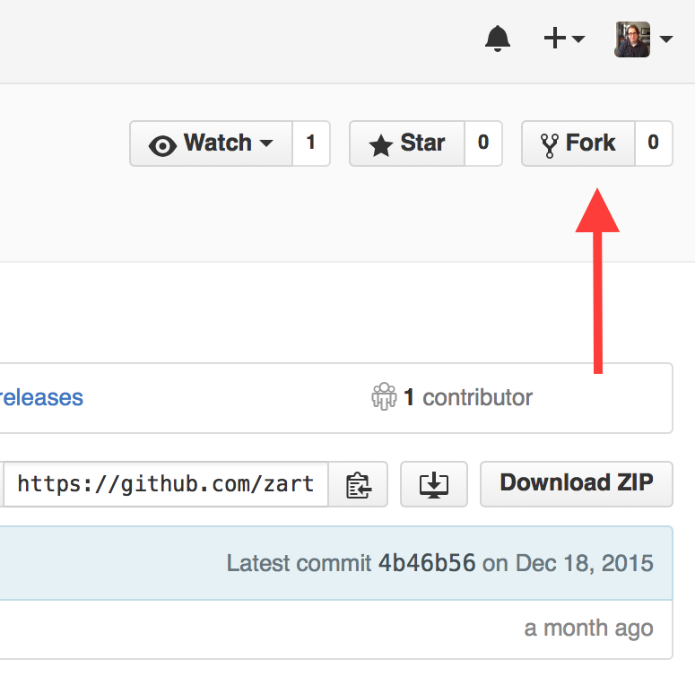
Forks
A copy of a repository
GitHub keeps track of upstream changes
We can import the project from GitHub into IntelliJ
gitignore used to ignore certain files

Slide 6
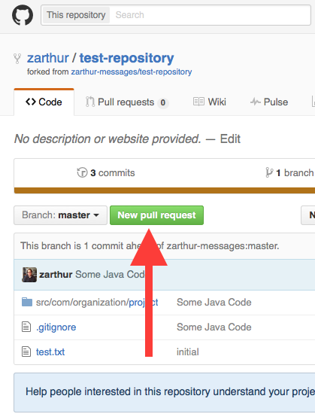
Pull Requests
Used to incorporate changes into original repository
Owner can approve changes by merging the pull request
We can get upstream changes using pull requests and by switching the base

Slide 7
Introduction to Object-Oriented Programming Topics
Classes, Instances, Interfaces, and Objects

Slide 8
Definitions
An class specifies a structure consisting of data attributes and code for acting on these attributes
An object is a specific instance of a class, created with the new operator, allowing us to use specific values for attributes
An instance method allow us to use or alter values unique to a given object
An interface specifies what attributes or methods a class will have.

Slide 9
Collection Interface
Method Signature | Description
boolean add(E e) | Add an element, e of type E to the collection; returns true if the element is added and false otherwise
void clear() | Remove all elements from the collection
boolean contains(Object o) | Returns true if the element o is present in the collection and false otherwise
boolean isEmpty() | Returns true when the collection has no elements and false otherwise
boolean remove(Object o) | Removes the element identified as o from the collection; returns true if the element is removed and false otherwise
int size() | Returns the number of elements in the collection or java.lang.Integer.MAX_VALUE if there are more elements than the the largest value represented by an int
Object[] toArray() | Returns an array containing all the elements stored in the collection

Slide 10
Primitive Type Wrappers
Objects created from classes implementing the Collection interface cannot store elements with primitive types
Special classes exist to represent primitive types
Boolean
Character
Float and Double
Byte, Short, Integer, and Long

Slide 11
Packages
Unique namespace that contains classes and sub-packages
Allow us to organize code similar to a folder structure for files
Declare packages with package statement
Use packages with the import statement

Slide 12
Lists
An ordered collection of elements

Slide 13
List Interface
Method | Description
void add(int index, E e) | Insert element e into the list at position index and shift elements to the right as necessary
E get(int index) | Returns the element of type E stored at position index
int indexOf(Object o) | Returns the index of the first occurrence of element o in the list
int lastIndexOf(Object o) | Returns the index of the last occurrence of element o in the list
E remove(int index) | Remove and return the element at index in the list
E set(int index, E e) | Replace the element at position index in the list with element e and return the previous element

Slide 14
List Implementations
ArrayList
LinkedList
Implementation based on arrays
Faster access to elements
Slower for updates
Implementation based on linked nodes (includes a value and location in memory of next node)
Slower access to elements
Faster for updates

Slide 15
Program to an interface, not an implementation
When declaring a variable or defining a method, its often more convenient to use the name of the most basic class or interface that supports your needs as the data type than the class of the instance you might be creating or passing to a method.

Slide 16
Sets
A collection that contains no duplicate elements

Slide 17
Set Implementations
TreeSet
HashSet
Implementation based on tree structure
Elements stored in sorted order
Slower access
Implementation based on HashMaps
No guarantee about order
Faster access

Slide 18
Maps
A collection of key/value pairs where each key is unique and corresponds to at most one value

Slide 19
Map Interface
Method | Description
void clear() | Removes all entries from the map.
boolean containsKey(Object key) | Returns true when the map contains an entry for the specified key and false otherwise.
boolean containsValue(Object value) | Returns true when the map maps one or more keys to value.
V get(Object key) | Return the value to which key is mapped or null if the map doesn't contain the key.
Set keySet() | returns a Set view of the keys contained in the map. Because this is a view, changes made to the map are reflected in the set and vice versa.
V put(K key, V value) | Associates value with key in the map. If the map previously contained a value for key, the value is replaced and the old value is returned.
V remove(Object key) | Removes the entry for key from the map and returns the associated value if the map contained an entry for key.
int size() | Returns the number of entries in the map.
Collection values() | Returns a Collection view of the values contained in the map.

Slide 20
Map Implementations
TreeMap
HashMap
Implementation based on tree structure
Entries sorted based on keys
Slower for access
Implementation based on hash table using hash code of keys
No guarantee about order
Faster for access

Slide 21
Exercise
Write a program that first prompts the user to enter a list of city names, one at a time until the user specifies "END". Next, the program should prompt the user to enter the average daily temperature for each of the next five days for each city. The program should store the user's cities and temperature data in one data structure. Next, calculate the five-day average for each city. Finally, display a message containing the city's name and the average for each city.
The code to prompt the user for input, to calculate the five-day average, and to display the results should be in separate methods.
Hint: You can use String.split(" ") to split a string into an array of strings based on where spaces occur in the original string.

