Slide 1
Programming Fundamentals for Android
Weeks 9 and 10: Abstract Classes and Interfaces
March 24, 2016 and March 31, 2016

Slide 2
Corresponding Text
Learn Java for Android Development, pp. 167-169, 174-183

Slide 3
Abstract Classes

Slide 4
Abstract Methods
An abstract method is a declared method without a body/implementation.
Declared by prefixing the method header with the abstract reserved word.

Slide 5
Abstract Classes
An abstract class is a class that cannot be used to create objects/instances directly – a subclass must be created.
Can be useful for describing generic categories where subclasses provide specific details.
An abstract class may or may not include abstract methods.
Any non-abstract subclasses must provide implementations for abstract methods.
Specified by prefixing the class declaration with abstract.

Slide 6
Exercise 1
Create an abstract class for contacts that stores a contact's name and defines an abstract method contact(). Create one class that makes use of the abstract contact class that stores and email address and implements the contact() method using the email address and another class that stores a phone number and implements the contact() method using the phone number. The implementation of the contact() method should simply print a string with the appropriate information like "Emailing aneuman1@cscc.edu" or "Calling 123-456-7890".

Slide 7
Interfaces

Slide 8
Interface vs Implementation
Class have both an interface and an implementation
A class’s interface consists of methods and fields that are available to other objects
A class’s implementation consists of code that provides functionality to the interface

Slide 9
Interface vs Implementation
class Dog {
private String breed;
private int age;
Dog(String breed, int age) {
this.breed = breed;
this.age = age;
}
public void speak() {
System.out.println("Woof!");
}
}
Interface
Implementation

Slide 10
Interfaces
We can formally define an interface using the interface reserved word
Interface types have no implementations

Slide 11
Declaring an Interface
Similar to class declaration
Use interface instead of class
A lot of interfaces end in –able (Callable, Throwable, Iterable) but there are many that do not (Collection, Map, List)
Methods declared in an Interface are implicitly publically-accessable; using private or protected will result in an error
Interface fields are constants
Method declarations must end with a semi-colon
Interface Flier {
void takeoff();
void fly();
void land();
}

Slide 12
Implementing Interfaces
A class can make use of an interface using the implements reserved word
Classes can implement multiple interfaces
When implementing an interface in a non-abstract class, implementations for declared methods must be provided
Class Airplane implements Flier {
@Override
public void takeoff() {
// code for takeoff
}
@Override
public void fly() {
// code for fly
}
@Override
public void land() {
// code for land
}
}

Slide 13
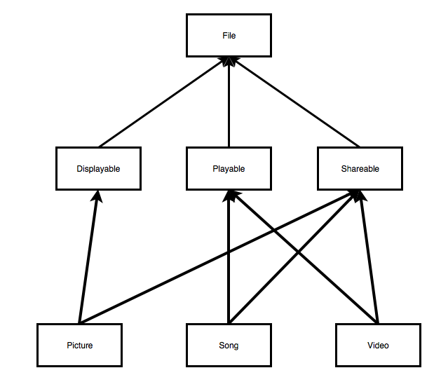
Multiple Inheritance

Slide 14
Multiple Inheritance
Java doesn’t support multiple implementation inheritance
Java does support multiple interface inheritance
Specify multiple interfaces using a comma-separated list of interfaces after implements

Slide 15
Decoupling Interface from Implementation
Interface inheritance provides ability to reuse code
Interface inheritance allows us to separate publically accessible methods from code that supports those methods
Allows us to write flexible code that supports different classes

Slide 16
Extending Interfaces
Like classes, we can can extended interfaces and create subinterfaces
Use the extends reserved word
An interface cannot implement another interface because we can’t specify implementation details in an interface

Slide 17
Standard Library
Standard library contains many interfaces
We’ve worked with examples from the Collections framework: List, Set, Map
Implementing Comparable allows us to sort lists of objects

Slide 18
Exercise 2
Create a class to store contact information consisting of a name and email address. Additionally, create a class to store a collection of contacts that implements the Iterable interface so that a for-each loop can be used with the the collection class. Demonstrate this functionality with a for-each loop in the Main.main() method that displays contact information.

