Slide 1

Using this PowerPoint Template
The following slides serve as a reference for users. For more detailed guidance, see the UCL brand site at ucl.ac.uk/brand,
or email the brand team on brand.comms.@ucl.ac.uk.
This template includes ready-made layouts designed to suit different types of content. To maintain a consistent brand experience across UCL presentations, please keep the structure and positioning of each layout unchanged where possible.
You can, however, adapt the following elements:
Resize text boxes or move them slightly to fit your page
Adjust font size to accommodate longer copy
Add new text boxes if additional copy is required
Replace dummy text, charts and images with your own content.
If you don’t need a particular design element, remove it in the Slide Master by clicking View → Slide Master.
How to apply this template to an existing presentation
Click Design at the top of your existing PowerPoint
Click the arrow pointing down on the right of themes
Choose ‘Browse for Themes’ (if not in Custom)
Select and upload the .potx file included with this template.
PowerPoint will then update the slide masters, layouts, theme colours, fonts,
and backgrounds. If any layouts do not match, you can adjust the slides by
clicking Home → Layout, or check View → Slide Master for consistency.
Replacing a dummy image can reset the order of layers, meaning full-size images cover the logo and text boxes. To avoid this, insert the image onto the slide, right-click it, and select ’Send to Back’. For more guidance, visit Microsoft’s guide to layering objects.
Notes:
The first four pages are template guide pages that explain how to use the templates, colour palettes for visualising data, and provide guidance on creating accessible documents. Please remove these pages once you have finalised your template.

Slide 2

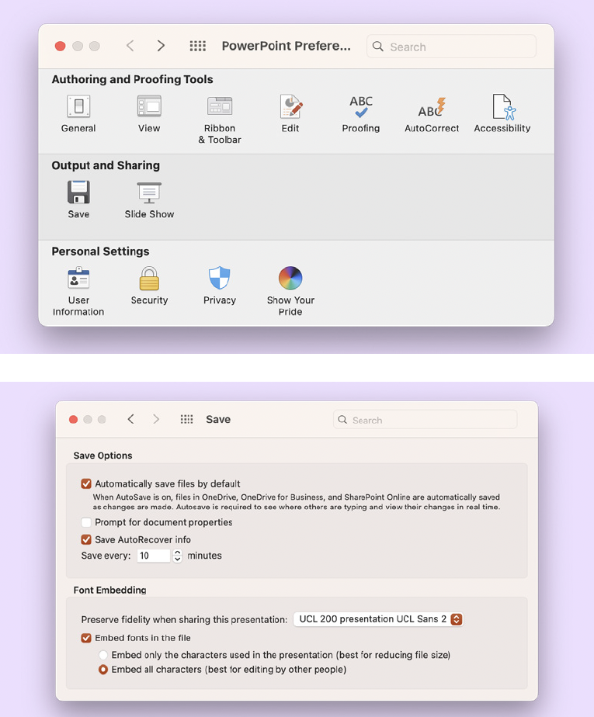
Using UCL Sans
Where possible, slides should use our brand font UCL Sans. Once installed, you can use it for all text, but to make sure it works correctly for anyone viewing your slides on their computer, you must embed the font in your presentation.
How to embed UCL Sans in your presentation
If your recipients do not have UCL Sans installed, your presentation will show the wrong font on their computer. Here’s how to avoid that happening.
On Windows PCs
Select File in the top-left corner of your PowerPoint
Click Options at the bottom of the left-hand menu
Select Save from the left-hand list in the PowerPoint Options window
Scroll down to the section titled ‘Preserve fidelity when sharing this presentation’
Tick the box labelled ‘Embed fonts in the file’
Select ‘Embed all characters’ (Note: this will increase the file size. If you prefer to keep the file size small, or if recipients are unlikely to edit the file, choose the other option.)
Click OK to save your settings, then save your presentation again before sharing with others.
On Apple Macs
Choose PowerPoint → Preferences in the menu bar of your PowerPoint
Click Save in the Preferences window
Under Font Embedding, tick ‘Embed fonts in the file’
Select ‘Embed all characters’ (Note: this will increase the file size. If you prefer to keep the file size small,
or if recipients are unlikely to edit the file, choose the other option.)
Click OK to save your settings, then save your presentation again before
sharing with others.
Notes:
The first four pages are template guide pages that explain how to use the templates, colour palettes for visualising data, and provide guidance on creating accessible documents. Please remove these pages once you have finalised your template.

Slide 3
System colours for visualising data
This template has been designed to meet accessibility guidelines using our purple brand colour palette. More colours are required for visualising data in charts and graphs however, so a set of system colours is also available.
Only use the following colours in graphs and charts
Dark blue
R00 G46 B166
#002ea6
Dark orange
R120 G28 B28
#781c1c
Dark fuchsia
R158 G26 B84
#9e1a54
Dark teal green
R00 G94 B92
#005e5c
Blue
R84 G135 B255
#5487ff
Orange
R245 G99 B00
#E36C2A
Fuchsia
R237 G54 B125
#ED367D
Teal green
R00 G158 B156
#57b444
Item D
Item B
Item A
Item E
Item C
Item F
You can find system colours in any colour window under ‘Recent colours’, or you may need to add them using the codes below and save them under ‘More colours’.
Notes:
The first four pages are template guide pages that explain how to use the templates, colour palettes for visualising data, and provide guidance on creating accessible documents. Please remove these pages once you have finalised your template.

Slide 4
PowerPoint accessibility checklist
These template slides have been designed with accessibility in mind. When creating your presentation, make sure each slide remains accessible for your audience, whether they are viewing it on a screen, on printouts, or during a talk or lecture.
UCL’s Information Services Division (ISD) has put together guidance on creating accessible slides, which covers:
Ordering objects on each slide to improve readability, especially for people using screen readers
Using slide notes
Alt text on images
Alignment and spacing of text
Punctuation and formatting to avoid
Use of colour (Note: the ‘white’ background of these slides is actually off white #FAFAFA to reduce contrast slightly.)
Useful resources
UCL’s Digital Accessibility Policy
UCL guidance on creating accessible slides
GOV.UK guidance on publishing accessible documents
We recommend running PowerPoint’s built-in Accessibility Checker before finalising your presentation. It will help you review and fix any issues, including missing titles and alt text. Go to Review → Check Accessibility.
Notes:
The first four pages are template guide pages that explain how to use the templates, colour palettes for visualising data, and provide guidance on creating accessible documents. Please remove these pages once you have finalised your template.

Slide 5
Main Headline style slide UCL Sans SemiBold 42pt
2-3 lines max
Names of Presenters, UCL Sans regular 24pt
Date, UCL Sans Regular 18pt
Notes:
Cover title slide using a full UCL Dark Purple colour as the background. The slide layout includes a main heading in the top left corner. The presenters’ names and the date are shown in the bottom left corner. The UCL logo is positioned in the bottom right corner of the slide.

Slide 6
Main Headline style slide UCL Sans SemiBold 42pt
2-3 lines max
Names of Presenters, UCL Sans regular 24pt
Date, UCL Sans Regular 18pt
Type in your faculty/department/unit name here
UCL Sans Regular 18pt
Notes:
Faculty, School, department name cover title slide, using a full UCL Dark Purple colour as the background. The slide layout includes a main heading in the top left corner. The presenters’ names and the date are shown in the bottom left corner. The UCL logo is positioned in the bottom right corner of the slide.

Slide 7
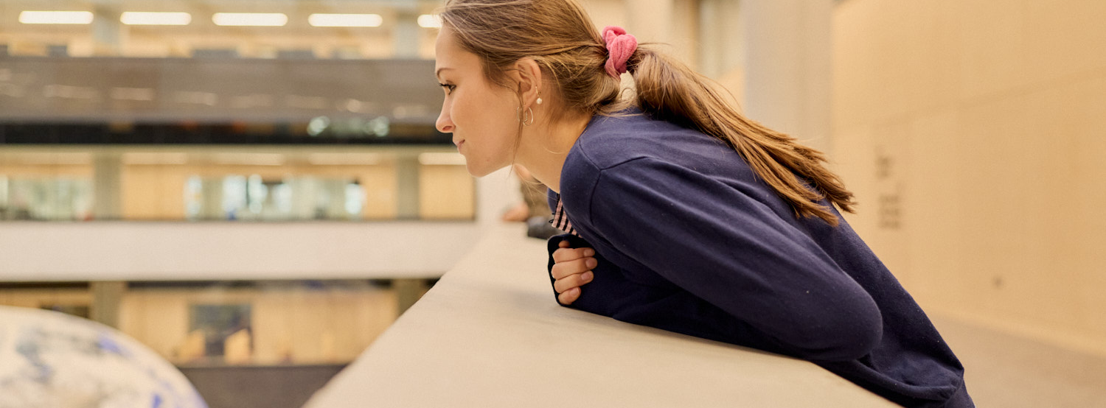
Main Headline style slide UCL Sans SemiBold 42pt
2-3 lines max
Notes:
Cover title slide using image at the bootom. The slide layout includes a main heading in the top left corner. UCL logo is positioned in the bottom right corner of the slide.

Slide 8
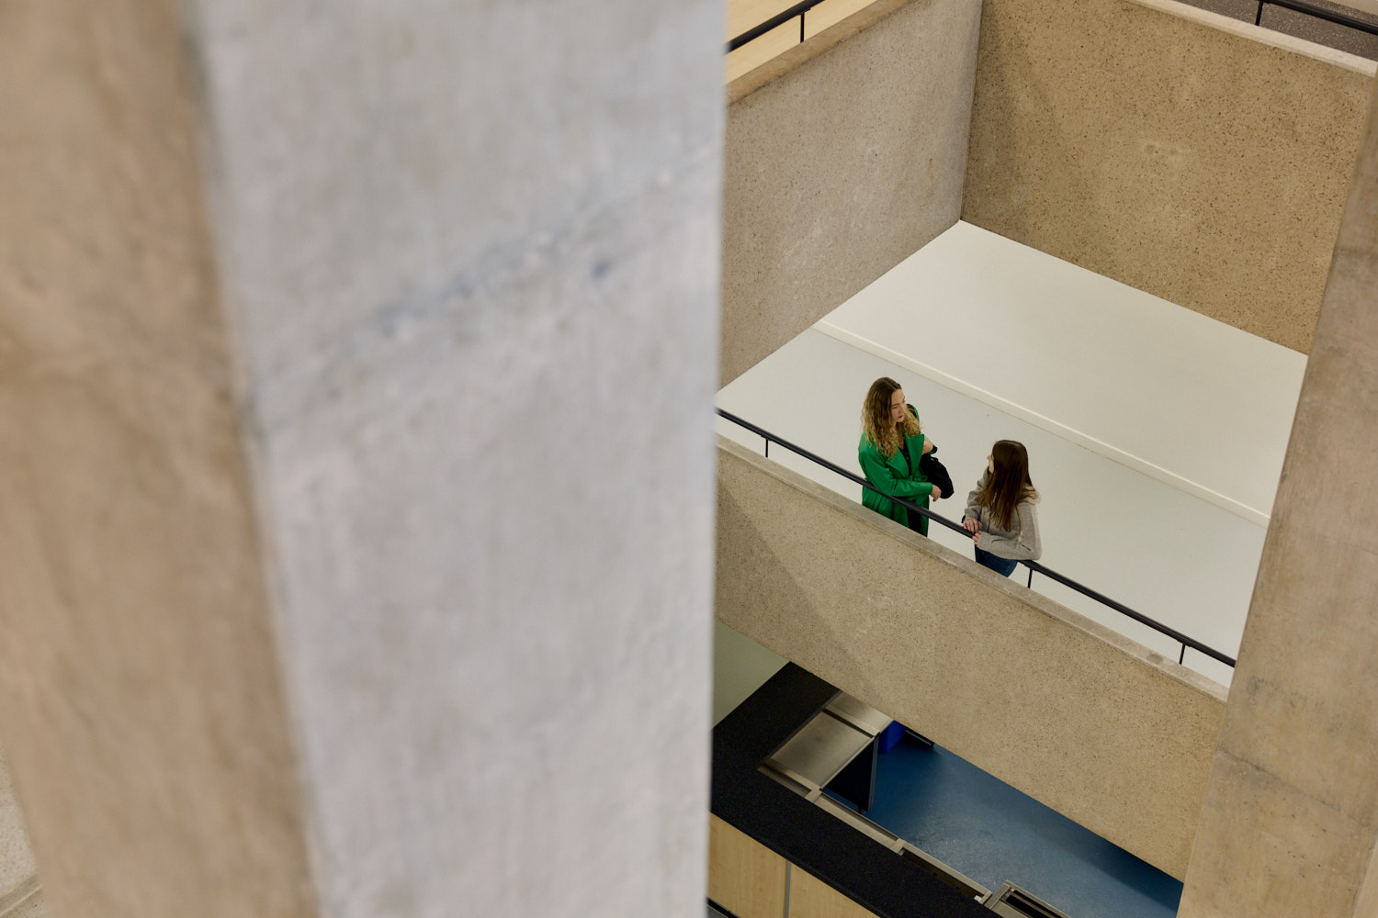
Main Headline style slide UCL Sans SemiBold 42pt 2-3 lines max
Names of Presenters,
UCL Sans regular 24pt
Date, UCL Sans regular 18pt
Notes:
Cover title slide layout features a full background image with a main heading positioned in the top left corner on a dark purple panel. The presenters’ names and the date sit beneath the title. The UCL logo is placed in the bottom right corner of the slide.

Slide 9
Divider section Title
UCL Sans SemiBold 36pt
Here, centuries of discoveries have been made by people thinking non-stop about the future.
Where thousands of staff and students gather from hundreds of countries to create a unique city within
a city.
Here, eleven faculties study everything from the oldest language to the newest neuroscience.
Where big plans and brave ideas have the scale and the support they need to succeed.
Example copy UCL Sans regular 18pt.
Notes:
Divider slide with a one-column layout. A headline is positioned at the top right and body text arranged beneath it. Sits on dark purple background.

Slide 10

Divider section Title UCL Sans SemiBold 36pt
Subheading, UCL Sans Regular 24pt
Here, centuries of discoveries have been made by people thinking non-stop about the future. Example copy UCL Sans regular 18pt
Notes:
Divider slide with an image on the left and one column text on the right. A headline is positioned at the top right and body text arranged beneath it. Sits on dark purple background.

Slide 11
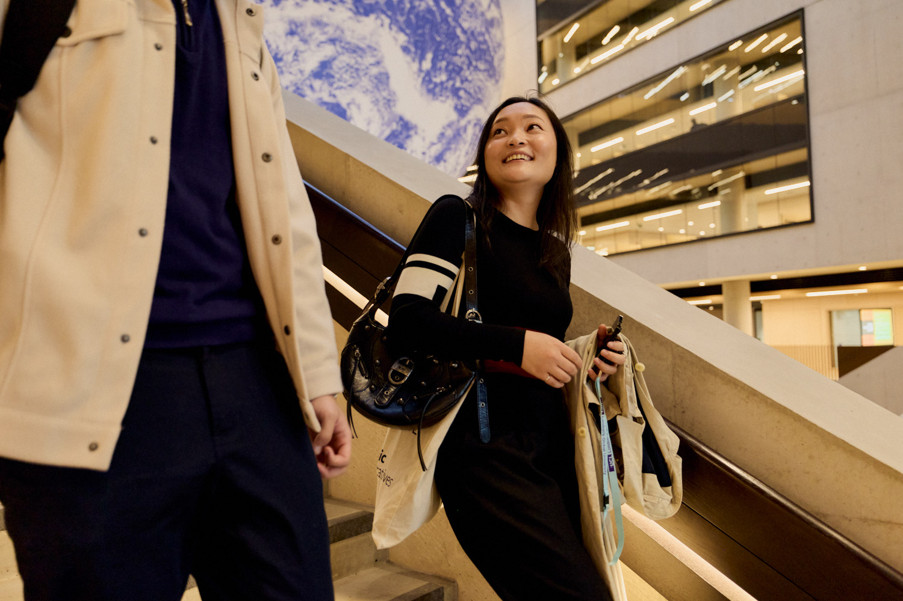
Divider section Title UCL Sans SemiBold 36pt
Subheading, UCL Sans Regular 24pt
Here, centuries of discoveries have been made by people thinking non-stop about the future. Example copy UCL Sans regular 18pt
Notes:
Divider slide divided 3 columns with an image on the mid-right and one column text on the left. A headline is positioned at the top left and body text arranged beneath it. Sits on dark purple background.

Slide 12
Headline UCL
Sans SemiBold 36pt
Here, centuries of discoveries have been made by people thinking non-stop about the future. Where thousands of staff and students gather from hundreds of countries to create a unique city within a city.
Example copy, UCL Sans Regular 18pt
Notes:
Content slide with a headline at the top left, followed by text box beneath it.

Slide 13
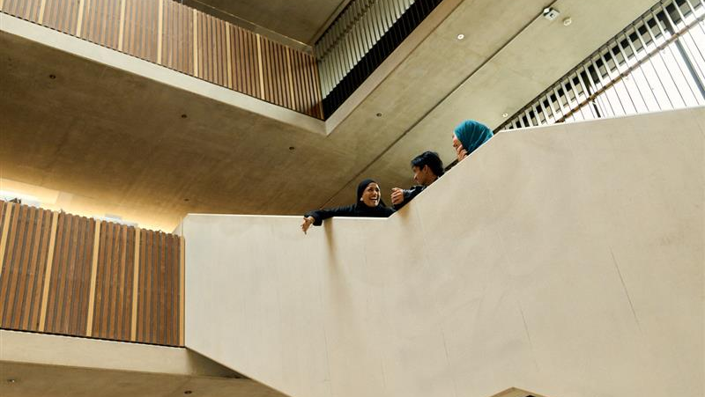

Notes:
Content slide full image with full colour logo

Slide 14

Headline
UCL Sans SemiBold 36pt
9th in the World 5th in Europe 4th in the UK
Subtitle, UCL Sans Regular 24pt
Position | University
1 | MIT
2 | Imperial
3 | Oxford
4 | Harvard
5 | Cambridge
6 | Stanford
7 | ETH Zurich
8 | NUS Singapore
9 | UCL
10 | Caltech
Notes:
Content slide with a full dark-purple background. A main heading appears in the top left corner, followed by a smaller subheading beneath it. Space for inserting a table sits below. An image is positioned on the left side of the slide with three columns of small text above the image.

Slide 15
Headline
UCL Sans SemiBold 36pt
Subheading text,
UCL Sans
regular 24pt
Here, centuries of discoveries have been made by people thinking non-stop about the future. Where thousands of staff and students gather from hundreds of countries to create a unique city within a city.
Example copy,
UCL Sans Regular 18pt
Notes:
Content slide with a headline at the top left, followed by 2 column text box, one for subheading and one for body text.

Slide 16


Headline
UCL Sans SemiBold 36pt
Here, centuries of discoveries have been made by people thinking non-stop about the future. Example copy, UCL Sans Regular 18pt
Where thousands of staff and students gather from hundreds of countries to create a unique city within a city. Example copy,
UCL Sans Regular 18pt
Notes:
This content slide features a headline at the top left, followed by two columns, each providing space for an image with accompanying copy beneath.

Slide 17

Headline
UCL Sans SemiBold 36pt
Here, centuries of discoveries have been made by people thinking non-stop about the future. Where thousands of staff and students gather from hundreds of countries to create a unique city within a city.
Example copy, UCL Sans Regular 18pt
Notes:
Content slide with a two-column layout. A headline is positioned at the top left, with an image on the left with body text arranged on the right.

Slide 18
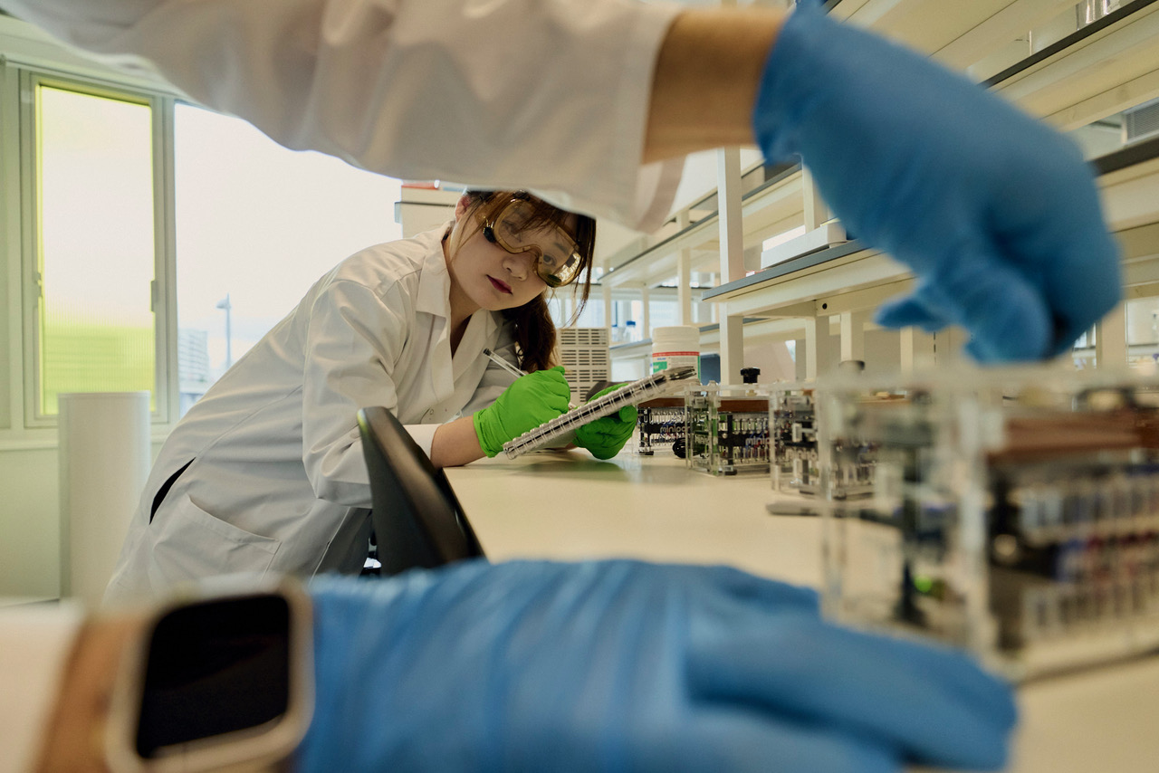
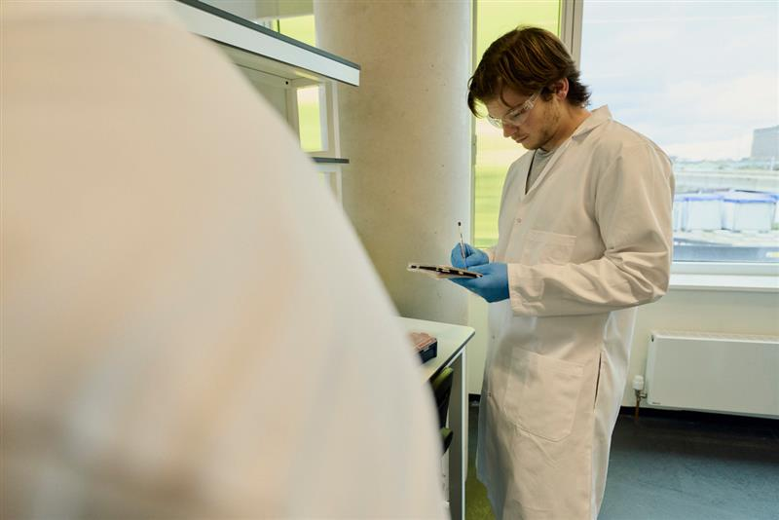
Here, centuries of discoveries have been made by people thinking non-stop about the future.
Headline
UCL Sans SemiBold 36pt
Here, eleven faculties study everything from the oldest language to the newest neuroscience.
Where big plans and brave ideas have the scale and the support they need to succeed.
Example copy,
UCL Sans Regular 18pt
Notes:
This content slide features a headline at the top left, followed by four columns, each providing space for an image with accompanying copy beneath.

Slide 19
Headline
UCL Sans
SemiBold 36pt
Subheading text style,
UCL Sans regular 24pt
Notes:
Content slide with a headline at the top left, followed by a subheading on the right. The lower section of the slide is divided into two columns, each providing space for graphs, images, or charts. When inserting charts, the font is automatically set to Aptos. Please remember to change it to UCL Sans to ensure consistency.

Slide 20
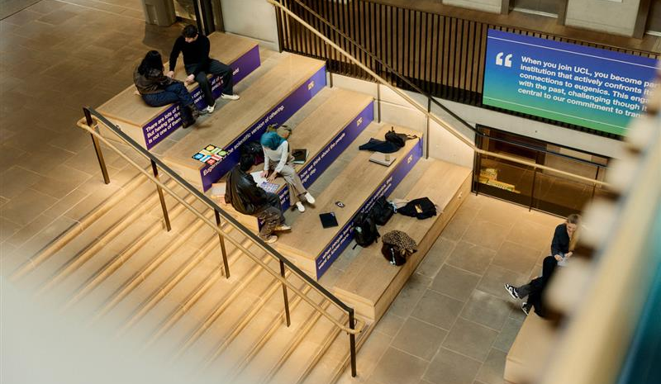

Notes:
Content slide full image with white logo

Slide 21
Headline
UCL Sans SemiBold 36pt
Notes:
Content slide with a headline at the top left, followed by a subheading on the right. The lower section of the is space for for graphs, images, charts or videos. When inserting charts, the font is automatically set to Aptos. Please remember to change it to UCL Sans to ensure consistency.

Slide 22
Headline
UCL Sans SemiBold 36pt
Notes:
Content slide with a headline at the top left, followed by a subheading on the right. The lower section of the is space for for graphs, images, charts or videos. When inserting charts, the font is automatically set to Aptos. Please remember to change it to UCL Sans to ensure consistency.

Slide 23
Headline
UCL Sans SemiBold 36pt
Here, centuries of discoveries have been example copy,
UCL Sans Regular 18pt
Here, eleven faculties study everything from the oldest language to the newest neuroscience.
Where big plans and brave ideas have the scale and the support they need to succeed.
Example copy
Bullet text, UCL Sans Regular 18pt
Here, centuries of discoveries have been example copy,
UCL Sans Regular 18pt
Here, eleven faculties study everything from the oldest language to the newest neuroscience.
Where big plans and brave ideas have the scale and the support they need to succeed.
Example copy
Bullet text, UCL Sans Regular 18pt
Notes:
Content slide with a headline at the top left, followed by 2 column bulleted text.

