Slide 1
Gmacs update & Saint Matthew Island Blue King Crab Assessment 2016
D’Arcy Webber, Jie Zheng, James Ianelli

Slide 2
Gmacs
Added seasons to Gmacs dynamics
Number of seasons
Proportion of M each season
Season molting and growth
Season recruitment
Season SSB
Retained continuous M/F
All data sets have a time stamp (season/year)
Added option to initialize numbers as free parameters
Plots

Slide 3
SMBKC in Gmacs
1978-2015
4 seasons (M = 0, 0.44, 0.185, 0.375)
1 sex, 1 shell type, 1 maturity class
3 stages (size-classes)
3 fleets (pot, trawl bycatch, fixed bycatch)
2 surveys (NMFS trawl and ADF&G pot) both in season 1
4 catch types (directed pot, pot discards, trawl bycatch, fixed bycatch) all during season 2
3 size compositions (pot season 2, NMFS trawl season 1, ADF&G pot season 1)

Slide 4
Gmacs dynamics
Season 1
1 July, start of fishing year
Surveys
Season 2
M=0.44 & catch
Season 3
M=0.185
Calculate MMB
Season 4
M=0.375
Growth and molting
Recruitment

Slide 5
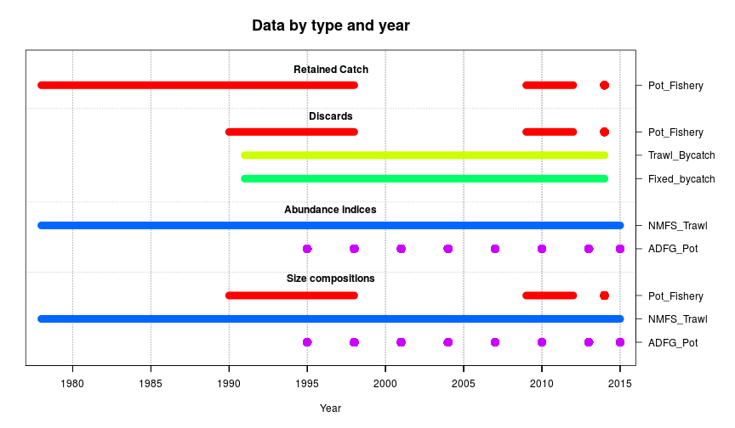
Data

Slide 6
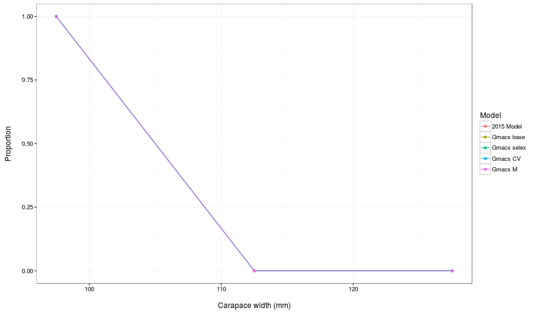
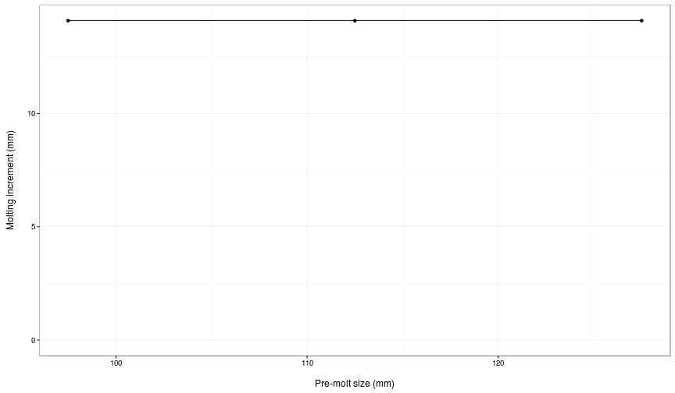
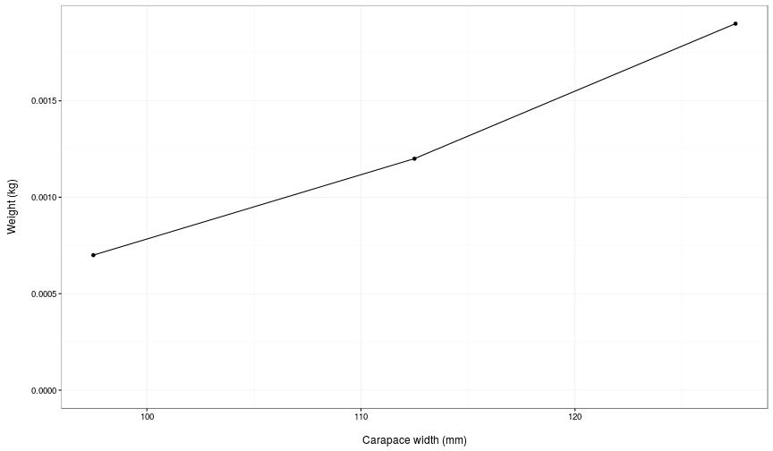
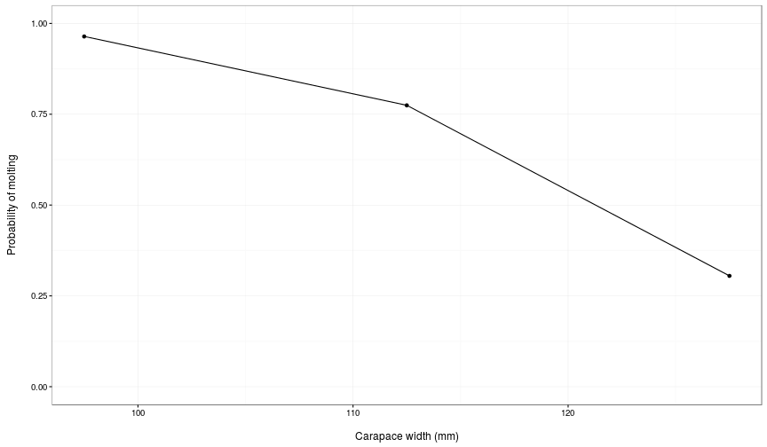

Slide 7
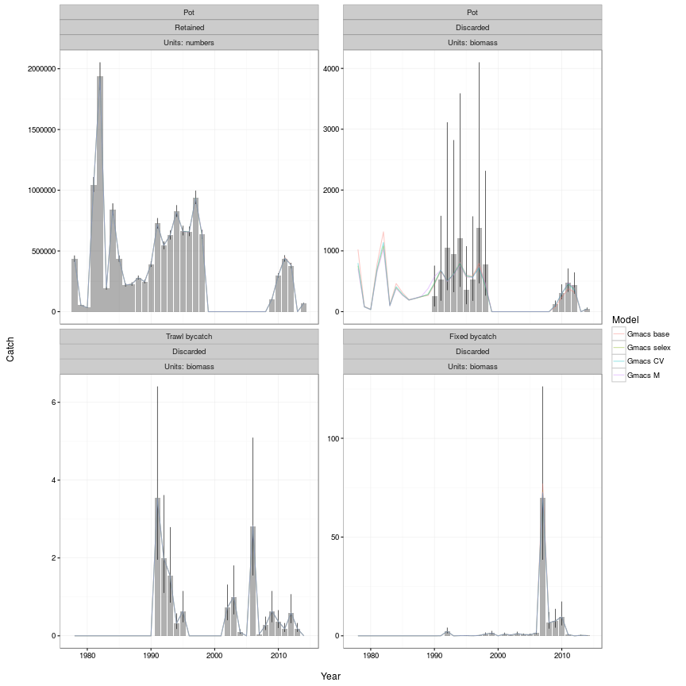

Slide 8
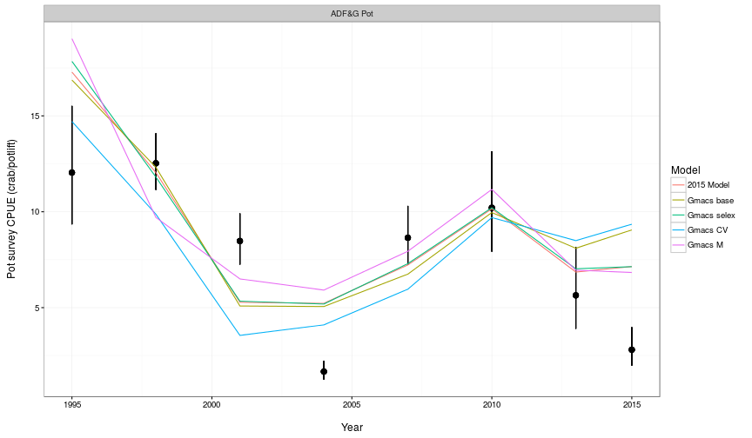

Slide 9
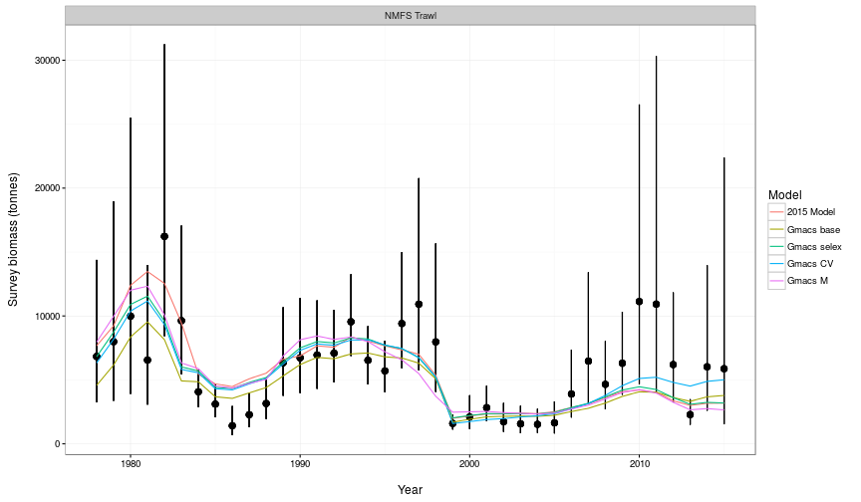

Slide 10
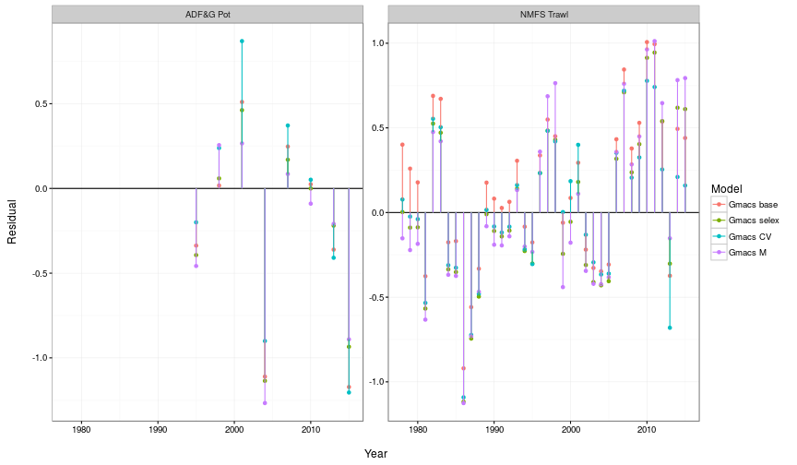

Slide 11
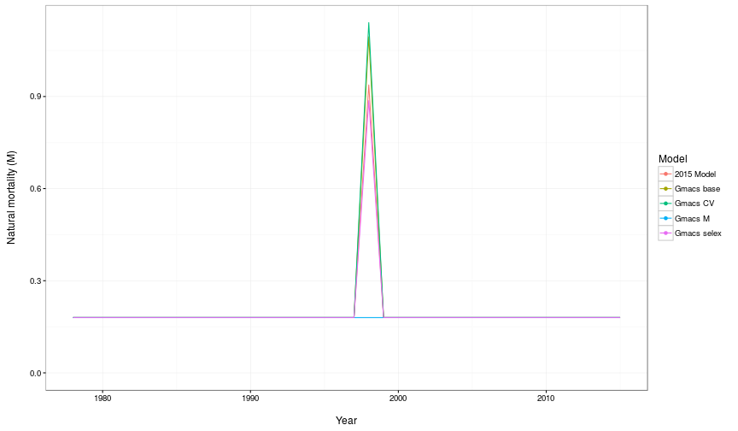

Slide 12
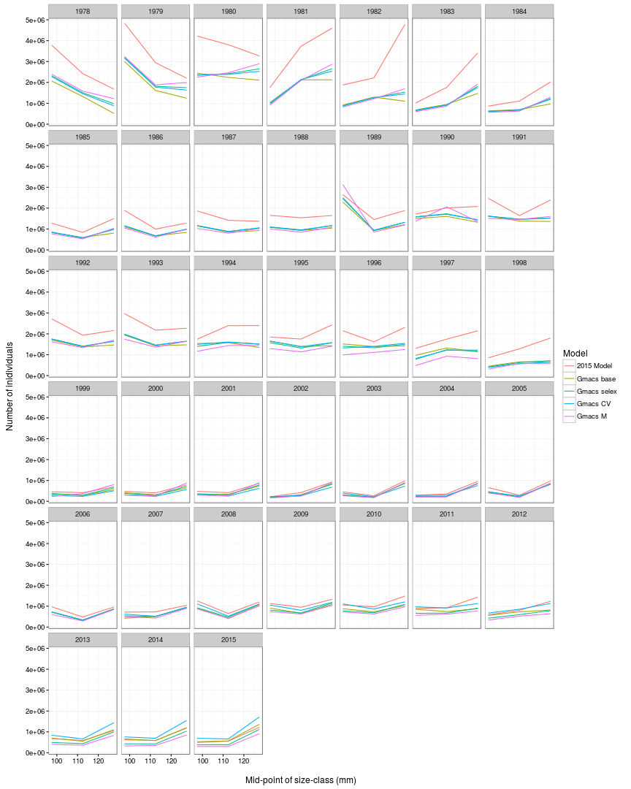

Slide 13
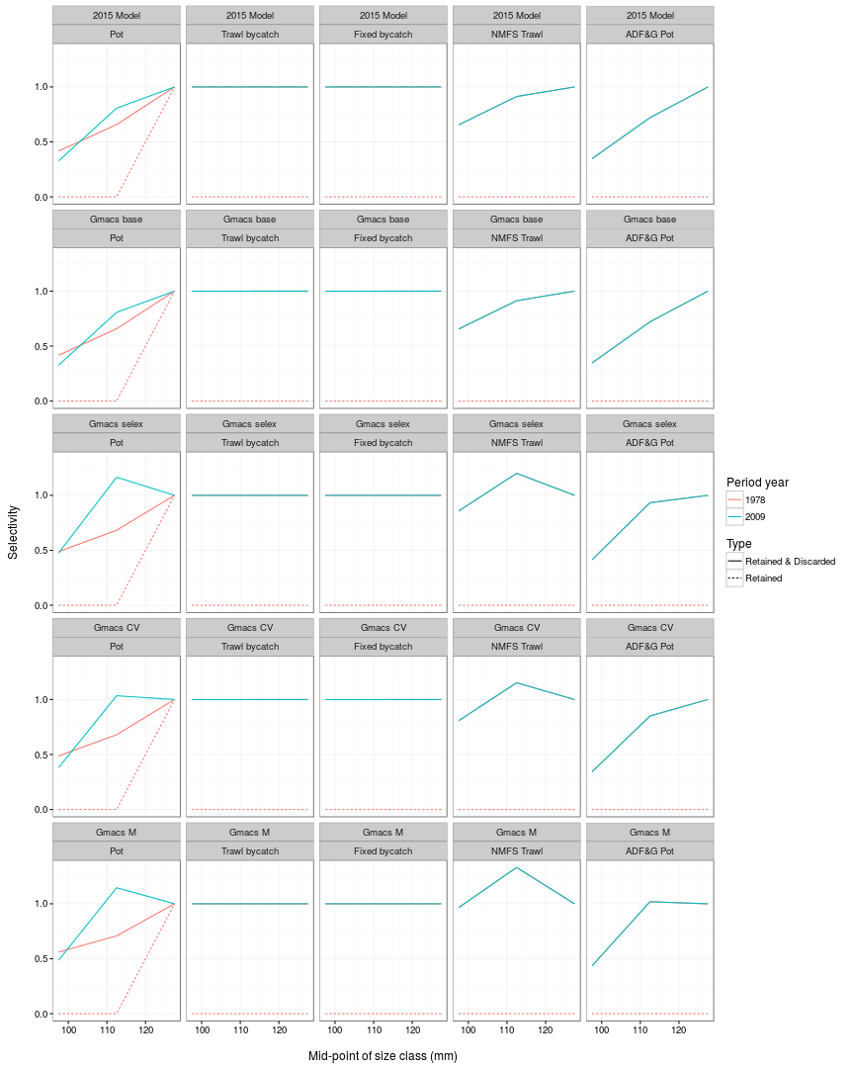

Slide 14
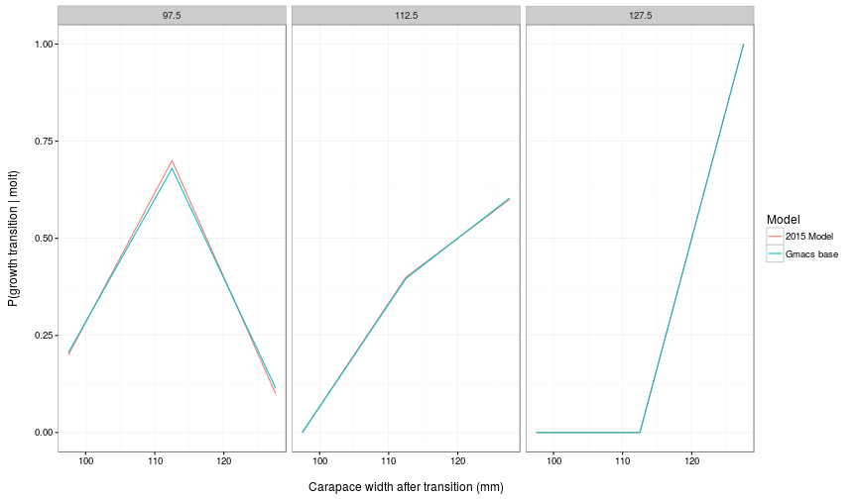

Slide 15
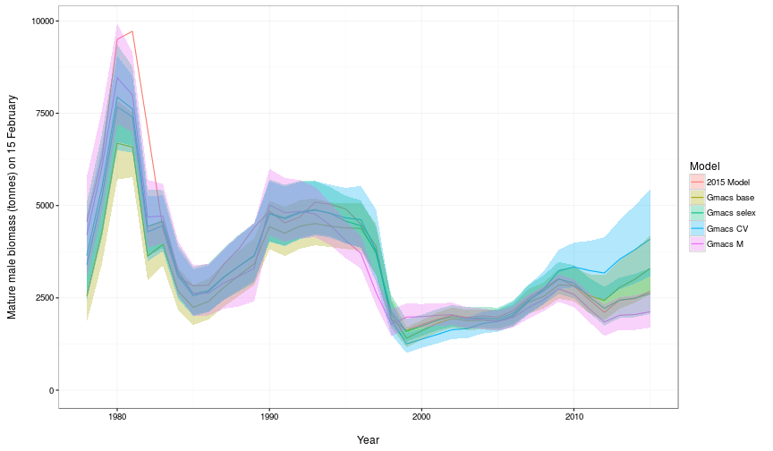

Slide 16
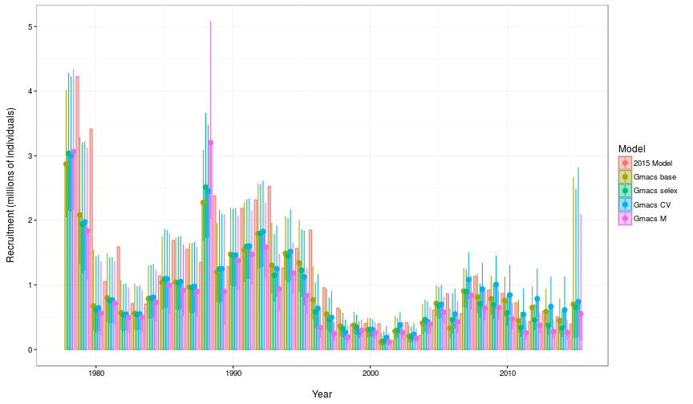

Slide 17
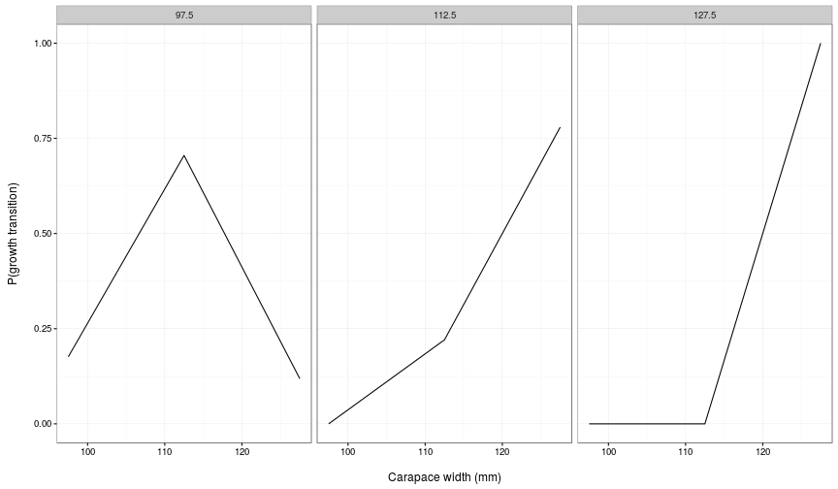

Slide 18
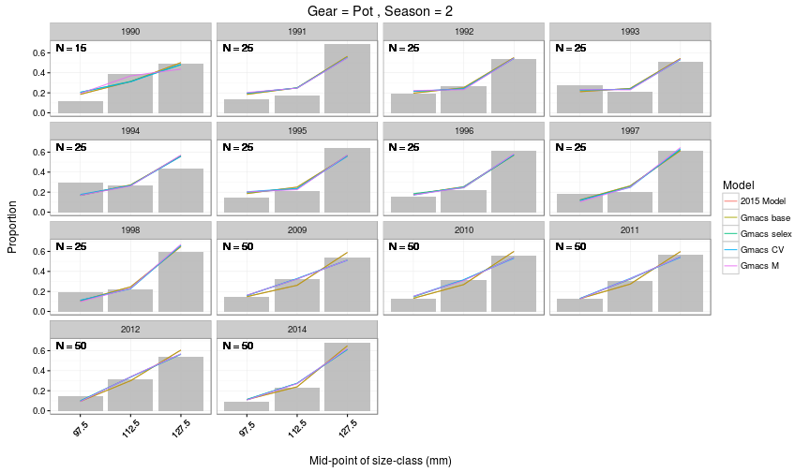

Slide 19
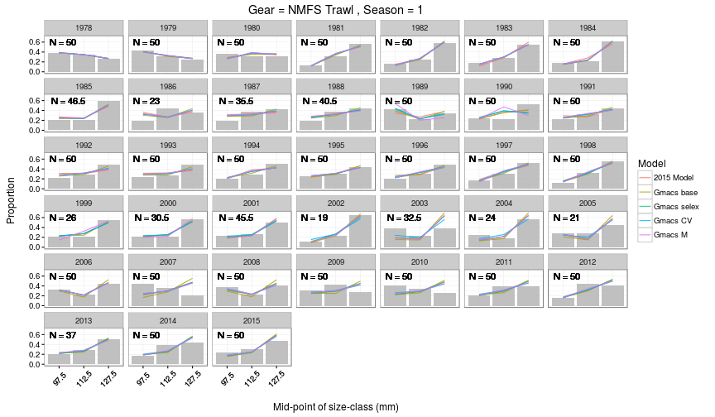

Slide 20
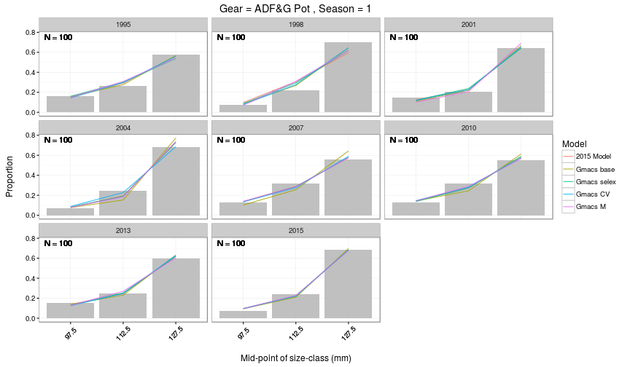

Slide 21
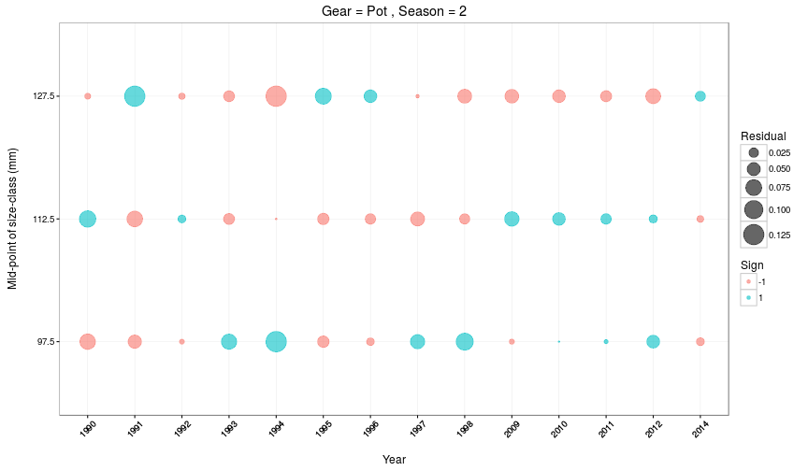

Slide 22
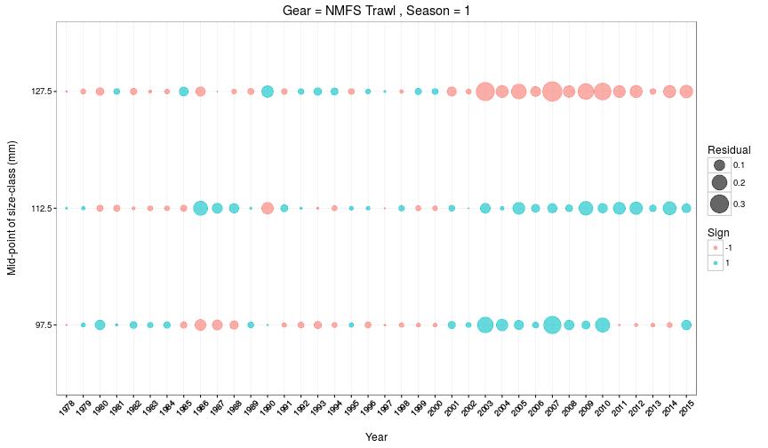

Slide 23
