Slide 1
Gmacs update & Saint Matthew Island Blue King Crab Assessment May 2016
D’Arcy Webber¹, Jie Zheng², James Ianelli³
¹University of Washington, ²Alaska Department of Fish and Game, ³NOAA

Slide 2
Gmacs progress
Added seasons to Gmacs dynamics
Retained continuous M/F (within each season)
Number of seasons
Proportion of M each season
Season molting and growth occur
Season recruitment occurs
Season SSB is to be calculated
All data sets have a time stamp (season/year)
Added option to initialize numbers as free parameters
New plotting functions in gmr
Draft SMBKC document

Slide 3
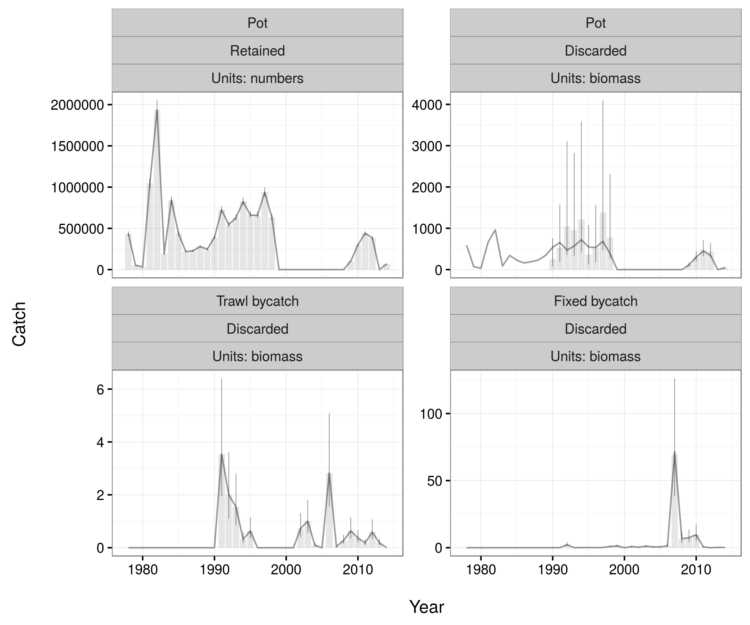
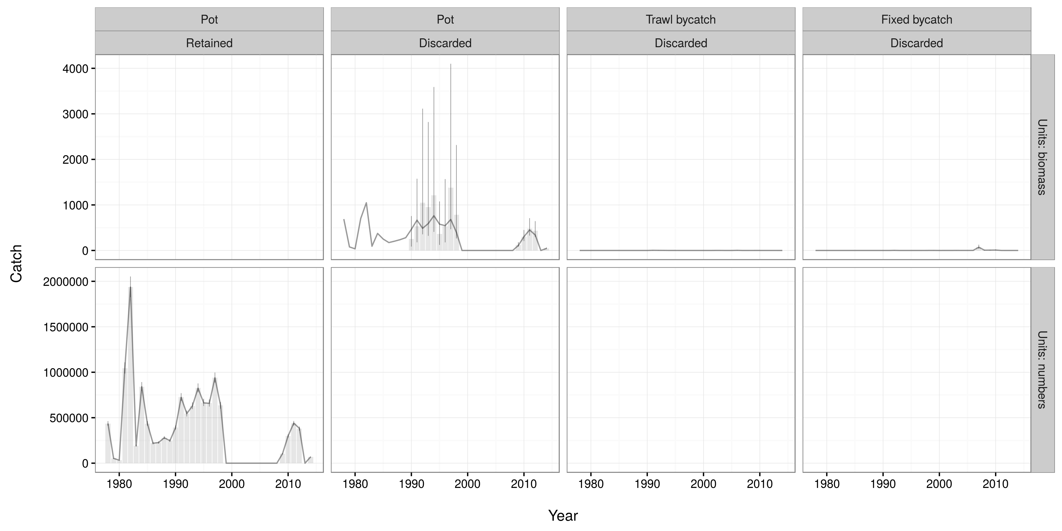

Slide 4
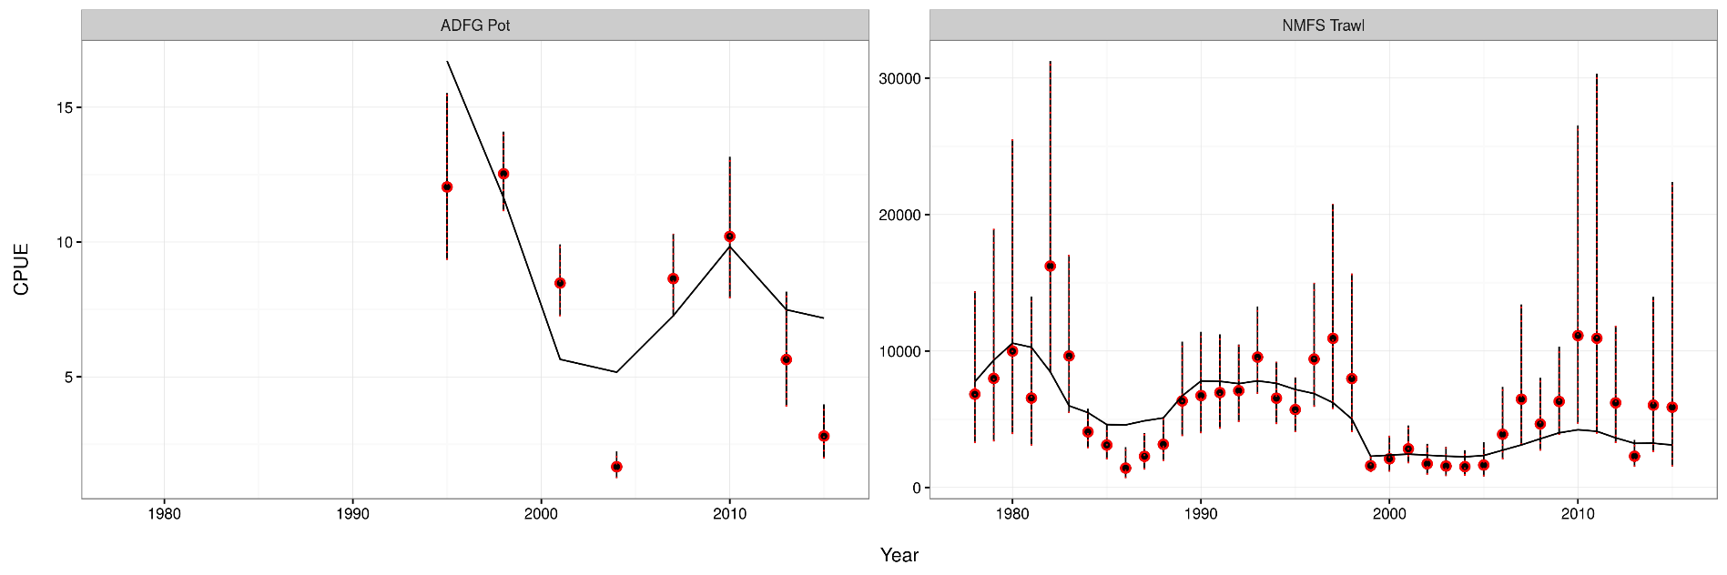
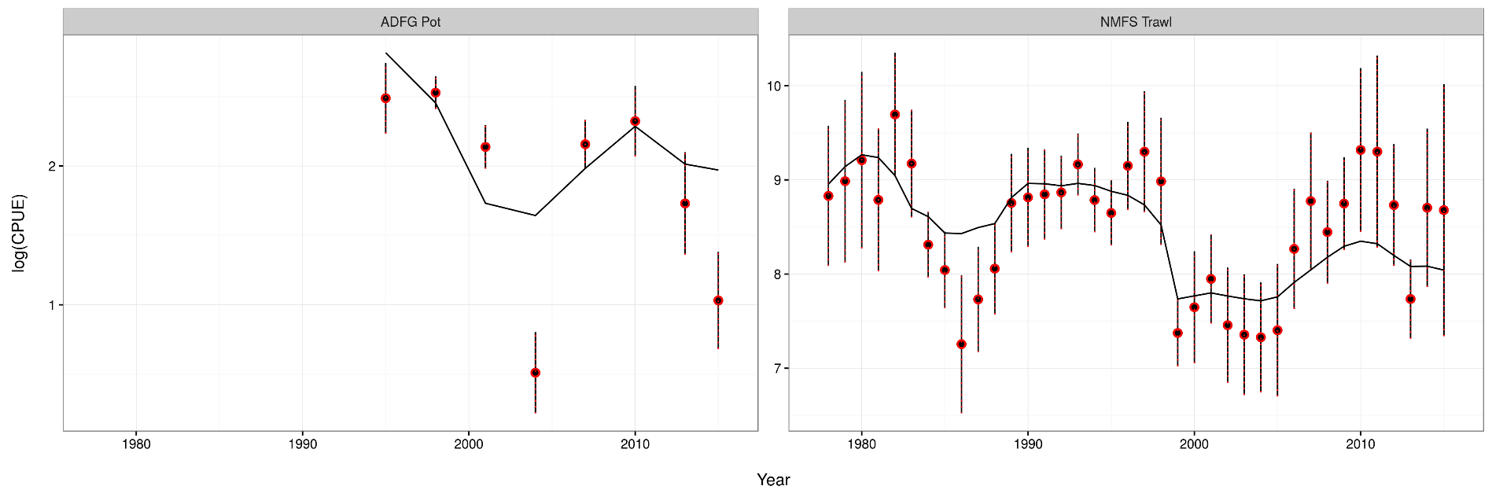

Slide 5
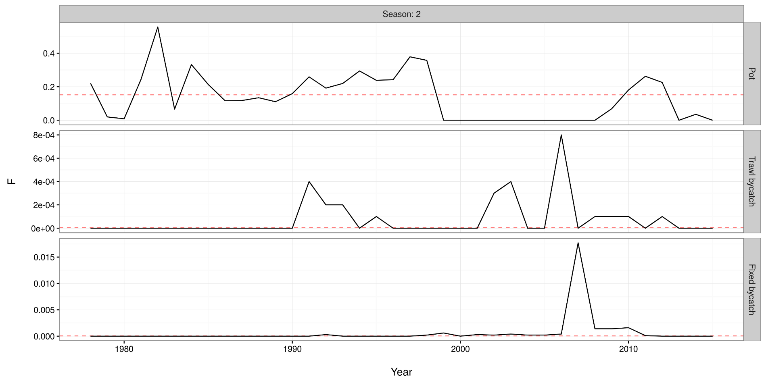

Slide 6
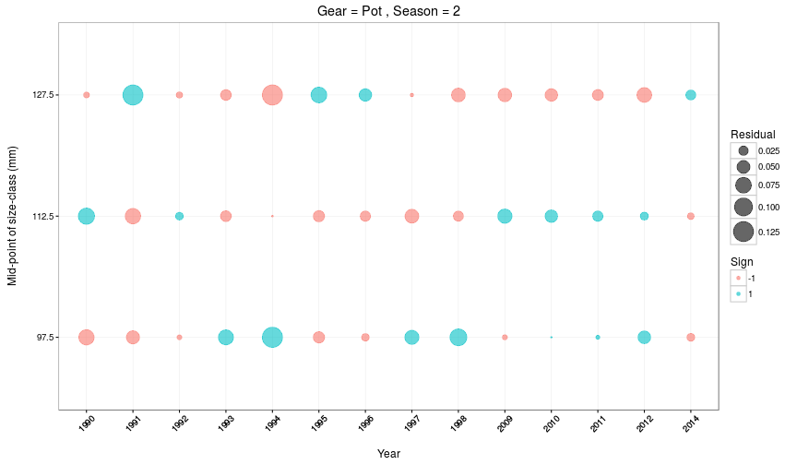

Slide 7
Gmacs in progress
Equilibrium numbers at length
Broke when seasonal changes added, can’t use the elegant solutions anymore
Not required for SMBKC as we estimate initial numbers as free parameters
The new function is complete but yet to be put in the right places
SPR calculations
As above/requires equilibrium numbers
Probably only a day or two of work but I fell asleep yesterday
BBRKC model
Runs but as above/requires equilibrium numbers

Slide 8
SMBKC in Gmacs
1978-2015
4 seasons (M = 0, 0.44, 0.185, 0.375)
3 stages (90-104, 105-119, 120+)
1 sex, 1 shell type, 1 maturity class
3 fleets (pot, trawl bycatch, fixed bycatch)
2 surveys (NMFS trawl and ADF&G pot CPUE) both in season 1
4 catch types (directed pot, pot discards, trawl bycatch, fixed bycatch) all during season 2
3 size compositions (pot in season 2, NMFS trawl in season 1, ADF&G pot in season 1)

Slide 9
SMBKC dynamics
Season 1
1 July, start of fishing year
Surveys
Season 2
M=0.44 & catch (note that this differs from 2015 model)
Season 3
M=0.185
Calculate MMB
Season 4
M=0.375
Growth and molting
Recruitment (all to stage-1)

Slide 10
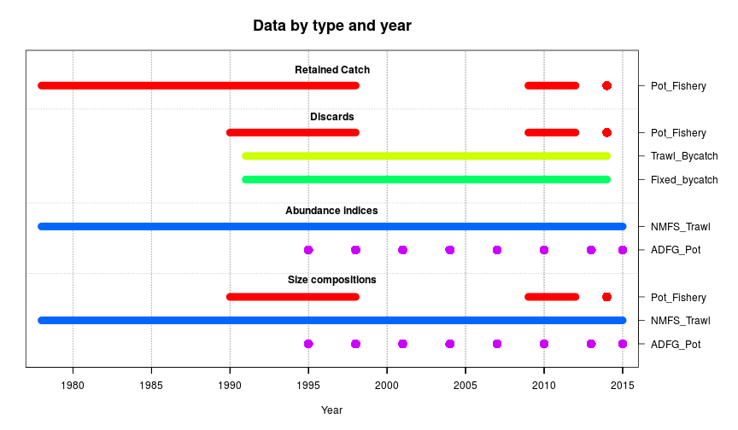
Data

Slide 11
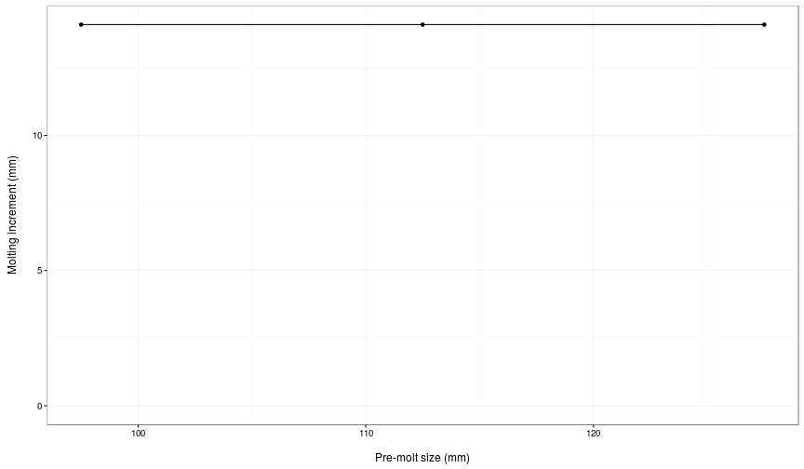
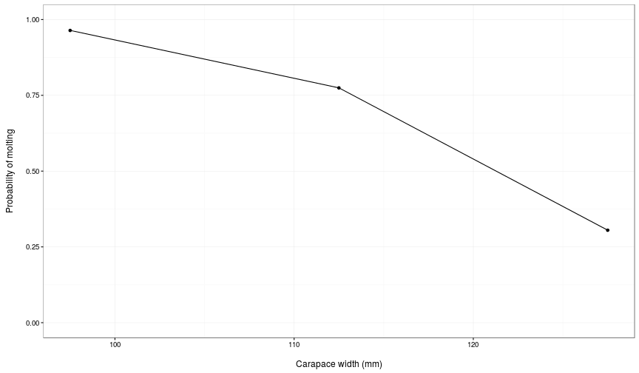

Slide 12
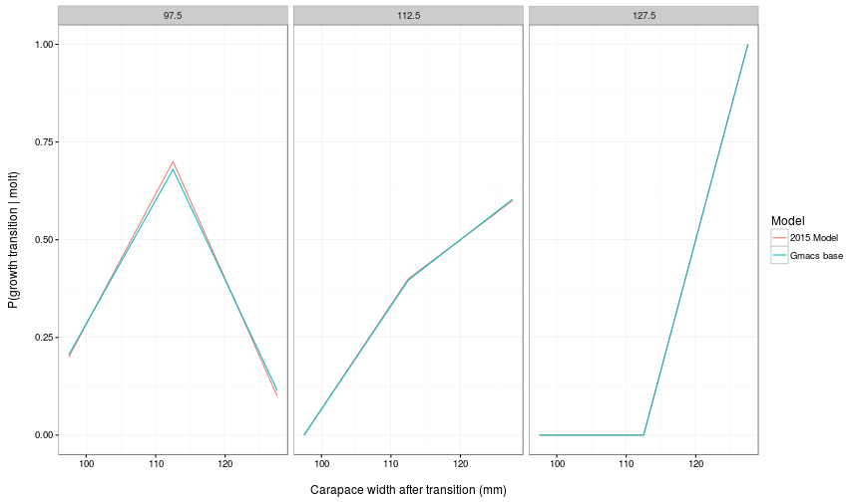
Size transition matrix

Slide 13
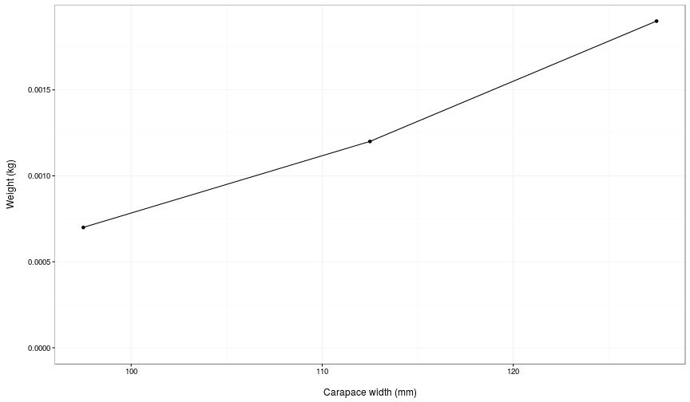
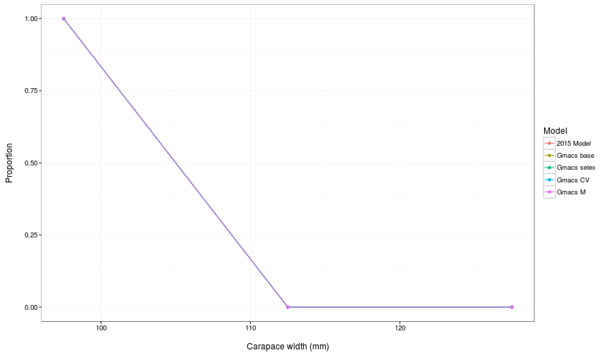

Slide 14
SMBKC
Jump to document.
Start with table of model runs.

Slide 15
What else would people like to see?
Model runs:
Estimate M₁₉₉₈ but with smaller SD constraining deviation?
Fix stage-2 selectivity at 1.0 (rather than stage-1) if estimated stage-2 selectivity > 1.0
Plots…

Slide 16
Tests
Checked that pars that are not used are off
Did some “jittering” to check for local minima
Implemented time-varying weight by stage (permanent)
Implemented time-varying season length (temporary, but do we wish to retain this feature?)
Added another season to SMBKC model that has M=0 and all of fishing mortality (i.e. pulse) after variable season length
Fixed initial conditions, average recruitment, recruitment deviations, and M_{1998/99} to the values estimated in 2015 model
Tried running the model using the same units as 2015 model, checked all data units and CV’s

Slide 17
SMBKC dynamics
Season 1
1 July, start of fishing year
Surveys
Season 2
Variable proportion of natural mortality
Season 3
Fishing mortality
Season 4
Variable proportion of natural mortality
Calculate MMB
Season 5
Proportion of natural mortality = 0.375
Growth and molting
Recruitment (all to stage-1)

Slide 18
0.000 0.070 0.000 0.560 0.370
0.000 0.060 0.000 0.570 0.370
0.000 0.070 0.000 0.560 0.370
0.000 0.050 0.000 0.580 0.370
0.000 0.070 0.000 0.560 0.370
0.000 0.120 0.000 0.510 0.370
0.000 0.100 0.000 0.530 0.370
0.000 0.140 0.000 0.490 0.370
0.000 0.140 0.000 0.490 0.370
0.000 0.140 0.000 0.490 0.370
0.000 0.140 0.000 0.490 0.370
0.000 0.140 0.000 0.490 0.370
0.000 0.140 0.000 0.490 0.370
0.000 0.180 0.000 0.450 0.370
0.000 0.140 0.000 0.490 0.370
0.000 0.180 0.000 0.450 0.370
0.000 0.180 0.000 0.450 0.370
0.000 0.180 0.000 0.450 0.370
0.000 0.180 0.000 0.450 0.370
0.000 0.180 0.000 0.450 0.370
0.000 0.180 0.000 0.450 0.370
0.000 0.180 0.000 0.450 0.370
0.000 0.180 0.000 0.450 0.370
0.000 0.180 0.000 0.450 0.370
0.000 0.180 0.000 0.450 0.370
0.000 0.180 0.000 0.450 0.370
0.000 0.180 0.000 0.450 0.370
0.000 0.180 0.000 0.450 0.370
0.000 0.180 0.000 0.450 0.370
0.000 0.180 0.000 0.450 0.370
0.000 0.180 0.000 0.450 0.370
0.000 0.440 0.000 0.190 0.370
0.000 0.440 0.000 0.190 0.370
0.000 0.440 0.000 0.190 0.370
0.000 0.440 0.000 0.190 0.370
0.000 0.440 0.000 0.190 0.370
0.000 0.440 0.000 0.190 0.370
0.000 0.440 0.000 0.190 0.370

