Slide 1
Gmacs update & Saint Matthew Island Blue King Crab Assessment May 2016
D’Arcy Webber¹, Jie Zheng², James Ianelli³
¹University of Washington, ²Alaska Department of Fish and Game, ³NOAA

Slide 2
Gmacs progress
Added seasons to Gmacs dynamics
Retained continuous M/F (within each season)
Number of seasons
Proportion of M each season
Season molting and growth occur
Season recruitment occurs
Season SSB is to be calculated
All data sets have a time stamp (season/year)
Added option to initialize numbers as free parameters
New plotting functions in gmr
Draft SMBKC document

Slide 3
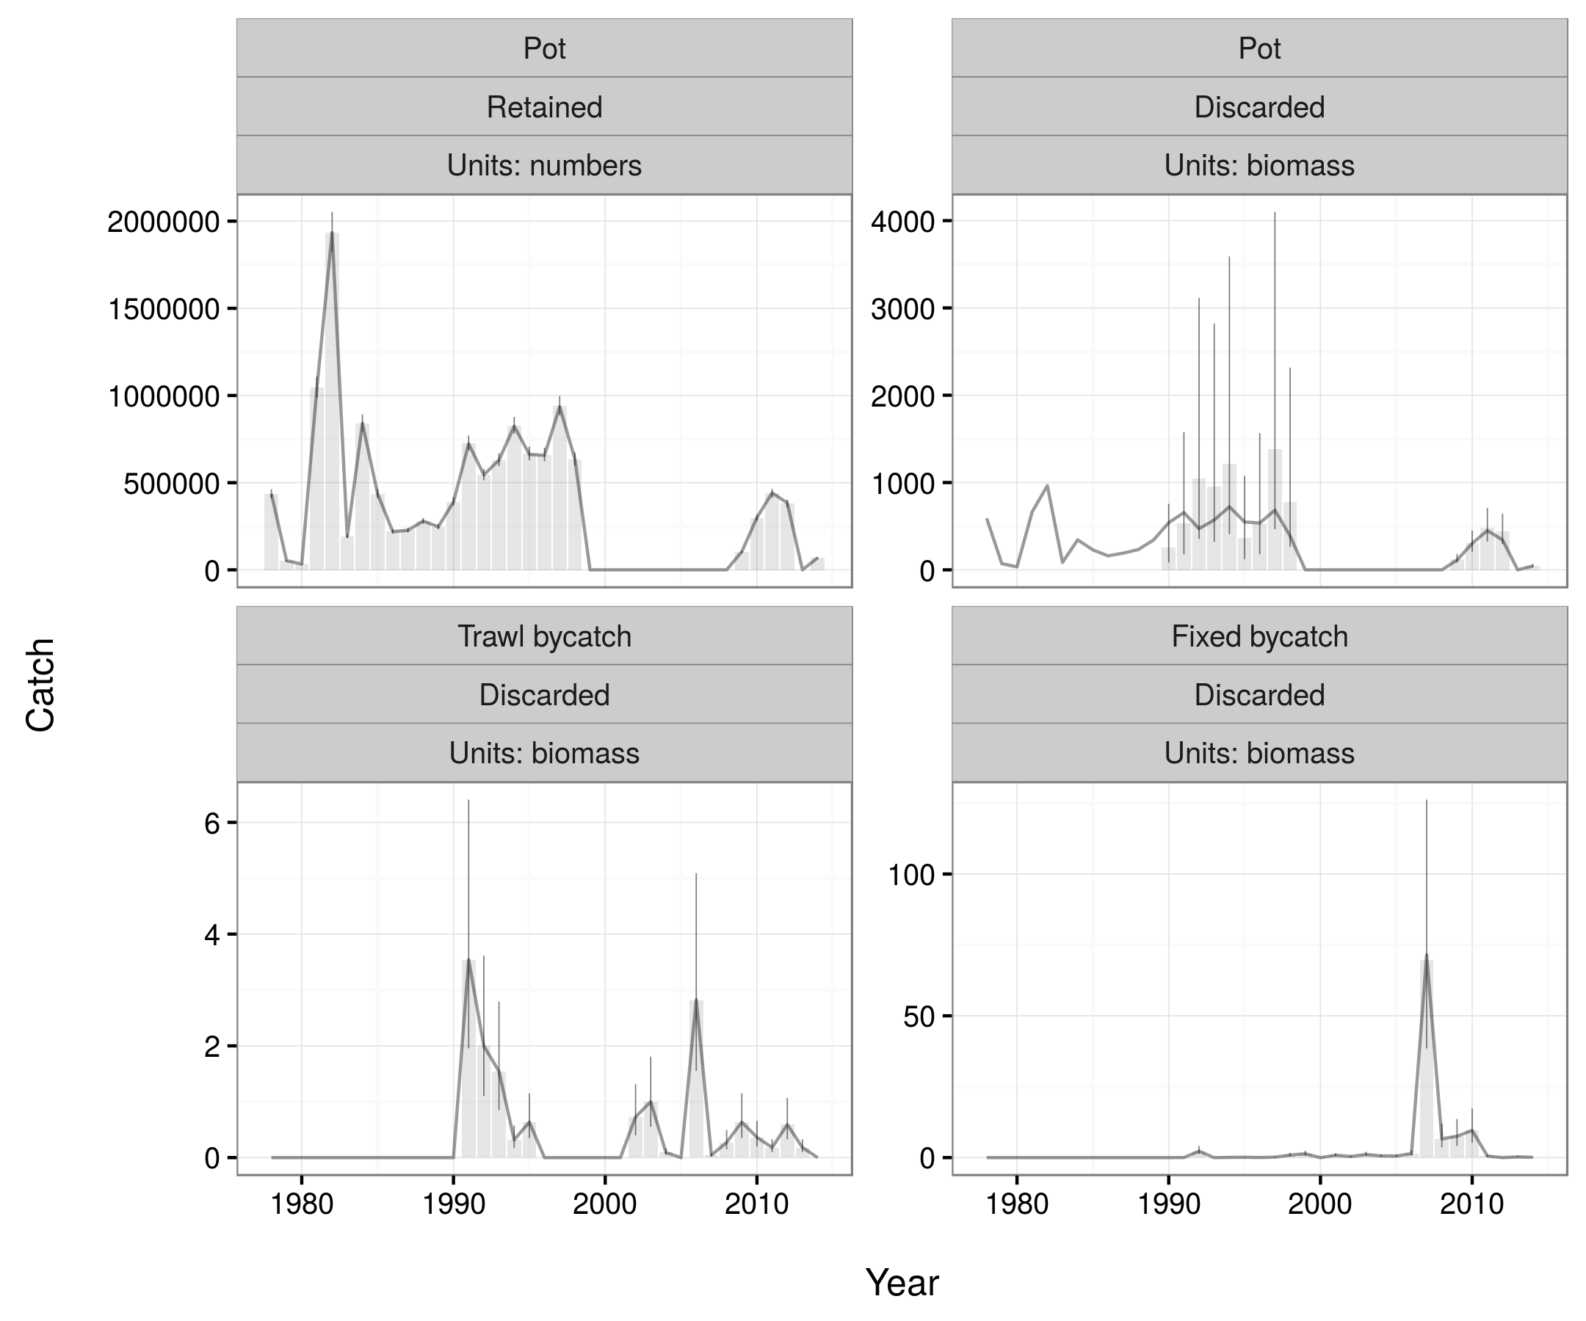
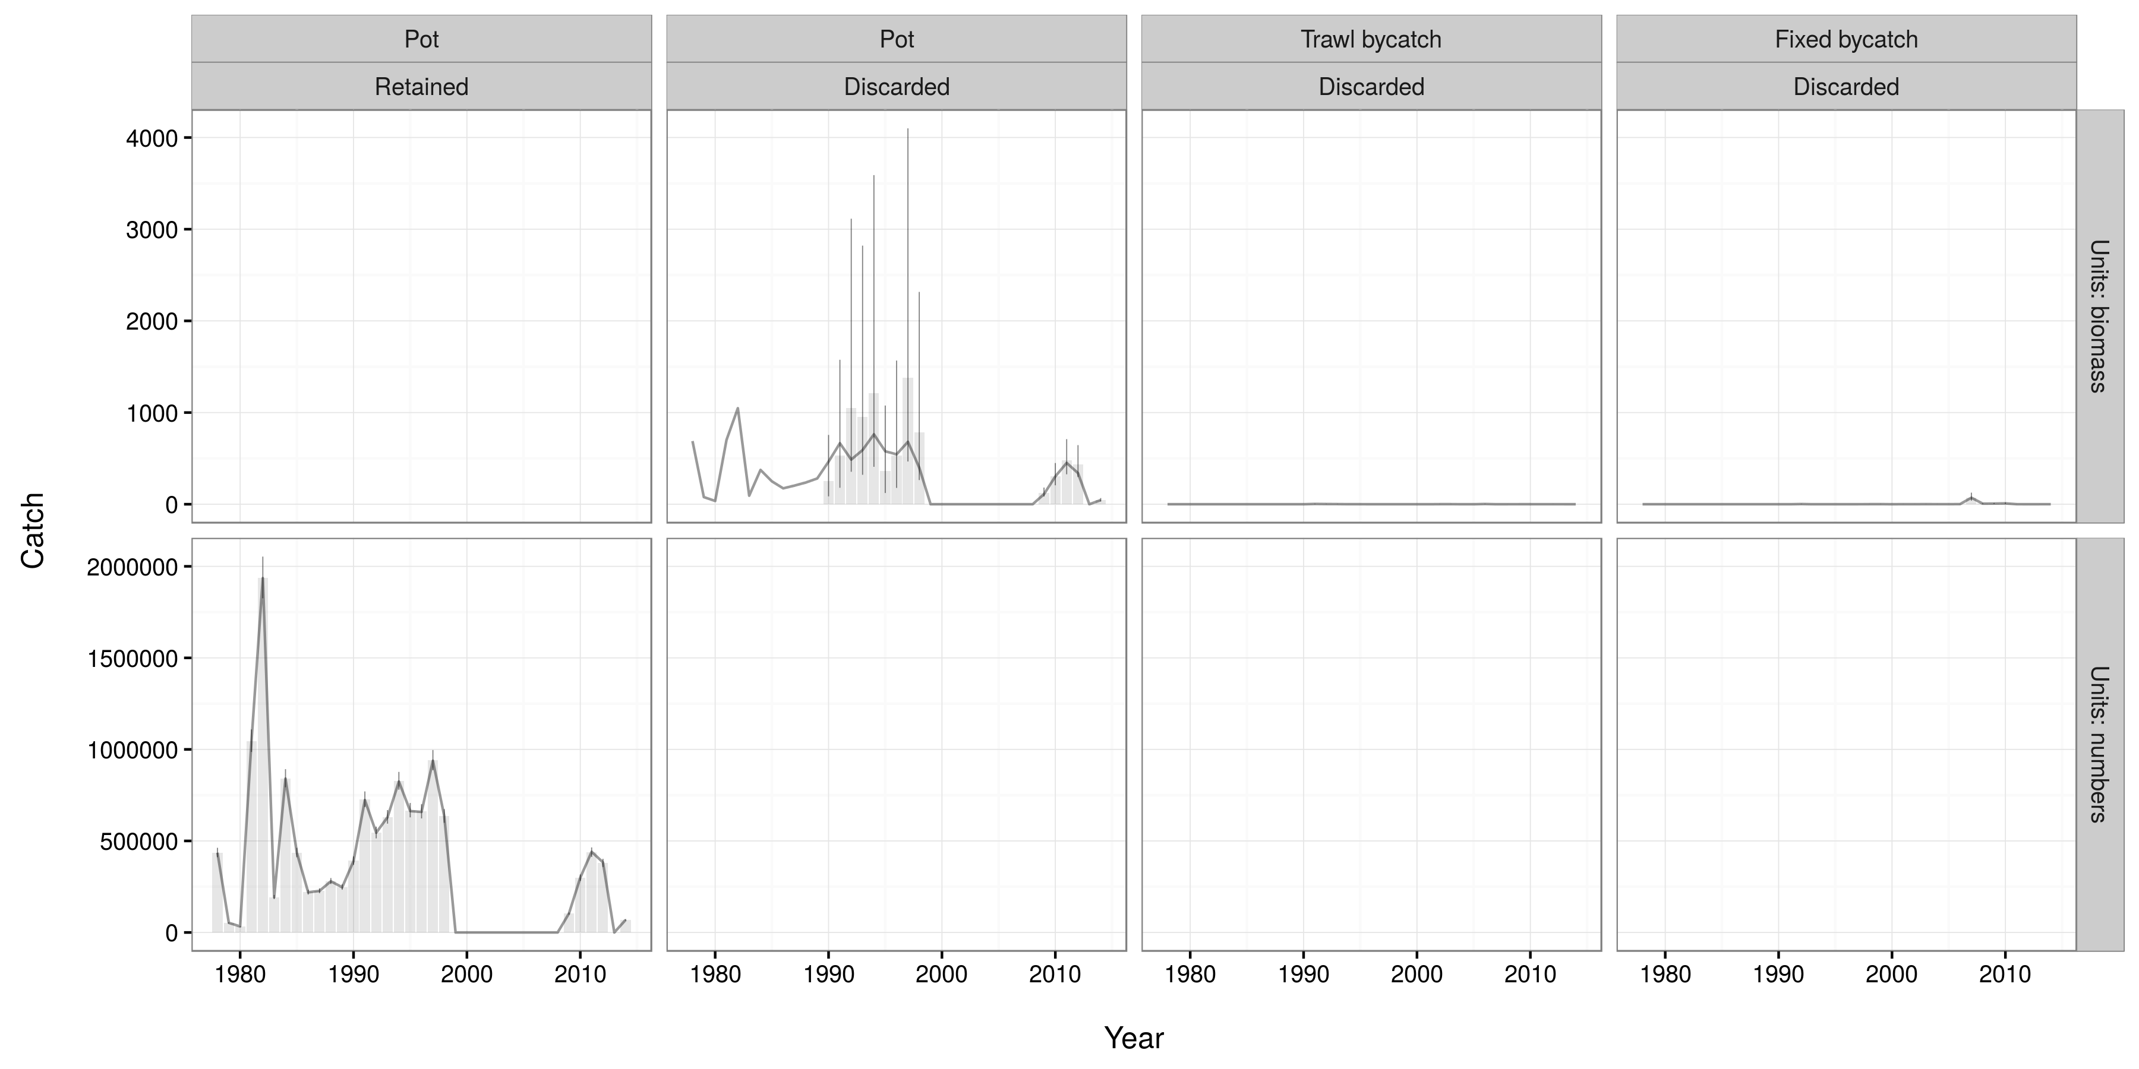

Slide 4
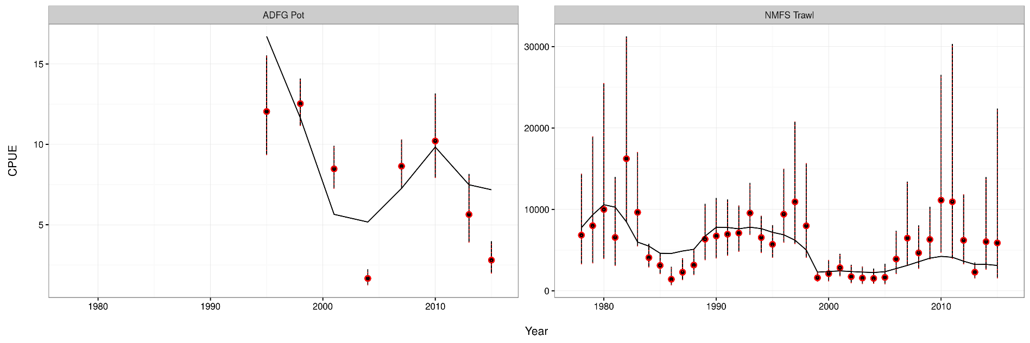
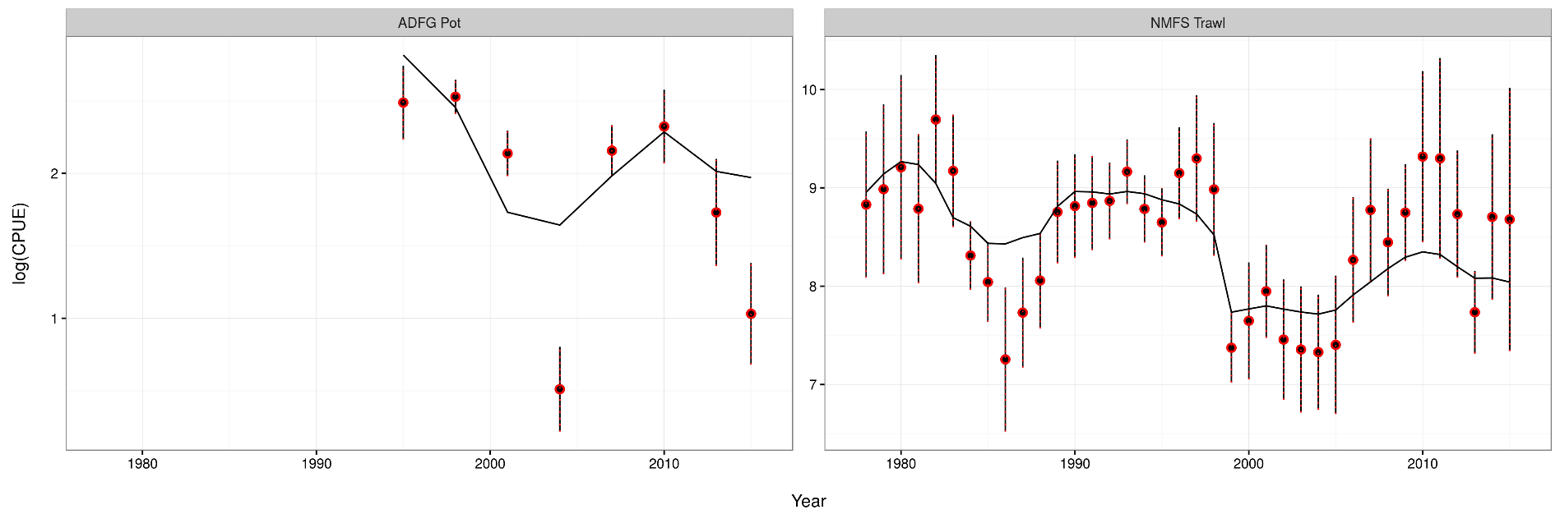

Slide 5
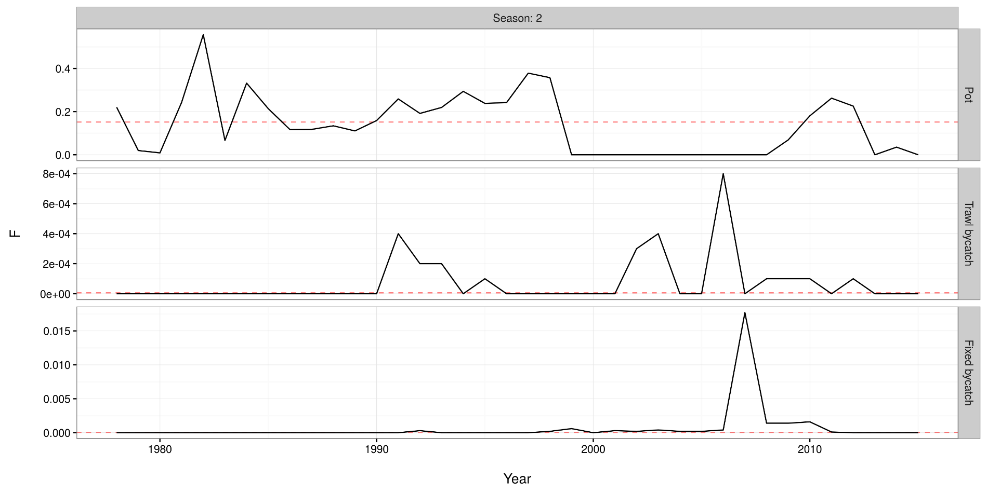

Slide 6
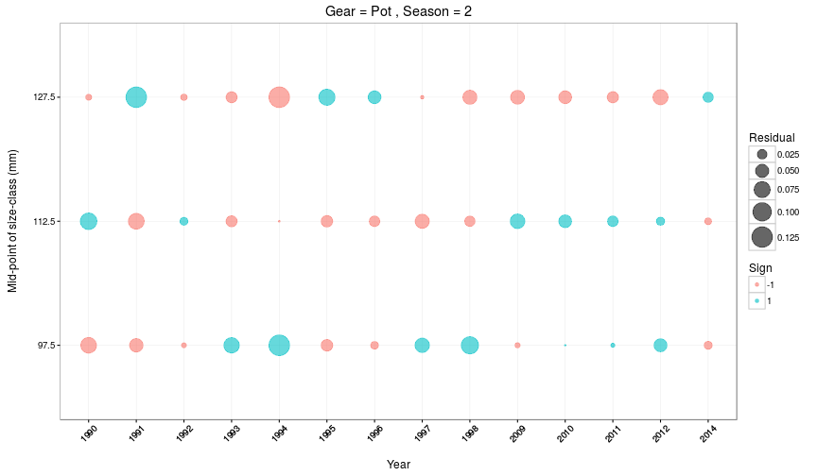

Slide 7
Gmacs in progress
Equilibrium numbers at length
Broke when seasonal changes added, can’t use the elegant solutions anymore
Not required for SMBKC as we estimate initial numbers as free parameters
The new function is complete but yet to be put in the right places
SPR calculations
As above/requires equilibrium numbers
Probably only a day or two of work but I fell asleep yesterday
BBRKC model
Runs but as above/requires equilibrium numbers

Slide 8
SMBKC in Gmacs
1978-2015
4 seasons (M = 0, 0.44, 0.185, 0.375)
3 stages (90-104, 105-119, 120+)
1 sex, 1 shell type, 1 maturity class
3 fleets (pot, trawl bycatch, fixed bycatch)
2 surveys (NMFS trawl and ADF&G pot CPUE) both in season 1
4 catch types (directed pot, pot discards, trawl bycatch, fixed bycatch) all during season 2
3 size compositions (pot in season 2, NMFS trawl in season 1, ADF&G pot in season 1)

Slide 9
SMBKC dynamics
Season 1
1 July, start of fishing year
Surveys
Season 2
M=0.44 & catch
Season 3
M=0.185
Calculate MMB
Season 4
M=0.375
Growth and molting
Recruitment (all to stage-1)

Slide 10
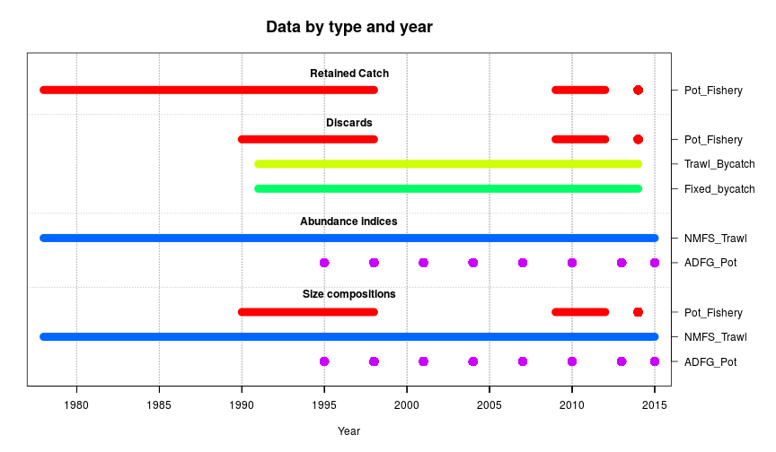
Data

Slide 11
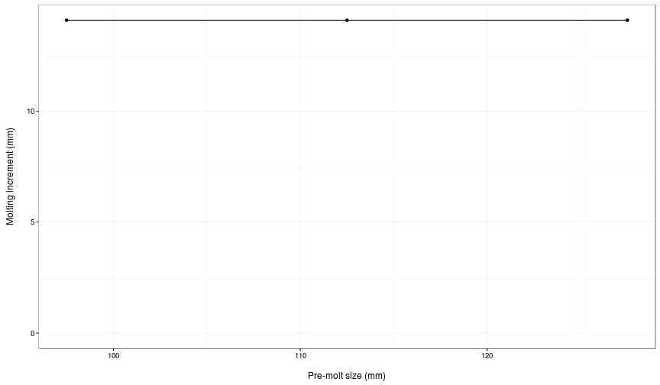
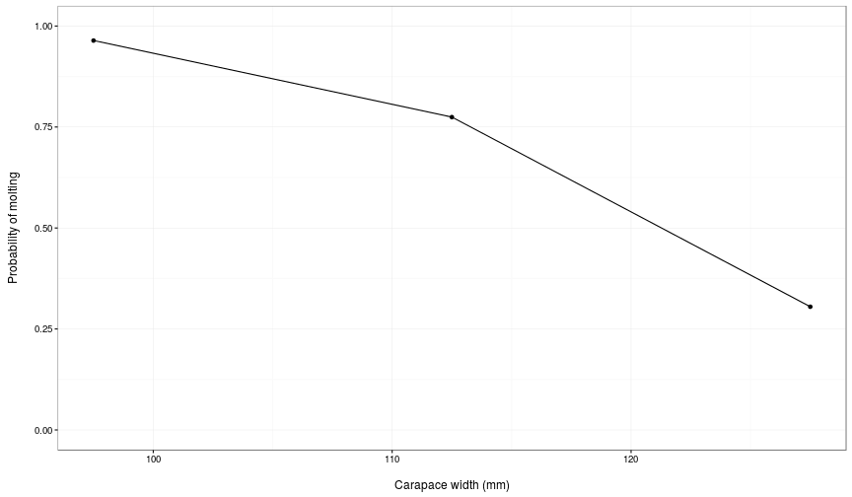

Slide 12
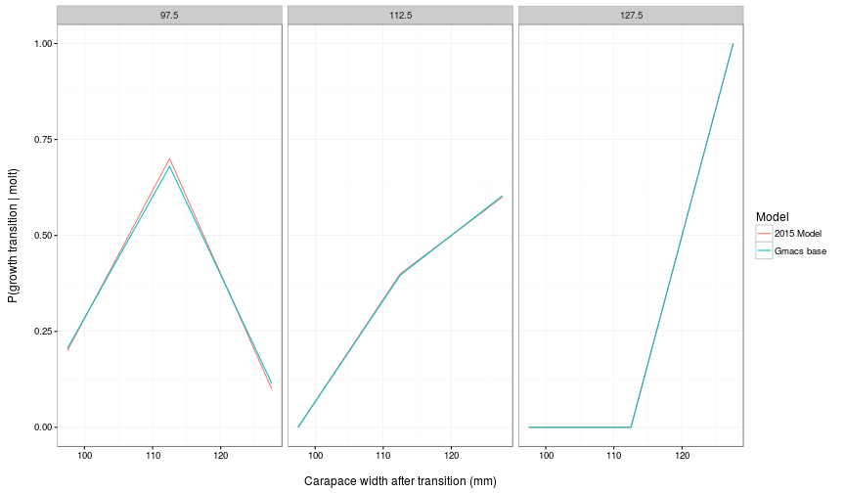
Size transition matrix

Slide 13
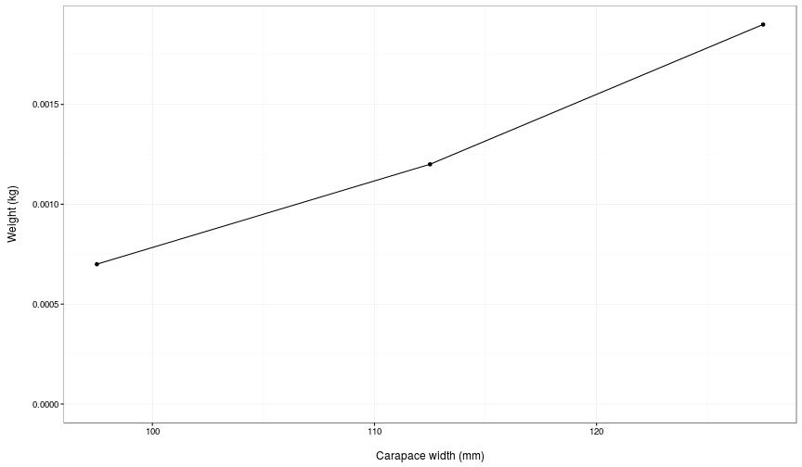
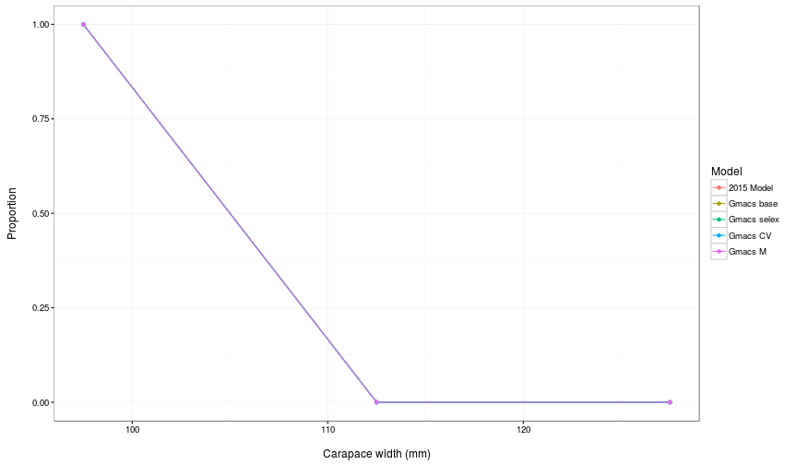

Slide 14
SMBKC
Jump to document

Slide 15
What else would people like to see?
Model runs:
Estimate M₁₉₉₈ but with smaller SD constraining deviation?
Plots…

Slide 17
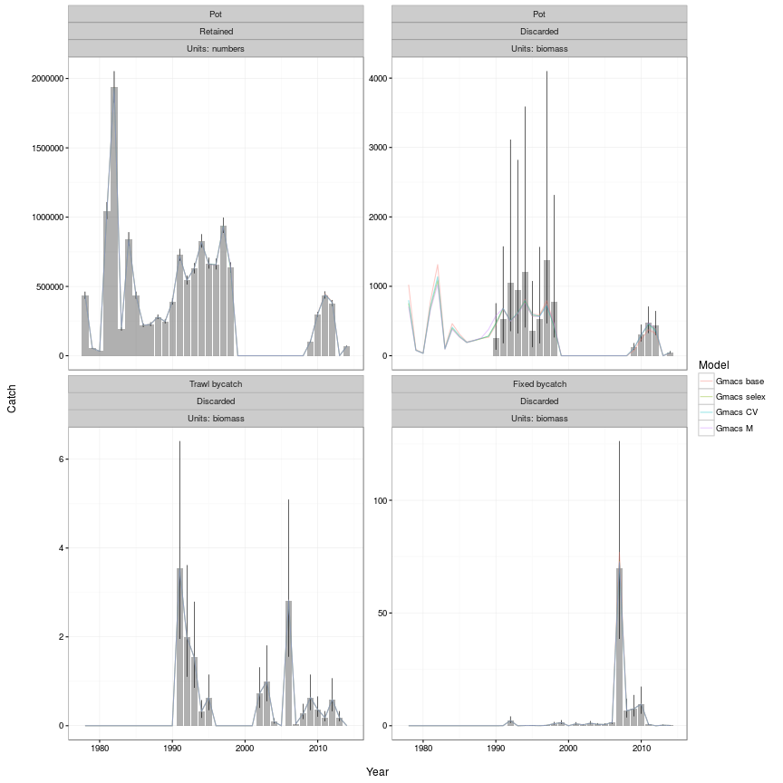

Slide 18
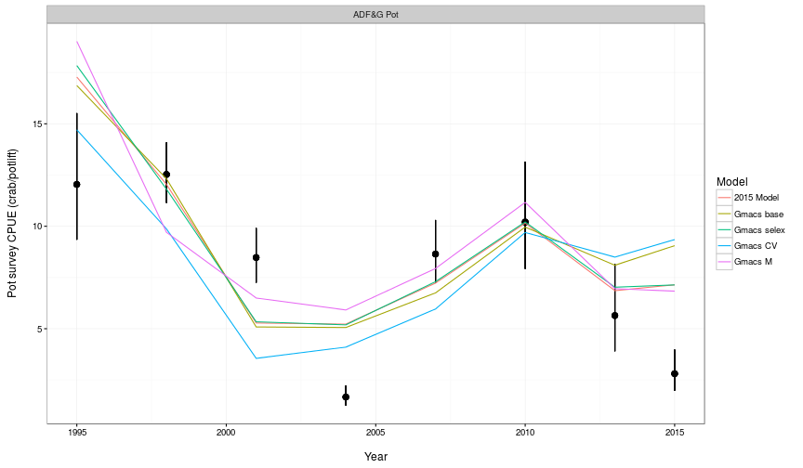

Slide 19
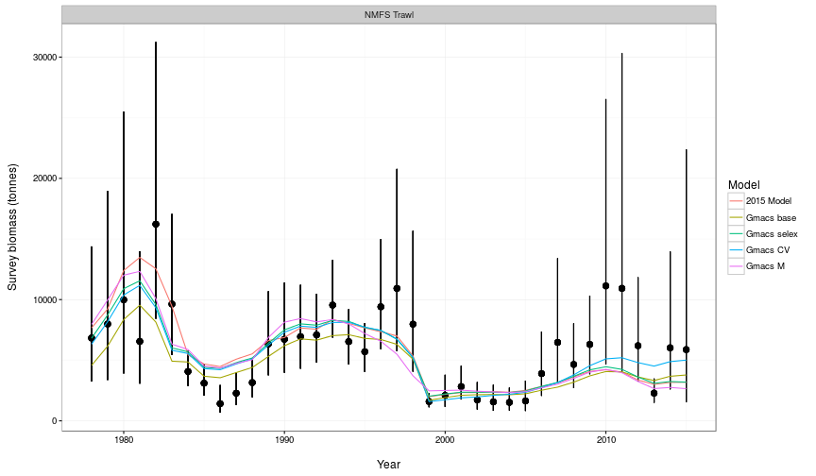

Slide 20
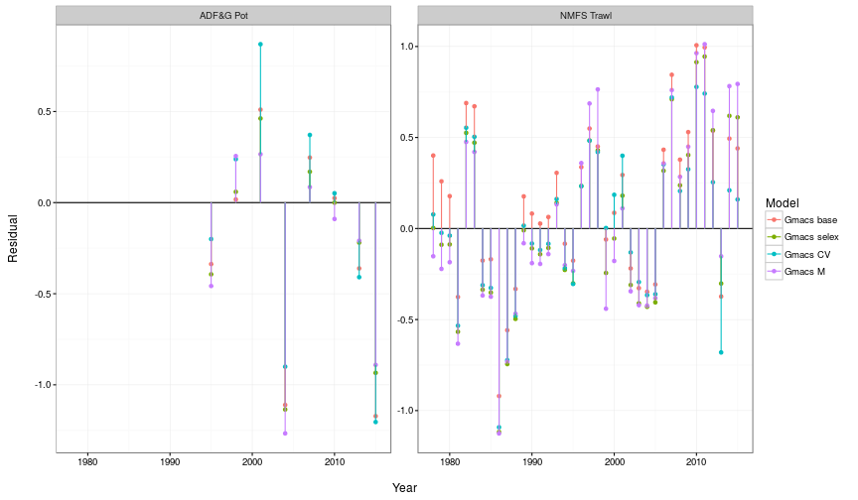

Slide 21
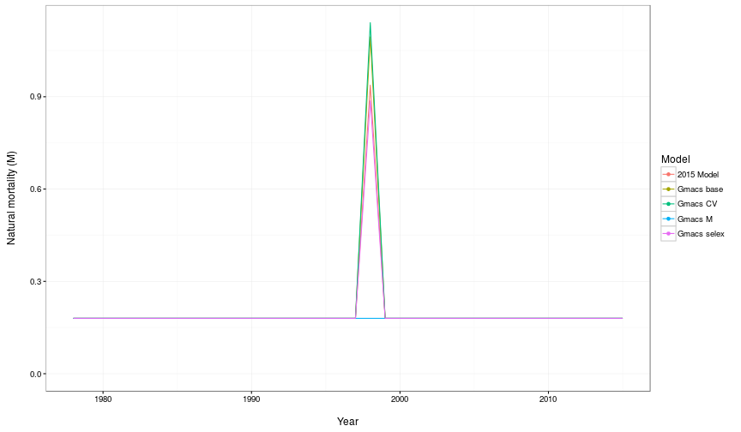

Slide 22
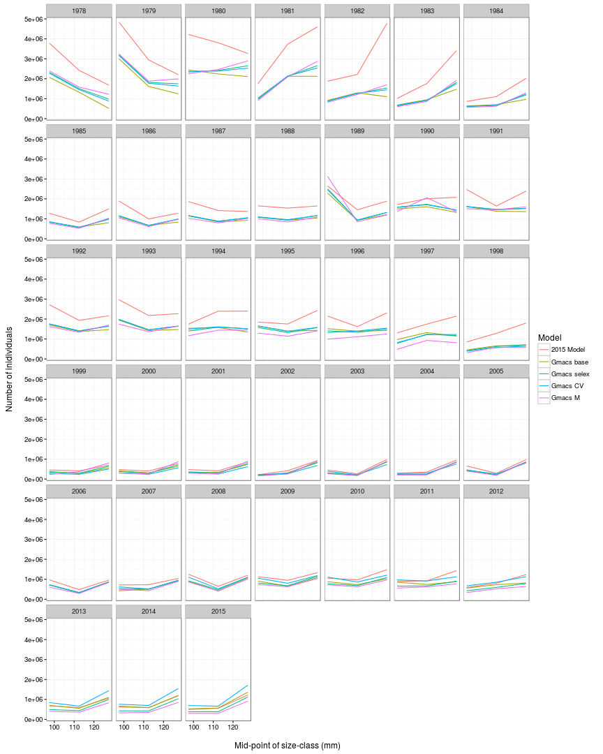

Slide 23
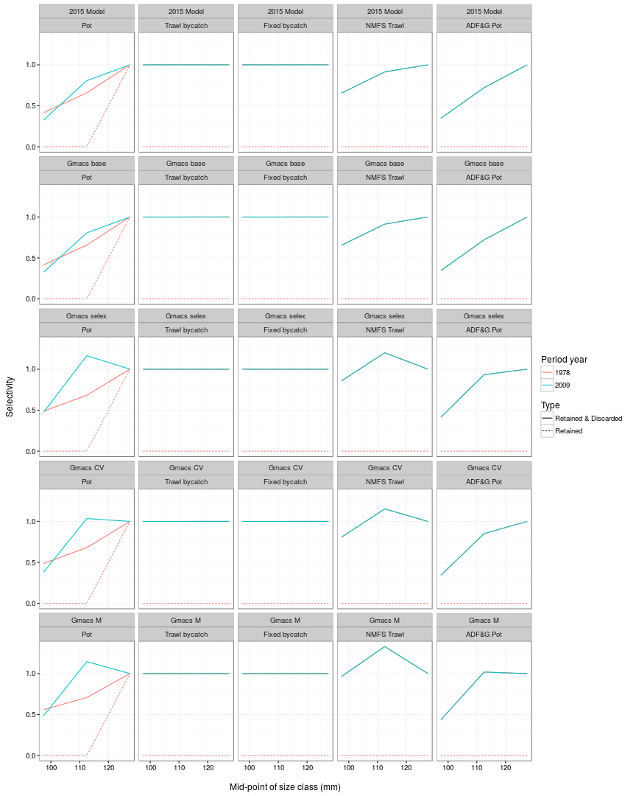

Slide 25
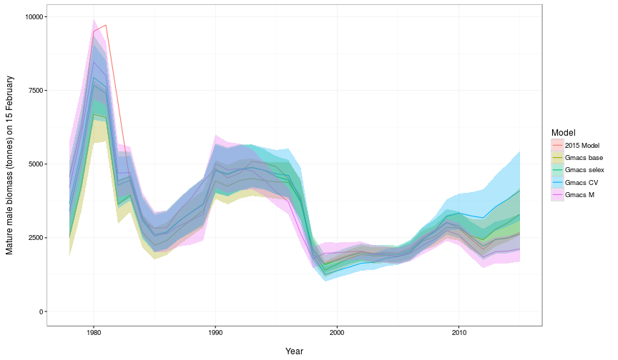

Slide 26
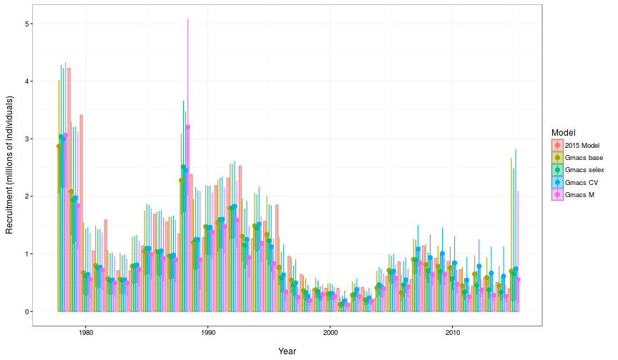

Slide 27
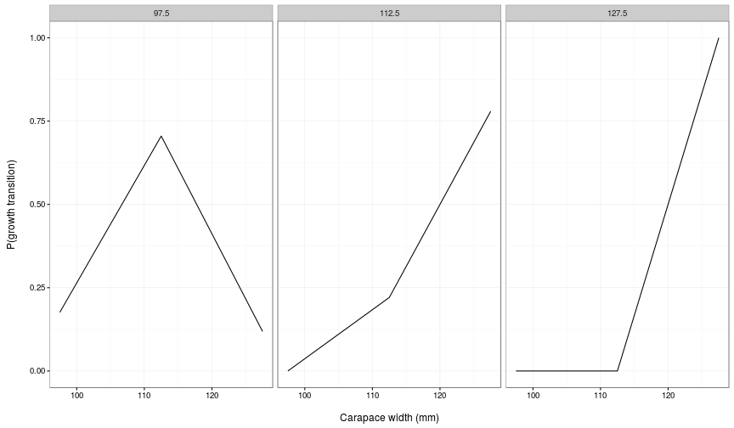

Slide 28
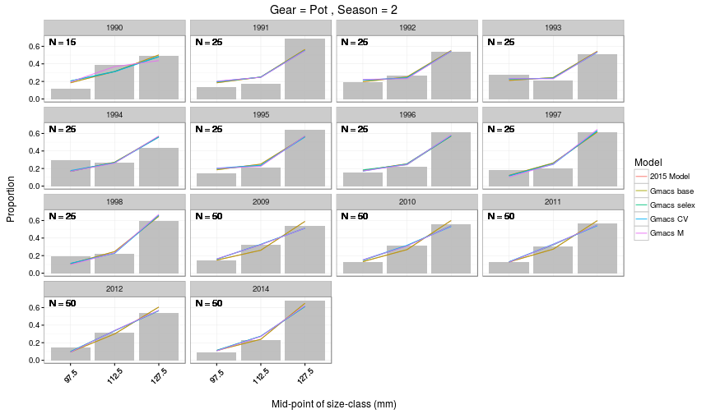

Slide 29
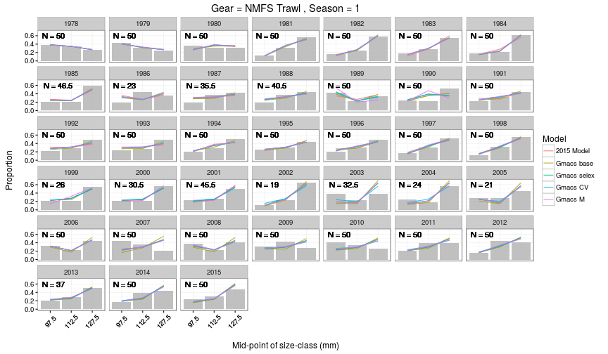

Slide 30
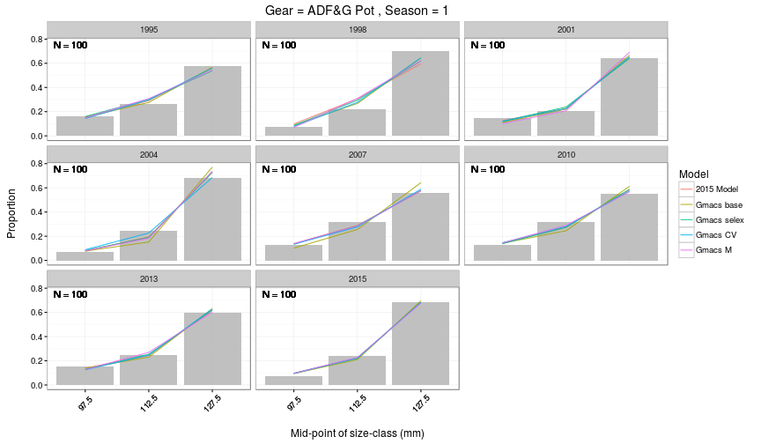

Slide 32
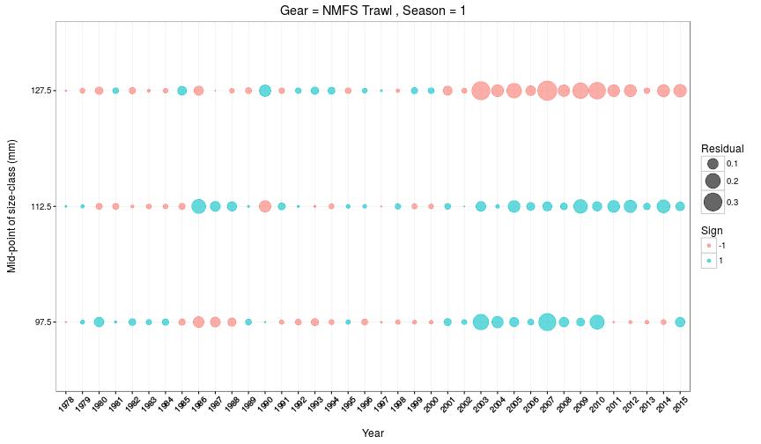

Slide 33
