Slide 1
Ames Housing Analysis
What Drives Home Sale Prices?
Ajirioghene Evovo | Ames Housing Dataset | 2,930 Homes

Slide 2
The Question
What factors drive home sale prices in Ames, Iowa — and how can buyers and sellers use this to make smarter decisions?

Slide 3
Data Cleaning
Made a copy of the original dataset before any changes
Stripped whitespace from column names
Filled missing numeric values with the median
Filled missing categorical values with 'Unknown'
Checked for and removed duplicate rows
Saved cleaned dataset to data/processed/cleaned_ames.csv

Slide 4
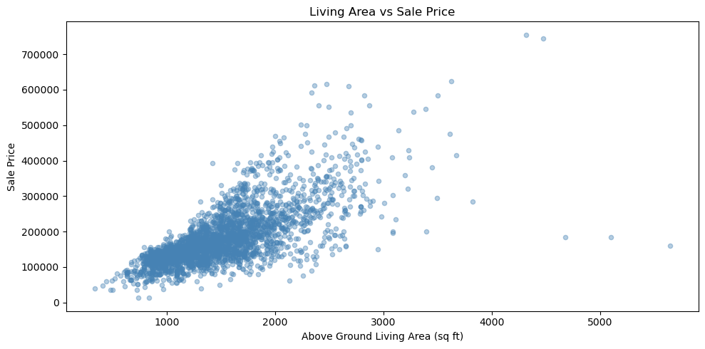
Finding 1 — Living Area Drives Price
0.71
Above ground living area (Gr_Liv_Area) has the strongest numeric relationship with sale price at 0.71.
Bigger homes consistently sell for more across all neighborhoods.
The scatter plot shows a clear upward trend — with more spread at higher prices, meaning expensive homes vary more.
Correlation with Sale Price

Slide 5
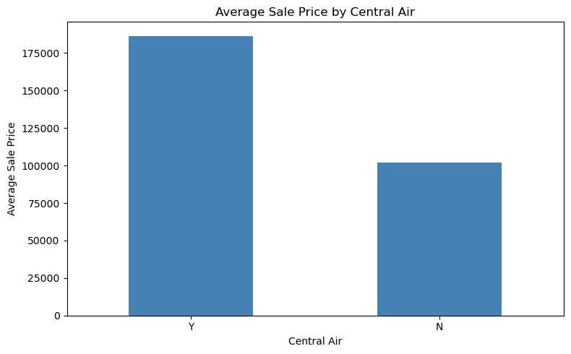
Finding 2 — Central Air Nearly Doubles Price
With central air: $186,452 avg
Without central air: $101,890 avg
That is almost double — making central air one of the strongest single predictors in the dataset.

Slide 6
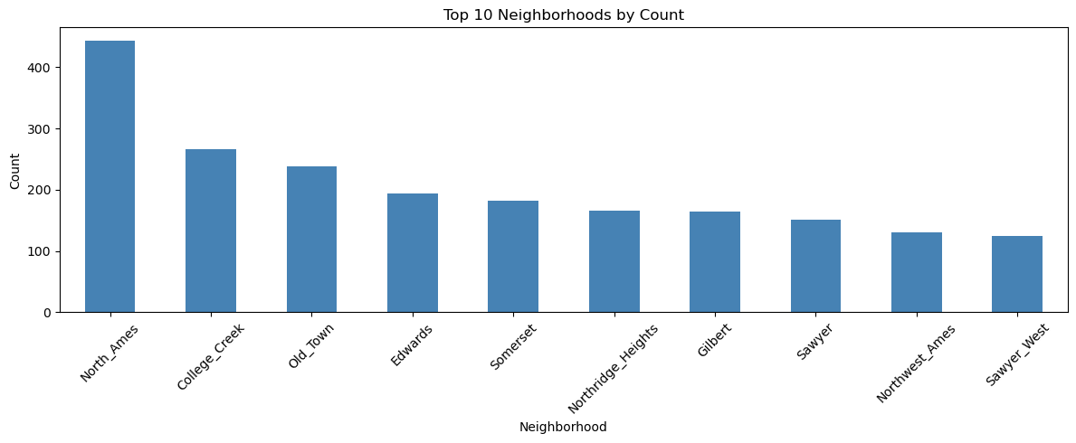
Finding 3 — Neighborhood Matters

Slide 7
Recommendations
For Sellers
For Buyers
Consider adding central air before listing. The data shows it nearly doubles average sale price — the return on investment could be significant.
Target larger homes in more affordable neighborhoods like North Ames or Edwards for better value than premium areas like Northridge.

Slide 8
Conclusion.
Size, central air, and neighborhood are the three biggest drivers of home sale prices in Ames, Iowa.
Thank you
Ajirioghene Evovo | Ames Housing Analysis

