Slide 1



SMART INDIA HACKATHON 2026
TITLE PAGE
  Problem Statement ID - SIH26044
  Problem Statement Title - Portal for Academia - Industry collaboration for Skill Mapping, Internships and Placement
  Theme - Smart Automation
  PS Category - Software
  Team ID - SIH26-A0H-T371
  Team Name - Strike Out

Slide 2

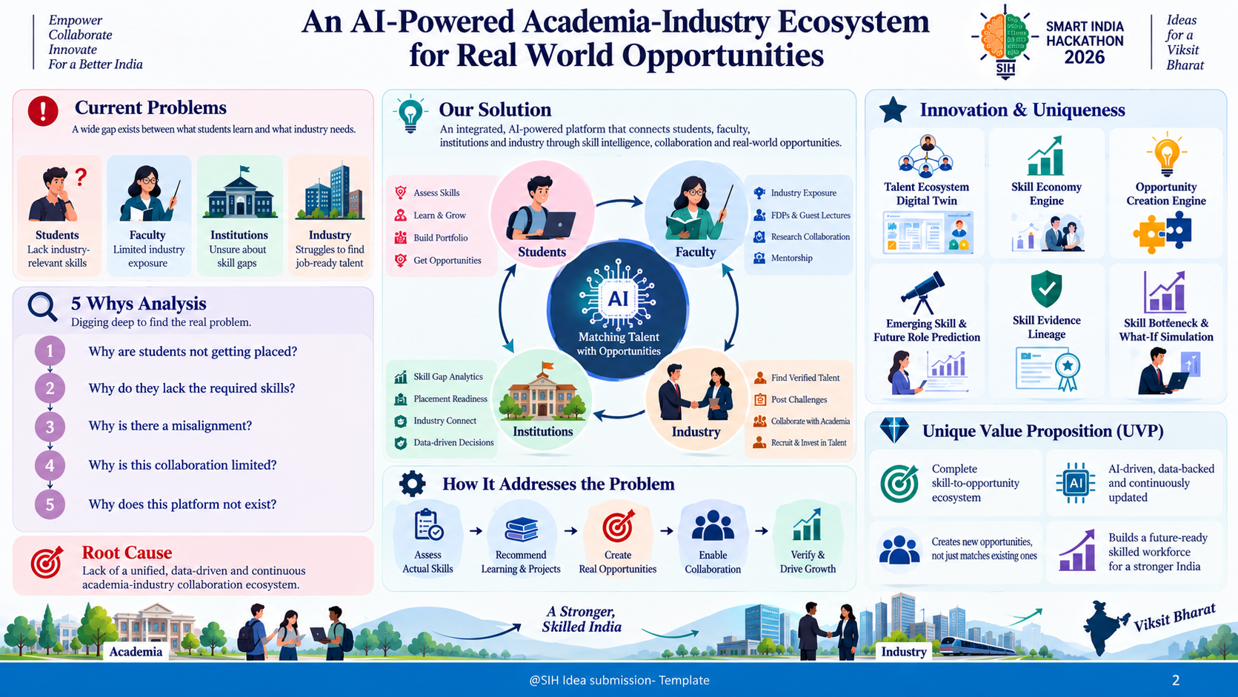
Strike Out
Strike Out
@SIH Idea submission- Template
2
Notes:
2

Slide 3
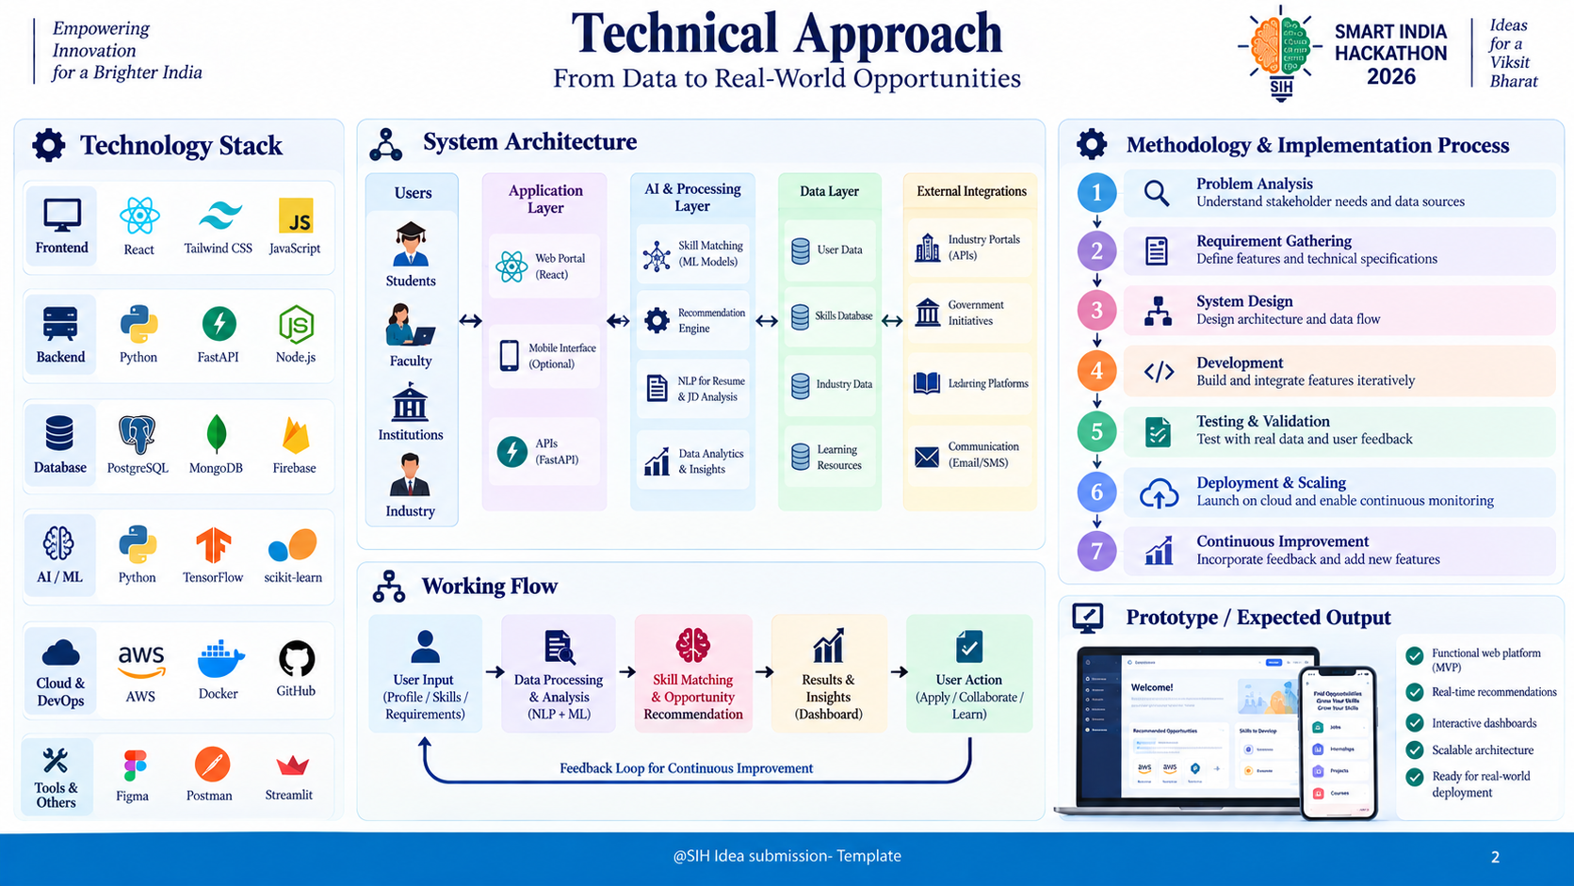
Strike Out
Strike Out
@SIH Idea submission- Template
3
Notes:
3

Slide 4
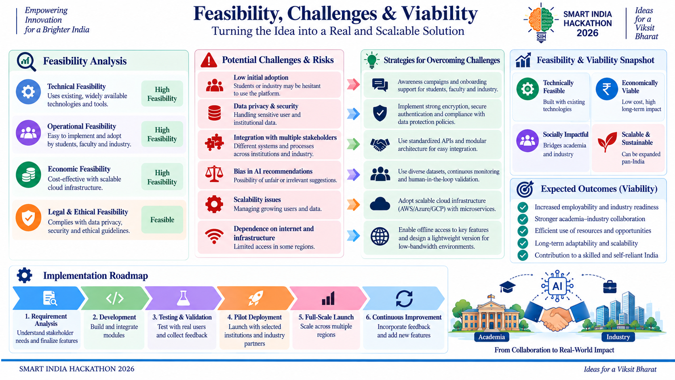
Strike Out
Strike Out
@SIH Idea submission- Template
4
Notes:
4

Slide 5
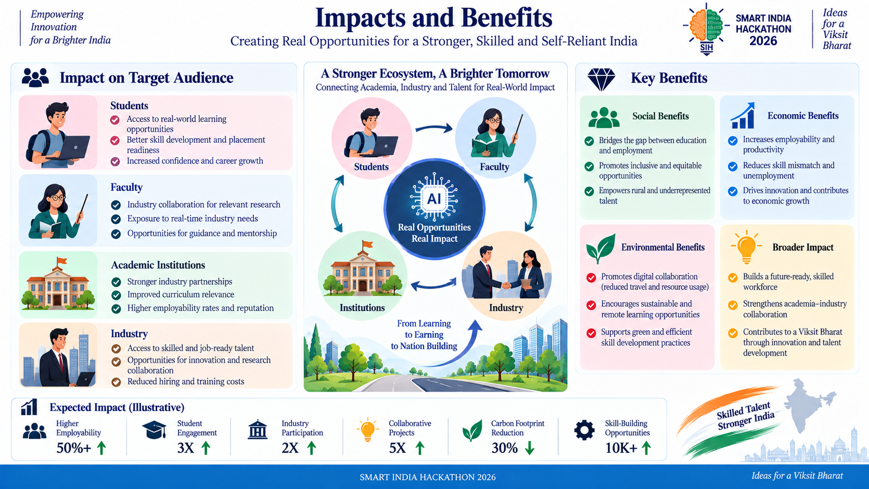
Strike Out
@SIH Idea submission- Template
5
Notes:
5

Slide 6
Strike Out
RESEARCH AND REFERENCES
1) Industry Skill Gaps & Future Demand
  Future of Jobs Report 2025 – World Economic Forum
  Skills Gaps as a Barrier to Business Transformation – WEF
2) India: Youth Employment & Skills
  India Employment Report 2024 – ILO
  India Employment Report 2024 – Full Research Repository
3) Skills Mismatch & Demand–Supply Gap
  Getting Skills Right: Skills for Jobs Indicators – OECD
  Assessing & Anticipating Changing Skill Needs – OECD
4) Skills-First & Evidence-Based Talent
  A Skills-First Labour Market – OECD, 2026
  Understanding Skill Gaps in Firms – OECD
5) AI & Higher Education Transformation
  AI for Skills Development in Higher Education – UNESCO
  AI and Technologies in Education – UNESCO
@SIH Idea submission- Template
6
Notes:
6

