Slide 1



SMART INDIA HACKATHON 2026
Problem Statement ID - SIH26132
Problem Statement Title - Strengthening market linkages and price discovery for farmers
Theme - Agriculture, FoodTech & Rural Development
PS Category - Software
Team ID - SIH26-A0H-T371
Team Name - Strike Out

Slide 2
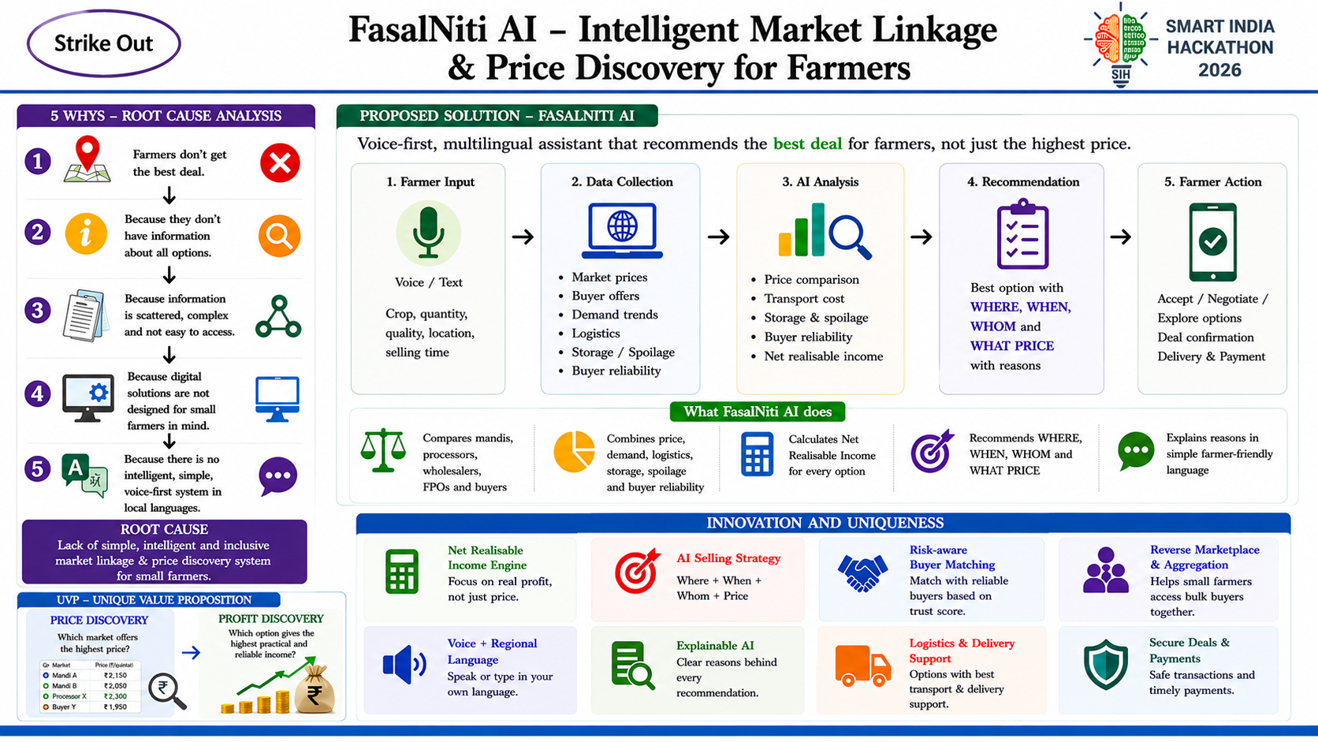

Strike Out
@SIH Idea submission- Template
2
Notes:
2

Slide 3
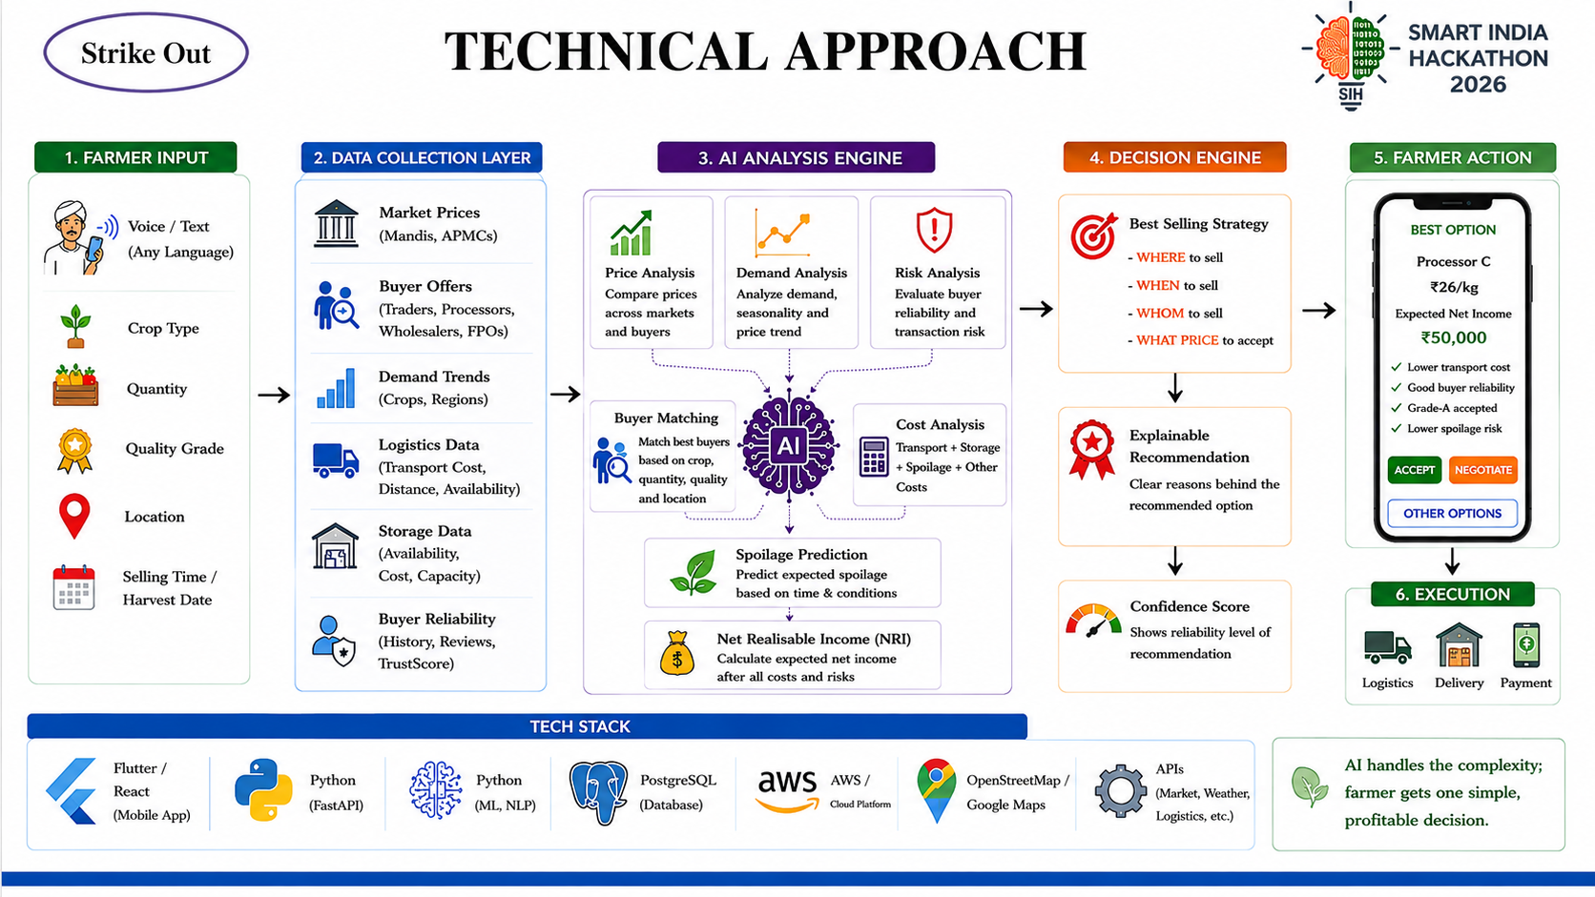
Strike Out
@SIH Idea submission- Template
3
Notes:
3

Slide 4
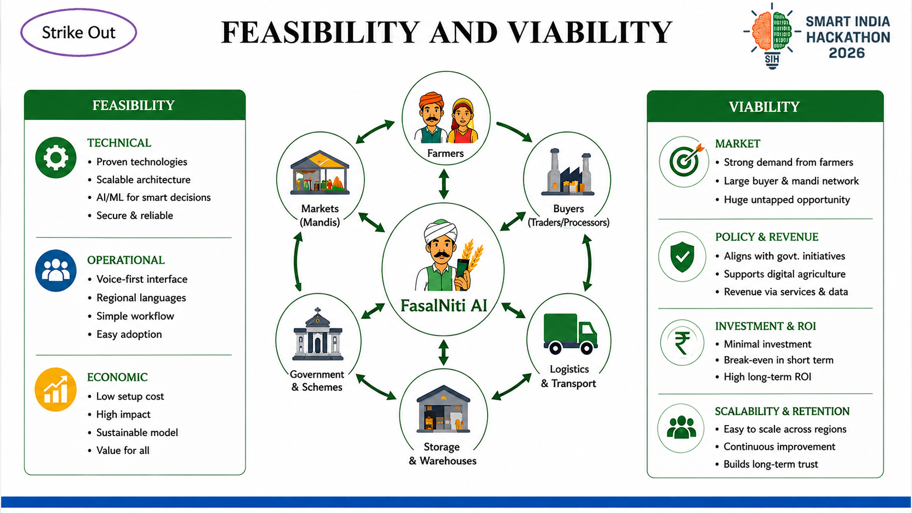
Strike Out
@SIH Idea submission- Template
4
Notes:
4

Slide 5
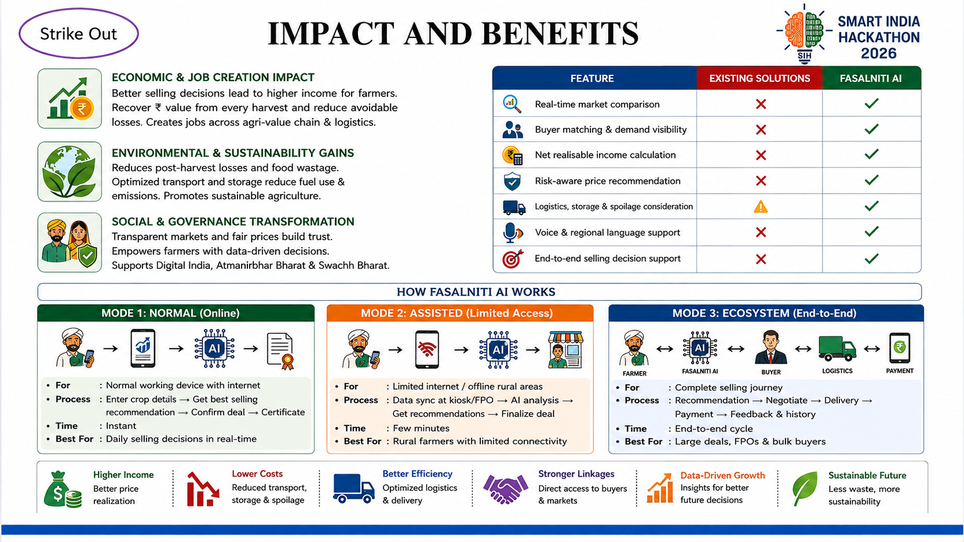
Strike Out
@SIH Idea submission- Template
5
Notes:
5

Slide 6
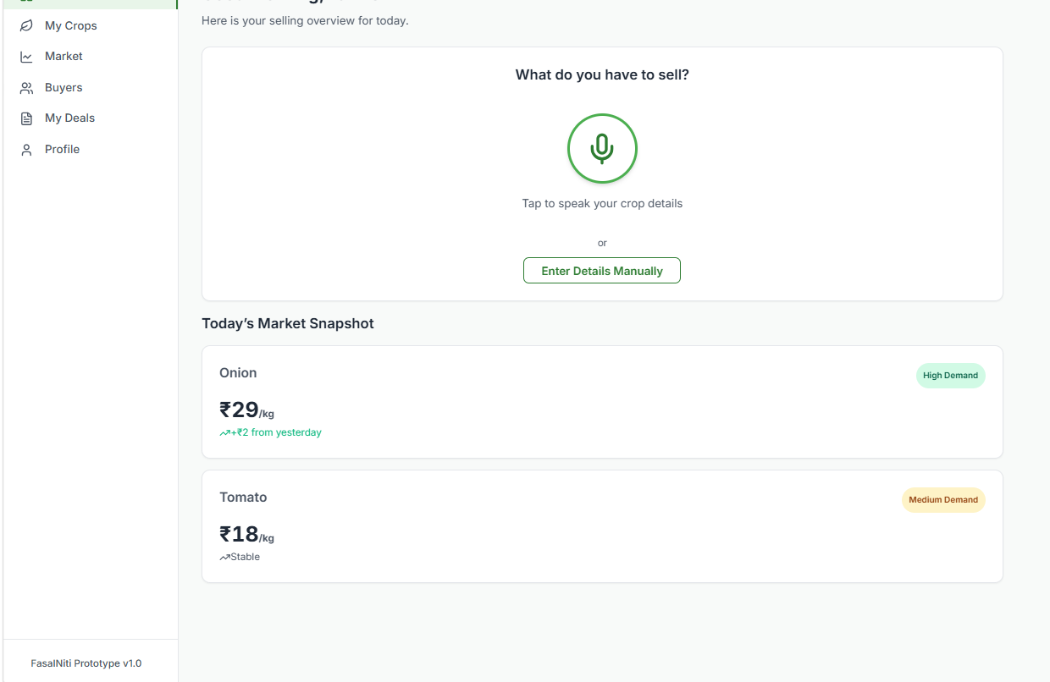
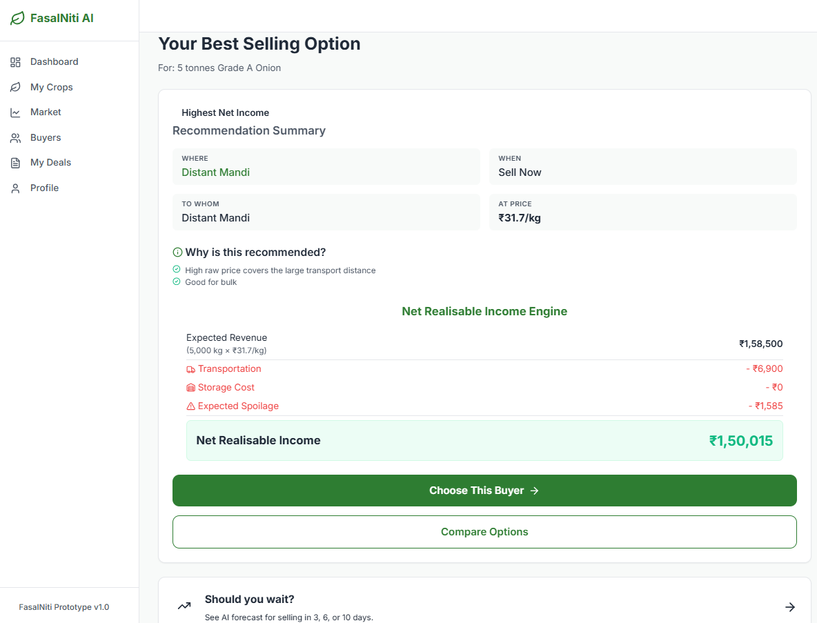
Strike Out
RESEARCH AND REFERENCES
1) Agricultural Market & Price Discovery
AGMARKNET – Agricultural Market Information
Agricultural Market Transformation & Digital Price Discovery – 2026
2) Farmer Market Access
Determinants of Small Farmers’ Access to Agricultural Markets – Springer Nature
Awareness and Determinants of Farmers’ Participation in e-Marketing – ICAR
e-NAM FPO Participation
3) Digital Agriculture & Farmer Adoption
Determinants, Knowledge and Constraints of e-NAM Adoption in Tamil Nadu – ICAR, 2026
Transforming Agricultural Trading and Commerce in India – Agricultural Economics Research Review
4) Government Research & Agricultural Markets
e-NAM Digital Transformation of Agricultural Trade – PIB, 2026
5) Post-Harvest Loss & Supply Chain
Study on Post-Harvest Losses of Agricultural Produce – MoFPI
DEMO LINK: Click Here
@SIH Idea submission- Template
6
Notes:
6

