Slide 1
Data Visualisation in R
Jemma Collova
Angus Hughes
Record...

Slide 2
Today’s Agenda
Basics of ggplot
What is it and how do I use it?
The bare bones: Using geoms to create common plots
Tweaking aesthetics to perfection using colours, fills, and themes
More advanced ggplot
Splitting your plots by group
Joining up several plots
Model-based predictions (time allowing)
Saving your plots
Feel free to ask questions at any time!

Slide 3
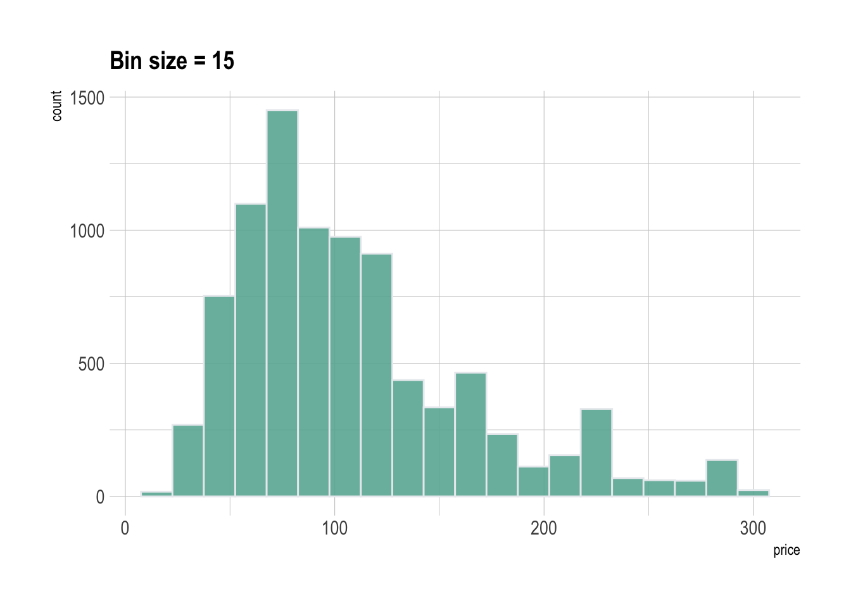
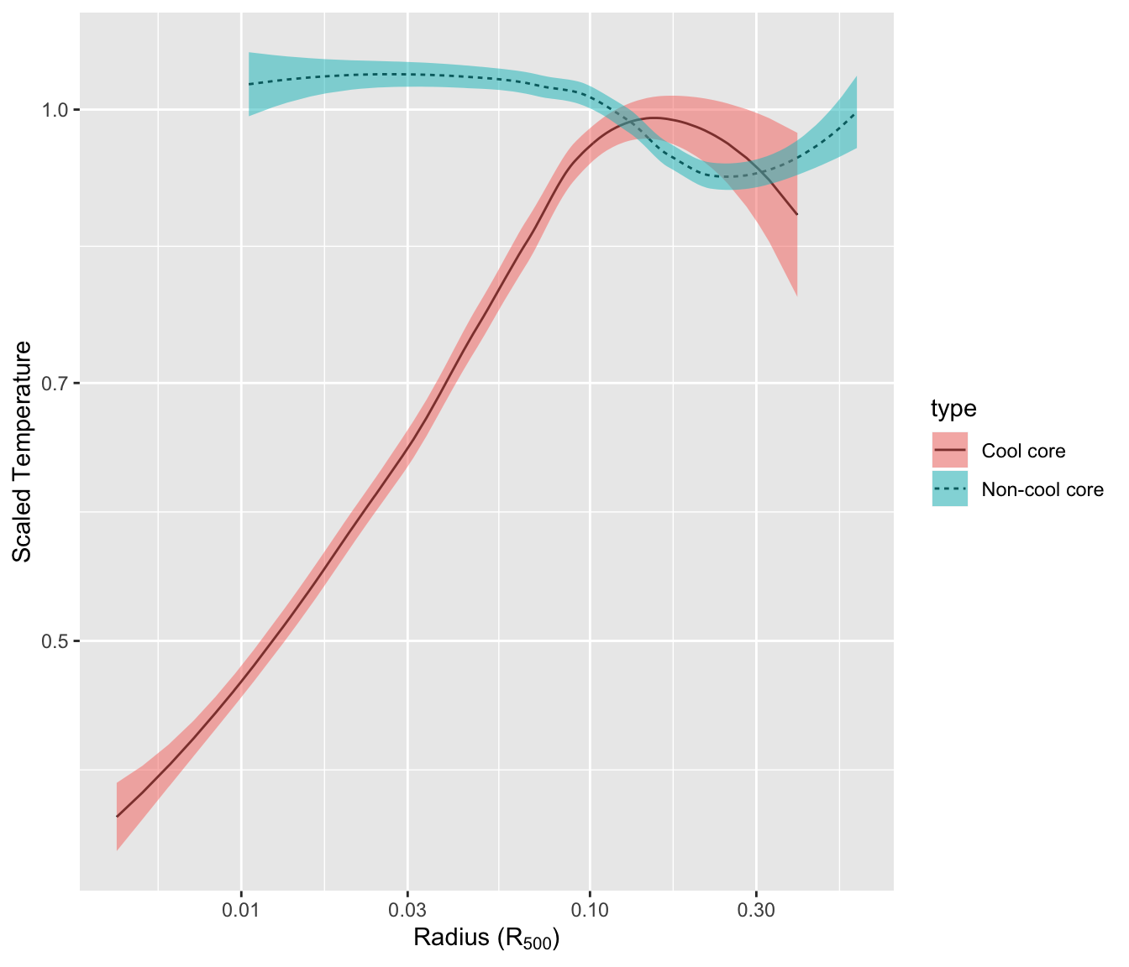
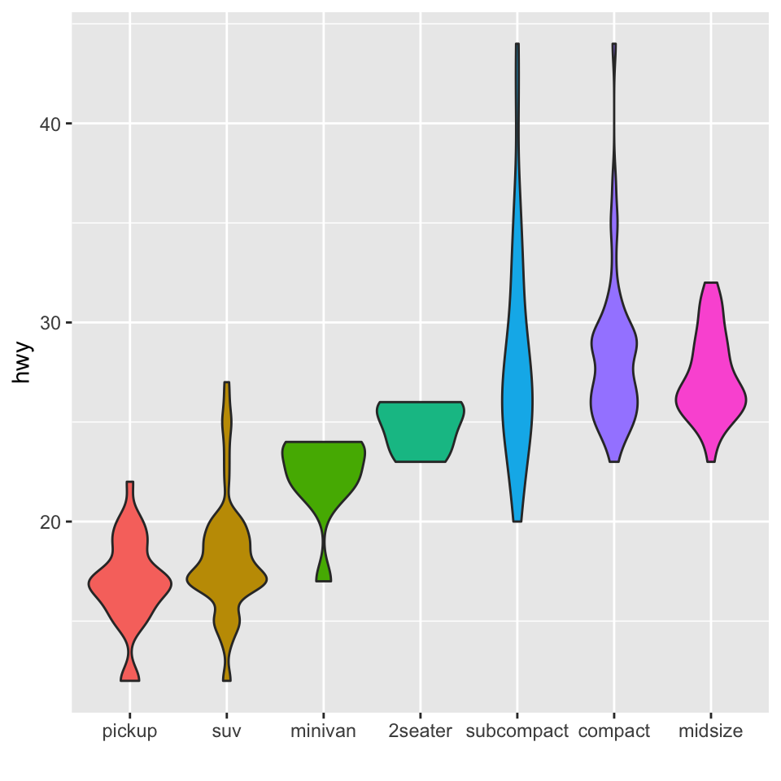
What is ggplot2?
Works within the ‘Tidyverse’ (suite of great packages)
One of the most powerful tools for visualization around
Gg stands for ‘grammar of graphics’

Slide 4
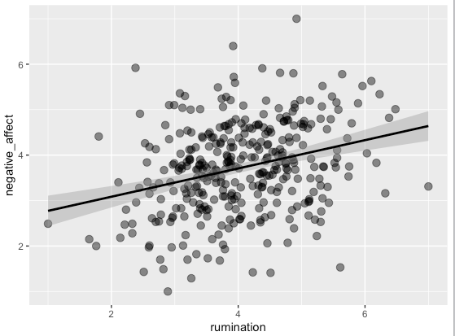
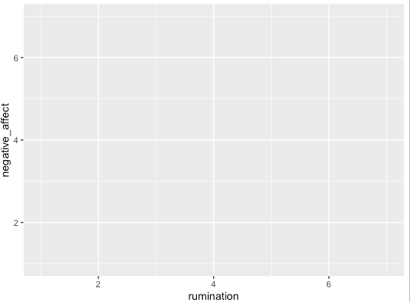
What is it, really?
ggplot creates a coordinate system
layers

Slide 5
How to use ggplot2
What data, what coordinates?
2. How to display?
Code: ggplot(DATA, aes(x =, y =)) + geom_FUNCTION ()
Geoms = visual marks that represent data points:
Notes:
An aesthetic is a visual property of the objects in your plot

Slide 6
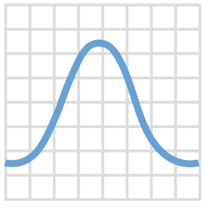
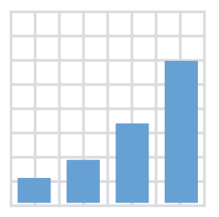
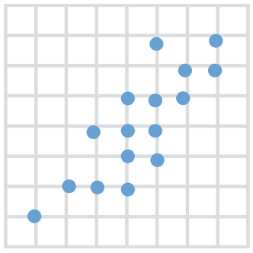
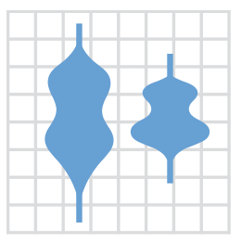
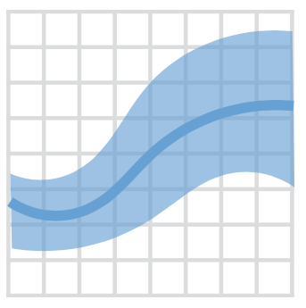

GEOMS
>40 geoms
Data + geom_bar()
Data + geom_density()
Data + geom_point()
Data + geom_violin()
Data + geom_smooth()
Data + geom_boxplot()

Slide 7
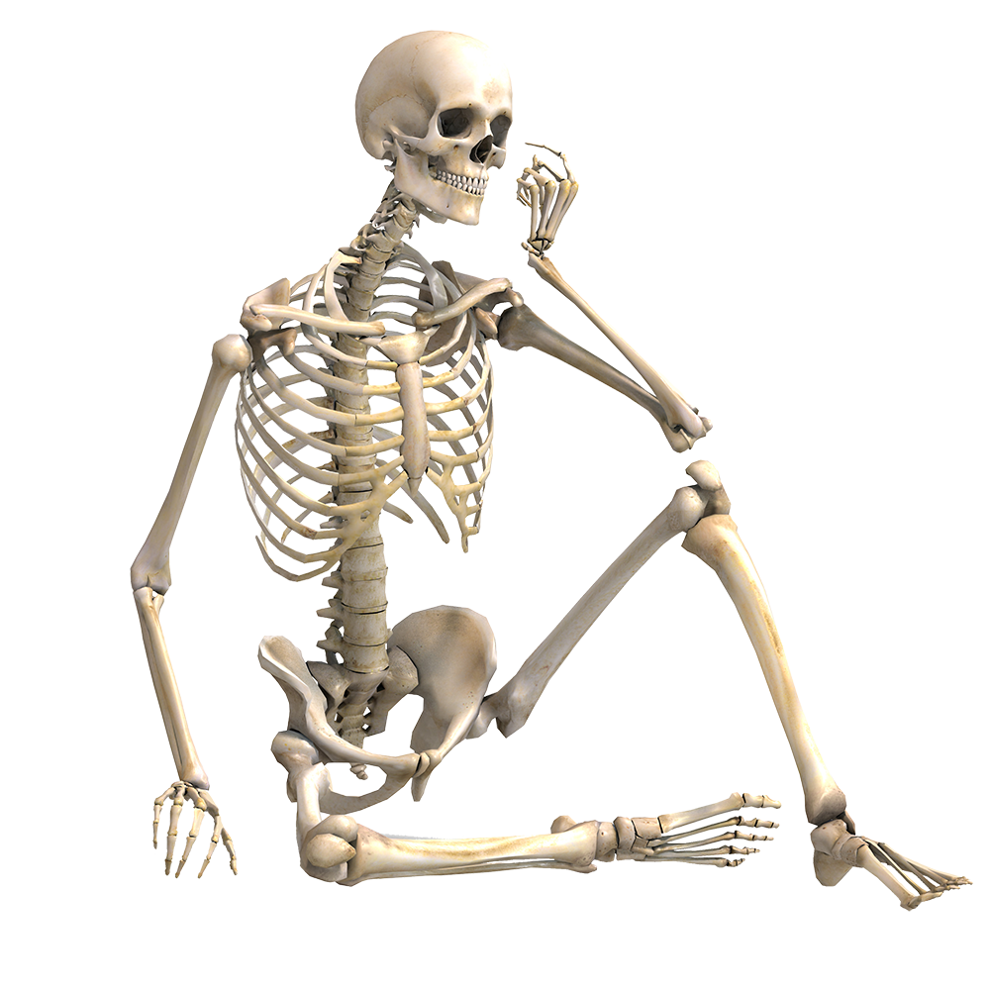
Using ggplot2 in R
The bare bones...

Slide 8
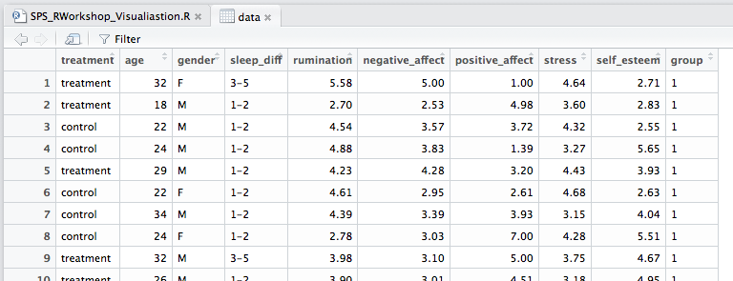
Practice data… Psychological Therapy
Let’s have a go plotting one variable!

Slide 9
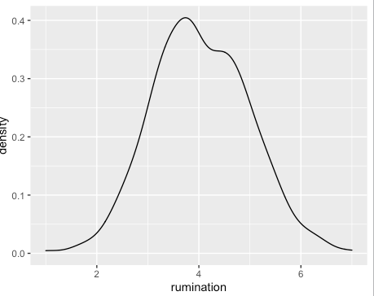
Density plot of a single, continuous variable
ggplot(data, aes(x = rumination)) +
geom_density()
With a density plot there’s no need to tell ggplot what the y-axis should be.

Slide 10
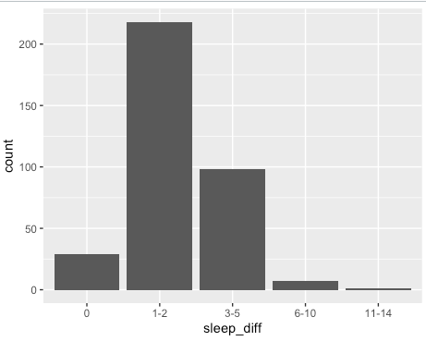
Bar chart of a single, discrete variable
ggplot(data, aes(x = sleep_diff)) +
geom_bar()
Likewise, by default a bar-chart will infer your y-axis to be counts on the x-axis variable.

Slide 11
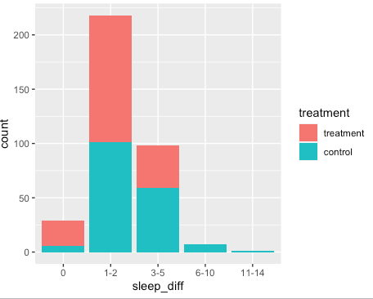
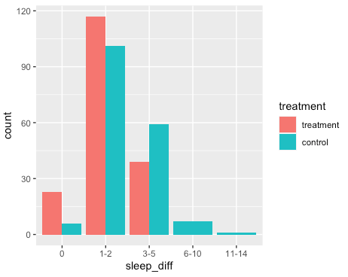
Adding more: Clustered bar chart
Let’s have a go!
1.
ggplot(data, aes(x = sleep_diff)) +
geom_bar()
2.
ggplot(data, aes(x = sleep_diff, fill = treatment)) +
geom_bar()
3.
ggplot(data, aes(x = sleep_diff, fill = treatment)) +
geom_bar(position = "dodge")

Slide 12
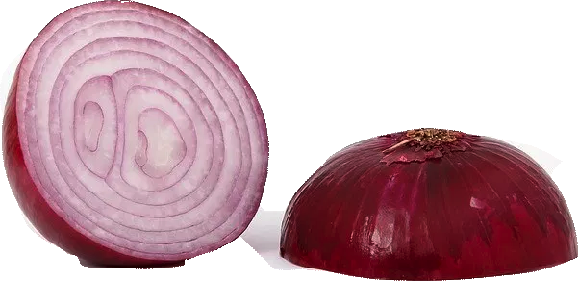
Plotting 2 Variables and adding some layers...
Labelling the X and Y axis
Adding themes
Colours / size

Slide 13
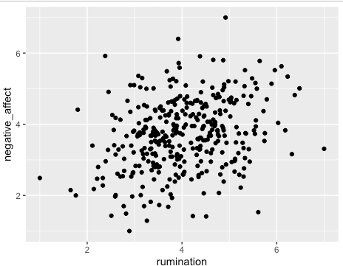
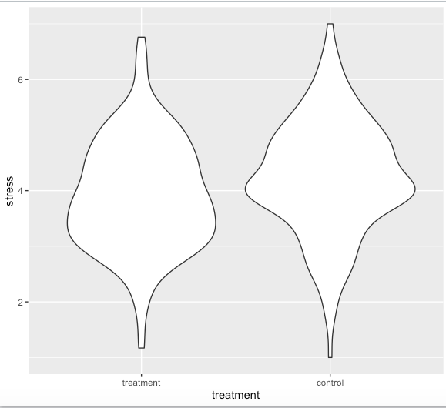
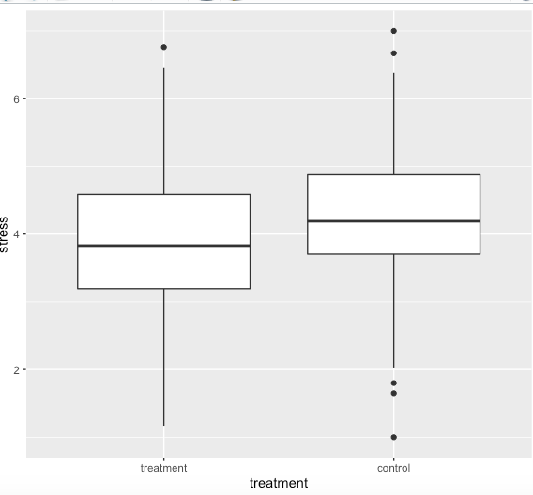
Plotting two variables
ggplot(data, aes(x = rumination,
y = negative_affect)) +
geom_point()

Slide 14
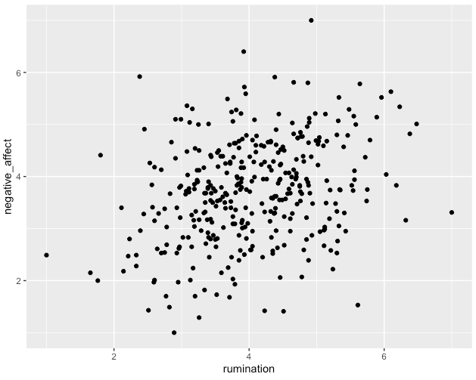
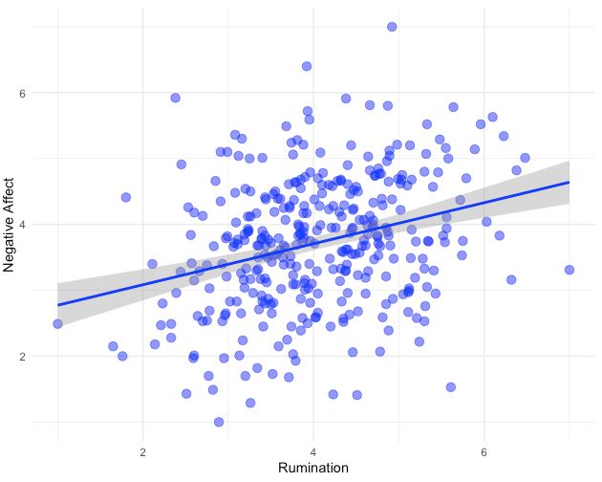
Scatterplot + linear trend + colours
Let’s have a go!
Notes:
Could add more details here about themes

Slide 15
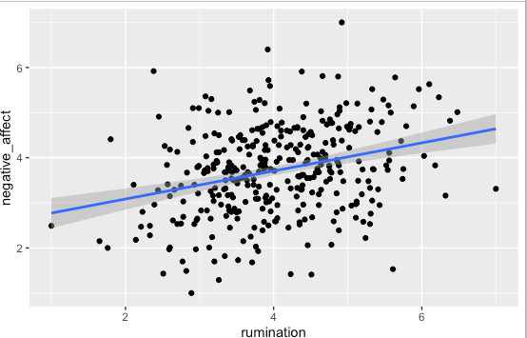
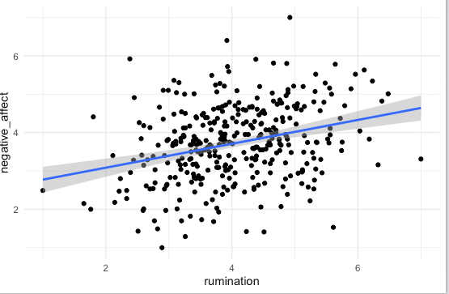
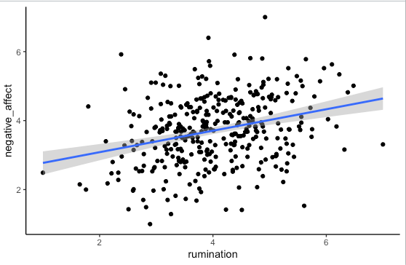
Themes
theme_classic()
theme_gray()
theme_minimal()
Many More: https://ggplot2.tidyverse.org/reference/ggtheme.html

Slide 16
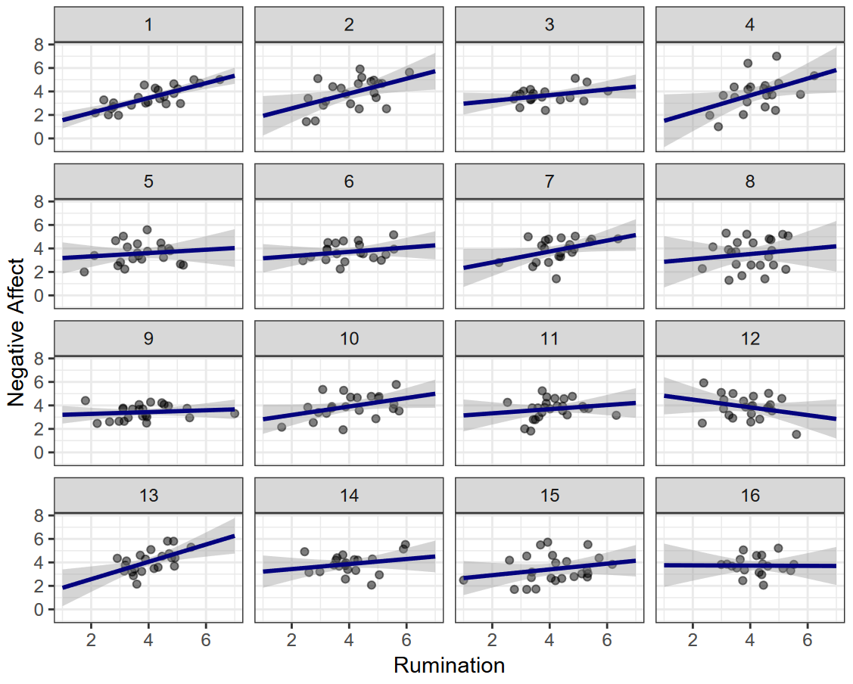
Splitting your plots with facet_wrap()
Notes:
Note the regression lines here are *not* from a multilevel model but fit individual per group!

Slide 17
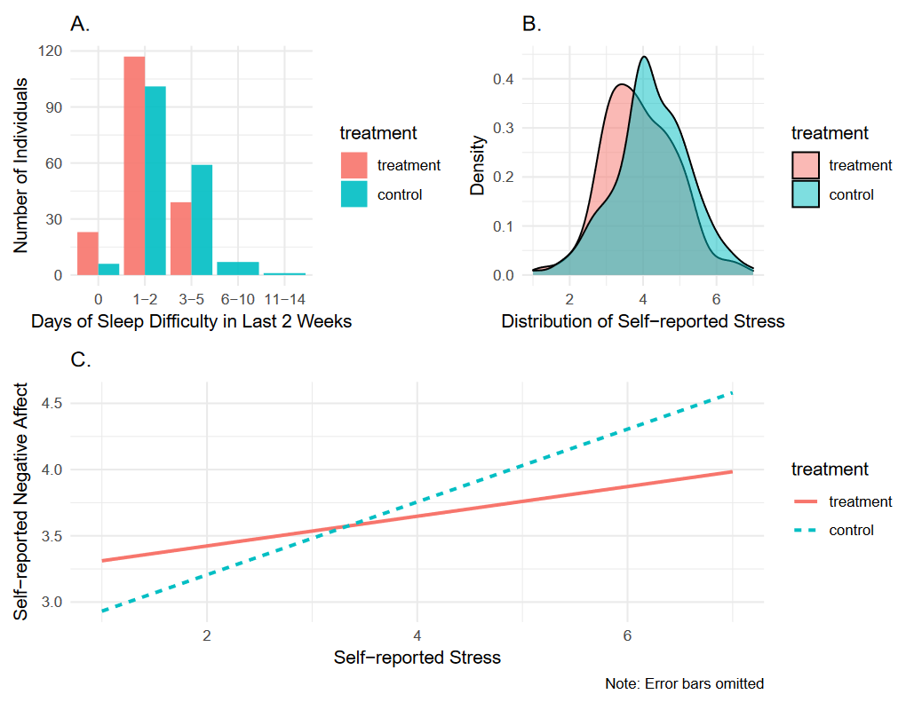
Joining your plots with patchwork
There are many packages available to ‘stitching together’ different ggplots
Here we work with arguably the cleanest and easiest: patchwork
Note: You may need to install this first
install.packages(“patchwork”)

Slide 18
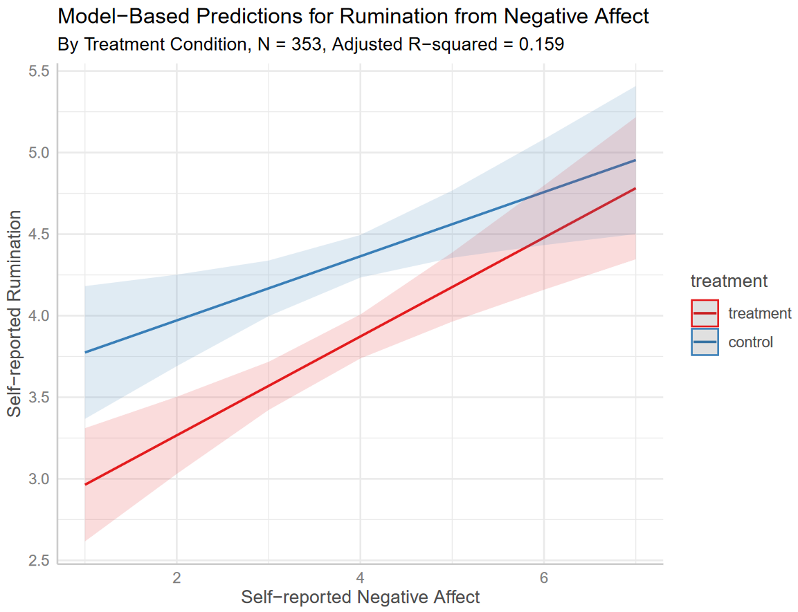
Model-based Predictions using ggeffects
If you’re working with a complex regression, making predictions from your model helps with interpretation!
Note: You may need to install this first
install.packages(“ggeffects”)

Slide 19
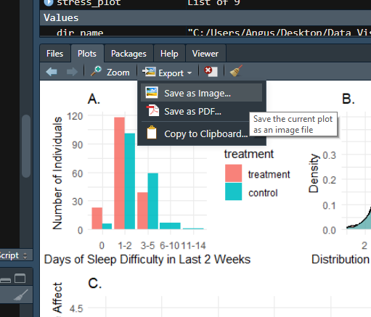
Saving your plots
The simplest way to save a plot is by simply clicking ‘Export’ on the RStudio Plot tab.
This will open a box where you can tell it the dimensions and where to save (file location).
Or manually, in code:
ggsave("plot.png", plot = my_cool_ggplot)
File name of your choosing
ggplot object you’ve made

Slide 20
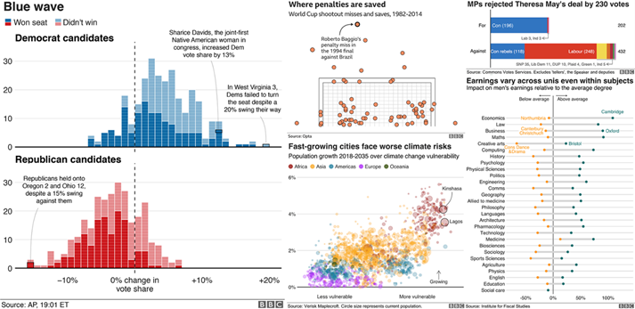
Wrapping Up
We’ve barely scratched the surface of what ggplot can do, but hopefully you’re feeling comfortable to explore more now!
Feel free to check out the ‘R for Data Science’ Textbook Chapter on Data Visualisation
https://r4ds.had.co.nz/data-visualisation.html
For a more comprehensive outlook, see the ggplot2 textbook
https://ggplot2-book.org/

Slide 21
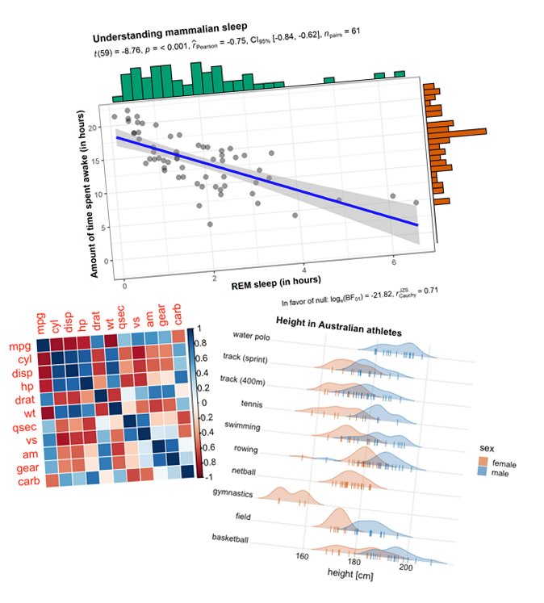
More ggplot2 fun
There’s also lots of cool packages building on ggplot for special purposes. Some neat ones:
Working with statistics - ggstatsplot
https://github.com/IndrajeetPatil/ggstatsplot
Correlation matrices - corrplot
https://github.com/taiyun/corrplot
Ridge plots - ggridges
https://github.com/wilkelab/ggridges

