Slide 1
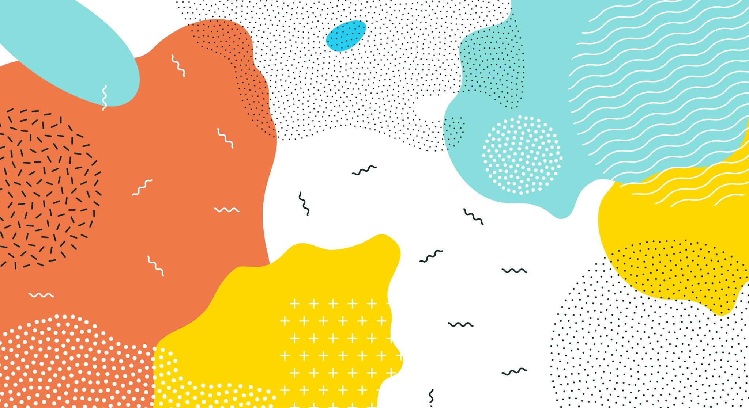
Data Visualisation in R
Angus Hughes
School of Psychological Science, UWA

Slide 2
Today’s Agenda
Basics of ggplot
What is it and how do I use it?
Using geoms to create common plots
Tweaking aesthetics to perfection using colours, fills, and themes
More advanced ggplot
Splitting your plots by group
Joining up several plots
Model-based predictions (time allowing)
Saving your plots

Slide 3
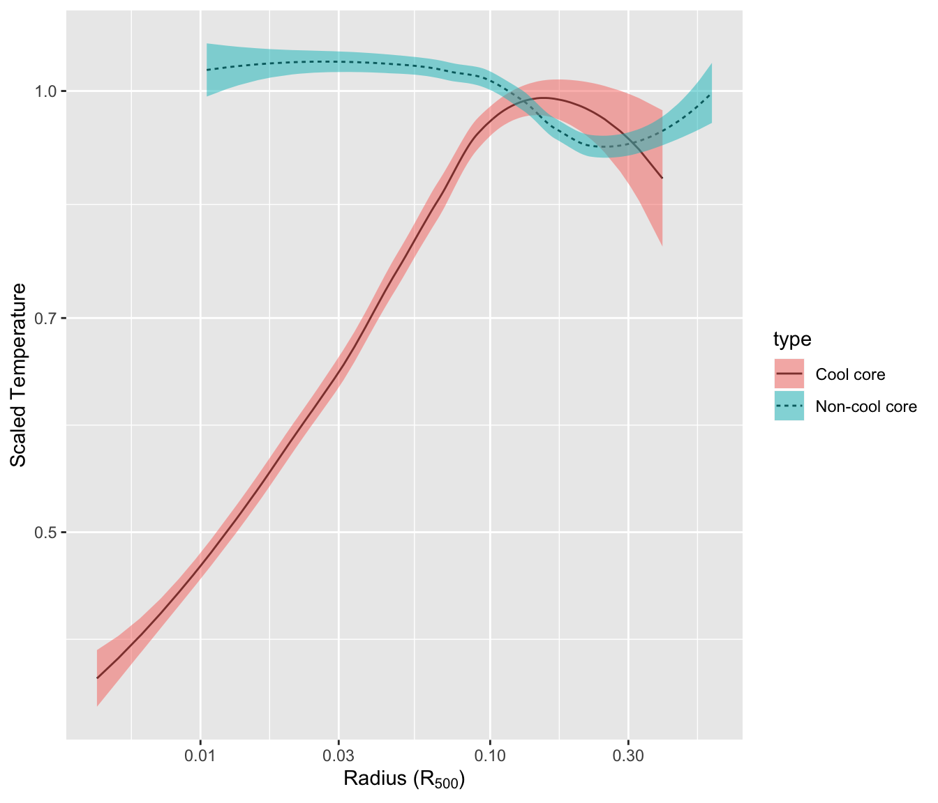
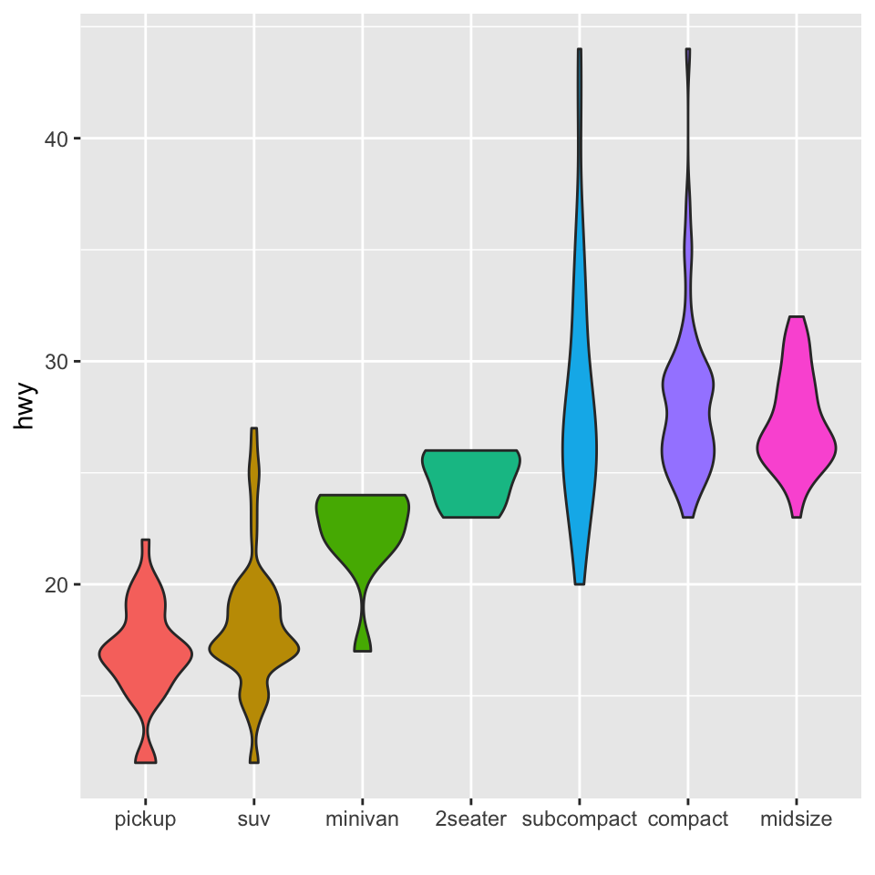
What is ggplot2?
One of the most powerful tools for visualization around
‘grammar of graphics’
Sits within the ‘Tidyverse’ (suite of great packages)

Slide 4
How to use ggplot2
Basic structure for beginning almost all plots:
ggplot(data, aes(x, y)) + geom_something()
We tell ggplot:
What data to use when plotting;
What variables will go on the x-axis (horizontal) and (usually) on the y-axis (vertical);
What kind of plot to create (using a “geom_” function).

Slide 5
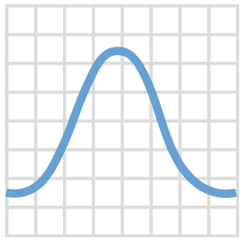
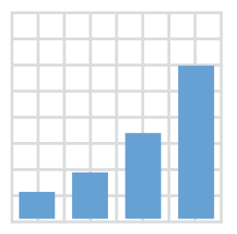
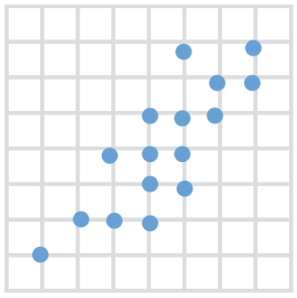
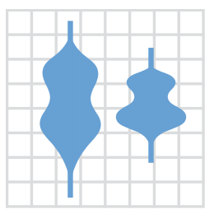
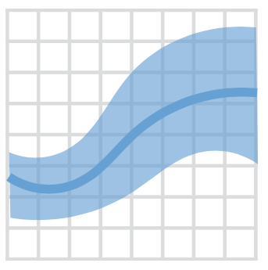

+ geom_density()
+ geom_bar()
+ geom_point()
+ geom_violin()
+ geom_smooth()
+ geom_boxplot()
>40 geoms available

Slide 6
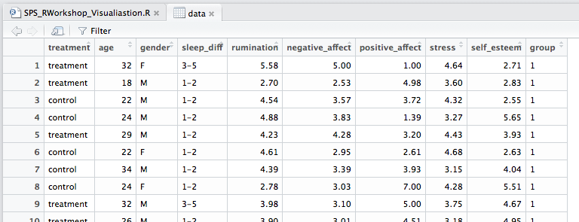
Demonstration Data
Our data come from a hypothetical RCT of a new psychological therapy.
We’ll begin by plotting one variable at a time

Slide 7
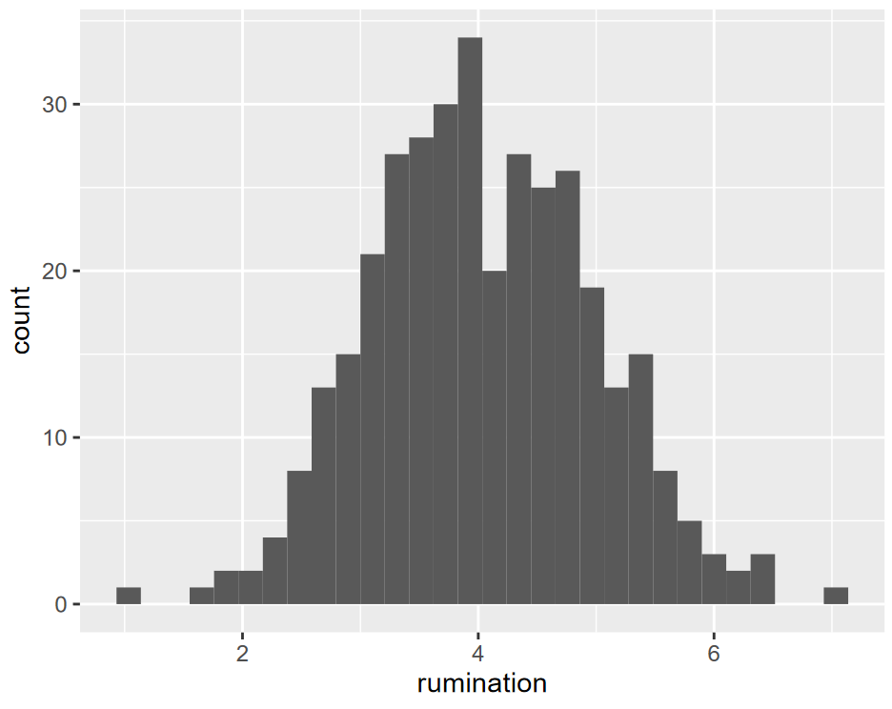
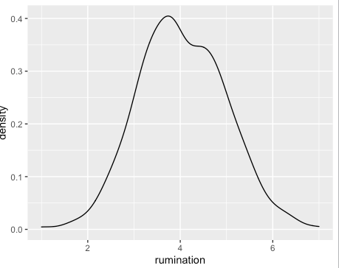
Plotting one variable Rumination (5-item Likert, averaged)
# Bar plot
ggplot(data, aes(x = rumination)) +
geom_bar()
# Density Plot
ggplot(data, aes(x = rumination)) +
geom_density()
In both cases, ggplot doesn’t need the y-axis
(it calculates the y-axis for you)

Slide 8
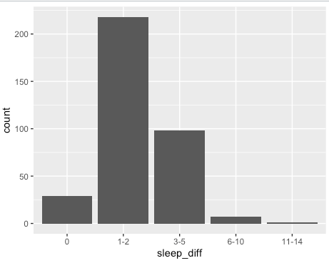
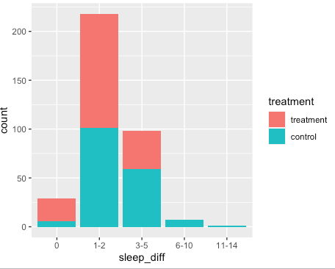
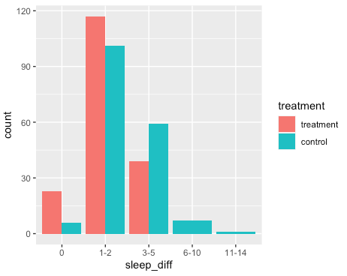
Adding some detail Sleep difficulty (1 item, Ordinal scale)
# Bar plot – same idea as before
ggplot(data, aes(x = sleep_diff)) +
geom_bar()
# Now create different bars using colours
ggplot(data, aes(x = sleep_diff, fill = treatment)) +
geom_bar()
# Make a clustered bar chart
ggplot(data, aes(x = sleep_diff, fill = treatment)) +
geom_bar(position = "dodge")

Slide 9
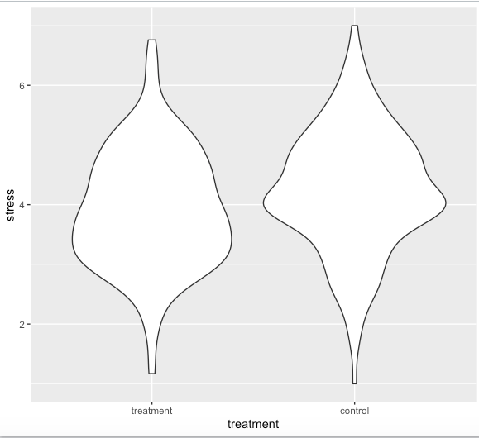
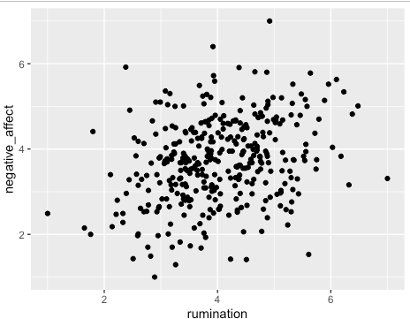
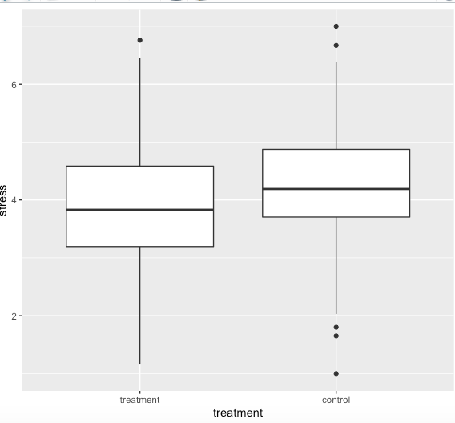
Plotting Two Variables
# Now we tell ggplot what goes on the y
ggplot(data, aes(x = rumination,
y = negative_affect))
Lots of different geoms possible for seeing how variables relate/differ.

Slide 10
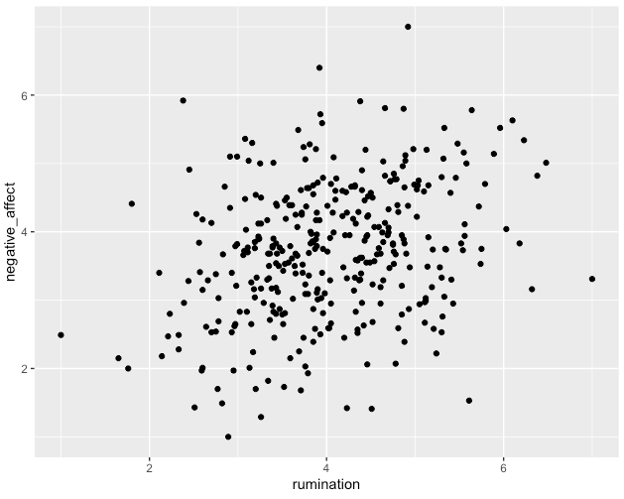
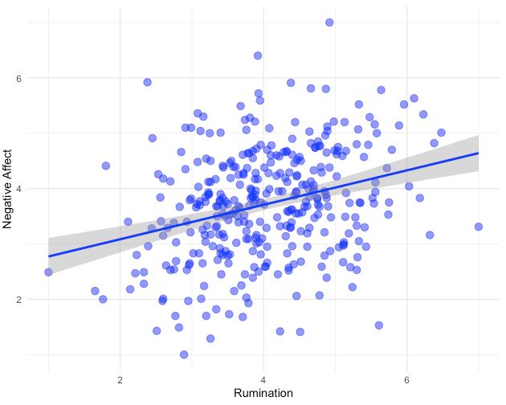
Scatterplot + Linear Fit + Colours

Slide 11
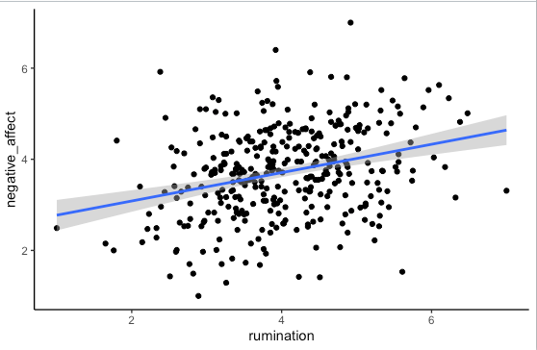
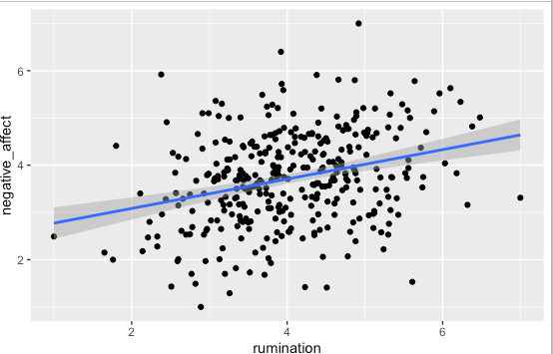
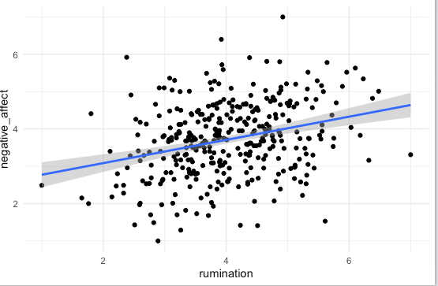
Themes
theme_classic()
theme_gray()
theme_minimal()
Many More: https://ggplot2.tidyverse.org/reference/ggtheme.html

Slide 12
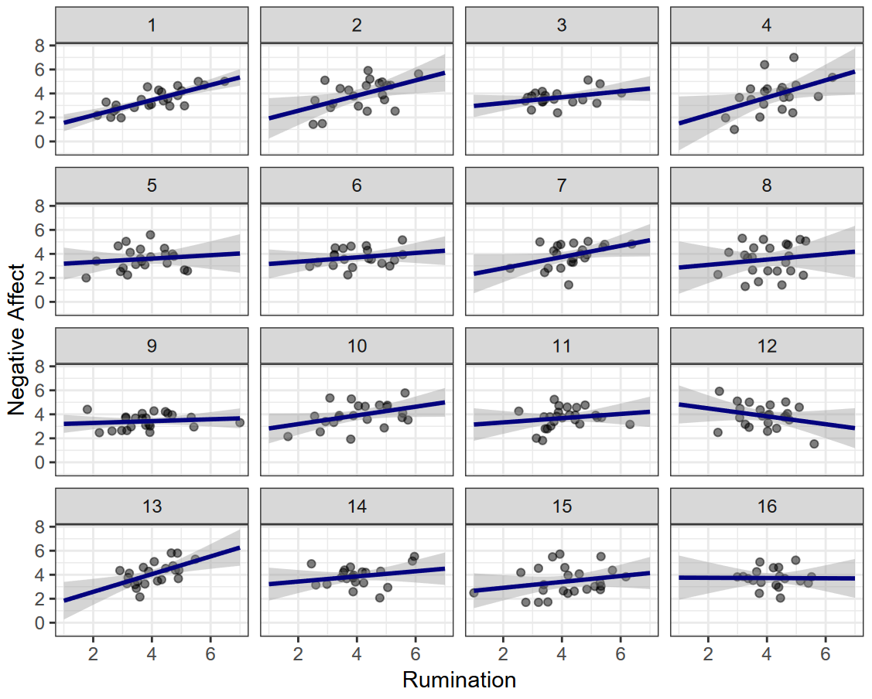
Splitting your Plots with facet_wrap()

Slide 13
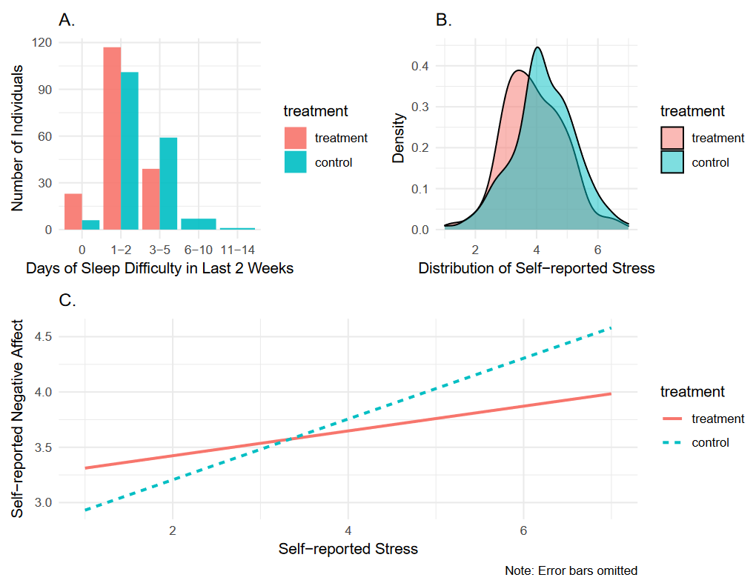
Joining your plots with patchwork
There are many packages available to ‘stitching together’ different ggplots
Here we work with arguably the cleanest and easiest: patchwork
Note: You may need to install this first
install.packages(“patchwork”)

Slide 14
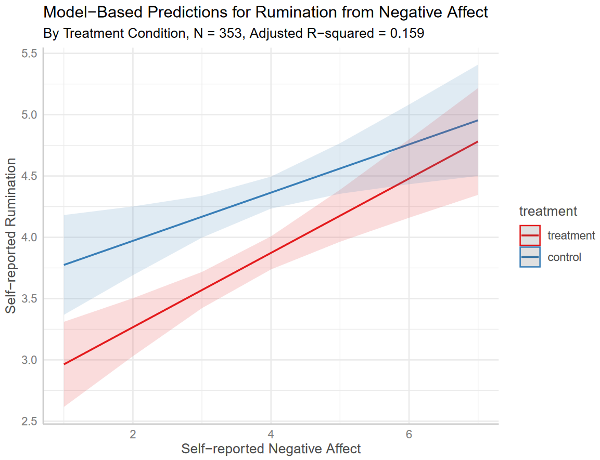
Model-based Predictions using ggeffects
If you’re working with a complex regression, making predictions from your model helps with interpretation!
Note: You may need to install this first
install.packages(“ggeffects”)

Slide 15
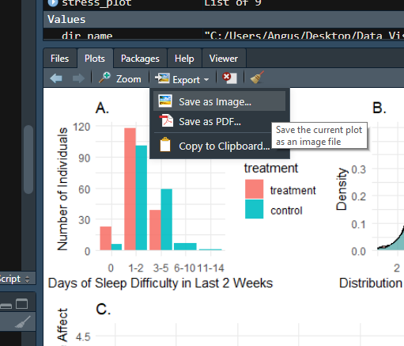
Saving your plots
The simplest way to save a plot is by simply clicking ‘Export’ on the RStudio Plot tab.
This will open a box where you can tell it the dimensions and where to save (file location).
Or manually, in code:
ggsave("plot.png", plot = my_cool_ggplot)
File name of your choosing
ggplot object you’ve made

Slide 16
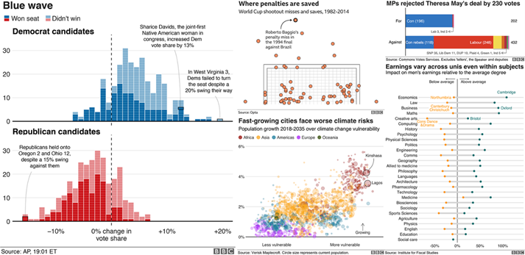
Wrapping up
We’ve barely scratched the surface of what ggplot can do, but hopefully you’re feeling comfortable to explore more now!
Feel free to check out the ‘R for Data Science’ Textbook Chapter on Data Visualisation
https://r4ds.had.co.nz/data-visualisation.html
For a more comprehensive outlook, see the ggplot2 textbook
https://ggplot2-book.org/

Slide 17
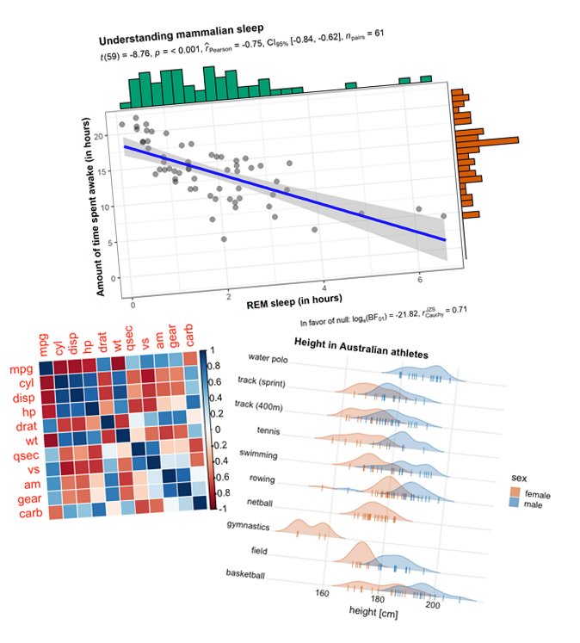
More ggplot2 fun
There’s also lots of cool packages building on ggplot for special purposes. Some neat ones:
Working with statistics - ggstatsplot
https://github.com/IndrajeetPatil/ggstatsplot
Correlation matrices - corrplot
https://github.com/taiyun/corrplot
Ridge plots - ggridges
https://github.com/wilkelab/ggridges

