Slide 1
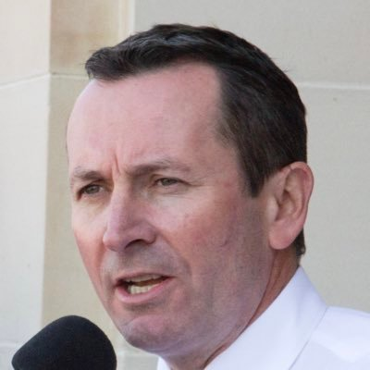
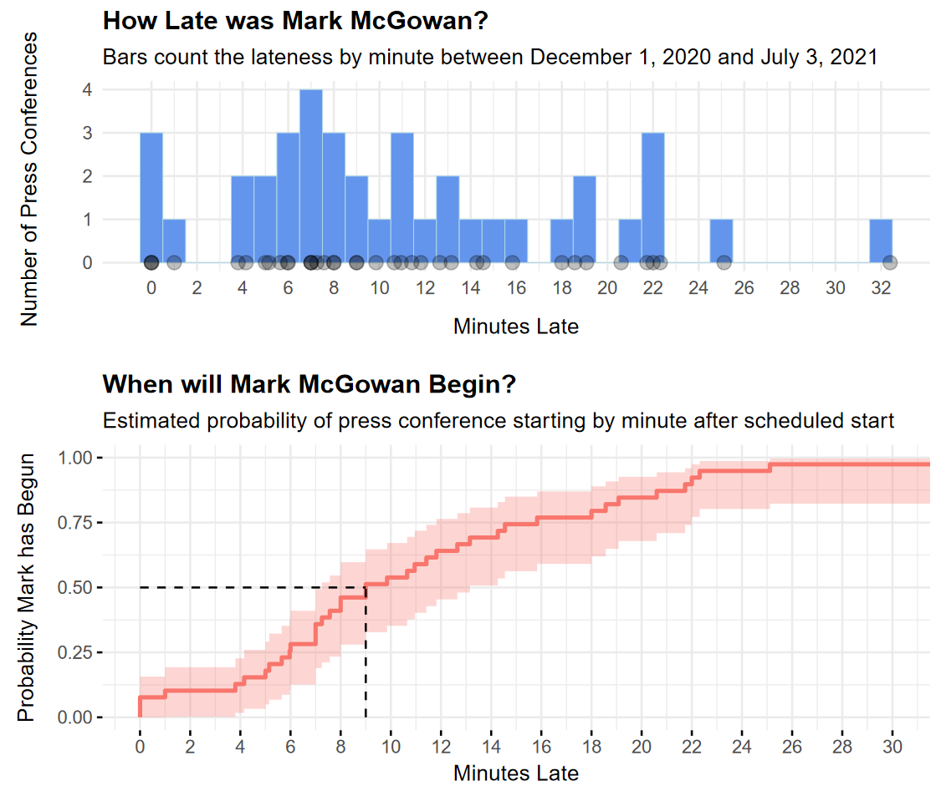
Latest start: 32.4 mins April 28th, 2021
Waiting for Mark
A data-driven approach to figuring out when the hell Mark McGowan will actually arrive at his press conferences
Based on data from 39 press conferences, Mark McGowan’s median lateness was 9 minutes ± 5.9 minutes (median absolute deviation)
Roughly 10% chance Mark starts on time
By about 22 - 23 minutes, there’s a 90%+ chance he’s begun
50/50 he’ll have started 9 minutes after the scheduled time
* Data sourced from ABC News Youtube and Facebook Livestreams.
For full data and code, see: https://github.com/awhug/Waiting_for_Mark

