Slide 1
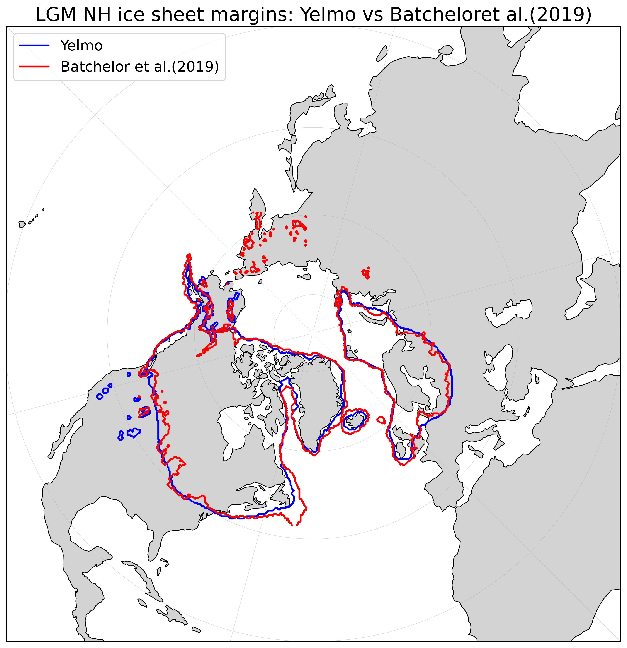
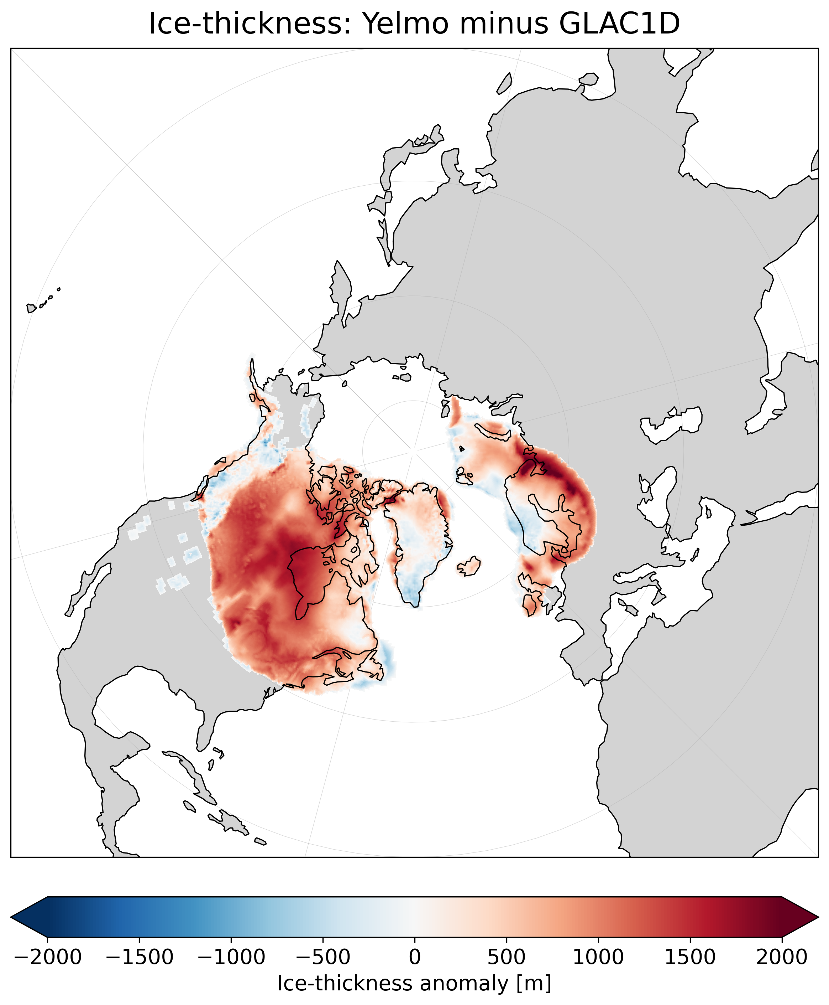
Northern Hemisphere LGM Ice-Sheet Reconstruction with Yelmo Forced by CLIMBER-X
Ahmadreza Masoum, Matteo Willeit, Alexander Robinson
Goals
Reconstruct NH ice sheets during the LGM using the ice-sheet model Yelmo interactively coupled with CLIMBER-X.
Bridge the gap between observation-based ice-sheet reconstructions and physically consistent coupled climate–ice-sheet simulations.
Evaluate the simulated LGM ice-sheet extent against the geomorphological reconstruction.
Identify regions of agreement and mismatch to guide future improvements in coupled ice-sheet reconstruction workflows.
LGM NH ice sheet margins: Yelmo vs Batchelor et al.(2019)
SMB Scheme
The surface mass balance is parameterized using a prescribed snow-line elevation based on latitude, atmospheric CO₂ concentration, and orbital forcing.
For each grid cell, SMB depends on the elevation difference between the surface elevation and the estimated snow line.
Separate SMB equations are applied above and below the snow line, with an additional correction using the paleo-informed ice-margin mask from Batchelor et al. (2019).
A relatively realistic, parameterized SMB scheme nudges ice growth toward the target LGM extent while allowing Yelmo to evolve dynamically.
Mahé Perrette, Britta Grusdt, Thom Laepple, Alexander Robinson
LGM data assimilation : a systematic sensitivity analysis
LGM ice-thickness: Yelmo minus GLAC1D
Simulation Setup
Run an ensemble of simulations varying ice-sheet and solid-earth model parameters.
Northern Hemisphere 32 km ice-sheet domain.
20 kyr simulation starting from LGM boundary conditions.
Climate forcing every 10 years.
Initialized from GLAC1D/Tarasov LGM geometry; Ice-sheet is then simulated freely by Yelmo.
Next Steps
Tune SMB parameters to improve the match with reconstructed ice thickness.
Test the sensitivity of the reconstructed ice sheets to different Earth viscosity structures.
Extend the model–data comparison beyond ice extent by including sea-level and glacial isostatic adjustment constraints.
References: Batchelor et al. (2019), Nature communications, 10(1):3713; Ganopolski and Brovkin (2017), Climate of the Past, 13(12), 1695-1716; Robinson et al. (2020), Geoscientific Model Development, 13(6):2805–2823; Tarasov et al. (2012), Earth and Planetary ScienceLetters, 315:30–40; Willeit et al. (2022), Geoscientific Model Development, 15(14):5905–5948.

