Slide 1
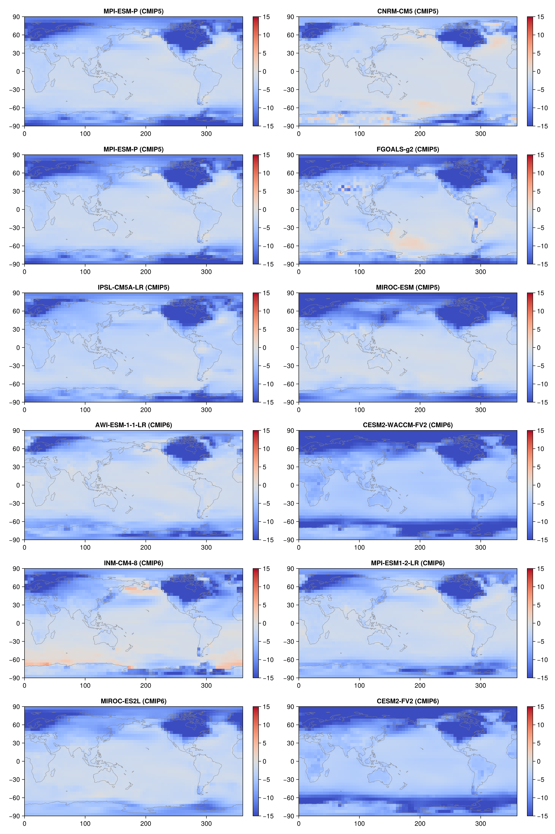
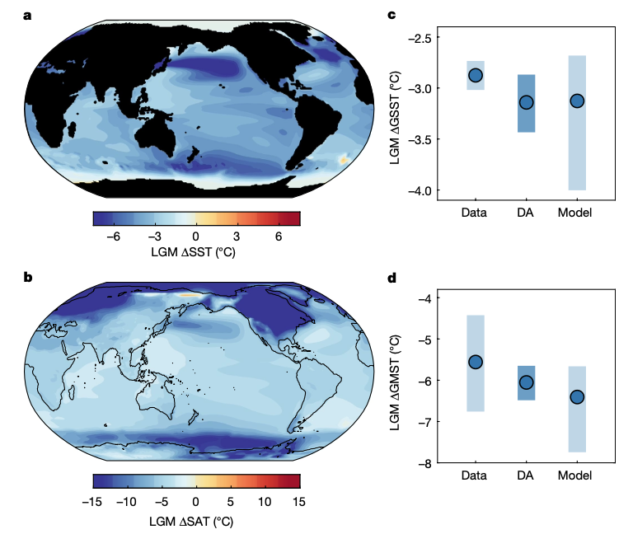
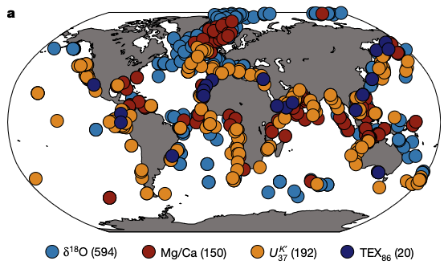
LGM data assimilation : a systematic sensitivity analysis
Mahé Perrette, Britta Grusdt, Thom Laepple, Alexander Robinson
Can DA really provide a robust estimate of LGM cooling?
Sparse, uncertain proxy data
Lack of diverse prior (not enough good model simulations)
Goals:
Understand key factors that influence reconstructions.
Provide more robust estimates with traceable assumptions.
Include new paleo proxy data – from terrestrial sources??
Example ΔT_{LGM} fields from PMIP models (6 models available from CMIP6)
ΔT_{LGM} > -5 K
ΔT_{LGM} < -6 K
Only used CESM for prior!
LGM marine proxy sites
ΔT_{LGM,DA} = -6.1±0.2 K
Tierney et al., 2020
Tierney et al., 2020

