Slide 1
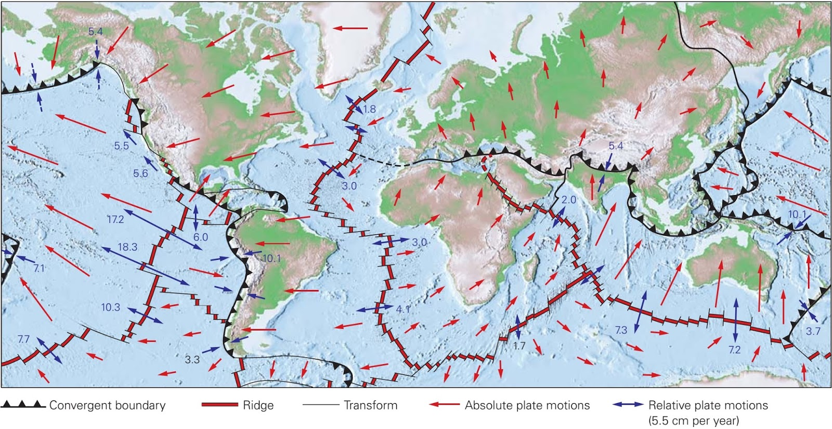

Slide 2
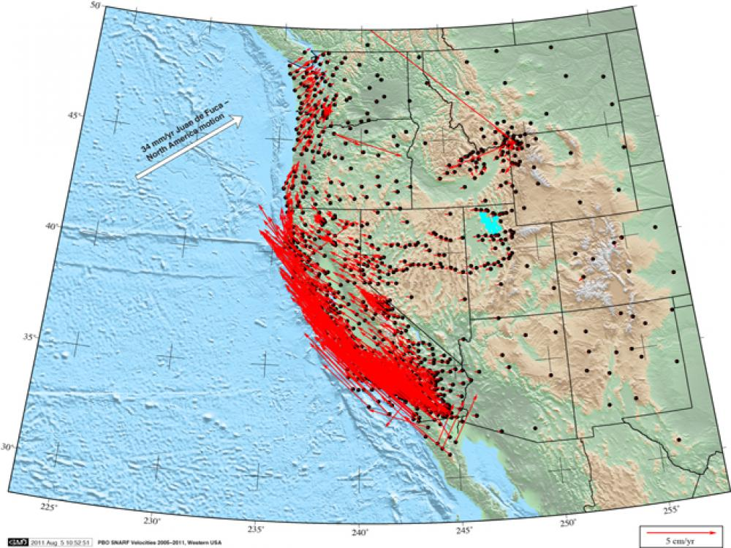

Slide 3
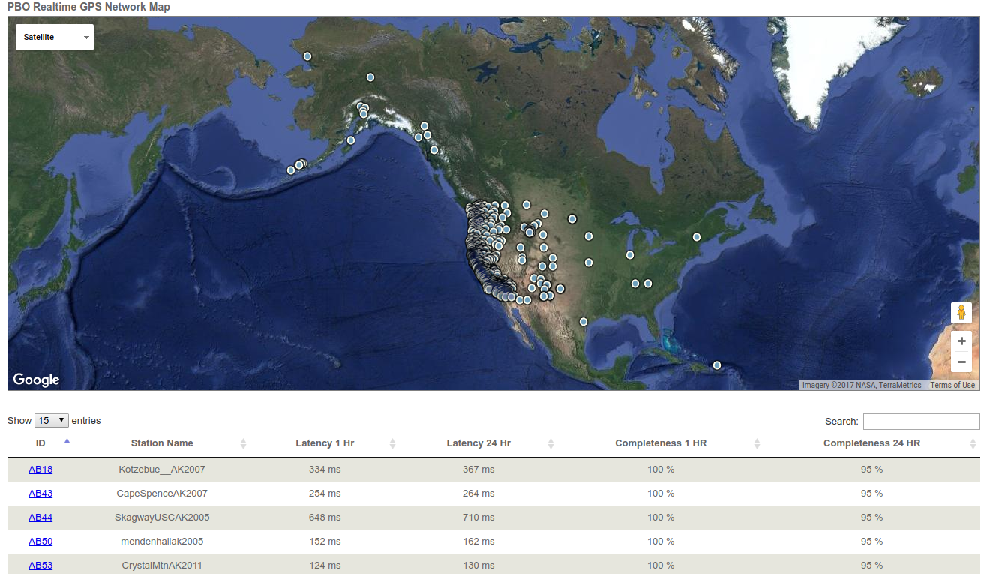

Slide 4
Links
https://www.unavco.org/instrumentation/networks/status/pbo/realtime
As far as I've gotten:
  https://github.com/awickert/pbo-plot

