Slide 1
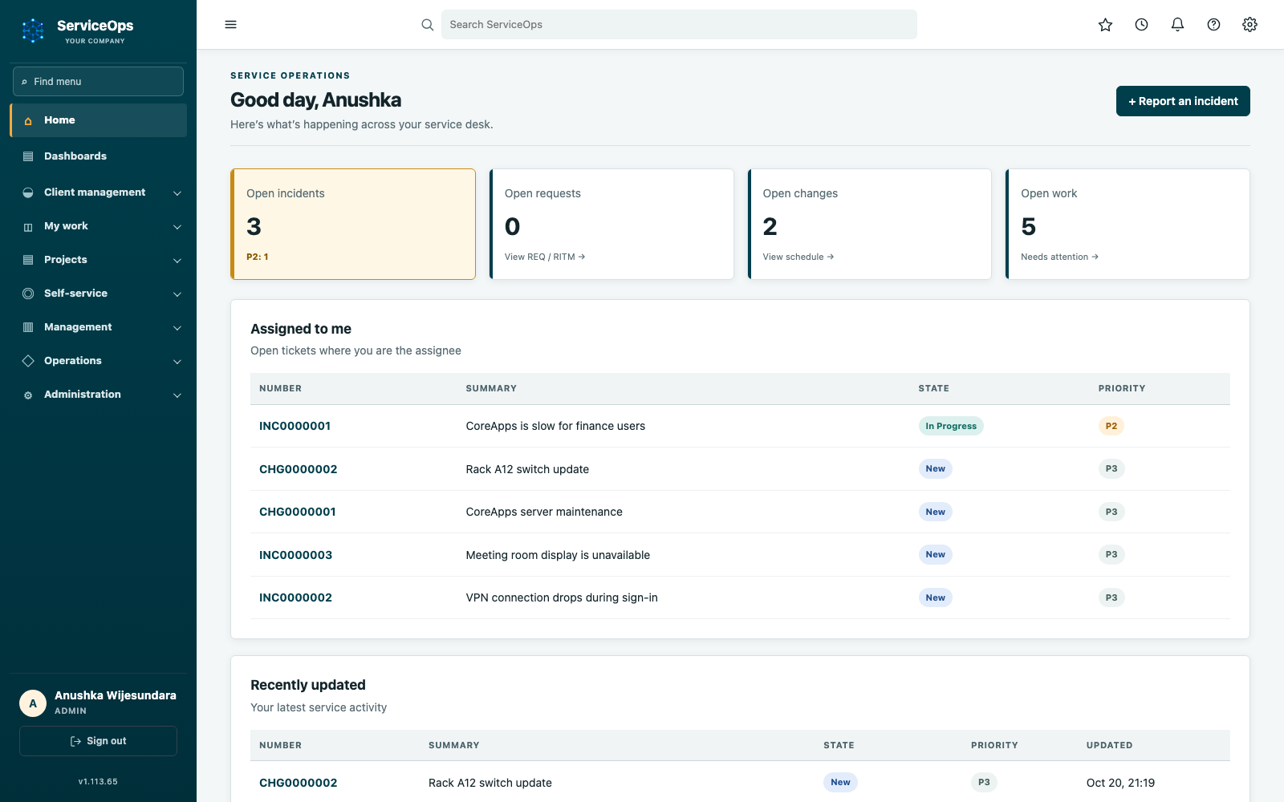

ServiceOps
Prevent change
conflicts.
Keep teams
aligned.
Safer changes. Shared context.
October 2026
01
Notes:
CORE PRESENTATION | Target: 35 seconds
ServiceOps is a self-hosted workspace for the people who request IT services, the teams who deliver them and the managers who approve the work. It connects service records to infrastructure, project delivery and decisions. Over the next twelve minutes we will follow what people actually do in the app. All web screenshots were captured on 20 October from an isolated copy of deployed application code, version 1.113.65, with synthetic records. These are interface examples, not live customer statistics. The original deck is retained separately.
Sources: ServiceOps/README.md; Current deployed source VERSION 1.113.65

Slide 2

Change conflicts start with disconnected teams.
SERVICEOPS
WHY SERVICEOPS EXISTS
01 Separate plans
02 Missing context
03 Unclear handovers
Two teams.
One collision.
Hidden links.
Missed impact.
Who knew?
Who owns it?
Overlapping work puts the
same service at risk.
A device change can affect
another team’s service.
Decisions get lost across
email, chat and spreadsheets.
ServiceOps connects plans, dependencies and people before work starts.
Anushka Wijesundara / Product overview / October 2026
02
Notes:
CORE PRESENTATION | Target: 40 seconds
Start with three familiar problems. An employee asks for help in email and cannot see who owns it. An engineer schedules maintenance without seeing a related team's work. A manager is asked to approve a change without the implementation and recovery plan in front of them. ServiceOps is designed to bring those records, owners and decisions into a connected workspace. These are intended benefits, not measured savings or a claim that software removes every operational risk.
Sources: ServiceOps/README.md; ServiceOps.wiki/Home.md

Slide 3
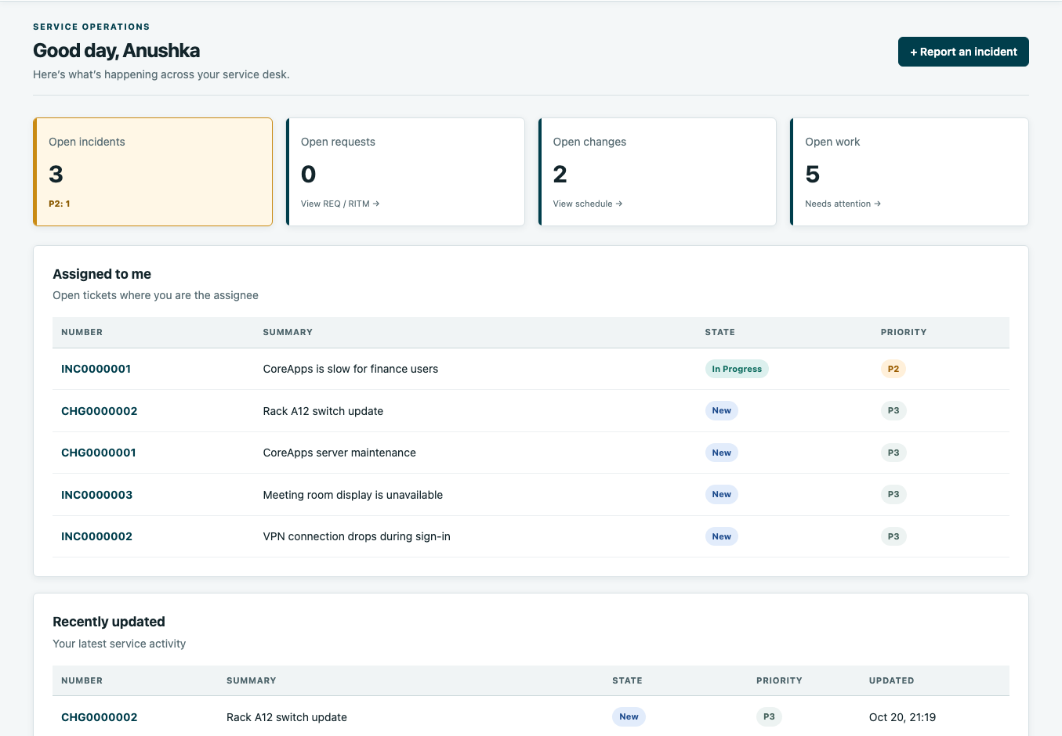
Give every team the same starting point.
SERVICEOPS
SHARED OPERATIONAL VIEW
Know what is open
See requests, incidents and
changes in one workspace.
Know who owns it
Make responsibility visible
to the teams doing the work.
Know what needs action
Review outstanding work
without chasing updates.
Shared context.
Less chasing.
Current app v1.113.65 / Isolated demo / Sample records
Anushka Wijesundara / Product overview / October 2026
03
Notes:
CORE PRESENTATION | Target: 45 seconds
Point to the open-work cards, then to Assigned to me. The dashboard connects a high-level view to actual records. Explain that an incident is an unplanned disruption, a request is an ask for a service and a change is planned work that can affect a service. People see the workspace their permissions allow. The visible counts are synthetic demo data. Do not read out every number; show how someone gets from overview to action.
Sources: ServiceOps.wiki/App-Guide.md; screenshots/dashboard.png

Slide 4
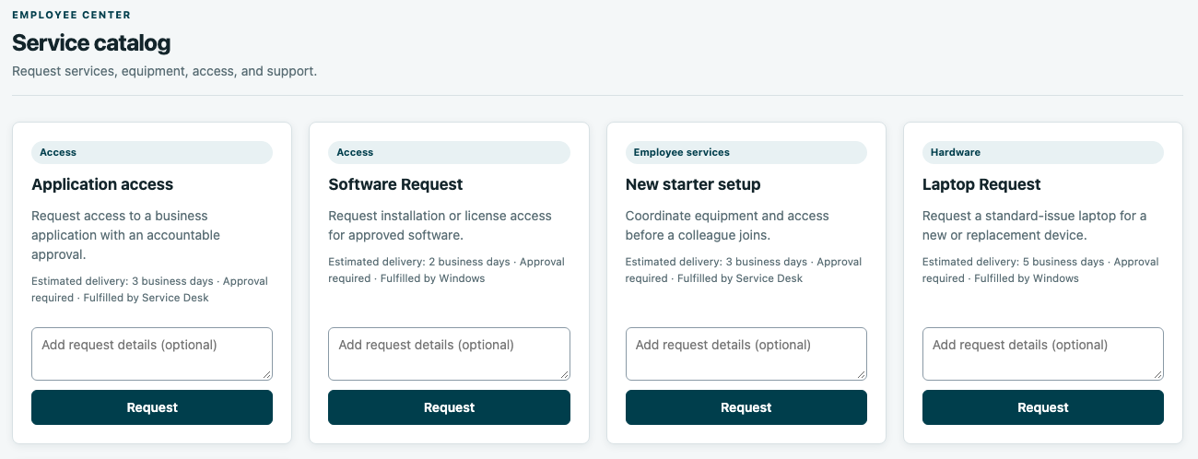
Replace request chasing with visible ownership.
SERVICEOPS
CLEAR REQUEST HANDOVERS
Make the ask clear
Capture the service needed.
Route the decision
Use the configured path
for approval and delivery.
Keep people informed
Show status and delivery
tasks on the same record.
Clear asks.
Clear handovers.
Current app v1.113.65 / Isolated demo / Sample records
Anushka Wijesundara / Product overview / October 2026
04
Notes:
CORE PRESENTATION | Target: 50 seconds
Use the laptop request as the nontechnical example: an employee chooses a published service, provides the required information and follows progress. ServiceOps separates the overall request, individual requested items and the tasks that fulfill them. Approval follows the configured policy; not every request requires the same path. The screenshot shows the real current catalog interface with three synthetic services. Explain the business outcome before naming the record types. An approval decision is distinct from a delivery task.
Sources: ServiceOps.wiki/Operations-Manual.md; screenshots/catalog.png

Slide 5
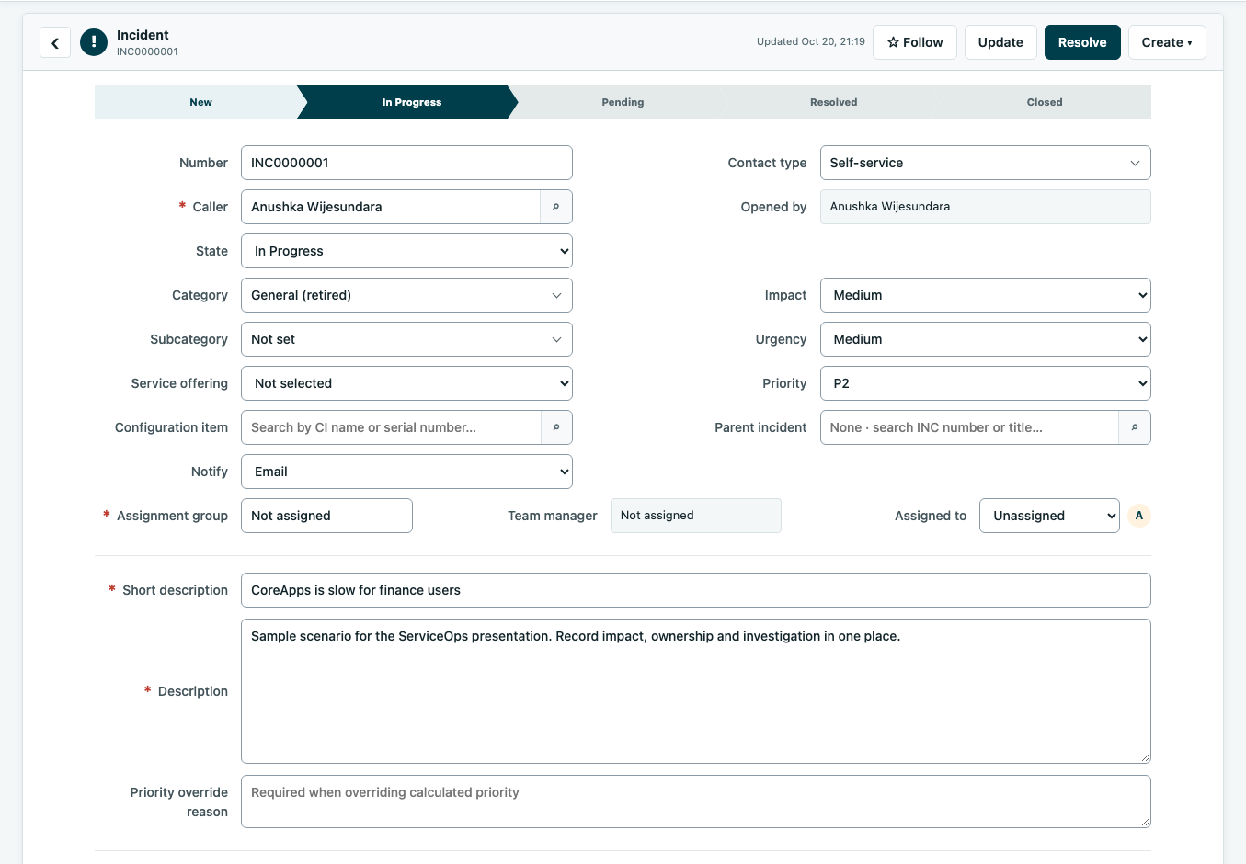
Keep incident teams aligned on impact and action.
SERVICEOPS
COORDINATED INCIDENT RESPONSE
Share the impact
Record the affected users
and service symptoms.
Name the owner
Make responsibility and
priority clear to all teams.
Keep one history
Retain investigation notes
and resolution on record.
One incident record.
A shared response.
Current app v1.113.65 / Isolated demo / Sample records
Anushka Wijesundara / Product overview / October 2026
05
Notes:
CORE PRESENTATION | Target: 60 seconds
Return to CoreApps: finance users report that the application is slow. Open the incident and point out the title, priority, assignee and activity areas. The incident is the shared record for investigation, communication and resolution. Technically, state transitions and access follow server-side permissions. Do not imply this screenshot is a real outage or that the sample incident has been resolved. Different teams can work from the same record rather than rebuilding the context in a separate email thread.
Sources: ServiceOps.wiki/Operations-Manual.md; screenshots/incident-detail.png

Slide 6
Tickets alone cannot reveal change conflicts.
SERVICEOPS
RT (REQUEST TRACKER) / CMDB GAP
CMDB = Configuration Management Database: devices, services, owners and dependencies.
01 Dependency gap
02 Coordination gap
03 Communication gap
Hidden
change impact
Clashing
change plans
Unclear
handovers
Without service links,
separate tickets can hide
a shared dependency.
Teams may approve work
without seeing another
team’s service exposure.
Scattered ownership and
configuration history make
coordination harder.
A maintained CMDB gives teams shared change context.
Scope: the stated RT deployment gap—not a claim that RT lacks asset features.
Anushka Wijesundara / Product overview / October 2026
06 / CMDB GAP
Notes:
CORE PRESENTATION | Target: 40 seconds
Start with three familiar problems. An employee asks for help in email and cannot see who owns it. An engineer schedules maintenance without seeing a related team's work. A manager is asked to approve a change without the implementation and recovery plan in front of them. ServiceOps is designed to bring those records, owners and decisions into a connected workspace. These are intended benefits, not measured savings or a claim that software removes every operational risk.
Sources: ServiceOps/README.md; ServiceOps.wiki/Home.md

Slide 7
CMDB connects ServiceOps through shared context.
SERVICEOPS
CMDB / CONFIGURATION MANAGEMENT DATABASE
Incident
Management
Service Level
Agreements
Service Desk
Threshold
Monitoring
CMDB
IT Service
Continuity
Management
Change
Workflow
Availability
Management
Knowledge
Base
Anushka Wijesundara / Product overview / October 2026
07 / CMDB
Notes:
CORE PRESENTATION | Target: 40 seconds
Start with three familiar problems. An employee asks for help in email and cannot see who owns it. An engineer schedules maintenance without seeing a related team's work. A manager is asked to approve a change without the implementation and recovery plan in front of them. ServiceOps is designed to bring those records, owners and decisions into a connected workspace. These are intended benefits, not measured savings or a claim that software removes every operational risk.
Sources: ServiceOps/README.md; ServiceOps.wiki/Home.md

Slide 8
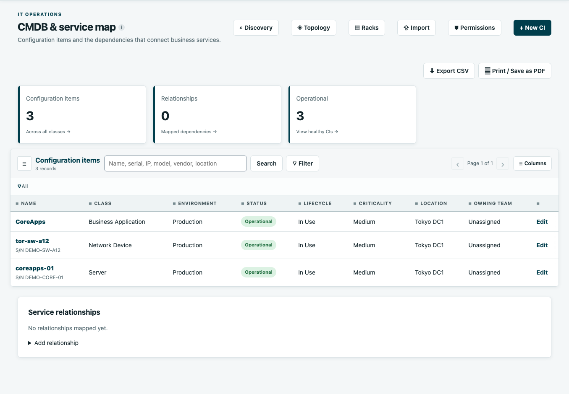
See what a change could affect—not just its ticket.
SERVICEOPS
DEPENDENCIES BEFORE DECISIONS
Identify the device
Find the asset, its owner
and its physical location.
Map the service links
Maintain the dependencies
that change checks need.
Bring teams together
Use shared infrastructure
context when planning work.
No maintained links,
no reliable impact view.
Illustrative inventory / No mapped links in demo / Map relationships before conflict testing
Anushka Wijesundara / Product overview / October 2026
06
Notes:
CORE PRESENTATION | Target: 55 seconds
CMDB means configuration management database: in plain language, the record of the things IT operates and their relationships. Show the server, switch and business application. In the CoreApps story the important relationship is that server maintenance and switch maintenance may affect the same service. Integrations such as NetBox can maintain inventory and physical context. Relationship-based impact and conflict checks are only as complete as the maintained links; ServiceOps does not automatically know every dependency.
Sources: ServiceOps.wiki/Operations-Manual.md; ServiceOps/README.md; screenshots/cmdb.png

Slide 9
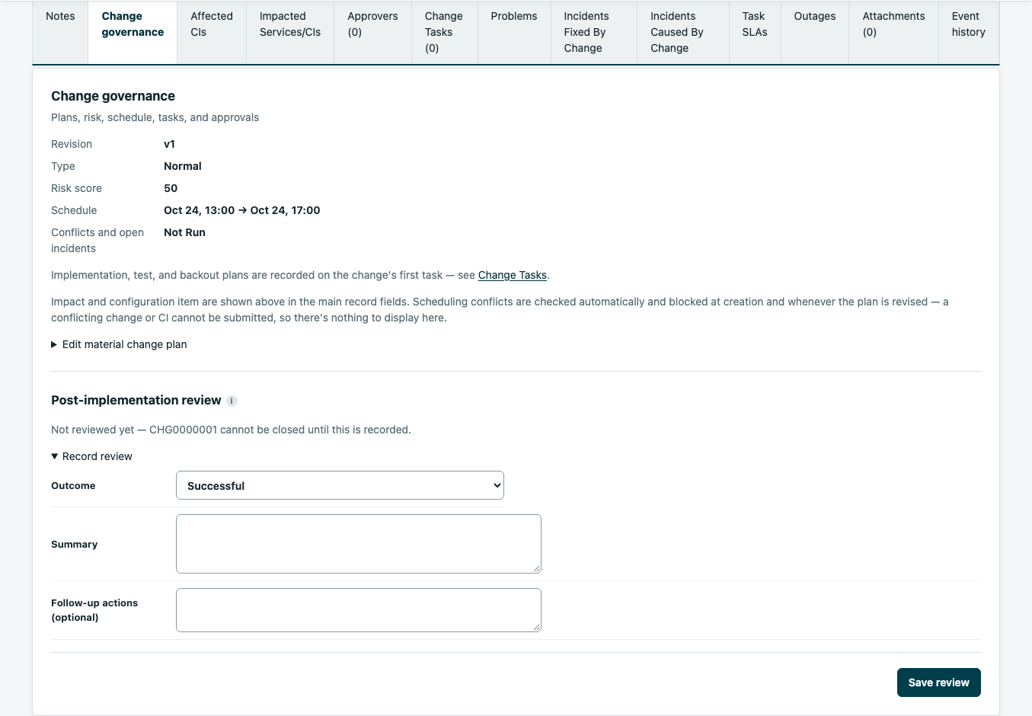
Check for collisions before approving the change.
SERVICEOPS
PREVENT CONFLICTS BEFORE WORK
Name the scope
Identify the device and
the maintenance window.
Check for conflicts
Review linked work and
configured freeze rules.
Align the decision
Keep approval, delivery
and backout plans together.
Plan together.
Check before delivery.
Current app v1.113.65 / Isolated demo / Sample records
Anushka Wijesundara / Product overview / October 2026
07
Notes:
CORE PRESENTATION | Target: 70 seconds
This is the CoreApps maintenance example. The Unix team wants to maintain coreapps-01 while the Network team wants to update the rack switch. Point to the schedule and governance details. The affected configuration item is on the main record; implementation, testing and backout plans can be inspected through the material-plan editor and change tasks. Explain that a linked-device conflict can surface before approval. A configured freeze blocks normal or standard changes in its window; emergency handling follows the configured governance. The current change interface states that conflicting schedules are blocked at creation and material plan revision. The usefulness of dependency checks still depends on maintained relationships and the configured scope. The demo record shows the form and sample plans, not evidence of a completed approval or conflict test. A backout plan explains how to restore service if the work fails.
Sources: ServiceOps.wiki/Operations-Manual.md; Current source serviceops_core/web/tickets.py; screenshots/change-detail.png

Slide 10
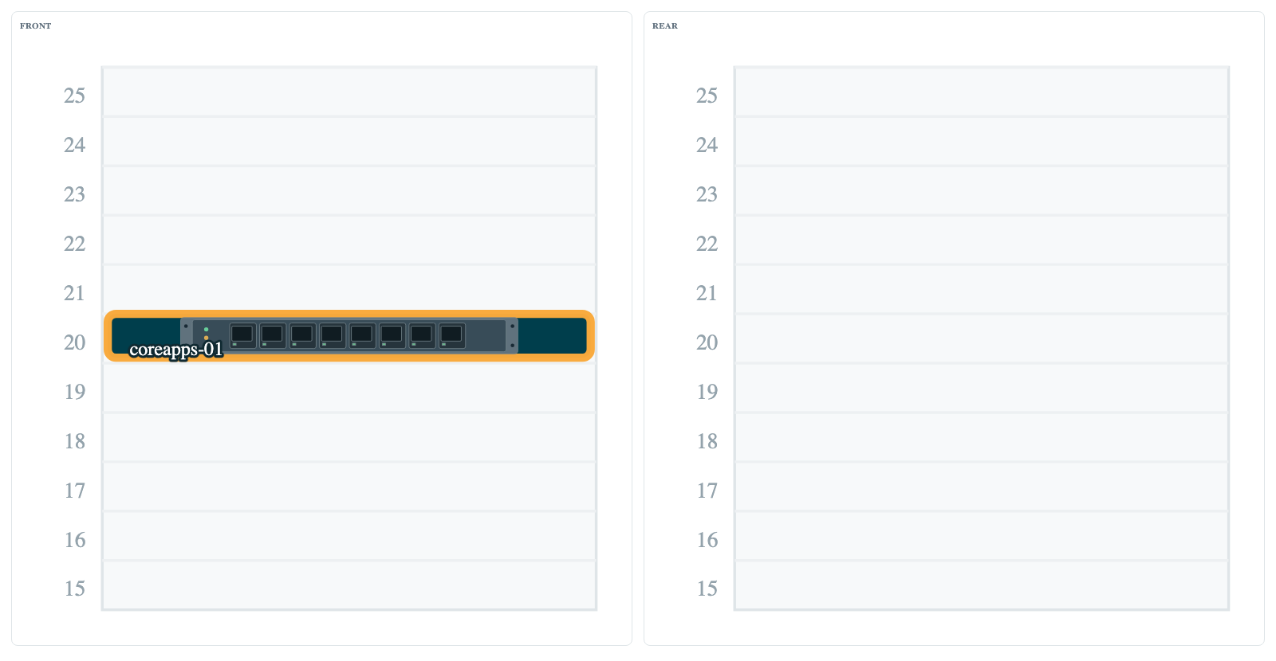
Give field engineers context—not another email chain.
SERVICEOPS
CLEAR FIELD HANDOVERS
Locate the device
See the rack and mounting
position before the visit.
Confirm the placement
Check front or rear context.
Keep the work linked
Connect physical details
to the maintenance record.
The same context,
from plan to rack.
Current app v1.113.65 / Isolated demo / Sample records
Anushka Wijesundara / Product overview / October 2026
08
Notes:
CORE PRESENTATION | Target: 40 seconds
Show rack A12 in Tokyo DC1, with the focused preview highlighting coreapps-01 at U20. The switch at U42 is part of the wider illustrative scenario. These are synthetic demo records chosen to preserve the original CoreApps story. Rack context helps a technician identify the intended equipment before carrying out a task. Physical accuracy still depends on maintained or synchronized inventory. NetBox is an optional integration, not a prerequisite for every manual rack record. Do not claim the sample rack was synchronized from NetBox; it was created only in the isolated screenshot demo.
Sources: ServiceOps/README.md; Current source serviceops_core/web/cmdb.py; screenshots/rack.png

Slide 11
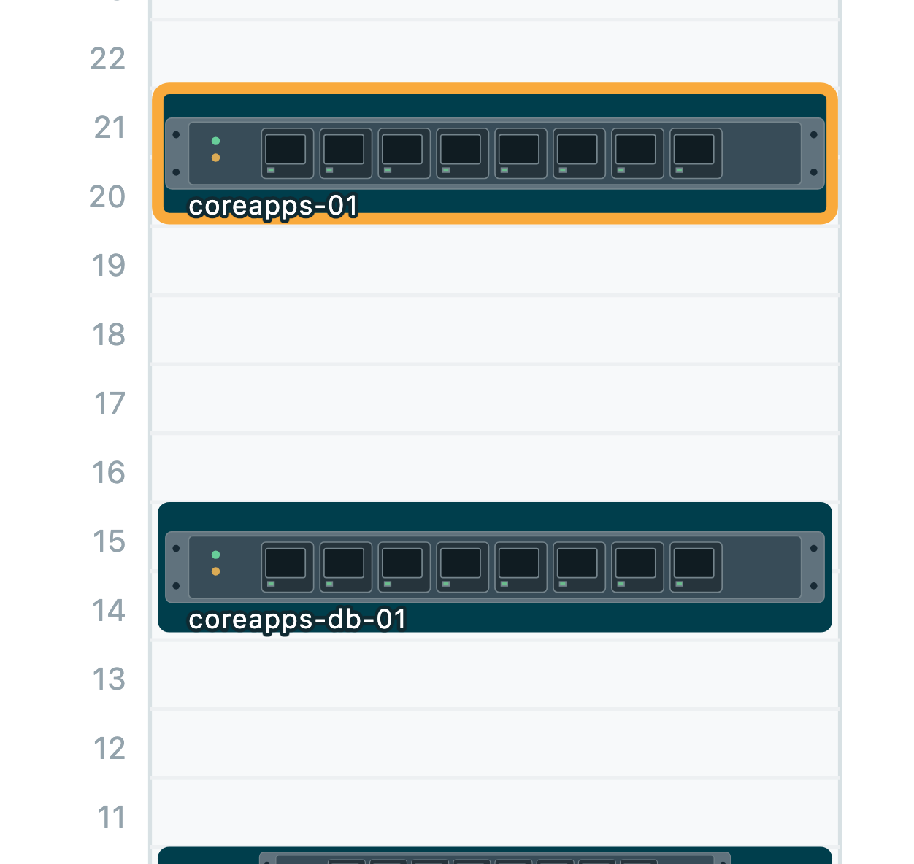
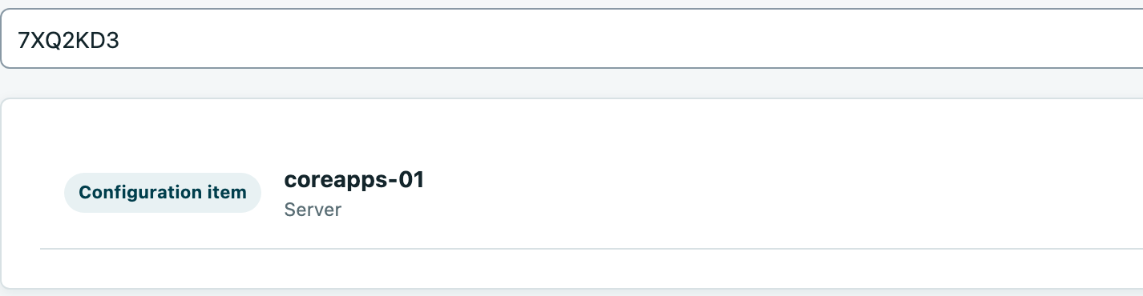
Turn a maintenance handover into actionable context.
SERVICEOPS
FROM PLAN TO THE RIGHT DEVICE
Illustrative example: coreapps-01, rack A12, Tokyo DC1; inventory synchronized from NetBox.
Know where to go
Give engineers the rack and slot before the visit.
Confirm the right device
Use the chassis serial number to open its record.
Keep support context close
Review warranty, support and cabling on the same page.
Anushka Wijesundara / Product overview
10
Notes:
Frame these as intended benefits of connected workflows, not quantified ROI claims. ServiceOps combines service work with infrastructure and governance.
Sources: ServiceOps.wiki/Home.md

Slide 12
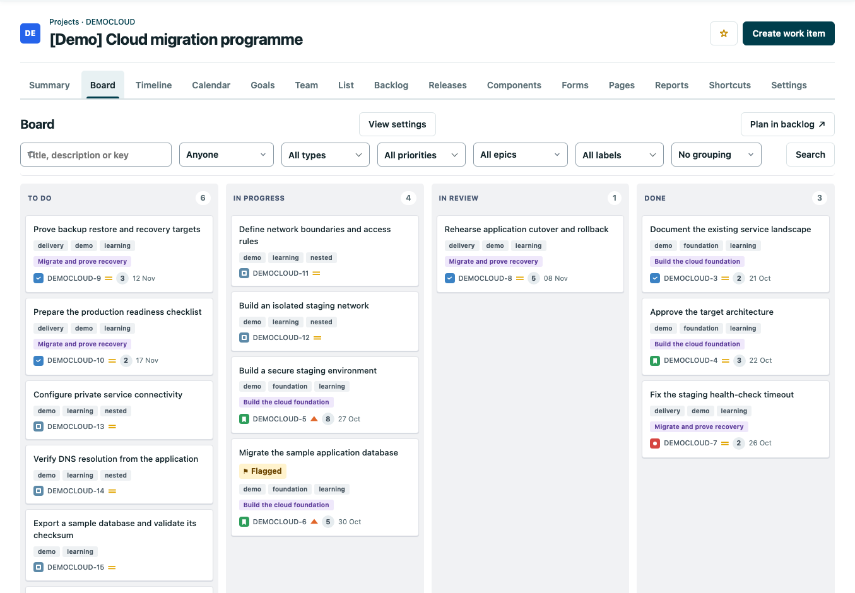
Keep delivery tasks visible across team handovers.
SERVICEOPS
COORDINATION BEYOND THE TICKET
Expose the work
Show task status so teams
can coordinate delivery.
Break down delivery
Link parent work and subtasks.
Surface the blockers
Track responsibility and
what is holding work back.
Shared delivery status.
Fewer assumptions.
Current app v1.113.65 / Isolated demo / Sample records
Anushka Wijesundara / Product overview / October 2026
09
Notes:
CORE PRESENTATION | Target: 55 seconds
The updated app includes project delivery, which was missing from the original presentation. Show the cloud migration demo board. Explain the columns as the team's agreed workflow and the cards as work that moves through it. Projects support nested work, assignment, blockers, sprints and related delivery views. This complements service operations: an incident restores service while a project can coordinate a longer-term improvement. The cloud programme is explicitly a learning scenario, not an actual production migration. Avoid describing sample sprint data as measured team performance.
Sources: ServiceOps.wiki/Project-Planning.md; screenshots/project-board.png

Slide 13
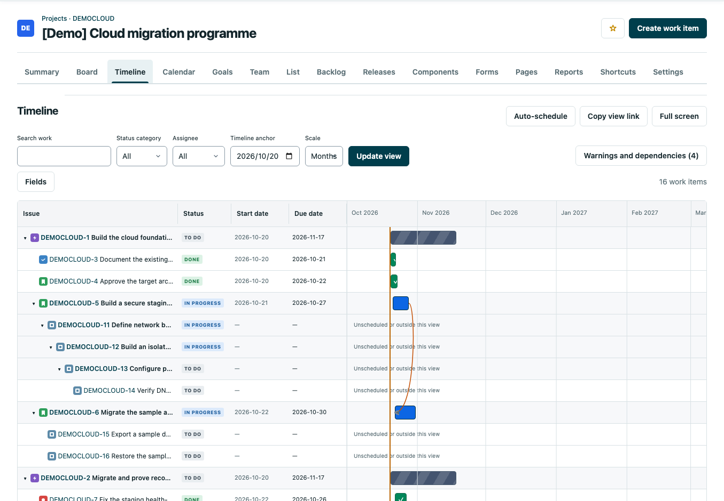
Align the sequence before teams commit to dates.
SERVICEOPS
SHARED DELIVERY SEQUENCE
Compare the dates
Review work and timing
in the shared plan.
Expose dependencies
See what needs to finish
before the next task starts.
Review changes first
Check proposed dates
before applying updates.
Agree the sequence.
Then commit.
Current app v1.113.65 / Isolated demo / Sample records
Anushka Wijesundara / Product overview / October 2026
10
Notes:
CORE PRESENTATION | Target: 55 seconds
Point to the hierarchy and timeline bars. Dependencies explain why a later task may need to wait for a prerequisite. Planning supports private draft changes, review and selected application after validation. Explain the difference between previewing a proposal and changing the work itself. Automatic scheduling is a bounded planning aid with explicit assumptions; it is not proof of optimal staffing or a complete employee availability calendar. For nontechnical listeners, describe this simply as making the sequence and proposed dates visible before a team commits.
Sources: ServiceOps.wiki/Project-Planning.md; screenshots/project-timeline.png

Slide 14
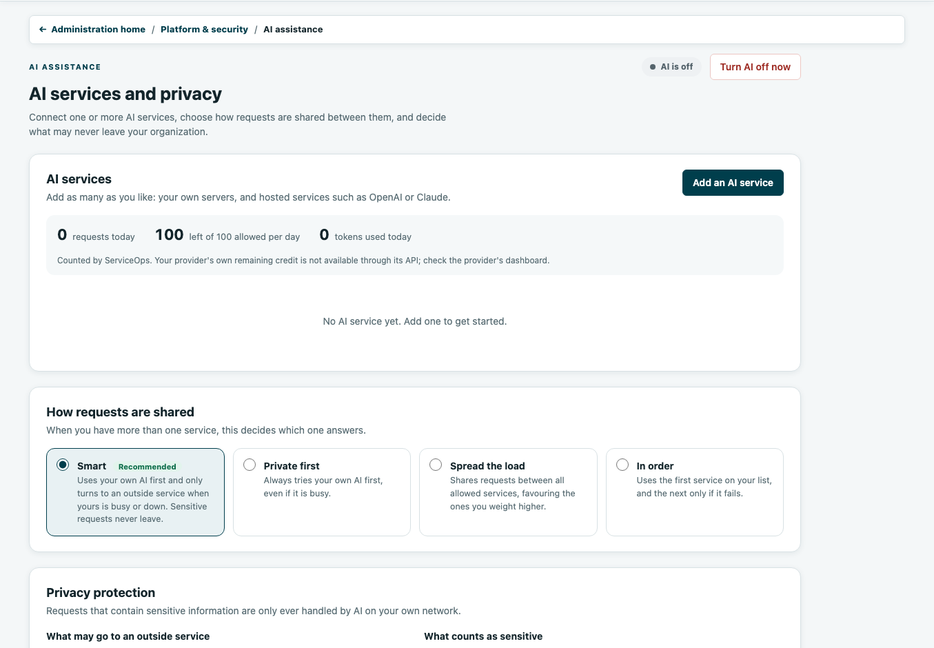
Use AI to clarify the work—not replace accountability.
SERVICEOPS
OPTIONAL AI / CLEARER CONTEXT
Prepare the context
Support investigation and
structured change drafts.
Control the provider
Administrators choose
configured AI services.
Keep human review
People verify the result
and submit the work.
AI assists.
People decide.
Current app v1.113.65 / Isolated demo / Sample records
Anushka Wijesundara / Product overview / October 2026
11
Notes:
CORE PRESENTATION | Target: 50 seconds
Explain AI through a useful example: help investigate an incident or prepare a structured ticket draft. The screenshot deliberately shows the actual administrator controls rather than a fabricated answer. Providers, data-sharing rules and permissions govern availability. Self-hosted inference is an option; an external provider has a different data boundary that must be reviewed. AI output requires human review. No live model response was generated for this deck, so do not present an answer or accuracy figure as verified. The app keeps access scoped to the acting user's permissions.
Sources: ServiceOps/README.md; ServiceOps.wiki/Operations-Manual.md; screenshots/ai-controls.png

Slide 15
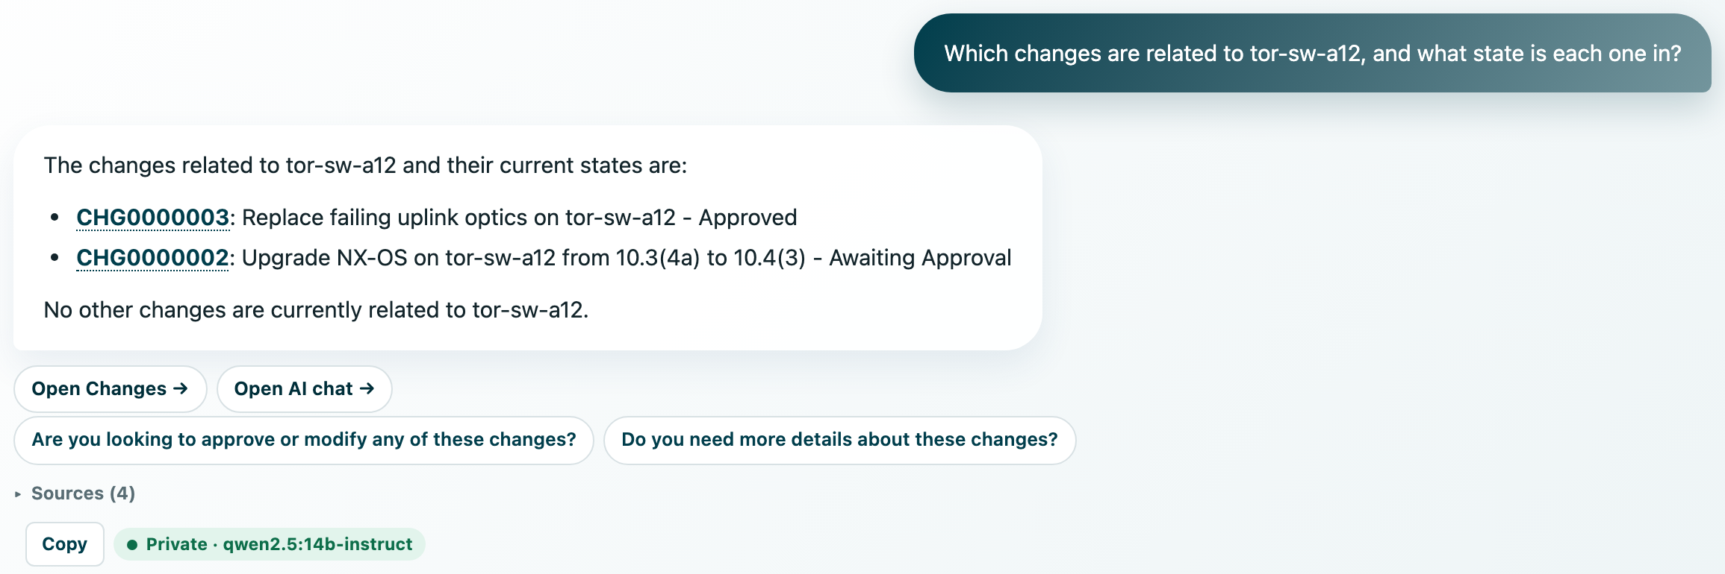
Ask about a change—and trace it to the record.
SERVICEOPS
ANSWERS TEAMS CAN VERIFY
Illustrative question: which changes affect this switch? Review the linked records before acting.
Ask in plain language
Start with the operational question.
Verify the answer
Open the linked change record.
Control the data path
Validate self-hosted AI before rollout.
Anushka Wijesundara / Product overview
12
Notes:
Frame these as intended benefits of connected workflows, not quantified ROI claims. ServiceOps combines service work with infrastructure and governance.
Sources: ServiceOps.wiki/Home.md

Slide 16
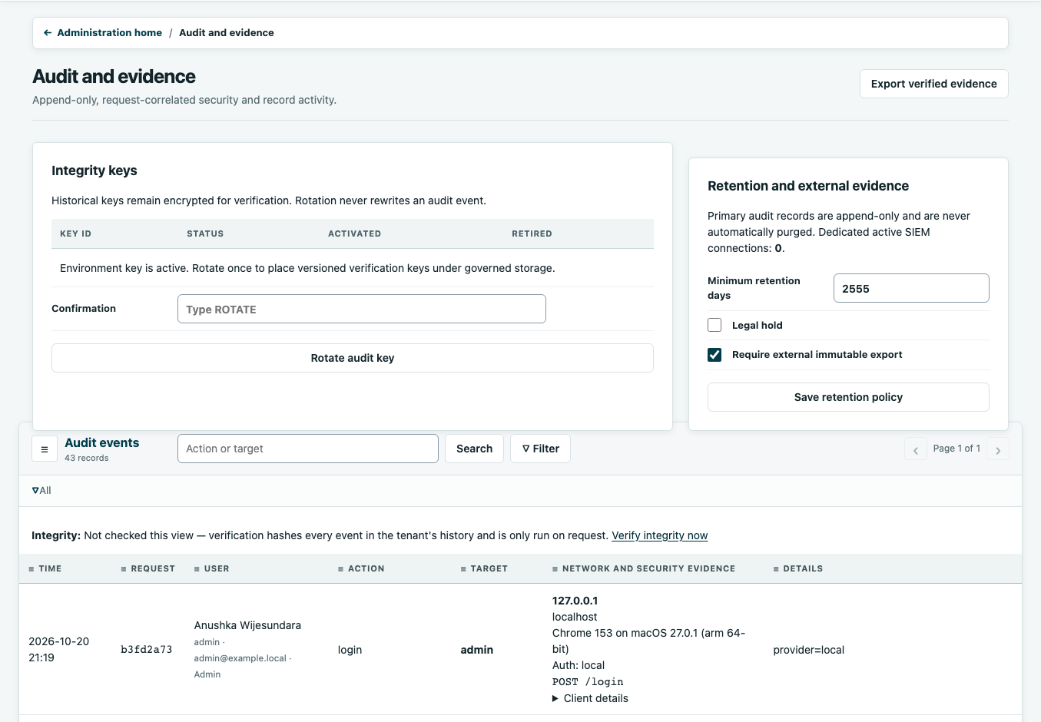
Replace “I thought it was approved” with a record.
SERVICEOPS
DECISIONS WITHOUT AMBIGUITY
Name the person
Attribute recorded actions
to an accountable user.
Retain the decision
Review the events and
changes in one history.
Control the access
Apply permissions and
configured retention policy.
Shared decisions.
Reviewable history.
Current app v1.113.65 / Isolated demo / Sample records
Anushka Wijesundara / Product overview / October 2026
12
Notes:
CORE PRESENTATION | Target: 45 seconds
Point out that the audit area is a distinct management view, not an ordinary user's activity feed. Approvals, record history and platform audit events answer related but different questions. Access and retention must be configured for the organization's requirements. A visible audit screen is not a claim of formal certification, complete retention validation or a guarantee that every possible event is covered. For a pilot, agree which decision evidence must be retrievable and demonstrate it end to end. Any events visible here were generated inside the isolated demo.
Sources: ServiceOps.wiki/Security-and-Compliance.md; ServiceOps.wiki/Operations-Manual.md; screenshots/audit.png

Slide 17
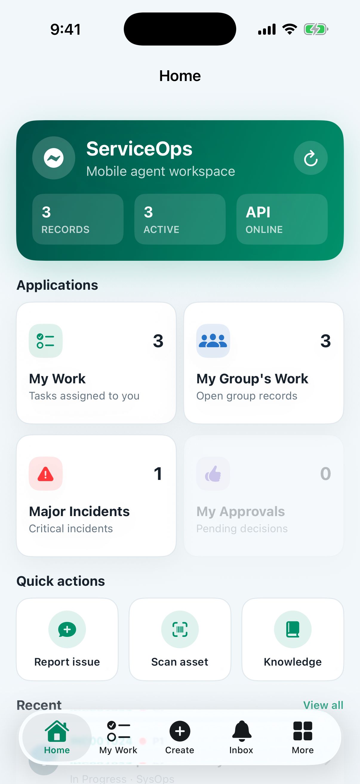
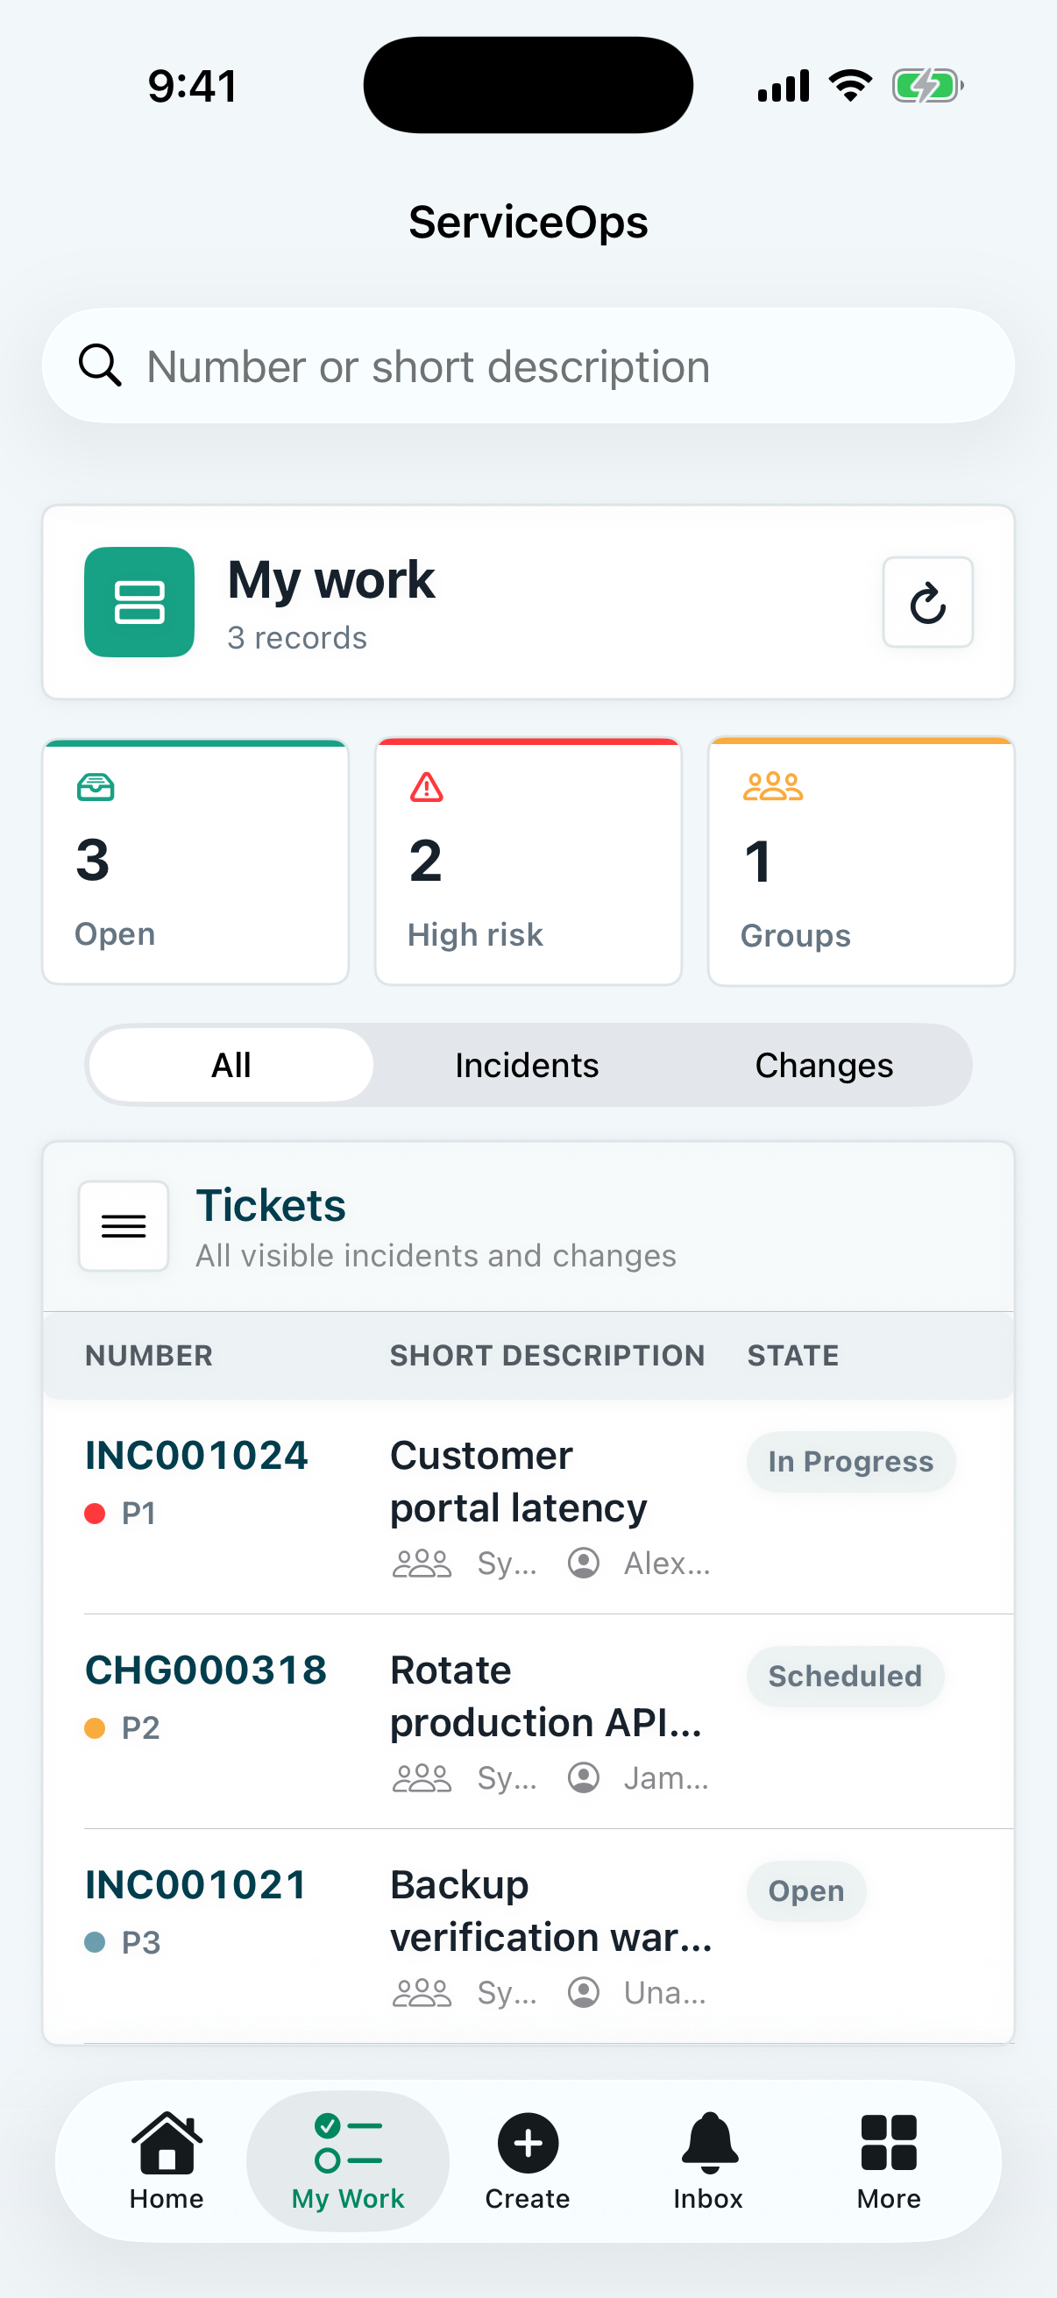
Keep teams aligned—even away from the desk.
SERVICEOPS
COORDINATION IN THE FIELD
Stay close to the work
Review home and assigned work.
Carry the decision context
Access tickets, approvals and knowledge.
Find the affected equipment
Use CMDB and rack views on site.
Native iOS documentation examples / Fixture records
Anushka Wijesundara / Product overview / October 2026
13
Notes:
CORE PRESENTATION | Target: 30 seconds
ServiceOps also has a native iPhone companion for home, work, approvals, knowledge and infrastructure context, subject to server permissions and configuration. These two images are existing iOS documentation screenshots with fixture records; they were not freshly captured from the current web deployment. Keep this slide brief. The point for managers and engineers is continuity of access when away from a desktop. The web interface also supports browser and PWA access.
Sources: ServiceOps_iOS/README.md; ServiceOps_iOS/docs/screenshots/iphone-home.png; ServiceOps_iOS/docs/screenshots/iphone-work.png

Slide 18
One shared record, with control of the connections.
SERVICEOPS
SELF-HOSTED SHARED CONTEXT
People
ServiceOps application
Configured connections
Browser / PWA
Native iPhone app
Changes, devices, decisions
and delivery workflows
Identity, notifications,
NetBox and optional AI
Workers
PostgreSQL
Managed uploads
Background
processing
Shared service
records
Persistent file storage
Keep teams connected while controlling infrastructure, access and data.
Anushka Wijesundara / Product overview / October 2026
14
Notes:
CORE PRESENTATION | Target: 55 seconds
This is a conceptual architecture, not a detailed inventory of the current cluster. Browser/PWA and native mobile access the ServiceOps application and its scoped interfaces. The application and background workers use PostgreSQL, while files are stored in managed uploads. Identity, messaging, infrastructure integrations and AI are configured connections. Deployment and recovery responsibilities include protected access, persistent data, backups, migrations and upgrades. Mention REST and read-only MCP only as integration options; do not imply every interface has the same capabilities. For a ten-minute audience, summarize this as: operated on your infrastructure, connected through controlled interfaces.
Sources: ServiceOps/README.md; ServiceOps.wiki/Deployment-and-Recovery.md; ServiceOps.wiki/Home.md

Slide 19
Judge ServiceOps by coordination—not ticket volume.
SERVICEOPS
DEFINE SUCCESS BEFORE ROLLOUT
01
02
03
Catch the conflict
Confirm the handover
Review the decision
Surface linked work before
the maintenance window.
Give each team the scope,
owner and next action.
Trace approval, reasons
and recovery plans.
Catch conflicts early. Make every handover clear.
Explore: github.com/awijesundara/ServiceOps
Anushka Wijesundara / Product overview / October 2026
15
Notes:
CORE PRESENTATION | Target: 45 seconds
Close on a practical next step, keeping the pilot explicitly a proposal. Pick one business service, the people who own it and a small inventory scope. Walk a request through approval and fulfillment, investigate one incident and review one planned change with relevant dependencies. Agree evidence before starting: clear ownership, reliable infrastructure links, recorded approval and recoverable data. Review optional AI separately before enabling data sharing. Ask the room which service and teams should be the first pilot. No sponsor, rollout date or measured saving is assumed by this presentation.
Sources: ServiceOps.wiki/Operations-Manual.md; ServiceOps.wiki/Deployment-and-Recovery.md

Slide 20
Two valid plans can still create one service conflict.
SERVICEOPS
ILLUSTRATIVE COREAPPS SCENARIO
Network
Unix
Business
tor-sw-a12
coreapps-01
CoreApps
Switch update: Sat 14:00-16:00
Server work: Sat 13:00-17:00
Shared application service
Shared dependencies turn separate plans into a joint decision.
Illustrative scenario—not a measured outcome. Conflict detection needs maintained
device links; freeze enforcement is a separate configured policy control.
Anushka Wijesundara / Product overview / October 2026
APPENDIX / 16
Notes:
OPTIONAL APPENDIX | Target: 90 seconds
Optional scenario discussion, excluded from the twelve-minute core talk. Unix proposes server maintenance from 13:00 to 17:00 on Saturday. Network proposes a switch update from 14:00 to 16:00. If the recorded dependency connects the switch to the server and service, the overlap can be surfaced for review. Reschedule or follow the authorized exception process. A freeze is a separate enforced policy: standard and normal changes within an active freeze are blocked at submission; emergency handling follows the configured approval path. These times and links are illustrative; the application's current change interface describes blocking of detected conflicts at creation and plan revision. The isolated rack was manually entered, and the deck does not claim that a live NetBox sync, conflict rejection or emergency approval was executed.
Sources: Original user-provided ServiceOps-Overview.pptx slides 8-11; Current source serviceops_models.ChangeFreezeWindow; ServiceOps.wiki/Operations-Manual.md

Slide 21
Reliable coordination starts with reliable records.
SERVICEOPS
TEST THE FOUNDATIONS
Approval ownership
Dependency accuracy
Test who can submit, approve and
change the plan.
Sample real devices, owners and links
before trusting conflict checks.
AI data boundaries
Recovery and history
Verify providers, outbound data paths
and human review.
Restore a backup and review decision
history, retention and upgrades.
Anushka Wijesundara / Product overview / October 2026
APPENDIX / 17
Notes:
OPTIONAL APPENDIX | Target: 90 seconds
Optional checklist for technical questions. Demonstrate the configured approval path and a denied unauthorized action. Validate a sample of inventory and dependency links against the real equipment. Confirm the data path for each AI provider before use. Prove a backup can be restored, and exercise the controlled migration and upgrade path. Confirm the required audit evidence, retention and access permissions. Check the deployed scoped API contract rather than inventing integrations. This is an acceptance discussion, not a claim that the deck itself has retested production operations, formal compliance, availability targets or disaster recovery.
Sources: ServiceOps.wiki/Deployment-and-Recovery.md; ServiceOps.wiki/Security-and-Compliance.md; ServiceOps.wiki/REST-API-Reference.md

Slide 22
The danger is not bad teams—it is separate plans.
SERVICEOPS
THE COST OF DISCONNECTED PLANS
When teams cannot see shared dependencies, valid changes can collide and handovers become assumptions.
01
Plans stay separate
Unix and Network can schedule overlapping work on linked equipment.
02
Decisions get lost
Email and chat leave teams unsure which plan was approved.
03
Impact stays hidden
Without maintained service links, teams cannot see who else is affected.
Anushka Wijesundara / Product overview
02
Notes:
Frame these as intended benefits of connected workflows, not quantified ROI claims. ServiceOps combines service work with infrastructure and governance.
Sources: ServiceOps.wiki/Home.md

Slide 23
Move from logging changes to coordinating them.
SERVICEOPS
FROM TRACKING TO COORDINATION
ServiceOps brings shared records, dependency context and change controls into the same workflow.
STEP 1
Share the plan
STEP 2
Check the impact
STEP 3
Align the teams
Make work visible
Record the scope, window and owner so teams do not plan in isolation.
Find the collision early
Use maintained links, conflict checks and freeze rules before delivery.
Make the handover clear
Keep approvals, tasks and recovery plans attached to the change.
Anushka Wijesundara / Product overview
03
Notes:
Frame these as intended benefits of connected workflows, not quantified ROI claims. ServiceOps combines service work with infrastructure and governance.
Sources: ServiceOps.wiki/Home.md

Slide 24
Keep every team working from the same change record.
SERVICEOPS
ONE PLAN / SHARED RESPONSIBILITY
Requesters, approvers and engineers need the same scope, owner and decision—not separate versions.
Employees
Make needs and impact visible
Service owners
Review impact on their services
Management
Review exceptions with context
Audit and compliance
Trace decisions and ownership
SERVICEOPS
One shared context for requests, changes, devices, decisions and delivery
Service desk
Coordinate the service response
Unix and Network
Compare plans before delivery
Data centre
Act on the right rack and device
Platform admins
Maintain policy, data and access
Shared visibility supports coordination; named owners make the next action clear.
Anushka Wijesundara / Product overview
04
Notes:
Frame these as intended benefits of connected workflows, not quantified ROI claims. ServiceOps combines service work with infrastructure and governance.
Sources: ServiceOps.wiki/Home.md

Slide 25
Four capabilities support one goal: coordinated change.
SERVICEOPS
HOW SERVICEOPS REDUCES COORDINATION GAPS
Shared work, change controls, infrastructure context and decision history reinforce each other.
Requester
Service desk
Change control
CMDB
AI and audit
Provider
Clear ownership
Give requests and incidents a record, an owner and a status.
Earlier checks
Review clashes, freezes and approval requirements before work.
Shared impact
Use maintained device and service links to expose dependencies.
Reviewable decisions
Use optional AI with human review; retain named decision history.
Anushka Wijesundara / Product overview
05
Notes:
Frame these as intended benefits of connected workflows, not quantified ROI claims. ServiceOps combines service work with infrastructure and governance.
Sources: ServiceOps.wiki/Home.md

Slide 26
Make coordination part of the change—not a side conversation.
SERVICEOPS
A CLEAR PATH FROM PLAN TO DELIVERY
Capture the plan, check dependencies, align approvals and hand off the work in one recorded flow.
Requester
1
Record
2
Check
3
Approve
4
Deliver
Delivery teams
Name the scope, affected devices, owner and window.
Check linked changes and configured freeze dates.
Route the decision through the configured approvers.
Give delivery teams the tasks and recovery context.
Shared history Keep recorded checks, decisions and actions tied to the change and accountable people.
Anushka Wijesundara / Product overview
06
Notes:
Frame these as intended benefits of connected workflows, not quantified ROI claims. ServiceOps combines service work with infrastructure and governance.
Sources: ServiceOps.wiki/Home.md

Slide 27
SERVICEOPS
ILLUSTRATIVE WALKTHROUGH
Before the change window
Two teams. One service. A clash to catch early.
The CoreApps example shows why Unix and Network need shared context in Tokyo DC1, rack A12.
Compare the plans · Follow the links · Agree the decision
Anushka Wijesundara / Product overview
07
Notes:
Introduce ServiceOps as a connected operational workspace, built by Anushka Wijesundara. The deck illustrates product capabilities, not customer adoption or measured business outcomes. Screenshots are existing documentation examples; their visible versions and sample counts are not current production metrics.
Sources: ServiceOps/README.md; ServiceOps.wiki/Home.md

Slide 28
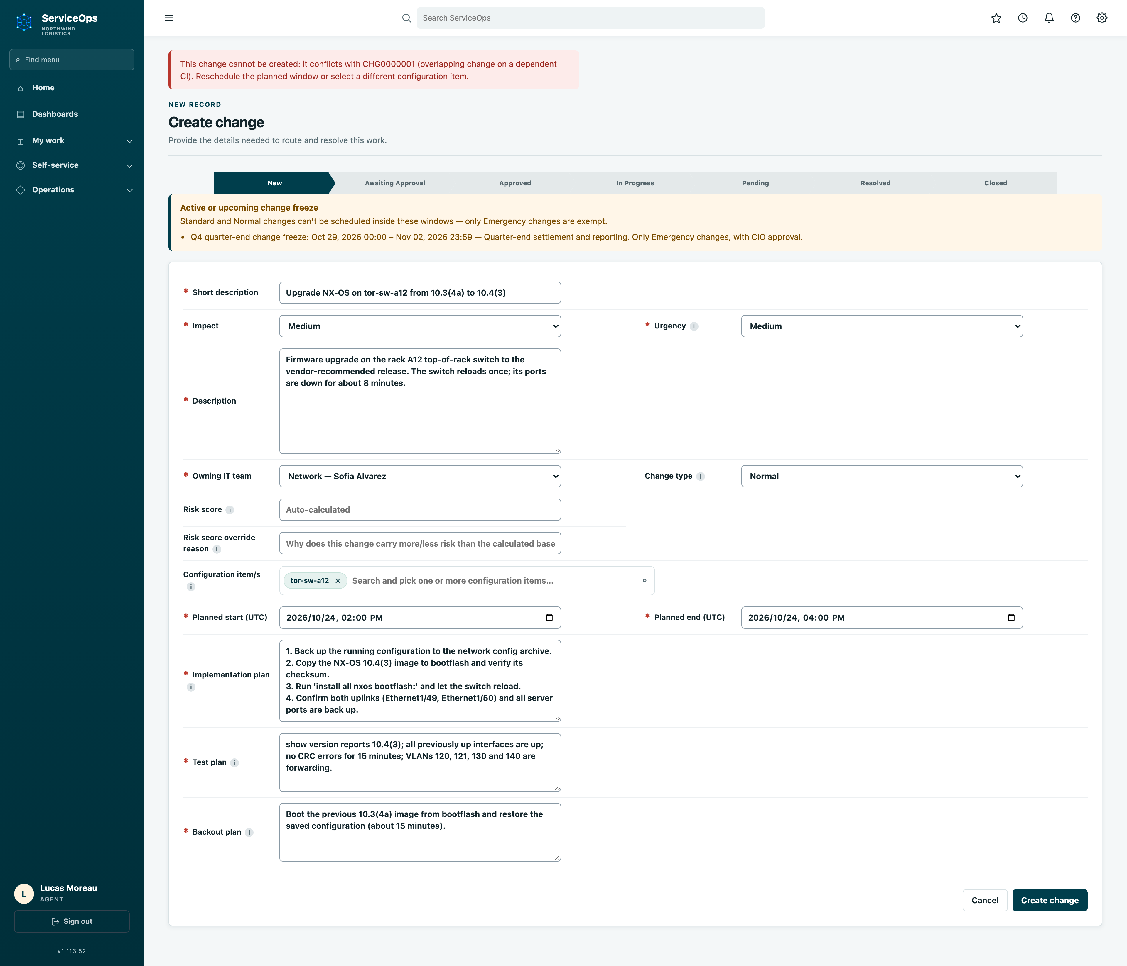
Find the overlap while there is still time to coordinate.
SERVICEOPS
CATCH THE COLLISION BEFORE DELIVERY
Illustrative scenario: linked Unix and Network changes overlap; detection needs maintained relationships.
Unix plans server work
CoreApps server upgrade: Saturday, 1–5 pm.
Network plans switch work
Connected switch update: Saturday, 2–4 pm.
Resolve the conflict first
Choose a non-overlapping window before booking.
Anushka Wijesundara / Product overview
08
Notes:
Frame these as intended benefits of connected workflows, not quantified ROI claims. ServiceOps combines service work with infrastructure and governance.
Sources: ServiceOps.wiki/Home.md

Slide 29
The missing link: a switch change is also a service change.
SERVICEOPS
THE CMDB / SHARED CHANGE IMPACT
A maintained configuration management database connects the device, the dependent server and the service.
NETWORK TEAM
tor-sw-a12
Switch · rack A12, U42
Update requested Sat 2–4 pm
UNIX TEAM
coreapps-01
Server · rack A12, U20
Upgrade booked Sat 1–5 pm
BUSINESS SERVICE
CoreApps
Critical business application
Linked to coreapps-01
Port 1/12
Hosts
1 Maintain the map
Sync inventory from NetBox and verify service relationships.
2 Identify the change
The Network team selects tor-sw-a12 and its window.
3 Expose the shared impact
Follow recorded links to overlapping server work, so teams can resolve the clash.
Anushka Wijesundara / Product overview
09
Notes:
Frame these as intended benefits of connected workflows, not quantified ROI claims. ServiceOps combines service work with infrastructure and governance.
Sources: ServiceOps.wiki/Home.md

Slide 30
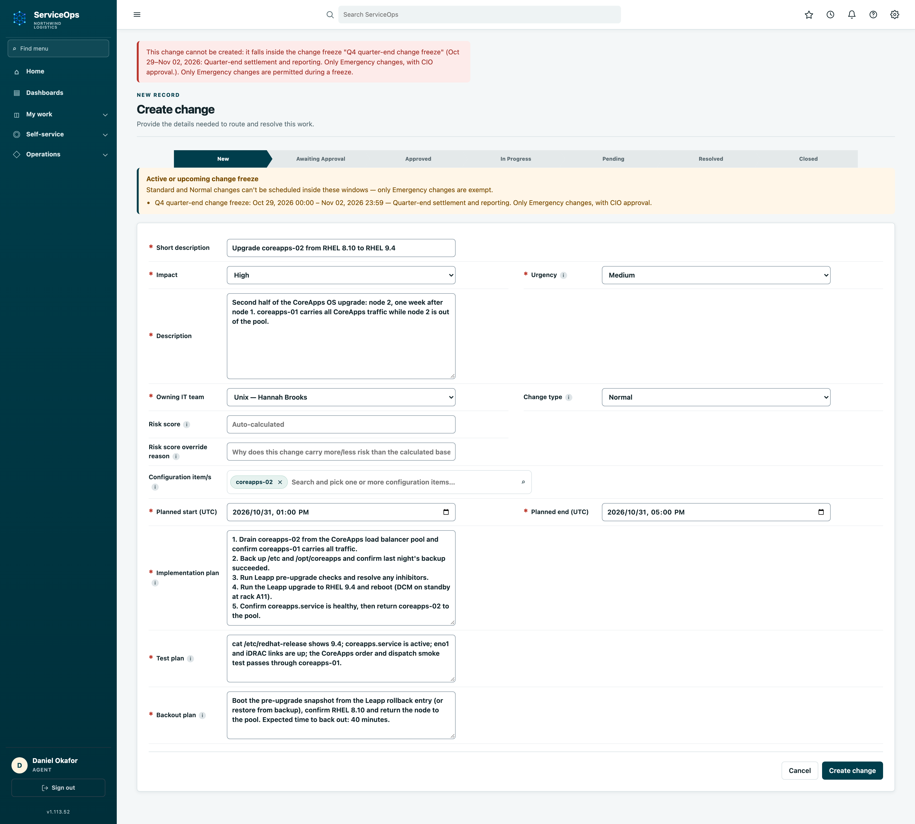
Make the freeze a workflow control—not an email reminder.
SERVICEOPS
POLICY TEAMS CANNOT MISS
Illustrative scenario: a configured freeze prevents routine work; emergencies follow configured approvals.
Publish the boundary
Set the dates and the reason in the shared system.
Make it visible at planning
Show the freeze where teams book a change.
Record the exception
Route emergencies through configured approvals.
Anushka Wijesundara / Product overview
11
Notes:
Frame these as intended benefits of connected workflows, not quantified ROI claims. ServiceOps combines service work with infrastructure and governance.
Sources: ServiceOps.wiki/Home.md

Slide 31
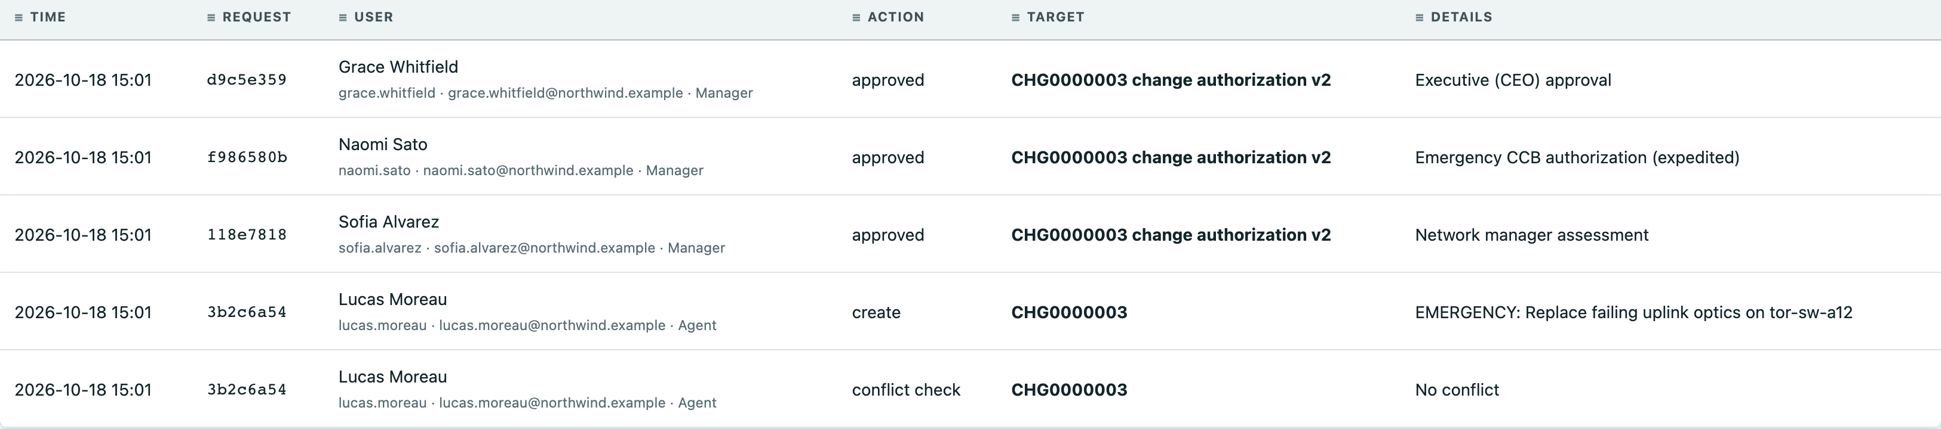
Make safer coordination something teams can verify.
SERVICEOPS
TRUST THE COORDINATION LAYER
Pilot the decision history, data boundaries and exception path before expanding operational use.
Reviewable history
Confirm decisions, retention and exportable evidence.
Controlled AI data
Verify model endpoints and outbound data paths.
Clear emergency ownership
Test the approver chain and recorded reasons.
Anushka Wijesundara / Product overview
13
Notes:
Frame these as intended benefits of connected workflows, not quantified ROI claims. ServiceOps combines service work with infrastructure and governance.
Sources: ServiceOps.wiki/Home.md

Slide 32
Less guesswork for the people who protect the service.
SERVICEOPS
VALUE FOR EACH TEAM
The value is coordinated action: visible plans, clearer impact and accountable handovers.
01
Change managers
Review planned work and detected conflicts in shared context.
02
Engineers
See linked work before committing to a maintenance window.
03
Data centre
Act with rack, device and delivery context—not assumptions.
04
Leadership
Review exceptions with named owners and recorded reasons.
Anushka Wijesundara / Product overview
14
Notes:
Frame these as intended benefits of connected workflows, not quantified ROI claims. ServiceOps combines service work with infrastructure and governance.
Sources: ServiceOps.wiki/Home.md

Slide 33
Test conflict prevention and handovers—not just features.
SERVICEOPS
PILOT / PROVE THE CORE PROMISE
Proposed one-month Tokyo DC1 pilot: name owners and capture evidence before deciding on expansion.
Acceptance check | Suggested owner | Evidence to review
Dependency accuracy | Data centre / NetBox owner | Sampled devices and service links match reality.
Conflict and freeze checks | Change manager | Test overlaps and freeze rules; record blocks and exceptions.
Handover clarity | Unix / Network leads | Both teams can identify the scope, owner and next action.
Approval and decision trail | Change manager / audit | Approvers, reasons and recovery plans are reviewable.
Anushka Wijesundara / Product overview
15
Notes:
Frame these as intended benefits of connected workflows, not quantified ROI claims. ServiceOps combines service work with infrastructure and governance.
Sources: ServiceOps.wiki/Home.md

Slide 34
Bring two teams and one service into the same plan.
SERVICEOPS
THE NEXT DECISION
Sponsor a focused Tokyo DC1 pilot to prove earlier conflict detection and clearer maintenance handovers.
01
Choose the service
Name the sponsor, Unix and Network leads, scope and acceptance checks.
02
Prove coordination
Run the proposed one-month pilot; review conflicts and handovers weekly.
03
Expand on evidence
Roll out only when the agreed checks pass; otherwise fix and retest.
Anushka Wijesundara / Product overview
16
Notes:
Frame these as intended benefits of connected workflows, not quantified ROI claims. ServiceOps combines service work with infrastructure and governance.
Sources: ServiceOps.wiki/Home.md

