Slide 1
EAST AFRICA UNIVERSITY – GAROWE
Faculty of Technology and Engineering · Department of Computer Science
Beeciye
A Web-Based Second-Hand Market Platform for Buying and Selling Used Goods
Bachelor's Thesis Presentation · B.Sc. Computer Science
PRESENTED BY
SUPERVISOR
DATE
[Student Full Name] · [ID]
[Supervisor Full Name]
[Month, Year]
Notes:
Assalaamu calaykum. Magacaygu waa [magacaaga]. Maanta waxaan idin hor dhigayaa thesis-kayga: Beeciye, oo ah suuq online ah oo lagu iibsado laguna iibiyo alaabta la isticmaalay (second-hand). Supervisor-kaygu waa [magaca supervisor-ka].

Slide 2
Presentation Outline
OUTLINE
01
02
03
04
Introduction & Problem
Objectives
Literature Review
Methodology & Tools
05
06
07
08
System Design
Implementation & Testing
Conclusion
Questions
Beeciye · Second-Hand Market Platform
Notes:
Presentation-kan wuxuu ka kooban yahay siddeed qaybood: hordhaca iyo dhibaatada, ujeeddooyinka, dib-u-eegista daraasadaha, habka shaqada, naqshadeynta nidaamka, hirgelinta iyo tijaabinta, gabagabada, ugu dambeyntiina su'aalaha.

Slide 3
Background of the Study
INTRODUCTION
In Garowe, second-hand phones, laptops, furniture and clothes are still traded through Facebook groups and word of mouth, not a dedicated platform.
1
2
3
Growing re-commerce
Informal local trade
The opportunity
Platforms like eBay and Mercari show that C2C marketplaces create value and extend product life.
Local listings have no categories, no search and no record of what was ordered or paid.
A structured, simple web platform built for the local second-hand market.
Beeciye · Second-Hand Market Platform
Notes:
Ganacsiga online-ka ah wuxuu beddelay sida alaabta loo iibsado. Adduunka, suuqyada alaabta la isticmaalay sida eBay iyo Mercari way koreen. Laakiin Garowe, alaabta second-hand-ka ah weli waxaa lagu iibiyaa Facebook groups iyo af-ka-af, iyadoo aan la haysan qaybo (categories), raadin, ama diiwaan dalab iyo lacag bixin. Taasi waa fursadda ay daraasaddani ka shaqaysay.

Slide 4
Four Gaps in Informal Second-Hand Trading
PROBLEM STATEMENT
1
Inefficient discovery
2
No order history
Listings are scattered across profiles and posts with no categories or search.
Buyers and sellers have no durable record of what was agreed or ordered.
3
Undocumented payments
4
No oversight
Manual payments cause disputes, especially with partial payments.
Nobody monitors sellers, moderates listings or steps in when problems arise.
Beeciye · Second-Hand Market Platform
Notes:
Dhibaatada waxay leedahay afar qaybood. Koowaad: alaabta in la helo way adag tahay, maadaama ay ku kala firirsan yihiin bogag kala duwan. Labaad: ma jiro diiwaan dalab (order history). Saddexaad: lacag bixintu waa gacan, mana la diiwaangeliyo, taas oo keenta khilaaf. Afraad: ma jirto maamul kormeera iibiyeyaasha iyo xayeysiisyada.

Slide 5
Objectives of the Study
OBJECTIVES
GENERAL OBJECTIVE
Design, develop and test a web-based second-hand marketplace where users buy and sell in one account, with full administrator oversight.
1
Design a relational database for users, products, orders and multiple payments.
2
Implement secure login with Administrator and User roles.
3
Build product listings with categories, search and an image gallery.
4
Build cart, Buy Now and checkout with Cash on Delivery or Mobile Money.
5
Provide seller and administrator dashboards with reports.
6
Test the whole system end-to-end.
Beeciye · Second-Hand Market Platform
Notes:
Ujeeddada guud waa in la naqshadeeyo, la dhiso, lana tijaabiyo suuq online ah oo qofku hal account ku iibsan karo kuna iibin karo, iyadoo admin-ku uu kormeerayo nidaamka oo dhan. Ujeeddooyinka gaarka ah waa lix: database, login iyo roles, liiska alaabta, cart iyo checkout, dashboards, iyo tijaabinta nidaamka oo dhan.

Slide 6
Existing Systems Compared with Beeciye
LITERATURE REVIEW
Feature | OLX / Jiji | Facebook | Beeciye
Category listing and search | Yes | Yes | Yes
Integrated shopping cart | No | No | Yes
In-platform checkout and order record | No | No | Yes
Multiple / partial payment tracking | No | No | Yes
Seller dashboard with sales analytics | No | No | Yes
Central administrative oversight | No | Limited | Yes
Research gap: local platforms only list items; none manage the order and payment inside the system.
Beeciye · Second-Hand Market Platform
Notes:
Daraasado hore sida Yrjölä (2021), Moriuchi iyo Takahashi (2022), iyo Jang iyo Kim (2023) waxay muujiyeen in kalsoonidu (trust) muhiim u tahay suuqyada C2C. Zhang iyo Meng (2022) waxay caddeeyeen in MVC iyo SQL Server ay ku habboon yihiin nidaamyadan. Marka la barbardhigo OLX, Jiji iyo Facebook Marketplace, waxay kaliya bixiyaan xayeysiis; ma laha cart, checkout, diiwaan lacag bixin, iyo maamul dhexe. Beeciye ayaa buuxiya farqigaas.

Slide 7
Research Approach and Data Collection
METHODOLOGY
A design-based study using an Agile, iterative SDLC: the system was built in rounds, each tested before the next.
1
2
30
4
Interviews
Observation
Questionnaire
System review
Talks with local buyers and sellers.
How Facebook groups and OLX-style listings are used.
Respondents in Garowe, with Likert-scale items.
Comparison of existing platforms.
Beeciye · Second-Hand Market Platform
Notes:
Daraasaddu waxay isticmaashay design-based research iyo Agile iterative SDLC. Xogta waxaa lagu ururiyay afar hab: wareysiyo lala yeeshay iibsadayaal iyo iibiyeyaal, indha-indheyn lagu sameeyay sida Facebook groups loo isticmaalo, su'aalo (questionnaire) loo qaybiyay 30 qof oo Garowe ah, iyo barbardhigga nidaamyada jira.

Slide 8
Eleven Development Rounds
METHODOLOGY
ROUND 1
ROUND 2
ROUND 3
ROUND 4
Core scaffold and data models
Login, products, cart, checkout
Navy-and-gold redesign
Seller and buyer merged into one User role
ROUND 5
ROUND 6
ROUND 7
ROUND 8
Multi-image gallery, admin forms
Order-to-Payment fixed to one-to-many
Full end-to-end verification
Guest listing without an account
ROUND 9
ROUND 10
ROUND 11
Buy Now, sold-out hiding, soft delete
Dynamic per-unit pricing
Profile picture upload
Beeciye · Second-Hand Market Platform
Notes:
Nidaamka waxaa loo dhisay 11 wareeg (rounds). Wareeg kasta wuxuu ku daray qayb cusub, kadibna waa la tijaabiyay. Tusaale ahaan, Round 6 waxaan ogaanay in xiriirka Order iyo Payment uu ahaa one-to-one, taas oo aan u beddelnay one-to-many si dalab kasta loogu diiwaangeliyo lacag bixin badan ama qayb-qayb ah. Tani waa faa'iidada habka iterative-ka.

Slide 9
Tools and Technologies
TOOLS
C#
MVC
EF
C# 13 · .NET 9
ASP.NET Core 9 MVC
EF Core 9
Programming language and runtime
Model-View-Controller web framework
Code-first ORM with migrations
SQL
ID
UI
SQL Server
ASP.NET Identity
Razor · Bootstrap 5
Relational database engine
Login, password hashing and roles
Interface, plus Chart.js for reports
Beeciye · Second-Hand Market Platform
Notes:
Qalabka la isticmaalay: C# iyo .NET 9, ASP.NET Core 9 MVC oo ah framework-ka, Entity Framework Core 9 oo ah ORM-ka isku xira code-ka iyo database-ka, Microsoft SQL Server, ASP.NET Core Identity oo maamula login-ka iyo roles-ka, iyo Razor, Bootstrap 5 iyo Chart.js oo loo isticmaalay interface-ka iyo warbixinnada.

Slide 10
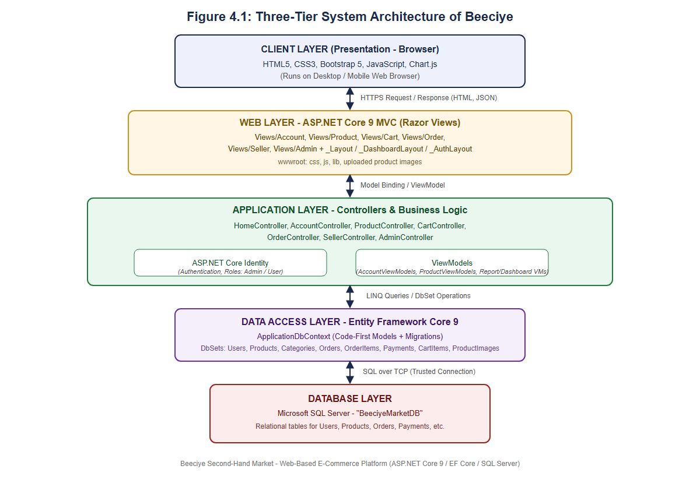
System Architecture
SYSTEM DESIGN
Three tiers following the MVC pattern.
1
Presentation
Browser with Razor views, Bootstrap and Chart.js
2
Application
Seven controllers plus ASP.NET Core Identity
3
Data
EF Core over Microsoft SQL Server
Figure 4.1 · Three-tier architecture
Notes:
Nidaamku wuxuu raacaa three-tier architecture. Lakabka koowaad waa browser-ka, kaas oo HTTPS ku la xiriira ASP.NET Core MVC. Lakabka labaad waa todobada controller iyo Identity oo maamula logic-ga. Lakabka saddexaad waa Entity Framework Core iyo SQL Server oo xogta kaydiya.

Slide 11
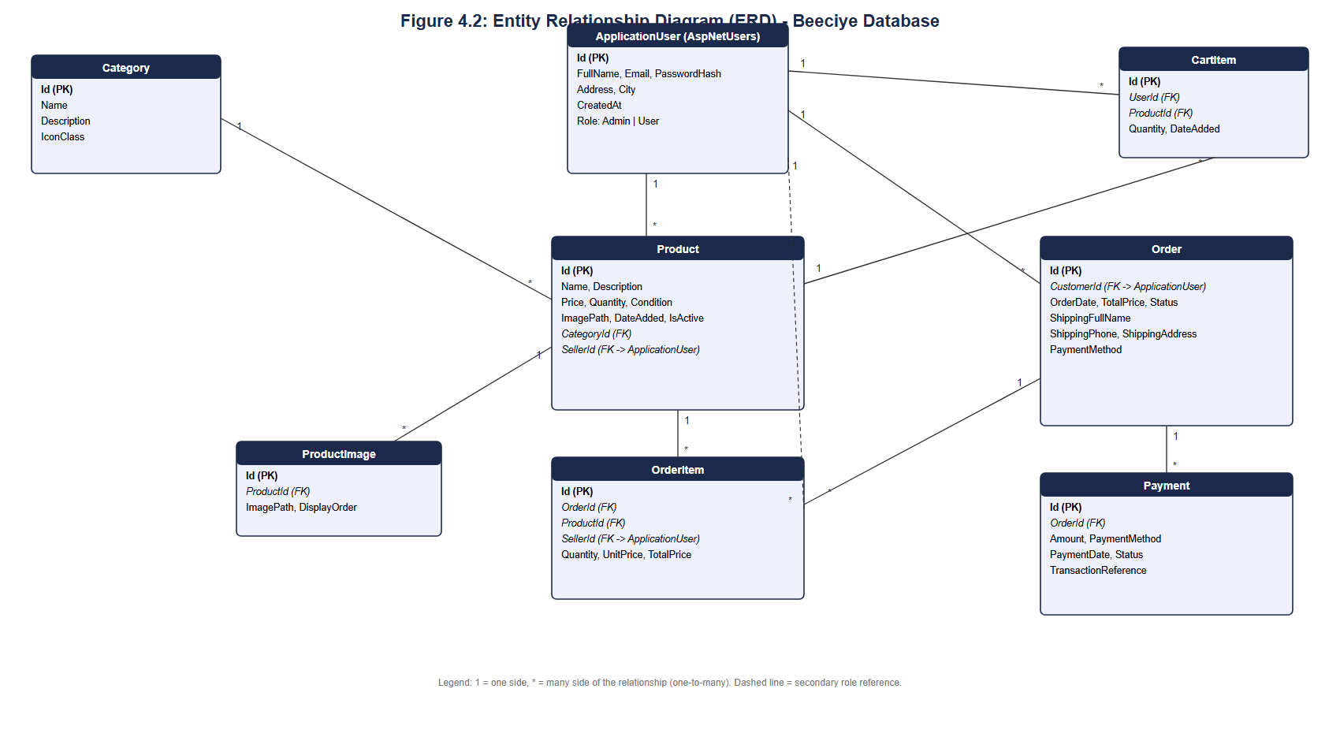
Database Design
SYSTEM DESIGN
8
entities, built code-first with EF Core migrations.
Key design: one Order can have many Payments, so partial and repeated payments are recorded.
Figure 4.2 · Entity Relationship Diagram
Notes:
Database-ku wuxuu leeyahay siddeed entity: User, Category, Product, ProductImage, CartItem, Order, OrderItem iyo Payment. Product kasta wuxuu leeyahay hal category iyo hal iibiye, sawirro badanna wuu yeelan karaa. Qodobka ugu muhiimsan: Order kasta wuxuu yeelan karaa Payments badan, si lacag qayb-qayb ah loogu diiwaangeliyo.

Slide 12
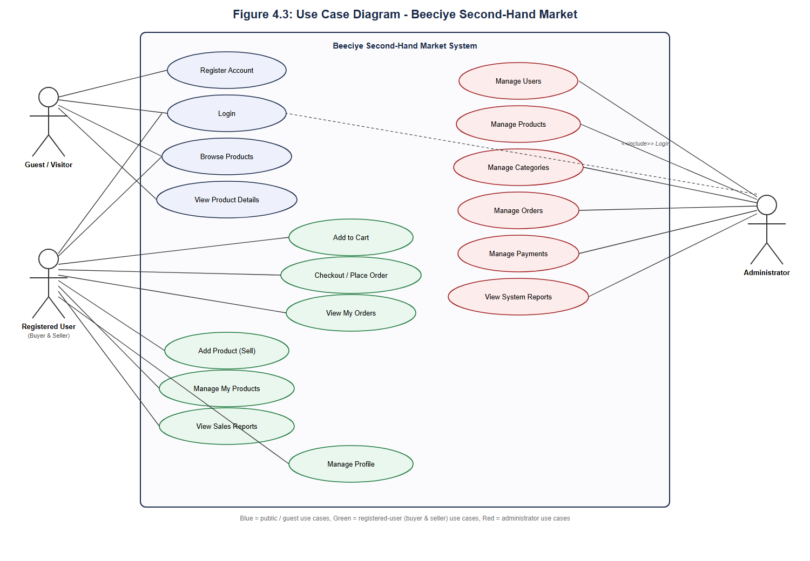
Use Case Diagram
SYSTEM DESIGN
Three actors use the system.
1
Guest
Browse, register, list an item with a phone number
2
Registered User
Buys and sells from one account
3
Administrator
Manages users, products, orders and payments
Figure 4.3 · Use case diagram
Notes:
Nidaamku wuxuu leeyahay saddex actor. Guest-ku wuu daawan karaa alaabta, wuu is-diiwaangelin karaa, wuxuuna iib geli karaa isagoo account aan lahayn, kaliya magac iyo telefoon. Registered User-ku hal account ayuu ku iibsadaa kuna iibiyaa. Admin-ku wuxuu maamulaa users, products, categories, orders iyo payments.

Slide 13
Key Features by Role
IMPLEMENTATION
Buying
Selling
Administration
Browse by category and search
Product gallery and details
Cart and one-click Buy Now
Cash on Delivery or Mobile Money
Order history
Add products with many images
Per-unit pricing from total price
Sold-out items hide automatically
Sales report with Chart.js
Guest listing, no account
Dashboard with system statistics
Manage users and roles
Manage products and categories
Manage orders and payments
System-wide reports
Beeciye · Second-Hand Market Platform
Notes:
Halkan waa astaamaha ugu muhiimsan. Dhinaca iibsiga: raadin iyo categories, cart, Buy Now, iyo laba hab lacag bixin: Cash on Delivery iyo Mobile Money. Dhinaca iibinta: sawirro badan, qiimo hal-unug ah oo laga xisaabiyo qiimaha guud, alaabta dhammaatay si toos ah ayay u qarsoontaa, iyo warbixin iib. Admin-ku wuxuu leeyahay dashboard iyo maamul buuxa.

Slide 14
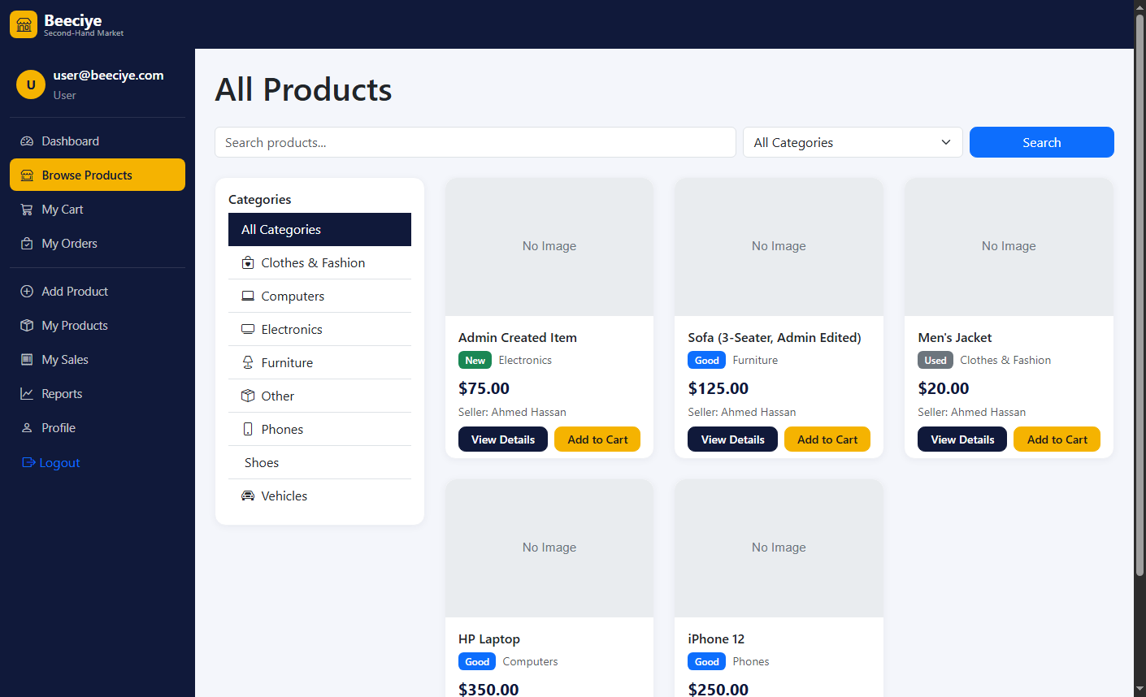
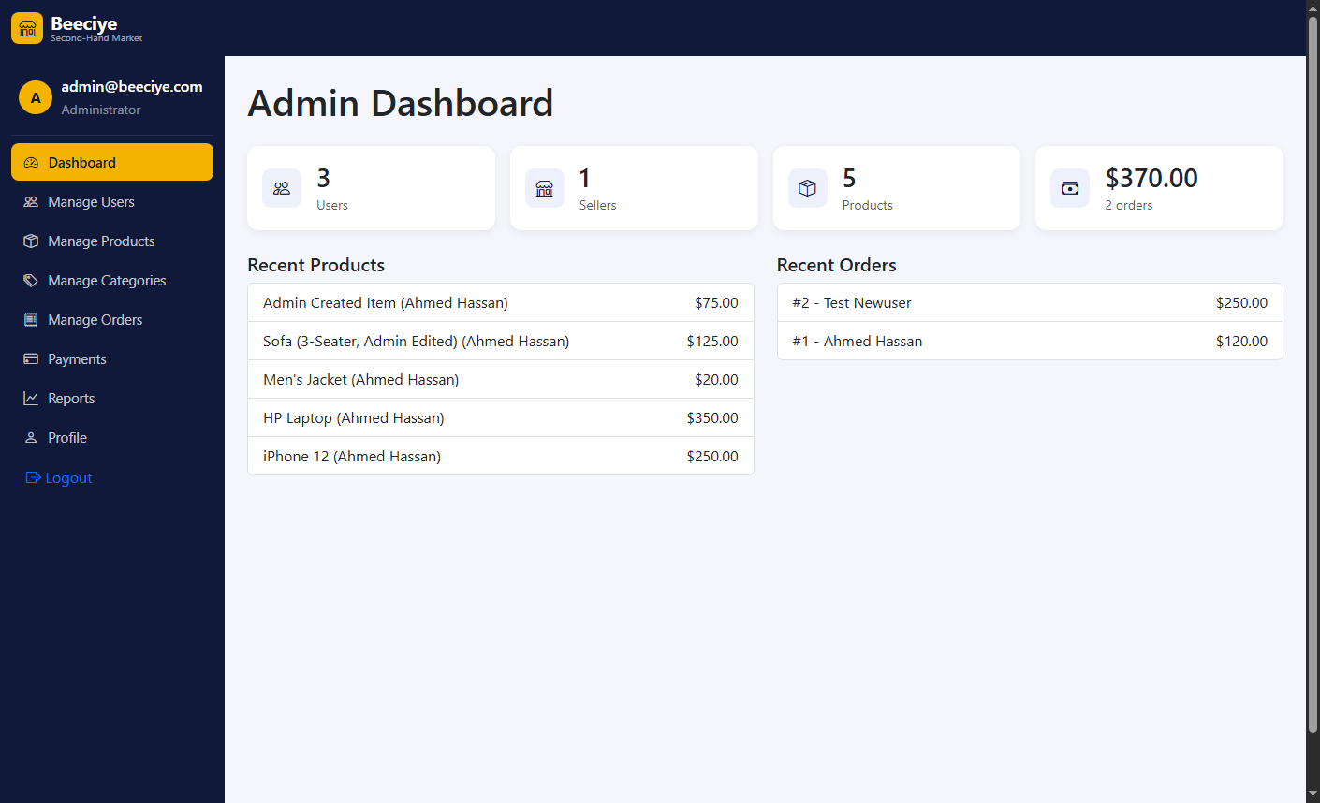
The Working System
IMPLEMENTATION
Browse Products · categories, search and cart
Admin Dashboard · system statistics at a glance
Screenshots from the running application
Notes:
Kuwani waa sawirro laga qaaday nidaamka oo shaqaynaya. Bidix: bogga Browse Products, halkaas oo user-ku ku raadin karo alaabta, ku kala sooci karo categories, kuna dari karo cart-ka. Midig: Admin Dashboard oo muujinaya tirada users, sellers, products iyo wadarta iibka. Haddii waqti la helo, halkan waxaan ku samayn karaa demo toos ah.

Slide 15
Testing Results
TESTING
ID | Test | Result
TC01 | Register a new account | Pass
TC02 | Out-of-stock item cannot be added to cart | Pass
TC04 | Checkout with Cash on Delivery | Pass
TC05 | Normal user blocked from /Admin | Pass
TC07 | Second payment added to one order | Pass
TC09 | Guest lists an item without an account | Pass
TC13 | $15 for 3 units charges $5 per unit | Pass
14/14
test cases passed
Manual, integration and smoke testing after every round
Sample from Table 5.1 · Test cases and results
Notes:
Nidaamka waxaan ku tijaabinay manual testing, integration testing iyo smoke testing wareeg kasta kadib. Dhammaan 14-ka test case way guuleysteen. Tusaale: user caadi ah ma geli karo bogga Admin-ka, alaab dhammaatay cart-ka laguma dari karo, dalab keliyana laba lacag bixin ayaa lagu diiwaangelin karaa.

Slide 16
Conclusion and Findings
CONCLUSION
A structured, role-based web platform can make second-hand trading in Garowe more organised, transparent and accountable.
✓
Database supports multiple payments per order
✓
Secure login with Admin and User roles
✓
Complete browse-to-checkout workflow with stock checks
✓
Seller and admin dashboards with reports
All six specific objectives were achieved.
Beeciye · Second-Hand Market Platform
Notes:
Gabagabadii, daraasaddani waxay muujisay in platform habaysan oo roles leh uu ka dhigi karo ganacsiga alaabta second-hand-ka ah ee Garowe mid habaysan, cad, lana xisaabtami karo. Dhammaan lixda ujeeddo ee gaarka ahaa waa la gaaray: database-ka, amniga, workflow-ga iibsiga, iyo dashboards-ka.

Slide 17
Recommendations and Future Work
RECOMMENDATIONS
Recommendations
Future enhancements
Clearer labels on the checkout form
Password reset by email
Seller ratings and reviews to build trust
Automated tests with xUnit
Public deployment and load testing
Real mobile-money payment gateway
Mobile app or progressive web app
Somali and English interface
Automated image moderation
Richer sales analytics
Beeciye · Second-Hand Market Platform
Notes:
Talooyinka: in foomka checkout-ka la hagaajiyo magacyada field-yada, in la sameeyo password reset, in lagu daro qiimeyn iyo faallooyin iibiyeyaasha si kalsoonidu u korto, tijaabin otomaatig ah, iyo in server dadweyne la geliyo. Mustaqbalka: in lagu xiro mobile money dhab ah sida EVC Plus, app mobile ah, luqadda Soomaaliga iyo Ingiriiska, iyo falanqeyn ballaaran.

Slide 18
Thank you
Questions and discussion
[Student Full Name] · Supervisor: [Supervisor Full Name]
East Africa University – Garowe
Notes:
Waad ku mahadsan tihiin dhageysiga. Hadda waxaan diyaar u ahay su'aalahiinna.

