Slide 1
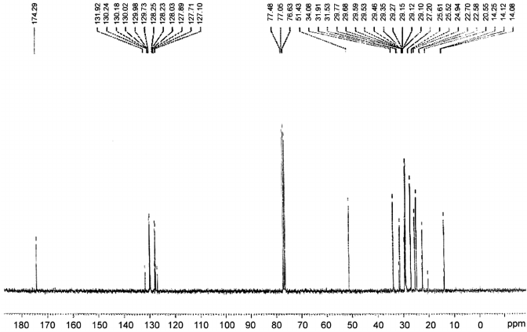
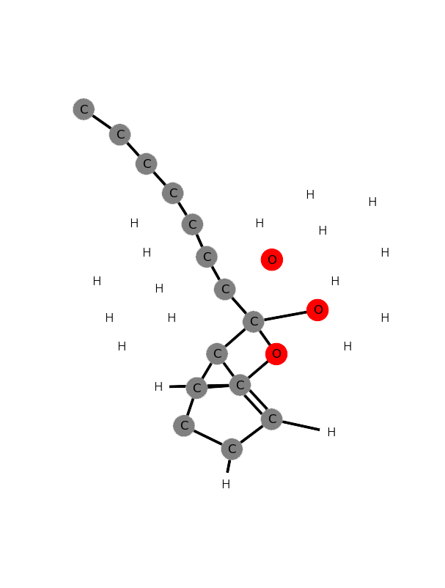
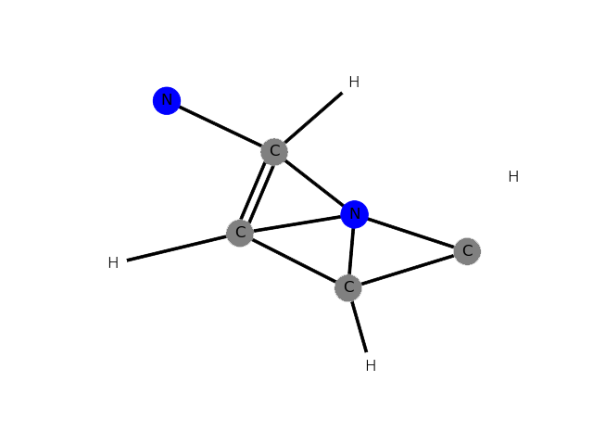
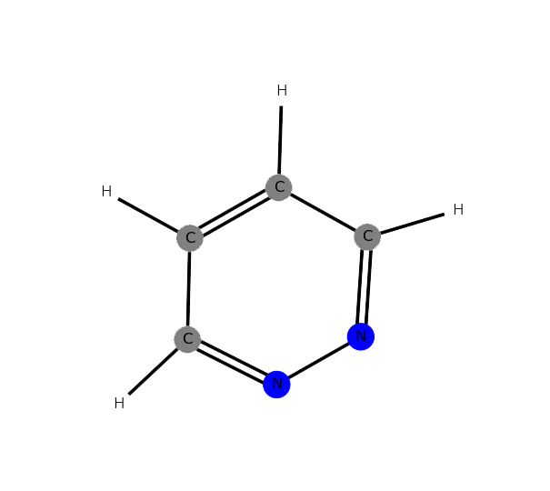
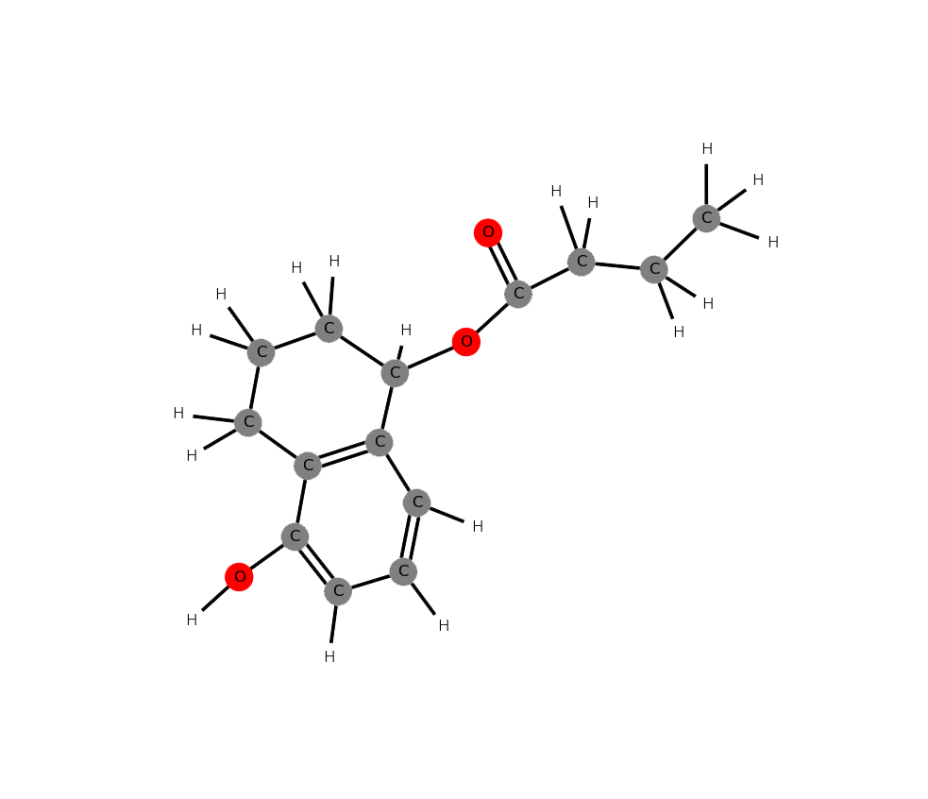




Spectral Structure Prediction In Neural Networks
Lauren Koulias, Ian Murphy, Torin Stetina, Andrew Wildman
Overview
Data Input
Results
Software package using neural networks to predict the structure of simple organic molecules based on nuclear magnetic resonance data
EMPIRICAL FORMULA
SHIFT | PEAK AREA | MULTIPLICITY
11.3 | 1 | S
21.5 | 1 | D
22.7 | 2 | T
........
Net outputs a predicted connectivity matrix
Bonding thresholded to integer values
Limited training time results in non-intuitive structures
Predicted
Export experimental data to a space delimited .txt file separating chemical shift, intensity, and multiplicity.
Training Data
Real
Input
Classes
Prediction
User Input
NN Translator
Predict
Parameters
Our neural network predicts the bonding behavior between atoms in the form of a connectivity matrix
Architecture
3,350 → 1,000 ; ELU
1,000 → 3,000 ; Sigmoid
3,000 → 186,624 ; ReLU
Future Work
Yes
Challenges | Potential Solutions
Extremely sparse output | -Take upper-triangle of connectivity matrix
Large output space | -Change output space -Bonding network -HOSE
¹³C NMR carries less than ideal structural information | -Database with ¹H NMR multiplicities
Functional group context | -Add more specific spectroscopy -Change output space
Sub-optimal prediction | -Increased neural net training time
Prediction
If < Total
No
exit
Translate Structure
Gradient
If Training
Penalty Function
Nope
Yup
Visualization
Use Cases
C | C | C | C | N | N | H | H
0 | 1 | 0 | 0 | 0 | 0 | 1 | 0
0 | 0 | 1 | 0 | 0 | 1 | 1 | 0
1 | 0 | 1 | 0 | 2 | 0 | 0 | 0
0 | 0 | 0 | 1 | 0 | 2 | 0 | 1
2 | 1 | 1 | 0 | 1 | 0 | 0 | 1
........
Automatic structural prediction from ¹³C NMR
References
Train custom nets using modular framework
provided by package
Visualize arbitrary chemical structures from
connectivity information
The full connectivity matrix is truncated to only include atoms which are predicted to participate in bonding with neighbors
This smaller matrix is then plotted using the Networkx visualization package
NMR Database:
http://nmrshiftdb.nmr.uni-koeln.de
Packages:
Keras, TensorFlow, Numpy, NetworkX
https://github.com/awild82/SSPINN

Slide 2


Spectral Structure Prediction
In Neural Networks
DEPARTMENT
LOGO

Slide 3
Input
Training Data
Classes
User Input
Parameters
NN Translator
Predict
Yes
Prediction
If < Total
No
exit
Translate Structure
If Training
Gradient
Nope
Yup
Penalty Function

Slide 4
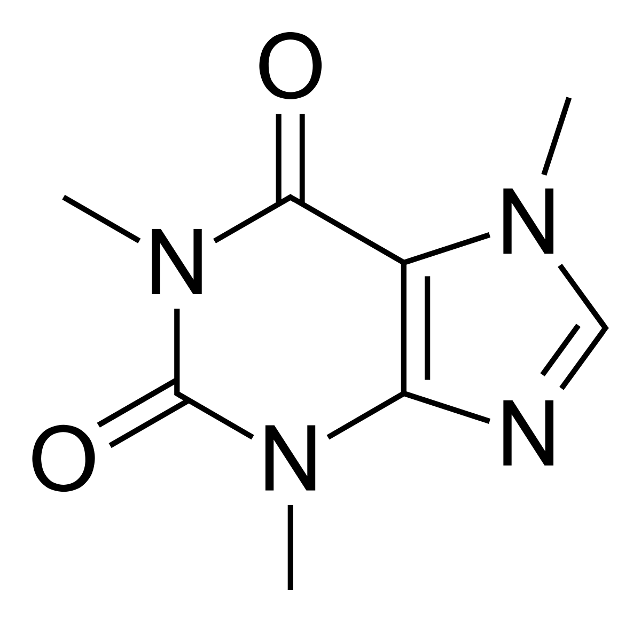
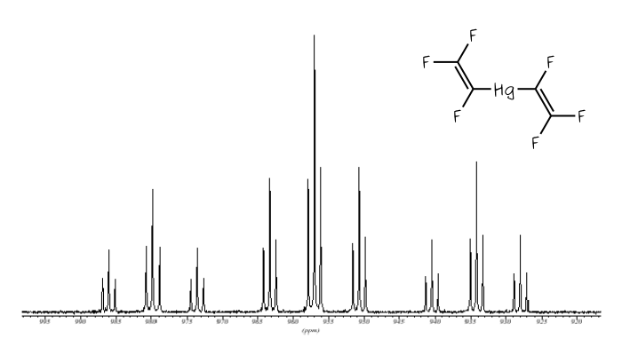

Slide 5
N
SPIN
SSPINN
S
SSPINN
SSPINN
SSPINN

Slide 6
4
1
N
Spectral Structure Prediction
Spectral Structure Prediction
N
SPIN
SPIN
In Neural Networks
S
S
In Neural Networks
2
5
Spectral Structure Prediction
Spectral Structure Prediction
N
N
SPIN
SPIN
S
S
In Neural Networks
6
In Neural Networks
3
N
Spectral Structure Prediction
SPIN
N
S
SPIN
S
Spectral Structure Prediction
In Neural Networks
In Neural Networks

Slide 7
