Slide 1
Handwritten-Digit-Classification Neural Network
Austin Wilhite, Joey Danial, Kshitij Jain
Notes:
Austin

Slide 2
Overview
A single-layer neural network hardware accelerator interfaced through an Avalon SOC bus that can identify handwritten digits found in raw image data
Neural Networks are powerful tools used in computer vision applications
Large amount of dense matrix multiplications makes them slow and computationally expensive
Implementing an FPGA/ASIC neural network speeds up the multiplications and reduces the load on the CPU
Notes:
Austin

Slide 3
System Level
Notes:
Austin

Slide 4
Architecture
Notes:
Austin
Make it clear what was done in the design to achieve the project specific success criteria
Mention one or two of the biggest design decisions that had to be made

Slide 5
Top-Level Operation
Notes:
Joey

Slide 6
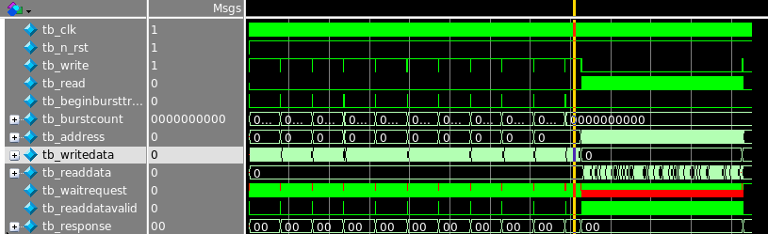
Top-Level Waveform
Write Weights
Computation
Write Pixels
Read Results
Notes:
Joey

Slide 7
Summary of Fixed Criteria
(2 points) Test benches exist for all top level components and the entire design. The test benches for the entire design can be demonstrated or documented to cover all of the functional requirements given in the design specific success criteria. | Satisfied
(4 points) Entire design synthesizes completely, without any inferred latches, timing arcs, and, sensitivity list warnings. | Satisfied
(2 points) Source and mapped version of the complete design behave the same for all test cases. The mapped version simulates without timing errors except at time zero. | Satisfied
(2 points) A complete IC layout is produced that passes all geometry and connectivity checks. | Not Satisfied
(2 points) The entire design complies with targets for area, pin count, throughput (if applicable), and clock rate. | Satisfied
Notes:
Kshitij

Slide 8
Summary of Design Specific Success Criteria
(2 points) Demonstrate by simulation of a Verilog test bench that the burst write of image data and network weights is performed correctly | Satisfied
(1 points) Demonstrate by simulation of a Verilog test bench that the matrix multiplication operation is performed correctly | Satisfied
(1 points) Demonstrate by simulation of a Verilog test bench that the clear data operation is performed correctly | Satisfied
(1 points) Demonstrate by simulation of a Verilog test bench that overflow and invalid writes are handled correctly | Satisfied
(2 points) Demonstrate by simulation of a Verilog test bench that the neural network hardware is able to correctly classify an image of a handwritten digit | Satisfied
(1 point) Demonstrate by verification with a C program the mapped functionality of the neural network hardware on an FPGA | Not Satisfied
Notes:
Kshitij

Slide 9
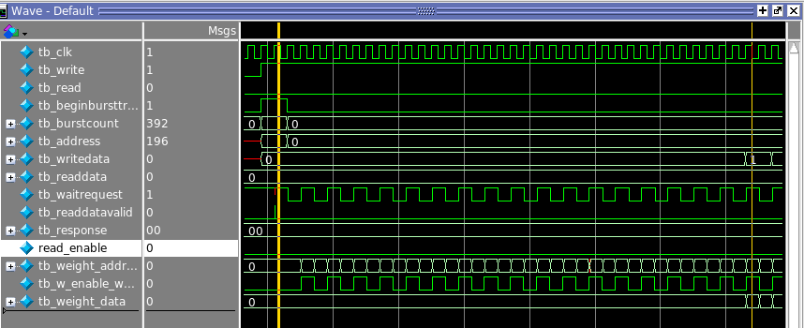
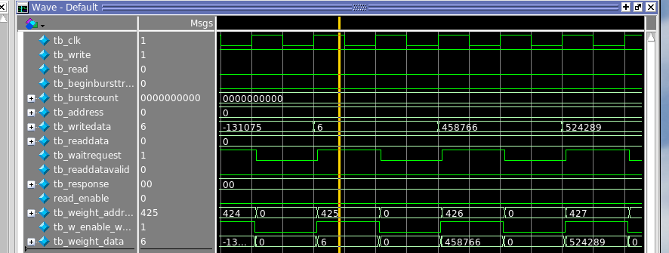
Burst Write of Network Weights
Burst Start
Writes to SRAM
Write Data
Computed Address
Notes:
Joey

Slide 10
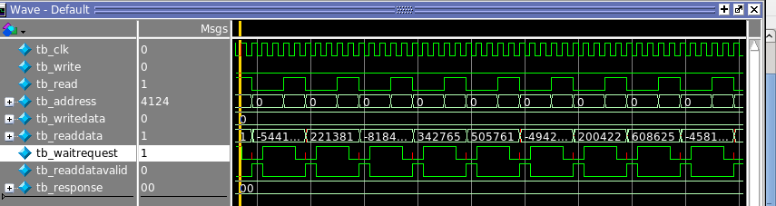
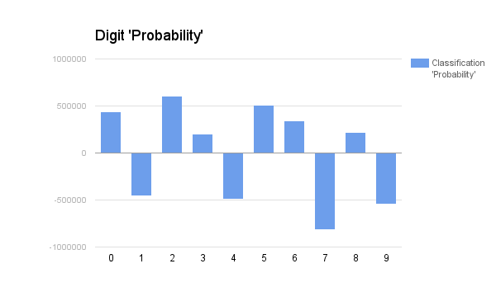
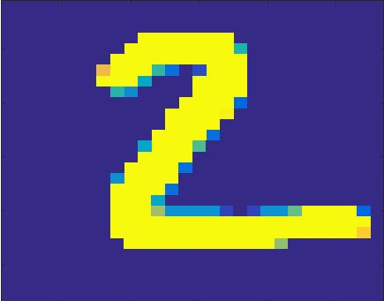
Digit Classification
Calculation Done
Notes:
Joey

Slide 11
Layout
Area:
Total cell area: 1685880 um^2 - 1.3mm x 1.3mm
Target area 9mm x 9mm
Timing:
Synthesis Critical Path : 9.75
Target Clock Rate 20 ns
Estimated Critical Path: 44.68 ns
Pin Count:
Actual Pin Count 96
Target Pin Count: 99
Notes:
Kshitij

Slide 12
Conclusions
Biggest Challenge: Memory constraints due to the large quantity of pixel and weight data.
Do Differently: Create original memory design independently of the FPGA implementation
Improvements: Fit design on the FPGA
Implement more advanced Neural Network structure
Notes:
Kshitij

Slide 13
Backup Slides

Slide 14
Avalon Interface State Transition Diagram

Slide 15
Main Control Unit State Transition Diagram

Slide 16
Matrix Multiplier State Transition Diagram

Slide 17
Block Diagrams

Slide 18
Avalon Interface

Slide 19
Matrix Multiplier Functional Block Diagram

Slide 20
Image Data Storage Controller

Slide 21
Network Weights Storage Controller

Slide 22
Result Registers Controller

Slide 23
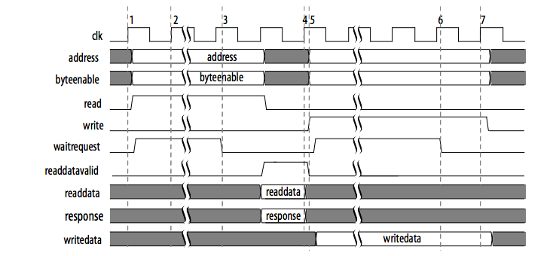
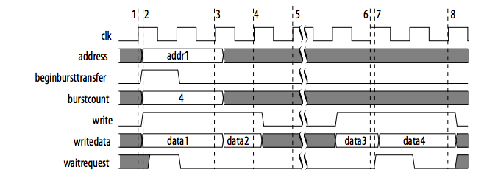
Data Sheets & Documentation

Slide 24
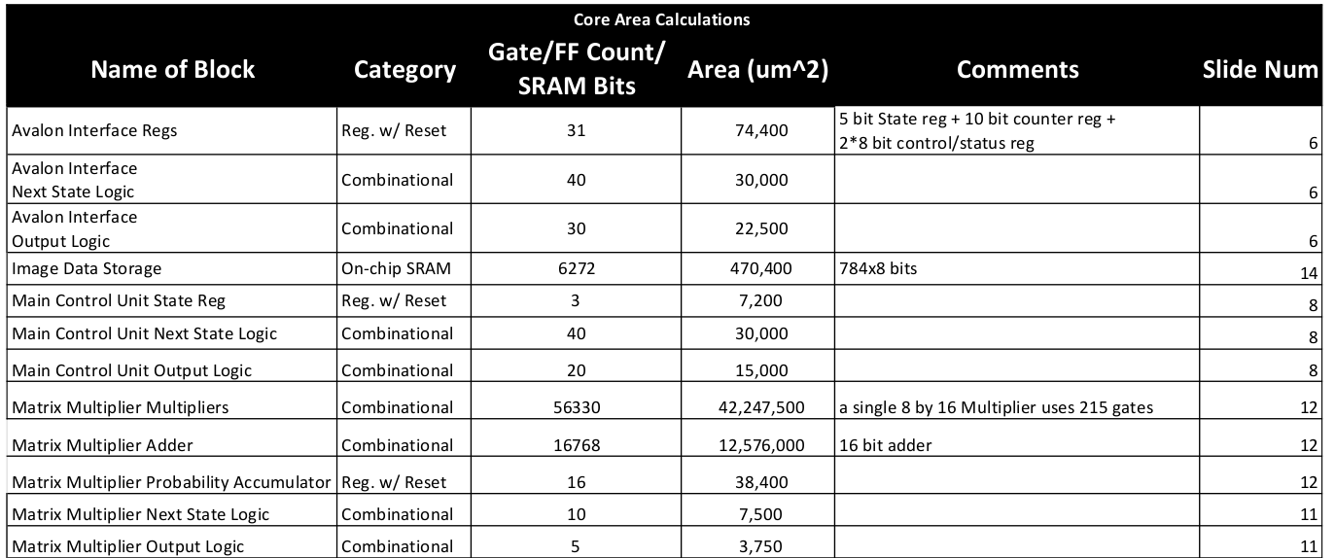
Area Budget Summary

Slide 25
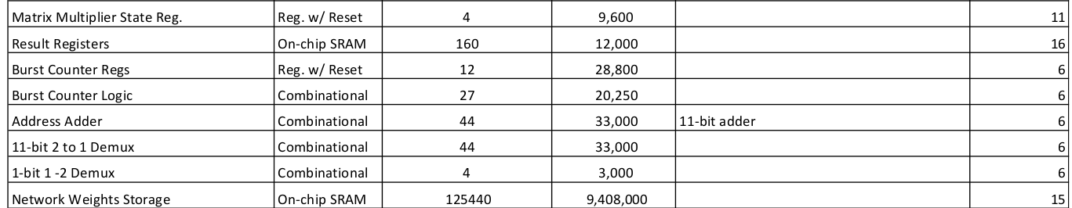
Area Budget Summary

Slide 26
System Design
Use two (2) to four (4) slides to describe the functionality and operation of your design.
Describe the overall architecture, operation, and external interfaces. These slides should correspond to the System Diagram, Operational Characteristics, and Architecture sections of the final report and/or proposal.
Use a top-level block diagram to explain at least one or two common sequences of operation.

Slide 27
Results
Results (4 to 7 slides)
This section should correspond to: The success criteria status and corresponding results summary (1 or 2 slides)
List all success criteria along with a statement of the results achieved or quantitative results for quantitative criteria such as area or pin count.

Slide 28
Key Design Specific Success Criteria Results
Key Design Specific Success Criteria Results Slides (2-4) You will likely not have enough time to discuss/show the results that prove all success criteria that you have met, so you will need to pick a subset of them that you think are the more important ones to focus on for the presentation.

Slide 29
Layout
Layout (1 slide) Make sure to indicate design dimensions, layout critical path delay, synthesis critical path delay, and timing budget estimated critical path delay.
Slides displaying test result waveforms should only display signals that are relevant to demonstrating correct functionality and must be annotated with easily readable text, circles, and arrows to highlight important details. Annotations should include a short statement of what is shown by the simulation results.

