Slide 1

A Comparison of United States Crop Yields and Crop Disease Status Based on Pesticide Usage Levels
CSC 4730: Data Visualization
Angel Williams
Final Project

Slide 2
Problem and Motivation
Pesticides are defined by the EPA as, “Any substance or mixture of substances intended for preventing, destroying, repelling, or mitigating any pest.”
The USDA asserts that damage from pests can often result in "adverse impacts...[such as]:...Damage to crops...[and] Disease and quality of life impacts in populated areas.
Problem: Pesticides are known to cause health problems for consumers. Despite the risks, pesticides are often used in commercial agriculture for the reasons defined by the EPA and the USDA. I am seeking to observe the effectiveness of pesticide usage, which could assist in deciding whether the benefits of pesticide use outweigh the risks.

Slide 3
Research Question & Claims
Question: Do crops grown within the United States experience both: a crop yield that is at or above the average and a crop disease status of mild or lower (None), when pesticide usage levels are at or above the United States’ average usage level?
Hypothesis0: Crops grown within the United States do experience both: a crop yield that is at or above the average and a crop disease status of mild or lower (None), when pesticide usage levels are at or above the United States’ average usage level
HypothesisA: Crops grown within the United States do not experience both: a crop yield that is at or above the average and a crop disease status of mild or lower (None), when pesticide usage levels are at or above the United States’ average usage level

Slide 4
Data Sources
EPA: https://www.epa.gov/minimum-risk-pesticides/what-pesticide
USDA: https://www.nifa.usda.gov/topics/pest-management
Dataset:https://www.kaggle.com/datasets/atharvasoundankar/smart-farming-sensor-data-for-yield-prediction
This dataset is a simulation of real-world smart farming operations.
The observations based on this dataset are not accurate to real-world data.
However, the simulated data establishes a premise of what could be analyzed for observation after real-world data collection is performed.

Slide 5
Data Wrangling
Preparing the dataset for visualizations and calculations:
1)Import the csv file
2)Drop unnecessary columns.
Required columns: farm_id, region, crop_type, pesticide_usage_ml, yield_kg_per_hectare, crop_disease_status
3)Strip Values of Whitespaces
4)Update Null values to meaningful data
5) Save filtered data to a new dataframe
According to the details page of the dataset
Records with crop_disease_status of ”No disease” are set to null
Update all null values for crop_disease status to “None”
6) Any required subtables can be derived from the filtered dataframe

Slide 6
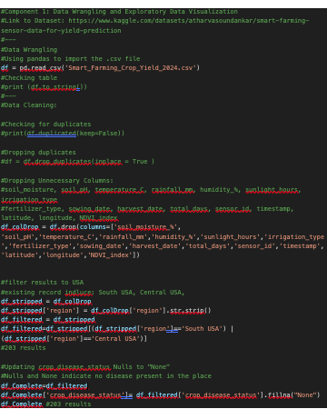
Data Wrangling in VisualStudioCode

Slide 7
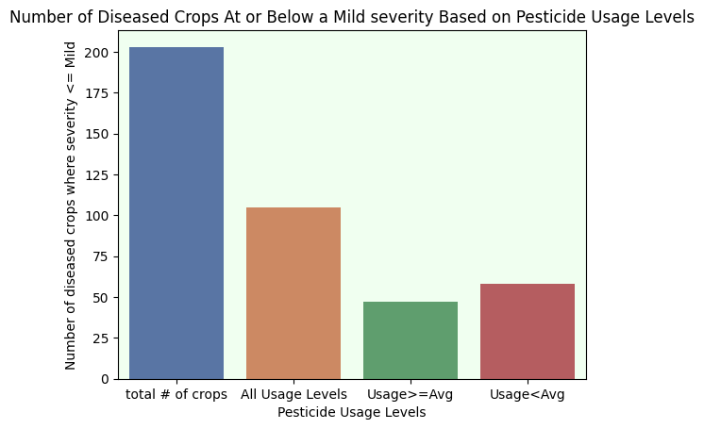
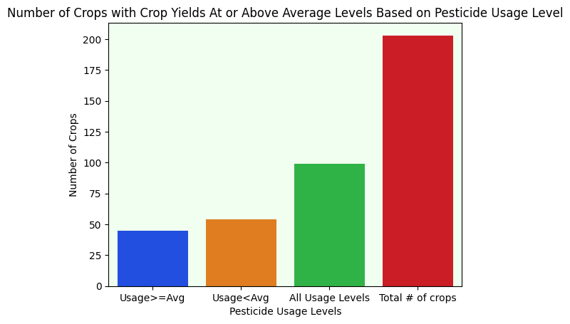
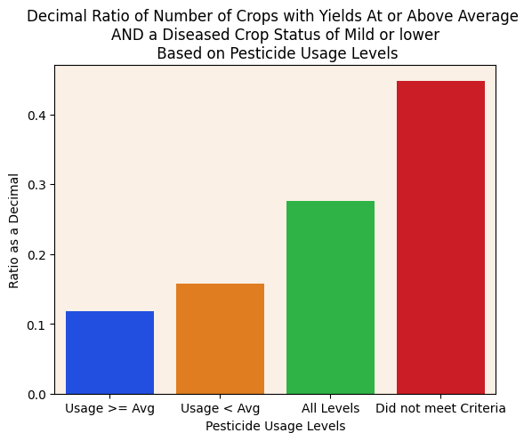
Statistical Observations: Data Visualizations
Compares both crop experience criteria requirements individually and combined
Created by making different sub-tables from the filtered data frame
Graphed and decorated with seaborn

Slide 8
Statistical Testing & Methods
Data was sorted into different groups based on the conditions derived from the hypothesis
To test my hypothesis, I used the z-score method because: the sample of the dataset is a normal to large large-sized sample (209), is independent with inference on the means, and has a known population variance which fits the requirements of the Z test
I did not use ANOVA beause I did not have 3 or more samples to compare
I did not use linear regression because part of one determining factors is categorical which is not suitable for the Assumption of Linearity Principle

Slide 9
Key Findings
As the data visualizations show, from my sample of the dataset, the number of crops grown within the United States did not experience a greater number of both: a crop yield that is at or above the average and a crop disease status of mild or lower (None), when pesticide usage levels were at or above the United States’ average usage level compared to when pesticide usage levels were below the United States’ average usage level
This resulted in a rejection of H0.
The z-score also reflects a rejection of H0.
Z-Critical at a 95% Confidence Level = 1.96, -1.96
Z-Score = 3.2
Since the z-score is within the z-critical, H0 is rejected

Slide 10
Interpretation, Conclusion, and Next Steps
It must be noted that these findings are based on a simulation and not real-world data
Interpretation: Based on the simulated data, the benefits of above average pesticide use on crops towards crop yield and disease status combined is less than no pesticide use.
Conclusion: Although the comparison of risk to benefits of pesticide use on crops is subjective, statistically, they provide fewer benefits than below-average pesticide use.
Next Steps: This observation could be further developed by using real-world data and including other factors of comparison

