Slide 1
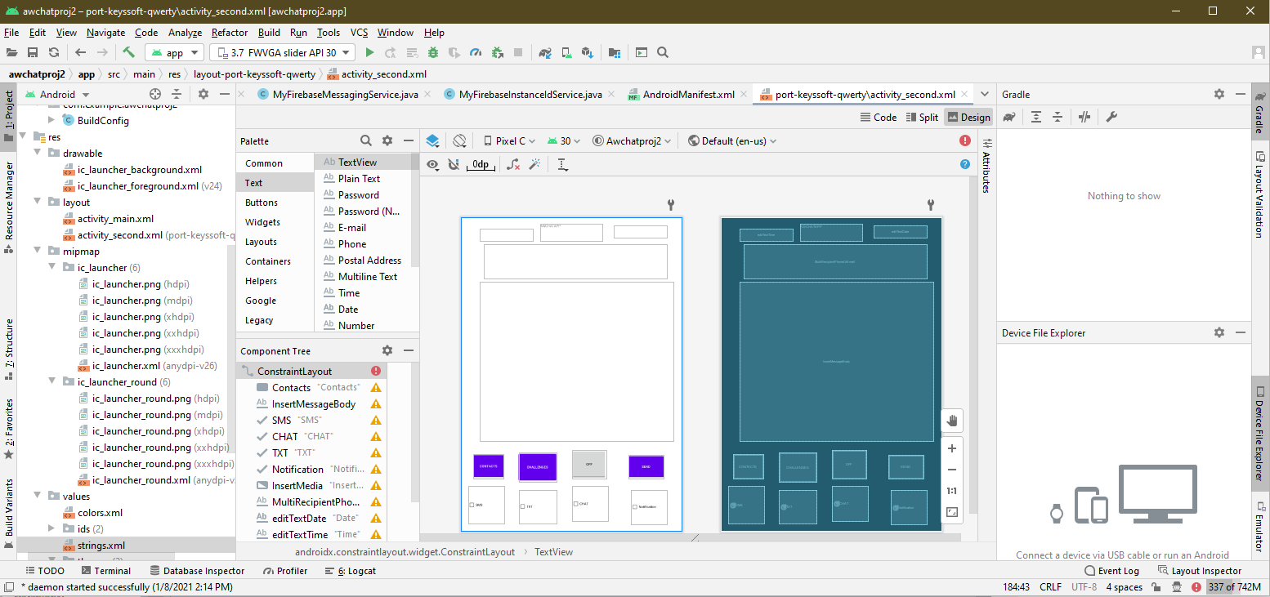
AWCORPCHAT
By: A Willis 4.
Description: A chat app intented for business purposes, and for use in a business environment, that is meant to provide monetary incentives in exchange for completion of issued tasks.

Slide 2

The 5 Habits of Personal Growth
The Five Habits are:
1). Be Respectful: Treat others how I want to be treated.
2). Be Responsive: Acknowledge, commit, and respond within reasonable timeframes.
3). Always Communicate: Ensure information flows (including difficult news) in a timely, proactive, and consistent manner.
4). Demonstrate Stewardship: Put my company's interest ahead of everything else (business unit/team/self).
5). Build Trust: Demonstrate a high say-do ratio in everything I do.

Slide 3

How Are the 5 Habits Useful?
Today, employers are looking to support their employees by creating a vibrant company culture.
Company culture is critical as employees want to be proud of who they work for, be happy with their job, and enjoy working with their colleagues.
Happy and confident employees are critical to the success of any company.
Company culture programs help create a common language (spoken and unspoken) that everyone can understand and support.
Imagine a company culture program called “Five Habits.” The belief is that when everyone in the company understands and uses the 5 habits in their daily life, a shared language and understanding is possible and the company culture can flourish.

Slide 4
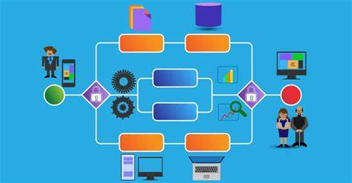
AWCORPCHAT
Is an app that would allow users to interface with each other in real time.
Incentives would be delivered upon in real time.
It may work as a supplement for base salary.
It may work to motivate people to complete tasks on a continuous and competitive basis.
It will register completed or attempted incentives of a user.

Slide 5
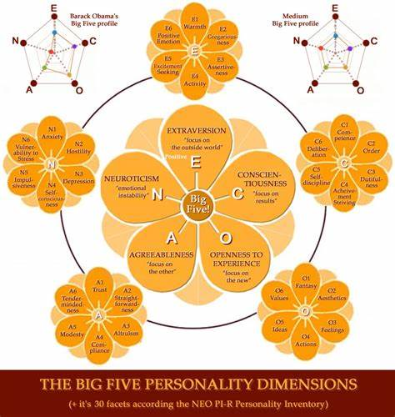
How does this relate to the 5 habits?
The app is purely on volunteer basis, but it provides moonetary incentives.
The incentives are timed, and are modifications of given workloads.
The app is also a chat app. Users may collaborate with other facets of the operation.
It is not meant for personal use.
Incentive rewards are stacked, of course.

Slide 6
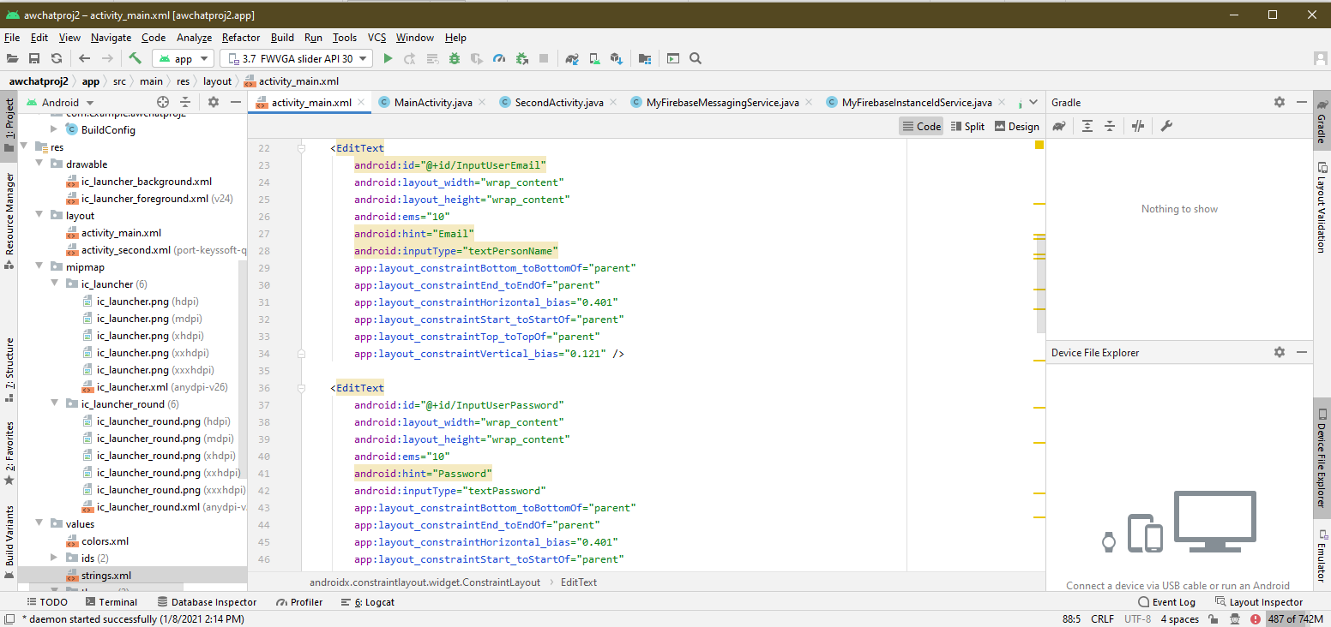
Rundown of Operation
The user inserts their email, phone, password, and company code at first to register, only company code of another company is needed for a different company.
The manager places you into a department, which defines which contacts come preloaded, and which incentives you will see.
Connect your bank through various apps to receive incentive, or place the incentive reward in a policy defined by the company.

Slide 7

A New Opportunity
It is a new opportunity to change the face of business.
It will add incentives to benefits and base pay.
You dont have to be an employee to participate.
It by its nature cannot decrease productivity.
It will give the average worker new reasons to work.
It was inspired by my experience as a freelancer.
It has a high chance of making work more fun, and more rewarding.
You never actually have to meet anyone in your contacts.

Slide 8

Copyright Notice @Corp
This is certifiably my idea,
Written by me, awillis4
It is not to be plagarized.

Slide 9
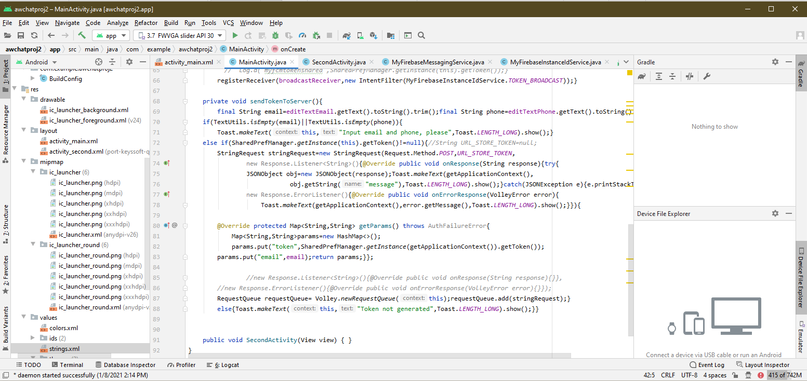
References
https://www.theladders.com/career-advice/5-positive-habits-for-rapid-personal-growth
https://managementisajourney.com/fascinating-numbers-top-5-employee-motivators/
https://brandongaille.com/17-employee-motivation-statistics-and-trends/
https://www.aptsg.com/index.php/articles-2/15-for-employers-hr-training-dept/36-top-10-factors-that-motivate-employees
https://corporatecoachgroup.com/blog/six-positive-motivators
www.handresearch.com/diagnostics/extraversion-hand-chart-extraverts-ambiverts-introverts.htm
https://blog.longfield-gardens.com/best-practices-for-watering-plants/
https://www.smartsheet.com/content/people-process-technology

