Slide 1

Chapter 2
Data Representation in Computer Systems
Linda Null,
Julia Lobur

Slide 2

Figure 02.UN01: Opening Quote: "There are 10 kinds of people in the world…"
Anonymous

Slide 3
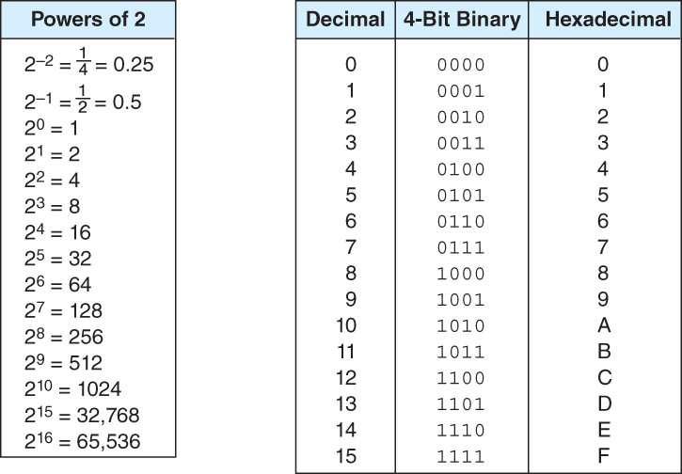
Table 02.T01: Some Numbers to Remember
-

Slide 4
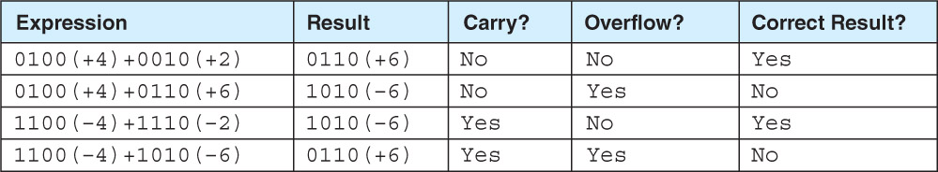
Table 02.T02: Examples of Carry and Overflow in Signed Numbers
-

Slide 5

Figure 02.F01: Simple Model Floating-Point Representation
-

Slide 6
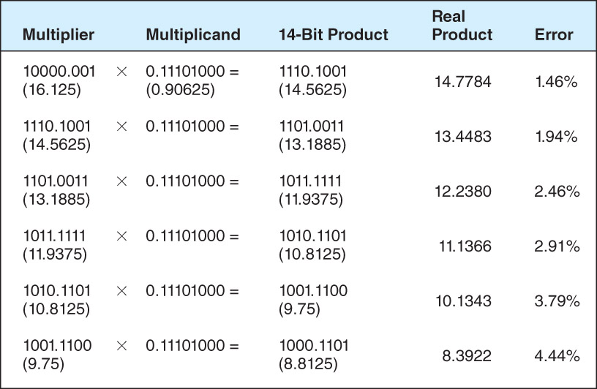
Table 02.T03: Error Propagation in a 14-Bit Floating-Point Number
-

Slide 7
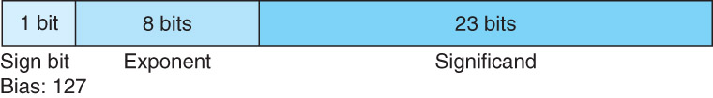
Figure 02.F02: IEEE-754 Single Precision Floating-Point Representation
-

Slide 8
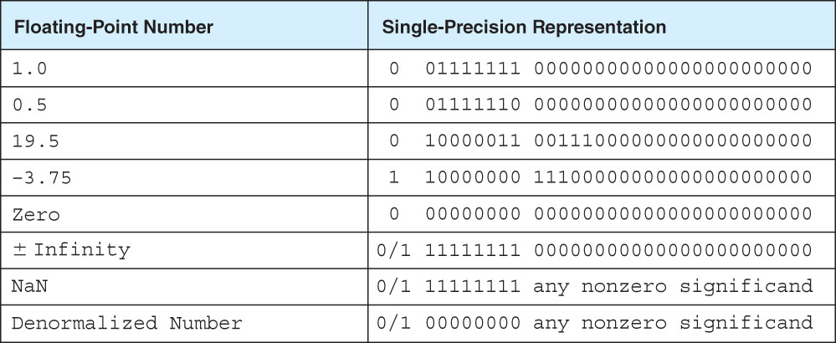
Table 02.T04: Some Example IEEE-754 Single-Precision Floating-Point Numbers
-

Slide 9
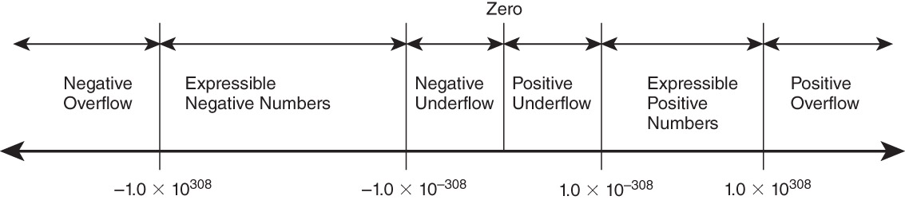
Figure 02.F03: Range of IEEE-754 Double-Precision Numbers
-

Slide 10
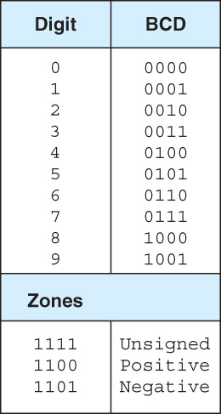
Table 02.T05: Binary-Coded Decimal
-

Slide 11
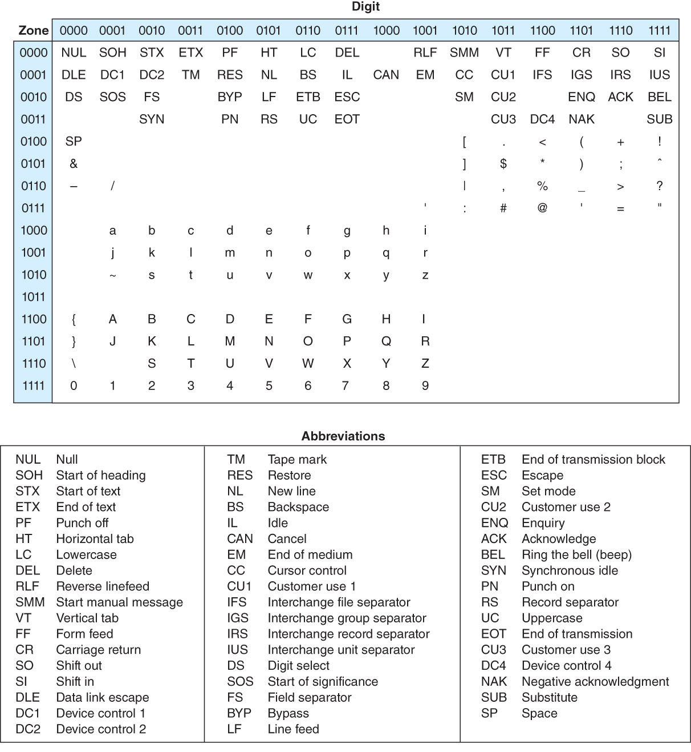
Table 02.T06: The EBCDIC Code (Values Given in Binary Zone-Digit Format)
-

Slide 12
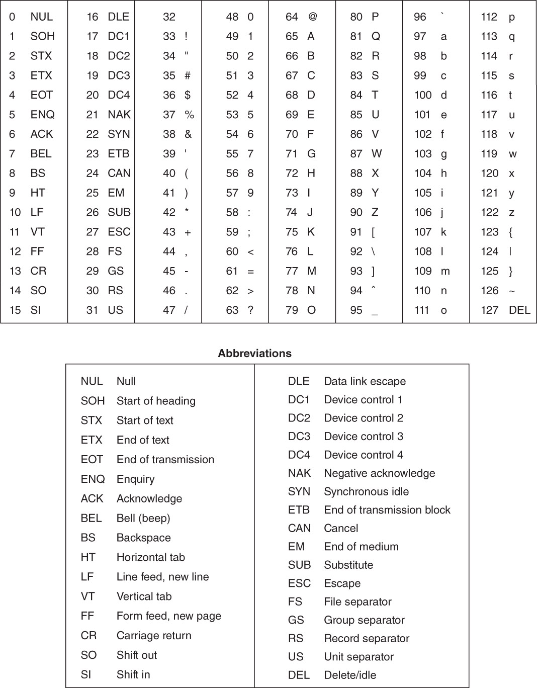
Table 02.T07: The ASCII Code (Values Given in Decimal)
-

Slide 13
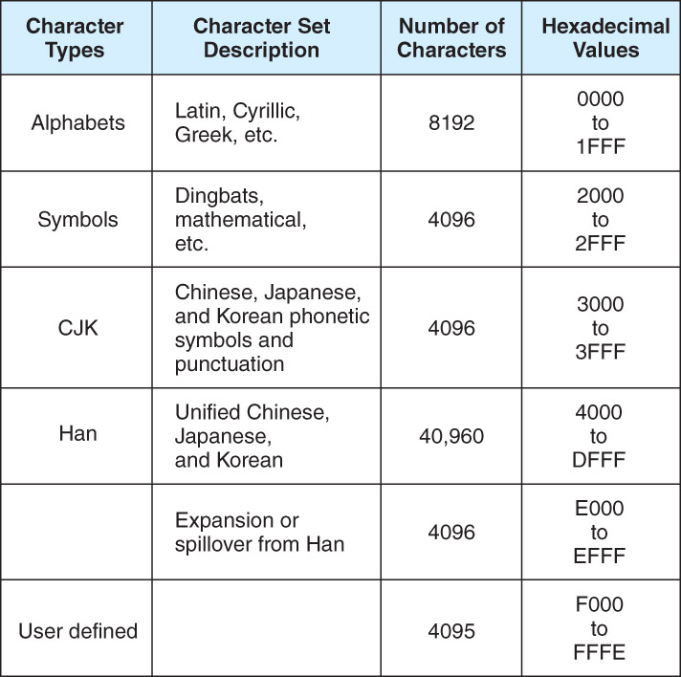
Table 02.T08: Unicode Codespace
-

Slide 14
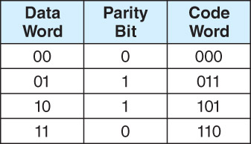
Table 02.UN02: Table listing code words for four possible words.
-

Slide 15
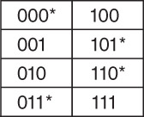
Table 02.UN03: Table listing 3 bit versions for 8 different bit patterns.
-

Slide 16
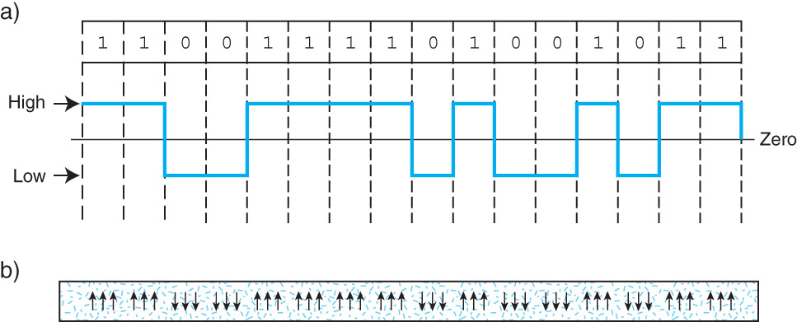
Figure 02.AP01: NRZ Encoding of OK as a) Transmission Waveform b) Magnetic Flux Pattern (The direction of the arrows indicates the magnetic polarity)
-

Slide 17
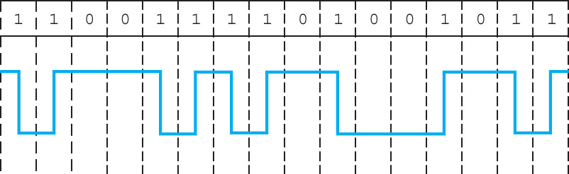
Figure 02.AP02: NRZI Encoding of OK
-

Slide 18
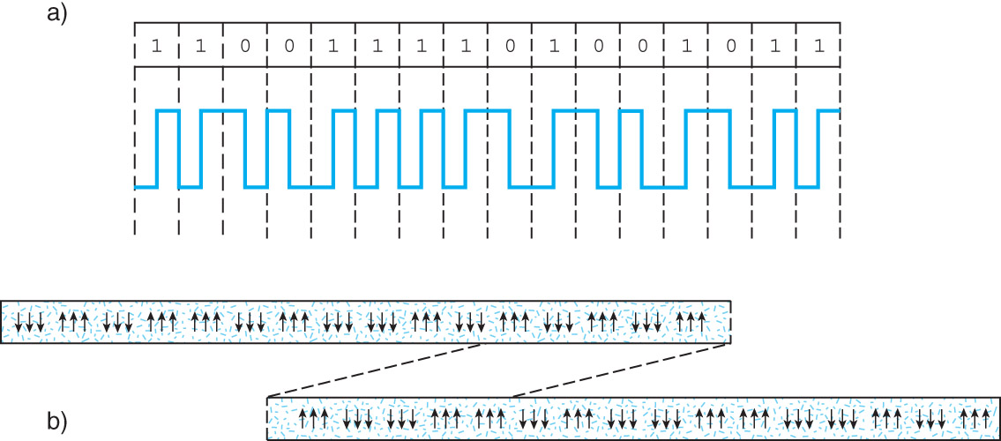
Figure 02.AP03: Phase Modulation (Manchester Coding) of the Word OK as: a) Transmission Waveform b) Magnetic Flux Pattern
-

Slide 19
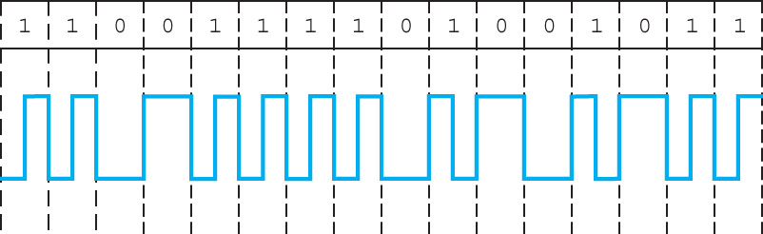
Figure 02.AP04: Frequency Modulation Coding of OK
-

Slide 20
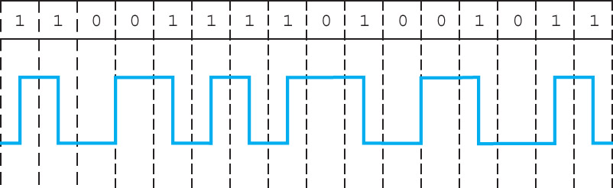
Figure 02.AP05: Modified Frequency Modulation Coding of OK
-

Slide 21
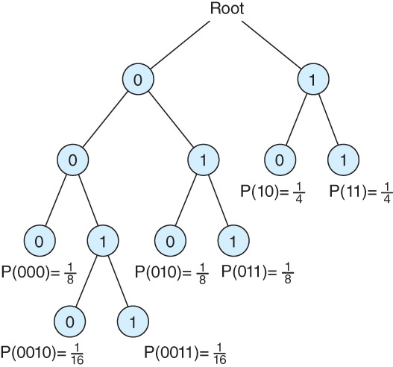
Figure 02.AP06: The Probability Tree for RLL (2, 7) Coding
-

Slide 22
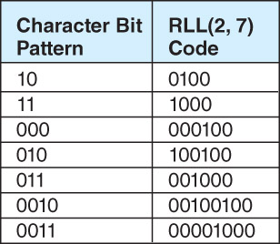
Table 02.T2A_01: RLL (2,7) Coding
-

Slide 23
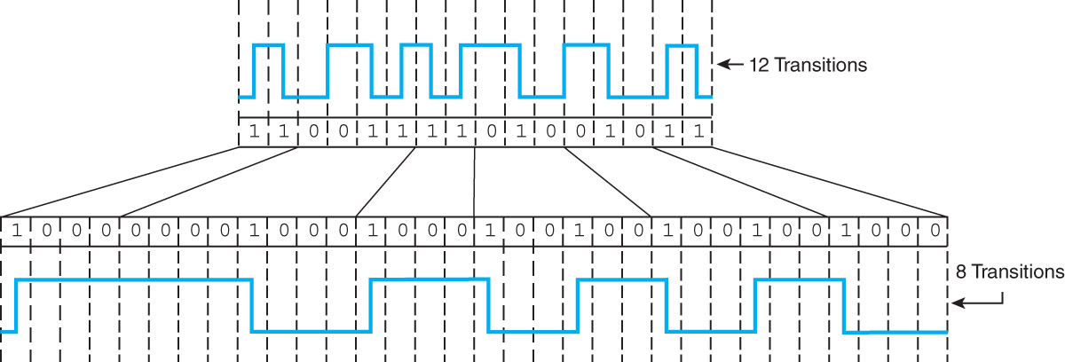
Figure 02.AP07: MFM (top) and RLL (2,7) Coding (bottom) for OK
-

Slide 24
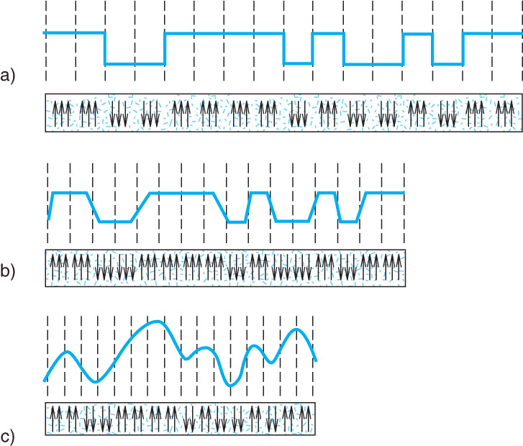
Figure 02.AP08: Magnetic Behaviors as Bit Density Increases. In a), b), and c) magnetic flux changes are pushed increasingly closer together.
-

