Slide 1
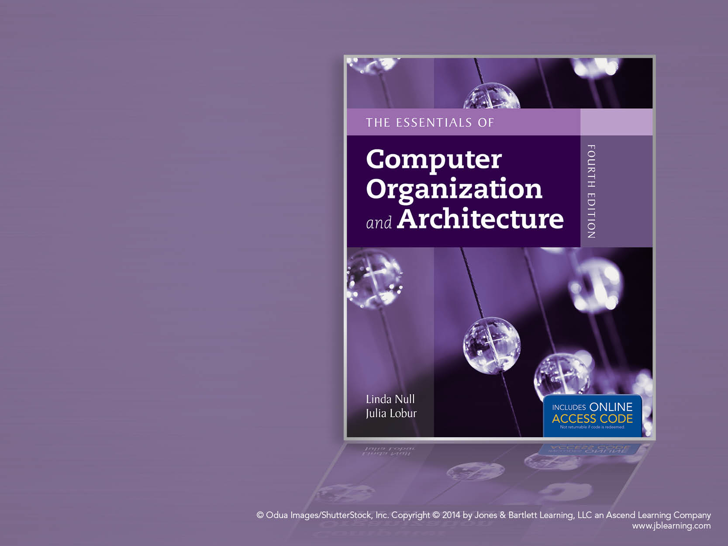
Chapter 8
System Software

Slide 2
Chapter 8 Objectives
Become familiar with the functions provided by operating systems, programming tools, database software, and transaction managers.
Understand the role played by each software component in maintaining the integrity of a computer system and its data.

Slide 3
8.1 Introduction
The biggest and fastest computer in the world is of no use if it cannot efficiently provide beneficial services to its users.
Users see the computer through their application programs. These programs are ultimately executed by computer hardware.
System software-- in the form of operating systems and middleware-- is the glue that holds everything together.

Slide 4
8.2 Operating Systems
The evolution of operating systems has paralleled the evolution of computer hardware.
As hardware became more powerful, operating systems allowed people to more easily manage the power of the machine.
In the days when main memory was measured in kilobytes, and tape drives were the only form of magnetic storage, operating systems were simple resident monitor programs.
The resident monitor could only load, execute, and terminate programs.

Slide 5
8.2 Operating Systems
In the 1960s, hardware has become powerful enough to accommodate multiprogramming, the concurrent execution of more than one task.
Multiprogramming is achieved by allocating each process a given portion of CPU time (a timeslice).
Interactive multiprogramming systems were called timesharing systems.
When a process is taken from the CPU and replaced by another, we say that a context switch has occurred.

Slide 6
8.2 Operating Systems
Today, multiprocessor systems have become commonplace.
They present an array of challenges to the operating system designer, including the manner in which the processors will be synchronized, and how to keep their activities from interfering with each other.
Tightly coupled multiprocessor systems share a common memory and the same set of I/O devices.
Symmetric multiprocessor systems are tightly coupled and load balanced.

Slide 7
8.2 Operating Systems
Loosely coupled multiprocessor systems have physically separate memory.
These are often called distributed systems.
Another type of distributed system is a networked system, which consists of a collection of interconnected, collaborating workstations.
Real time operating systems control computers that respond to their environment.
Hard real time systems have tight timing constraints, soft real time systems do not.

Slide 8
8.2 Operating Systems
Personal computer operating systems are designed for ease of use rather than high performance.
The idea that revolutionized small computer operating systems was the BIOS (basic input-output operating system) chip that permitted a single operating system to function on different types of small systems.
The BIOS takes care of the details involved in addressing divergent peripheral device designs and protocols.

Slide 9
8.2 Operating Systems
Operating systems having graphical user interfaces were first brought to market in the 1980s.
At one time, these systems were considered appropriate only for desktop publishing and games. Today they are seen as technology enablers for users with little formal computer education.
Once solely a server operating system, Linux holds the promise of bringing Unix to ordinary desktop systems.

Slide 10
8.2 Operating Systems
Two operating system components are crucial: The kernel and the system programs.
As the core of the operating system, the kernel performs scheduling, synchronization, memory management, interrupt handling and it provides security and protection.
Microkernel systems provide minimal functionality, with most services carried out by external programs.
Monolithic systems provide most of their services within a single operating system program.

Slide 11
8.2 Operating Systems
Microkernel systems provide better security, easier maintenance, and portability at the expense of execution speed.
Examples are Windows 2000, Mach, and QNX.
Symmetric multiprocessor computers are ideal platforms for microkernel operating systems.
Monolithic systems give faster execution speed, but are difficult to port from one architecture to another.
Examples are Linux, MacOS, and DOS.

Slide 12
8.2 Operating Systems
Process management lies at the heart of operating system services.
The operating system creates processes, schedules their access to resources, deletes processes, and deallocates resources that were allocated during process execution.
The operating system monitors the activities of each process to avoid synchronization problems that can occur when processes use shared resources.
If processes need to communicate with one another, the operating system provides the services.

Slide 13
8.2 Operating Systems
The operating system schedules process execution.
First, the operating system determines which process shall be granted access to the CPU.
This is long-term scheduling.
After a number of processes have been admitted, the operating system determines which one will have access to the CPU at any particular moment.
This is short-term scheduling.
Context switches occur when a process is taken from the CPU and replaced by another process.
Information relating to the state of the process is preserved during a context switch.

Slide 14
8.2 Operating Systems
Short-term scheduling can be nonpreemtive or premptive.
In nonpreemptive scheduling, a process has use of the CPU until either it terminates, or must wait for resources that are temporarily unavailable.
In preemptive scheduling, each process is allocated a timeslice. When the timeslice expires, a context switch occurs.
A context switch can also occur when a higher-priority process needs the CPU.

Slide 15
8.2 Operating Systems
Four approaches to CPU scheduling are:
First-come, first-served where jobs are serviced in arrival sequence and run to completion if they have all of the resources they need.
Shortest job first where the smallest jobs get scheduled first. (The trouble is in knowing which jobs are shortest!)
Round robin scheduling where each job is allotted a certain amount of CPU time. A context switch occurs when the time expires.
Priority scheduling preempts a job with a lower priority when a higher-priority job needs the CPU.

Slide 16
8.3 Protected Environments
In their role as resource managers and protectors, many operating systems provide protected environments that isolate processes, or groups of processes from each other.
Three common approaches to establishing protected environments are virtual machines, subsystems, and partitions.
These environments simplify system management and control, and can provide emulated machines to enable execution of programs that the system would otherwise be unable to run.

Slide 17
8.3 Protected Environments
Virtual machines are a protected environment that presents an image of itself -- or the image of a totally different architecture -- to the processes that run within the environment.
A virtual machine is exactly that: an imaginary computer.
The underlying real machine is under the control of the kernel. The kernel receives and manages all resource requests that emit from processes running in the virtual environment.
The next slide provides an illustration.

Slide 18
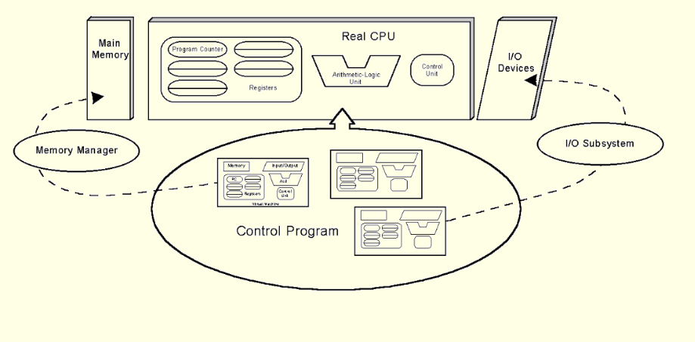
8.3 Protected Environments

Slide 19
8.3 Protected Environments
Subsystems are another type of protected environment.
They provide logically distinct environments that can be individually controlled and managed. They can be stopped and started independent of each other.
Subsystems can have special purposes, such as controlling I/O or virtual machines. Others partition large application systems to make them more manageable.
In many cases, resources must be made visible to the subsystem before they can be accessed by the processes running within it.
The next slide provides an illustration.

Slide 20
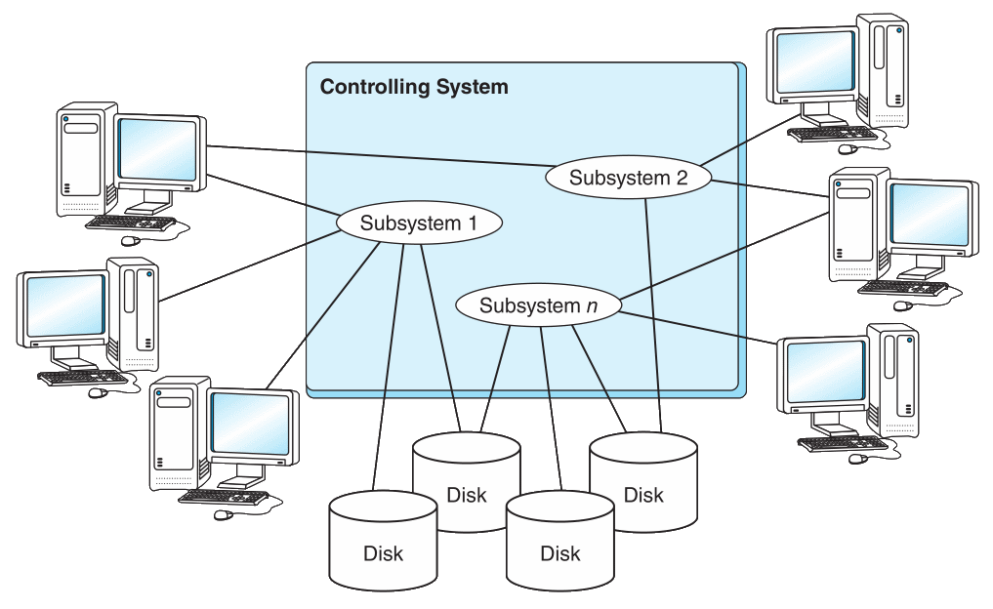
8.3 Protected Environments

Slide 21
8.3 Protected Environments
In very large computers, subsystems do not go far enough to establish a protected environment.
Logical partitions (LPARs) provide much higher barriers: Processes running within a logical partition have no access to processes running in another partition unless a connection between them (e.g., FTP) is explicitly established.
LPARs are an enabling technology for the recent trend of consolidating hundreds of small servers within the confines of a single large system.
The next slide provides an illustration.

Slide 22
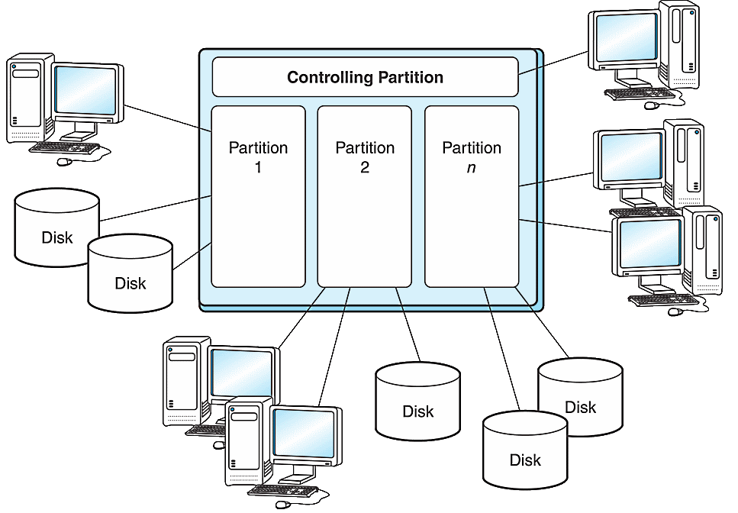
8.3 Protected Environments

Slide 23
8.4 Programming Tools
Programming tools carry out the mechanics of software creation within the confines of the operating system and hardware environment.
Assemblers are the simplest of all programming tools. They translate mnemonic instructions to machine code.
Most assemblers carry out this translation in two passes over the source code.
The first pass partially assembles the code and builds the symbol table
The second pass completes the instructions by supplying values stored in the symbol table.

Slide 24
8.4 Programming Tools
The output of most assemblers is a stream of relocatable binary code.
In relocatable code, operand addresses are relative to where the operating system chooses to load the program.
Absolute (nonrelocatable) code is most suitable for device and operating system control programming.
When relocatable code is loaded for execution, special registers provide the base addressing.
Addresses specified within the program are interpreted as offsets from the base address.
The next slide illustrates this idea.

Slide 25
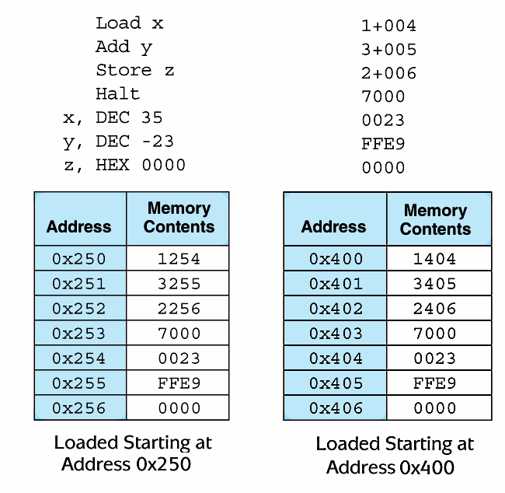
8.4 Programming Tools
Example MARIE Code
Assembled version is on top right. The “+” indicates relative offset.

Slide 26
8.4 Programming Tools
The process of assigning physical addresses to program variables is called binding.
Binding can occur at compile time, load time, or run time.
Compile time binding gives us absolute code.
Load time binding assigns physical addresses as the program is loaded into memory.
With load time, binding the program cannot be moved!
Run time binding requires a base register to carry out the address mapping.

Slide 27
8.4 Programming Tools
On most systems, binary instructions must pass through a link editor (or linker) to create an executable module.
Link editors incorporate various binary routines into a single executable file as called for by a program’s external symbols.
Like assemblers, link editors perform two passes: The first pass creates a symbol table and the second resolves references to the values in the symbol table.
The next slide shows this process schematically.

Slide 28
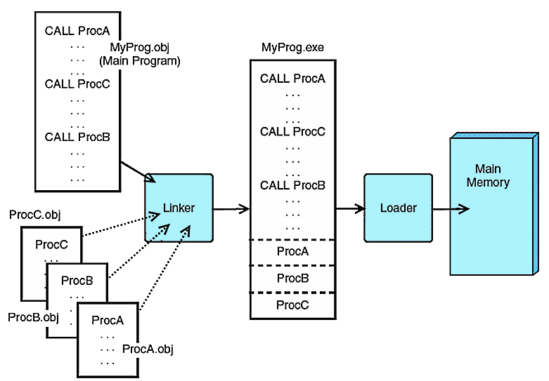
8.4 Programming Tools

Slide 29
8.4 Programming Tools
Dynamic linking is when the link editing is delayed until load time or at run time.
External modules are loaded from from dynamic link libraries (DLLs).
Load time dynamic linking slows down program loading, but calls to the DLLs are faster.
Run time dynamic linking occurs when an external module is first called, causing slower execution time.
Dynamic linking makes program modules smaller, but carries the risk that the programmer may not have control over the DLL.

Slide 30
8.4 Programming Tools
Assembly language is considered a “second generation” programming language (2GL).
Compiled programming languages, such as C, C++, Pascal, and COBOL, are “third generation” languages (3GLs).
Each language generation presents problem solving tools that are closer to how people think and farther away from how the machine implements the solution.

Slide 31
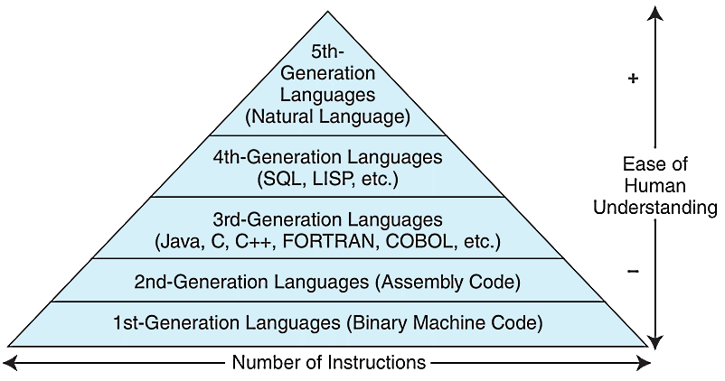
8.4 Programming Tools
Keep in mind that the computer can understand only the 1GL!

Slide 32
8.4 Programming Tools
Compilers bridge the semantic gap between the higher level language and the machine’s binary instructions.
Most compilers effect this translation in a six-phase process. The first three are analysis phases:
1. Lexical analysis extracts tokens, e.g., reserved words and variables.
2. Syntax analysis (parsing) checks statement construction.
3. Semantic analysis checks data types and the validity of operators.

Slide 33
8.4 Programming Tools
The last three compiler phases are synthesis phases:
4. Intermediate code generation creates three address code to facilitate optimization and translation.
5. Optimization creates assembly code while taking into account architectural features that can make the code efficient.
6. Code generation creates binary code from the optimized assembly code.
Through this modularity, compilers can be written for various platforms by rewriting only the last two phases.
The next slide shows this process graphically.

Slide 34
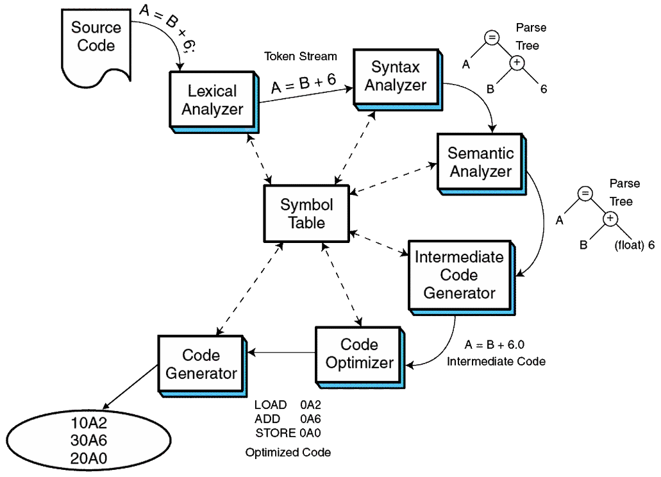
8.4 Programming Tools

Slide 35
8.4 Programming Tools
Interpreters produce executable code from source code in real time, one line at a time.
Consequently, this not only makes interpreted languages slower than compiled languages but it also affords less opportunity for error checking.
Interpreted languages are, however, very useful for teaching programming concepts, because feedback is nearly instantaneous, and performance is rarely a concern.

Slide 36
8.5 Java: All of the Above
The Java programming language exemplifies many of the concepts that we have discussed in this chapter.
Java programs (classes) execute within a virtual machine, the Java Virtual Machine (JVM).
This allows the language to run on any platform for which a virtual machine environment has been written.
Java is both a compiled and an interpreted language. The output of the compilation process is an assembly-like intermediate code (bytecode) that is interpreted by the JVM.

Slide 37
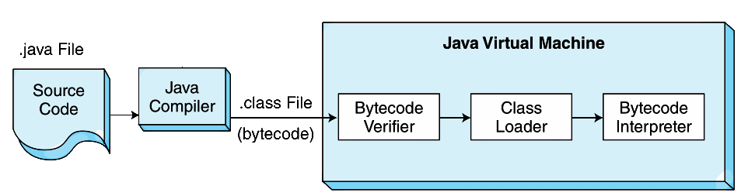
8.5 Java: All of the Above
The JVM is an operating system in miniature.
It loads programs, links them, starts execution threads, manages program resources, and deallocates resources when the programs terminate.
Because the JVM performs so many tasks at run time, its performance cannot match the performance of a traditional compiled language.

Slide 38
8.5 Java: All of the Above
At execution time, a Java Virtual Machine must be running on the host system.
It loads end executes the bytecode class file.
While loading the class file, the JVM verifies the integrity of the bytecode.
The loader then performs a number of run-time checks as it places the bytecode in memory.
The loader invokes the bytecode interpreter.
38
Notes:
38

Slide 39
8.5 Java: All of the Above
The bytecode interpreter:
Performs a link edit of the bytecode instructions by asking the loader to supply all referenced classes and system binaries, if they are not already loaded.
Creates and initializes the main stack frame and local variables.
Creates and starts execution thread(s).
Manages heap storage by deallocating unused storage while the threads are executing.
Deallocates resources of terminated threads.
Upon program termination, kills any remaining threads and terminates the JVM.
39
Notes:
39

Slide 40
8.5 Java: All of the Above
Because the JVM does so much as it loads and executes its bytecode, its can't match the performance of a compiled language.
This is true even when speedup software like Java’s Just-In-Time (JIT) compiler is used.
However class files can be created and stored on one platform and executed on a completely different platform.
This “write once, run-anywhere” paradigm is of enormous benefit for enterprises with disparate and geographically separate systems.
Given its portability and relative ease of use, the Java language and its virtual machine environment are the ideal middleware platform.

Slide 41
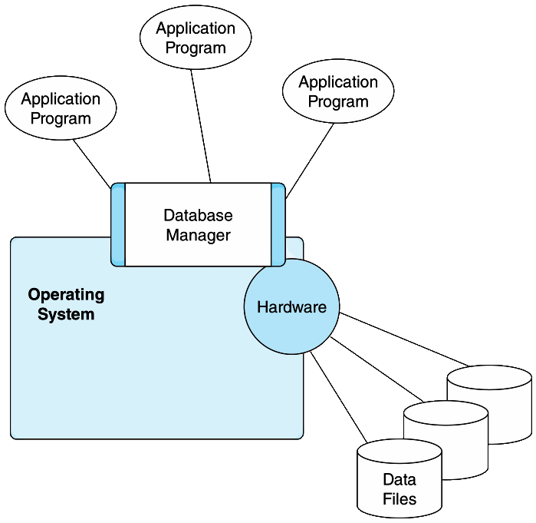
8.6 Database Software
Database systems contain the most valuable assets of an enterprise. They are the foundation upon which application systems are built.
41
Notes:
41

Slide 42
8.6 Database Software
Database systems provide a single definition, the database schema, for the data elements that are accessed by application programs.
A physical schema is the computer’s view of the database that includes locations of physical files and indexes.
A logical schema is the application program’s view of the database that defines field sizes and data types.
Within the logical schema, certain data fields are designated as record keys that provide efficient access to records in the database.

Slide 43
8.6 Database Software
Keys are stored in physical index file structures containing pointers to the location of the physical records.
Many implementations use a variant of a B+ tree for index management because B+ trees can be optimized with consideration to the I/O system and the applications.
In many cases, the “higher” nodes of the tree will persist in cache memory, requiring physical disk accesses only when traversing the lower levels of the index.

Slide 44
8.6 Database Software
Most database systems also include transaction management components to assure that the database is always in a consistent state.
Transaction management provides the following properties:
Atomicity - All related updates occur or no updates occur.
Consistency - All updates conform to defined data constraints.
Isolation - No transaction can interfere with another transaction.
Durability - Successful updates are written to durable media as soon as possible.
These are the ACID properties of transaction management.

Slide 45
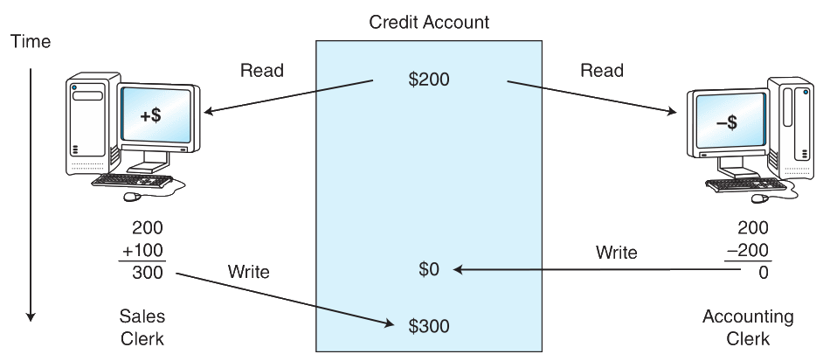
8.6 Database Software
Without the ACID properties, race conditions can occur:

Slide 46
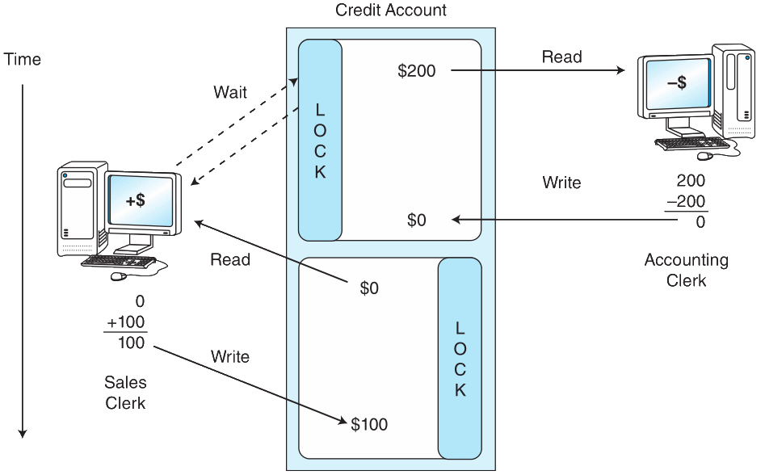
8.6 Database Software
Record locking mechanisms assure isolated, atomic database updates:

Slide 47
8.7 Transaction Managers
One way to improve database performance is to ask it to do less work by moving some of its functions to specialized software.
Transaction management is one component that is often partitioned from the core database system.
Transaction managers are especially important when the transactions involve more than one physical database, or the application system spans more than one class of computer, as in a multitiered architecture.
One of the most widely-used transaction management systems is CICS shown on the next slide.

Slide 48
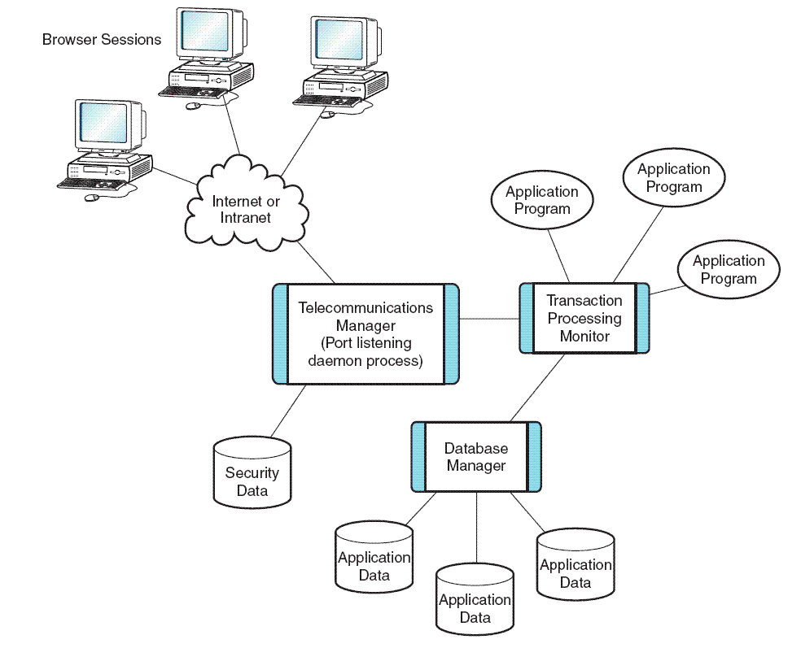
8.7 Transaction Managers

Slide 49
Chapter 8 Conclusion
The proper functioning and performance of a computer system depends as much on its software as its hardware.
The operating system is the system software component upon which all other software rests.
Operating systems control process execution, resource management, protection, and security.
Subsystems and partitions provide compatibility and ease of management.

Slide 50
Chapter 8 Conclusion
Programming languages are often classed into generations, with assembly language being the first generation.
All languages above the machine level must be translated into machine code.
Compilers bridge this semantic gap through a series of six steps.
Link editors resolve system calls and external routines, creating a unified executable module.

Slide 51
Chapter 8 Conclusion
The Java programming language incorporates the idea of a virtual machine, a compiler and an interpreter.
Database software provides controlled access to data files through enforcement of ACID properties.
Transaction managers provide high performance and cross-platform access to data.

