Slide 1
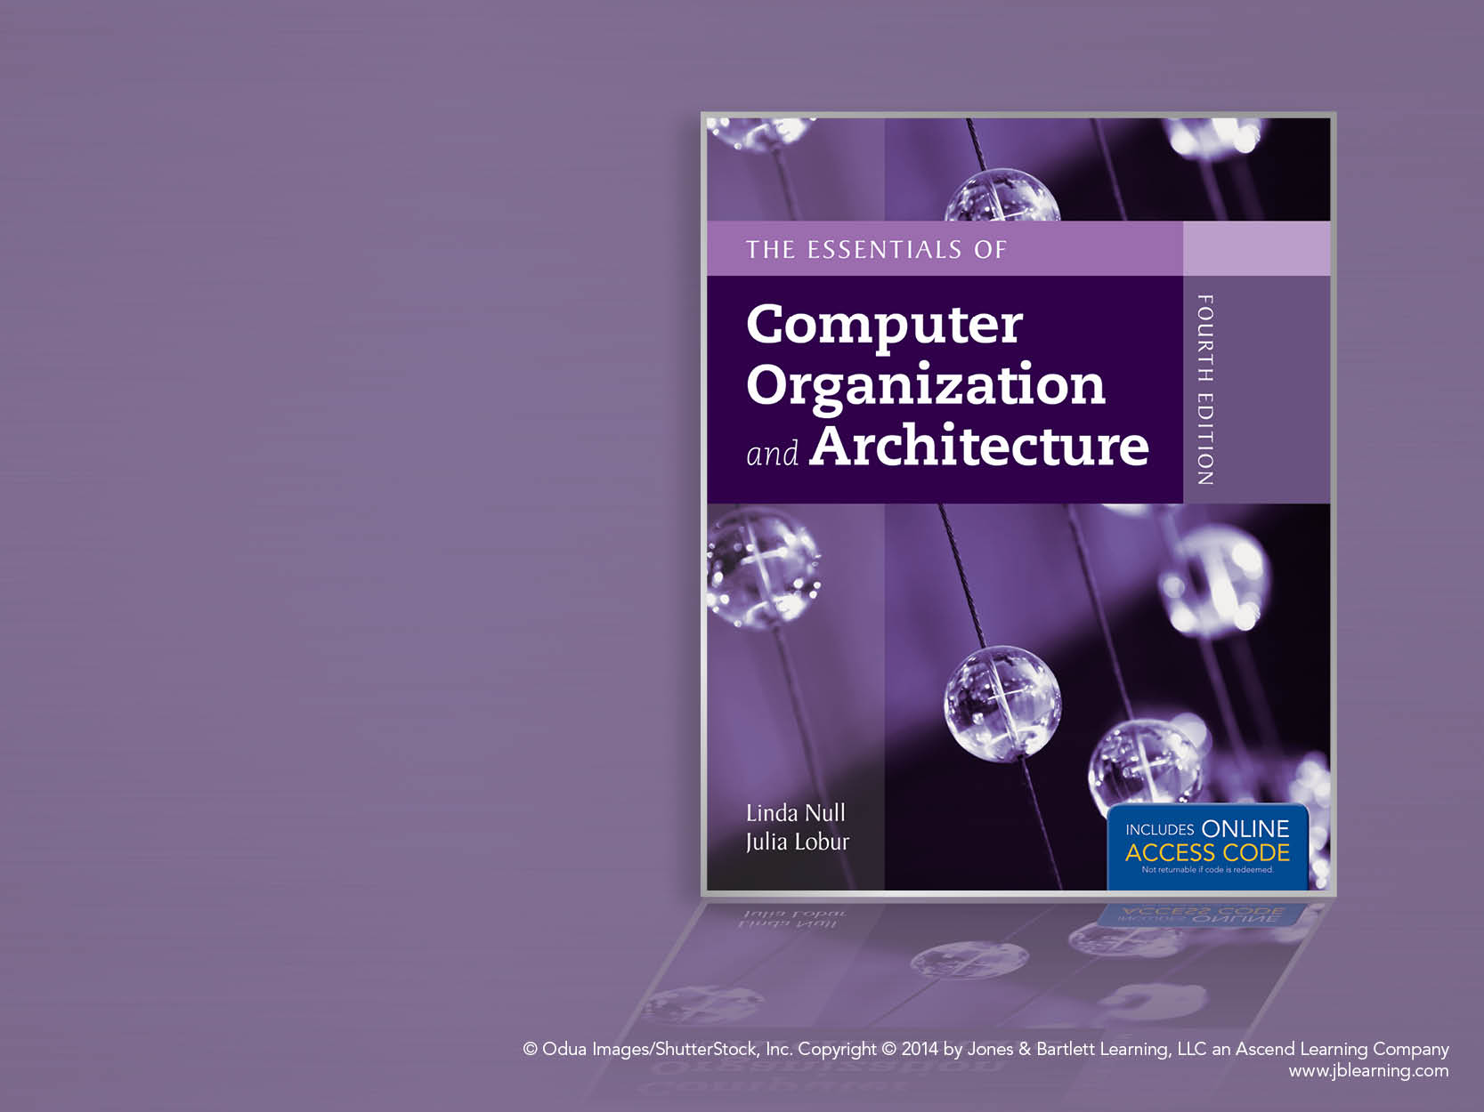
Chapter 10
Topics in Embedded
Systems

Slide 2
Chapter 10 Objectives
Understand the ways in which embedded systems differ from general purpose systems.
Be able to describe the processes and practices of embedded hardware design.
Understand key concepts and tools for embedded software development.

Slide 3
10.1 Introduction
Embedded systems are real computer systems that support the operation of a device (or machine) that usually is not a computer.
The user of the embedded system is rarely aware of its existence within the device.
These systems are all around us. They are in watches, automobiles, coffeepots, TVs, telephones, aircraft, and just about any “intelligent” device that reacts to people or its environment.

Slide 4
10.1 Introduction
Embedded systems are different from general-purpose systems in several important ways. Some key differences are:
Embedded systems are resource constrained. Utilization of memory and power are critical. The economy of hardware and software is often paramount, and can affect design decisions.
Partitioning of hardware and software is fluid.
Embedded systems programmers must understand every detail about the hardware.
Signal timing and event handling are crucial.

Slide 5
10.2 Embedded Hardware Overview
We will classify embedded hardware according to the extent to which it is adapted or adaptable by the people who program and install the system into the device that it supports.
Accordingly, we say that embedded hardware falls into categories of:
Off-the-shelf
Configurable
Fully-Customized
Note: There are many other taxonomies. This one is convenient for our purposes.

Slide 6
10.2 Embedded Hardware Overview
Using off-the-shelf hardware, minimal hardware customization possible.
Perhaps add memory or peripherals. The internal wiring stays the same.
The most common off-the-shelf hardware is the microcontroller.
Microcontrollers are often derivatives of “old” PC technology. They are inexpensive because development costs were recouped long ago.
There are thousands of different microcontrollers.

Slide 7
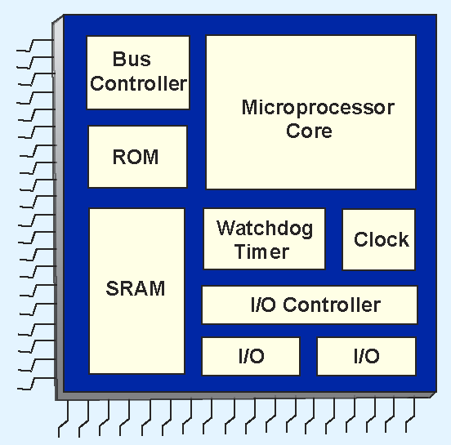
10.2 Embedded Hardware Overview
Example microcontrollers are Motorola's 68HC12, Intel’s 8051, Microchip's 16F84A, and the PIC family.
A simplified block diagram of a microcontroller is shown at the right.

Slide 8
10.2 Embedded Hardware Overview
We have seen all of these components before except for the watchdog timer.
A watchdog timer helps guard against system hangs by continually checking for liveness.
Watchdog timers are not used in all microcontrollers.

Slide 9
10.2 Embedded Hardware Overview
For some applications, microcontrollers are too limited in their functionality.
Systems-on-a-chip (SOCs) are full blown computer systems-- including all supporting circuits-- that are etched on a single die.
Alternatively, separate chips are needed to provide the same services.
The additional chips are costly and consume power and space.

Slide 10
10.2 Embedded Hardware Overview
Semi-custom systems-on-a-chip can be fabricated whenever a suitable off-the-shelf SOC is unavailable.
The chip mask is created using blocks of pre-designed, pre-tested intellectual property (IP) circuits.
The semi-custom approach is costly. To save money, off-the-shelf SOCs are preferred, even when their functionality is not an exact fit for the application.

Slide 11
10.2 Embedded Hardware Overview
Programmable logic devices (PLDs) are configurable devices in which the behavior of the circuits can be changed to suit the needs of an application.
Programmable array logic (PAL) chips consist of programmable AND gates connected to a set of fixed OR gates.
Programmable logic array (PLA) chips consist of programmable AND gates connected through programmable OR gates.

Slide 12
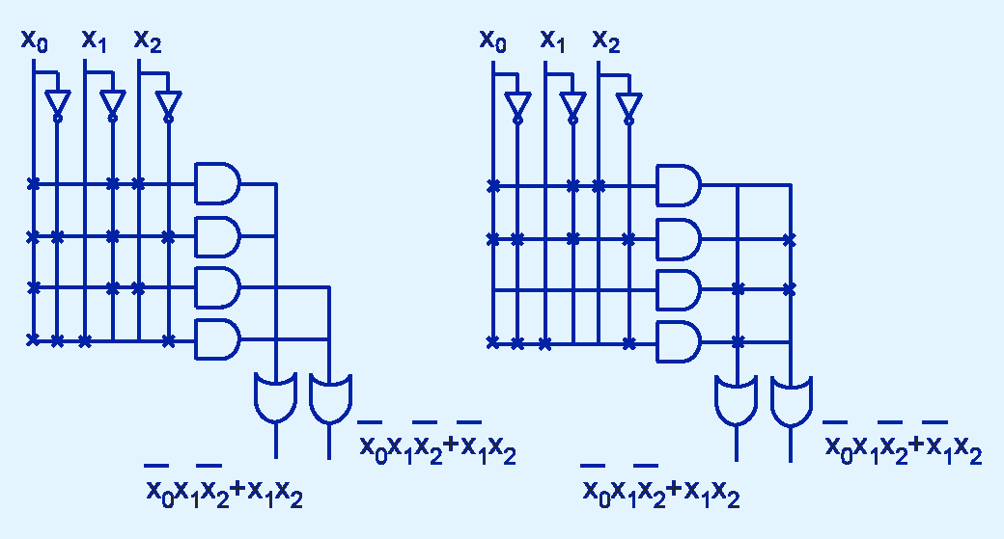
10.2 Embedded Hardware Overview
A programmed PAL and a programmed PLA:

Slide 13
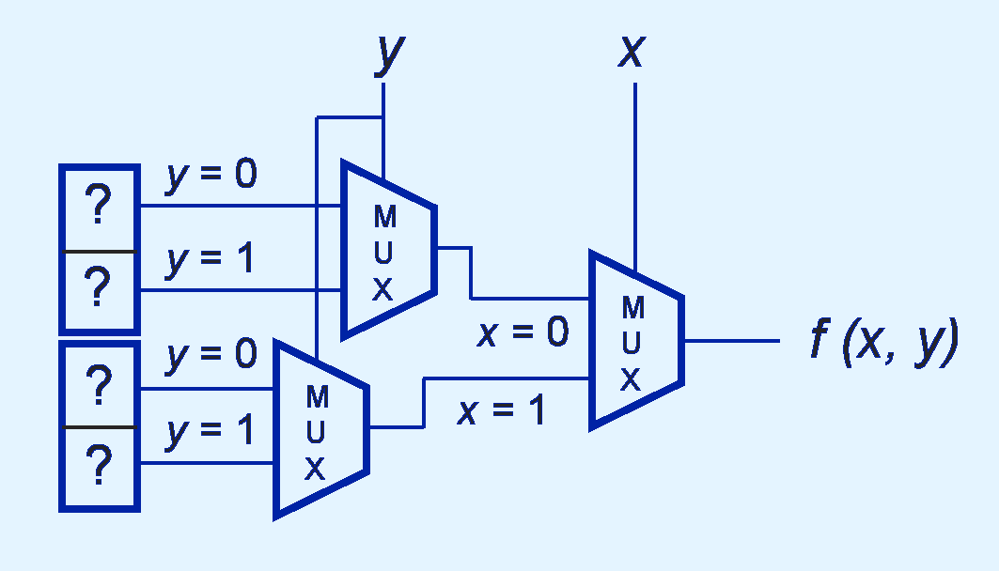
10.2 Embedded Hardware Overview
The behavior of field programmable gate arrays (FPGAs) is controlled through values stored in memory lookup tables rather than by changing connections between logic elements.

Slide 14
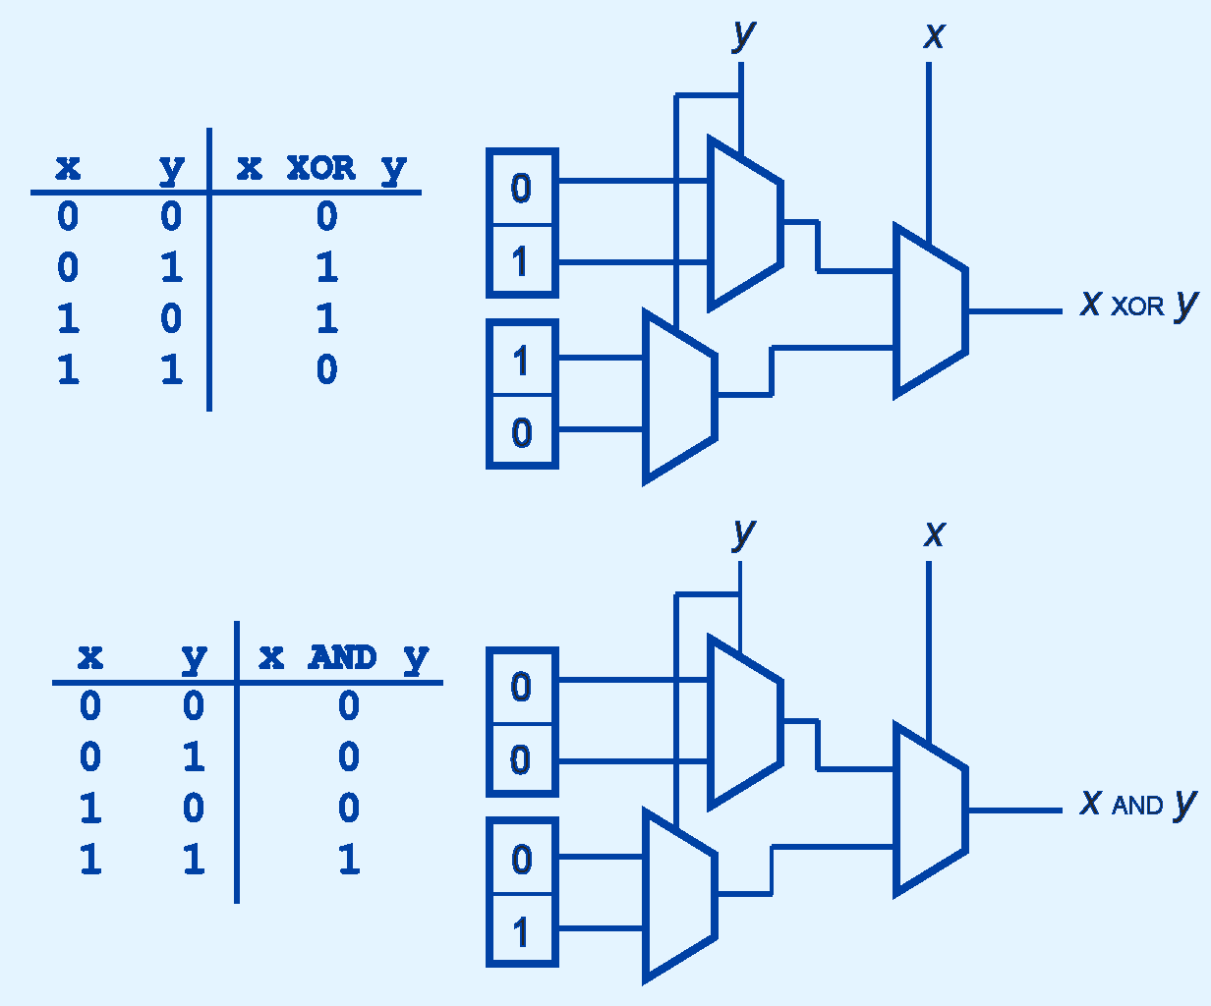
10.2 Embedded Hardware Overview
Truth tables are entered directly into FPGA memory.

Slide 15
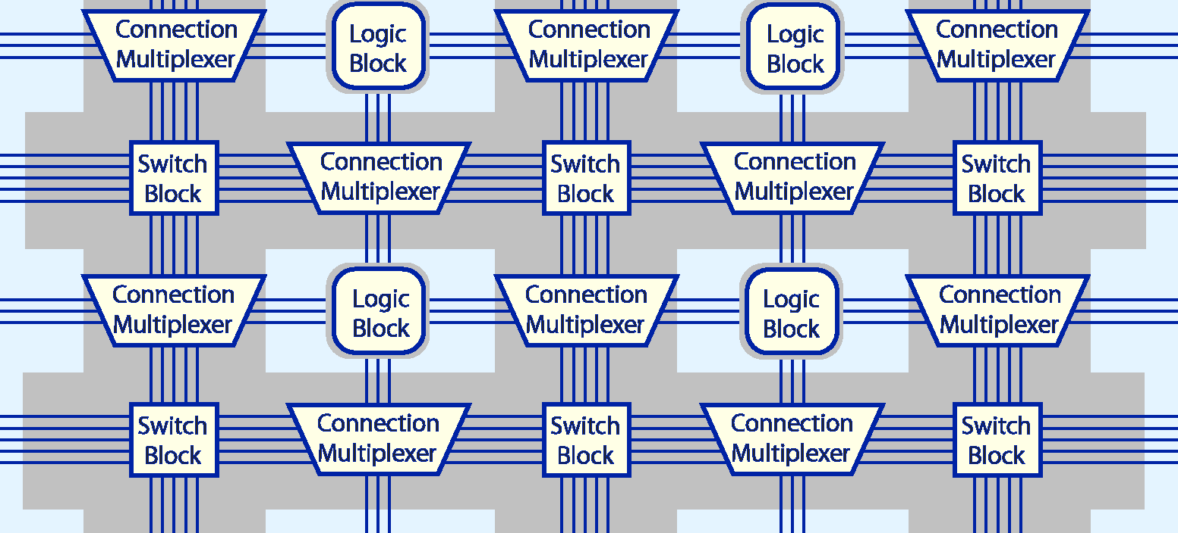
10.2 Embedded Hardware Overview
FPGAs typically consist of blocks of logic elements interconnected by switches and multiplexers in an “island” configuration.

Slide 16
10.2 Embedded Hardware Overview
When:
Off-the-shelf microcontrollers and SOCs do not have sufficient functionality for the task at hand...
Or off-the-shelf microcontrollers and SOCs have too much functionality, with the excess consuming resources needlessly…
And a semi-custom chip cannot be economically fabricated from commercially available IP designs...
And PLDs are too expensive or too slow…
The only option left is to design an application-specific integrated circuit (ASIC) from scratch.

Slide 17
10.2 Embedded Hardware Overview
To design a chip from scratch we need to think about it from three points of view:
What do we need the chip to do?
Which logic components can provide the behavior we need?
What is the best way to position the components on the silicon die in order to reduce cost and provide the best performance?

Slide 18
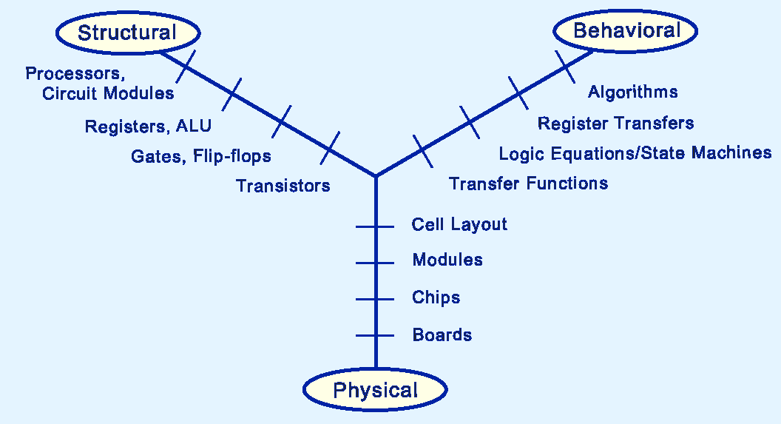
10.2 Embedded Hardware Overview
Gajski’s Logic Synthesis Y-Chart depicts the relationship of these three dimensions of circuit design.

Slide 19
10.2 Embedded Hardware Overview
Creating circuit designs along all three dimensions is an enormously complex task that is nearly impossible to do--with any amount of accuracy or effectiveness-- without a good toolset.
Hardware definition languages (HDLs) were invented in the latter part of the twentieth century. HDLs help designers manage circuit complexity by expressing circuit logic in algorithmic terms.

Slide 20
10.2 Embedded Hardware Overview
Two of the most popular HDLs are Verilog and VHDL.
Verilog is a C-like language invented in 1983. It is now IEEE 1364-2001.
VHDL is an ADA-like HDL released in 1985. It is now IEEE 1097-2002.
The output from the compilation of both of these languages is a netlist, which is suitable for use as input to electronic design automation machines that produce integrated circuit masks.

Slide 21
10.2 Embedded Hardware Overview
Traditional HDLs manipulate circuit definitions in terms of RTL and discrete signal patterns.
Using these languages, engineers are strained to keep up with the complexity of today’s SOCs.
To make design activities more accurate and cost efficient, the level of abstraction must be raised above the RTL level.
SystemC and SpecC are two recent HDLs that were invented to help solve this problem.

Slide 22
10.2 Embedded Hardware Overview
SystemC is an extension of C++ that includes classes and libraries specifically created for embedded systems design, to include modeling events, timing specifications, and concurrency.
SpecC is a C-like language, created from the outset as a system design language.
A SpecC development package includes a methodology that guides engineers through four phases of system development:
Specification, architecture, communication channels, and implementation.

Slide 23
10.2 Embedded Hardware Overview
Embedded systems have been traditionally developed by specialized teams that collaboratively:
Produce a detailed specification derived from a functional description.
Select a suitable processor or decide to build one.
Determine the hardware-software partition.
Design the circuit and write the program(s) that will run on the system.
Prototype and test the system.
This system design cycle is shown on the next slide.

Slide 24
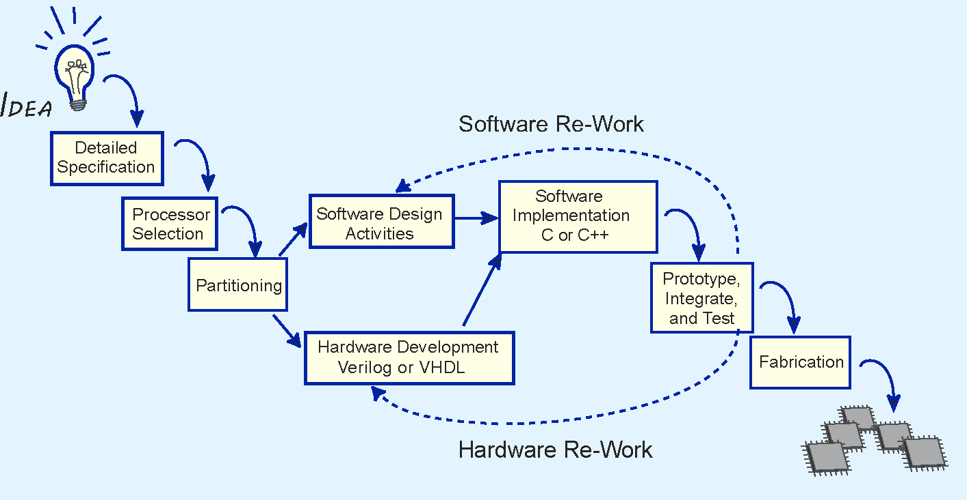
10.2 Embedded Hardware Overview
Notice the back arrows. These steps are costly.

Slide 25
10.2 Embedded Hardware Overview
SystemC and SpecC facilitate changes to the traditional design lifecycle.
Hardware developers and software developers can speak the same language.
Codevelopment teams work side-by-side simultaneously creating hardware designs and writing programs.
Codevelopment shortens the development lifecycle and improves product quality.
The embedded system codesign lifecycle is shown on the next slide.

Slide 26
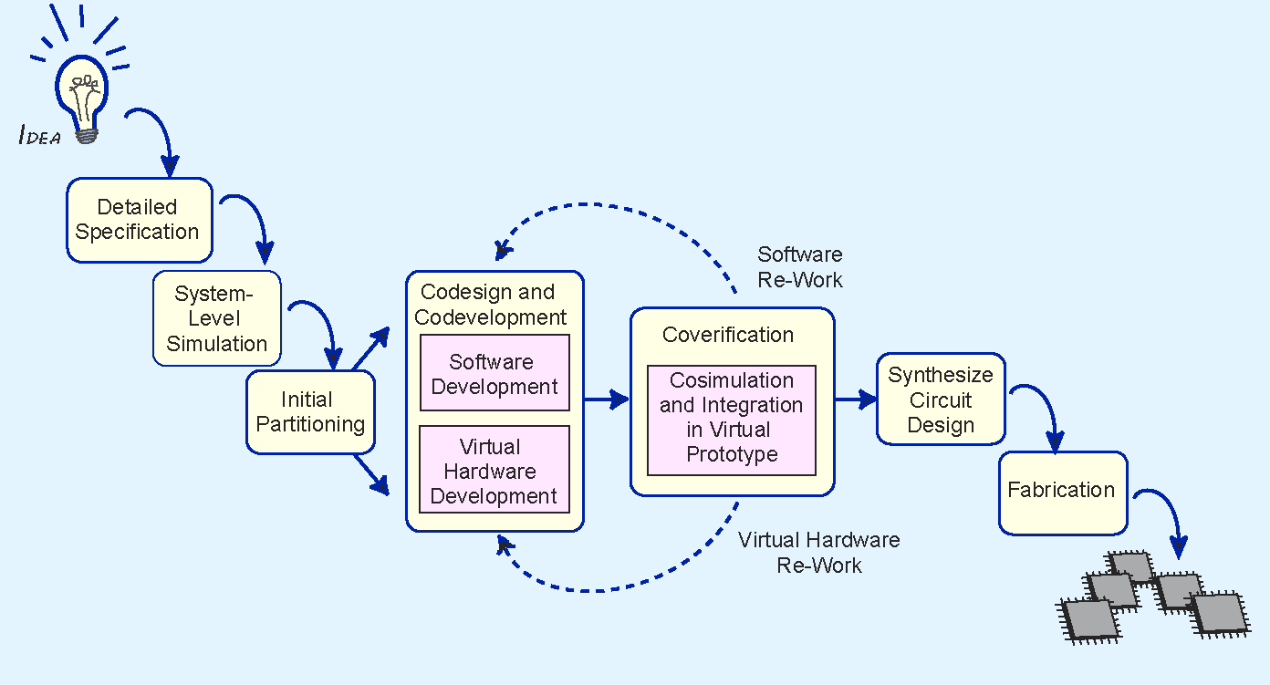
10.2 Embedded Hardware Overview
Rework takes place on a virtual system.

Slide 27
10.3 Embedded Software Overview
Software development for embedded systems presents a distinct set of challenges.
Some of these challenges are related to the uniqueness of the hardware, such as its particular memory organization.
Memory limitations are almost always a software development constraint.
Virtual memory is not suitable for most embedded applications.

Slide 28
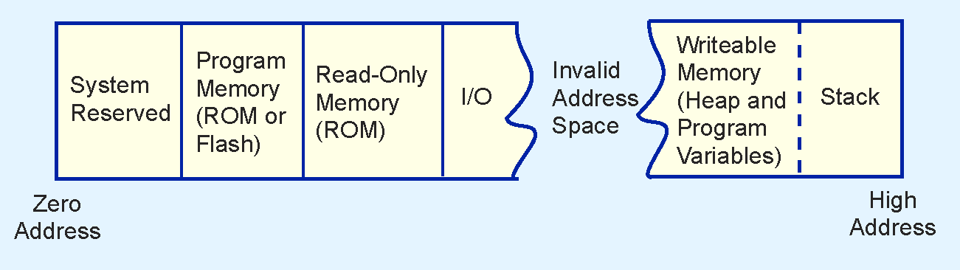
10.3 Embedded Software Overview
Embedded system memory can consist of several different kinds, including RAM, ROM, and flash, all sharing the same address space.
Memory leaks in embedded systems are especially problematic.

Slide 29
10.3 Embedded Software Overview
Embedded operating systems differ from general-purpose operating systems in a number of ways.
Responsiveness is one of the major distinguishing features.
Not all embedded operating systems are real-time operating systems.
Timing requirements may differ little from a desktop computer.
Hard real-time systems have strict timing constraints.
In soft real-time systems, timing is important but not critical.

Slide 30
10.3 Embedded Software Overview
Interrupt latency is the elapsed time between the occurrence of an interrupt and the execution of the first instruction of the interrupt service routine (ISR).
Interrupt latency is indirectly related to system responsiveness. The smaller the latency, the faster the response.
Interrupts can happen at any time and in any order.
The ISR for one interrupt possibly may not be completed before another interrupt occurs.
High-quality systems support such interrupt nesting.

Slide 31
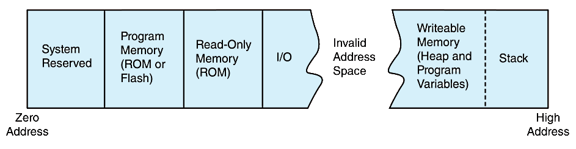
10.3 Embedded Software Overview
Memory organization in resource-constrained systems differs from traditional systems.
The entire address space might not be used.
The stack and the heap typically start at different ends of the address space.

Slide 32
10.3 Embedded Software Overview
Memory footprint is a critical concern with embedded operating systems.
If an operating system takes up too much memory, additional memory may be required.
Memory consumes power.
Thus, the smaller the operating system, the better.
Most embedded operating systems are modular, allowing only the most necessary features to be installed.

Slide 33
10.3 Embedded Software Overview
IEEE 1003.1-2001, POSIX, is the specification for standardized Unix, to which Embedded Linux adheres.
Other popular embedded operating systems include Windows Embedded 8, QNX, and MS-DOS.
Windows Embedded 8 has several versions, each intended for a particular application area.
There are hundreds of others, each having its distinctive behavior and target hardware.
Licensing costs for the operating system are as great a concern as hardware costs.

Slide 34
10.3 Embedded Software Overview
General-purpose software development is usually iterative and incremental.
Code a little, test a little.
Embedded systems development requires a much more rigorous and linear path.
Functional requirements must be clear, complete, and accurate when work begins.
Formal languages, such as Z, are helpful in providing accuracy and correctness.

Slide 35
10.3 Embedded Software Overview
Large software projects are usually partitioned into chunks so that the chunks can be assigned to different teams.
Embedded software doesn’t partition so easily, making team assignments difficult.
To improve performance, some embedded programmers advocate the use of global variables and unstructured code.
Others rail against this idea, saying that it is not good engineering practice regardless of the platform for which the software is written.

Slide 36
10.3 Embedded Software Overview
Event handling is a major challenge to the embedded programmer.
It lies at the heart of embedded systems functionality
Events can happen asynchronously and in any order.
It is virtually impossible to test all possible sequences of events.
Testing must be rigorous and thorough.

Slide 37
10.3 Embedded Software Overview
Embedded programming is essentially a matter of raising and responding to signals.
Hardware support may be designed into a chip to facilitate the tracing and debugging of signal patterns.
Examples are ICE, Motorola’s BDM, IEEE 1149.1 JTAG, and IEEE 5001 Nexus.
Some platforms offer no tool support in the way of debuggers or even compilers.
Writing software for these systems is called bare metal programming.

Slide 38
Chapter 10 Conclusion
Embedded systems differ from general-purpose systems because:
They are resource constrained.
Programming requires deep awareness of the underlying hardware.
Signal timing and event handling are critical.
The hardware-software partition is moveable.
Embedded hardware can be off-the-shelf, semi-customized, fully-customized, or configurable.

Slide 39
Chapter 10 Conclusion
Programmable logic devices include:
PALs: Programmable AND gates connected to a set of fixed OR gates.
PLA: Programmable AND gates connected through programmable OR gates.
FPGA: Logic functions provided through lookup tables.
PLDs tend to be slow and expensive as compared to off-the-shelf ICs.

Slide 40
Chapter 10 Conclusion
Hardware definition languages Verilog, VHDL specify the functions and layout of full-custom chips.
SpecC and SystemC raise the level of abstraction in chip design.
Hardware-software codesign and cosimulation reduces errors and brings products to market faster.

Slide 41
Chapter 10 Conclusion
Embedded operating systems differ from general purpose operating systems in their timing and memory footprint requirements.
IEEE 1003.1-2001, POSIX, is the specification for standardized Unix, to which Embedded Linux adheres.
Other popular embedded operating systems include the Windows Embedded 8 series, QNX, and MS-DOS.

Slide 42
Chapter 10 Conclusion
Embedded software requires accurate specifications and rigorous development practices.
Formal languages help.
Event processing requires careful specification and testing.
Embedded system debugging can be supported by hardware interfaces to include ICE, BDM, JTAG, and Nexus.

