Slide 1
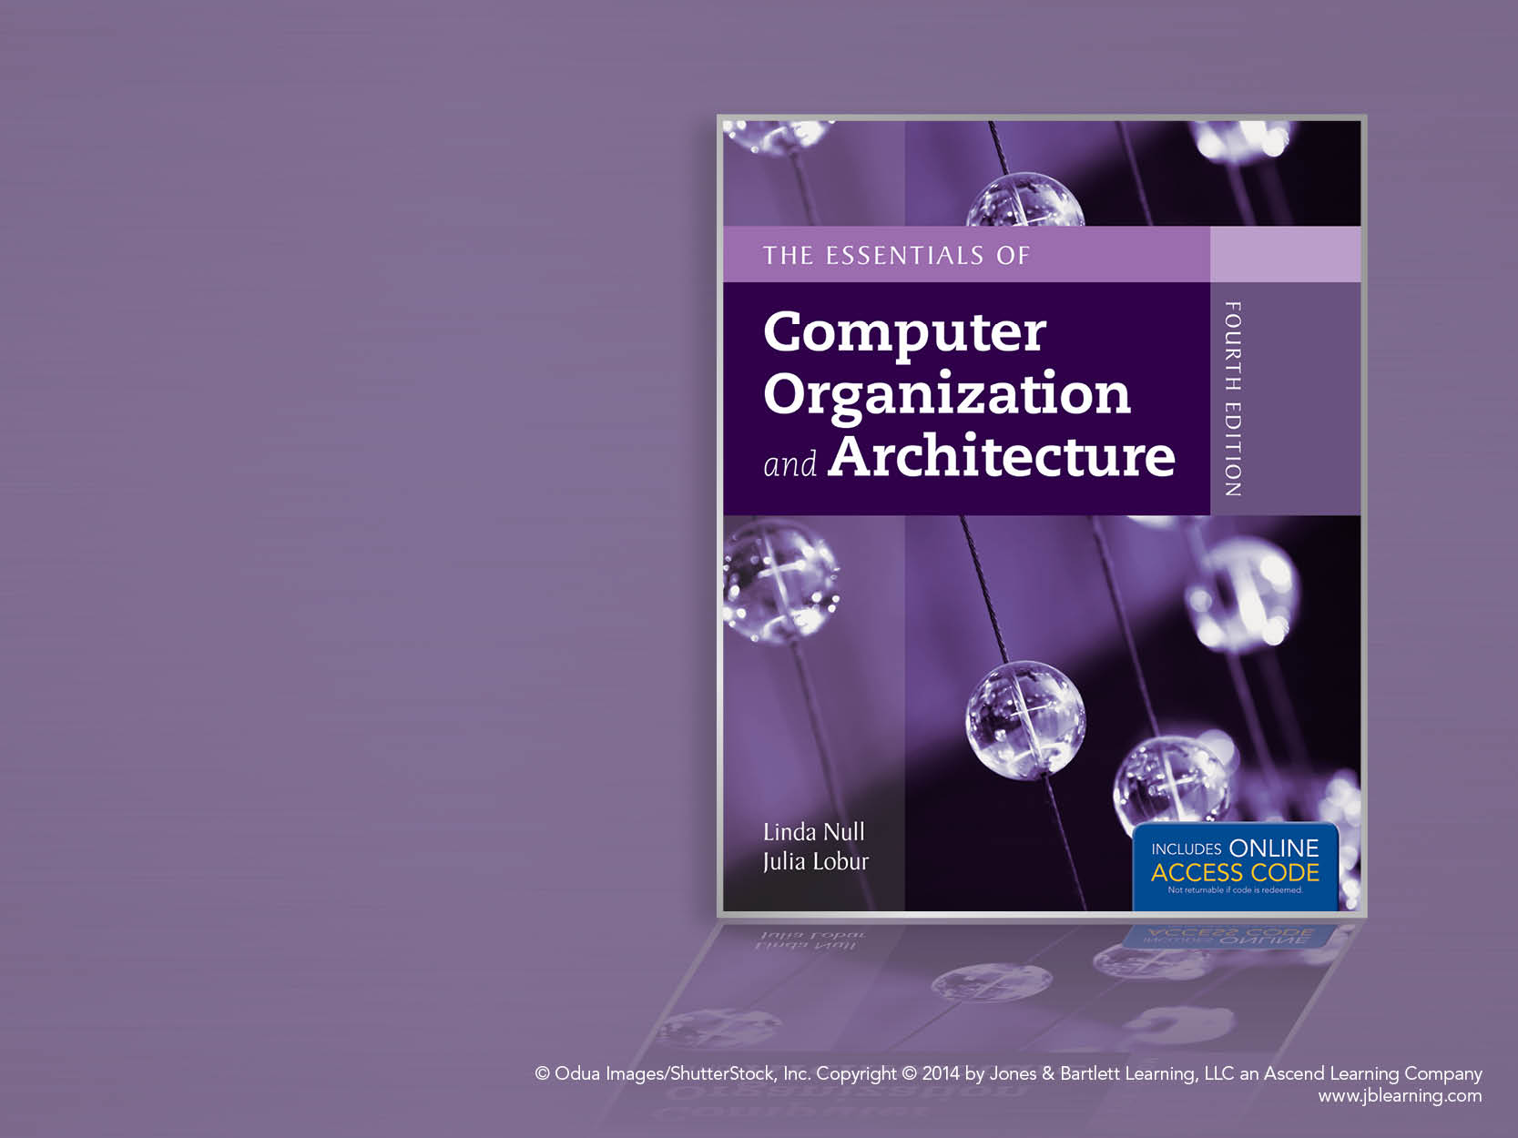
Chapter 12
Network Organization and Architecture

Slide 2
Chapter 12 Objectives
Become familiar with the fundamentals of network architectures.
Learn the basic components of a local area network.
Become familiar with the general architecture of the Internet.

Slide 3
12.1 Introduction
The network is a crucial component of today’s computing systems.
Resource sharing across networks has taken the form of multitier architectures having numerous disparate servers, sometimes far removed from the users of the system.
If you think of a computing system as collection of workstations and servers, then surely the network is the system bus of this configuration.

Slide 4
12.2 Early Business Computer Networks
The first computer networks consisted of a mainframe host that was connected to one or more front end processors.
Front end processors received input over dedicated lines from remote communications controllers connected to several dumb terminals.
The protocols employed by this configuration were proprietary to each vendor’s system.
One of these, IBM’s SNA became the model for an international communications standard, the ISO/OSI Reference Model.

Slide 5
12.3 Early Academic and Scientific Networks
In the 1960s, the Advanced Research Projects Agency funded research under the auspices of the U.S. Department of Defense.
Computers at that time were few and costly. In 1968, the Defense Department funded an interconnecting network to make the most of these precious resources.
The network, DARPANet, designed by Bolt, Beranek, and Newman, had sufficient redundancy to withstand the loss of a good portion of the network.
DARPANet, later turned over to the public domain, eventually evolved to become today’s Internet.

Slide 6
12.4 Network Protocols I ISO/OSI Reference Model
To address the growing tangle of incompatible proprietary network protocols, in 1984 the ISO formed a committee to devise a unified protocol standard.
The result of this effort is the ISO Open Systems Interconnect Reference Model (ISO/OSI RM).
The ISO’s work is called a reference model because virtually no commercial system uses all of the features precisely as specified in the model.
The ISO/OSI model does, however, lend itself to understanding the concept of a unified communications architecture.

Slide 7
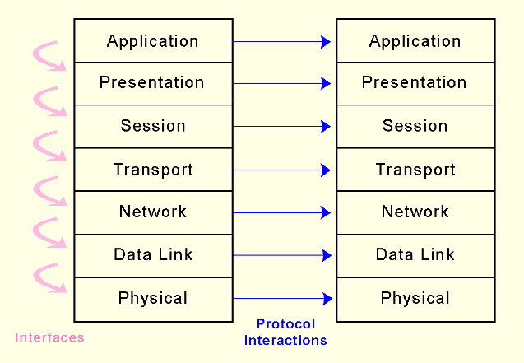
12.4 Network Protocols I ISO/OSI Reference Model
The OSI RM contains seven protocol layers, starting with physical media interconnections at Layer 1, through applications at Layer 7.

Slide 8
12.4 Network Protocols I ISO/OSI Reference Model
OSI model defines only the functions of each of the seven layers and the interfaces between them.
Implementation details are not part of the model.

Slide 9
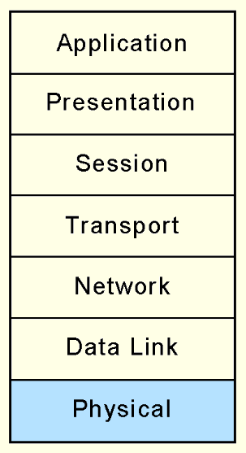
12.4 Network Protocols I ISO/OSI Reference Model
The Physical layer receives a stream of bits from the Data Link layer above it, encodes them and places them on the communications medium.
The Physical layer conveys transmission frames, called Physical Protocol Data Units, or Physical PDUs. Each physical PDU carries an address and has delimiter signal patterns that surround the payload, or contents, of the PDU.

Slide 10
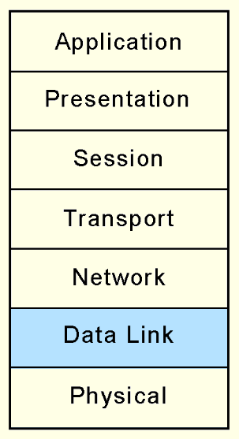
12.4 Network Protocols I ISO/OSI Reference Model
The Data Link layer negotiates frame sizes and the speed at which they are sent with the Data Link layer at the other end.
The timing of frame transmission is called flow control.
Data Link layers at both ends acknowledge packets as they are exchanged. The sender retransmits the packet if no acknowledgement is received within a given time interval.

Slide 11
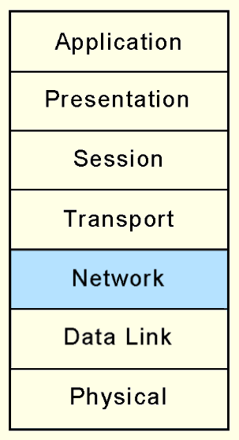
12.4 Network Protocols I ISO/OSI Reference Model
At the originating computers, the Network layer adds addressing information to the Transport layer PDUs.
The Network layer establishes the route and ensures that the PDU size is compatible with all of the equipment between the source and the destination.
Its most important job is in moving PDUs across intermediate nodes.

Slide 12
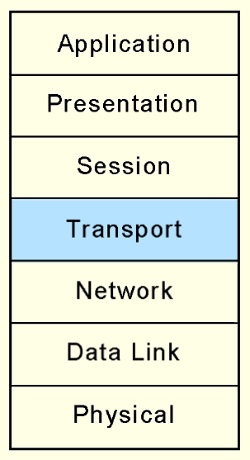
12.4 Network Protocols I ISO/OSI Reference Model
the OSI Transport layer provides end-to-end acknowledgement and error correction through its handshaking with the Transport layer at the other end of the conversation.
The Transport layer is the lowest layer of the OSI model at which there is any awareness of the network or its protocols.
Transport layer assures the Session layer that there are no network-induced errors in the PDU.

Slide 13
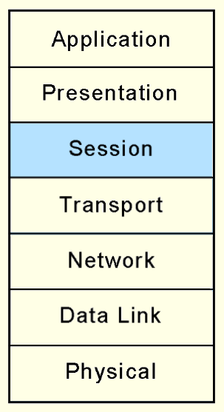
12.4 Network Protocols I ISO/OSI Reference Model
The Session layer arbitrates the dialogue between two communicating nodes, opening and closing that dialogue as necessary.
It controls the direction and mode (half -duplex or full-duplex).
It also supplies recovery checkpoints during file transfers.
Checkpoints are issued each time a block of data is acknowledged as being received in good condition.

Slide 14
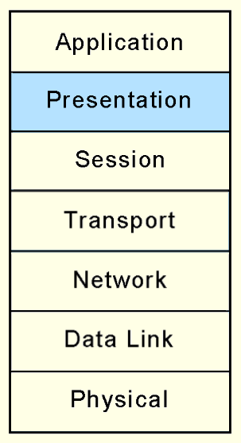
12.4 Network Protocols I ISO/OSI Reference Model
The Presentation layer provides high-level data interpretation services for the Application layer above it, such as EBCDIC-to-ASCII translation.
Presentation layer services are also called into play if we use encryption or certain types of data compression.

Slide 15
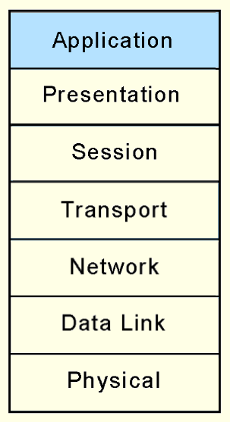
12.5 Network Protocols II TCP/IP Network Architecture
The Application layer supplies meaningful information and services to users at one end of the communication and interfaces with system resources (programs and data files) at the other end of the communication.
All that applications need to do is to send messages to the Presentation layer, and the lower layers take care of the hard part.

Slide 16
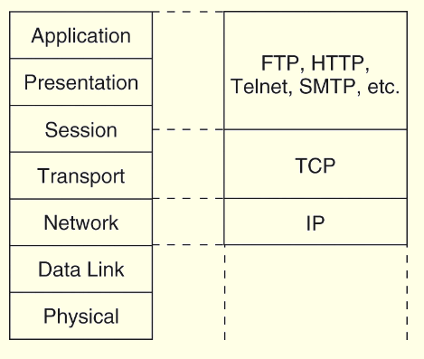
12.5 Network Protocols II TCP/IP Network Architecture
TCP/IP is the de facto global data communications standard.
It has a lean 3-layer protocol stack that can be mapped to five of the seven in the OSI model.
TCP/IP can be used with any type of network, even different types of networks within a single session.

Slide 17
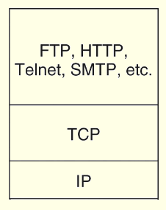
12.5 Network Protocols II TCP/IP Network Architecture
The IP Layer of the TCP/IP protocol stack provides essentially the same services as the Network and Data Link layers of the OSI Reference Model.
It divides TCP packets into protocol data units called datagrams, and then attaches routing information.

Slide 18
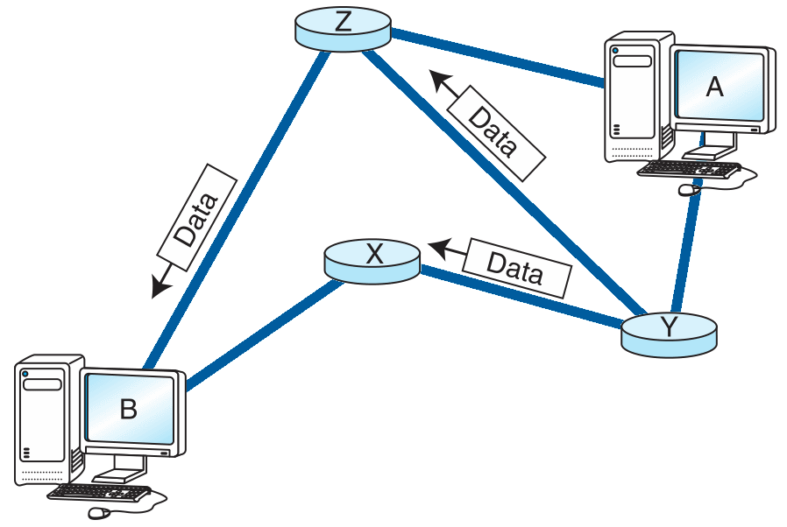
12.5 Network Protocols II TCP/IP Network Architecture
The concept of the datagram was fundamental to the robustness of ARPAnet, and now, the Internet.
Datagrams can take any route available to them without human intervention.

Slide 19
12.5 Network Protocols II TCP/IP Network Architecture
The current version of IP, IPv4, was never designed to serve millions of network components scattered across the globe.
It limitations include 32-bit addresses, a packet length limited to 65,635 bytes, and that all security measures are optional.
Furthermore, network addresses have been assigned with little planning which has resulted in slow and cumbersome routing hardware and software.
We will see later how these problems have been addressed by IPv6.

Slide 20
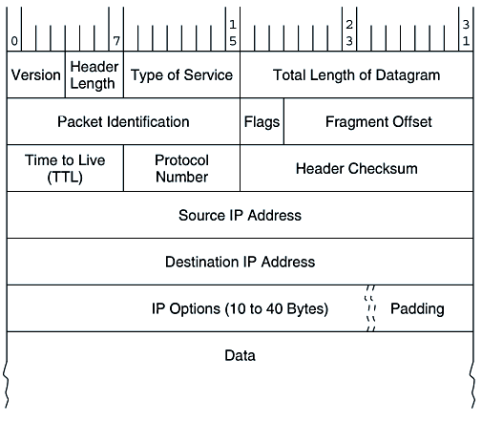
12.5 Network Protocols II TCP/IP Network Architecture
IPv4 Packet Header

Slide 21
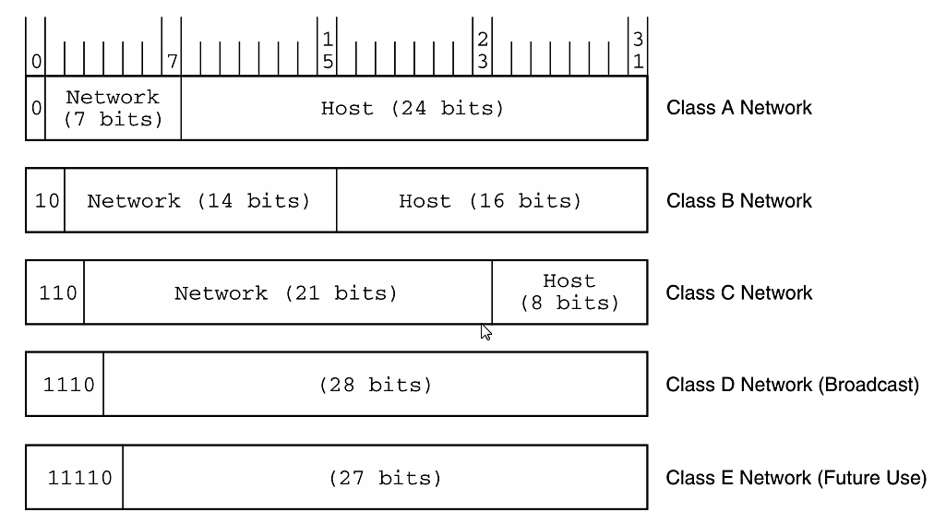
12.5 Network Protocols II TCP/IP Network Architecture
IPv4 Address Space

Slide 22
12.5 Network Protocols II TCP/IP Network Architecture
Transmission Control Protocol (TCP) is the consumer of IP services.
It engages in a conversation-- a connection-- with the TCP process running on the remote system.
A TCP connection is analogous to a telephone conversation, with its own protocol "etiquette."

Slide 23
12.5 Network Protocols II TCP/IP Network Architecture
As part of initiating a connection, TCP also opens a service access point (SAP) in the application running above it.
In TCP, this SAP is a numerical value called a port.
The combination of the port number, the host ID, and the protocol designation becomes a socket, which is logically equivalent to a file name (or handle) to the application running above TCP.
Port numbers 0 through 1023 are called “well-known” port numbers because they are reserved for particular TCP applications.

Slide 24
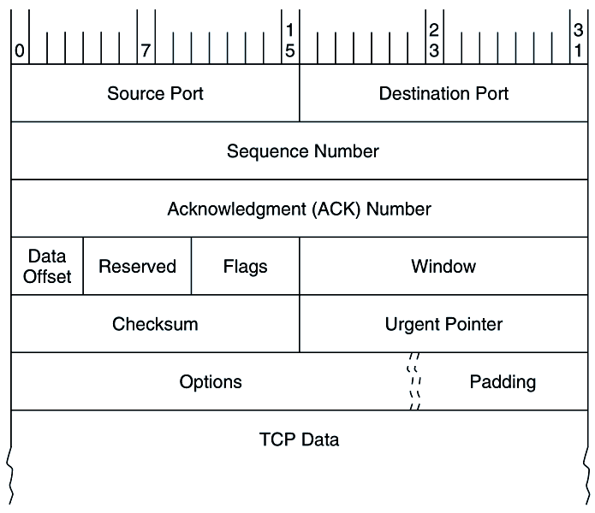
12.5 Network Protocols II TCP/IP Architecture
TCP Segment Format

Slide 25
12.5 Network Protocols II TCP/IP Architecture
TCP Segment Format

Slide 26
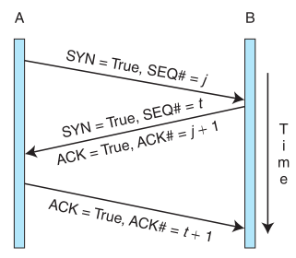
12.5 Network Protocols II TCP/IP Architecture
TCP session initiation handshake

Slide 27
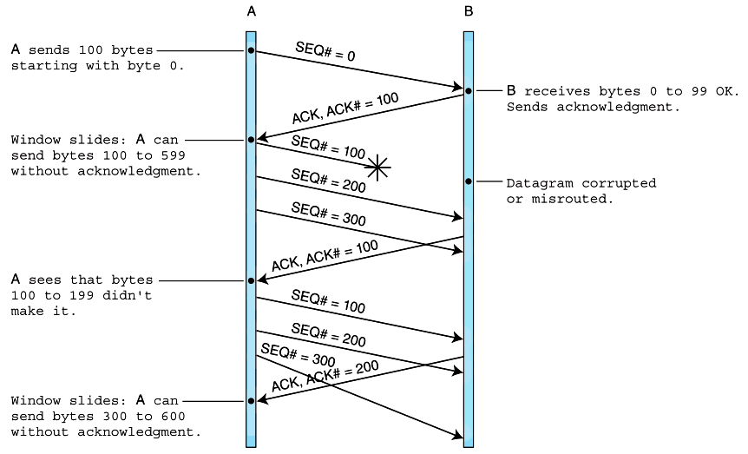
12.5 Network Protocols II TCP/IP Architecture
TCP data exchange

Slide 28
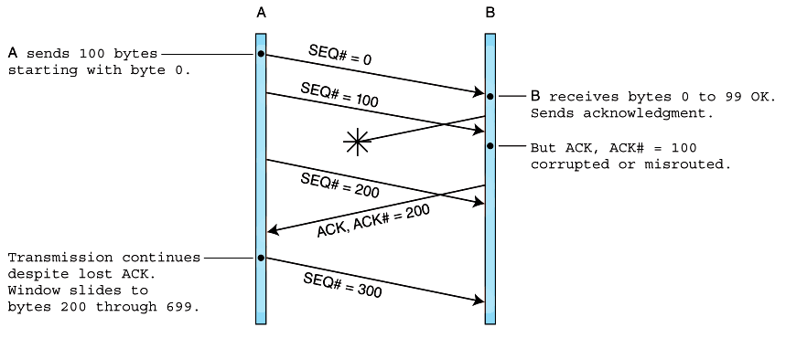
12.5 Network Protocols II TCP/IP Architecture
TCP data exchange with lost acknowledgement

Slide 29
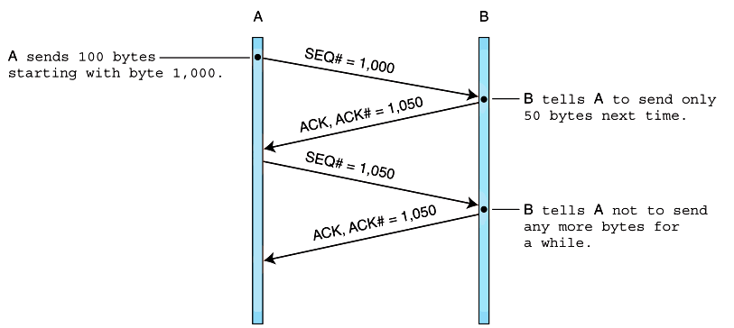
12.5 Network Protocols II TCP/IP Architecture
TCP flow control

Slide 30
12.5 Network Protocols II TCP/IP Architecture
In 1994, the Internet Engineering Task Force began work on what is now IP Version 6.
The IETF's primary motivation in designing a successor to IPv4 was, of course, to extend IP's address space beyond its current 32-bit limit to 128 bits for both the source and destination host addresses.
This is a seemingly inexhaustible address space, giving 2¹²⁸ possible host addresses.
The IETF also devised the Aggregatable Global Unicast Address Format to manage this huge address space.

Slide 31
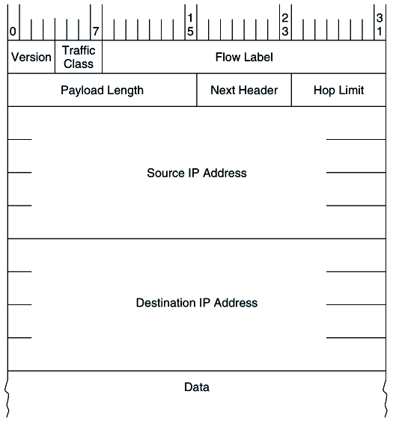
12.5 Network Protocols II TCP/IP Architecture
IPv6 Header Format

Slide 32
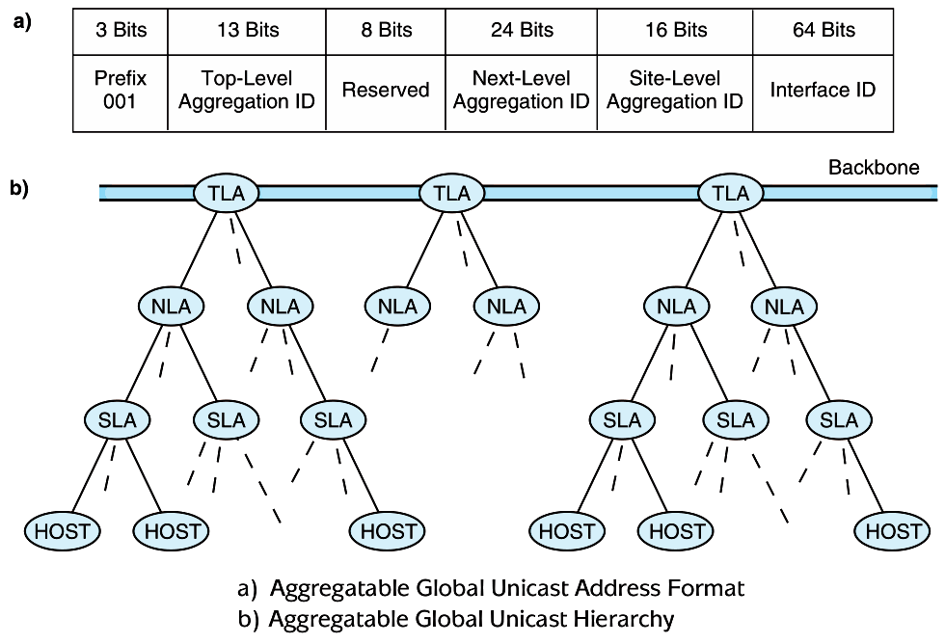
12.5 Network Protocols II TCP/IP Architecture

Slide 33
12.6 Network Organization
Computer networks are often classified according to their geographic service areas.
The smallest networks are local area networks (LANs). LANs are typically used in a single building, or a group of buildings that are near each other.
Metropolitan area networks (MANs) are networks that cover a city and its environs.
LANs are becoming faster and more easily integrated with WAN technology, it is conceivable that someday the concept of a MAN may disappear entirely.
Wide area networks (WANs) can cover multiple cities, or span the entire world.

Slide 34
12.6 Network Organization
In this section, we examine the physical network components common to LANs, MANs and WANs.
We start at the lowest level of network organization, the physical medium level, Layer 1.
There are two general types of communications media: Guided transmission media and unguided transmission media.
Unguided media broadcast data over the airwaves using infrared, microwave, satellite, or broadcast radio carrier signals.

Slide 35
12.6 Network Organization
Guided media are physical connectors such as copper wire or fiber optic cable that directly connect to each network node.
The electrical phenomena that work against the accurate transmission of signals are called noise.
Signal and noise strengths are both measured in decibels (dB).
Cables are rated according to how well they convey signals at different frequencies in the presence of noise.

Slide 36
12.6 Network Organization
The signal-to-noise rating, measured in decibels, quantifies the quality of the communications channel.
The bandwidth of a medium is technically the range of frequencies that it can carry, measured in Hertz.
In digital communications, bandwidth is the general term for the information-carrying capacity of a medium, measured in bits per second (bps).
Another important measure is bit error rate (BER), which is the ratio of the number of bits received in error to the total number of bits received.

Slide 37
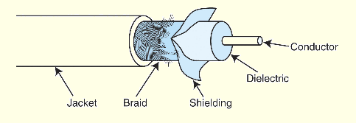
12.6 Network Organization
Coaxial cable was once the medium of choice for data communications.
It can carry signals up to trillions of cycles per second with low attenuation.
Today, it is used mostly for broadcast and closed circuit television applications.
_
Coaxial cable also carries signals for residential Internet services that piggyback on cable television lines.

Slide 38
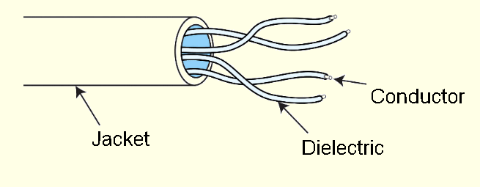
12.6 Network Organization
Twisted pair cabling, containing two twisted wire pairs, is found in most local area network installations today.
It comes in two varieties: shielded and unshielded. Unshielded twisted pair is the most popular.
_
The twists in the cable reduce inductance while the shielding protects the cable from outside interference..

Slide 39
12.6 Network Organization
Electronic Industries Alliance (EIA), along with the Telecommunications Industry Association (TIA) established a rating system called EIA/TIA-568B.
The EIA/TIA category ratings specify the maximum frequency that the cable can support without excessive attenuation.
The ISO rating system refers to these wire grades as classes.
Most local area networks installed today are equipped with Category 5 or better cabling. Some are installing fiber optic cable.

Slide 40
12.6 Network Organization
Optical fiber network media can carry signals faster and farther than either or twisted pair or coaxial cable.
Fiber optic cable is theoretically able to support frequencies in the terahertz range, but transmission speeds are more commonly in the range of about two gigahertz, carried over runs of 10 to 100 Km (without repeaters).
Optical cable consists of bundles of thin (1.5 to 125 μm) glass or plastic strands surrounded by a protective plastic sheath.

Slide 41


12.6 Network Organization
Optical fiber supports three different transmission modes depending on the type of fiber used.
Single-mode fiber provides the fastest data rates over the longest distances. It passes light at only one wavelength, typically, 850, 1300 or 1500 nanometers.
Multimode fiber can carry several different light wavelengths simultaneously through a larger fiber core.

Slide 42

12.6 Network Organization
Multimode graded index fiber also supports multiple wavelengths concurrently, but it does so in a more controlled manner than regular multimode fiber
Unlike regular multimode fiber, light waves are confined to the area of the optical fiber that is suitable to propagating its particular wavelength.
Thus, different wavelengths concurrently transmitted through the fiber do not interfere with each other.

Slide 43
12.6 Network Organization
Fiber optic media offer many advantages over copper, the most obvious being its enormous signal-carrying capacity.
It is also immune to EMI and RFI, making it ideal for deployment in industrial facilities.
Fiber optic is small and lightweight, one fiber being capable of replacing hundreds of pairs of copper wires.
But optical cable is fragile and costly to purchase and install. Because of this, fiber is most often used as network backbone cable, which bears the traffic of hundreds or thousands of users.

Slide 44
12.6 Network Organization
Unguided data communications media transmit byes over carrier waves such as those provided by cellular telephone networks, Bluetooth, and 802.11x.
There are others, including free space optical lasers, microwaves, and satellite communications, to name a few.
Cellular wireless networks use a cellular telephone network to transmit data.
First generation technology allowed a maximum transmission rate of around 1Mbps.

Slide 45
12.6 Network Organization
Cell network data technology is now in its third generation (3G).
Transmission rates up to 2.048Mbps are supported.
3G also supports a wide array of equipment, including the seamless integration of low-Earth-orbiting (LEO) satellites.
This technology makes it possible for the entire world to finally have access to the World Wide Web!

Slide 46
12.6 Network Organization
Bluetooth, also known as IEEE 802.15.1-2002 was first conceived by Ericsson in 1994.
Bluetooth’s purpose is to connect small peripheral devices with a nearby host.
Examples include mice, keyboards, printers, and cameras.
The collection of these devices forms a personal area network, or piconet.
Transmission at 720Kbps occurs over an unregulated 2.45GHz frequency using power no greater than 100 milliwatts.

Slide 47
12.6 Network Organization
Wireless local area networks (WLANs) are slower than their wired counterparts, but they make up for this in their versatility.
A WLAN can be set up just about anywhere.
Two WLAN specifications are dominant in the US:
802.11: up to 54Mbps
802.11n: Over 54Mbps and up to 100Mbps
The IEEE 802.11 series of standards also includes provisions for fast roaming, cellular integration, and management.

Slide 48
12.6 Network Organization
WLANs consist of a collection of wireless access points (WAPs) that broadcast to nearby computer nodes.
Distances are limited by ambient interference and obstructions such as walls.
Connection speeds decrease as distance and obstructions increase.
Security continues to be a concern even when wired equivalent protocol (WEP) is employed.
Some security experts believe that it is impossible to make a WLAN as secure as a wired LAN.

Slide 49
12.6 Network Organization
Transmission media are connected to clients, hosts and other network devices through network interfaces.
Because these interfaces are often implemented on removable circuit boards, they are commonly called network interface cards, or simply NICs.
A NIC usually embodies the lowest three layers of the OSI protocol stack.
NICs attach directly to a system’s main bus or dedicated I/O bus.

Slide 50
12.6 Network Organization
Every network card has a unique 6-byte MAC (Media Access Control ) address burned into its circuits.
The first three bytes are the manufacturer's identification number, which is designated by the IEEE. The last three bytes are a unique identifier assigned to the NIC by the manufacturer.
Network protocol layers map this physical MAC address to at least one logical address.
It is possible for one computer (logical address) to have two or more NICs, but each NIC will have a distinct MAC address.

Slide 51
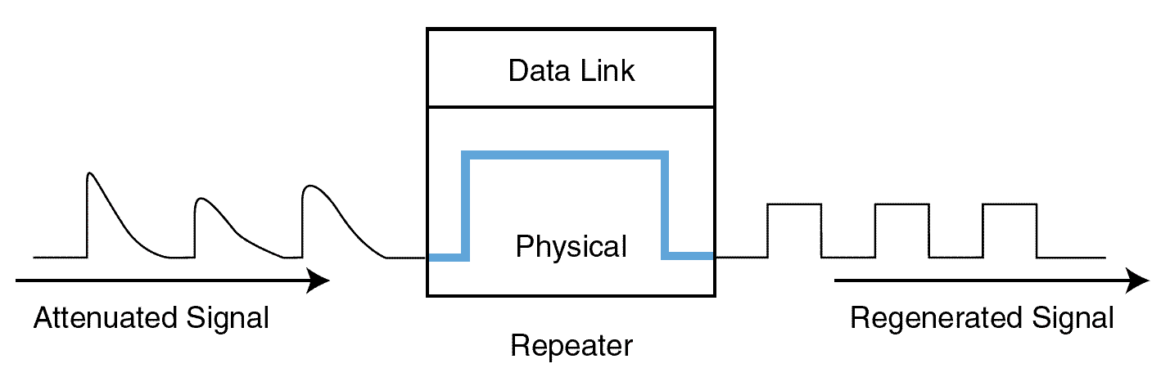
12.6 Network Organization
Signal attenuation is corrected by repeaters that amplify signals in physical cabling.
Repeaters are part of the network medium (Layer 1).
In theory, they are dumb devices functioning entirely without human intervention. However, some repeaters now offer higher-level services to assist with network management and troubleshooting.

Slide 52
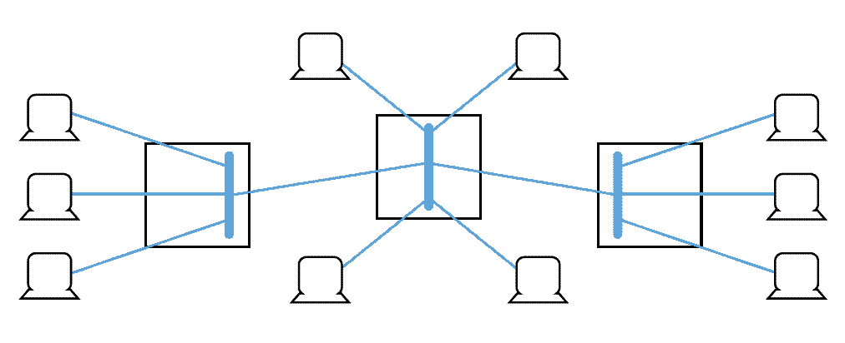
12.6 Network Organization
Hubs are also Physical layer devices, but they can have many ports for input and output.
They receive incoming packets from one or more locations and broadcast the packets to one or more devices on the network.
Hubs allow computers to be joined to form network segments.

Slide 53
12.6 Network Organization
A switch is a Layer 2 device that creates a point-to-point connection between one of its input ports and one of its output ports.
Switches contain buffered input ports, an equal number of output ports, a switching fabric and digital hardware that interprets address information encoded on network frames as they arrive in the input buffers.
Because all switching functions are carried out in hardware, switches are the preferred devices for interconnecting high-performance network components.

Slide 54
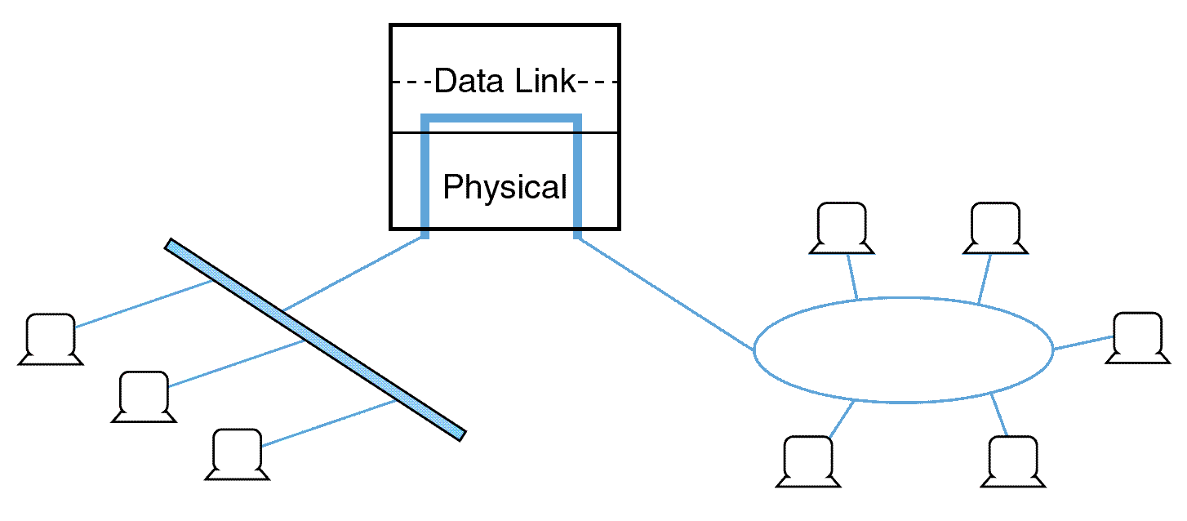
12.6 Network Organization
Bridges are Layer 2 devices that join two similar types of networks so they look like one network.
Bridges can connect different media having different media access control protocols, but the protocol from the MAC layer through all higher layers in the OSI stack must be identical in both segments.

Slide 55
12.6 Network Organization
A router is a device connected to at least two networks that determines the destination to which a packet should be forwarded.
Routers are designed specifically to connect two networks together, typically a LAN to a WAN.
Routers are by definition Layer 3 devices, they can bridge different network media types and connect different network protocols running at Layer 3 and below.
Routers are sometimes referred to as “intermediate systems” or “gateways” in Internet standards literature.

Slide 56
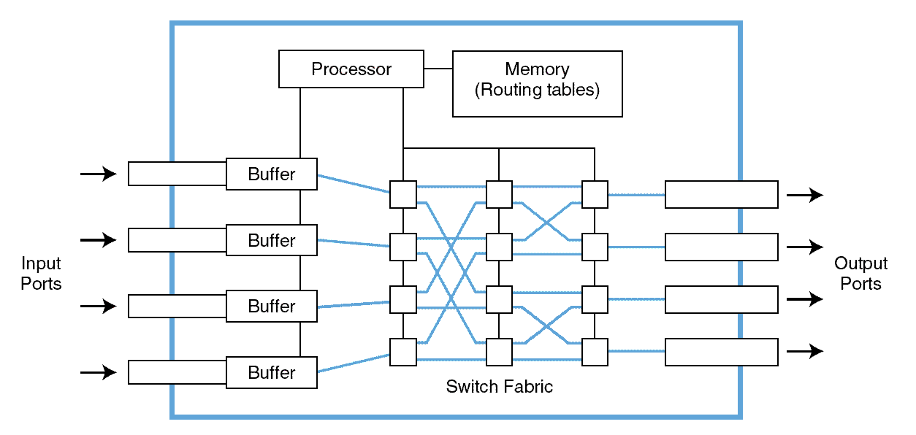
12.6 Network Organization
Routers are complex devices because they contain buffers, switching logic, memory, and processing power to calculate the best way to send a packet to its destination.

Slide 57
12.6 Network Organization
Dynamic routers automatically set up routes and respond to the changes in the network.
They explore their networks through information exchanges with other routers on the network.
The information packets exchanged by the routers reveal their addresses and costs of getting from one point to another.
Using this information, each router assembles a table of values in memory.
Typically, each destination node is listed along with the neighboring, or next-hop, router to which it is connected.

Slide 58
12.6 Network Organization
When creating their tables, dynamic routers consider one of two metrics. They can use either the distance to travel between two nodes, or they can use the condition of the network in terms of measured latency.
The algorithms using the first metric are distance vector routing algorithms. Link state routing algorithms use the second metric.
Distance vector routing is easy to implement, but it suffers from high traffic and the count-to-infinity problem where an infinite loop finds its way into the routing tables.

Slide 59
12.7 Internet Fragility
Practically everyone understands that the Internet is crucial to global commerce.
What is less clear is the importance of the Internet to the health and safety of the modern world.
SCADA (supervisory control and data acquisition) systems operate vital portions of our physical infrastructure including:
power generation
transportation networks
sewage systems
oil and gas pipelines

Slide 60
12.7 Internet Fragility
Reliance on the Internet as a physical infrastructure is only going to increase with the Internet of Things (IoT) or Machine-to-Machine (M2M) communication.
Cisco estimates 50 billion sensor nodes by 2020
Can the Internet deal with this traffic? Congestive collapse is a concern.
Congestive collapse: routers become overwhelmed, reroute packets to other routers which then become overwhelmed in cascading fashion.
The ultimate fix is to make the Internet “smarter,” but this won’t happen quickly. Till then, we worry.

Slide 61
Chapter 12 Conclusion
The ISO/OSI RM describes a theoretical network architecture. This architecture has to some extent been incorporated into digital telecommunication systems.
TCP/IP using IPv4 is the protocol supported by the Internet. IPv6 has been defined and implemented by numerous vendors, but its adoption is incomplete.

Slide 62
Chapter 12 Conclusion
Network organization consists of physical (or wireless) media, repeaters, hubs, switches, routers, and computers. Each has its place in the OSI RM.
Types of networks include WANs, MANs, and LANS.
The Internet of Things holds the promise of making life better, but it will do so only if the Internet can handle the traffic.
Smarter routing needs to be put in place.

