Slide 1
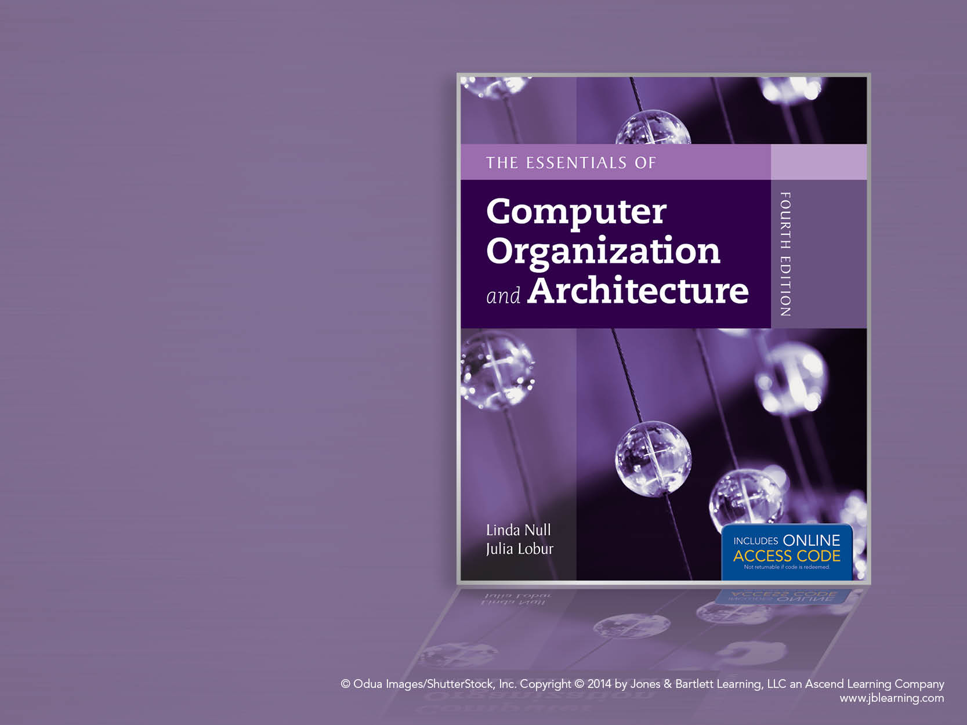
Chapter 13
Selected Storage
Systems and Interface

Slide 2

Chapter 13 Objectives
Appreciate the role of enterprise storage as a distinct architectural entity.
Expand upon basic I/O concepts to include storage protocols.
Understand the interplay between data communications and storage architectures.
Become familiar with a variety of widely installed I/O interfaces.

Slide 3
13.1 Introduction
This chapter is a brief introduction to several important mass storage systems.
You will encounter these ideas and architectures throughout your career.
The demands and expectations placed on storage have been growing exponentially.
Storage management presents an array of interesting problems, which are a subject of ongoing research.

Slide 4
13.1 Introduction
Storage systems have become independent systems requiring good management tools and techniques.
The challenges facing storage management include:
Identifying and extracting meaningful information from multi-terabyte systems.
Organizing disk and file structures for optimum performance.
Protecting large storage pools from disk crashes.

Slide 5
13.2 SCSI
SCSI, an acronym for Small Computer System Interface, is a set of protocols and disk I/O signaling specifications that became an ANSI standard in 1986.
The key idea behind SCSI is that it pushes intelligence from the host to the interface circuits thus making the system nearly self-managing.
The SCSI specification is now in its third generation, SCSI-3, which includes both serial and parallel interfaces.

Slide 6
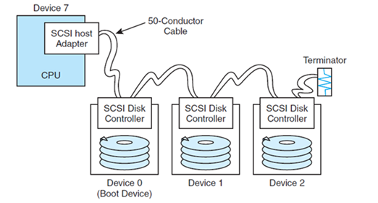
13.2 SCSI
Classic SCSI-2 daisy chains the host and disk devices along a parallel cable.
Depending on the implementation, the cable may contain as many as 68 pins.

Slide 7
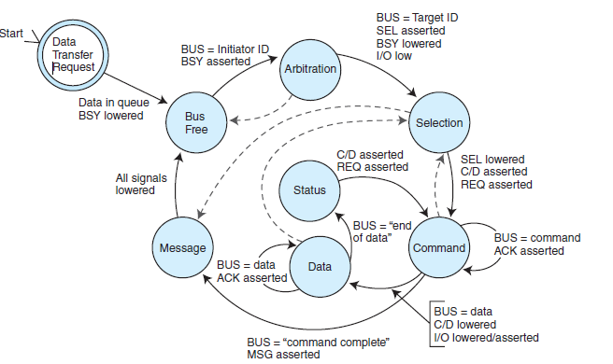
13.2 SCSI
The SCSI-2 protocol uses phases, as shown in this state diagram.

Slide 8
13.2 SCSI
The SCSI-3 Architecture Model (SAM) is a layered architecture of specifications for numerous serial and parallel interfaces.
Each layer interacts with a host-level command architecture called the SCSI-3 Common Access Method (CAM) that can interface with practically any type of storage device.
The layers communicate with each other using protocol service requests, indications, responses, and confirmations. We show the SAM on the next slide.

Slide 9
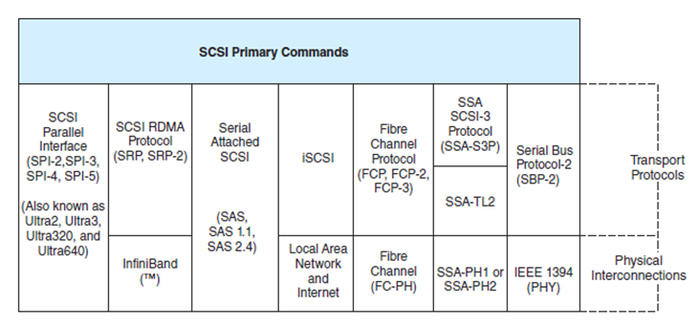
13.2 SCSI
The SCSI-3 Architecture Model

Slide 10
13.2 SCSI
One of the interesting SAM serial protocols is the IEEE 1394 interface, which is also known as FireWire.
IEEE 1394 isn’t just a storage interface, it is a peer-to-peer storage network.
Its salient features include:
A 6-conductor sable, 4 for data and control, 2 for power.
Up to 15 feet of cable between each device.
Up to 63 daisy chained devices.
Support of hot plugging.
The next slide shows an example configuration.

Slide 11
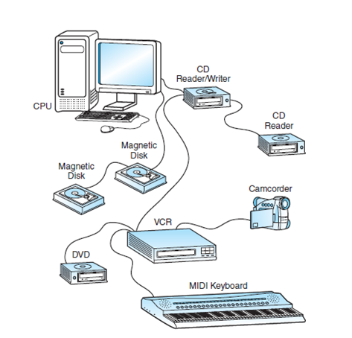
13.2 SCSI
An IEEE 1394
Tree Configuration

Slide 12
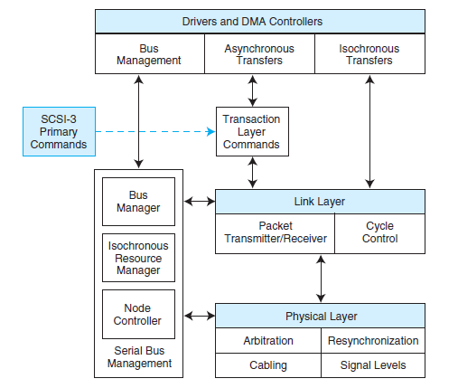
13.2 SCSI
This is the
IEEE 1394
protocol stack.

Slide 13
13.2 SCSI
Serial Storage Architecture (SSA) is now of interest only in a historical sense.
In the early 1990s, SSA proved the superiority of serial protocols in high demand environments.
Until SSA, peripheral devices in the data center were interconnected using parallel cables.
Its dual loop topology provided throughput at 40MBps (simplex) or 80MBps (duplex).
The next slide shows an example configuration.

Slide 14
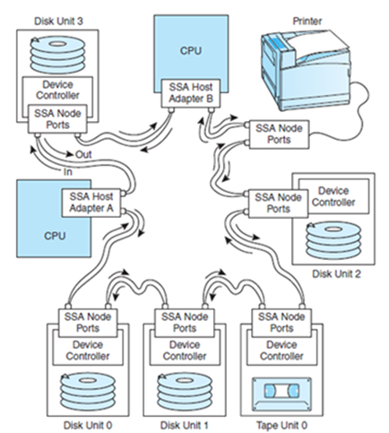
13.2 SCSI

Slide 15
13.2 SCSI
SSA offered low attenuation over long cable runs, and was compatible with SCSI-2 commands.
Devices were self-managing. They could exchange data concurrently if there was bandwidth available between the devices.
There was no need to go through a host.
SSA was the most promising storage architecture of its day, but its day didn’t last long.
SSA was soon replaced by much superior Fibre Channel technology.

Slide 16
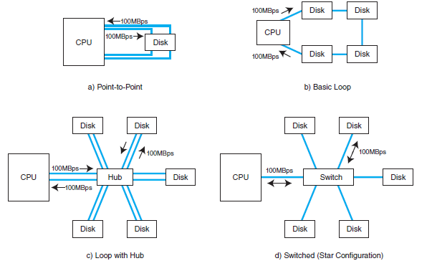
13.2 SCSI
Fibre Channel is one of the preferred storage interfaces employed by large data centers and server farms.
Interconnection
topologies can
be any of three
types:
switched,
point-to-point,
or looped.

Slide 17
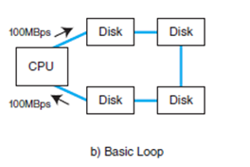
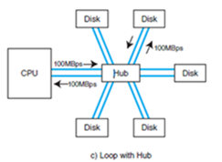
13.2 SCSI
The most widely used form of Fibre Channel is Fibre Channel Arbitrated Loop (FC-AL) in basic loop or switched hub configurations.
Switched hub configurations provide maximum throughput (100MBps over fiber) for a practically unlimited number of devices (up to 2²⁴).

Slide 18
13.2 SCSI
Fibre Channel is as much a data network protocol as it is a storage network protocol.
The lower three layers of its protocol stack (shown on the next slide) are the same for data networks and storage networks.
Owing to its higher level protocol mappings, Fibre Channel networks do not require direct connection to a host, and they can fit seamlessly into a data network configuration.

Slide 19
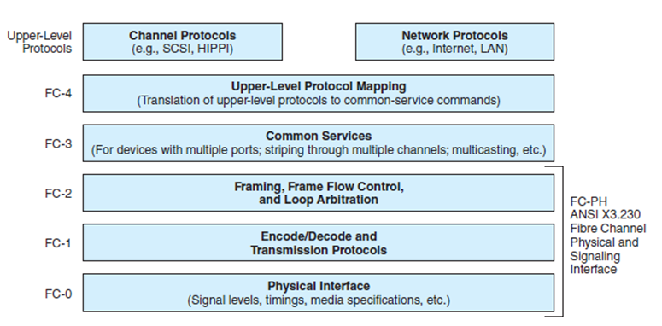
13.2 SCSI

Slide 20
13.3 Internet SCSI
Fibre Channel components are costly, and the installation and maintenance of Fibre Channel systems requires specialized training.
Because of this, a number of alternatives are taking hold. One of the most widely deployed of these is Internet SCSI (iSCSI).
The general idea is to replace the SCSI bus with an Internet connection.

Slide 21
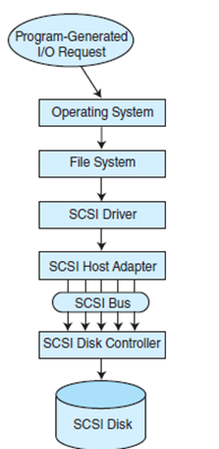
13.3 Internet SCSI
This diagram illustrates how a traditional parallel SCSI system processes an I/O request made by a program running on a host.

Slide 22
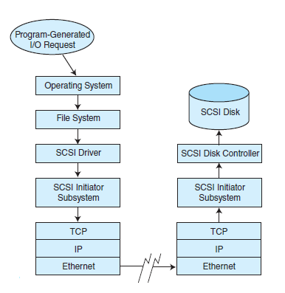
13.3 Internet SCSI
This diagram illustrates how an iSCSI system processes an I/O request.

Slide 23
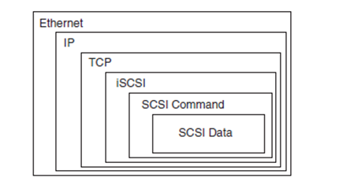
13.3 Internet SCSI
Of course, there is considerable overhead involved with traversing so many protocol layers.
By the time a packet of SCSI data gets to the Internet, it is encapsulated in numerous PDUs.

Slide 24
13.3 Internet SCSI
In order to deal with such heavy overhead, iSCSI systems incorporate special embedded processors called TCP offload engines (TOEs) to relieve the main processors of the protocol conversion work.
An advantage of iSCSI is that there are technically no distance limitations.
But the use of the Internet to transfer sensitive data raises a number of security concerns that must be dealt with head on.

Slide 25
13.3 Internet SCSI
Many organizations support both Fibre Channel and iSCSI systems.
The Fibre Channel systems are used for those storage arrays that support heavy transaction processing that requires excellent response time.
The iSCSI arrays are used for user file storage that is tolerant of delays, or for long-distance data archiving.
No one expects either technology to become obsolete anytime soon.

Slide 26
13.4 Storage Area Networks
Fibre Channel technology has enabled the development of storage area networks (SANs), which are designed specifically to support large pools of mass storage.
SANs are logical extensions of hos storage buses.
Any type of host connected to the network has access to the same storage pool.
PCs, servers, and mainframes all see the same storage system.
SAN storage pools can be miles distant from their hosts. The next slide shows an example SAN.

Slide 27
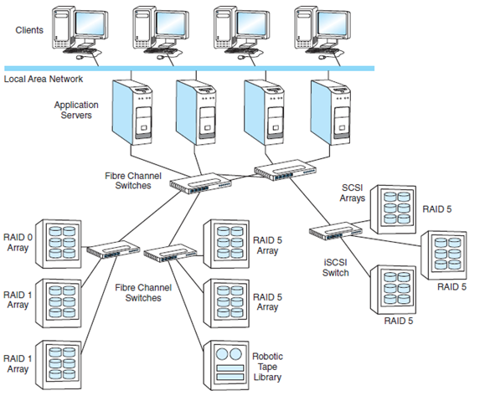
13.4 Storage Area Networks

Slide 28
13.4 Storage Area Networks
SANs differ from network attached storage (NAS) because they can be isolated from routine network traffic.
This isolation facilitates storage management and enables various security methods.
SANs have a lower protocol overhead than NAS because only the storage protocols are involved.
NAS is gaining popularity because of lower costs for equipment and training of personnel, most of whom are familiar with data networking protocols.
The next slide shows an example NAS.

Slide 29
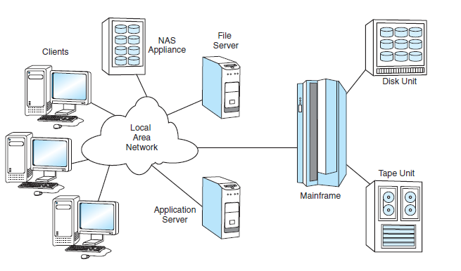
13.4 Storage Area Networks

Slide 30
13.5 Other I/O Connections
There are a number of popular I/O architectures that are outside the sphere of the SCSI-3 Architecture Model.
The parallel I/O buses common in microcomputers are an example.
The original IBM PC used an 8-bit PC/XT bus. It became an IEEE standard and was renamed the Industry Standard Architecture (ISA) bus.
This bus eventually became a bottleneck in small computer systems.

Slide 31
13.5 Other I/O Connections
Several improvements to the ISA bus have taken place over the years.
The most popular is the AT bus.
Variations to this bus include the AT Attachment (ATA), ATAPI, FastATA, and EIDE.
Theoretically, ATA buses run as fast as 100MBps. Ultra ATA supports a burst transfer rate of 133MBps.
AT buses are inexpensive and well supported in the industry.
They are, however, too slow for today’s systems.

Slide 32
13.5 Other I/O Connections
As processor speeds continue to increase, even Ultra ATA cannot keep up.
Furthermore, these fast processors dissipate a lot of heat, which must be moved away from the CPU as quickly as possible. Fat parallel disk ribbon cables impede air flow.
Serial ATA (SATA) is one solution to these problems.
Its present transfer rate is 300MBps (with faster rates expected soon).
SATA uses thin cables that operate with lower voltages and longer distances.

Slide 33
13.5 Other I/O Connections
Serial attached SCSI (SAS) is plug compatible with SATA.
SAS also moves data at 300MBps, but unlike SATA, it can (theoretically) support 16,000 devices.
Peripheral Component Interconnect (PCI) is yet another proposed replacement for the AT bus.
It is a data bus replacement that operates as fast as 264MBps for a 32-bit system, and 528MBps for a 64-bit system.

Slide 34
13.5 Other I/O Connections
Universal Serial Bus (USB) is another I/O architecture of interest.
USB isn’t really a bus: It’s a serial peripheral interface that connects to a microcomputer expansion bus.
Up to 127 devices can be cascaded off of one another up to five deep.
USB 2.0 supports transfer rates of up to 480Mbps.
Its low power consumption makes USB a good choice for laptop and handheld computers.

Slide 35
13.5 Other I/O Connections
The High Performance Peripheral Interface (HIPPI) is another interface that is outside of the SCSI-3 Architecture Model.
It is designed to interconnect supercomputers and high-performance mainframes.
Present top speeds are 100MBps with work underway for a 6.4GPps implementation.
Without repeaters, HIPPI can travel about 150 feet (50 meters) over copper and 6 miles (10 km) over fiber.

Slide 36
Chapter 13 Conclusion
We have examined a number of popular I/O architectures to include SCSI-2, FC-AL, ATA, SATA, SAS, PCI, USB, IEEE 1394, and HIPPI.
Many of these architectures are part of the SCSI Architecture Model.
Fiber Channel is most often deployed as Fiber Channel Arbitrated Loop, forming the infrastructure for storage area networks, although iSCSI is gaining fast.
The next slide summarizes the capabilities of the I/O architectures presented in this chapter.

Slide 37
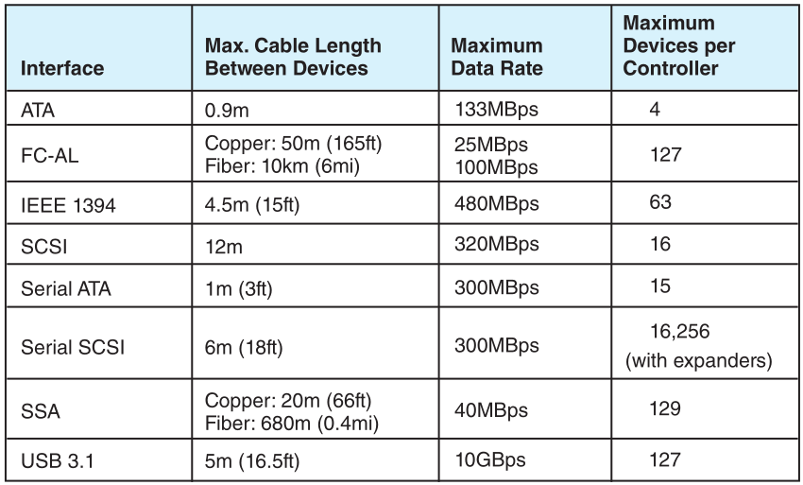
Chapter 13 Conclusion

