Slide 1
A Short Presentation on the Achievements of XeroX
Xerox started in 1906 as the Haloid Photographic company. Its primary function was to manufacture, market, and sell paper and other equipment for photographic use. What seemed like a boring and dull future as such changed when its CEO (Joseph C Wilson) agreed to develop a dry writing process that he called Xerography. This process was developed by a long struggling physicist and psychic named Chester Carlson, who had already been turned down by several companies, and even his best friend, in the marketing of his idea.

Slide 2
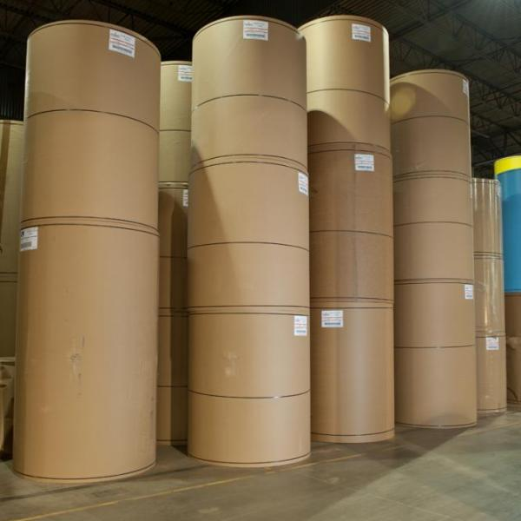
Coating paper rolls

Slide 3
Long-term goal
The original marketing of the idea was the Xerox 914. It applied 600 volts to a drum coated with electrostatic film (toner), which would deposit the ink directly onto ordinary paper. It served as a launching pad for many future innovations of that type that would then have allowed for the mass production of copies and prints for industrial, military, or office use. Out of this invention, the Xerox company was able to make millionaires of the investors who funded the research and development phase of this concept over many years. It changed the company name from Haloid to Xerox, and funded the Wilson center for Research and Technology.

Slide 4
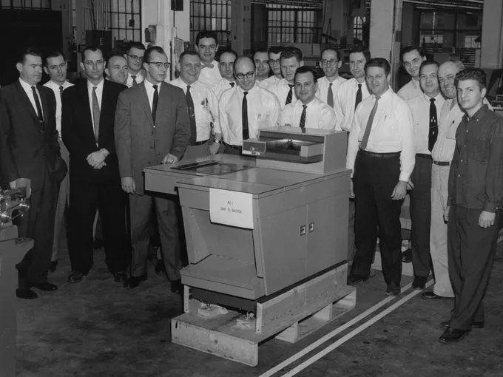
The Xerox 914

Slide 5
Immediate Developments
In just 4 years, the amount of copies that could be generated per hour by newer versions jumped from 300 to 3600. This was the difference between the 1960s X914 and the 1964 Xerox 3600 duplicator, at this time, Xerox development had implemented a system that was an automatic feeder, sorter, perforator, and duplicator, all in the same process. Xerox had also begun selling faxcopiers, which allowed users to print and send documents through the existing phone services.

Slide 6
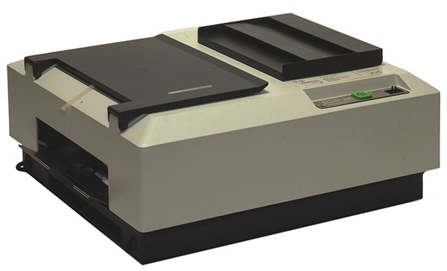
Potential Alternatives

Slide 7
Xerox in the 70s.
As Xerox attempted to market the world's first color photocopier, its new CEO reported record sales, income, and revenue. After spreading the company throughout much of North America, the Xerox company introduced the Xerox 9200 series, which featured a copying speed of 7200 per hour. They received a blessing from the archdiocese of New York after claiming that their copier would have saved them decades of manual copying. In 1979, Xerox purchases Western Union International with the hopes of creating a trade for international communications.

Slide 8
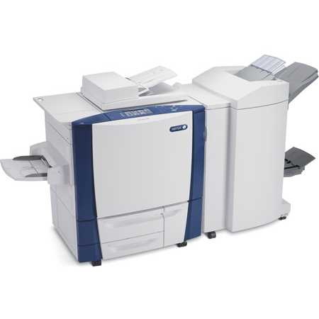
Xerox 9201

Slide 9
Xerox PARC
In 1970 as a division of xerox corporation, Palo Alto Research Labs was created and would grow to become the origin of many of Xerox's successful achievements. Although it was built 3000 miles away from Xerox, its close proximity to Stanford University allowed it to hire recent graduates of science to work at its labs. It was also built nearby the already fully established Stanford Research Institute Augmentation Research Center. This research center was able to transfer some of its senior department personnel over to PARL when its sustainment funding began failing. They would go on to develop many xerox
Products.

Slide 10
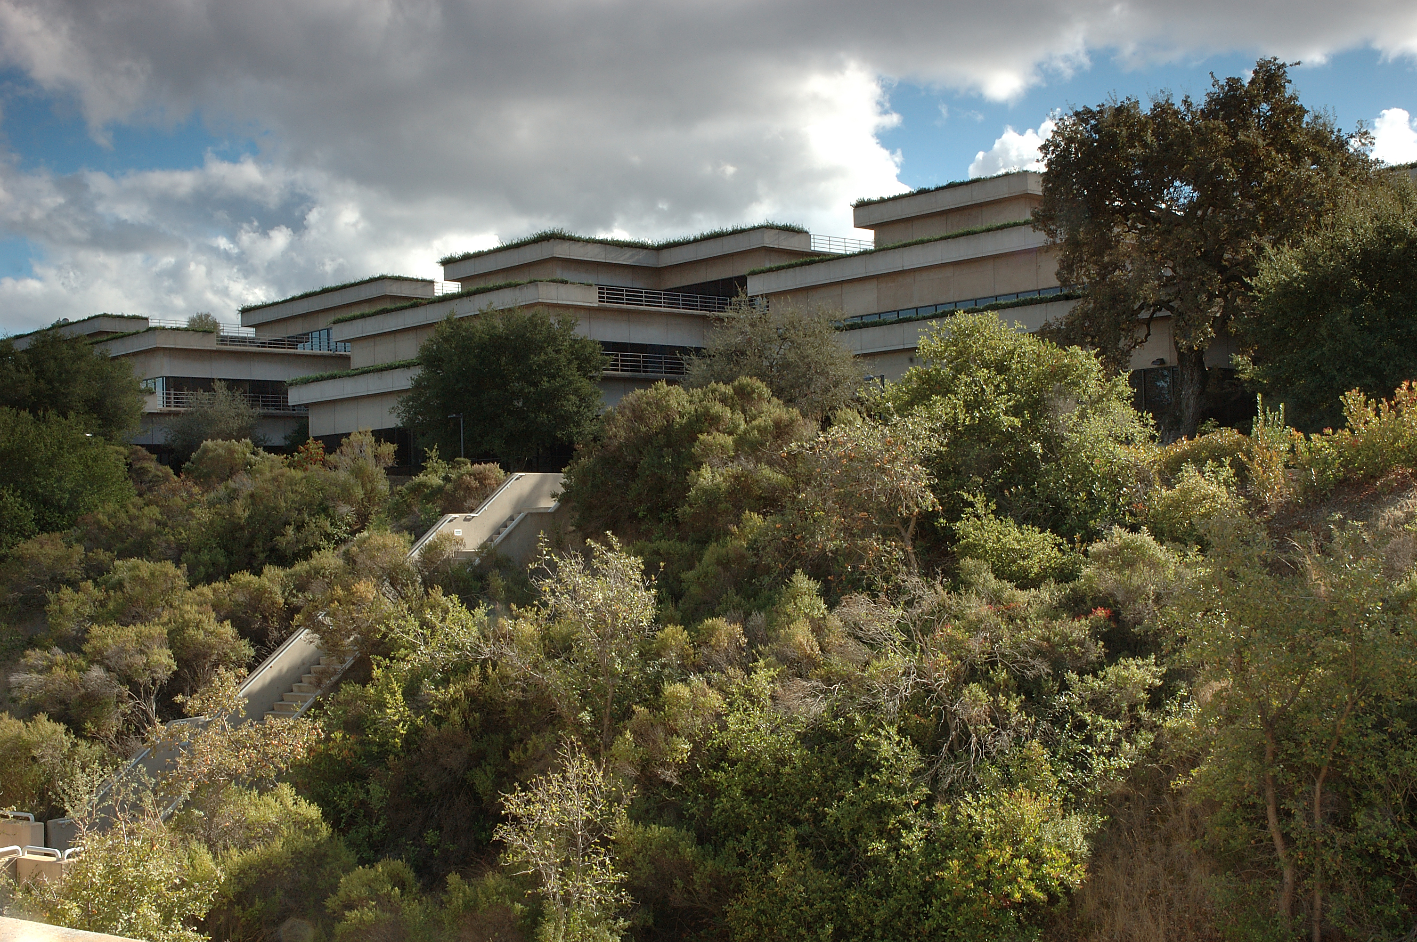
The Xerox PARC Institute

Slide 11
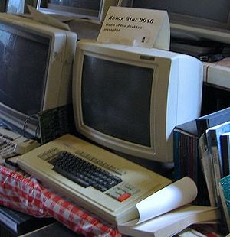
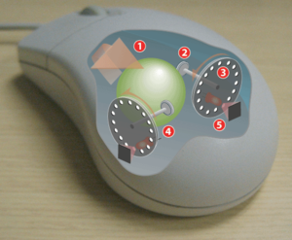
Parc work in computing
Some of these achievents include the Xerox star computer, and the rollerball mouse.

Slide 12
Xerox 1990s
In the 1990s, The Xerox company issued in their Phaser line of printers. At this time, many other companies were competent in the photocopier business. The phaser series was fully computerized with internet access, scanning and faxing capabilities, image queing, laser inkjet printing, and point to point pixel triangulation technologies. It remains the pinnacle of the achievements of
Xerography.

Slide 13
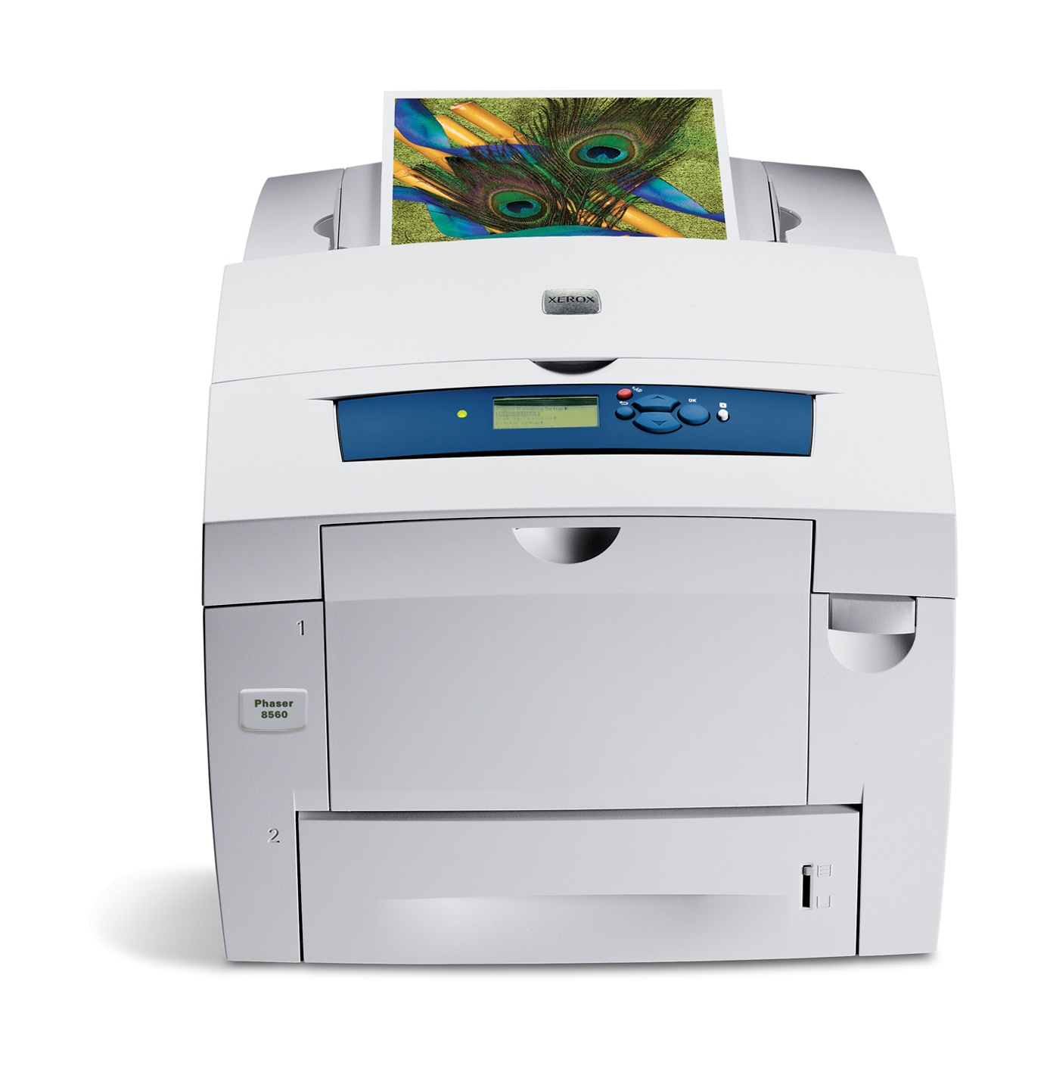
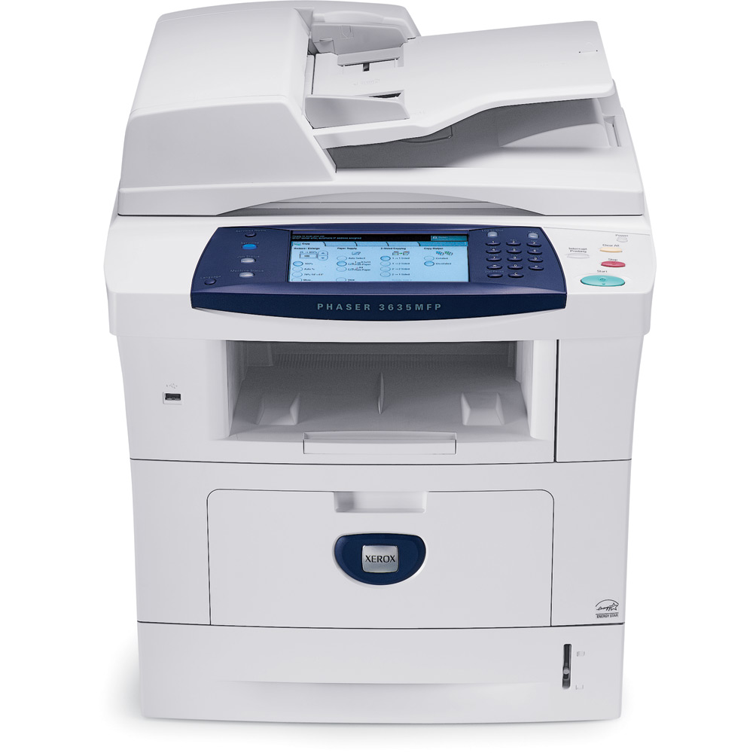
The Xerox Phaser series

Slide 14
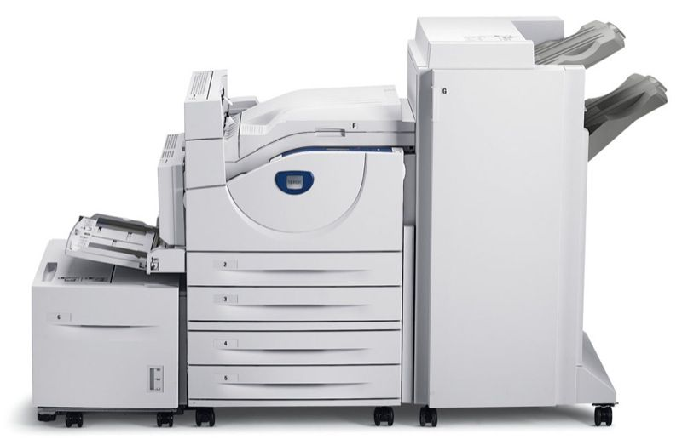
The Xerox Phaser 5550

Slide 15
Current Developments
Palo Alto Research Labs is now researching 3d printing, Holographic Imagery, Touchscreen and Touchless (gesture) interfacing, and several other higher logical functions of computing.
Xerox itself remains steadfast in modifying its existing machinery, and finding new components to add to their products, new ways to make ink, and new ways to portray images.

Slide 16
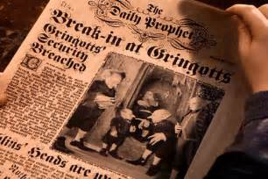
What Next?
Paper thin computer screens!

Slide 17
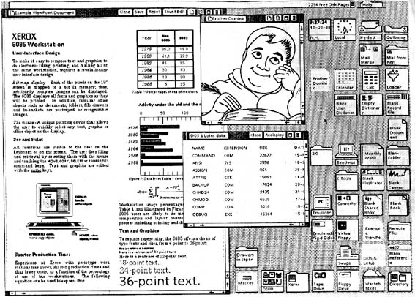
The Xerox Parc Gui (1969)

Slide 18
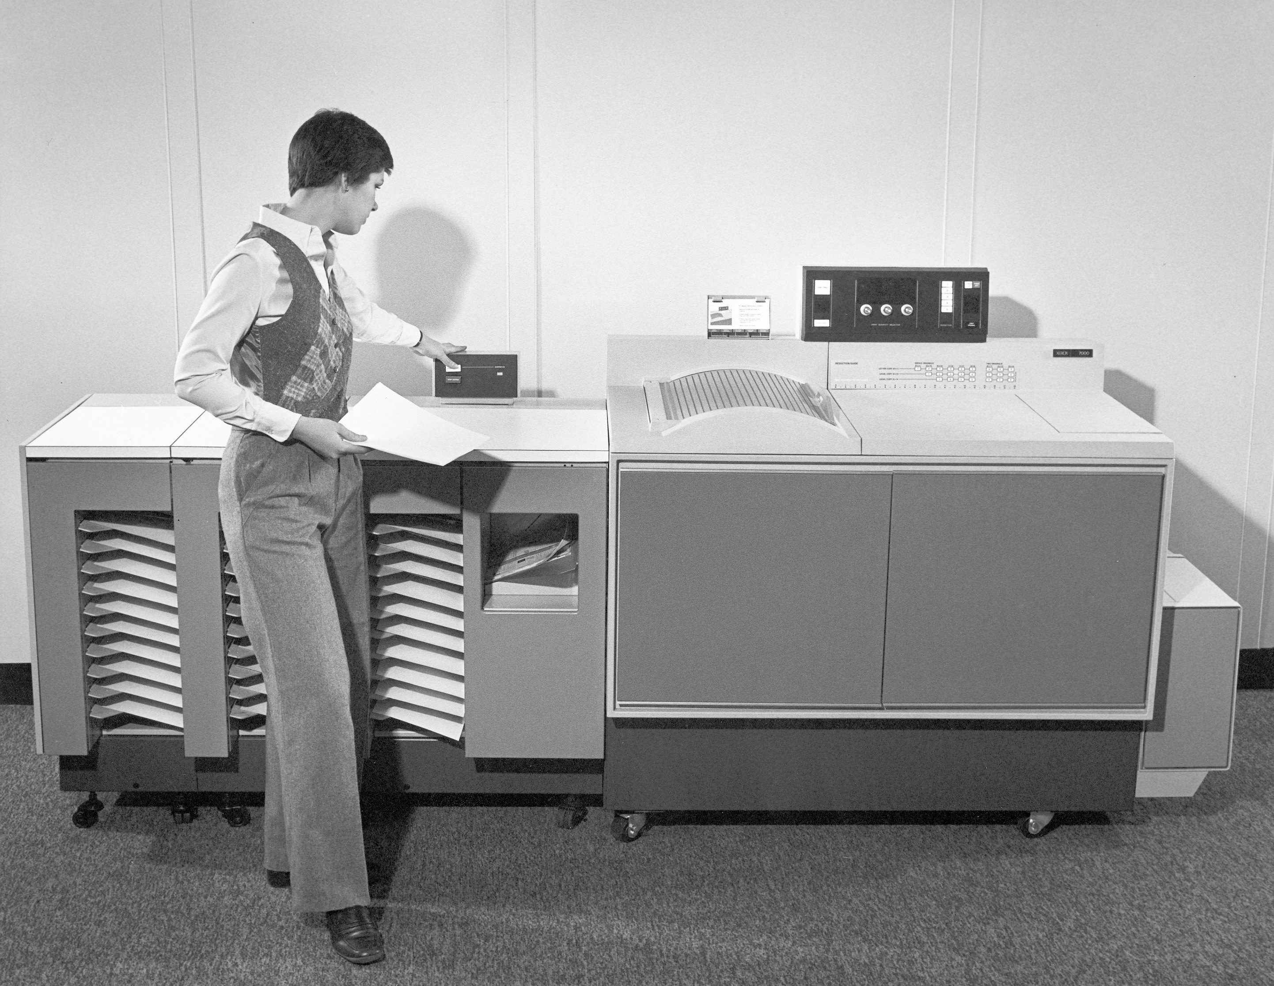
A 1960s Xerox Workcentre

