Slide 1

Chapter 2 Special Section
Focus on Codes for Data Recording and Transmission

Slide 2
2.A Introduction
The main part of Chapter 2 provides great detail about the various ways in which digital computers express numeric and non-numeric values.
These expressions are an abstraction for the way in which the values are actually stored on computer media and sent over transmission media.

Slide 3
2.A Introduction
To transmit data, pulses of “high” and “low” voltage are sent across communications media.
To store data, changes are induced in the magnetic polarity of the recording medium.
These polarity changes are called flux reversals.
The period of time during which a bit is transmitted, or the area of magnetic storage within which a bit is stored is called a bit cell.

Slide 4
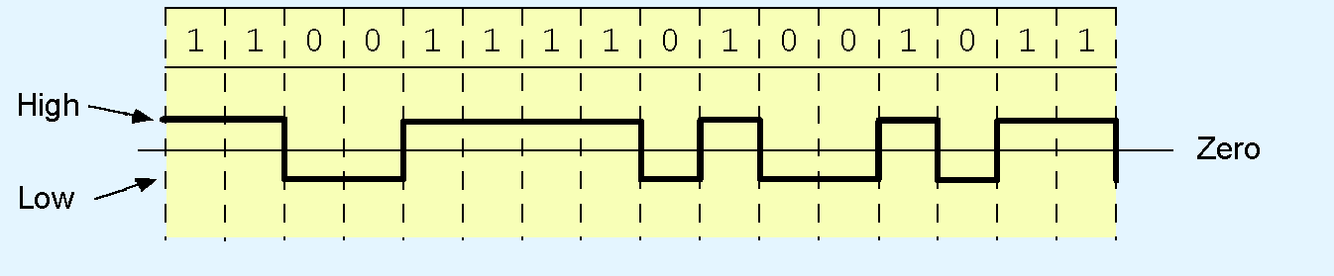
2.A.1 Non-Return-to-Zero Code
The simplest data recording and transmission code is the non-return-to-zero (NRZ) code.
NRZ encodes 1 as “high” and 0 as “low.”
The coding of OK (in ASCII) is shown below.

Slide 5
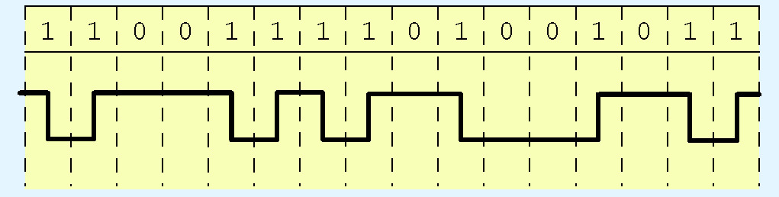
2.A.1 Non-Return-to-Zero Code
The problem with NRZ code is that long strings of zeros and ones cause synchronization loss.
Non-return-to-zero-invert (NRZI) reduces this synchronization loss by providing a transition (either low-to-high or high-to-low) for each binary 1.

Slide 6
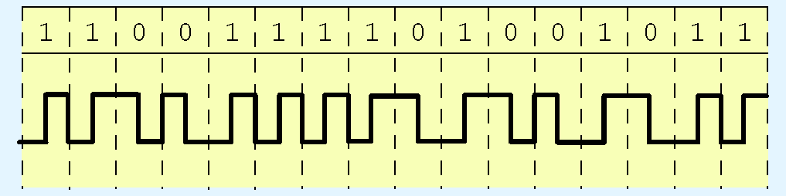
2.A.3 Manchester Code
Although it prevents loss of synchronization over long strings of binary ones, NRZI coding does nothing to prevent synchronization loss within long strings of zeros.
Manchester coding (also known as phase modulation) prevents this problem by encoding a binary one with an “up” transition and a binary zero with a “down” transition.

Slide 7
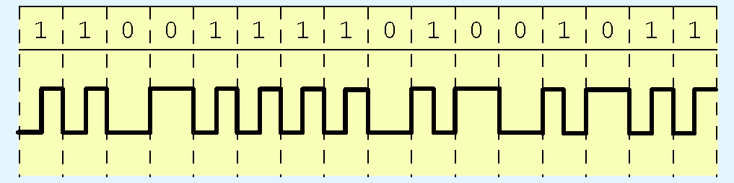
2.A.4 Frequency Modulation
For many years, Manchester code was the dominant transmission code for local area networks.
It is, however, wasteful of communications capacity because there is a transition on every bit cell.
A more efficient coding method is based upon the frequency modulation (FM) code. In FM, a transition is provided at each cell boundary. Cells containing binary ones have a mid-cell transition.

Slide 8
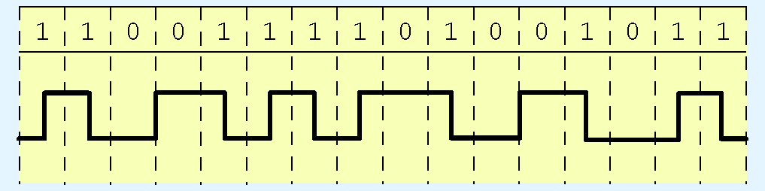
2.A.4 Frequency Modulation
At first glance, FM is worse than Manchester code, because it requires a transition at each cell boundary.
If we can eliminate some of these transitions, we would have a more economical code.
Modified FM does just this. It provides a cell boundary transition only when adjacent cells contain zeros.
An MFM cell containing a binary one has a transition in the middle as in regular FM.

Slide 9
2.A.5 Run-Length Limited
The main challenge for data recording and trans-mission is how to retain synchronization without chewing up more resources than necessary.
Run-length-limited, RLL, is a code specifically designed to reduce the number of consecutive ones and zeros.
Some extra bits are inserted into the code.
But even with these extra bits RLL is remarkably efficient.

Slide 10
2.A.5 Run-Length Limited
An RLL(d,k) code dictates a minimum of d and a maximum of k consecutive zeros between any pair of consecutive ones.
RLL(2,7) had been the dominant disk storage coding method for many years.
An RLL(2,7) code contains more bit cells than its corresponding ASCII or EBCDIC character.
However, the coding method allows bit cells to be smaller, thus closer together, than in MFM or any other code.

Slide 11
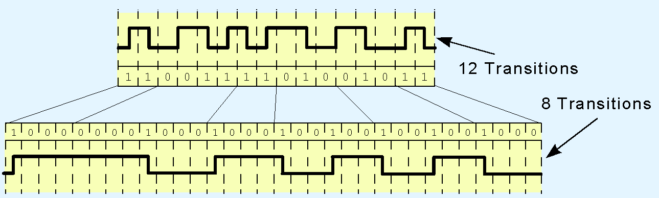
2.A.5 Run-Length Limited
The RLL(2,7) coding for OK is shown below, compared to MFM. The RLL code (bottom) contains 25% fewer transitions than the MFM code (top).
The details as to how this code is derived are given in the text.

Slide 12
2.A.6 Partial Response Maximum Likelihood Coding
RLL by itself is insufficient for reliable recording on ultra high density media.
Adjacent bits interfere with each other at very high densities.
As fewer magnetic grains are available to each bit cell, the magnetic flux weakens proportionately.
This phenomenon, called superpositioning is shown on the next slide.

Slide 13
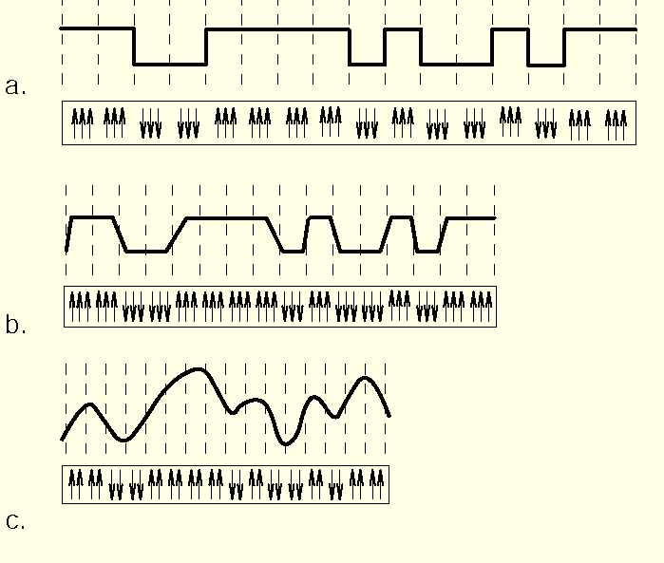
2.A.6 Partial Response Maximum Likelihood Coding
Fortunately, this behavior is well understood and can be used to our advantage.

Slide 14
2.A.6 Partial Response Maximum Likelihood Coding
The patterns in the previous slide can be made meaningful when each bit cell is sampled several times.
The sampling determines a “partial response” pattern.
A Viterbi detector tries to match the partial response with the most likely pattern.
This technique is stunningly accurate. We describe it in detail in Chapter 3.

Slide 15
Section 2A Conclusion
Data transmission and storage codes are devised to convey or store bytes reliably and economically.
A coding scheme that uses fewer magnetic transitions is more efficient than one with more magnetic transitions per character.
Long strings of zeroes and ones can result in synchronization loss.

Slide 16
Section 2A Conclusion
RLL(d,k) code dictates a minimum of d and a maximum of k consecutive zeros between any pair of consecutive ones.
MFM was widely used until PRML and its extensions became widely used.
PRML requires multiple samplings per bit cell, but permits bit cells to be spaced closer together.
We return to this subject in Chapter 3.

