Slide 1
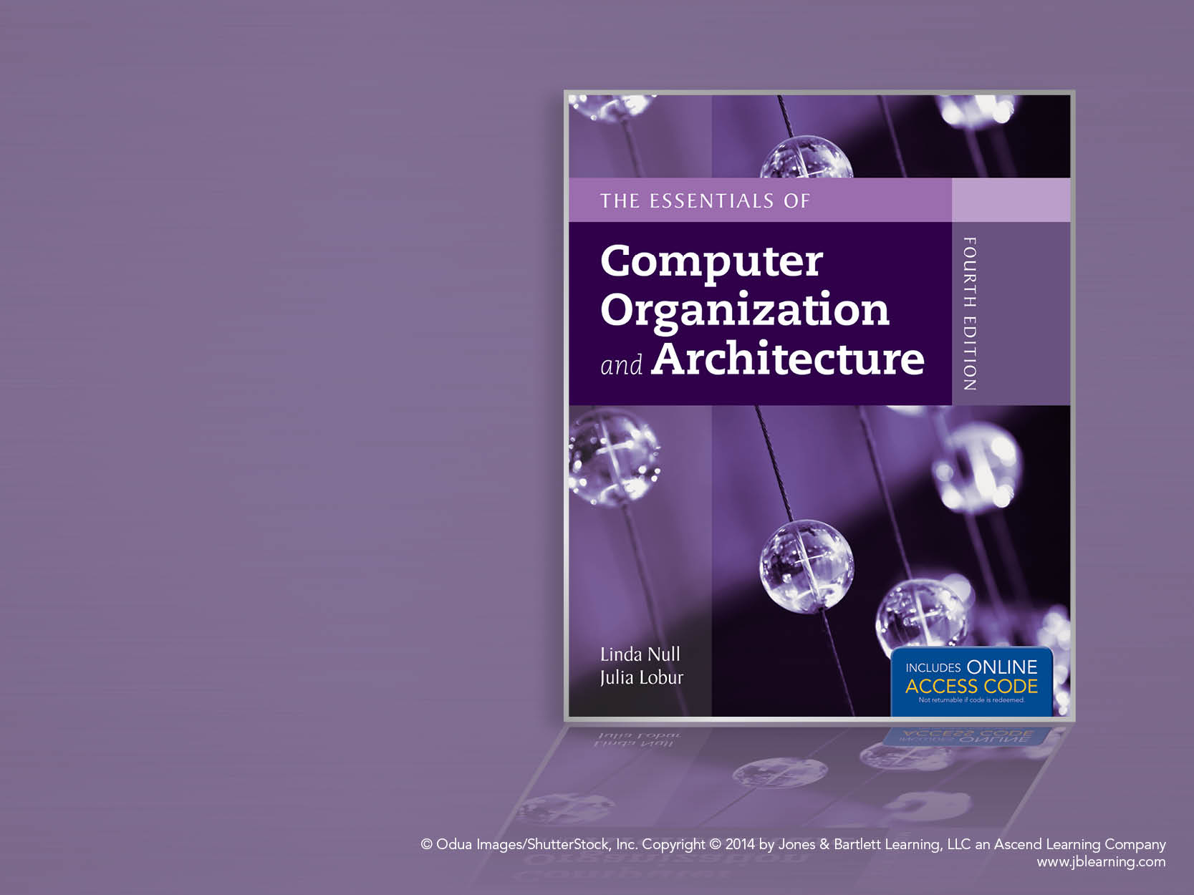
Chapter 4
MARIE: An Introduction
to a Simple Computer

Slide 2
Chapter 4 Objectives
Learn the components common to every modern computer system.
Be able to explain how each component contributes to program execution.
Understand a simple architecture invented to illuminate these basic concepts, and how it relates to some real architectures.
Know how the program assembly process works.

Slide 3
4.1 Introduction
Chapter 1 presented a general overview of computer systems.
In Chapter 2, we discussed how data is stored and manipulated by various computer system components.
Chapter 3 described the fundamental components of digital circuits.
Having this background, we can now understand how computer components work, and how they fit together to create useful computer systems.

Slide 4
4.2 CPU Basics
The computer’s CPU fetches, decodes, and executes program instructions.
The two principal parts of the CPU are the datapath and the control unit.
The datapath consists of an arithmetic-logic unit and storage units (registers) that are interconnected by a data bus that is also connected to main memory.
Various CPU components perform sequenced operations according to signals provided by its control unit.

Slide 5
4.2 CPU Basics
Registers hold data that can be readily accessed by the CPU.
They can be implemented using D flip-flops.
A 32-bit register requires 32 D flip-flops.
The arithmetic-logic unit (ALU) carries out logical and arithmetic operations as directed by the control unit.
The control unit determines which actions to carry out according to the values in a program counter register and a status register.

Slide 6
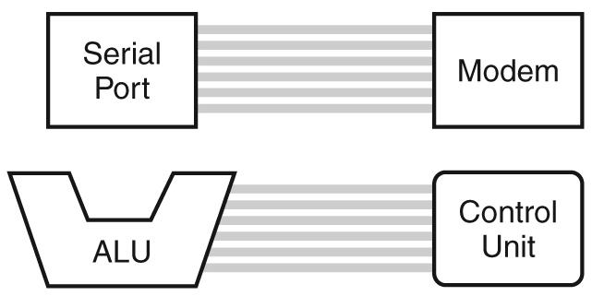
4.3 The Bus
The CPU shares data with other system components by way of a data bus.
A bus is a set of wires that simultaneously convey a single bit along each line.
Two types of buses are commonly found in computer systems: point-to-point, and multipoint buses.
These are point-to-point buses:

Slide 7
4.3 The Bus
Buses consist of data lines, control lines, and address lines.
While the data lines convey bits from one device to another, control lines determine the direction of data flow, and when each device can access the bus.
Address lines determine the location of the source or destination of the data.
The next slide shows a model bus configuration.

Slide 8
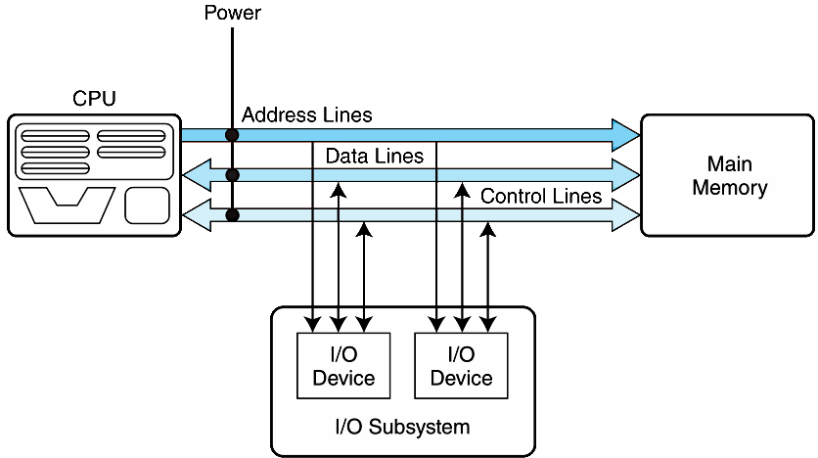
4.3 The Bus

Slide 9
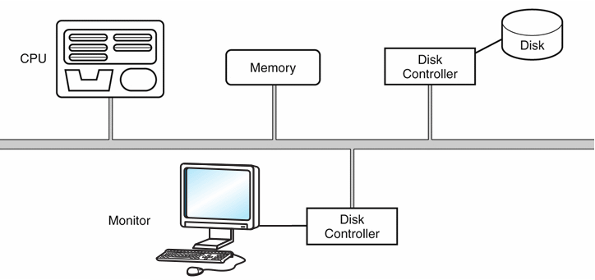
4.3 The Bus
A multipoint bus is shown below.
Because a multipoint bus is a shared resource, access to it is controlled through protocols, which are built into the hardware.

Slide 10
4.3 The Bus
In a master-slave configuration, where more than one device can be the bus master, concurrent bus master requests must be arbitrated.
Four categories of bus arbitration are:
Daisy chain: Permissions are passed from the highest-priority device to the lowest.
Centralized parallel: Each device is directly connected to an arbitration circuit.
Distributed using self-detection: Devices decide which gets the bus among themselves.
Distributed using collision-detection: Any device can try to use the bus. If its data collides with the data of another device, it tries again.

Slide 11
4.4 Clocks
Every computer contains at least one clock that synchronizes the activities of its components.
A fixed number of clock cycles are required to carry out each data movement or computational operation.
The clock frequency, measured in megahertz or gigahertz, determines the speed with which all operations are carried out.
Clock cycle time is the reciprocal of clock frequency.
An 800 MHz clock has a cycle time of 1.25 ns.

Slide 12

4.4 Clocks
Clock speed should not be confused with CPU performance.
The CPU time required to run a program is given by the general performance equation:
We see that we can improve CPU throughput when we reduce the number of instructions in a program, reduce the number of cycles per instruction, or reduce the number of nanoseconds per clock cycle.
We will return to this important equation in later chapters.

Slide 13
4.5 The Input/Output Subsystem
A computer communicates with the outside world through its input/output (I/O) subsystem.
I/O devices connect to the CPU through various interfaces.
I/O can be memory-mapped-- where the I/O device behaves like main memory from the CPU’s point of view.
Or I/O can be instruction-based, where the CPU has a specialized I/O instruction set.
We study I/O in detail in chapter 7.

Slide 14
4.6 Memory Organization
Computer memory consists of a linear array of addressable storage cells that are similar to registers.
Memory can be byte-addressable, or word-addressable, where a word typically consists of two or more bytes.
Memory is constructed of RAM chips, often referred to in terms of length × width.
If the memory word size of the machine is 16 bits, then a 4M × 16 RAM chip gives us 4 megabytes of 16-bit memory locations.

Slide 15
4.6 Memory Organization
How does the computer access a memory location corresponds to a particular address?
We observe that 4M can be expressed as 2 ² × 2 ²⁰ = 2 ²² words.
The memory locations for this memory are numbered 0 through 2 ²² -1.
Thus, the memory bus of this system requires at least 22 address lines.
The address lines “count” from 0 to 2²² - 1 in binary. Each line is either “on” or “off” indicating the location of the desired memory element.

Slide 16
4.6 Memory Organization
Physical memory usually consists of more than one RAM chip.
Access is more efficient when memory is organized into banks of chips with the addresses interleaved across the chips
With low-order interleaving, the low order bits of the address specify which memory bank contains the address of interest.
Accordingly, in high-order interleaving, the high order address bits specify the memory bank.
The next two slides illustrate these two ideas.

Slide 17
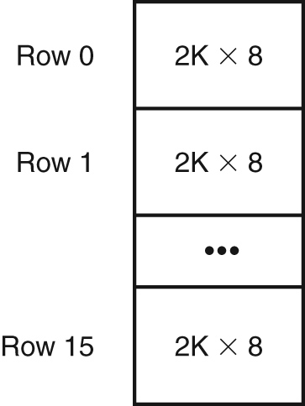
4.6 Memory Organization
Example: Suppose we have a memory consisting of 16 2K x 8 bit chips.
Memory is 32K = 2⁵ × 2¹⁰ = 2¹⁵
15 bits are needed for each address.
We need 4 bits to select the chip, and 11 bits for the offset into the chip that selects the byte.

Slide 18
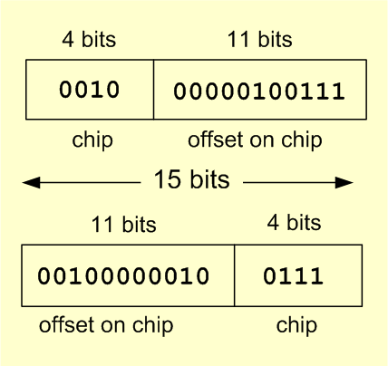
4.6 Memory Organization
In high-order interleaving the high-order 4 bits select the chip.
In low-order interleaving the low-order 4 bits select the chip.

Slide 19
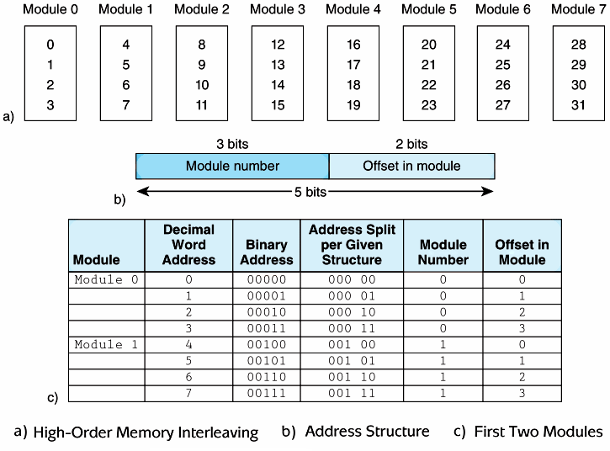
4.6 Memory Organization

Slide 20
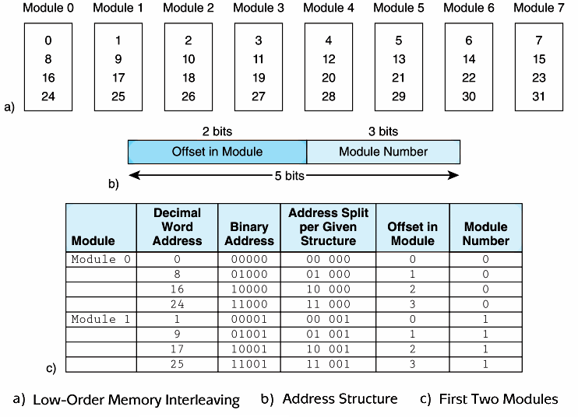
4.6 Memory Organization

Slide 21
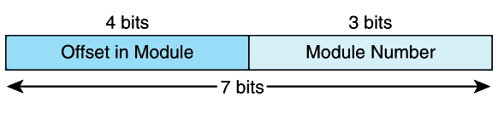
4.6 Memory Organization
EXAMPLE 4.1 Suppose we have a 128-word memory that is 8-way low-order interleaved
which means it uses 8 memory banks; 8 = 2³
So we use the low-order 3 bits to identify the bank.
Because we have 128 words, we need 7 bits for each address (128 = 2 ⁷ ).

Slide 22
4.7 Interrupts
The normal execution of a program is altered when an event of higher-priority occurs. The CPU is alerted to such an event through an interrupt.
Interrupts can be triggered by I/O requests, arithmetic errors (such as division by zero), or when an invalid instruction is encountered.
Each interrupt is associated with a procedure that directs the actions of the CPU when an interrupt occurs.
Nonmaskable interrupts are high-priority interrupts that cannot be ignored.

Slide 23
4.8 MARIE
We can now bring together many of the ideas that we have discussed to this point using a very simple model computer.
Our model computer, the Machine Architecture that is Really Intuitive and Easy, MARIE, was designed for the singular purpose of illustrating basic computer system concepts.
While this system is too simple to do anything useful in the real world, a deep understanding of its functions will enable you to comprehend system architectures that are much more complex.

Slide 24
4.8 MARIE
The MARIE architecture has the following characteristics:
Binary, two's complement data representation.
Stored program, fixed word length data and instructions.
4K words of word-addressable main memory.
16-bit data words.
16-bit instructions, 4 for the opcode and 12 for the address.
A 16-bit arithmetic logic unit (ALU).
Seven registers for control and data movement.

Slide 25
4.8 MARIE
MARIE’s seven registers are:
Accumulator, AC, a 16-bit register that holds a conditional operator (e.g., "less than") or one operand of a two-operand instruction.
Memory address register, MAR, a 12-bit register that holds the memory address of an instruction or the operand of an instruction.
Memory buffer register, MBR, a 16-bit register that holds the data after its retrieval from, or before its placement in memory.

Slide 26
4.8 MARIE
MARIE’s seven registers are:
Program counter, PC, a 12-bit register that holds the address of the next program instruction to be executed.
Instruction register, IR, which holds an instruction immediately preceding its execution.
Input register, InREG, an 8-bit register that holds data read from an input device.
Output register, OutREG, an 8-bit register, that holds data that is ready for the output device.

Slide 27
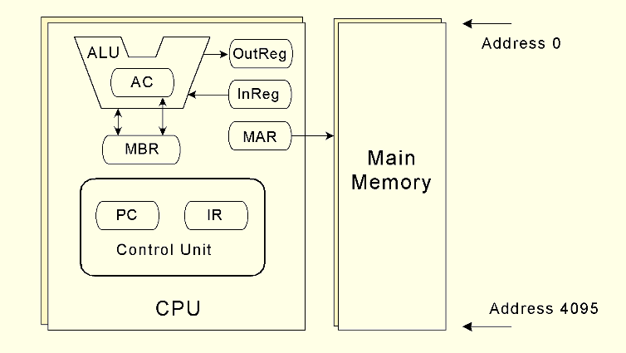
4.8 MARIE
This is the MARIE architecture shown graphically.

Slide 28
4.8 MARIE
The registers are interconnected, and connected with main memory through a common data bus.
Each device on the bus is identified by a unique number that is set on the control lines whenever that device is required to carry out an operation.
Separate connections are also provided between the accumulator and the memory buffer register, and the ALU and the accumulator and memory buffer register.
This permits data transfer between these devices without use of the main data bus.

Slide 29
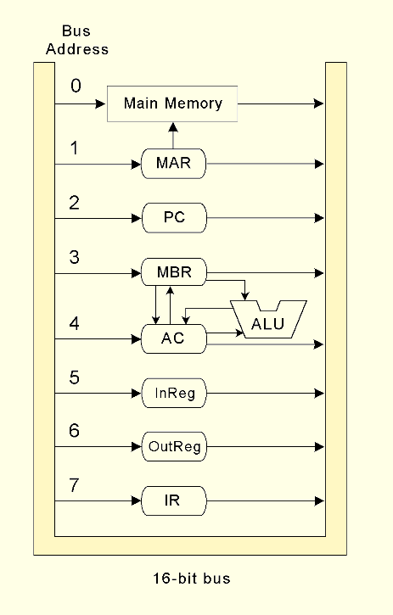
4.8 MARIE
This is the MARIE data path shown graphically.

Slide 30
4.8 MARIE
A computer’s instruction set architecture (ISA) specifies the format of its instructions and the primitive operations that the machine can perform.
The ISA is an interface between a computer’s hardware and its software.
Some ISAs include hundreds of different instructions for processing data and controlling program execution.
The MARIE ISA consists of only thirteen instructions.

Slide 31
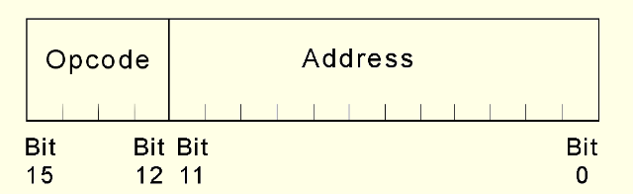
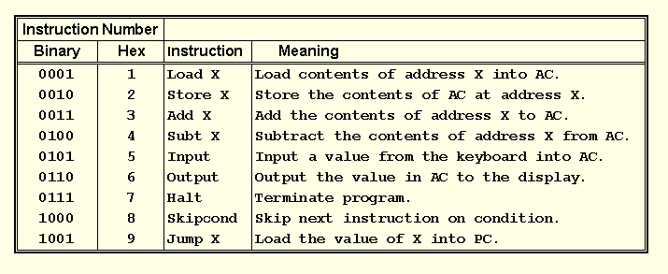
4.8 MARIE
This is the format
of a MARIE instruction:
The fundamental MARIE instructions are:

Slide 32
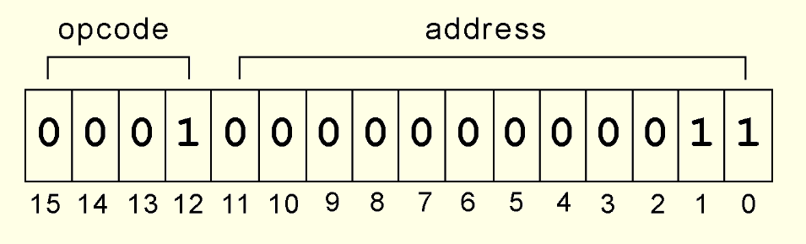
4.8 MARIE
This is a bit pattern for a LOAD instruction as it would appear in the IR:
We see that the opcode is 1 and the address from which to load the data is 3.

Slide 33
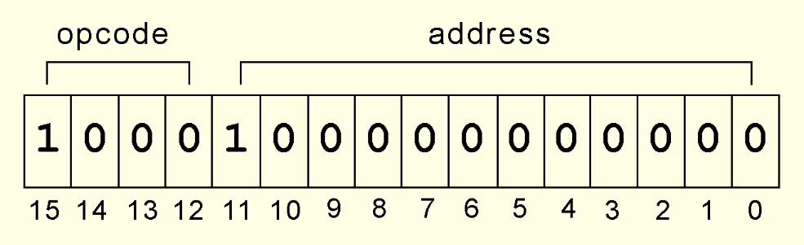
4.8 MARIE
This is a bit pattern for a SKIPCOND instruction as it would appear in the IR:
We see that the opcode is 8 and bits 11 and 10 are 10, meaning that the next instruction will be skipped if the value in the AC is greater than zero.
What is the hexadecimal representation of this instruction?

Slide 34
4.8 MARIE
Each of our instructions actually consists of a sequence of smaller instructions called microoperations.
The exact sequence of microoperations that are carried out by an instruction can be specified using register transfer language (RTL).
In the MARIE RTL, we use the notation M[X] to indicate the actual data value stored in memory location X, and ← to indicate the transfer of bytes to a register or memory location.

Slide 35
4.8 MARIE
The RTL for the LOAD instruction is:
Similarly, the RTL for the ADD instruction is:
MAR ← X
MBR ← M[MAR]
AC ← MBR
MAR ← X
MBR ← M[MAR]
AC ← AC + MBR

Slide 36
4.8 MARIE
Recall that SKIPCOND skips the next instruction according to the value of the AC.
The RTL for the this instruction is the most complex in our instruction set:
If IR[11 - 10] = 00 then
If AC < 0 then PC ← PC + 1
else If IR[11 - 10] = 01 then
If AC = 0 then PC ← PC + 1
else If IR[11 - 10] = 11 then
If AC > 0 then PC ← PC + 1

Slide 37
4.9 Instruction Processing
The fetch-decode-execute cycle is the series of steps that a computer carries out when it runs a program.
We first have to fetch an instruction from memory, and place it into the IR.
Once in the IR, it is decoded to determine what needs to be done next.
If a memory value (operand) is involved in the operation, it is retrieved and placed into the MBR.
With everything in place, the instruction is executed.
The next slide shows a flowchart of this process.

Slide 38
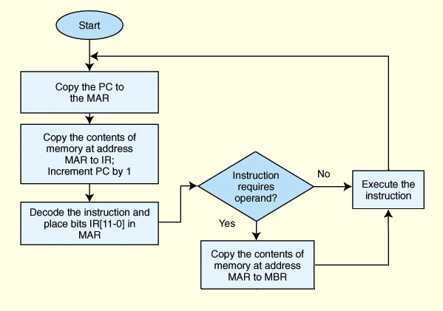
4.9 Instruction Processing

Slide 39
4.9 Instruction Processing
All computers provide a way of interrupting the fetch-decode-execute cycle.
Interrupts occur when:
A user break (e.,g., Control+C) is issued
I/O is requested by the user or a program
A critical error occurs
Interrupts can be caused by hardware or software.
Software interrupts are also called traps.

Slide 40
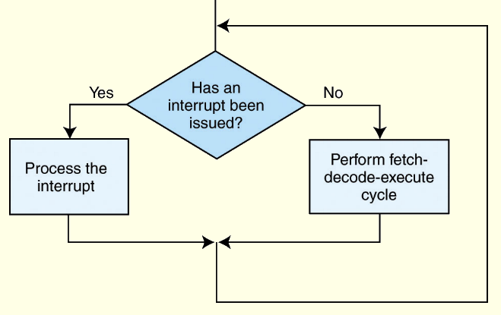
4.9 Instruction Processing
Interrupt processing involves adding another step to the fetch-decode-execute cycle as shown below.
The next slide shows a flowchart of “Process the interrupt.”

Slide 41
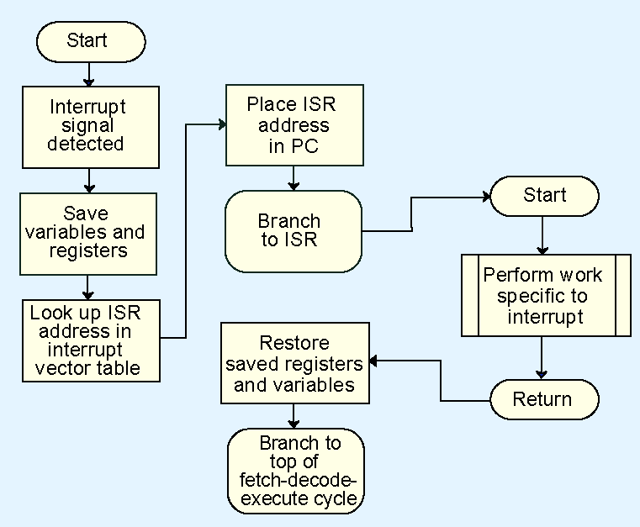
4.9 Instruction Processing

Slide 42
4.9 Instruction Processing
For general-purpose systems, it is common to disable all interrupts during the time in which an interrupt is being processed.
Typically, this is achieved by setting a bit in the flags register.
Interrupts that are ignored in this case are called maskable.
Nonmaskable interrupts are those interrupts that must be processed in order to keep the system in a stable condition.

Slide 43
4.9 Instruction Processing
Interrupts are very useful in processing I/O.
However, interrupt-driven I/O is complicated, and is beyond the scope of our present discussion.
We will look into this idea in greater detail in Chapter 7.
MARIE, being the simplest of simple systems, uses a modified form of programmed I/O.
All output is placed in an output register, OutREG, and the CPU polls the input register, InREG, until input is sensed, at which time the value is copied into the accumulator.

Slide 44
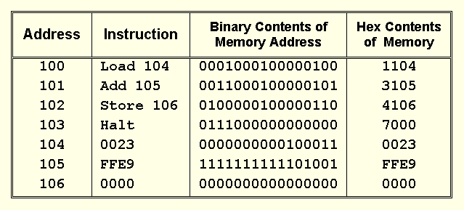
4.10 A Simple Program
Consider the simple MARIE program given below. We show a set of mnemonic instructions stored at addresses 0x100 – 0x106 (hex):

Slide 45
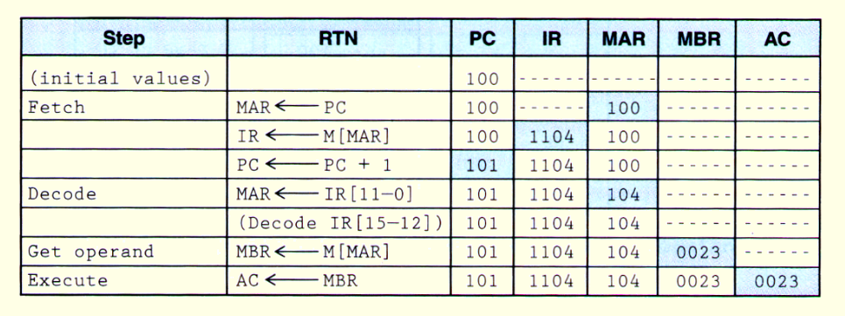
4.10 A Simple Program
Let’s look at what happens inside the computer when our program runs.
This is the LOAD 104 instruction:

Slide 46
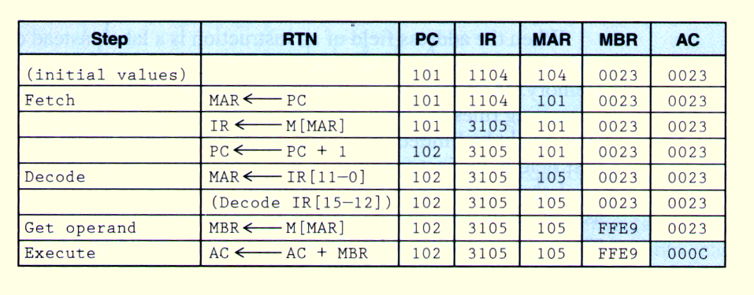
4.10 A Simple Program
Our second instruction is ADD 105:

Slide 47
4.11 A Discussion on Assemblers
Mnemonic instructions, such as LOAD 104, are easy for humans to write and understand.
They are impossible for computers to understand.
Assemblers translate instructions that are comprehensible to humans into the machine language that is comprehensible to computers
We note the distinction between an assembler and a compiler: In assembly language, there is a one-to-one correspondence between a mnemonic instruction and its machine code. With compilers, this is not usually the case.

Slide 48
4.11 A Discussion on Assemblers
Assemblers create an object program file from mnemonic source code in two passes.
During the first pass, the assembler assembles as much of the program as it can, while it builds a symbol table that contains memory references for all symbols in the program.
During the second pass, the instructions are completed using the values from the symbol table.

Slide 49
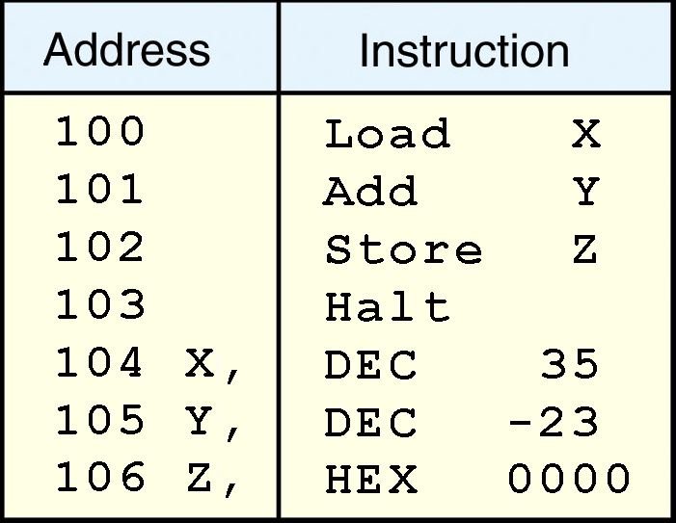
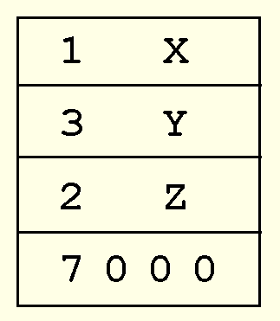
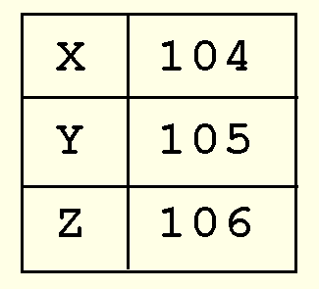
4.11 A Discussion on Assemblers
Consider our example program at the right.
Note that we have included two directives HEX and DEC that specify the radix of the constants.
The first pass, creates a symbol table and the partially-assembled instructions as shown.

Slide 50
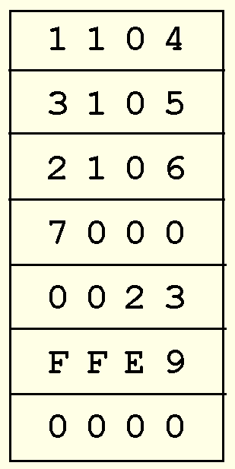
4.11 A Discussion on Assemblers
After the second pass, the assembly is complete.

Slide 51
4.12 Extending Our Instruction Set
So far, all of the MARIE instructions that we have discussed use a direct addressing mode.
This means that the address of the operand is explicitly stated in the instruction.
It is often useful to employ a indirect addressing, where the address of the address of the operand is given in the instruction.
If you have ever used pointers in a program, you are already familiar with indirect addressing.

Slide 52
4.12 Extending Our Instruction Set
We have included three indirect addressing mode instructions in the MARIE instruction set.
The first two are LOADI X and STOREI X where specifies the address of the operand to be loaded or stored.
In RTL :
MAR ← X
MBR ← M[MAR]
MAR ← MBR
MBR ← M[MAR]
AC ← MBR
MAR ← X
MBR ← M[MAR]
MAR ← MBR
MBR ← AC
M[MAR] ← MBR
STOREI X

Slide 53
4.12 Extending Our Instruction Set
The ADDI instruction is a combination of LOADI X and ADD X:
In RTL:
MAR ← X
MBR ← M[MAR]
MAR ← MBR
MBR ← M[MAR]
AC ← AC + MBR
ADDI X

Slide 54
4.12 Extending Our Instruction Set
Another helpful programming tool is the use of subroutines.
The jump-and-store instruction, JNS, gives us limited subroutine functionality. The details of the JNS instruction are given by the following RTL:
MBR ← PC
MAR ← X
M[MAR] ← MBR
MBR ← X
AC ← 1
AC ← AC + MBR
AC ← PC
Does JNS permit recursive calls?

Slide 55
4.12 Extending Our Instruction Set
Our first new instruction is the CLEAR instruction.
All it does is set the contents of the accumulator to all zeroes.
This is the RTL for CLEAR:
We put our new instructions to work in the program on the following slide.
AC ← 0

Slide 56
4.12 Extending Our Instruction Set
100 | LOAD Addr
101 | STORE Next
102 | LOAD Num
103 | SUBT One
104 | STORE Ctr
105 |Loop LOAD Sum
106 | ADDI Next
107 | STORE Sum
108 | LOAD Next
109 | ADD One
10A | STORE Next
10B | LOAD Ctr
10C | SUBT One
10D | STORE Ctr
10E | SKIPCOND 000
10F | JUMP Loop
110 | HALT
111 |Addr HEX 117
112 |Next HEX 0
113 |Num DEC 5
114 |Sum DEC 0
115 |Ctr HEX 0
116 |One DEC 1
117 | DEC 10
118 | DEC 15
119 | DEC 2
11A | DEC 25
11B | DEC 30

Slide 57
4.13 A Discussion on Decoding
A computer’s control unit keeps things synchronized, making sure that bits flow to the correct components as the components are needed.
There are two general ways in which a control unit can be implemented: hardwired control and microprogrammed control.
With microprogrammed control, a small program is placed into read-only memory in the microcontroller.
Hardwired controllers implement this program using digital logic components.

Slide 58
4.13 A Discussion on Decoding
Your text provides a complete list of the register transfer language for each of MARIE’s instructions.
The microoperations given by each RTL define the operation of MARIE’s control unit.
Each microoperation consists of a distinctive signal pattern that is interpreted by the control unit and results in the execution of an instruction.
Recall, the RTL for the Add instruction is:
MAR ← X
MBR ← M[MAR]
AC ← AC + MBR

Slide 59
4.13 A Discussion on Decoding
Each of MARIE’s registers and main memory have a unique address along the datapath.
The addresses take the form of signals issued by the control unit.
How many signal lines does MARIE’s control unit need?

Slide 60
4.13 A Discussion on Decoding
Let us define two sets of three signals.
One set, P₂, P₁, P₀, controls reading from memory or a register, and the other set consisting of P₅, P₄, P₃, controls writing to memory or a register.
The next slide shows a close up view of MARIE’s MBR.

Slide 61
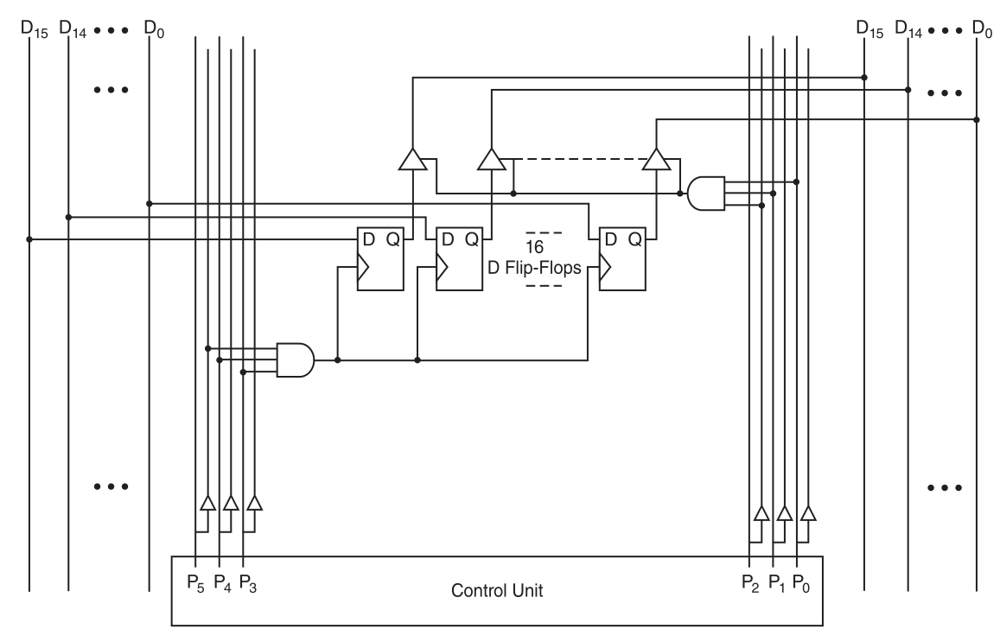
4.13 A Discussion on Decoding
This register is enabled for reading when P0 and P1 are high, and enabled for writing when P3 and P4 are high

Slide 62
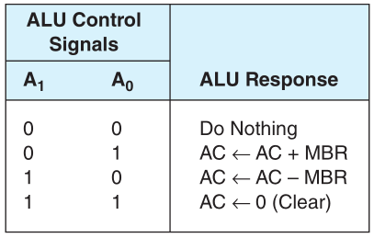
4.13 A Discussion on Decoding
Careful inspection of MARIE’s RTL reveals that the ALU has only three operations: add, subtract, and clear.
We will also define a fourth “do nothing” state.
The entire set of MARIE’s control signals consists of:
Register controls: P₀ through P_{5,} M_{R} , and M_{W}.
ALU controls: A₀ through A₃ and L_{ALT} to control the ALU’s data source.
Timing: T₀ through T₇ and counter reset C_{r}

Slide 63
4.13 A Discussion on Decoding
Consider MARIE’s Add instruction. Its RTL is:
MAR ← X
MBR ← M[MAR]
AC ← AC + MBR
After an Add instruction is fetched, the address, X, is in the rightmost 12 bits of the IR, which has a datapath address of 7.
X is copied to the MAR, which has a datapath address of 1.
Thus we need to raise signals P₀, P₁, and P₂ to read from the IR, and signal P₃ to write to the MAR.

Slide 64
4.13 A Discussion on Decoding
Here is the complete signal sequence for MARIE’s Add instruction:
P₃ P₂ P₁ P₀ T₃ : MAR ← X
P₄ P₃ T₄ M_{R} : MBR ← M[MAR]
C_{r} A₀ P₅ T₅ L_{ALT} : AC ← AC + MBR
[Reset counter]
These signals are ANDed with combinational logic to bring about the desired machine behavior.
The next slide shows the timing diagram for this instruction.

Slide 65
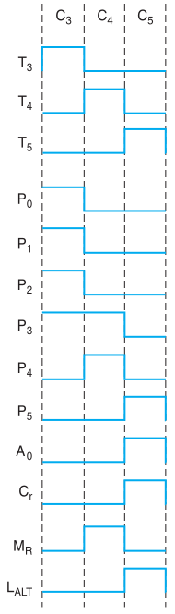
4.13 Decoding
Notice the concurrent signal states during each machine cycle: C₀ through C₃.
P₃ P₂ P₁ P₀ T₃ : MAR ← X
P₄ P₃ T₄ M_{R} : MBR ← M[MAR]
C_{r} A₀ P₅ T₅ L_{ALT} : AC ← AC + MBR
[Reset counter]

Slide 66
4.13 A Discussion on Decoding
We note that the signal pattern just described is the same whether our machine used hardwired or microprogrammed control.
In hardwired control, the bit pattern of machine instruction in the IR is decoded by combinational logic.
The decoder output works with the control signals of the current system state to produce a new set of control signals.
A block diagram of a hardwired control unit is shown on the following slide.

Slide 67
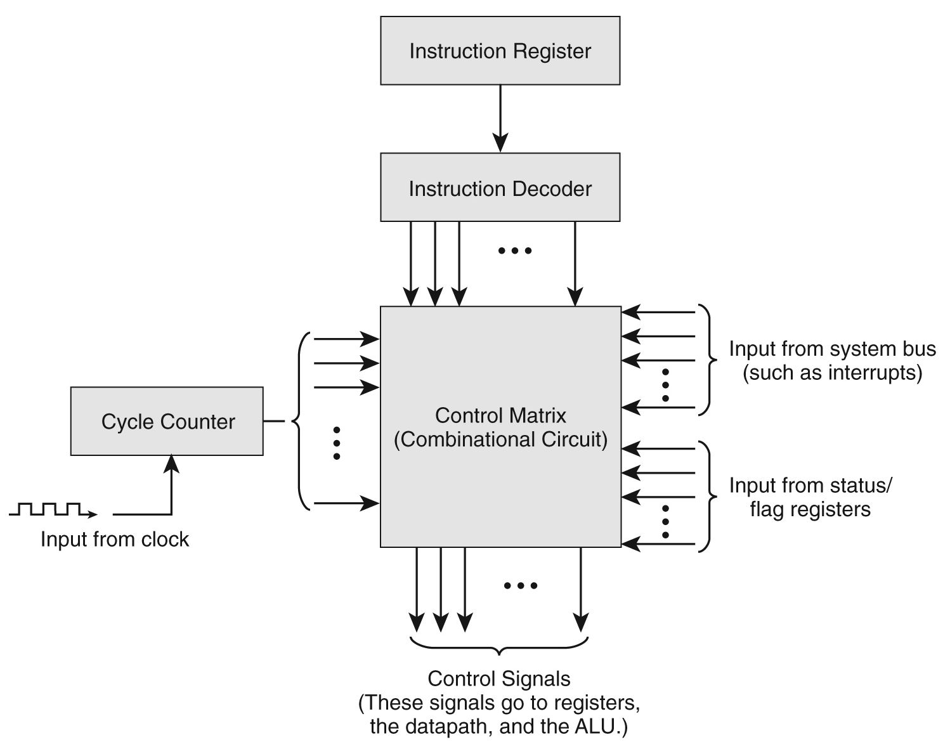
4.13 A Discussion on Decoding

Slide 68
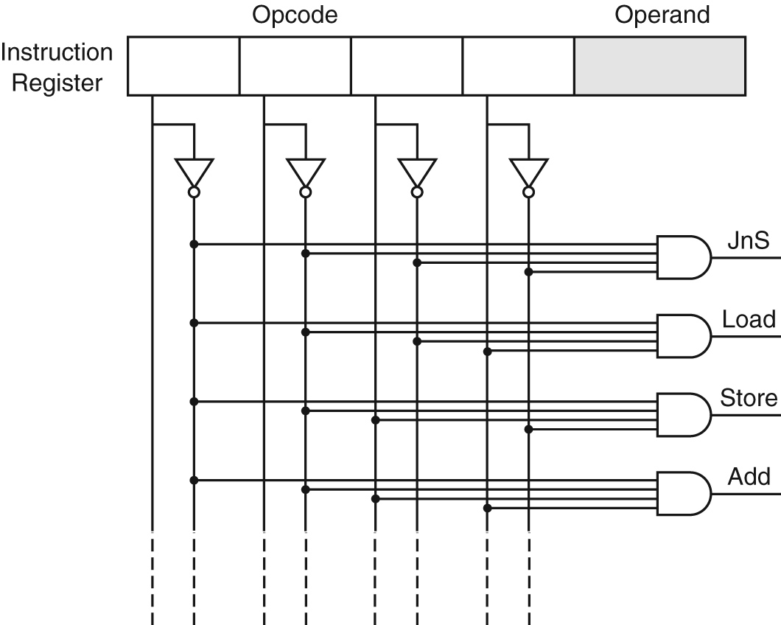
4.13 A Discussion on Decoding
MARIE's instruction decoder. (Partial.)

Slide 69
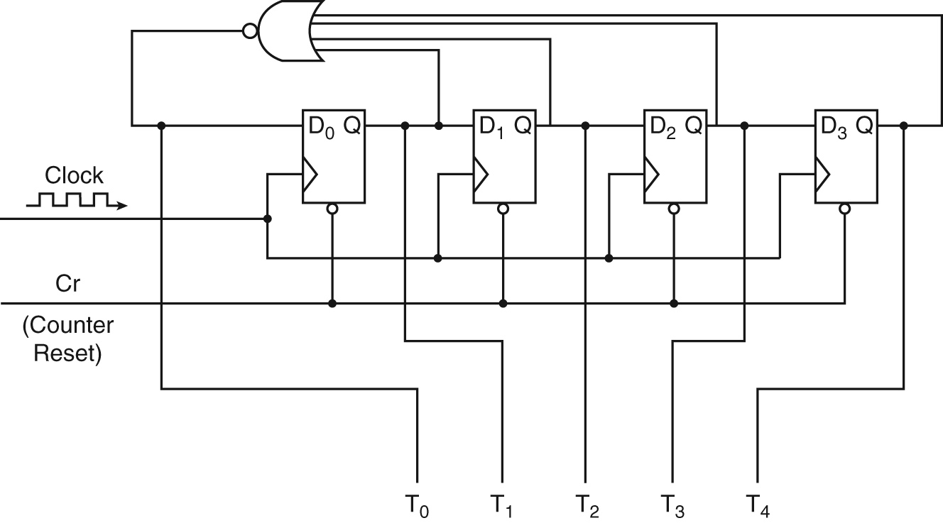
4.13 A Discussion on Decoding
A ring counter that counts from 0 to 5

Slide 70
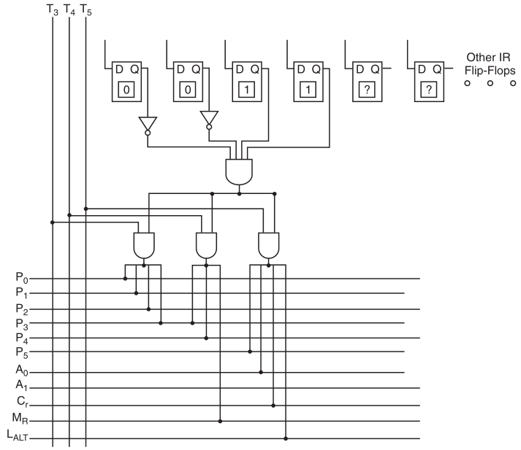
This is the hardwired logic for MARIE’s Add = 0011 instruction.

Slide 71
4.13 A Discussion on Decoding
In microprogrammed control, instruction microcode produces control signal changes.
Machine instructions are the input for a microprogram that converts the 1s and 0s of an instruction into control signals.
The microprogram is stored in firmware, which is also called the control store.
A microcode instruction is retrieved during each clock cycle.

Slide 72
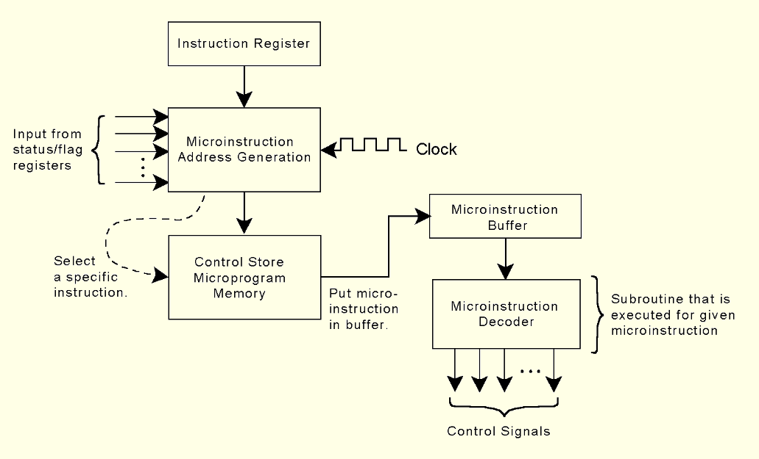
4.13 A Discussion on Decoding
This is how a generic microprogrammed control unit might look.

Slide 73
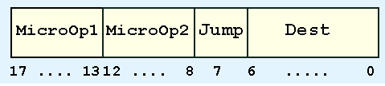
4.13 A Discussion on Decoding
If MARIE were microprogrammed, the microinstruction format might look like this:
MicroOp1 and MicroOp2 contain binary codes for each instruction. Jump is a single bit indicating that the value in the Dest field is a valid address and should be placed in the microsequencer.

Slide 74
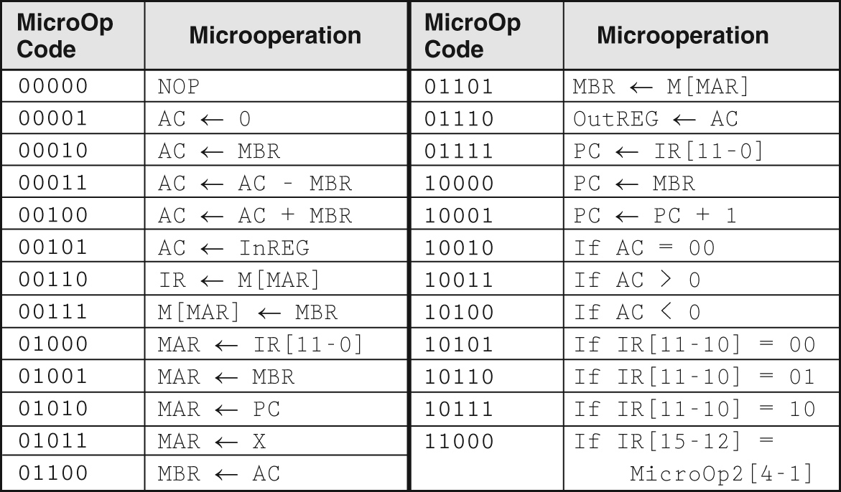
4.13 A Discussion on Decoding
The table below contains MARIE’s microoperation codes along with the corresponding RTL:

Slide 75
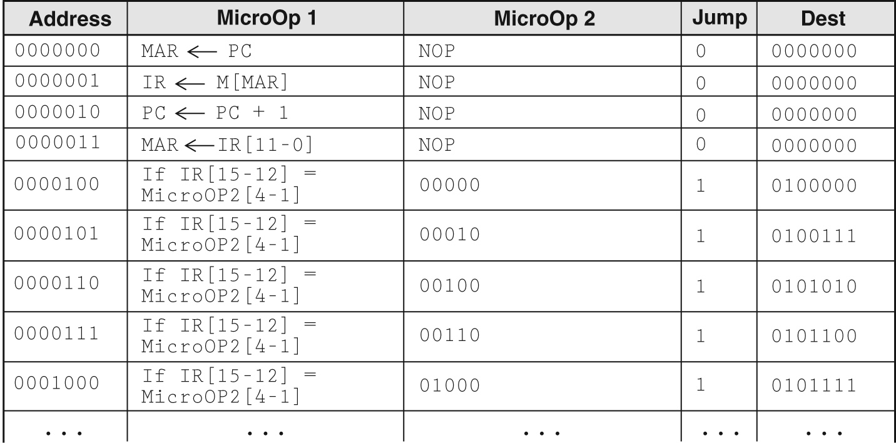
4.13 A Discussion on Decoding
The first nine lines of MARIE’s microprogram are given below (using RTL for clarity):

Slide 76
4.13 A Discussion on Decoding
The first four lines are the fetch-decode-execute cycle.
The remaining lines are the beginning of a jump table.

Slide 77
4.13 A Discussion on Decoding
It’s important to remember that a microprogrammed control unit works like a system-in-miniature.
Microinstructions are fetched, decoded, and executed in the same manner as regular instructions.
This extra level of instruction interpretation is what makes microprogrammed control slower than hardwired control.
The advantages of microprogrammed control are that it can support very complicated instructions and only the microprogram needs to be changed if the instruction set changes (or an error is found).

Slide 78
4.14 Real World Architectures
MARIE shares many features with modern architectures but it is not an accurate depiction of them.
In the following slides, we briefly examine two machine architectures.
We will look at an Intel architecture, which is a CISC machine and MIPS, which is a RISC machine.
CISC is an acronym for complex instruction set computer.
RISC stands for reduced instruction set computer.
We delve into the “RISC versus CISC” argument in Chapter 9.

Slide 79
4.14 Real World Architectures
MARIE shares many features with modern architectures but it is not an accurate depiction of them.
In the following slides, we briefly examine two machine architectures.
We will look at an Intel architecture, which is a CISC machine and MIPS, which is a RISC machine.
CISC is an acronym for complex instruction set computer.
RISC stands for reduced instruction set computer.

Slide 80
4.14 Real World Architectures
The classic Intel architecture, the 8086, was born in 1979. It is a CISC architecture.
It was adopted by IBM for its famed PC, which was released in 1981.
The 8086 operated on 16-bit data words and supported 20-bit memory addresses.
Later, to lower costs, the 8-bit 8088 was introduced. Like the 8086, it used 20-bit memory addresses.
What was the largest memory that the 8086 could address?

Slide 81
4.14 Real World Architectures
The 8086 had four 16-bit general-purpose registers that could be accessed by the half-word.
It also had a flags register, an instruction register, and a stack accessed through the values in two other registers, the base pointer and the stack pointer.
The 8086 had no built in floating-point processing.
In 1980, Intel released the 8087 numeric coprocessor, but few users elected to install them because of their high cost.

Slide 82
4.14 Real World Architectures
In 1985, Intel introduced the 32-bit 80386.
It also had no built-in floating-point unit.
The 80486, introduced in 1989, was an 80386 that had built-in floating-point processing and cache memory.
The 80386 and 80486 offered downward compatibility with the 8086 and 8088.
Software written for the smaller-word systems was directed to use the lower 16 bits of the 32-bit registers.

Slide 83
4.14 Real World Architectures
Intel’s Pentium 4 introduced a brand new NetBurst architecture.
Speed enhancing features include:
Hyperthreading
Hyperpipelining
Wider instruction pipeline
Execution trace cache (holds decoded instructions for possible reuse) multilevel cache and instruction pipelining.
Intel, along with many others, is marrying many of the ideas of RISC architectures with microprocessors that are largely CISC.

Slide 84
4.14 Real World Architectures
The MIPS family of CPUs has been one of the most successful in its class.
In 1986 the first MIPS CPU was announced.
It had a 32-bit word size and could address 4GB of memory.
Over the years, MIPS processors have been used in general purpose computers as well as in games.
The MIPS architecture now offers 32- and 64-bit versions.

Slide 85
4.14 Real World Architectures
MIPS was one of the first RISC microprocessors.
The original MIPS architecture had only 55 different instructions, as compared with the 8086 which had over 100.
MIPS was designed with performance in mind: It is a load/store architecture, meaning that only the load and store instructions can access memory.
The large number of registers in the MIPS architecture keeps bus traffic to a minimum.
How does this design affect performance?

Slide 86
Chapter 4 Conclusion
The major components of a computer system are its control unit, registers, memory, ALU, and data path.
A built-in clock keeps everything synchronized.
Control units can be microprogrammed or hardwired.
Hardwired control units give better performance, while microprogrammed units are more adaptable to changes.

Slide 87
Chapter 4 Conclusion
Computers run programs through iterative fetch-decode-execute cycles.
Computers can run programs that are in machine language.
An assembler converts mnemonic code to machine language.
The Intel architecture is an example of a CISC architecture; MIPS is an example of a RISC architecture.

