Slide 1

David M. Kroenke and David J. Auer Database Processing Fundamentals, Design, and Implementation
Appendix A:
Getting Started with Microsoft
Access 2013

Slide 2
Chapter Objectives
To be able to create databases in Access 2013
To be able to create tables in Access 2013
To understand Access 2013 data types
To be able to insert data into tables in Access 2013
To be able to create relationships between tables in Access 2013
To be able to create Query-by-Example (QBE) queries in Access 2013
To understand the use of the Form Wizard in Access 2013
To understand the use of the Report Wizard in Access 2013

Slide 3

Example Database Design Three tables: STUDENT, CLASS, and GRADE

Slide 4
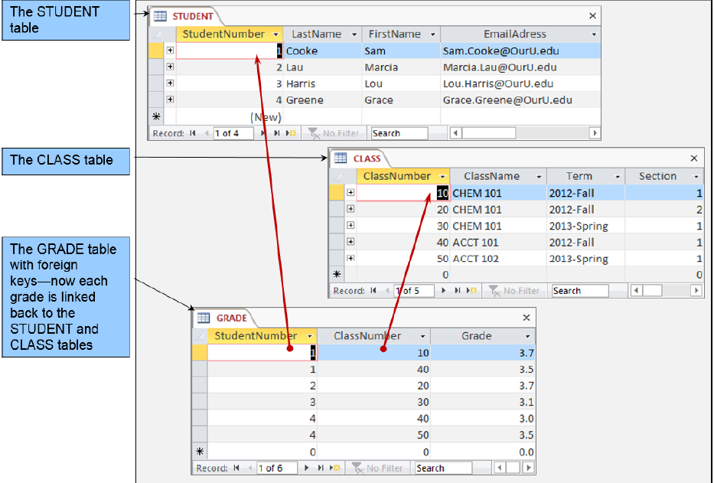
Example Database Design Three tables: STUDENT, CLASS, and GRADE

Slide 5
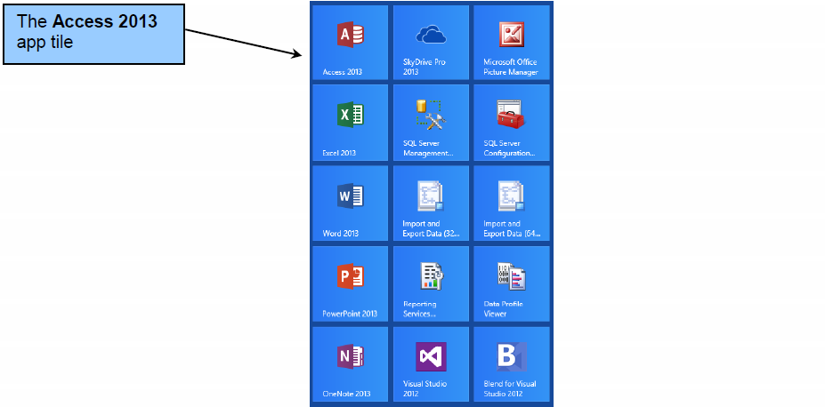
The Microsoft Access 2013 App Tile

Slide 6
Microsoft Access—Table Keys
Each table has a key.
A key is one or more columns that identify a row.
StudentNumber in STUDENT
ClassNumber in CLASS
Keys composed of more than one column are called composite keys.
(StudentNumber, ClassNumber) in GRADE
See Chapter Three for a complete discussion of keys.
In this Appendix, the following keys are relevant:
Primary key—the key used to identify rows in a table
Foreign key—the key used to link to another table
Surrogate key—a short, numeric key added to the table as an ideal identifier when other fields don’t work as well

Slide 7
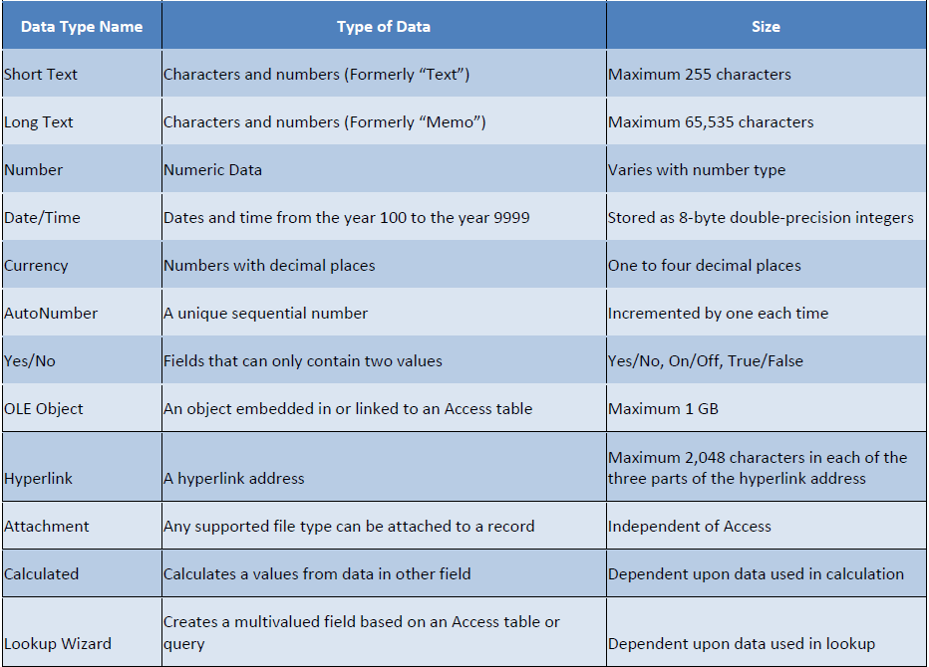
Microsoft Access 2013 Basic Data Types

Slide 8
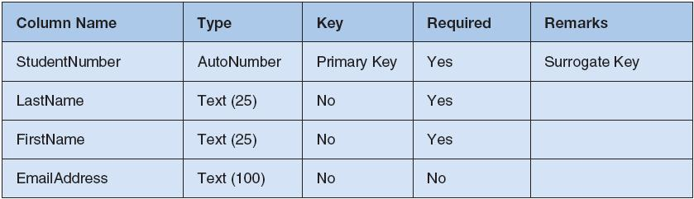
Example Database Design The STUDENT Table

Slide 9
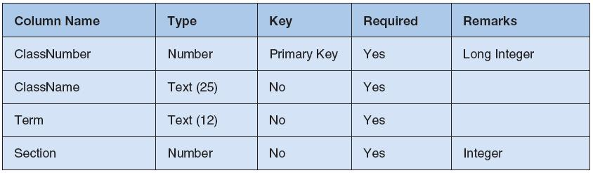
Example Database Design The CLASS Table

Slide 10
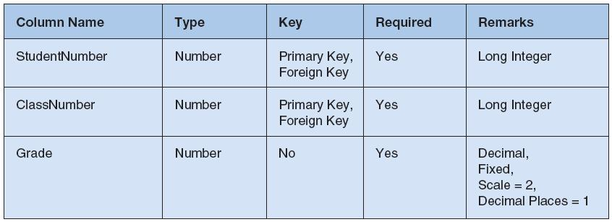
Example Database Design The GRADE Table

Slide 11
Microsoft Access—Relationships
StudentNumber in GRADE creates a relationship to StudentNumber in STUDENT.
ClassNumber in GRADE creates a relationship to ClassNumber in CLASS
StudentNumber in GRADE and ClassNumber in GRADE are examples of foreign keys.

Slide 12
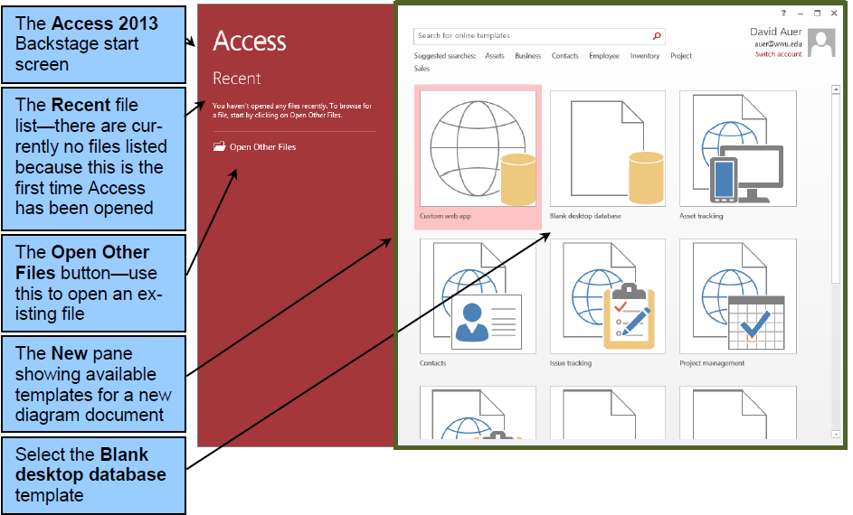
Creating a Database I

Slide 13
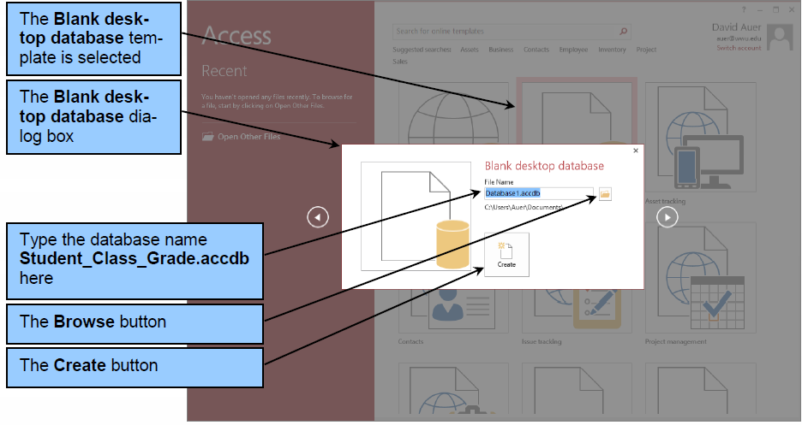
Creating a Database II

Slide 14
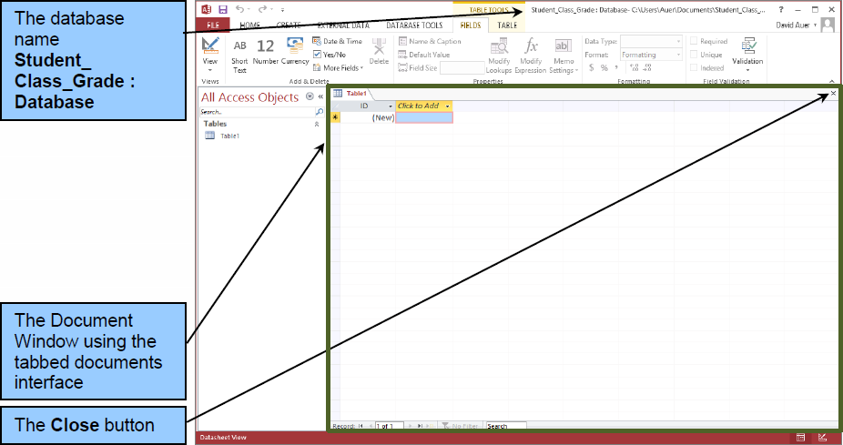
Creating a Database III

Slide 15
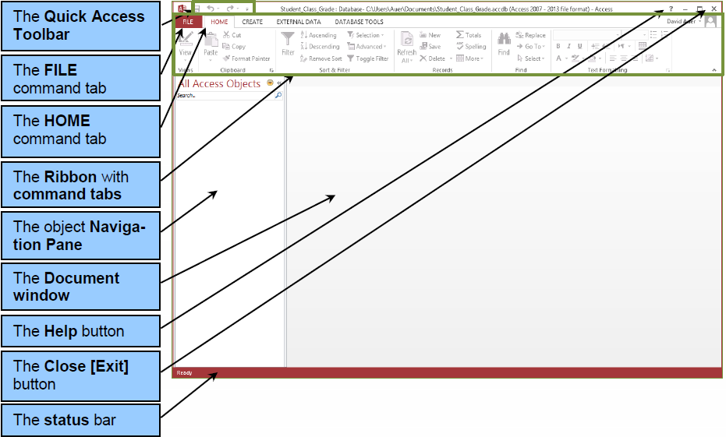
The Microsoft Office Fluent User Interface

Slide 16
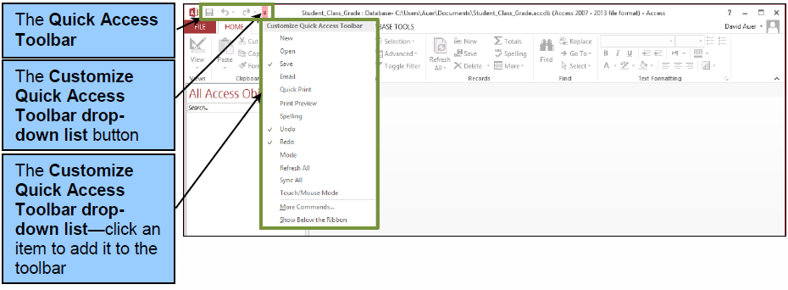
The Quick Access Toolbar

Slide 17
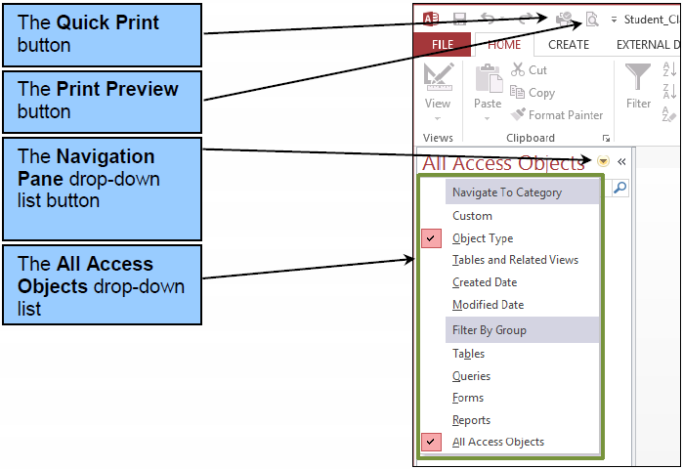
Database Objects and the Navigation Pane I

Slide 18
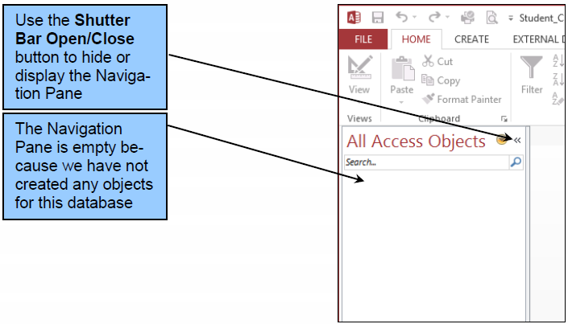
Database Objects and the Navigation Pane II

Slide 19
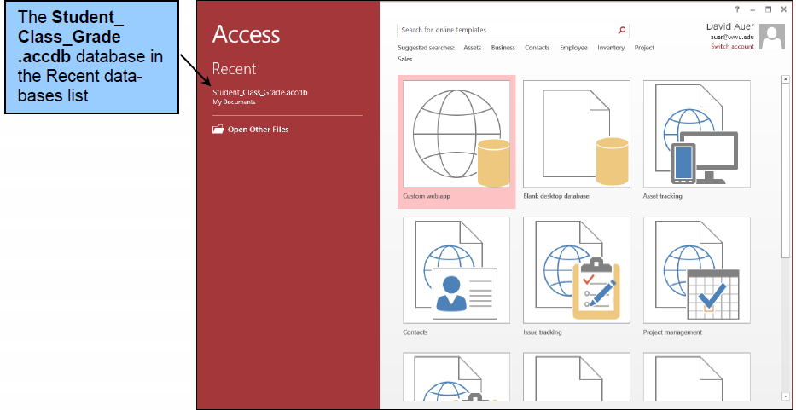
Opening an Existing Database: The Backstage View

Slide 20
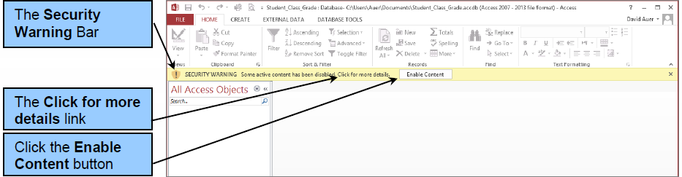
The Security Warning Bar

Slide 21
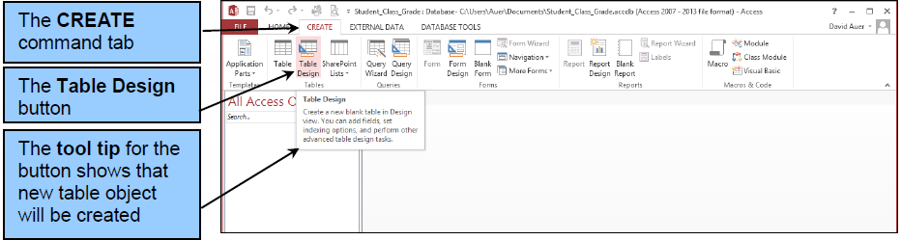
Creating a Table I

Slide 22
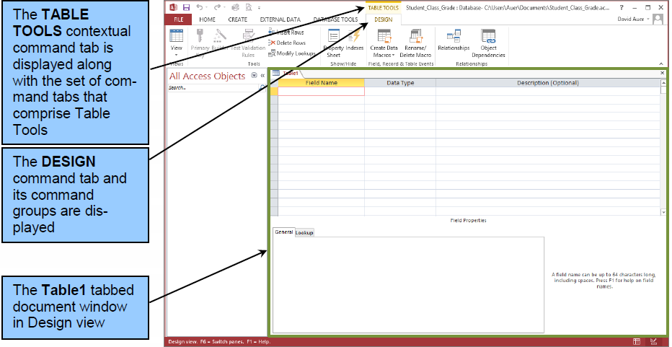
Creating a Table II

Slide 23
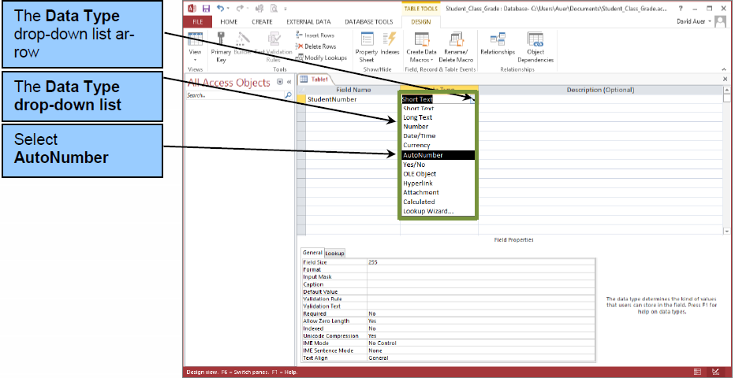
Creating Columns (Fields) I

Slide 24
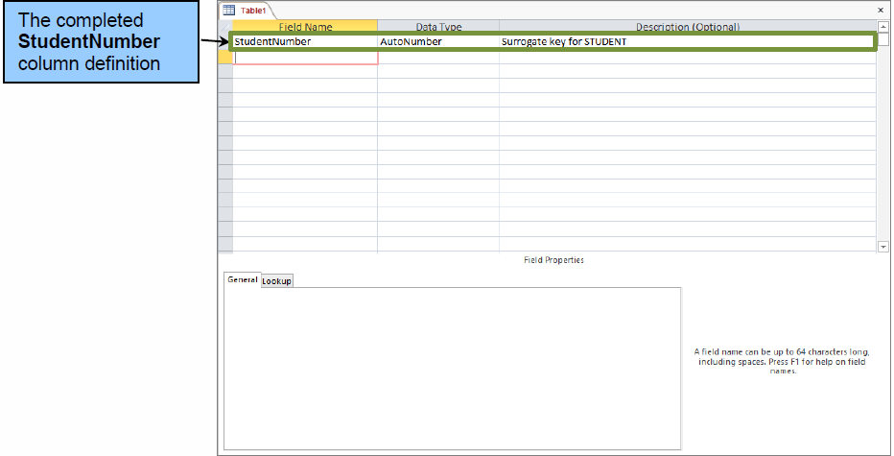
Creating Columns (Fields) II

Slide 25
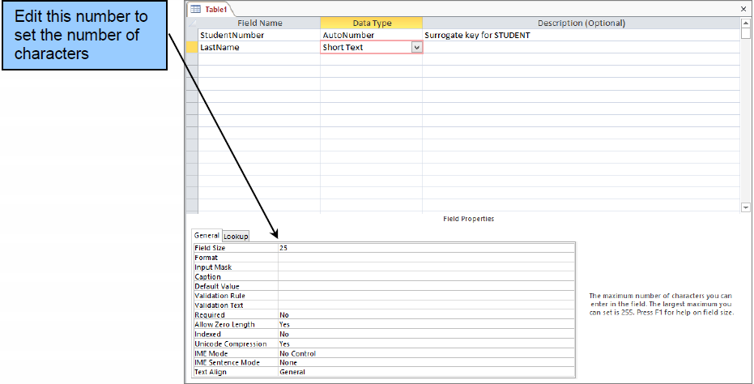
Creating Columns (Fields) III

Slide 26
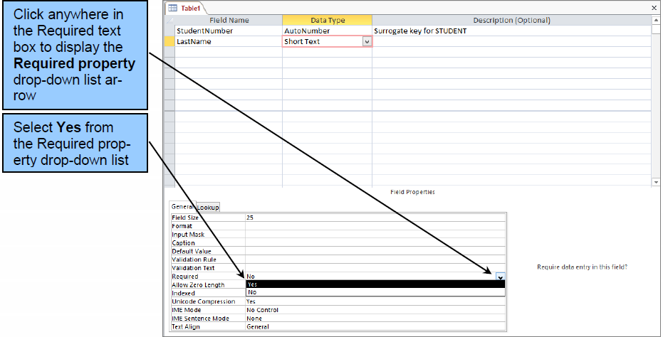
Creating Columns (Fields) IV

Slide 27
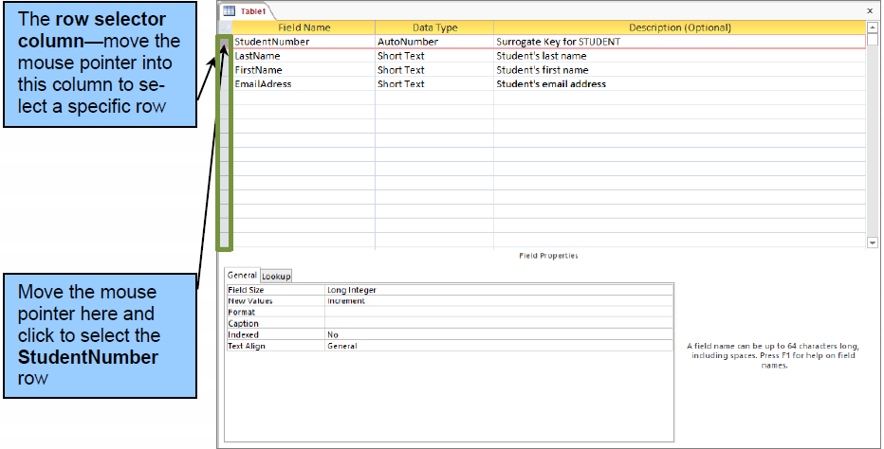
Setting the Primary Key I

Slide 28
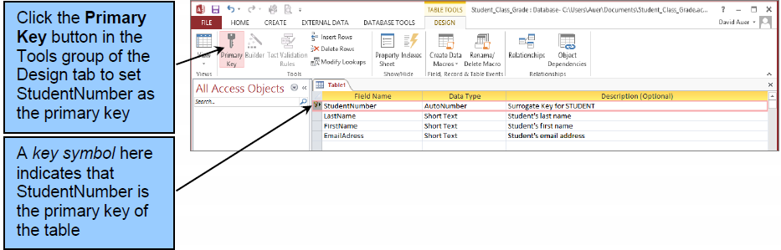
Setting the Primary Key II

Slide 29
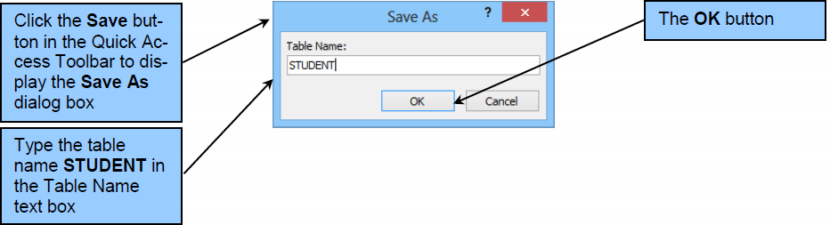
Saving the Table Structure I

Slide 30
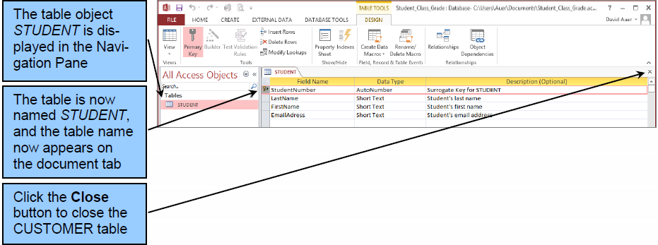
Saving the Table Structure II

Slide 31
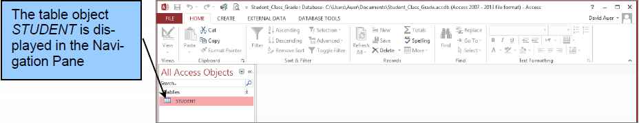
Saving the Table Structure III

Slide 32
Adding Data to Tables
We can add data to a table by:
Using the datasheet view
Using a form

Slide 33
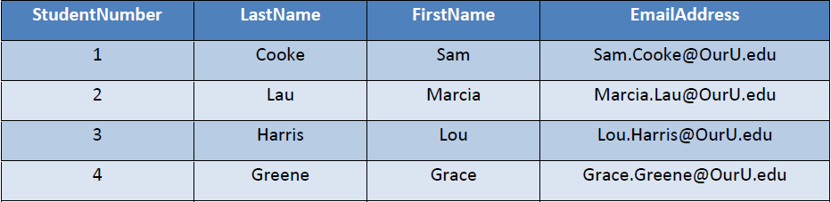
STUDENT Data

Slide 34
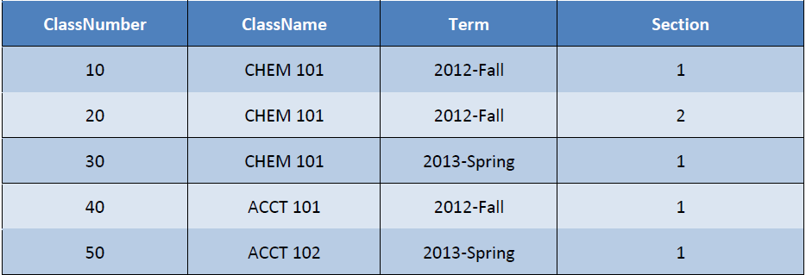
CLASS Data

Slide 35
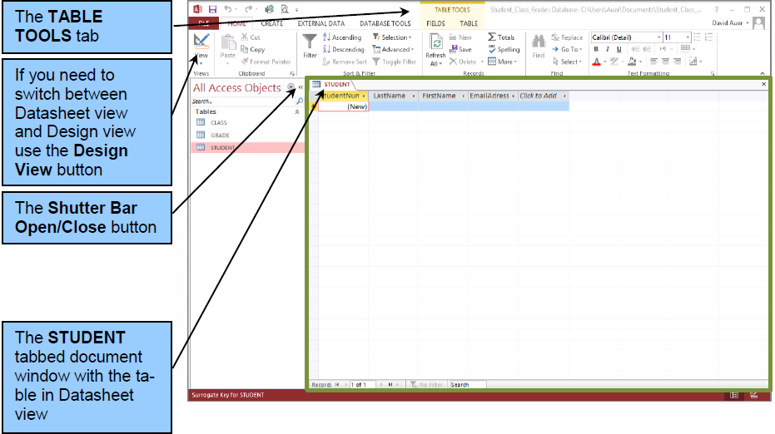
Adding Data to Tables: Using the Datasheet View I

Slide 36
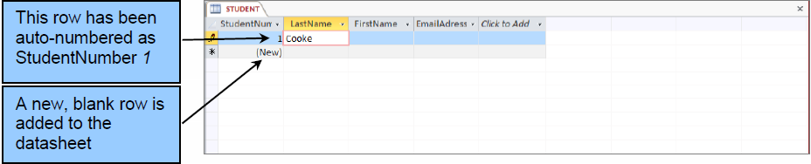
Adding Data to Tables: Using the Datasheet View II

Slide 37
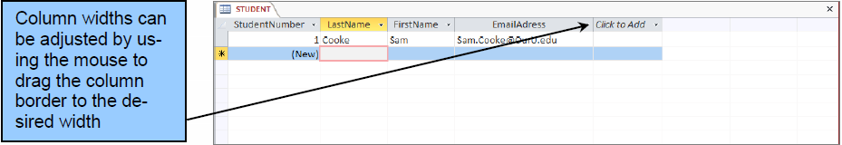
Adding Data to Tables: Using the Datasheet View III

Slide 38
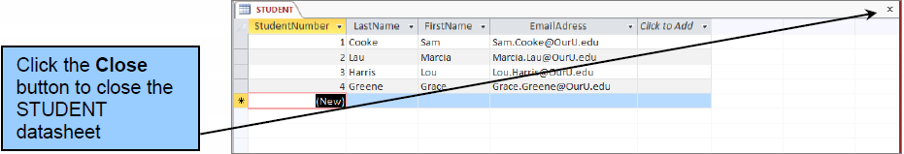
Adding Data to Tables: Using the Datasheet View IV

Slide 39
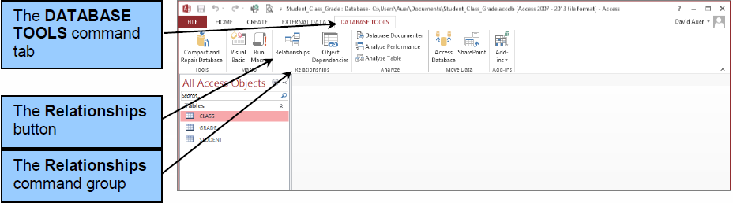
Creating Relationships I

Slide 40
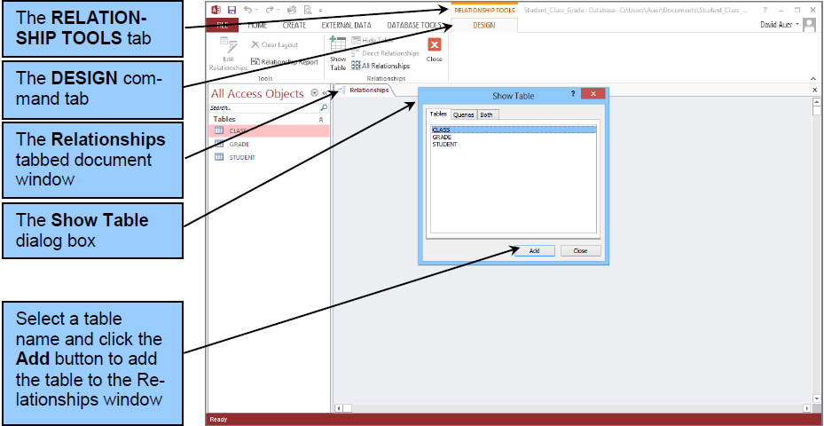
Creating Relationships II

Slide 41
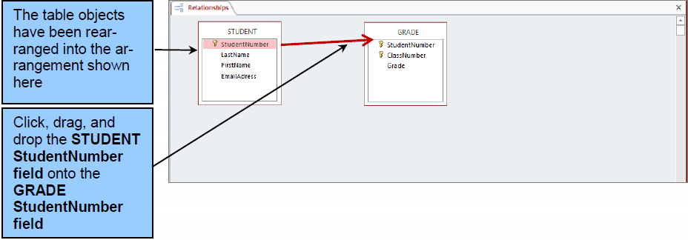
Creating Relationships III

Slide 42
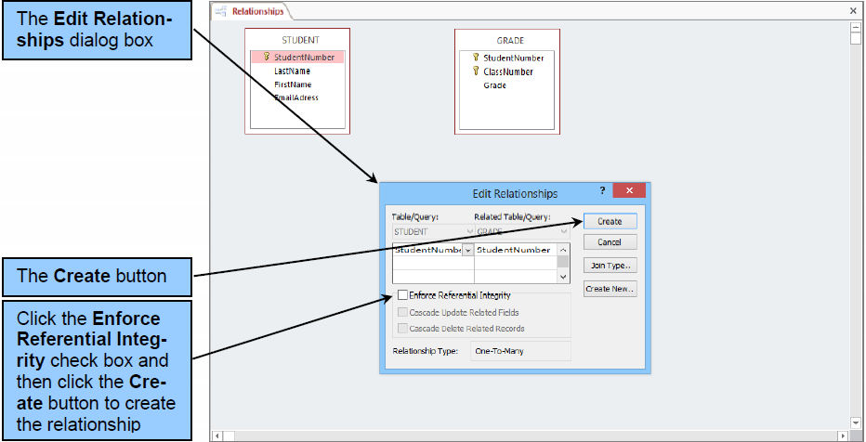
Creating Relationships IV

Slide 43
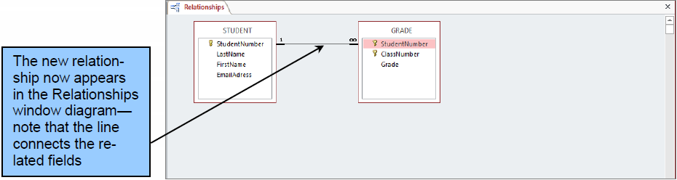
Creating Relationships V

Slide 44
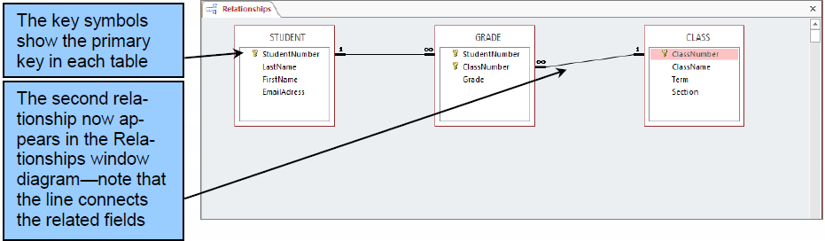
Creating Relationships VI

Slide 45
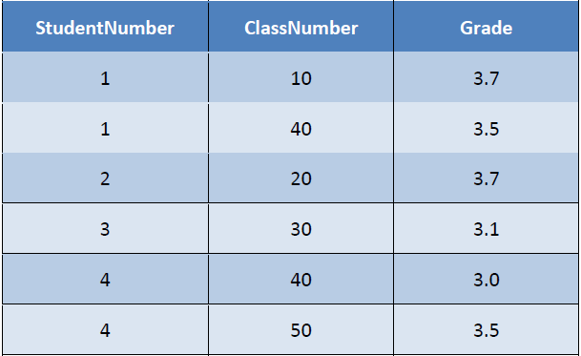
GRADE Data

Slide 46
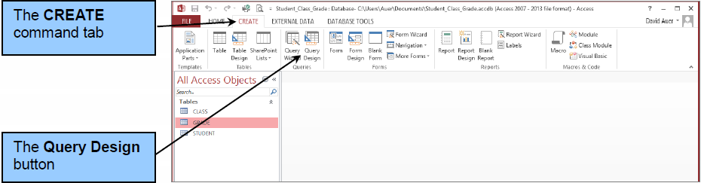
Creating QBE Queries I

Slide 47
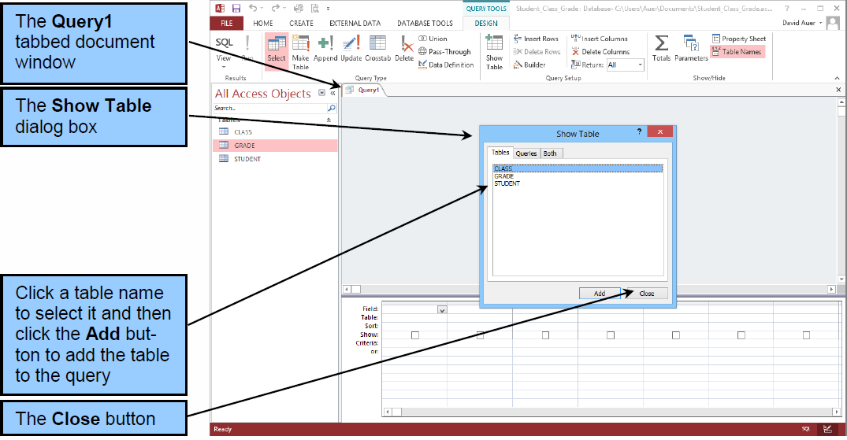
Creating QBE Queries II

Slide 48
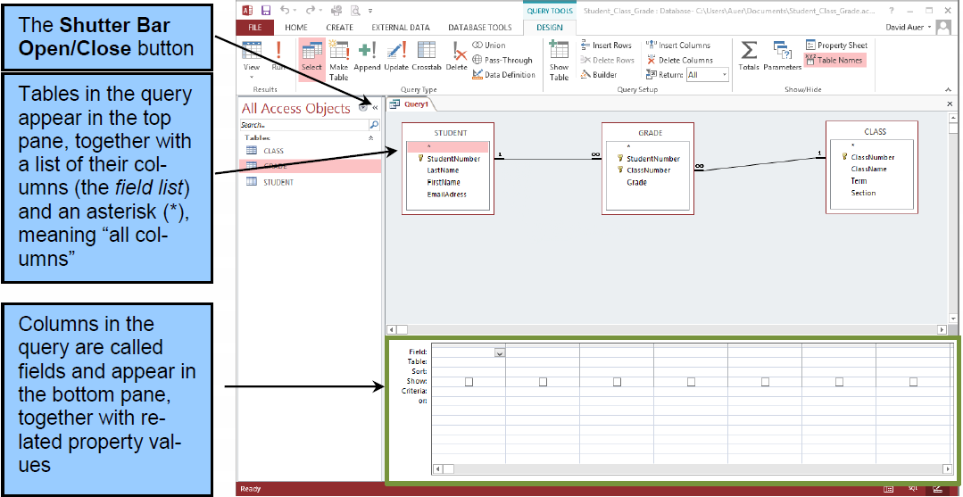
Creating QBE Queries III

Slide 49
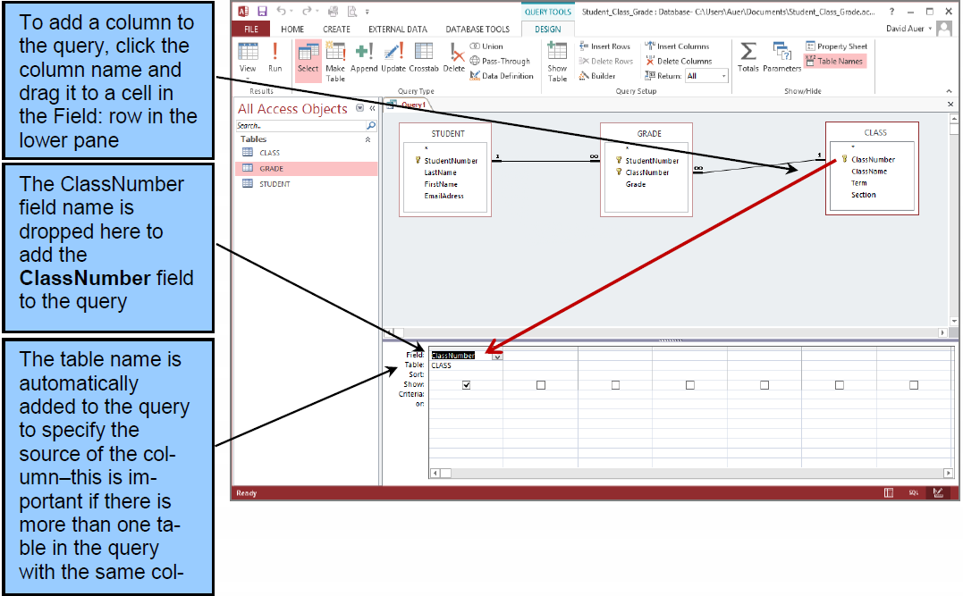
Creating QBE Queries IV

Slide 50
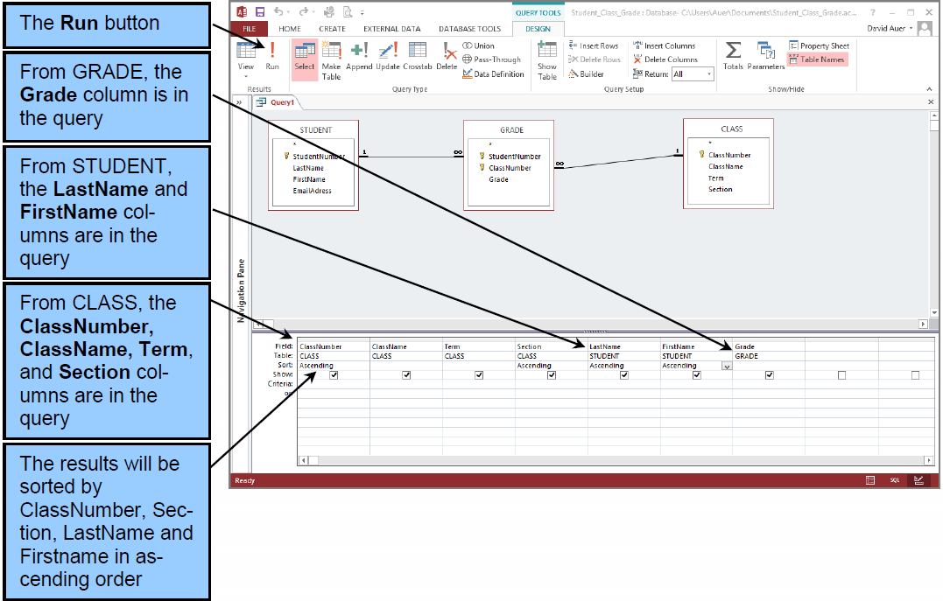
Creating QBE Queries V

Slide 51
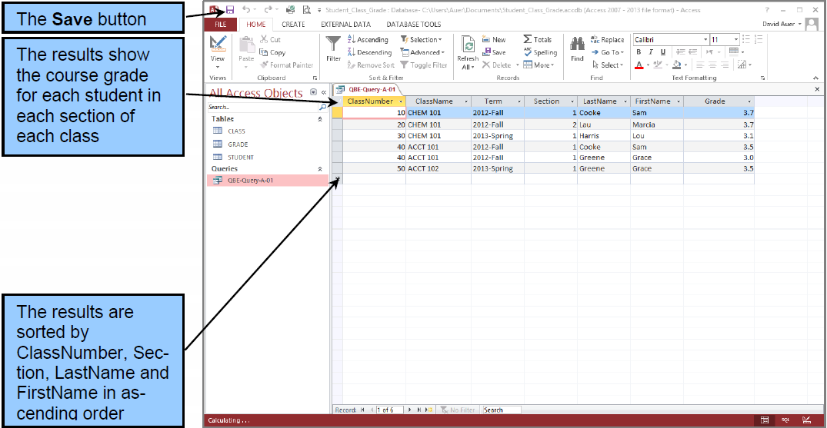
Creating QBE Queries VI

Slide 52
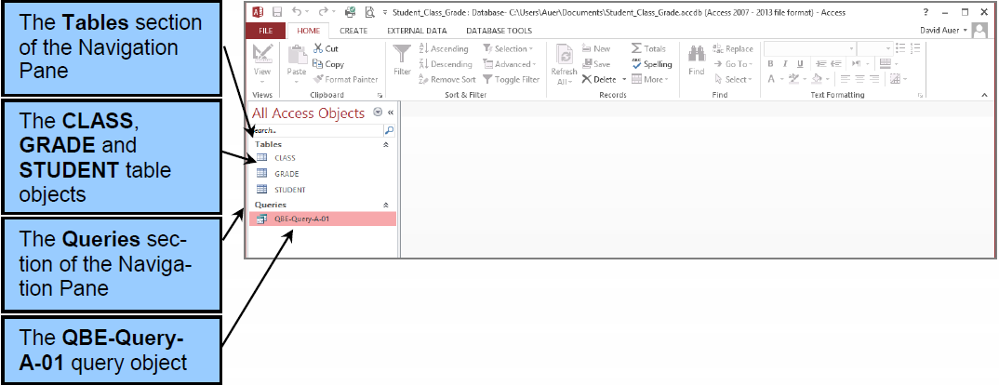
Creating QBE Queries VII

Slide 53
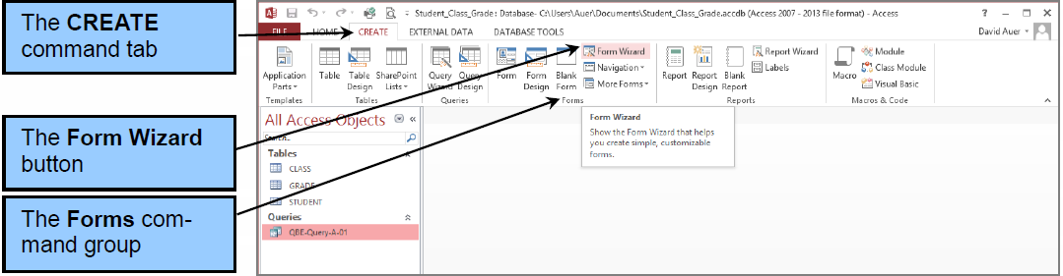
Access 2013 Forms

Slide 54
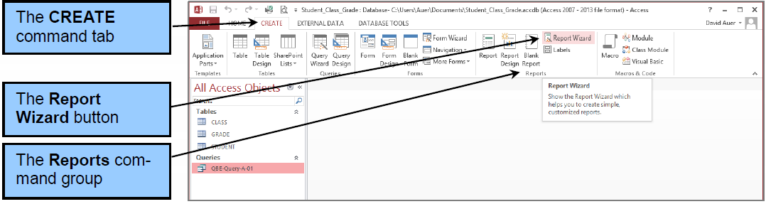
Access 2013 Reports

Slide 55
David Kroenke and David Auer Database Processing Fundamentals, Design, and Implementation (13th Edition)
End of Presentation:
Appendix A

Slide 56

All rights reserved. No part of this publication may be reproduced, stored in a retrieval system, or transmitted, in any form or by any means, electronic, mechanical, photocopying, recording, or otherwise, without the prior written permission of the publisher. Printed in the United States of America.

