Slide 1

David M. Kroenke and David J. Auer Database Processing Fundamentals, Design, and Implementation
Appendix B:
Getting Started in Systems Analysis and Design

Slide 2
Appendix Objectives
To understand information systems
To understand business processes
To understand and be able to apply the systems development life cycle (SDLC) model
To understand business process modeling using Business Processing Modeling Notation (BPMN)
To be able to gather data and information during Requirements Analysis

Slide 3
Appendix Objectives
To understand use cases
To understand business rules
To be able to create a user requirements document (URD)
To be able to create a statement of work (SOW)
To understand how the topics in this document link to chapters in Database Processing: Fundamentals, Design, and Implementation (13th Edition)

Slide 4
Data and Information
Data — Recorded facts and numbers
Information
Knowledge derived from data
Data presented in a meaningful context
Data processed by summing, ordering, averaging, grouping, comparing or other similar operations

Slide 5
Information Systems
System — A set of components that interact to achieve some purpose or goal
Information system — A system that has the goal of producing information

Slide 6
Five Component Information Systems Framework

Slide 7
Competitive Strategy
Competitive Strategy — A company's organized response to the industry structure of the industry in which it operates, and thus, how to compete within that structure

Slide 8
Porter’s Five Forces Model
The industry structure is determined by relative strength or weakness within the industry of:
The bargaining power of customers.
The availability ("threat") of substitutable products.
The bargaining power of suppliers.
The ease ("threat") of new competitors entering the industry.
The rivalry between competitors.

Slide 9
Porter’s Primary or Operational Activities
Inbound logistics: receiving, storing and distributing product inputs
Manufacturing operations: transforming inputs into the final product
Outbound logistics: collecting, storing, and distributing the product to buyers
Sales and marketing: convincing customers to buy the product and selling it to them
Customer service: assisting the customers in their use of the product

Slide 10
Porter’s Support Activities
Procurement: managing supplier relationships and buying the product inputs
Technology management: product research and development and new procedures, methods and techniques
Human resources management: managing employee resources
Firm infrastructure management: general management of the firm, finance, accounting, legal services, and government affairs

Slide 11
Business Process
Business process — A set of activities that transforms inputs into outputs

Slide 12
The Manufacturing Process

Slide 13
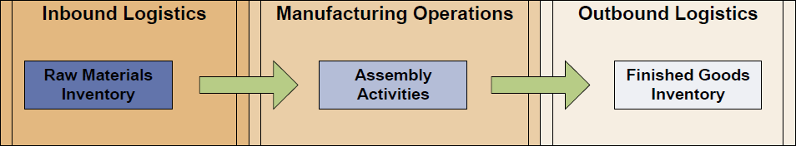
The Manufacturing Process as it Overlays Porter’s Operational Activities

Slide 14
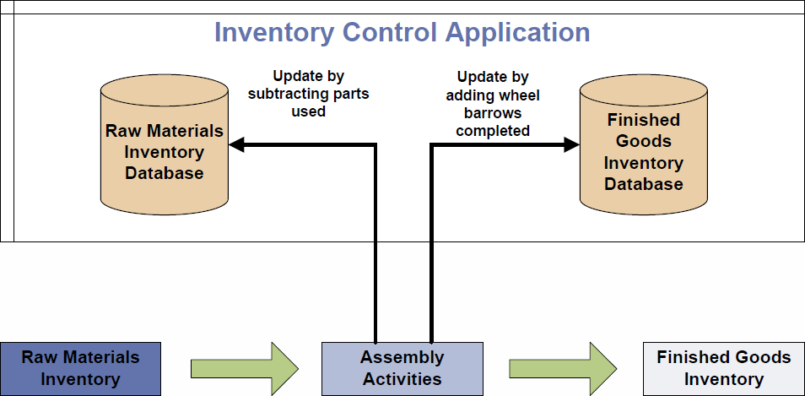
The Manufacturing Process with Supporting Information System

Slide 15
Business Process Modeling
Business process modeling — The study and documentation of business processes
Business process modeling notation (BPMN) — A commonly used system for drawing business process models
Microsoft Visio Insights blog
Microsoft Visio 2013 Premium has BPMN template
Object Management Group’s Business Process Management Initiative

Slide 16
Systems Analysis and Design
Systems analysis and design — The process of creating and maintaining information systems
Systems development life cycle (SDLC) —The classic methodology used in systems analysis and design to develop information systems
System definition
Requirements analysis
Component design
Implementation
System maintenance
Deliverables — Each step should produce one or more deliverables, which are the step results.

Slide 17
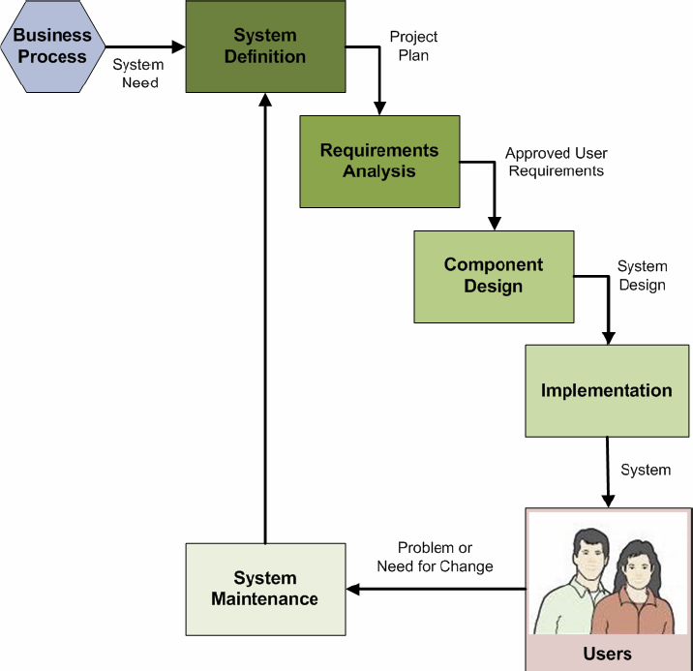
The SDLC in Use

Slide 18
Systems Definition Step
The system definition step is a process that starts with the need for an information system to support a business process as its input, and produces a project plan as its output.
Define the information system project goals and scope
Assess the feasibility of the project (cost, schedule, technical, organizational)
Form the project team
Plan the project (specify tasks, assign personnel, determine task dependencies, set schedules)

Slide 19
Requirements Analysis Step
The requirements analysis step is a process that starts with the project plan as its input, and produces a set of approved user requirements as its output.
Conduct user interviews
Evaluate existing systems
Determine needed new forms/reports/queries
Identify needed new application features and functions
Consider security
Create the data model
Consider the five components of an information system: hardware, software, data, procedures and people

Slide 20
Requirements Analysis Step Deliverables
The requirements analysis deliverables may include:
Data model
User requirements document (URD)
Statement of Work (SOW)

Slide 21
Component Design Step
The component design step is a process that starts with the approved user requirements as its input, and produces a final system design as its output.
Determine hardware specifications
Determine program (software) specifications
Create the database design
Design business procedures
Create job descriptions for business personnel

Slide 22
Component Design Step Deliverables
The component design deliverables may include:
Database design
Documented system design

Slide 23
Implementation Step
The implementation step is a process that starts with the final system design as its input, and produces a final system as its output.
Build system component
Conduct component tests
Integrate the components
Conduct integrated component tests
Convert to the new system
The implementations deliverable is:
The installed information system, including a
Database.

Slide 24
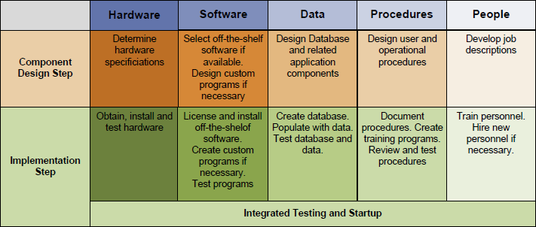
The SDLC Design and Implementation Steps for the Five Information System Components

Slide 25
System Maintenance Step
The system maintenance step is a process that starts with the implemented system as its input, and produces an updated system or a request for system modification using the SDLC as its output.
Update the system with patches, service packs and new software releases
Record and prioritize requests for system changes or enhancements

Slide 26
Project Scope
Project scope — The work that must be done to provide a product, service, or result to the customer with the specified functions and features

Slide 27
Use Cases
Use cases — Descriptions of the ways users will employ the features and functions of the new information system
A use case consists of a description of the roles users will play when utilizing the new system, together with descriptions of activities scenarios. Inputs provided to the system and outputs generated by the system are defined.
Use cases provide sources of requirements and also can be used to validate the data model, database design, and implementation.

Slide 28
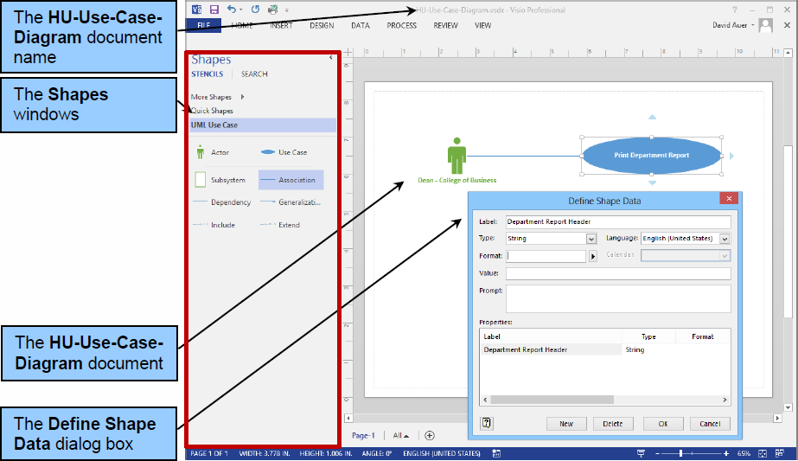
Use Cases in Microsoft Visio 2013

Slide 29
Business Rules
Business rules are constraints on database activities.
Generally, such rules arise from business policy and practice.

Slide 30
User Requirements Document (URD)
A deliverable for requirements analysis is an approved set of user requirements as a user requirements document (URD).
Typically a URD may contain:
A table of contents
A revision history
An introduction
A general description of the project (including project assumptions and dependencies)
A data model
Functional requirements
Non-functional requirements (speed and time, capacity and reliability)
Project delivery requirements

Slide 31
Statement of Work (SOW)
Typically a Statement of Work (SOW) may contain:
A history of the problem or need that generated the project.
An identification of the client for the work.
An identification of who will do the work.
The scope of the work to be done.
The objectives of the work to be done.
Any constraints on the work to be done.
The location of the work (where the work will be done).
A set of tasks with an associated timeline:
An outline of the tasks that will make up the work to be done
The time period for the work (start date, finish date, details about how many hours may be worked, etc.)
A deliverables schedule.
Criteria for determining whether the project has been successfully completed.
A payment schedule.
Signature blocks to record acceptance of the SOW by all parties.

Slide 32
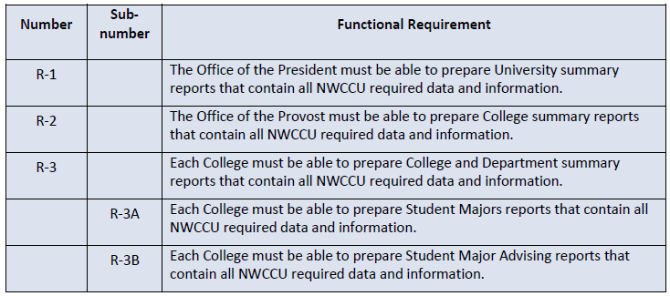
Highline University: Functional Requirements (Partial List)

Slide 33
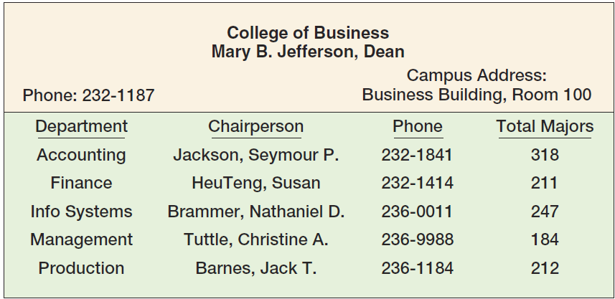
Highline University: Sample College Report

Slide 34
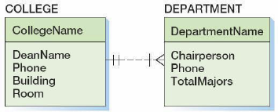
Highline University: Data Model for Sample College Report

Slide 35
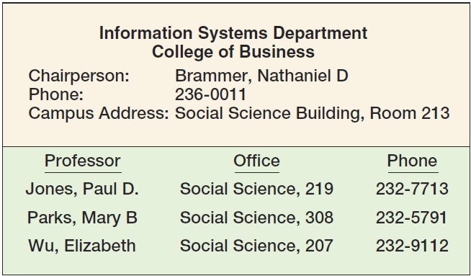
Highline University: Sample Department Report

Slide 36
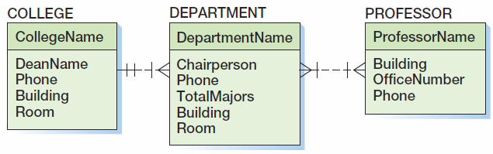
Highline University: Data Model Using N:M Relationship

Slide 37
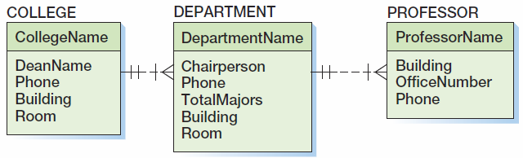
Highline University: Data Model Using 1:N Relationship

Slide 38
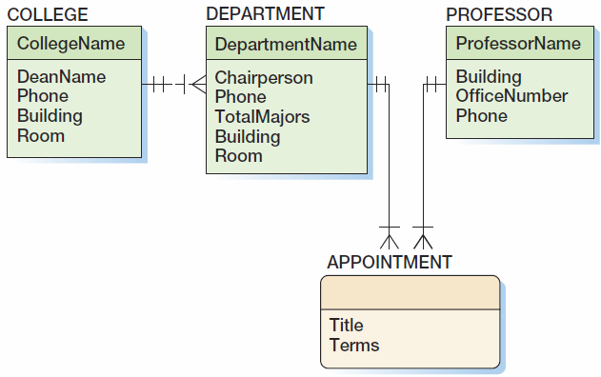
Highline University: Data Model Using an Association Pattern

Slide 39
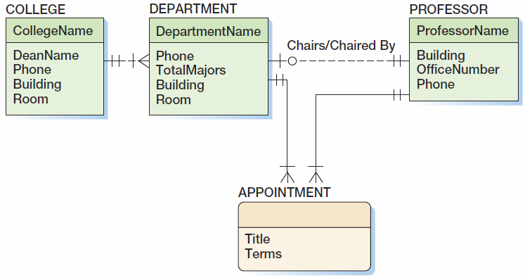
Highline University: Data Model Using an Association Pattern and a 1:1 Relationship

Slide 40
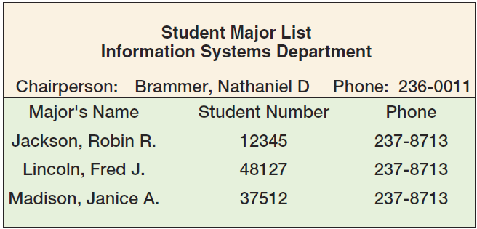
Highline University: Sample Department Student Report

Slide 41
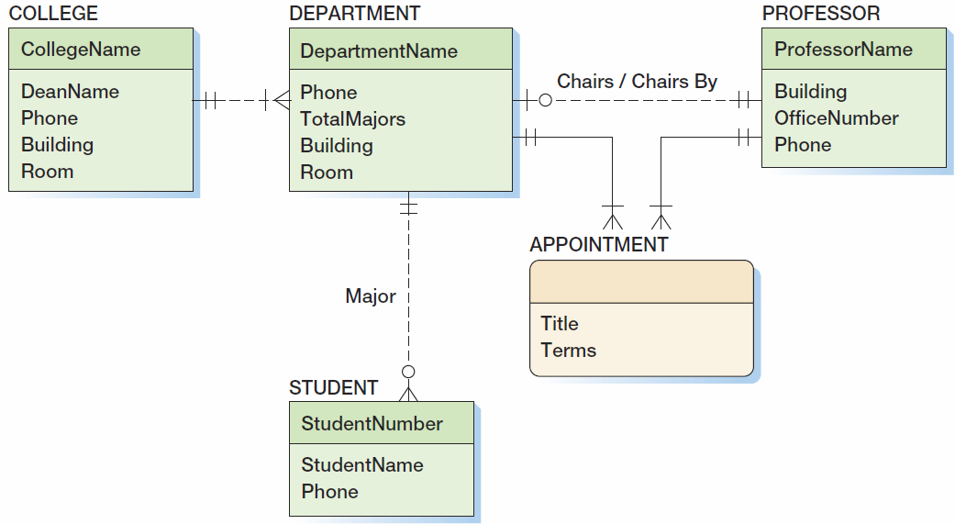
Highline University: Data Model with STUDENT Entity

Slide 42
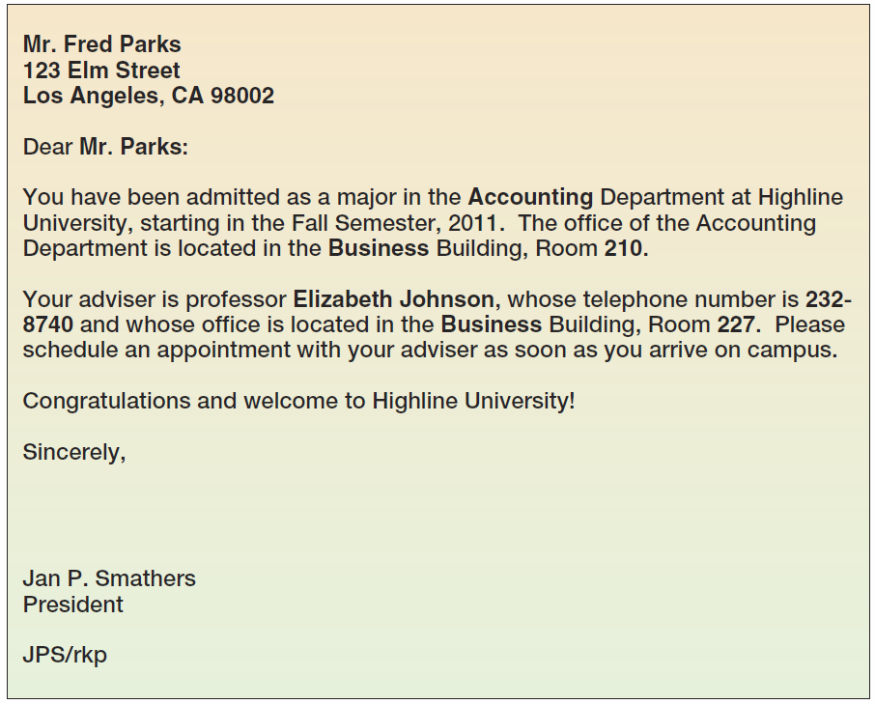
Highline University: Sample Department Student Report

Slide 43
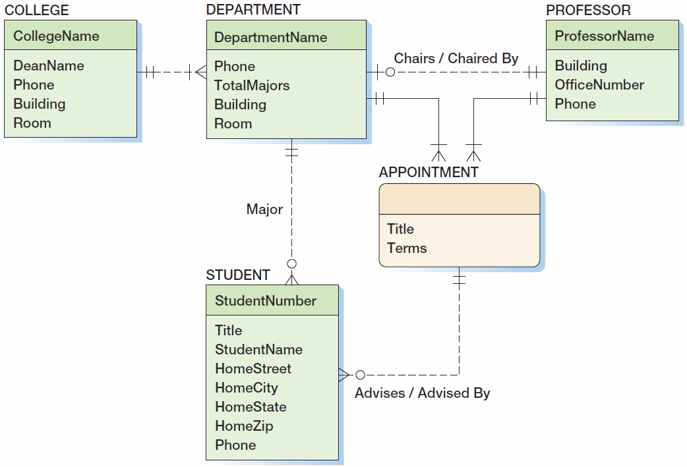
Highline University: Data Model with STUDENT Entity

Slide 44
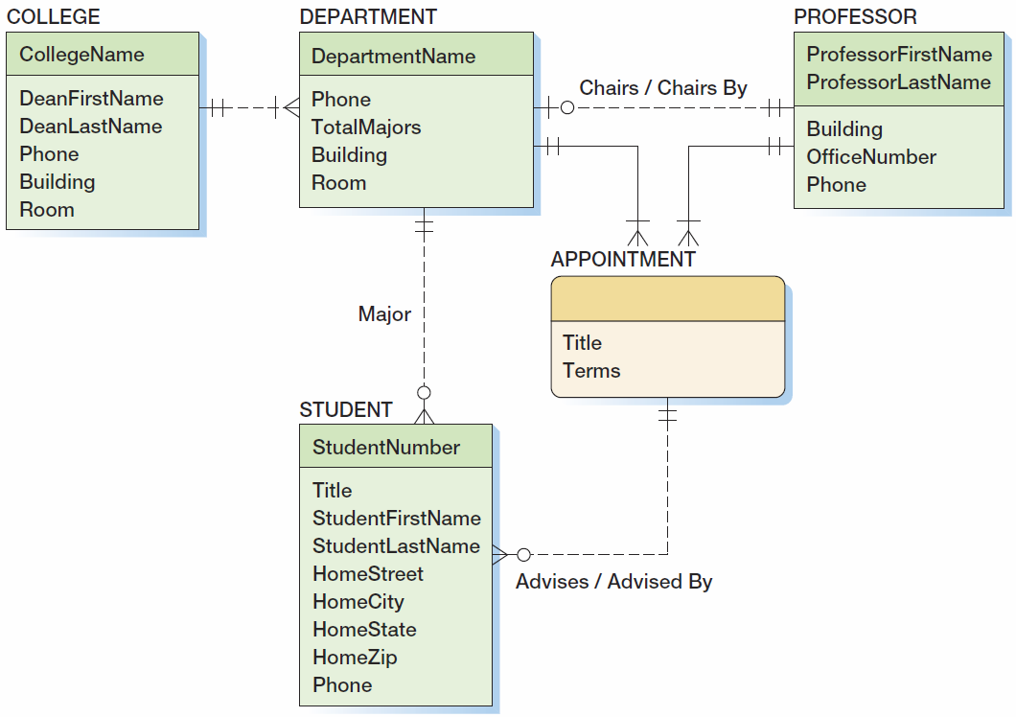
Highline University: The Final Data Model

Slide 45
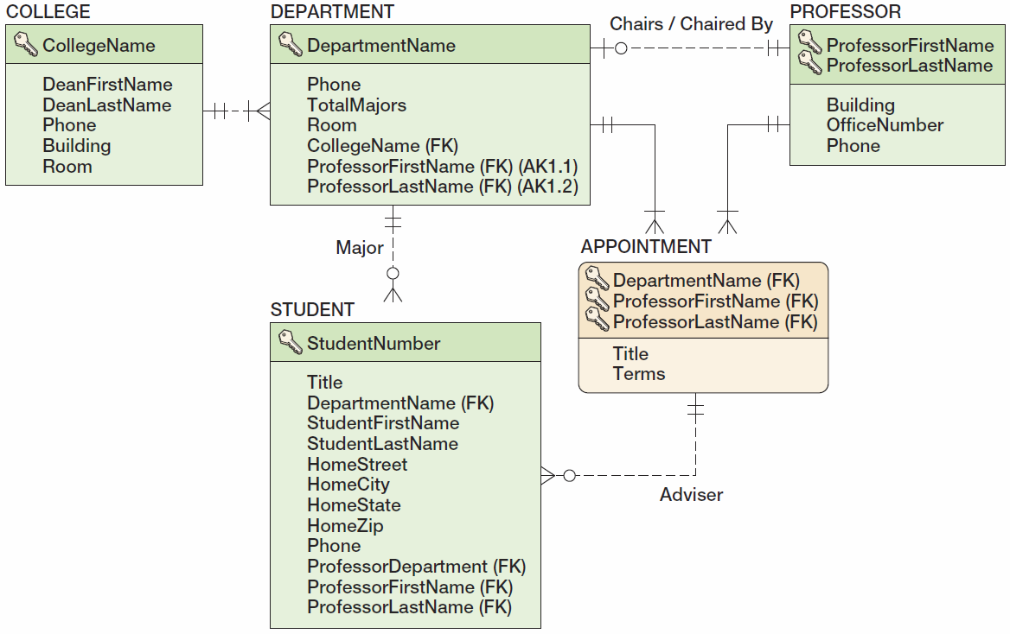
Highline University: The Database Design

Slide 46
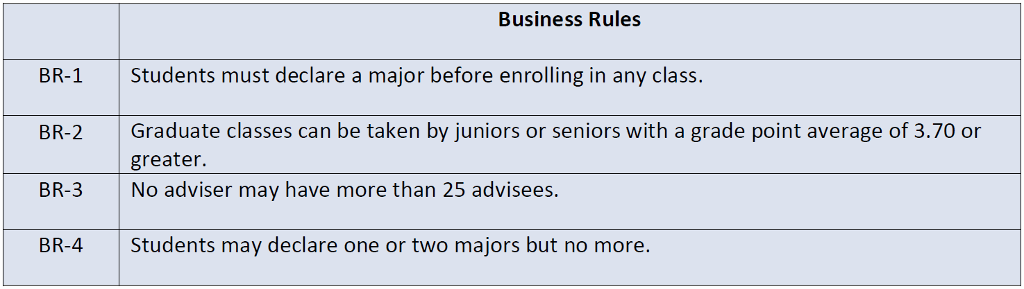
Highline University: Business Rules

Slide 47
David Kroenke and David Auer Database Processing Fundamentals, Design, and Implementation (13th Edition)
End of Presentation:
Appendix B

Slide 48
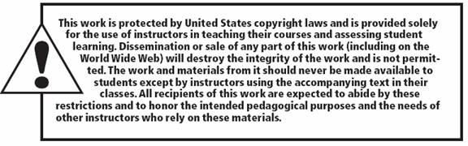
All rights reserved. No part of this publication may be reproduced, stored in a retrieval system, or transmitted, in any form or by any means, electronic, mechanical, photocopying, recording, or otherwise, without the prior written permission of the publisher. Printed in the United States of America.

