Slide 1

David M. Kroenke and David J. Auer Database Processing Fundamentals, Design, and Implementation
Appendix C:
E-R Diagrams and
The IDEF1X Standard

Slide 2
Chapter Objectives
To understand IDEF1X-standard E-R diagrams
To be able to model nonidentifying connection relationships, identifying connection relationships, nonspecific relationships, and categorization relationships using the IDEF1X E-R model
To understand the differences between E-R generalization/subtype relationships and IDEF1X categorization relationships
To understand the use of domains in the IDEF1X E-R model

Slide 3
IDEF1X
IDEF1X is an acronym for Integrated Definition 1, Extended.
IDEF1X is a variation of the entity-relationship (E-R) model discussed in Chapter Five.
IDEF1X was announced as a national standard in 1993.
IDEF1X assumes that a relational database will be used.
Being a government standard, most data modeling products support IDEF1X.

Slide 4
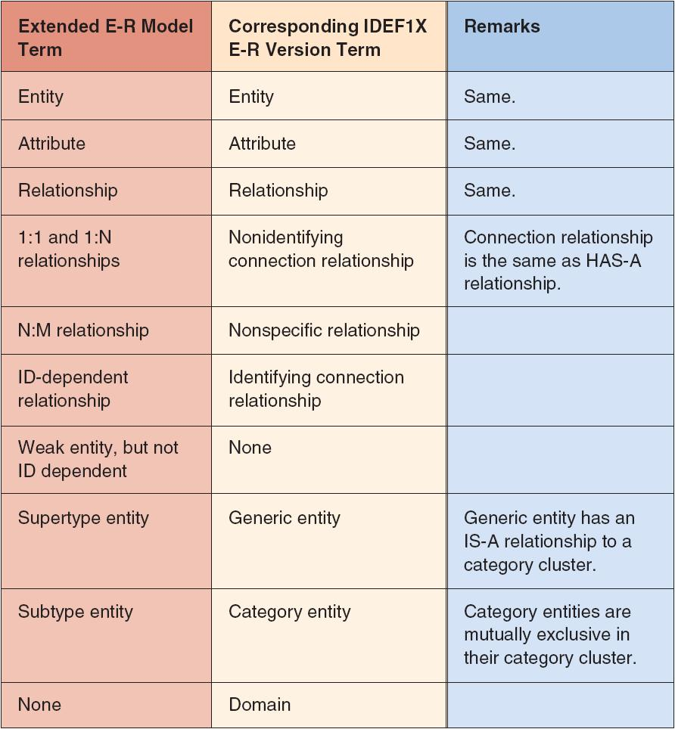
Extended E-R Model : IDEF1X

Slide 5
IDEF1X Relationship Types
Nonidentifying Connection Relationships
Identifying Connection Relationships
Nonspecific Relationships
Categorization Relationships

Slide 6
IDEF1X Relationship Types: Nonidentifying Connection Relationships
1:1 or 1:N relationships between non-ID-dependent entities
Same as HAS-A relationships

Slide 7
IDEF1X Relationship Types: Nonidentifying Connection Relationships
Default cardinality is 1:N, M-O.
This is shown by a dashed line with a filled-in circle by the child.
P (Positive = one or more) by the circle shows a required child.
 (Diamond) next to parent indicates an optional parent.
1:1 is notated with a 1 next to the filled in circle.
Z indicates 0 or 1 children are allowed.

Slide 8
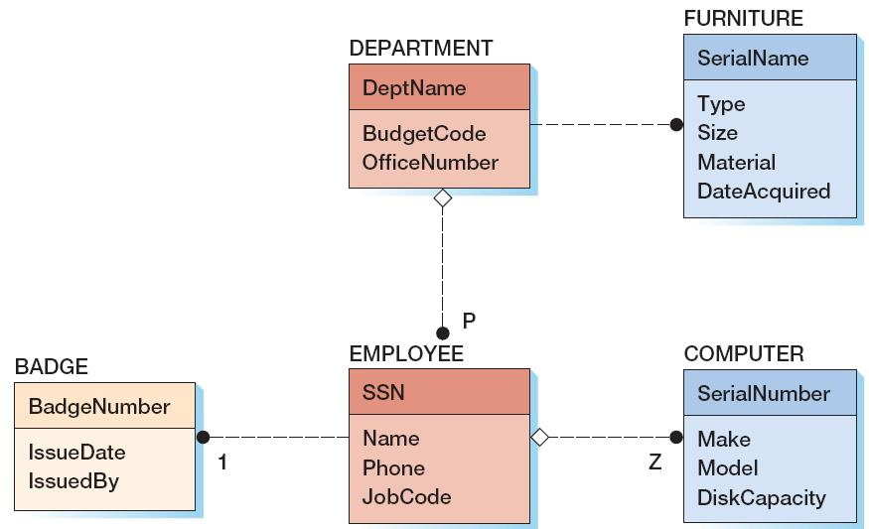
IDEF1X Relationship Types: Nonidentifying Connection Relationships
1:N, O-M with EMPLOYEE as parent and DEPARTMENT as child
1:1, M-O with EMPLOYEE as parent and BADGE as child
1:[0 or 1], O-O with EMPLOYEE as parent and COMPUTER as child

Slide 9
IDEF1X Relationship Types: Identifying Connection Relationships
Same as ID-dependent relationships.
The identifier of the parent is always part of the identifier of the child.
Default cardinality is 1:N, M-O.
This is shown by a solid line with a filled-in circle by the child.
P (Positive) indicates one or more.
1 indicates one.
Z indicates zero or one.
The corners of the ID-dependent entity are rounded.

Slide 10
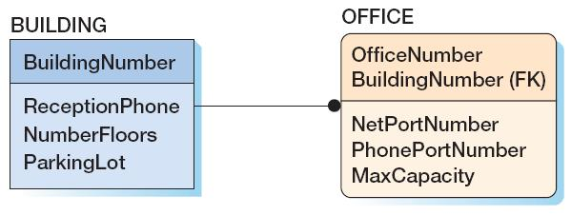
IDEF1X Relationship Types: Identifying Connection Relationships
1:N, M-O with BUILDING as parent and OFFICE as child

Slide 11
IDEF1X Relationship Types: Nonspecific Relationships
Same as many-to-many (N:M) relationships.
Default cardinality is N:M, O-O.
This is shown by a solid line with a filled-in circle by both the parent and the child.
There is no way to indicate minimum cardinalities for this relationship.

Slide 12
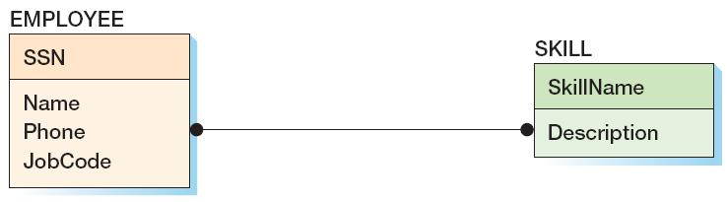
IDEF1X Relationship Types: Nonspecific Relationships
N:M, O-O with EMPLOYEE and SKILL

Slide 13
IDEF1X Relationship Types: Categorization Relationships
Same as supertype/subtype relationships.
A generic entity is a supertype.
A category entity is a subtype.
Category are grouped into category clusters.
There may be a discriminator.
Two types:
Complete—every possible category is shown (two lines)
Incomplete—not all possible categories are shown (one line)
Default cardinality is 1:1, M-O.
This is shown by a solid line with a Z (0 or 1) by both the category cluster symbol and each category entity (child).
Minimum cardinality of 1 on the parent is not shown.

Slide 14
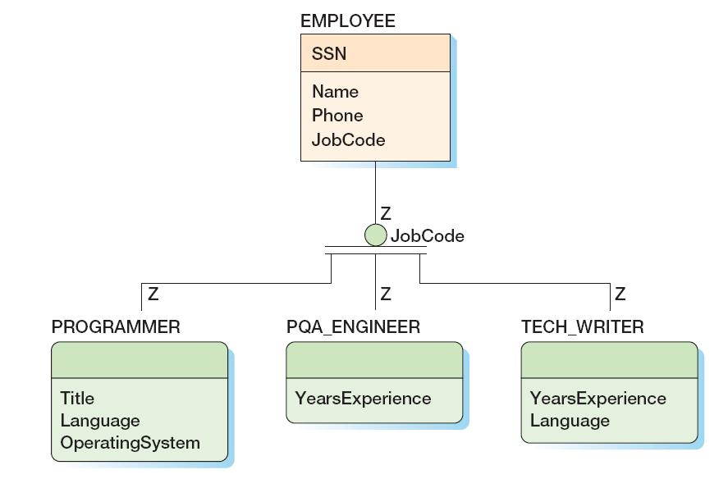
IDEF1X Relationship Types: Categorization Relationships
1:[0 or 1] between EMPLOYEE and Category Cluster
1:[0 or1], M-O between EMPLOYEE as parent and each category as a child
1:[0 or1], M-O between Category Cluster and categories

Slide 15
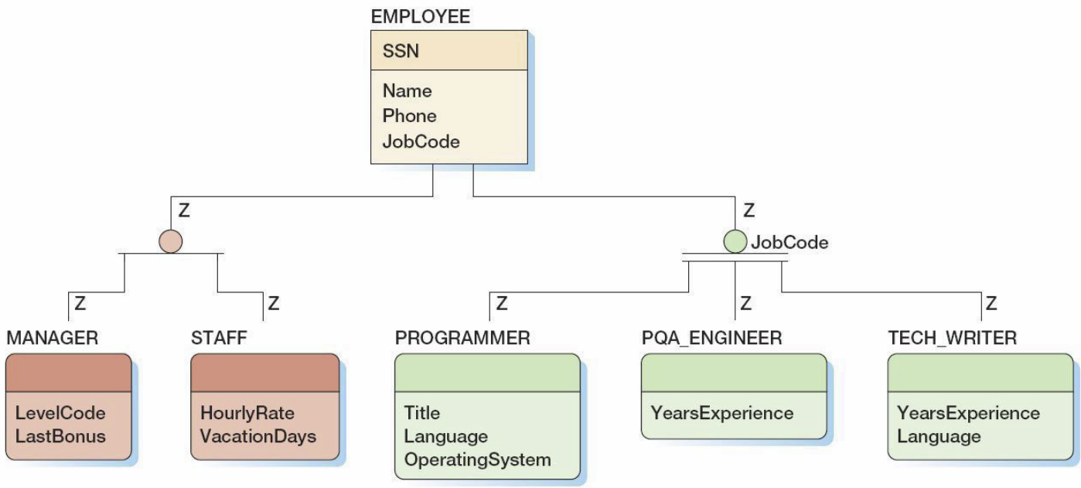
Categorization Relationships: Complete and Incomplete Category Clusters
Incomplete Category Cluster
Complete Category Cluster

Slide 16
Domains
A domain is a named set of values that an attribute can have:
May be general (CharacterString(max50))
May be specific ({Red, Blue, Green})
May be a range (1000-1999)
Domains reduce ambiguity.
Domains are useful.
Domain types:
Base Domain—a domain having a data type and possibly a value list or range definition
Type Domain—a subset of a base domain or another type domain

Slide 17
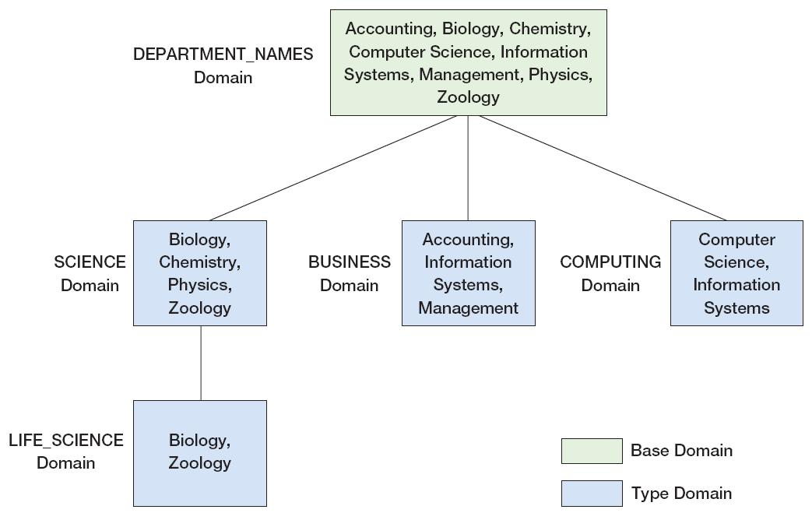
Domains: A Domain Hierarchy

Slide 18
David Kroenke and David Auer Database Processing Fundamentals, Design, and Implementation (13th Edition)
End of Presentation:
Appendix C

Slide 19

All rights reserved. No part of this publication may be reproduced, stored in a retrieval system, or transmitted, in any form or by any means, electronic, mechanical, photocopying, recording, or otherwise, without the prior written permission of the publisher. Printed in the United States of America.

