Slide 1

David M. Kroenke and David J. Auer Database Processing Fundamentals, Design, and Implementation
Appendix D:
E-R Diagrams and
The UML Standard

Slide 2
Chapter Objectives
To understand UML-style E-R diagrams
To be able to model HAS-A, nonidentifying, identifying, and IS-A relationships using UML symbols
To understand the object-oriented programming language constructs used in UML

Slide 3
Unified Modeling Language
Unified Modeling Language (UML) is
A set of structures and techniques for modeling and designing object-oriented programs (OOPs) and applications.
Promoted by the Object Management Group.
Beginning to see widespread use among OOP developers.
More of a subject for a systems development course.
Used to develop database designs.

Slide 4
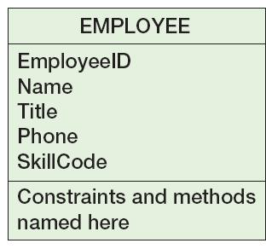
UML Entities
Three segments:
Top—name (and some other data)
Middle—attributes
Bottom—constraints and methods

Slide 5
UML Relationships
Shown as a solid line between two entities
Cardinalities are shown as x..y
x is the minimum required
y is the maximum allowed
* means an unlimited number

Slide 6
UML Relationships
1..1
Mandatory One
0..1
Optional One
UML Relationships
0..*
Optional Many
1..*
Mandatory Many

Slide 7
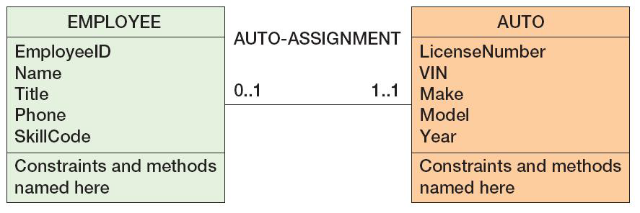
UML Relationships: 1:1

Slide 8
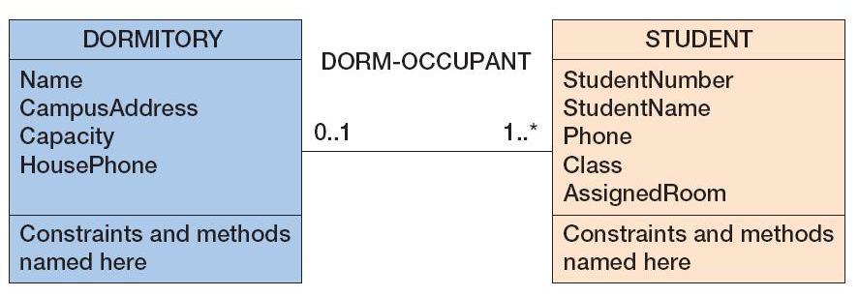
UML Relationships: 1:N

Slide 9
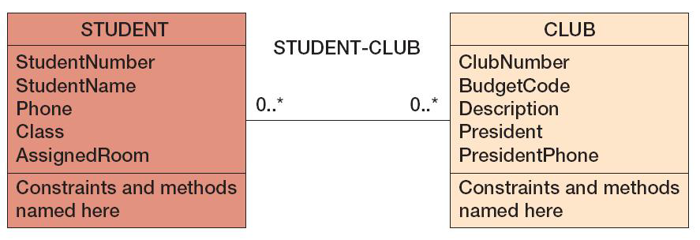
UML Relationships: N:M

Slide 10
UML Relationships: Weak Entities
A filled-in diamond is placed next to the parent of the weak entity (the child).
All weak entities have a parent, so the cardinality on the parent entity is always shown as 1.
ID-dependent weak entity relationships are denoted as <identifying>.
Non-ID-dependent weak entity relationships are denoted as <non-identifying>.

Slide 11
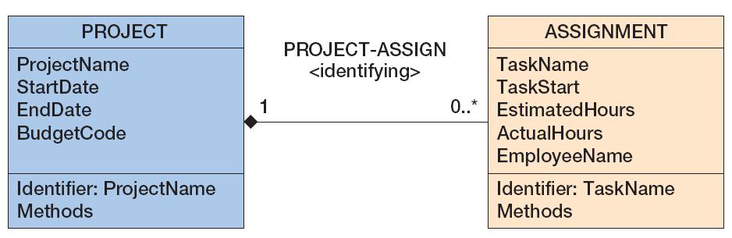
UML Weak Entity Relationships: Identifying

Slide 12
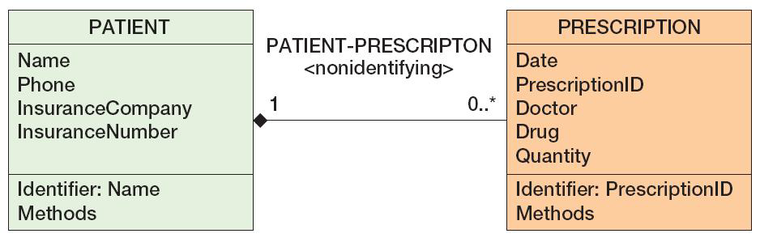
UML Weak Entity Relationships: Nonidentifying

Slide 13
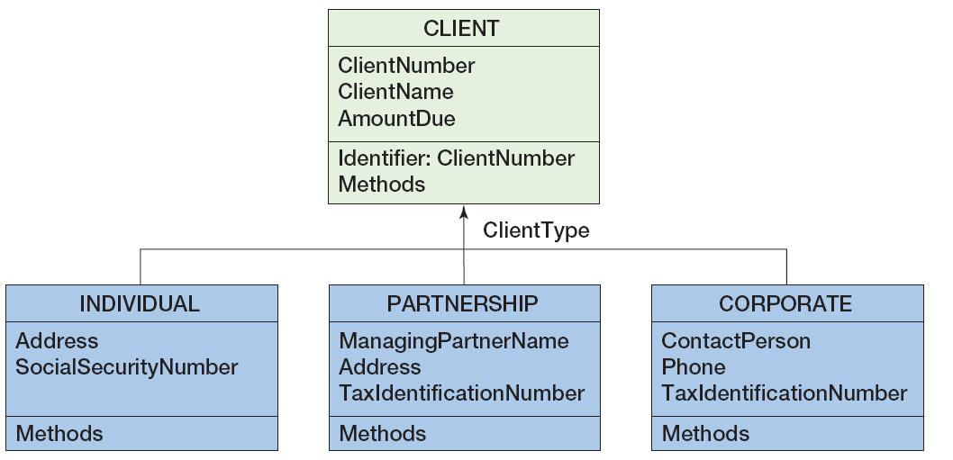
UML Weak Entity Relationships: Supertypes and Subtypes
UML does not have a notation for exclusivity

Slide 14
UML OOP Constructs
All entities that are to be stored are labeled <<Persistent>>.
Data should continue to exist even if the OOP object that processes it is destroyed, or in other words:
The entity class is to be stored in the database.
UML entity classes can have class attributes.
Attributes of the class, not of entity instances
Cannot be stored in relational model databases
Can be computed at run time
Can be stored in a new entity

Slide 15
UML OOP Constructs
Notation for visibility of attributes and methods
+ (plus sign)—indicates attribute is public
Is accessible and changeable by any method of any object
# (number sign)—indicates attribute is protected
Is accessible only to methods of this class or its subclasses
- (minus sign)—indicates attribute is private
Is accessible only to methods of this class
UML third segment holds constraints and methods
Constraints such as PrimaryKey
Methods such as GetName()

Slide 16
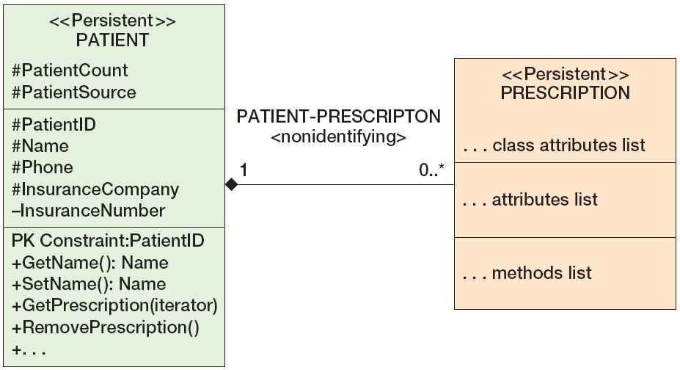
UML E-R Diagram with OOP Constructs

Slide 17
David Kroenke and David Auer Database Processing Fundamentals, Design, and Implementation (13th Edition)
End of Presentation:
Appendix D

Slide 18
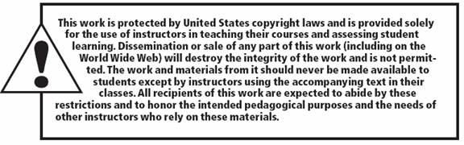
All rights reserved. No part of this publication may be reproduced, stored in a retrieval system, or transmitted, in any form or by any means, electronic, mechanical, photocopying, recording, or otherwise, without the prior written permission of the publisher. Printed in the United States of America.

