Slide 1

David M. Kroenke and David J. Auer Database Processing Fundamentals, Design, and Implementation
Appendix F:
Getting Started with Microsoft Visio 2013

Slide 2
Appendix Objectives
To learn how to create data models in Microsoft Visio 2013
To learn how to create database designs in Microsoft Visio 2013
To understand that Microsoft Visio 2013 has a template for creating process diagrams using Business Processing Modeling Notation (BPMN)

Slide 3
The Database Model Diagram
Microsoft Visio 2013 uses the Database Model Diagram template as the basis for data models as discussed in Chapter 5

Slide 4
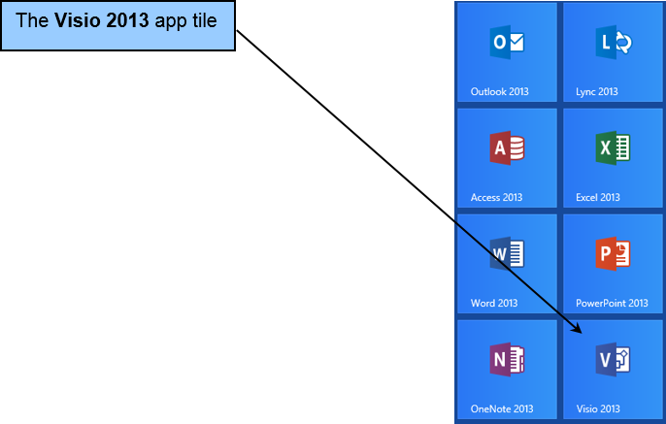
The Microsoft Visio 2013 Windows 8 App Tile

Slide 5
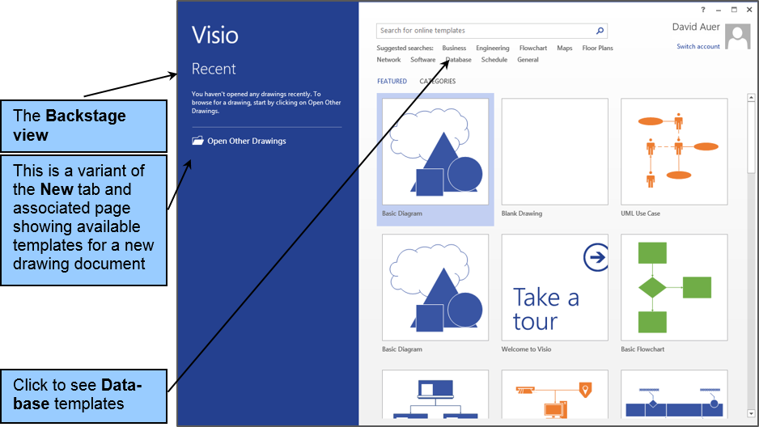
The Microsoft Visio 2013 Backstage View Splash Screen

Slide 6
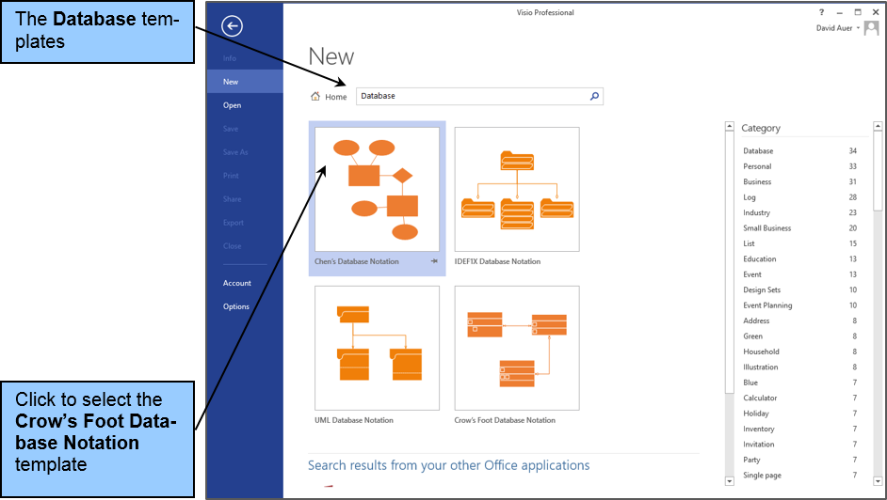
The Database Templates

Slide 7
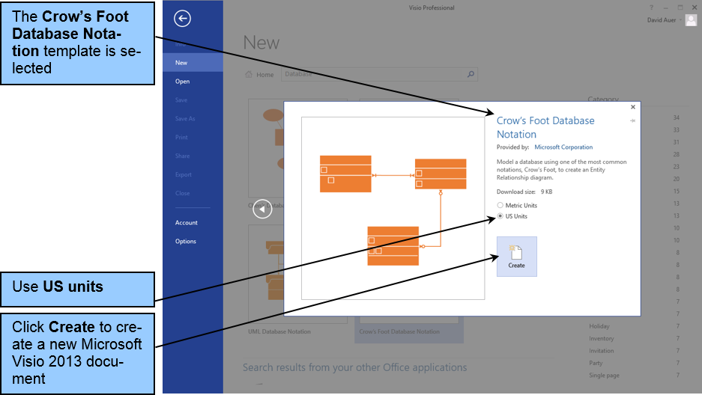
The Crow’s Foot Database Notation Template

Slide 8
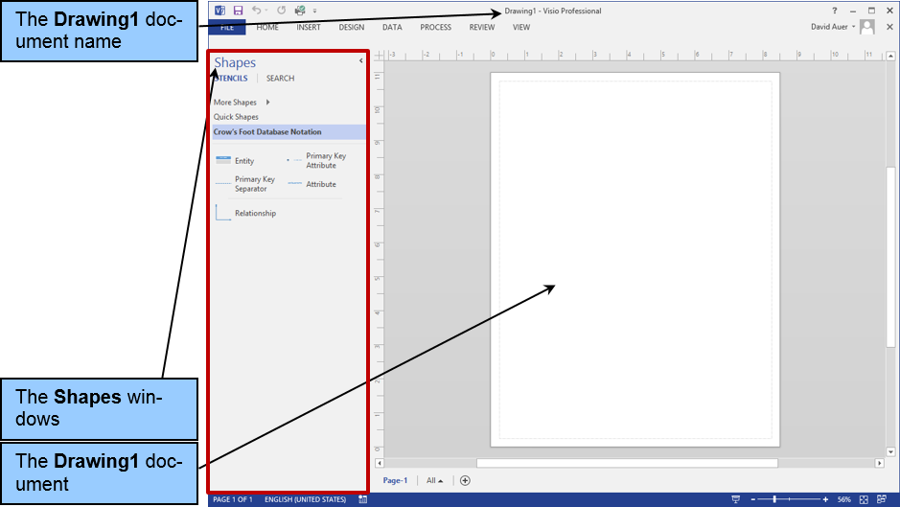
The Microsoft Visio 2013 Database Model Diagram

Slide 9
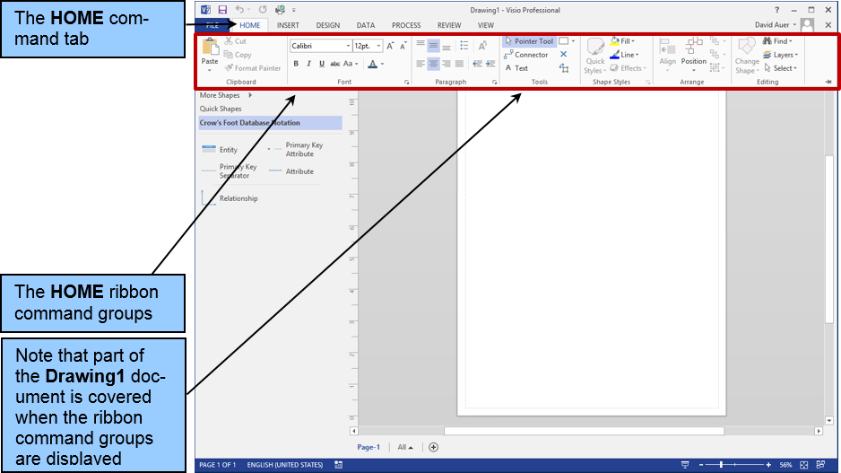
The Microsoft Visio 2013 The HOME Command Tab Ribbon

Slide 10
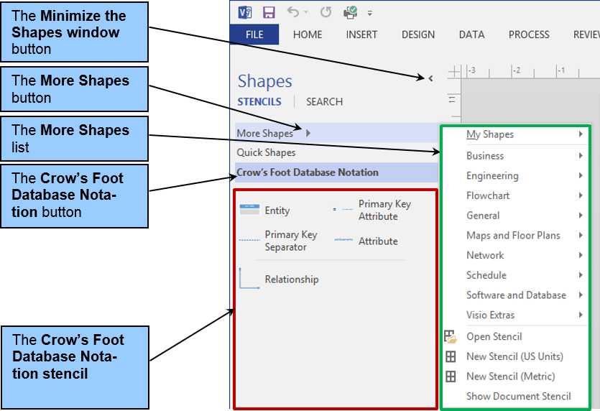
The Shapes Window

Slide 11
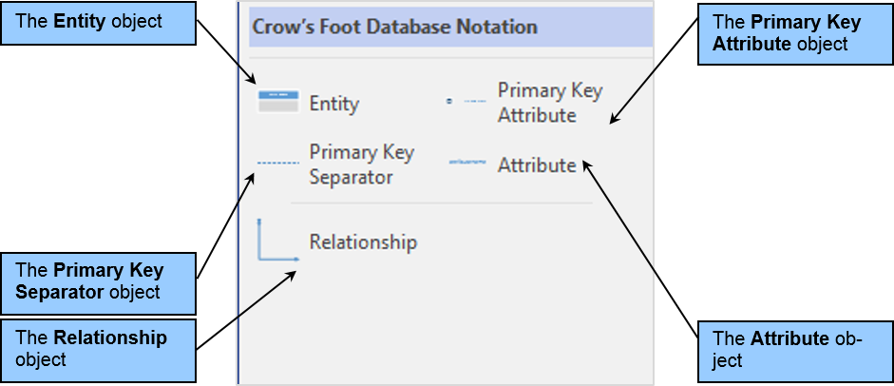
The Crow’s Foot Database Notation (US units) Stencil Objects I

Slide 12
The Entity Relationship (US units) Stencil Objects II
The Entity object — Use this object to create entities (data model) in the Microsoft Visio database model diagram.
The Relationship object — Use this object to create relationships between entities in data models (this is actually usually referred to as a Dynamic connector object).

Slide 13
The Entity Relationship (US units) Stencil Objects III
The Primary Key Attribute object — Use this object to indicate primary key attributes in data models.
The Primary Key Separator object — Use this object to separate primary key attributes from other (non-primary key) attributes.
The Attribute object — Use this object to indicate non-primary key attributes.

Slide 14
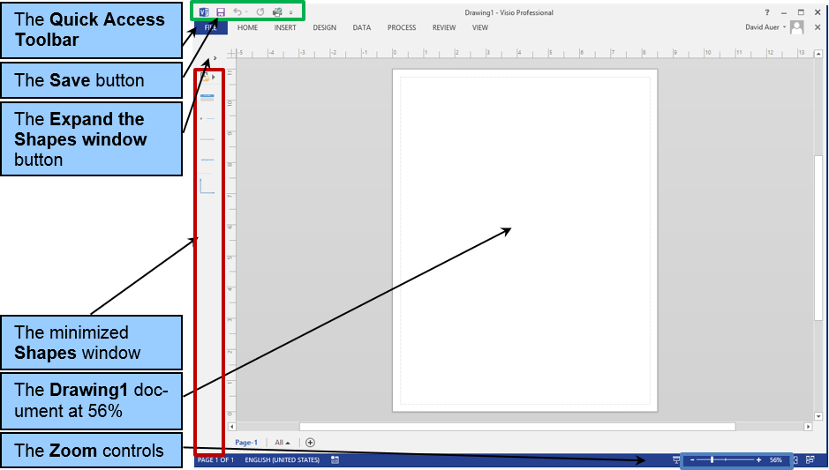
The Microsoft Visio 2013 Database Model Diagram with Minimized Shapes Window

Slide 15
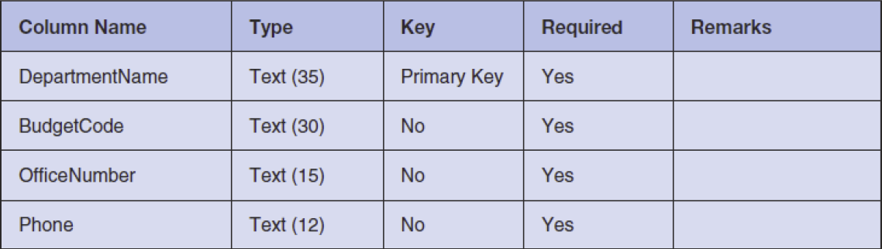
The WPC Database Column Characteristics DEPARTMENT Table

Slide 16
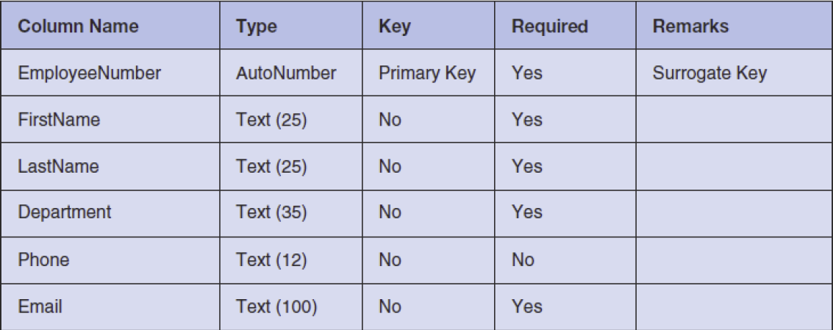
The WPC Database Column Characteristics EMPLOYEE Table

Slide 17
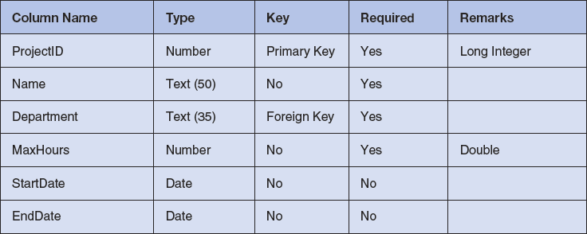
The WPC Database Column Characteristics PROJECT Table

Slide 18
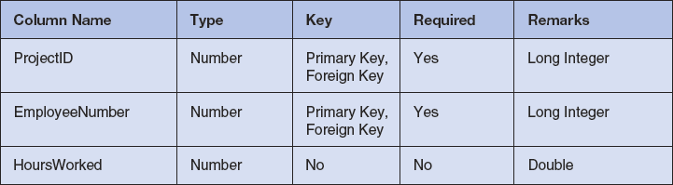
The WPC Database Column Characteristics ASSIGNMENT Table

Slide 19
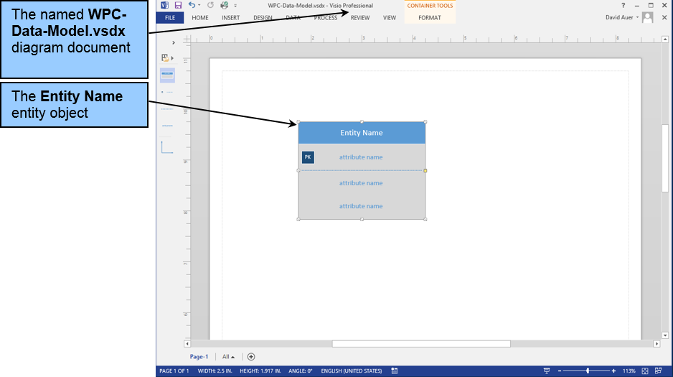
The Entity Name Entity Object

Slide 20
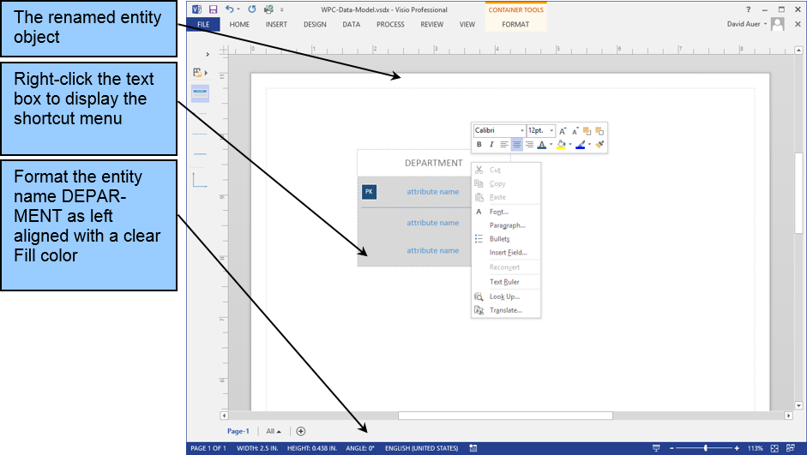
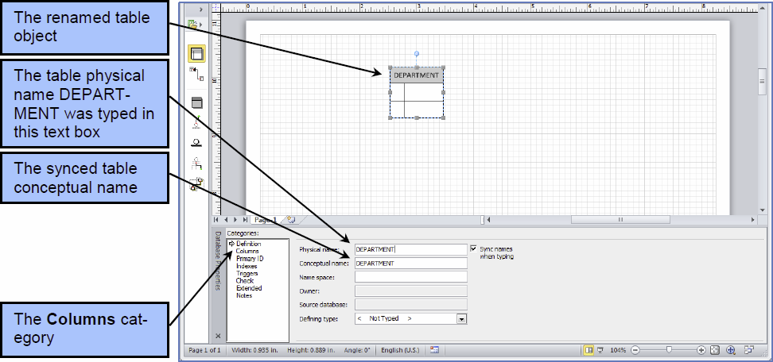
Naming and Formatting the Entity

Slide 21
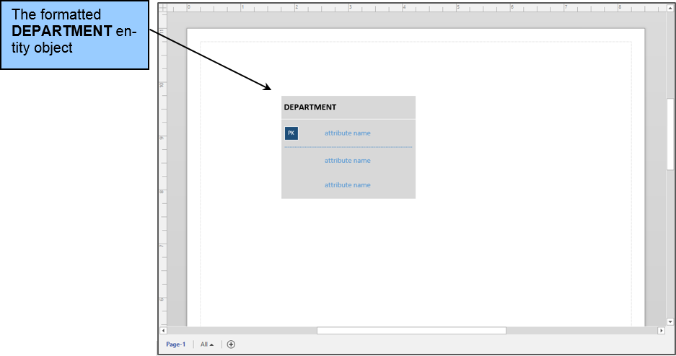
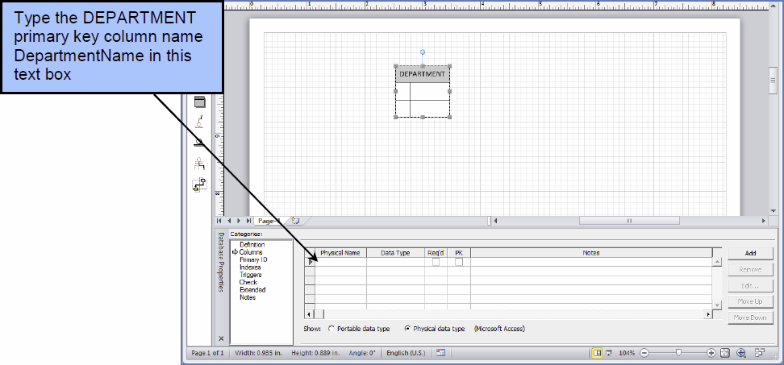
The Named and Formatted DEPARTMENT Entity

Slide 22
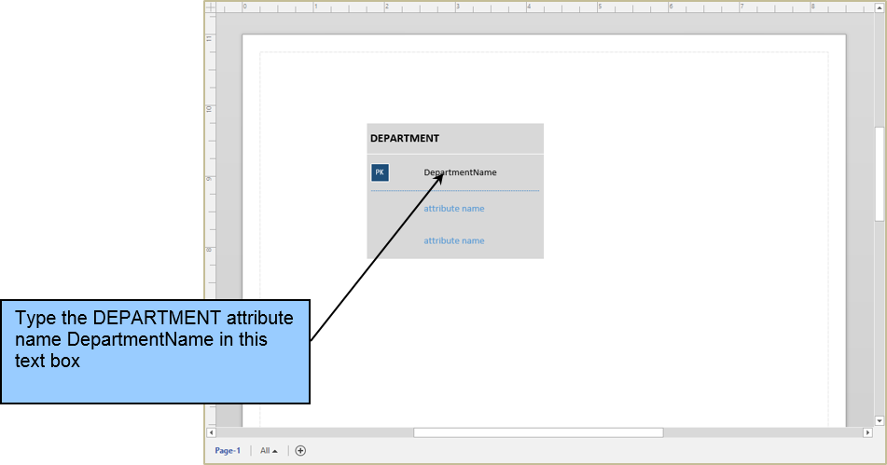
Naming the Primary Key Attribute

Slide 23
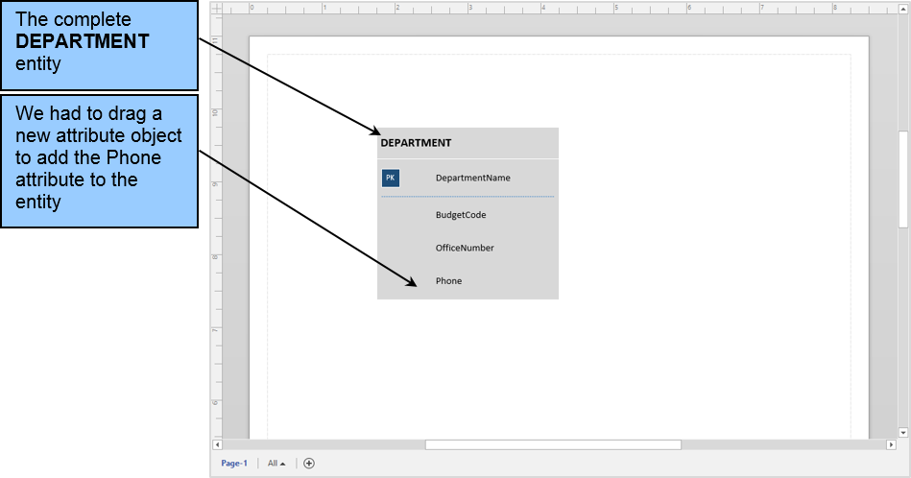
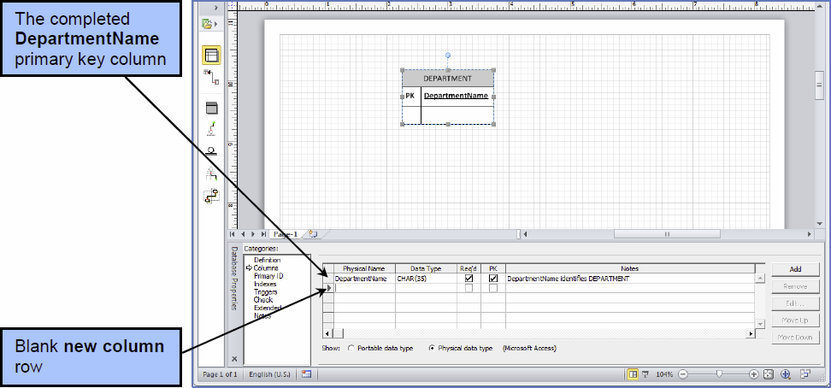
The Completed DEPARTMENT Entity

Slide 24
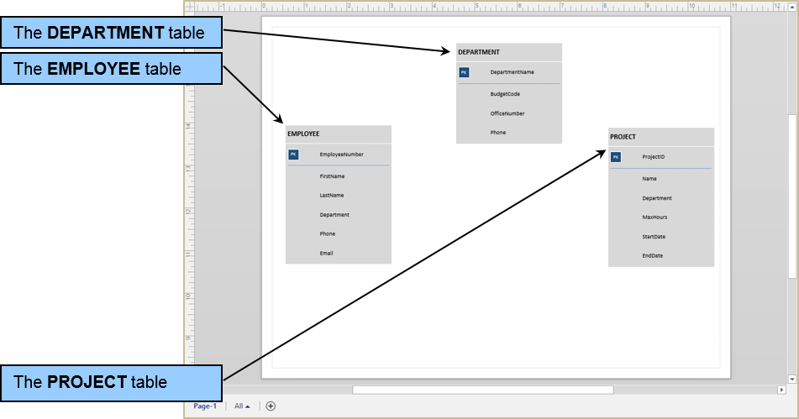
The Completed DEPARTMENT, EMPLOYEE and PROJECT Tables

Slide 25
Relationships
In Microsoft Visio 2013 we use the Relationship connector—used between two entities (which is a renamed variant of the Microsoft Visio Dynamic connector).

Slide 26
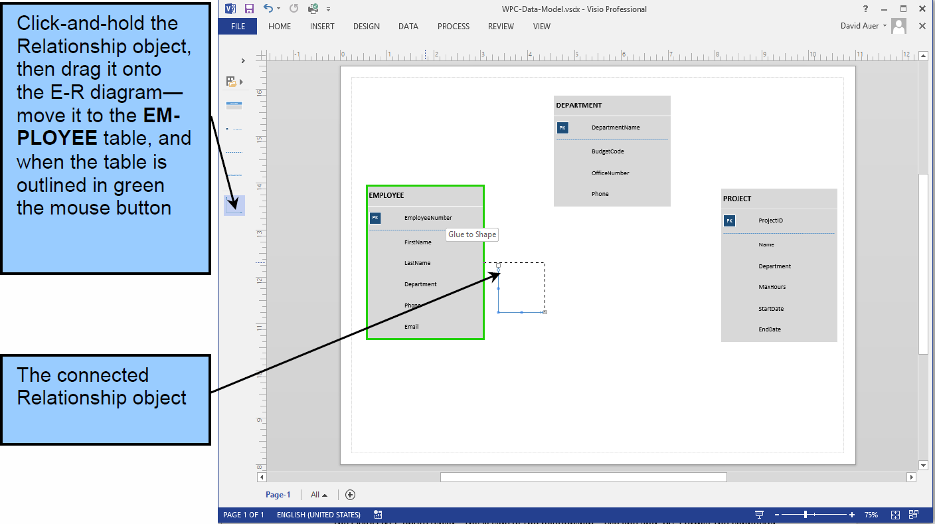
The Dynamic Connector Attached to the EMPLOYEE Table

Slide 27
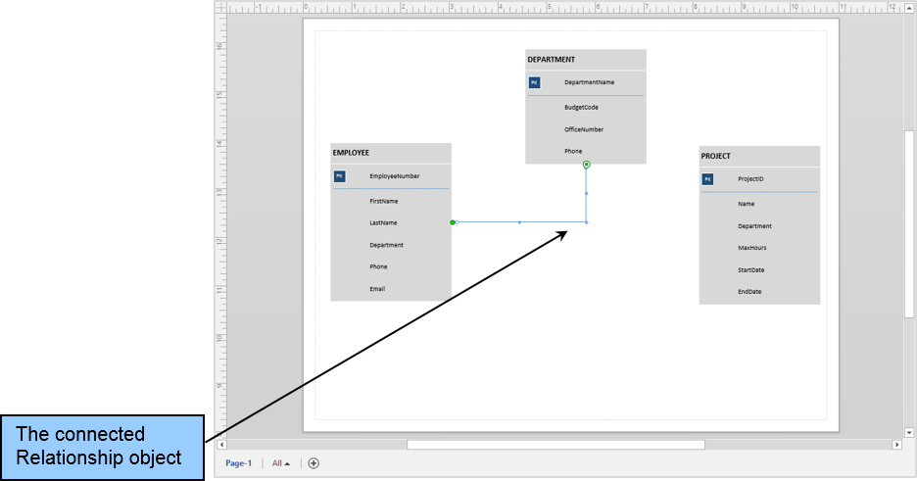
The Dynamic Connector Attached to Both the EMPLOYEE and DEPARTMENT Tables

Slide 28
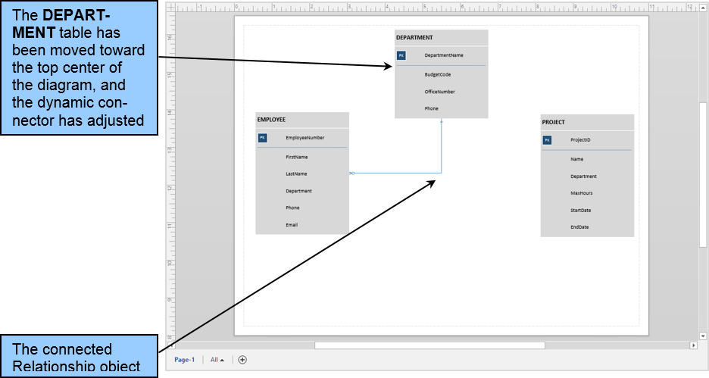
The Dynamic Connector Adjusts as the DEPARTMENT Table is Moved

Slide 29
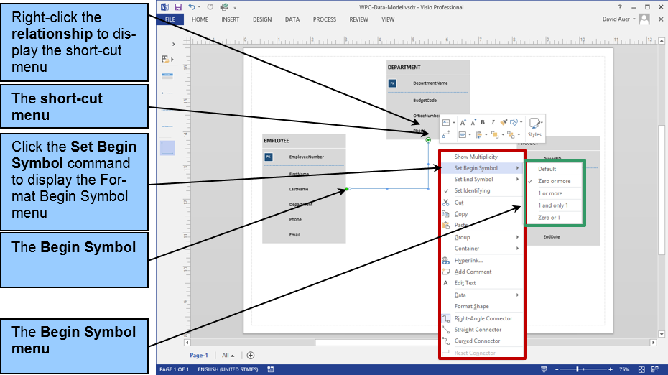
The Short-cut Menu

Slide 30
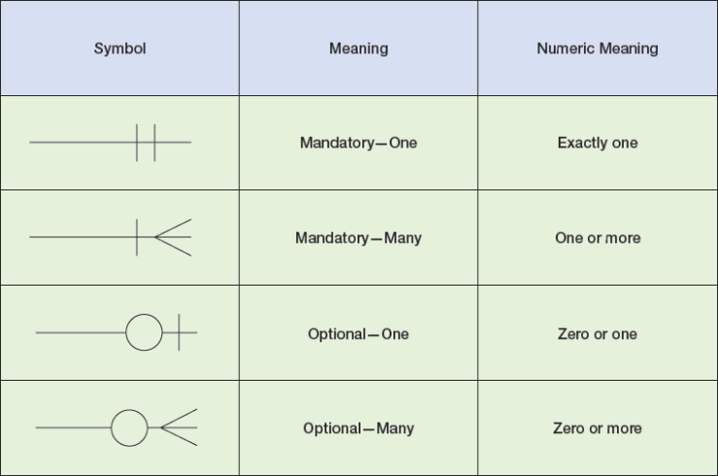
Crow’s Foot Symbols and Line Symbols

Slide 31
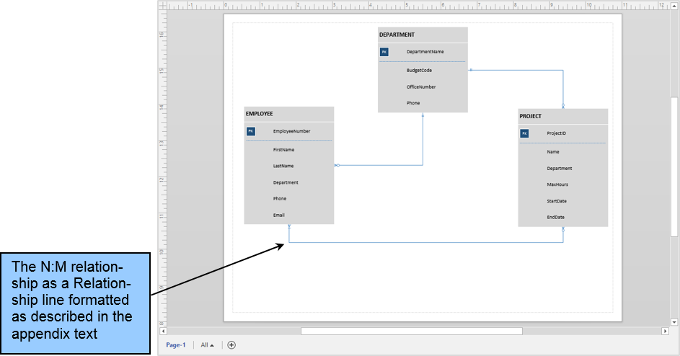
The N:M Relationship in the Data Model

Slide 32
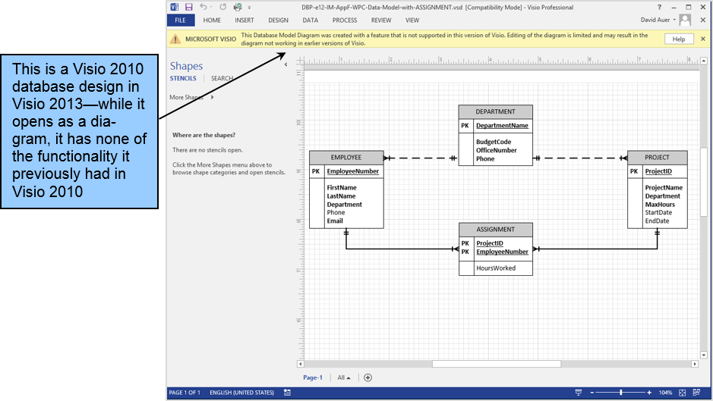
The Visio 2010 Database Design in Visio 2013

Slide 33
Business Processing Modeling Notation (BPMN) in Microsoft Visio 2013
See the Microsoft Visio Insights blog at http://blogs.msdn.com/b/visio/archive/2009/12/03/bpmn-support-in-visio-2010.aspx for a good discussion of BPNM in Microsoft Visio.
Unfortunately, full BPMN support is only available in the Visio Premium edition (see http://office.microsoft.com/en-us/visio/visio-edition-comparison-FX101838162.aspx).
For more information on BPMN, see the Object Management Group’s Business Process Management Initiative Web page at http://www.bpmn.org/.

Slide 34
David Kroenke and David Auer Database Processing Fundamentals, Design, and Implementation (13th Edition)
End of Presentation:
Appendix F

Slide 35

All rights reserved. No part of this publication may be reproduced, stored in a retrieval system, or transmitted, in any form or by any means, electronic, mechanical, photocopying, recording, or otherwise, without the prior written permission of the publisher. Printed in the United States of America.

