Slide 1

David M. Kroenke and David J. Auer Database Processing Fundamentals, Design, and Implementation
Appendix G:
Data Structures for
Database Processing

Slide 2
Chapter Objectives
To define the term data structures
To define and illustrate the terms flat file, sequential list, linked list, and index
To define and illustrate B-tree multilevel indexes
To demonstrate how binary relationships are represented using trees, simple networks, and complex networks
To define and illustrate primary and secondary keys
To define and illustrate unique and nonunique secondary keys

Slide 3
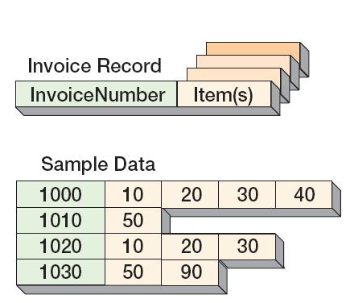
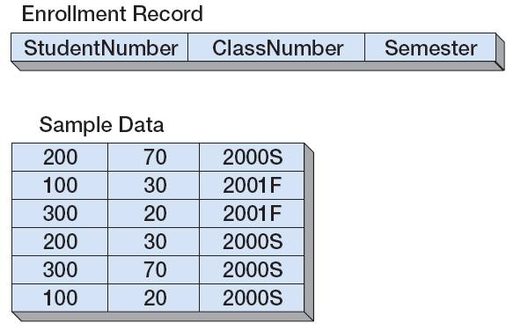
Flat Files
A flat file is a file that has no repeating groups.
They are usually processed in some predetermined order.
Flat File:
Nonflat File:

Slide 4
Processing Flat Files
Flat files can be ordered using the following data structures:
Sequential lists: physically placing the records in the sequence in which they will be processed
Linked lists: attaching to each data record a pointer to another logically related record
Indexes or inverted list: building a table, separate from the data records that contains pointers to related records
B-trees are special applications of indexes.
Data structures can be used to represent record relationships as well as secondary keys.

Slide 5
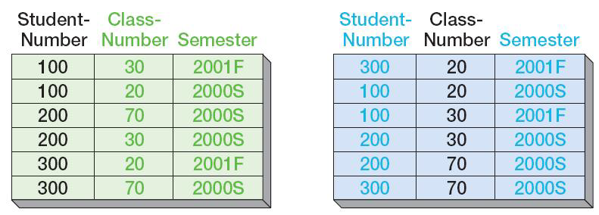
Sequential Lists
Stored by StudentNumber:
Stored by ClassNumber:

Slide 6
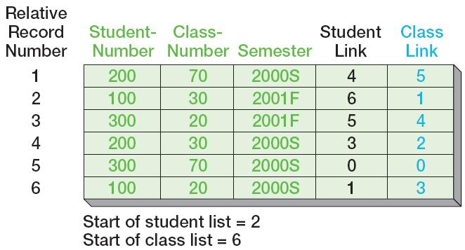
Linked Lists
ENROLLMENT data in two orders using linked lists:

Slide 7
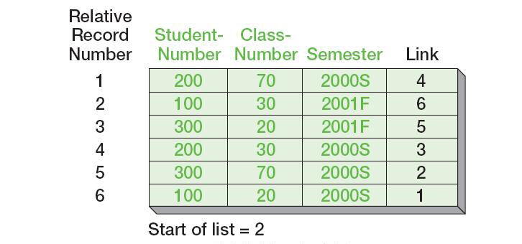
Circular Linked Lists
ENROLLMENT data sorted by StudentNumber using a circular linked list:

Slide 8
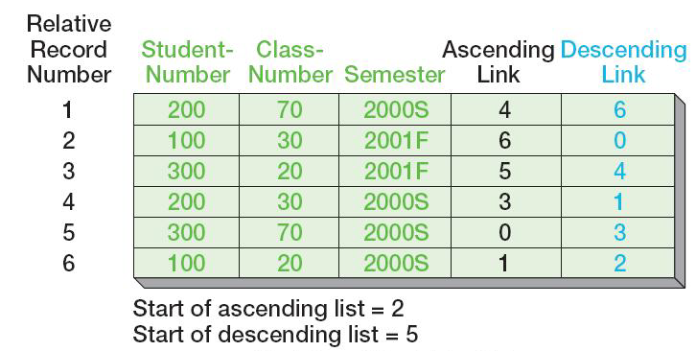
Two-Way Linked Lists
ENROLLMENT data sorted by StudentNumber using a two-way linked list:

Slide 9
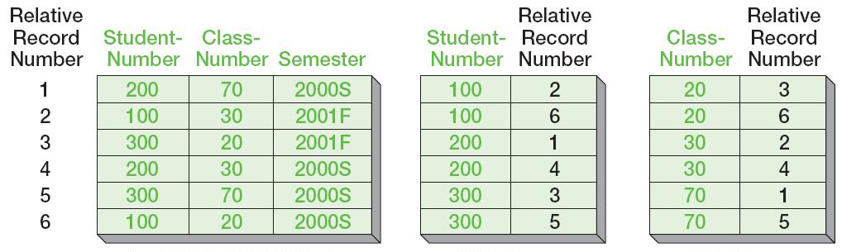
Indexes
ENROLLMENT data and corresponding indexes:
ENROLLMENT data:
Index on StudentNumber:
Index on ClassNumber:

Slide 10
B-Trees
A B-Tree is a multilevel index that allows both sequential and direct process of data records.
A B-Tree index has two parts:
The sequence set is an index containing an entry for every record in the file in physical sequence (usually by primary key value).
The index set is an index pointing to groups of entries in the sequence set data.
By definition, B-Trees are balanced—all of the data records are exactly the same distance from the top entry in the index set.

Slide 11
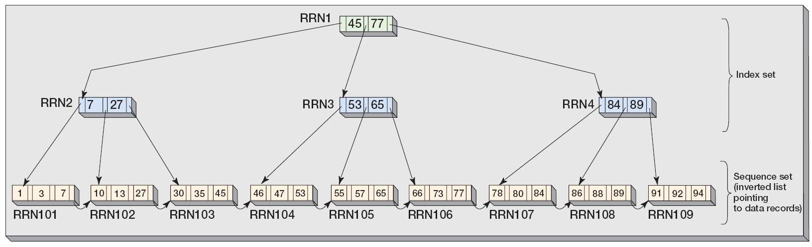
B-Trees: General Structure

Slide 12
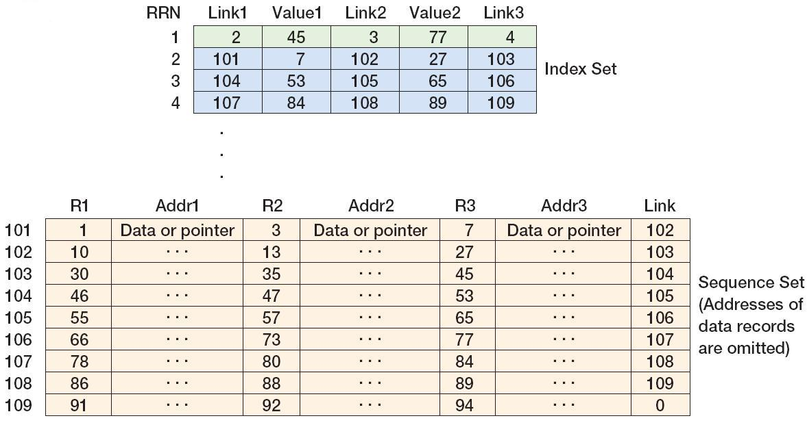
B-Trees: Index Set and Sequence Set

Slide 13
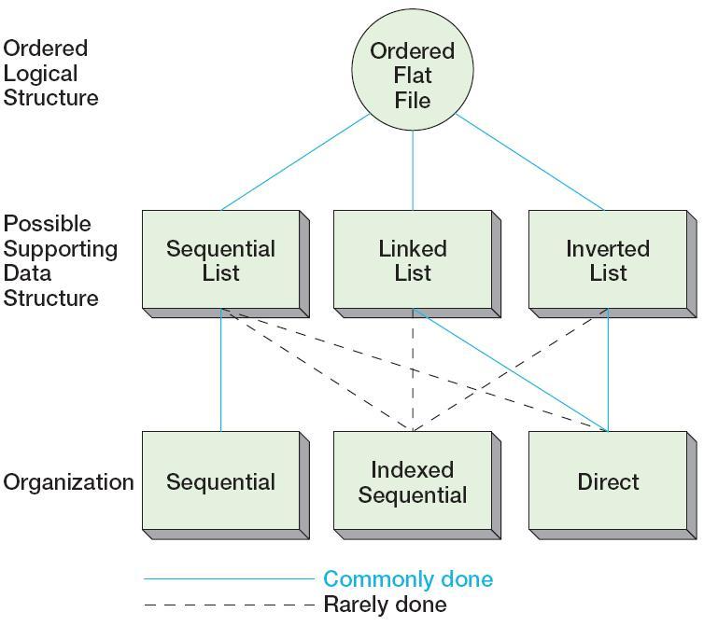
Summary of Data Relationships and Data Organizations Used for Ordered Flat Files

Slide 14
Representing Binary Relationships: Record Relationships
Records can be related in three ways:
A tree relationship has 1:N relationships where each child record has only one parent record.
A simple network is a collection of records and the 1:N relationships among them.
A complex network is a collection of records and the N:M relationships among them.

Slide 15
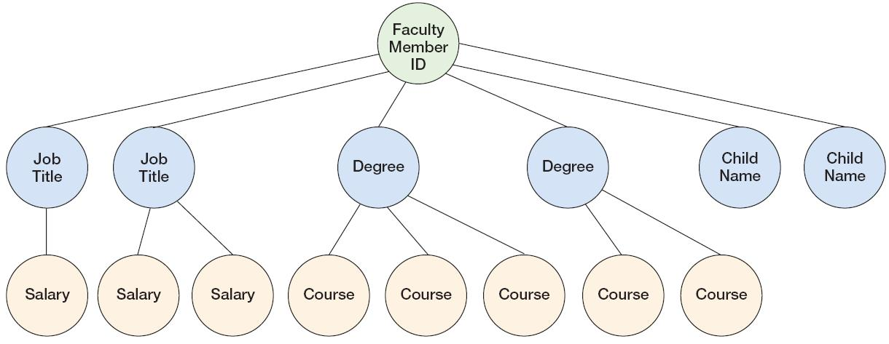
Tree Relationships: Occurrence of a Faculty Member Record

Slide 16
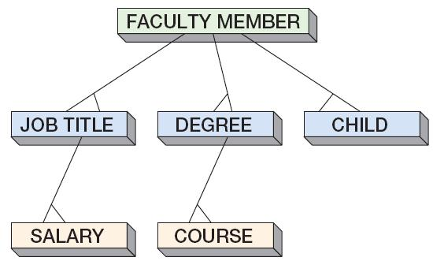
Tree Relationships: Schematic of a Faculty Member Tree Structure

Slide 17
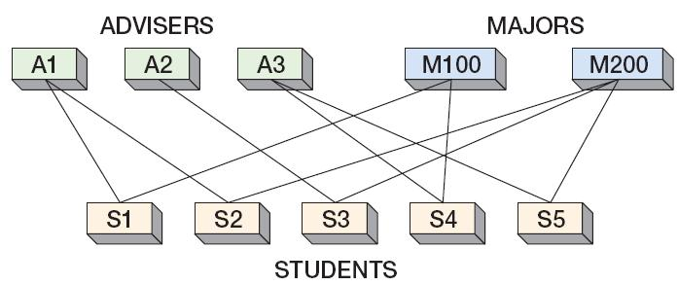
Simple Networks: Occurrence of a Simple Network

Slide 18
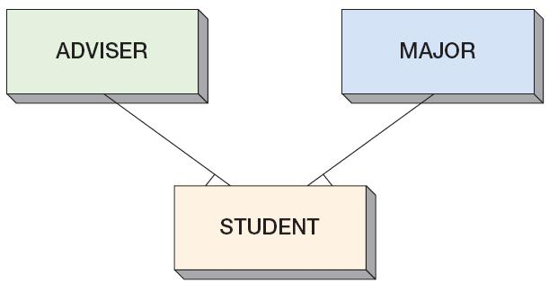
Simple Networks: General Structure of a Simple Network

Slide 19
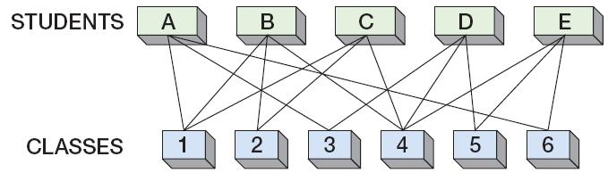
Complex Networks: Occurrence of a Complex Network

Slide 20
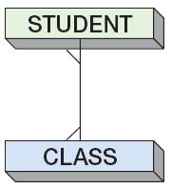
Complex Networks: General Structure of a Complex Network

Slide 21
Representing Trees
Sequential lists, linked lists, and indexes can all be used to represent trees.

Slide 22
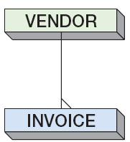
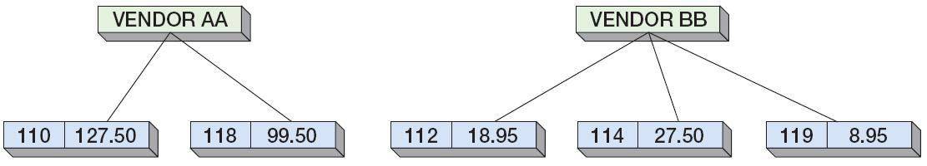
Representing Trees: The VENDOR-INVOICE Tree
Example tree relating VENDOR and INVOICE records:
Two occurrences of the VENDOR-INVOICE tree:

Slide 23
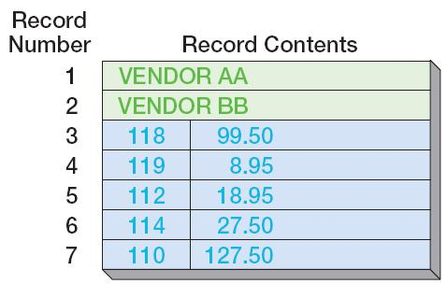
Representing Trees with Sequential Lists: The VENDOR-INVOICE Tree

Slide 24
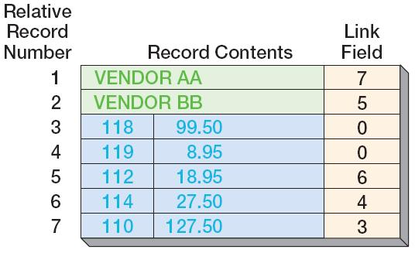
Representing Trees with Linked Lists: The VENDOR-INVOICE Tree

Slide 25
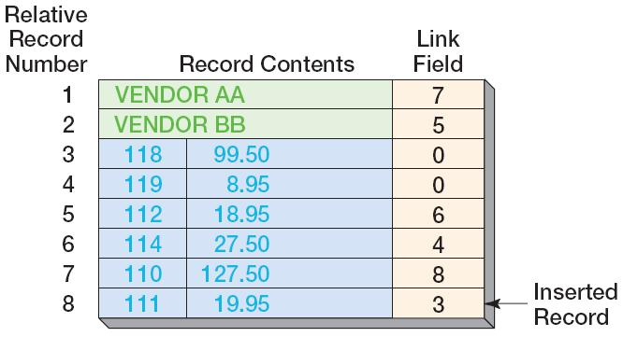
Representing Trees with Linked Lists: Inserting a Record

Slide 26
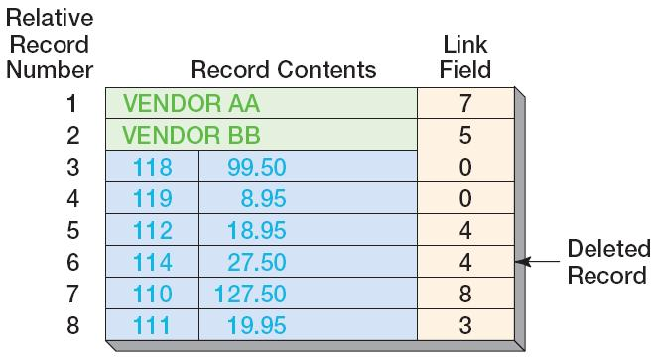
Representing Trees with Linked Lists: Deleting a Record

Slide 27
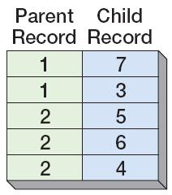
Representing Trees with Indexes: The VENDOR-INVOICE Tree
Index:

Slide 28
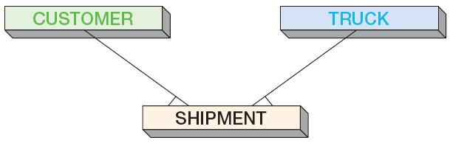
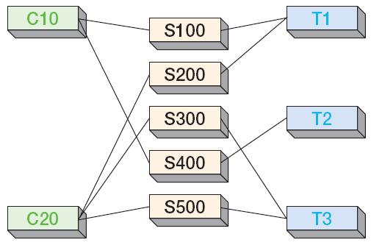
Representing Simple Networks: The CUSTOMER-TRUCK-SHIPMENT Structure
Example simple network relating CUSTOMER, TRUCK, and SHIPMENT records:
Occurrences of the CUSTOMER-TRUCK-SHIPMENT simple network:

Slide 29
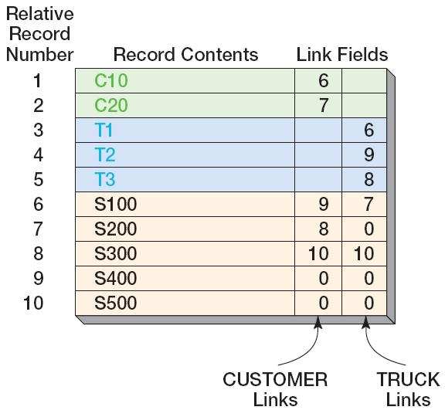
Representing Simple Networks with Linked Lists: The CUSTOMER-TRUCK-SHIPMENT Structure

Slide 30
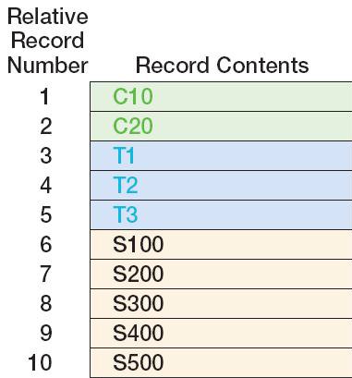
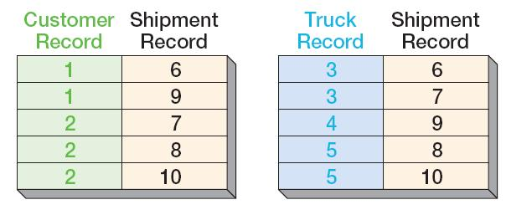
Representing Simple Networks with Indexes: The CUSTOMER-TRUCK-SHIPMENT Structure
Indexes:

Slide 31
Representing Complex Networks
Complex networks represented by:
Decomposing them into trees
Decomposing them into simple networks
This will require an intersection record
Can be represented using techniques for simple networks
Using indexes
Linked lists are not used by any DBMS product to represent complex networks.

Slide 32
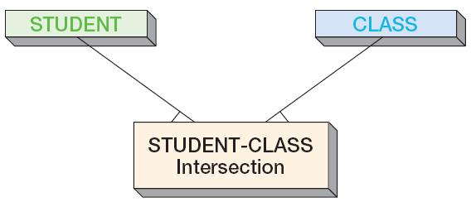
Representing Complex Networks: Decomposition into Simple Networks
Example STUDENT-CLASS complex network:
Decomposition of the STUDENT-CLASS complex network into a simple network using STUDENT-CLASS intersection records:

Slide 33
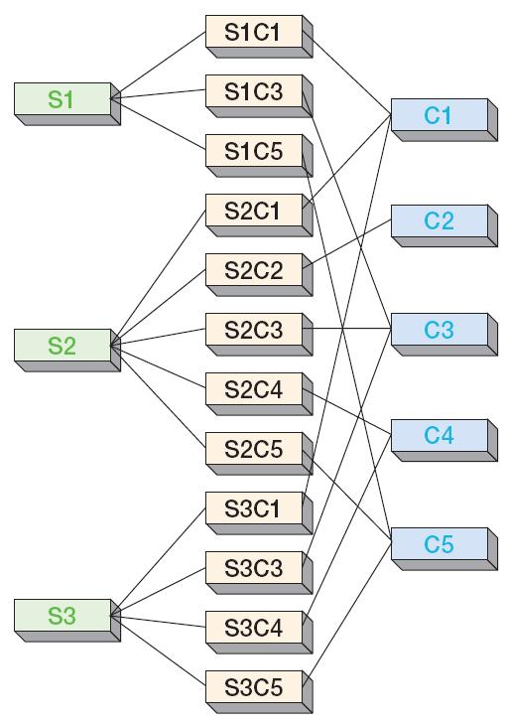
Representing Complex Networks: Decomposition into Simple Networks
Occurrences of the STUDENT-CLASS simple network with STUDENT-CLASS intersection records:

Slide 34
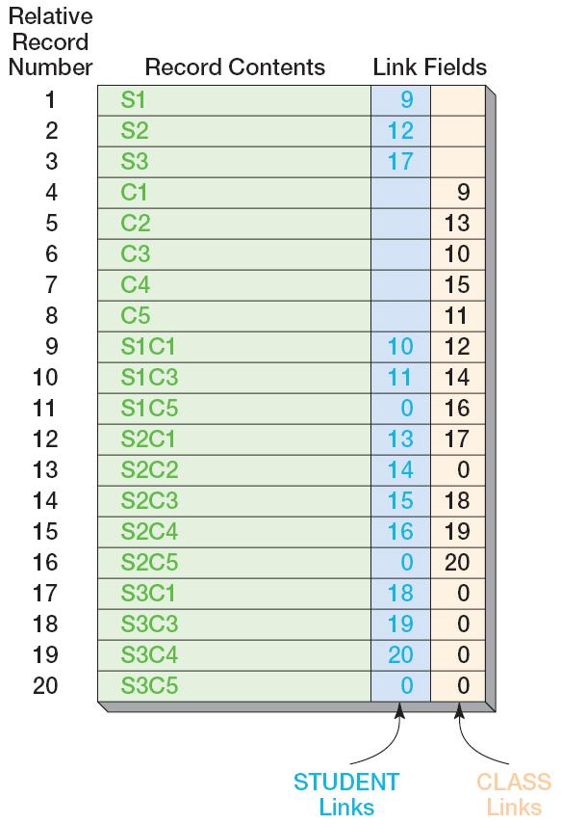
Representing Complex Networks with Linked Lists: The STUDENT-CLASS Structure

Slide 35
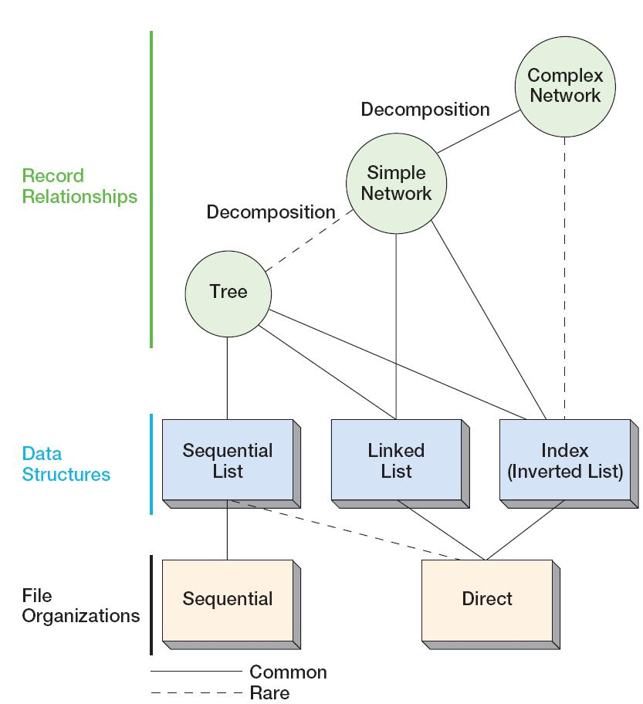
Summary of Relationship Representations

Slide 36
Secondary Key Representations
Key indicates a field (or fields) used to uniquely identify a row or record.
This key usually is called the primary key.
Secondary keys are used to access the data on some field besides the primary key.
Secondary keys can be unique or nonunique.
Nonunique secondary keys can be represented with both linked lists and indexes.
Set refers to all records that have the same value of a nonunique secondary key.
Unique secondary keys can be represented only with indexes.

Slide 37
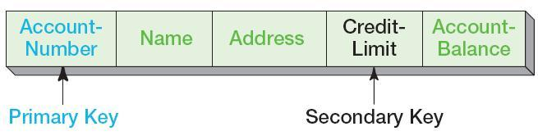
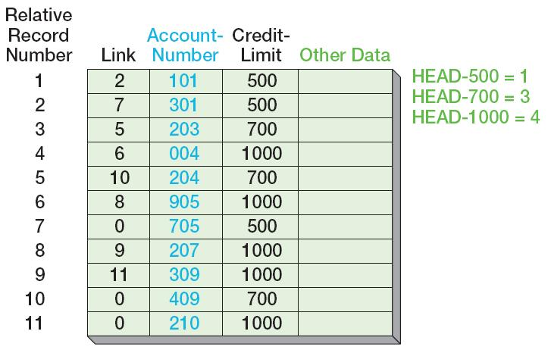
Representing Secondary Keys with Linked Lists: The CUSTOMER Records
The CUSTOMER Record Structure:
Representing the secondary key CreditLimit using a linked list:

Slide 38
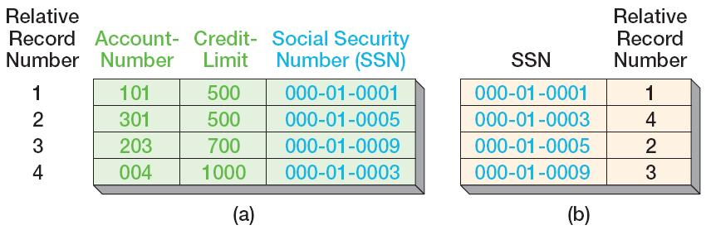
Representing Secondary Keys with Indexes: Unique Secondary Keys
The CUSTOMER Record Structure:
Assume that CUSTOMER has a field named SSN to hold the Social Security Number. These numbers are unique.
Sample CUSTOMER data with SSN and an index on SSN as a secondary key:

Slide 39
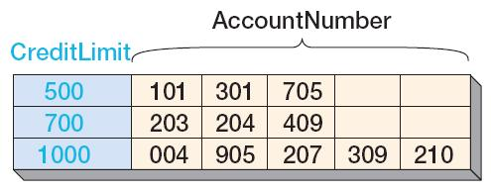
Representing Secondary Keys with Indexes: Nonunique Secondary Keys
The CUSTOMER Record Structure:
The CUSTOMER field named CreditLimit holds numbers that are nonunique.
Sample CUSTOMER data values for CreditLimit and an index on CreditLimit as a secondary key (See earlier slide with CUSTOMER table for complete data set):

Slide 40
Representing Secondary Keys with Indexes: Nonunique Secondary Keys
Representing and processing nonunique secondary keys are complex tasks.
One common commercial DBMS method uses values tables and occurrence tables:
Values table—Contains two fields:
Secondary key value
Pointer into the occurrence table
Occurrence table —Contains record addresses
Those record addresses that form a set are stored together in the occurrence table

Slide 41
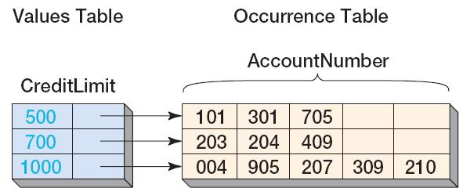
Representing Secondary Keys with Indexes: Nonunique Secondary Keys
The CUSTOMER Record Structure:
The CUSTOMER field named CreditLimit holds numbers that are nonunique.
Sample CUSTOMER data values for CreditLimit and an index on CreditLimit as a secondary key (See earlier slide with CUSTOMER table for complete data set) using a values table and an occurrence table:

Slide 42
David Kroenke and David Auer Database Processing Fundamentals, Design, and Implementation (13th Edition)
End of Presentation:
Appendix G

Slide 43

All rights reserved. No part of this publication may be reproduced, stored in a retrieval system, or transmitted, in any form or by any means, electronic, mechanical, photocopying, recording, or otherwise, without the prior written permission of the publisher. Printed in the United States of America.

