Slide 1

David M. Kroenke and David J. Auer Database Processing: Fundamentals, Design, and Implementation
Chapter One:
Introduction

Slide 2
Chapter Objectives
To understand the nature and characteristics of databases
To survey some important and interesting database applications
To gain a general understanding of tables and relationships
To describe the components of a Microsoft Access database system and explain the functions they perform
To describe the components of an enterprise-class database system and explain the functions they perform
To define the term database management system (DBMS) and describe the functions of a DBMS

Slide 3
Chapter Objectives
To define the term database and describe what is contained within the database
To define the term metadata and provide examples of metadata
To define and understand database design from existing data
To define and understand database design as new systems development
To define and understand database design in database redesign
To understand the history and development of database processing

Slide 4
The Characteristics of Databases
The purpose of a database is to help people track things of interest to them.
Data is stored in tables, which have rows and columns like a spreadsheet. A database may have multiple tables, where each table stores data about a different thing.
Each row in a table stores data about an occurrence or instance of the thing of interest.
A database stores data and relationships.

Slide 5
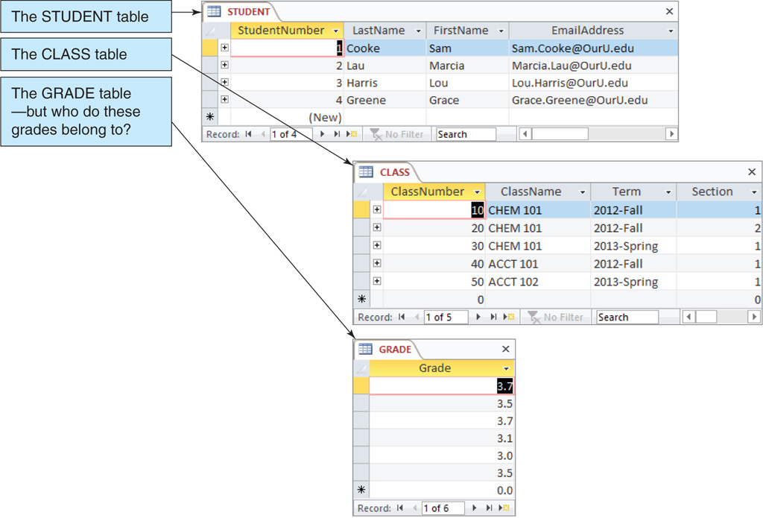
Data in Tables

Slide 6
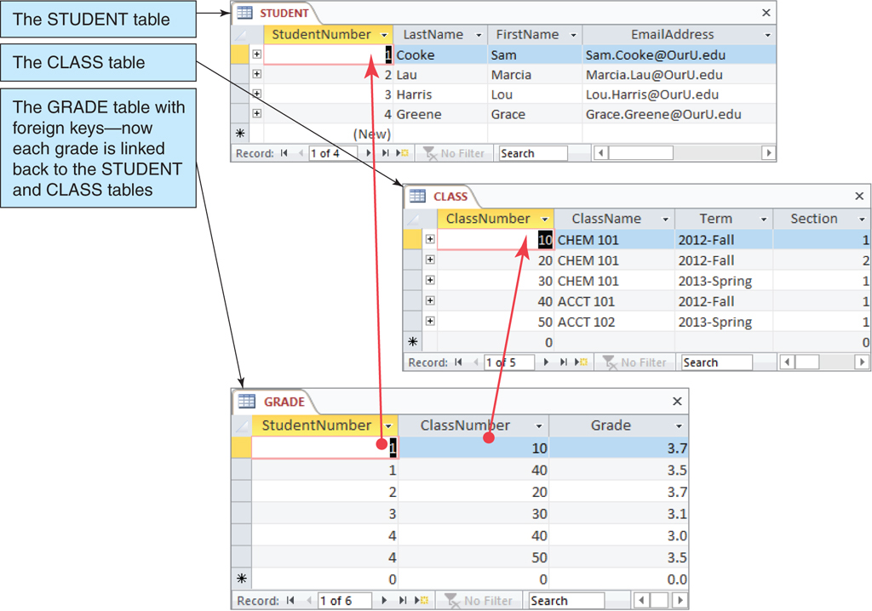
The Key Characteristic of Databases: Related Tables

Slide 7
Naming Conventions in this Textbook
Table names are written with all capital letters:
STUDENT, CLASS, GRADE
Column names are written with an initial capital letter, and compound names are written with a capital letter on each word:
Term, Section, ClassNumber, StudentName

Slide 8
Databases Create Information
Data = recorded facts and figures
Information = knowledge derived from data
Databases record data, but they do so in such a way that we can produce information from the data.
The data on STUDENTs, CLASSes, and GRADEs could produce information about each student’s GPA.

Slide 9
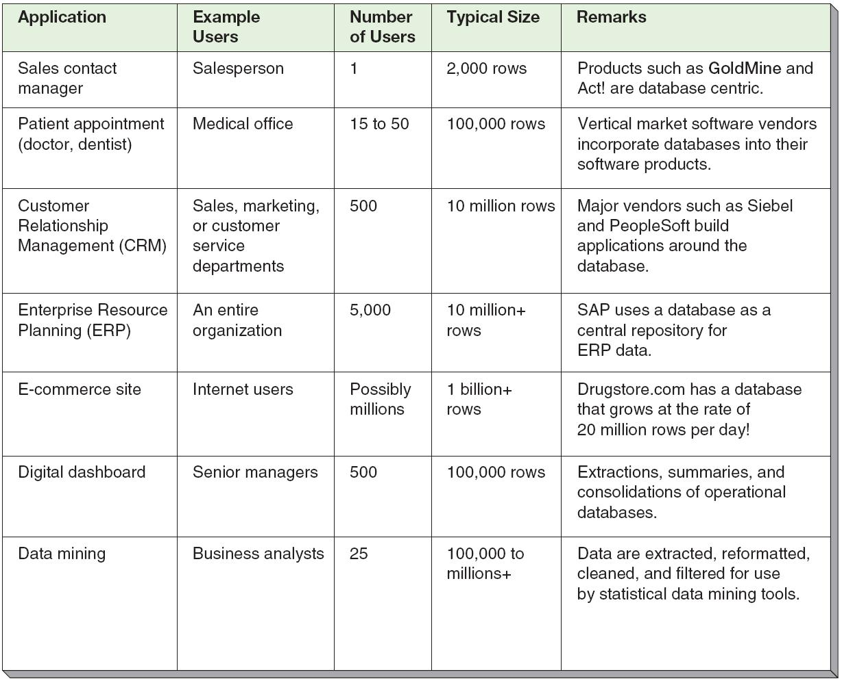
Database Examples

Slide 10
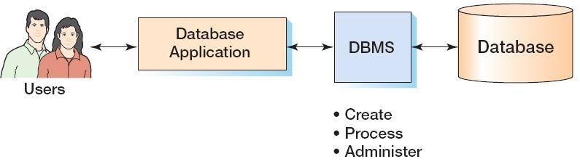
Components of a Database System

Slide 11
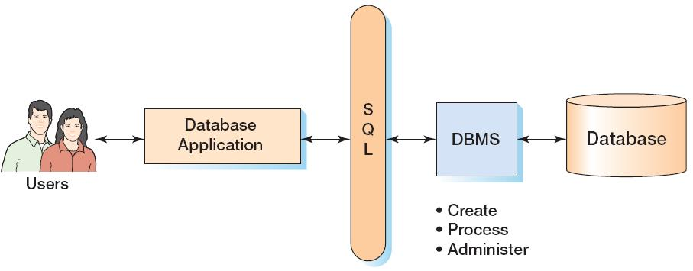
Components of a Database System with SQL

Slide 12
Applications, the DBMS, and SQL
Applications are the computer programs that users work with.
The Database Management System (DBMS) creates, processes, and administers databases.
Structured Query Language (SQL) is an internationally recognized standard database language that is used by all commercial DBMSs.

Slide 13
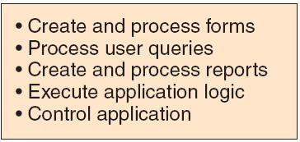
Database Applications

Slide 14
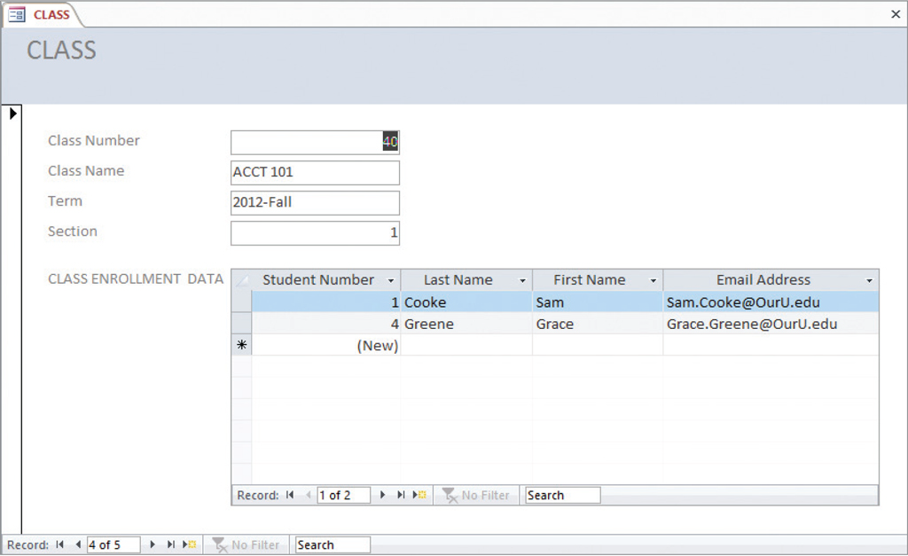
Database Applications—Forms

Slide 15
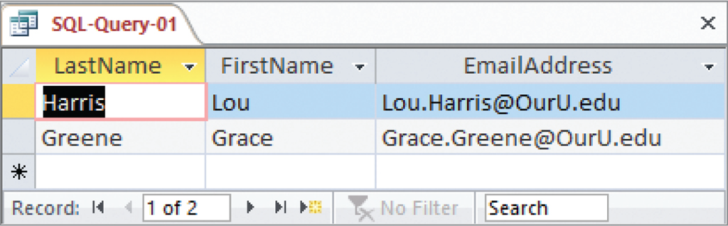
Database Applications—Queries
SELECT LastName, FirstName, EmailAddress
FROM STUDENT
WHERE StudentNumber > 2;

Slide 16
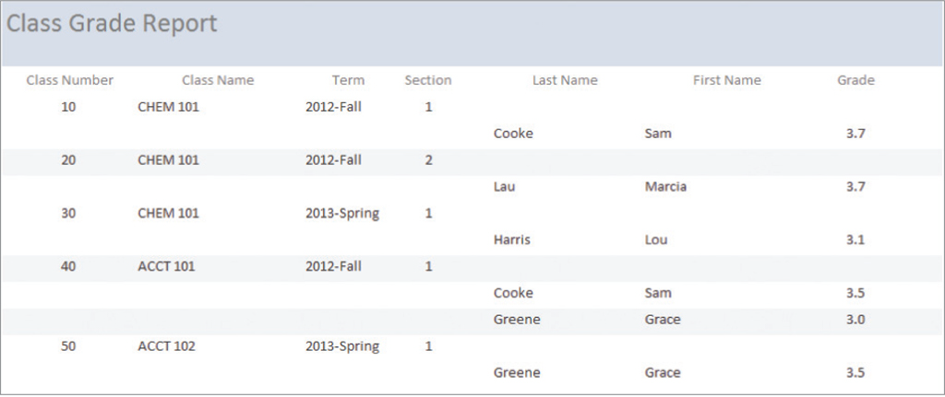
Database—Reports

Slide 17
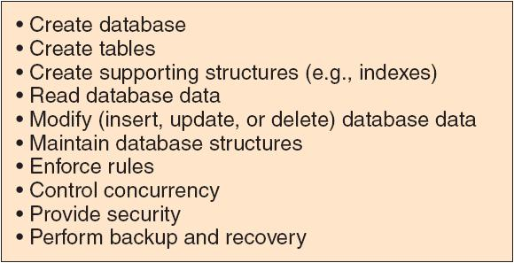
The DBMS

Slide 18
The Database
A database is a self-describing collection of integrated tables.
The tables are called integrated because they store data about the relationships between the rows of data.
A database is called self-describing because it stores a description of itself.
The self-describing data is called metadata, which is data about data.

Slide 19
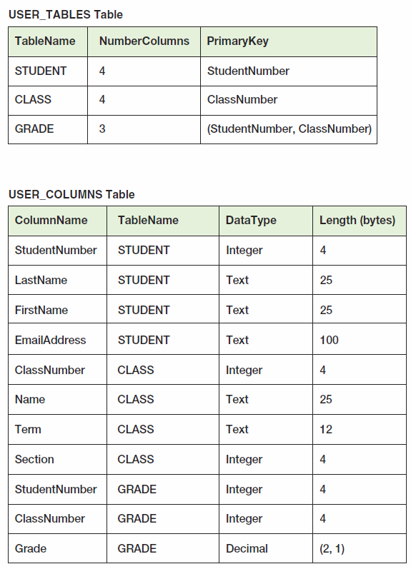
Typical Metadata Tables

Slide 20
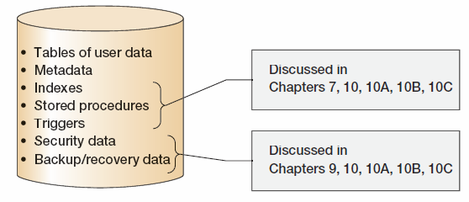
Database Contents

Slide 21
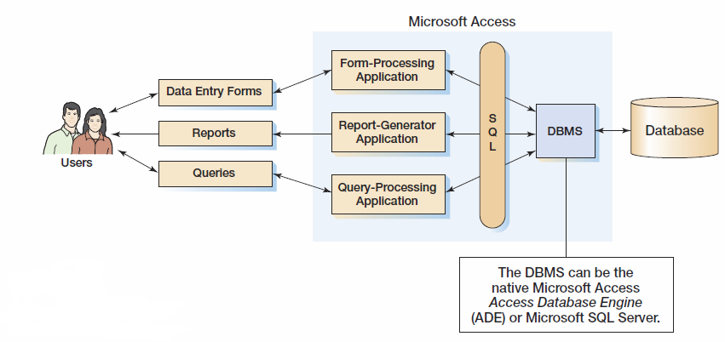
Personal Database Systems: Microsoft Access

Slide 22
Microsoft Access
Microsoft Access is a low-end product intended for individual users and small workgroups.
Microsoft Access tries to hide much of the underlying database technology from the user.
A good strategy for beginners, but not for database professionals.
NOTE: Microsoft Access 2013 is discussed in detail in Appendix A.

Slide 23
What Is Microsoft Access?
Microsoft Access is a DBMS plus an application generator:
The DBMS creates, processes, and administers Microsoft Access databases.
The application generator includes query, form, and report components.
The Microsoft Access DBMS engine is called the Access Data Engine (ADE).
Microsoft Access 2000 thru 2010 can be used as an application generator for the Microsoft SQL Server DBMS.

Slide 24
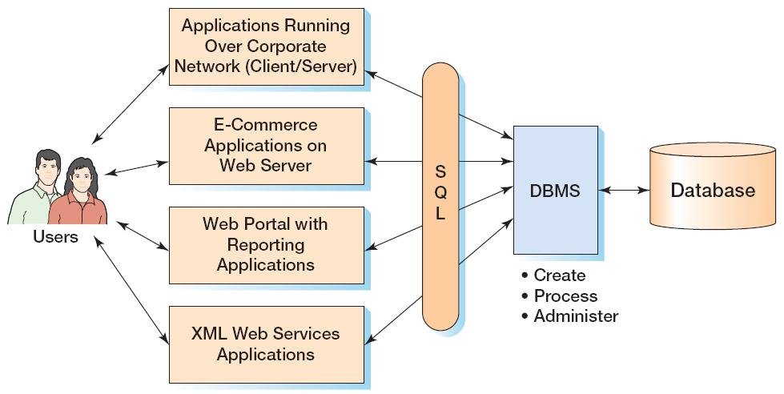
Enterprise-Class Database Systems

Slide 25
Prominent DBMS Products
Microsoft Access 2013
Microsoft SQL Server 2012
Microsoft SQL Server 2012 Express
Oracle Corporation Oracle Database 11g Release 2
MySQL 5.6
IBM DB2

Slide 26
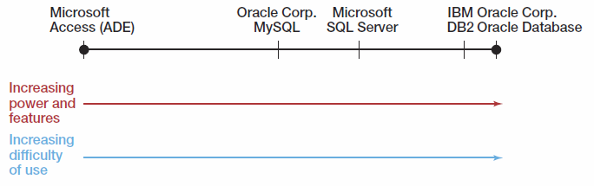
DBMS Power vs. Ease of Use

Slide 27
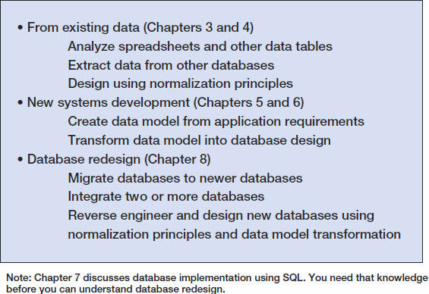
Three Types of Database Design

Slide 28
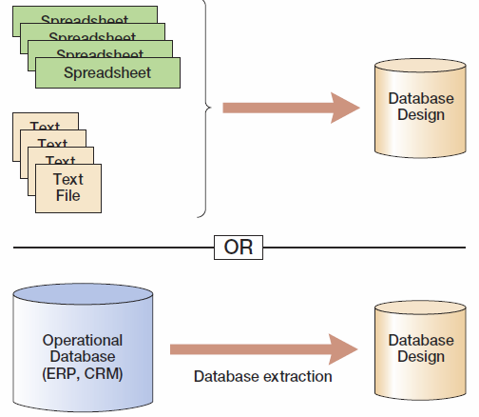
Database Design from Existing Data

Slide 29
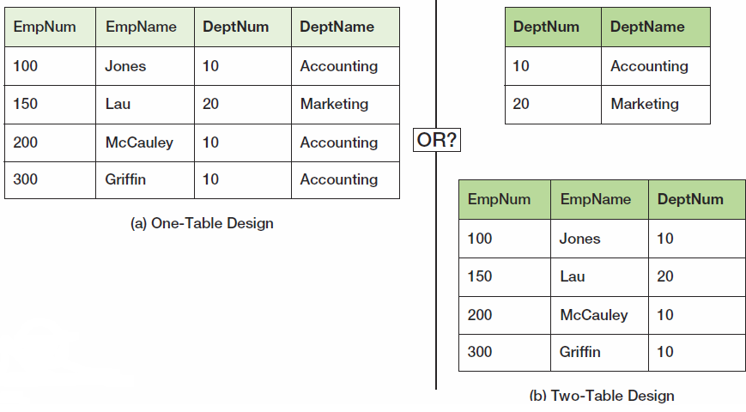
Data Import: One or Two Tables?
This is an important decision, and based on a set of rules known as normalization (which is covered in Chapter 3).

Slide 30
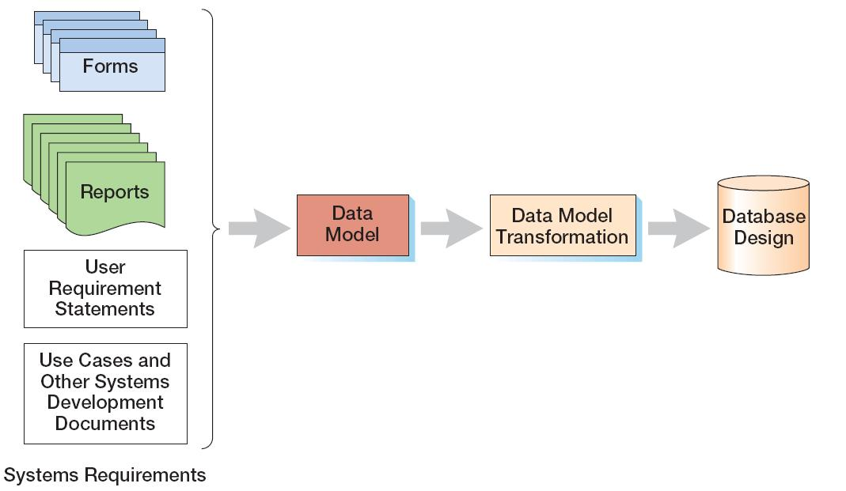
Database Design from New Systems Development
Entity-Relationship data modeling is covered in Chapter 5, and data model transformations to database designs are covered in Chapter 6.

Slide 31
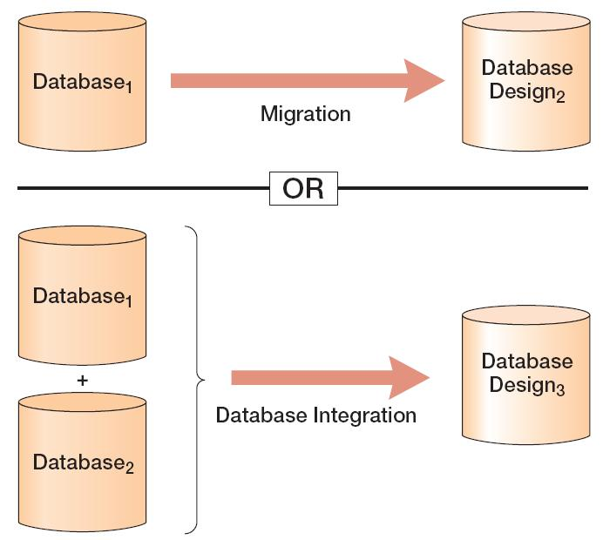
Database Design from Database Redesign
Database redesign is covered in Chapter 8, after coverage of SQL in Chapter 7.

Slide 32
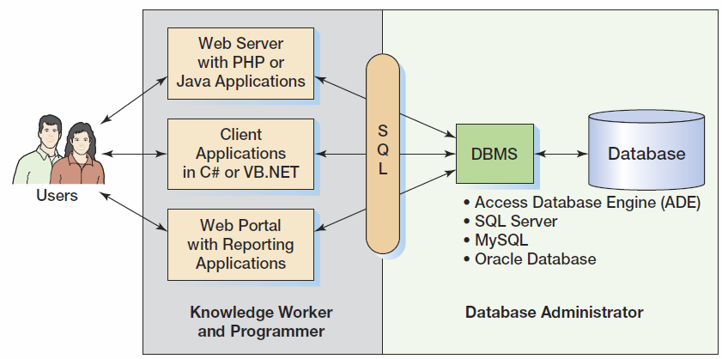
What You Need To Learn

Slide 33
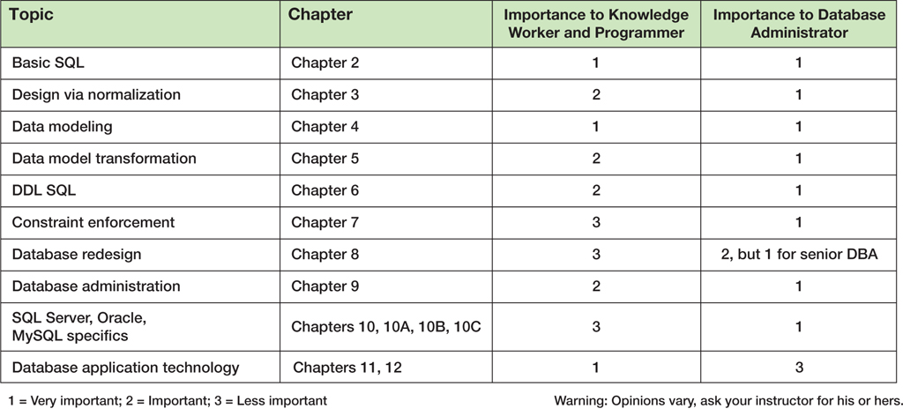
Knowledge Priorities

Slide 34
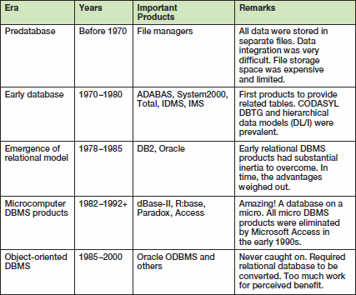
A Brief History of Database Processing I

Slide 35
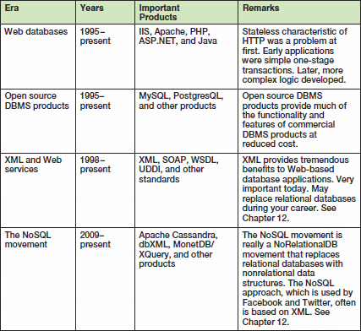
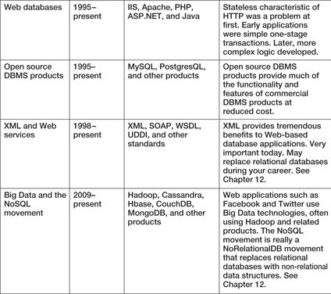
A Brief History of Database Processing II

Slide 36
The Relational Database Model
The dominant database model is the relational database model—all current major DBMS products are based on it.
It was created by IBM engineer E. F. Codd in 1970.
It was based on mathematics called relational algebra.
This text examines and explains the relational database model.

Slide 37
David Kroenke and David Auer Database Processing (13th Edition) Fundamentals, Design, and Implementation
End of Presentation:
Chapter One

Slide 38

All rights reserved. No part of this publication may be reproduced, stored in a retrieval system, or transmitted, in any form or by any means, electronic, mechanical, photocopying, recording, or otherwise, without the prior written permission of the publisher. Printed in the United States of America.

