Slide 1

David M. Kroenke and David J. Auer Database Processing Fundamentals, Design, and Implementation
Chapter Eight:
Database Redesign

Slide 2
Chapter Objectives
To understand the need for database redesign
To be able to use correlated subqueries
To be able to use the SQL EXISTS and NOT EXISTS keywords in correlated subqueries
To understand reverse engineering
To be able to use dependency graphs
To be able to change table names
To be able to change table columns
To be able to change relationship cardinalities
To be able to change relationship properties
To be able to add and delete relationships

Slide 3
Need for Database Redesign
Database redesign is necessary:
To fix mistakes made during the initial database design.
To adapt the database to changes in system requirements.
Because information systems and organizations create each other, a new information system will cause changes in systems requirements:
When a new system is installed, users can behave in new ways.
As the users behave in the new ways, they will want changes to the system to accommodate their new behaviors.

Slide 4
Correlated Subqueries
A correlated subquery looks similar to a regular subquery.
A regular subquery can be processed from the bottom up.
For a correlated subquery, the processing is nested, i.e., a row from an upper query statement is used in comparison with rows in a lower-level query.

Slide 5
Non-Correlated Subquery
We used the following type of subquery in Chapter 2.
It contains two separate tables in the levels of the query.
ARTIST in the top level query
WORK in the subquery
SELECT A.Name
FROM ARTIST A
WHERE A.ArtistID IN
(SELECT W.ArtistID
FROM WORK W
WHERE W.Title =
‘Blue Interior‘);

Slide 6

Non-Correlated Subquery Results

Slide 7
Correlated Subquery
The following is a correlated subquery.
It contains the same tables in both levels of the query.
SELECT W1.Title, W1.Copy
FROM WORK W1
WHERE W1.Title IN
(SELECT W2.Title
FROM WORK W2
WHERE W1.Title = W2.Title
AND W1.WorkID <> W2.WorkID);

Slide 8
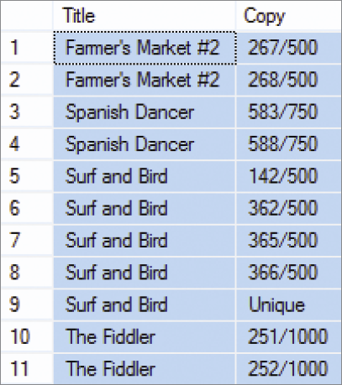
Correlated Subquery Results

Slide 9
Checking Functional Dependencies
The following correlated subquery can be used to check for any rows that violate the functional dependency.
Department → BudgetCode
SELECT E1.Department, E1.BudgetCode
FROM EMPLOYEE E1
WHERE E1.Department IN
(SELECT E2.Department
FROM EMPLOYEE E2
WHERE E1.Department = E2.Department
AND E1.BudgetCode <> E2.BudgetCode);

Slide 10
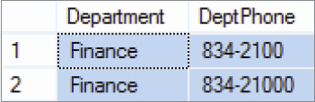
Checking Functional Dependencies Results

Slide 11
EXISTS and NOT EXISTS
EXISTS and NOT EXISTS are specialized forms of correlated subqueries.
An EXISTS condition is true if any row in the subquery meets the specified conditions.
A NOT EXISTS condition is true only if all rows in the subquery do not meet the specified condition.
The use of a double NOT EXISTS can be used to find rows that have some specified condition to every row of a table.

Slide 12
Checking Functional Dependencies
Here is the code to check the previous functional dependency using EXISTS:
SELECT E1.Department, E1.BudgetCode
FROM EMPLOYEE E1
WHERE EXISTS
(SELECT *
FROM EMPLOYEE E2
WHERE E1.Department = E2.Department
AND E1.BudgetCode <> E2.BudgetCode);

Slide 13
Double NOT EXISTS
The following code determines the name of any ARTIST that is of interest to every CUSTOMER:
SELECT A.Name
FROM ARTIST AS A
WHERE NOT EXISTS
(SELECT C.CustomerID
FROM CUSTOMER C
WHERE NOT EXISTS
(SELECT CI.CustomerID
FROM CUSTOMER_artist_int CI
WHERE C.CustomerID = CI.CustomerID
AND A.ArtistID = CI.ArtistID));

Slide 14

Double NOT EXISTS Results

Slide 15
Database Redesign
Three principles for database redesign:
Measure twice and cut once: understand the current structure and contents of the database before making any structure changes.
Test the new changes on a test database before making real changes.
Create a complete backup of the operational database before making any structure changes.
Technique: Reverse Engineering (RE)

Slide 16
Reverse Engineering (RE)
Reverse engineering (RE) is the process of reading and producing a data model from a database schema.
A reverse engineered (RE) data model:
Provides a basis to begin the database redesign project.
Is neither truly a conceptual nor an internal schema as it has characteristics of both.
Should be carefully reviewed because it almost always has missing information.

Slide 17
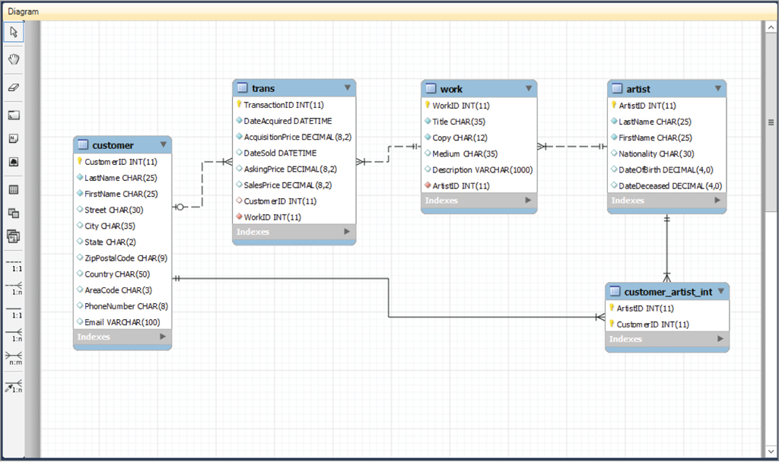
Reverse Engineered Data Model

Slide 18
Dependency Graphs
Dependency graphs are diagrams used to portray the dependency of one element on another.

Slide 19
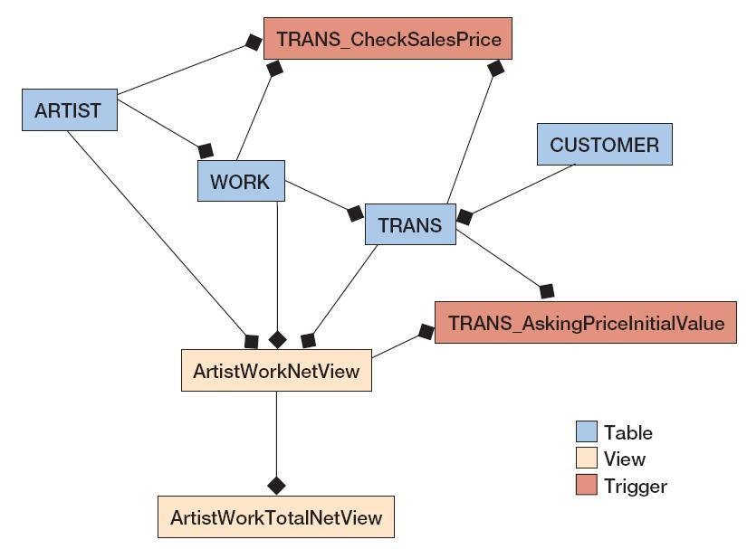
Composite Dependency Graph [Incomplete]

Slide 20
Database Backup and Test Databases
Before making any changes to an operational database:
A complete backup of the operational database should be made.
Any proposed changes should be thoroughly tested.
Three different copies of the database schema used in the redesign process:
A small test database for initial testing
A large test database for secondary testing
The operational database

Slide 21
Database Redesign Changes
Changing tables and columns
Changing table names
Adding and dropping table columns
Changing data type or constraints
Adding and dropping constraints
Changing relationships
Changing cardinalities
Adding and deleting relationships
Adding and removing relationships for denormalization

Slide 22
Changing Table Names
Although SQL or DBMS specific commands exist, there is no good command to change a table name except in the most simple cases.
The table needs to be re-created under the new name, tested, and the old table is dropped.
Changing a table name has a surprising number of potential consequences.
Therefore, using views defined as table aliases is more appropriate.
Only views that define the aliases would need to be changed when the source table name is changed.

Slide 23
Adding Columns
To add NULL columns to a table:
ALTER TABLE WORK
ADD COLUMN DateCreated Date NULL;
Other column constraints, e.g., DEFAULT or UNIQUE, may be included with the column definition.
Newly added DEFAULT constraint will be applied to only new rows, existing rows will have null values.
Three steps to add a NOT NULL column:
Add the column as NULL.
Add data to every row.
Alter the column constraint to NOT NULL.

Slide 24
Dropping Columns
To drop nonkey columns:
ALTER TABLE WORK
DROP COLUMN DateCreated;
To drop a foreign key column, the foreign key constraint must first be dropped.
To drop the primary key, all foreign keys using the primary key must first be dropped; followed by dropping the primary key constraint.

Slide 25
Changing Data Type or Constraints
Use the ALTER TABLE ALTER COLUMN to change data types and constraints.
For some changes, data will be lost or the DBMS may refuse the change.
To change a constraint from NULL to NOT NULL, all rows must have a value first.

Slide 26
Changing Data Type or Constraints
Converting more specific data type, e.g., date, money, and numeric, to char or varchar will usually succeed.
Changing a data type from char or varchar to a more specific type can be a problem.
Example:
ALTER TABLE ARTIST
ALTER COLUMN Birthdate Numeric (4,0) NULL;

Slide 27
Adding and Dropping Constraints
Use the ALTER TABLE ADD (DROP) CONSTRAINT to add (remove) constraints
Example
ALTER TABLE ARTIST
ADD CONSTRAINT NumericBirthYearCheck
CHECK (Birthdate > 1900 and
Birthdate < 2100);

Slide 28
Changing Minimum Cardinalities
On the parent side:
To change from zero to one, change the foreign key constraint from NULL to NOT NULL.
Can only be done if all the rows in the table have a value.
To change from one to zero, change the foreign key constraint from NOT NULL to NULL.
On the child side:
Add (to change from zero to one) or drop (to change from one to zero) triggers that enforce the constraint.

Slide 29
Changing Maximum Cardinalities: 1:1 to 1:N
If the foreign key is in the correct table, remove the unique constraint on the foreign key column.
If the foreign key is in the wrong table, move the foreign key to the correct table and do not place a unique constraint on that table.

Slide 30
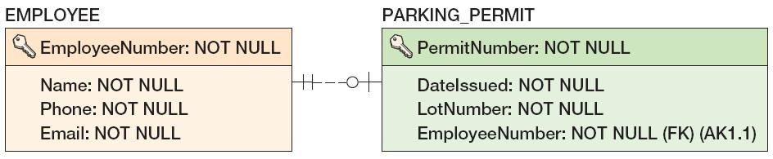
Changing Maximum Cardinalities: 1:1 to 1:N Example

Slide 31
Changing Maximum Cardinalities: 1:N to N:M
Build a new intersection table and move the key and foreign key values to the intersection table

Slide 32
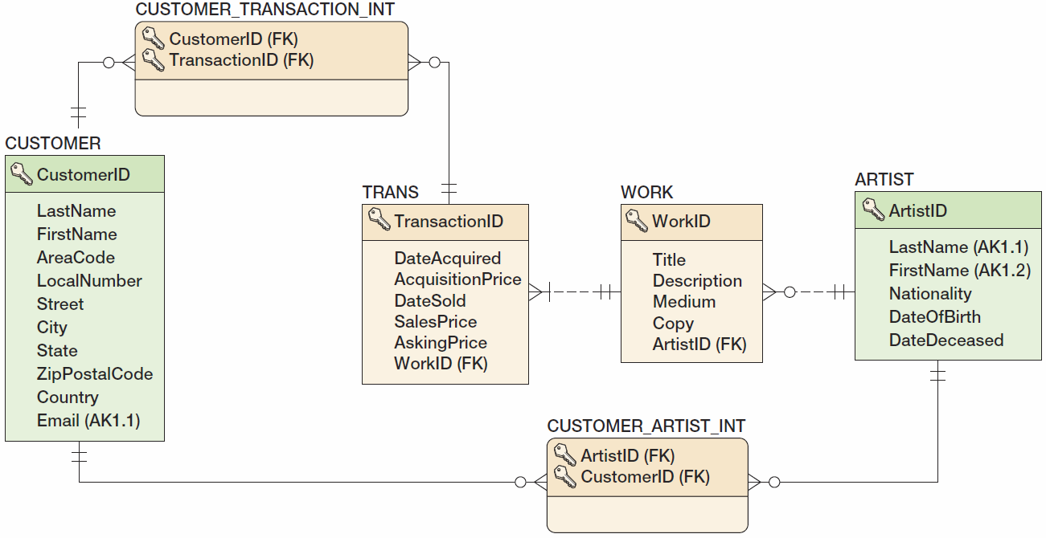
Changing Maximum Cardinalities: 1:N to N:M Example

Slide 33
Reducing Cardinalities
Reducing cardinalities may result in data loss.
Reducing N:M to 1:N:
Create a foreign key in the parent table and move one value from the intersection table into that foreign key.
Reducing 1:N to 1:1:
Remove any duplicates in the foreign key and then set a uniqueness constraint on that key.

Slide 34
Adding and Deleting Relationships
Adding new tables and relationships:
Add the tables and relationships using CREATE TABLE statements with FOREIGN KEY constraints.
If an existing table has a child relationship to the new table, add a FOREIGN KEY constraint using the existing table.
Deleting relationships and tables:
Drop the foreign key constraints and then drop the tables.

Slide 35
Forward Engineering
Forward engineering is the process of applying data model changes to an existing database.
Results of forward engineering should be tested before using it on an operational database.
Some tools will show the SQL that will execute during the forward engineering process:
If so, that SQL should be carefully reviewed.

Slide 36
David Kroenke and David Auer Database Processing Fundamentals, Design, and Implementation (13th Edition)
End of Presentation:
Chapter Eight

Slide 37

All rights reserved. No part of this publication may be reproduced, stored in a retrieval system, or transmitted, in any form or by any means, electronic, mechanical, photocopying, recording, or otherwise, without the prior written permission of the publisher. Printed in the United States of America.

