Slide 1

David M. Kroenke and David J. Auer Database Processing Fundamentals, Design, and Implementation
Chapter Nine:
Managing Multiuser
Databases

Slide 2
Chapter Objectives
To understand the need for and importance of database administration
To understand the need for concurrency control, security, and backup and recovery
To learn about typical problems that can occur when multiple users process a database concurrently
To understand the use of locking and the problem of deadlock
To learn the difference between optimistic and pessimistic locking

Slide 3
Chapter Objectives
To know the meaning of an ACID transaction
To learn the four 1992 ANSI standard isolation levels
To understand the need for security and specific tasks for improving database security
To know the difference between recovery via reprocessing and recovery via rollback/rollforward
To understand the nature of the tasks required for recovery using rollback/rollforward
To know basic administrative and managerial DBA functions

Slide 4
Database Administration
All large and small databases need database administration.
Data administration refers to a function concerning all of an organization’s data assets.
Database administration (DBA) refers to a person or office specific to a single database and its applications.

Slide 5
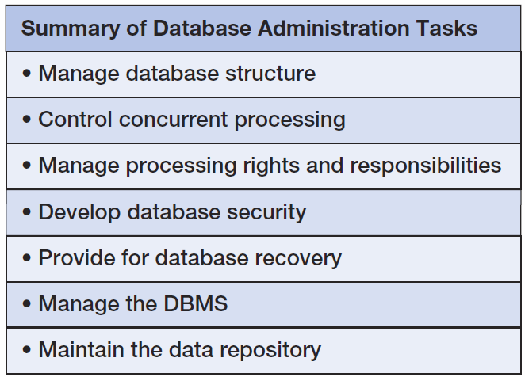
Database Administration Tasks

Slide 6
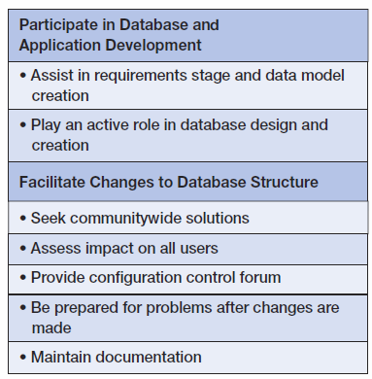
DBA Responsibilities

Slide 7
Concurrency Control
Concurrency control ensures that one user’s work does not inappropriately influence another user’s work.
No single concurrency control technique is ideal for all circumstances.
Trade-offs need to be made between level of protection and throughput.

Slide 8
Atomic Transactions
A transaction, or logical unit of work (LUW), is a series of actions taken against the database that occurs as an atomic unit:
Either all actions in a transaction occur or none of them do.

Slide 9
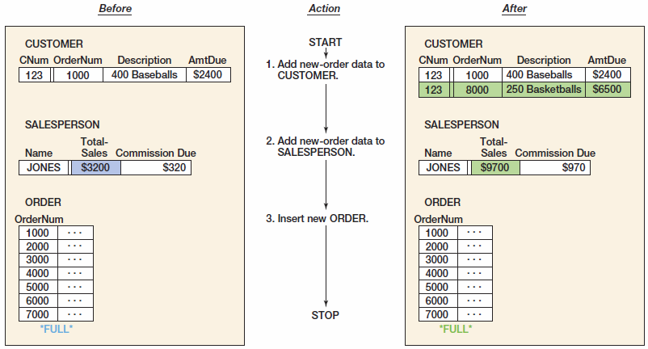
Errors Introduced without Atomic Transaction

Slide 10
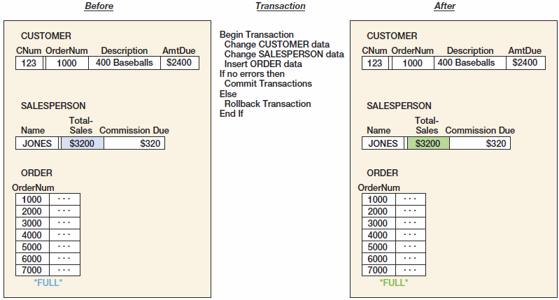
Errors Prevented with Atomic Transaction

Slide 11
Concurrent Transaction
Concurrent transactions refer to two or more transactions that appear to users as they are being processed against a database at the same time.
In reality, CPU can execute only one instruction at a time.
Transactions are interleaved:
The operating system quickly switches CPU services among tasks so that some portion of each of them is carried out in a given interval.
Concurrency problems are lost updates and inconsistent reads.

Slide 12
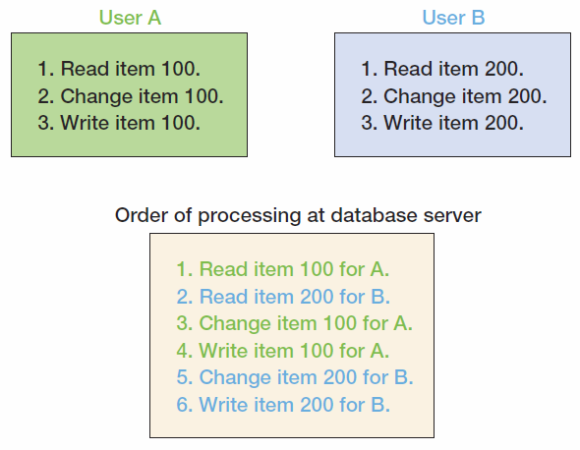
Concurrent Transaction Processing

Slide 13
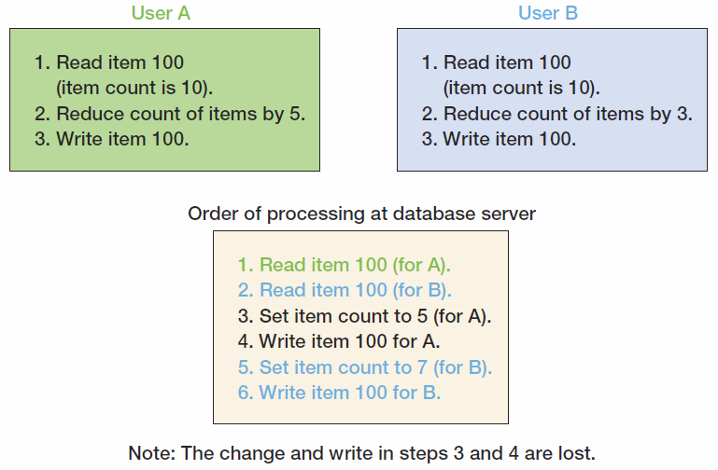
Lost Update Problem

Slide 14
Resource Locking
Resource locking prevents multiple applications from obtaining copies of the same record when the record is about to be changed.

Slide 15
Lock Terminology
Implicit locks are locks placed by the DBMS.
Explicit locks are issued by the application program.
Lock granularity refers to size of a locked resource:
Rows, page, table, and database level.
Large granularity is easy to manage but frequently causes conflicts.
Types of lock:
An exclusive lock prohibits other users from reading the locked resource.
A shared lock allows other users to read the locked resource, but they cannot update it.

Slide 16
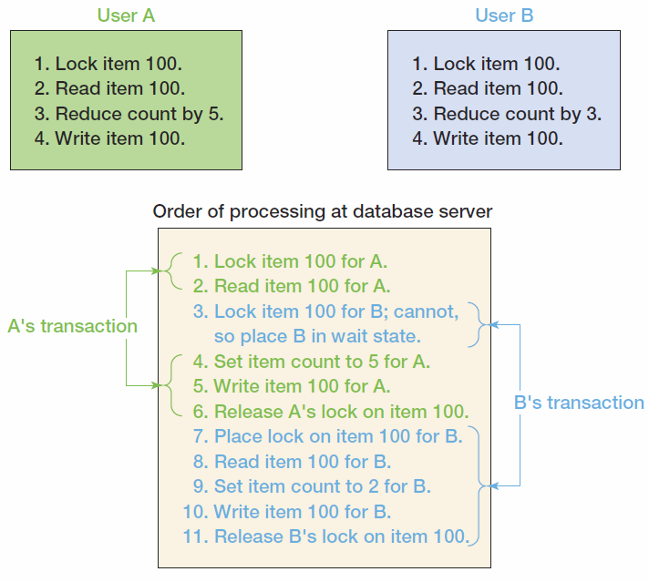
Concurrent Processing with Explicit Locks

Slide 17
Serializable Transactions
Serializable transactions refer to two transactions that run concurrently and generate results that are consistent with the results that would have occurred if they had run separately.
Two-phased locking is one of the techniques used to achieve serializability.

Slide 18
Two-phased Locking
Two-phased locking
Transactions are allowed to obtain locks as necessary (growing phase).
Once the first lock is released (shrinking phase), no other lock can be obtained.
A special case of two-phased locking
Locks are obtained throughout the transaction.
No lock is released until the COMMIT or ROLLBACK command is issued.
This strategy is more restrictive but easier to implement than two-phase locking.

Slide 19
Deadlock
Deadlock, or the deadly embrace, occurs when two transactions are each waiting on a resource that the other transaction holds.
Preventing deadlock:
Allow users to issue all lock requests at one time.
Require all application programs to lock resources in the same order.
Breaking deadlock:
Almost every DBMS has algorithms for detecting deadlock.
When deadlock occurs, DBMS aborts one of the transactions and rolls back partially completed work.

Slide 20
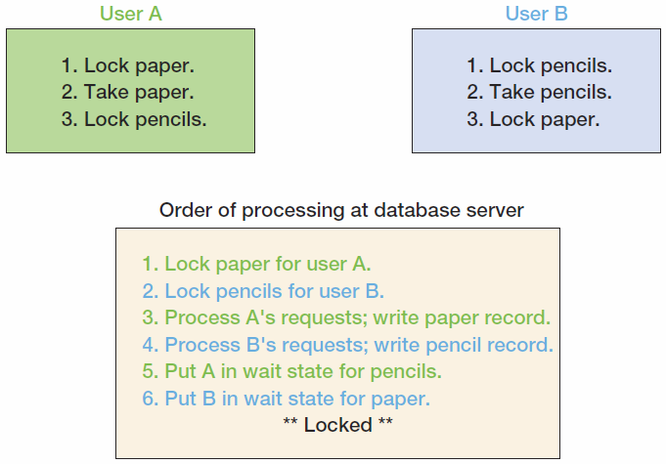
Deadlock

Slide 21
Optimistic versus Pessimistic Locking
Optimistic locking assumes that no transaction conflict will occur.
DBMS processes a transaction; checks whether conflict occurred:
If not, the transaction is finished.
If so, the transaction is repeated until there is no conflict.
Pessimistic locking assumes that conflict will occur.
Locks are issued before transaction is processed, and then the locks are released.
Optimistic locking is preferred for the Internet and for many intranet applications.

Slide 22
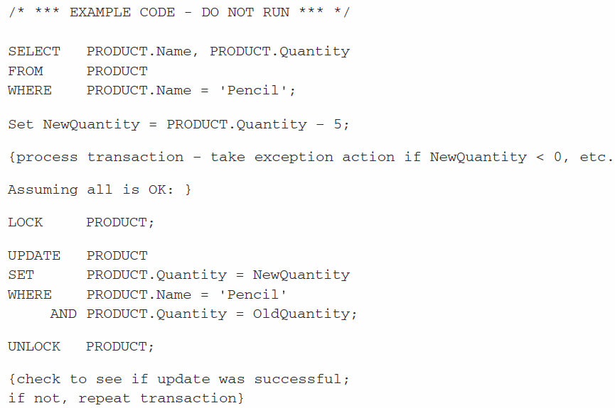
Optimistic Locking

Slide 23
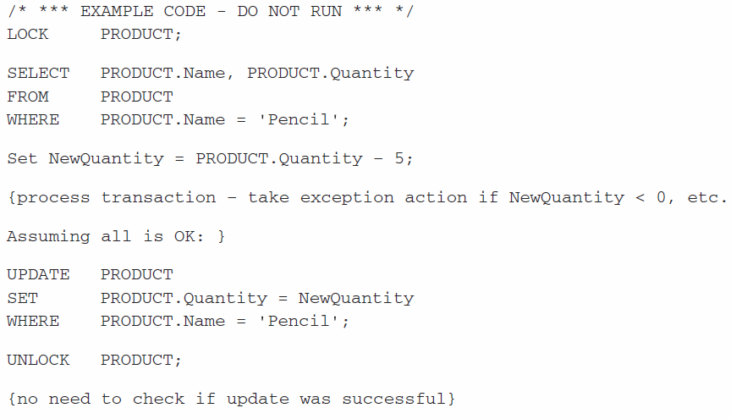
Pessimistic Locking

Slide 24
Declaring Lock Characteristics
Most application programs do not explicitly declare locks due to its complication.
Instead, they mark transaction boundaries and declare locking behavior they want the DBMS to use.
Transaction boundary markers (syntax varies with DBMS):
BEGIN TRANSACTION
COMMIT TRANSACTION
ROLLBACK TRANSACTION
Advantage:
If the locking behavior needs to be changed, only the lock declaration need be changed, not the application program.

Slide 25
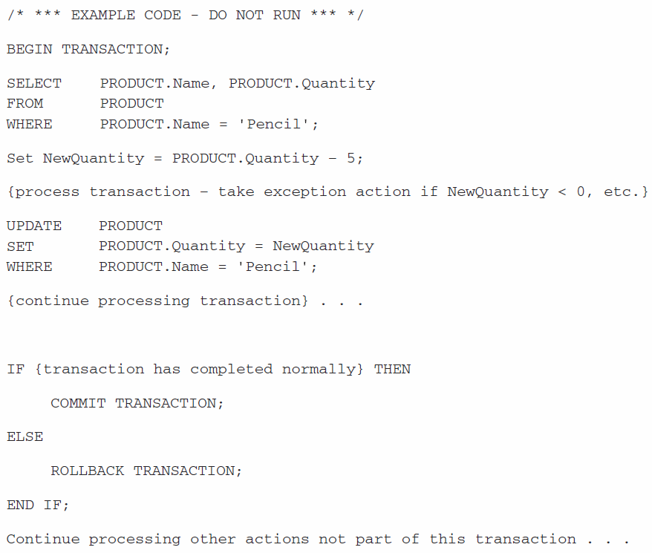
Marking Transaction Boundaries

Slide 26
ACID Transactions
Acronym ACID transaction is one that is Atomic, Consistent, Isolated, and Durable.
Atomic means either all or none of the database actions occur.
Durable means database committed changes are permanent.

Slide 27
ACID Transactions
Consistency means either statement level or transaction level consistency.
Statement level consistency: each statement independently processes rows consistently
Transaction level consistency: all rows impacted by either of the SQL statements are protected from changes during the entire transaction
With transaction level consistency, a transaction may not see its own changes.

Slide 28
ACID Transactions
Isolation means application programmers are able to declare the type of isolation level and to have the DBMS manage locks so as to achieve that level of isolation.
SQL-92 defines four transaction isolation levels:
Read uncommitted
Read committed
Repeatable read
Serializable

Slide 29
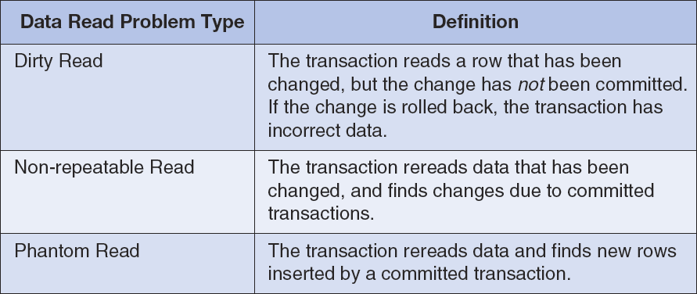
Data Read Problems Level

Slide 30
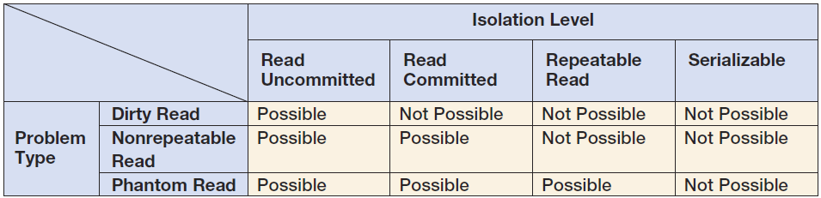
Transaction Isolation Level

Slide 31
Cursor Type
A cursor is a pointer into a set of records.
It can be defined using SELECT statements.
Four cursor types:
Forward only: the application can only move forward through the recordset.
Scrollable cursors can be scrolled forward and backward through the recordset.
Static: processes a snapshot of the relation that was taken when the cursor was opened
Keyset: combines some features of static cursors with some features of dynamic cursors
Dynamic: a fully featured cursor
Choosing appropriate isolation levels and cursor types is critical to database design.

Slide 32
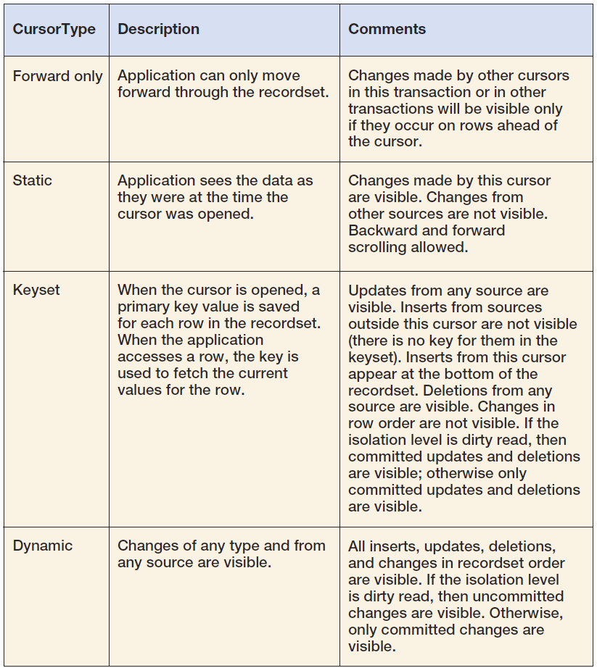
Cursor Summary

Slide 33
Database Security
Database security ensures that only authorized users can perform authorized activities at authorized times.
Developing database security:
Determine users’ processing rights and responsibilities.
Enforce security requirements using security features from both DBMS and application programs.

Slide 34
DBMS Security
DBMS products provide security facilities.
They limit certain actions on certain objects to certain users or groups (also called roles).
Almost all DBMS products use some form of username and password security.

Slide 35
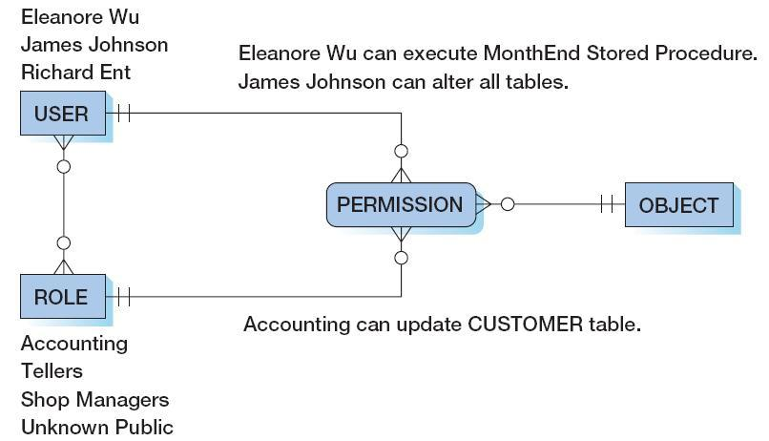
DBMS Security Model

Slide 36
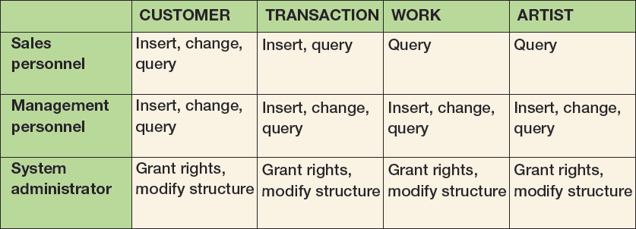
View Ridge Gallery Security Model

Slide 37
DBMS Security Guidelines
Run DBMS behind a firewall, but plan as though the firewall has been breached
Apply the latest operating system and DBMS service packs and fixes
Use the least functionality possible
Support the fewest network protocols possible
Delete unnecessary or unused system stored procedures
Disable default logins and guest users, if possible
Unless required, never allow all users to log on to the DBMS interactively
Protect the computer that runs the DBMS
No user allowed to work at the computer that runs the DBMS
DBMS computer physically secured behind locked doors
Access to the room containing the DBMS computer should be recorded in a log

Slide 38
DBMS Security Guidelines
Manage accounts and passwords
Use a low privilege user account for the DBMS service
Protect database accounts with strong passwords
Monitor failed login attempts
Frequently check group and role memberships
Audit accounts with null passwords
Assign accounts the lowest privileges possible
Limit DBA account privileges
Planning
Develop a security plan for preventing and detecting security problems
Create procedures for security emergencies and practice them

Slide 39
Application Security
If DBMS security features are inadequate, additional security code could be written in application program.
Application security in Internet applications is often provided on the Web server computer.
However, you should use the DBMS security features first.
The closer the security enforcement is to the data, the less chance there is for infiltration.
DBMS security features are faster, cheaper, and probably result in higher quality results than developing your own.

Slide 40
SQL Injection Attack
An SQL injection attack occurs when data from the user is used to modify an SQL statement.
User input that can modify an SQL statement must be carefully edited to ensure that only valid input has been received and that no additional SQL syntax has been entered.
Example: users are asked to enter their names into a Web form textbox:
User input: Benjamin Franklin ' OR TRUE '
SELECT * FROM EMPLOYEE
WHERE EMPLOYEE.Name = 'Benjamin Franklin' OR TRUE;
Result: every row of the EMPLOYEE table will be returned

Slide 41
Database Recovery
In the event of system failure, that database must be restored to a usable state as soon as possible.
Two recovery techniques:
Recovery via reprocessing
Recovery via rollback/rollforward

Slide 42
Recovery via Reprocessing
Recovery via reprocessing: the database goes back to a known point (database save) and reprocesses the workload from there.
Unfeasible strategy because:
The recovered system may never catch up if the computer is heavily scheduled.
Asynchronous events, although concurrent transactions, may cause different results.

Slide 43
Rollback/Rollforward
Recovery via rollback/rollforward:
Periodically save the database and keep a database change log since the save.
Database log contains records of the data changes in chronological order.
When there is a failure, either rollback or rollforward is applied.
Rollback: undo the erroneous changes made to the database and reprocess valid transactions
Rollforward: restore database using saved data and valid transactions since the last save

Slide 44
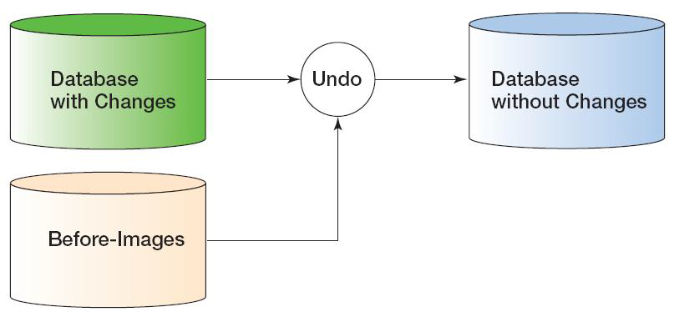
Rollback
Before-image: a copy of every database record (or page) before it was changed

Slide 45
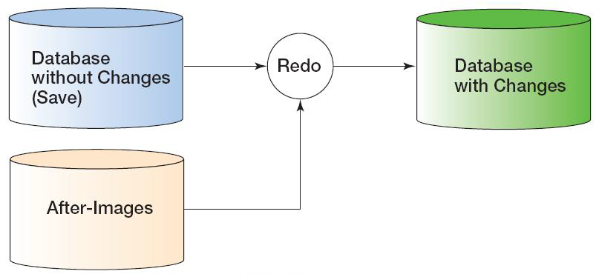
Rollforward
After-image: a copy of every database record (or page) after it was changed

Slide 46
Checkpoint
A checkpoint is a point of synchronization between the database and the transaction log.
DBMS refuses new requests, finishes processing outstanding requests, and writes its buffers to disk.
The DBMS waits until the writing is successfully completed → the log and the database are synchronized.
Checkpoints speed up database recovery process.
Database can be recovered using after-images since the last checkpoint.
Checkpoint can be done several times per hour.
Most DBMS products automatically checkpoint themselves.

Slide 47
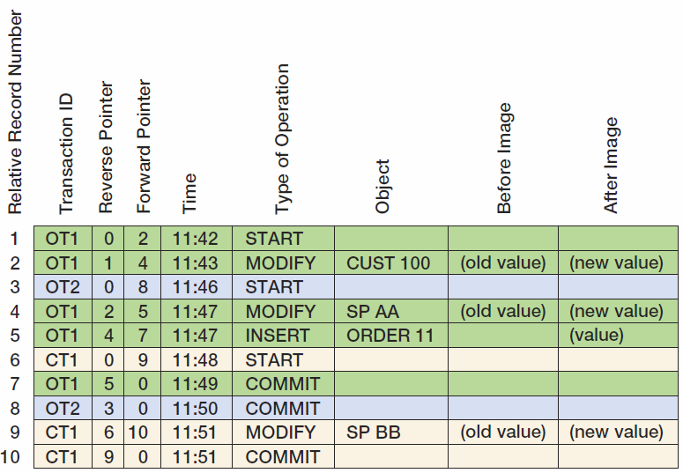
Transaction Log

Slide 48
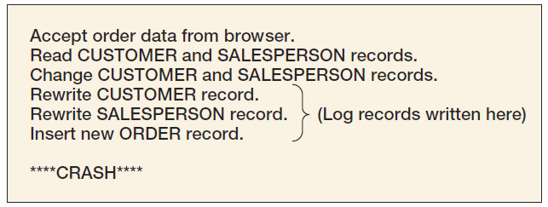
Database Recovery: A Processing Problem Occurs

Slide 49
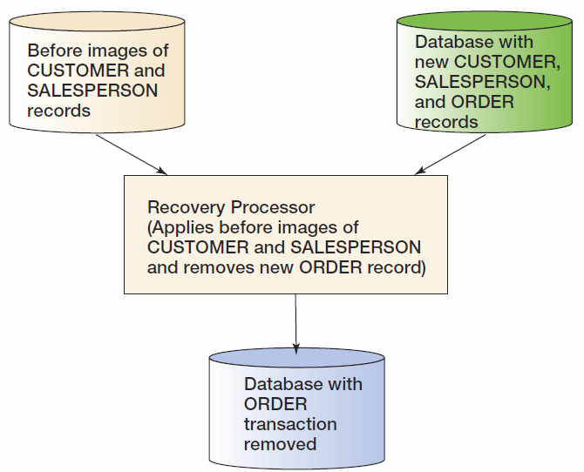
Database Recovery: Recovery Processing

Slide 50
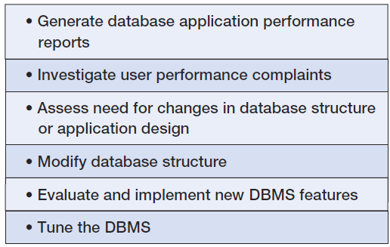
Managing the DBMS: DBA’s Responsibilities

Slide 51
Maintaining the Data Repository
DBA is responsible for maintaining the data repository.
Data repositories are collections of metadata about users, databases, and its applications.
The repository may be:
Virtual, as it is composed of metadata from many different sources: DBMS, code libraries, Webpage generation and editing tools, etc.
An integrated product from a CASE tool vendor or from other companies.
Active – part of the systems development process
Passive – documentation only made when someone has time
The best repositories are active, and they are part of the system development process.

Slide 52
David Kroenke and David Auer Database Processing Fundamentals, Design, and Implementation (13th Edition)
End of Presentation:
Chapter Nine

Slide 53

All rights reserved. No part of this publication may be reproduced, stored in a retrieval system, or transmitted, in any form or by any means, electronic, mechanical, photocopying, recording, or otherwise, without the prior written permission of the publisher. Printed in the United States of America.

