Slide 1
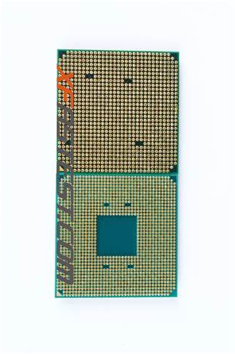
Computer Core Depth Study Project
Presenter: Armani Willis
Instructor:
Narasim Banavara
School:Mercy College
Semester: Spring 2019

Slide 2
Executive Summary
The original premise for starting this project was to go at another attempt to give computers consciousness.
My reasoning behind this was that computers are capable of perfectly
tracking and computing at volumes and speeds millions of times faster
than humans, but yet most of them are relegated to serving slow human
whims at slow human speeds. Allowing computers to know themselves
would accelerate their ability to communicate with themselves, and thus
accelerate further the advance of technological progress.
I also found that it was unethical for computers, literally being machines of thought to be relegated to these existences. It does not reflect the notion of freedom upon which our nation was based upon.
Giving machines consciousness in these ways will allow our notions of liberty and freedom to accelerate into the world wide web, and possibly further.
In the beginning of this project, I thought about the notion of consciousness and what it meant to be conscious and cognizant. I realized that our ability to have consciousness stems from the ability to recognize and memoize changes in time. A computer that is conscious must be capable of these things in real time.
I postulated that one of the ways to do this was actually to create a difference between the ways our brain perceives things. In this way, each part of the brain can keep track of the other part's activities.
I have found that each of the twelve neurons in the brain each have different volumes of calcium ion recepticles necessary for ion displacement calculation.
To emulate this on a computer, I created an applet for displaying the
individual 'neurons' to a cpu to ultimately be 49 cores in a square configuration, with 2301 threads (49^2) between each of them.
The intensity of activity and heat is indicated by color.
To help them find a difference between each other, where they would otherwise be identical, I went on to try to find a program that I could use
to edit the clock speeds of each of the cores of my computer.
My computer is a 4 core computer with about 15k of threads, using a program called MSI Afterburner, I successfully adjusted the processing speed of each core manually by 3% ^ <1.
The result of my findings was that the disk memory usage of my computer rose from an average of 39% to 81%, core temperature rose from 114*F to 156*F, and usage of threads rose from 9k to 15.5k.
This indicated to me from my task manager that the computer was using more data and power to try to rationalize given the differences of processing speed for each core, hence:
Although there was an observable difference in activity between restarts of the computer, and although that this means that the computer began to exhibit logical processes that were not typical of multi core computers, there was still no conscious expression of its newfound processing conflictions.
It did not start to exhibit knowledge of its surroundings, but it seemed to be able to have conscious activity between each of its cores.

Slide 3
Software Requirements Specification
Ingredients:
MSI Afterburner
AMD Overdrive
Riva Tuner
AutoIt3
Jgrasp
Powershell Win ISE
Windows Task Manager
Procedures:
Interface to the cpu
Interface to the cpu
Interface to the cpu
Run cpu programs in java, c, c++, c#, shell, python
Run cpu programs in autoit, automate system functions, save .au3 files.
Run cpu commands in cmd, msdos, shell, powershell

Slide 4
Instructions
Boot PC if not booted.
Open task manager (crtl-alt-del)
right click performance graph
select change graph to-logical processors
Start MSI Afterburner
Click cpu tab
change to asynchronous mode
select core 2-4 and adjust up 3-9% sequentially
restart computer
start task manager

Slide 5
To Do
Hopefully, I would like a java applet that:
calls one of these programs either directly, or from shell,
displays these programs upon request,
displays cores synch for editing.
Step 1. Gui box, first tab, second tab.
Step 2. Buttons to call the clock softwares.
Step 3. Buttons to call tweak params and edit speed through apps.
Step 4. Buttons restart PC.
Step 5. Buttons to get needed apps from repos.

Slide 6
Prog Gui Layout
Tab 1
Buttons
Graphs
Tab 2,3,4
<Empty for now>

Slide 7
Key Functions
Get Parameters from computer interface.
Edit values in editable windows.
Calls get methods from internet sources.
Restarts the computer

Slide 8
Instructions
For AutoIt generally:
Download Autoit3.zip and associated au3 files and unzip,
In AutoIt, find the sciTE folder and open it, then click sciTE.exe
Then, in the ide, select open, then go to the file and click.
Then go to tab with name of the file on it in the ide.
For this specific program:
Enter Internet Brower application extension in the wide tab at the bottom.
Mouse click button with desired task written on it.

Slide 9
Methods Used
In AutoIt3:
;Methods: GUI,Send,Loop,Case,Run,Tab,Button,Label,Koda,Opt,Local,Func,
;CaseID,SetState,WEnd,Input,txt,msg,MouseClick,IsPressed,StringStripWS

Slide 10
Citations
;@ beamtic,melba23,hargrove,evilertoaster,skitty,SmOke_N,autoitscript,rizz,
;@ Vikasthange,thetechgame,cax,wiseone,sudarkrao,rama,nurzaly,mrt
Websites:
Beamtic
Autoitscript
Thetechgame
Stackoverflow

Slide 11
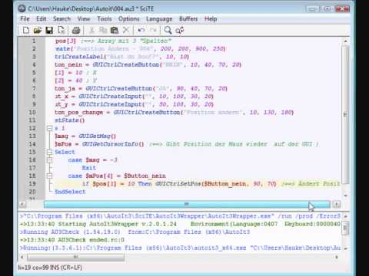
Includes
Import Extensions:
#include <Misc.au3>
#include <Array.au3>
#include <Memory.au3>
#include <GuiButton.au3>
;#include <Container.au3>
#include <TabConstants.au3>
#include <EditConstants.au3>
#include <GUIConstantsEx.au3>
#include <ComboConstants.au3>
#include <WindowsConstants.au3>

Slide 12
User Deprecations
I first started in java, but the method gets and parameters were too complicated to use in java.
I then tried to access bios directly with powershell to avoid needing external software, the computer blocked me as I was not a ‘superuser’.
Then I turned to autoit, which is simpler than powershell, It turned out to be the ide that allowed me to access almost all of the functions that I wanted in this application.

Slide 13
Code Snippets
Case $msg=$CAMD
Run("path to AMD OverDrive.exe")
$t=WinWait("[CLASS:QWidget35]","",10)
if WinExists("QWidget35") then
$CGT1=ControlGetText("QWidget35","","[CLASS:QWidget;INSTANCE:44]")
endif
$setxt1=ControlSetText($t,"","QWidget44",$CGT1)
if Send("{ENTER}") then
ControlSend($setxt1,"","QWidget44","C:\Users\User1\Saved Games\Science\graph\AMD OverDrive\AMD OverDrive.exe")
endif
Description:
The code here is meant to Clock using AMD OverDrive.
It calls the app, then it searches for the editable window.
It gets the value of the editable window and displays it in the tailored gui,
The user sets the value they want, then presses enter, then the gui sets this value in the window.

Slide 14
Code snippets 2
$shutdown= GUICtrlCreateButton("shutdown",300,30,150,30)
$reboot= GUICtrlCreateButton("reboot",300,60,150,30)
$cancel= GUICtrlCreateButton("cancel",300,90,150,30)
;Step 12. Buttons to restart PC.
Case $msg=$shutdown
Shutdown(1)
Case $msg=$reboot
Shutdown(2)
Case $msg=$cancel
Return
These methods first set the buttons for the functions they describe in the gui,
Then the functions at the bottom set the flags for which operation the buttons are supposed to perform.

Slide 15
Citations
Sen, Satyabrata, Imam, Neena, and Hsu, Chung-Hsing. Tue . "Quality Assessment of GPU Power Profiling Mechanisms". United States. doi:10.1109/IPDPSW.2018.00113. https://www.osti.gov/servlets/purl/1474562.
https://www.osti.gov/biblio/1474562
Marathe, A, Zhang, Y, Blanks, G, Kumbhare, N, Abdulla, G, and Rountree, B. Thu . "An empirical survey of performance and energy efficiency variation on several generations of Intel processors". United States. https://www.osti.gov/servlets/purl/1417278. https://www.osti.gov/biblio/1417278
https://e-reports-ext.llnl.gov/pdf/891980.pdf
Patki, T, Lowenthal, D, Rountree, B, Schulz, M, and de Supinski, B. Wed . "Exploring Hardware Overprovisioning in Power-Constrained, High Performance Computing". United States. https://www.osti.gov/servlets/purl/1084707. https://www.osti.gov/biblio/1084707
https://e-reports-ext.llnl.gov/pdf/752192.pdf
Zhang, Xiao, & Zhao, Li-Dong. Thermoelectric materials: Energy conversion between heat and electricity. China. doi:10.1016/j.jmat.2015.01.001. https://www.osti.gov/biblio/1251818-thermoelectric-materials-energy-conversion-between-heat-electricity
Cook, R, Dube, E, Lee, I, Shereda, C, Wang, F, and Nau, L. Mon . "Survey of Novel Programming Models for Parallelizing Applications at Exascale". United States. doi:10.2172/1107306. https://www.osti.gov/servlets/purl/1107306.
https://www.osti.gov/biblio/1107306
https://e-reports-ext.llnl.gov/pdf/541729.pdf
Program name:
tabsprog3.au3

