Slide 1
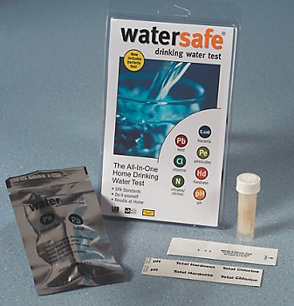
Waste biomass as eco-friendly adsorbents of pollutants
Kibrewossen Tesfagiorgis, PhD, PE

Slide 2
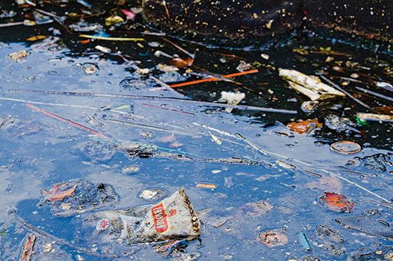
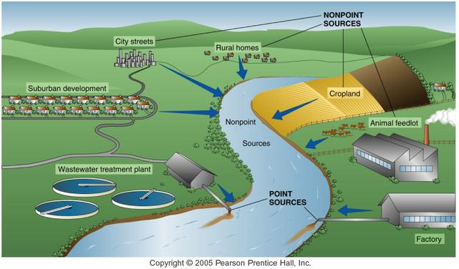
Background
What is water pollution?
Any physical, biological or chemical change in water quality that adversely affects living organisms or makes the water unsuitable for desired uses
Category of Pollution Sources:
– point sources
– nonpoint sources
New York News & Politics

Slide 3
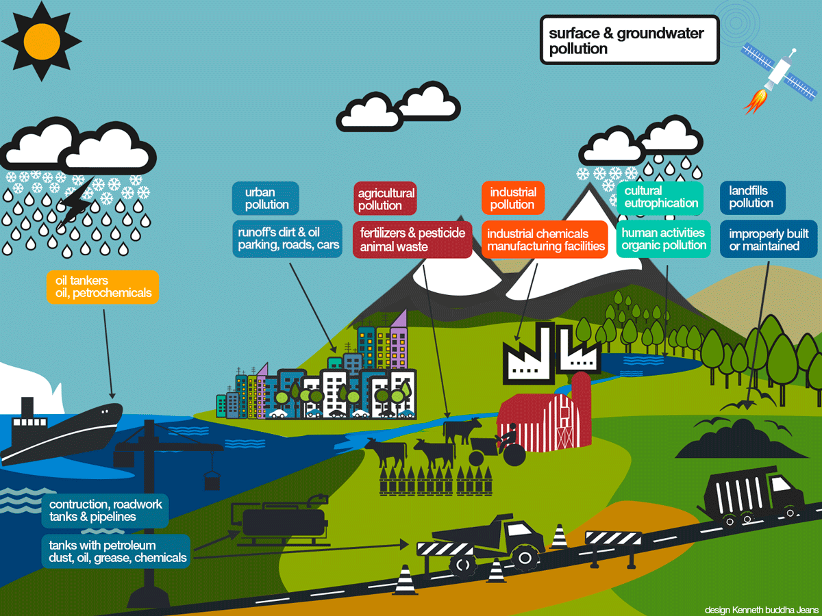
Types of water pollution
Infectious agents
Plant nutrients and Eutrophication
Toxic inorganic materials
Organic chemicals
Sediment and suspended solids
Thermal pollution/ thermal shock

Slide 4
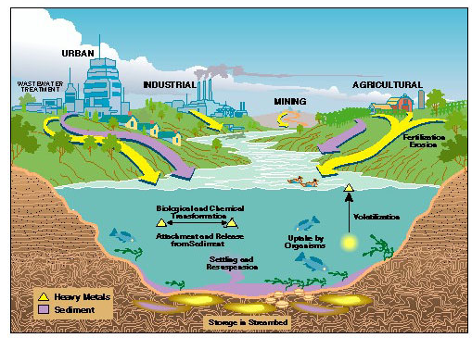
Toxic inorganic substances
Heavy metals:
mercury, lead, cadmium and nickel
lead pipes
gold mining
mining wastes
tin on boat bottoms
Source: USGS

Slide 5
What is a heavy metals?
The term heavy metal refers to any metallic chemical element that has a relatively high density and is toxic or poisonous at low concentrations.

Slide 6
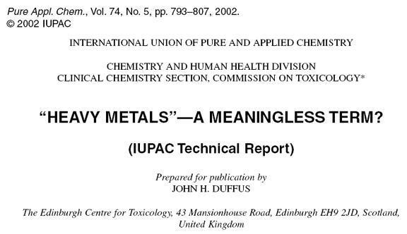
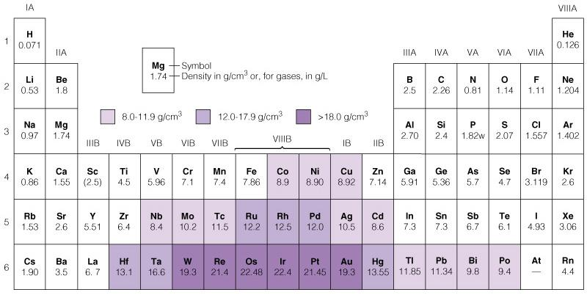
What is a heavy metal?
Lists of heavy metals differ, assumes all species are toxic.
Notes:
http://www.iupac.org/publications/pac/2002/pdf/7405x0793.pdf
Lists of heavy metals differ, assumes all species are toxic.

Slide 7
Heavy metals
are natural components of the Earth's crust
they cannot be degraded or destroyed
to a small extent they enter our bodies via food, drinking water and air
as trace elements, some heavy metals (e.g. copper,
selenium, zinc) are essential to maintain the metabolism of the human body
however, at higher concentrations they can lead to poisoning
heavy metal poisoning could result, for instance, from drinking-water contamination (e.g. lead pipes), high ambient air concentrations near emission sources, or intake via the food chain

Slide 8
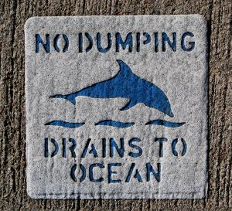
Water Pollution Solutions
Ban or regulate use of some chemicals
advanced water treatment to remove them
Control agricultural runoff
Control urban runoff
Control sediments and acids from mines
protect wetlands – protect and revegetate

Slide 9
Clean Water Acts
Federal Water Pollution Control Act – Clean Water Act of 1972 (amended 1977)
goal was to make all U.S. surface waters safe for fishing and swimming by 1983 and restores and maintain the chemical, physical and biological integrity of the nations waters
established controls for each major type of pollutant – provides billions of dollars for sewage treatment plants

Slide 10
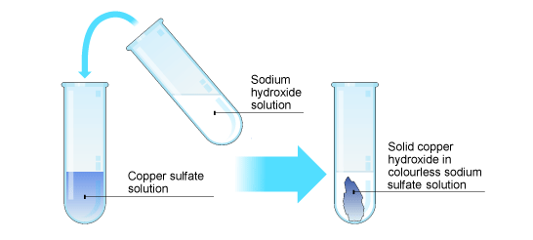
Metal removal from polluted water
Hydroxide ppt / coagulation
Conventional method of removing heavy metals. Chemical ppt of the metal as hydroxides followed by coagulation of the metal particles into larger, heavier floc particles which then separate from the water.
Metal concentrations can be reduced to 0.3 – 1.5 mg/L
Source: bbc.co.uk

Slide 11
Metal removal from polluted water
Hydroxide ppt / coagulation
Typically heavy metals are dissolved under acidic conditions and precipitate under alkaline conditions.
pH increase by NaOH (caustic), Ca(OH)₂ lime addition
Cu²⁺ + 2NaOH → Cu(OH)₂ + 2 Na⁺
Cu²⁺ + Ca(OH)₂ → Cu(OH)₂ + Ca²⁺

Slide 12
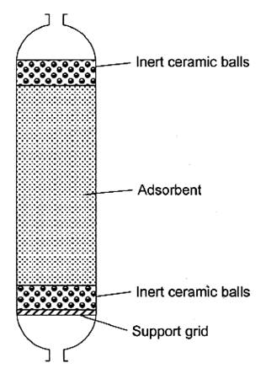
Other Treatment Alternatives for Metal Removal: Adsorption
Adsorption on
activated carbon
aluminum oxides
silica clays
synthetic materials like zeolites and resins.
Berkley.edu

Slide 13
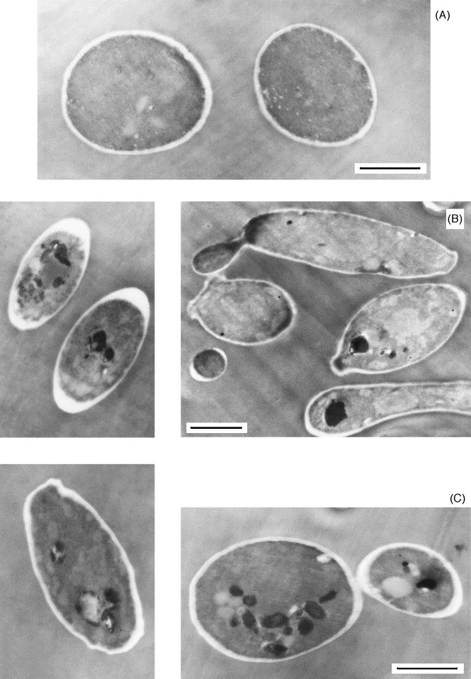
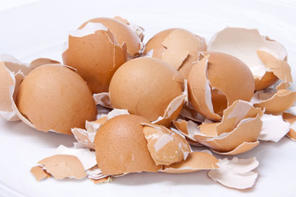
Bioremediation
Use of biological techniques to remove pollutants from air, soil and water.
Bioaccumulation: Living organism
Biosorption: Dead biomass

Slide 14
Biosorption
Use of non-living biomasses to passively remove pollutants.
Driven by physico-chemical processes
Marine algae, crustacean shells, nutshell, fruit peels, TEALEAVES.
Fast kinetics (saturation time).
Potential recyclability of waste

Slide 15
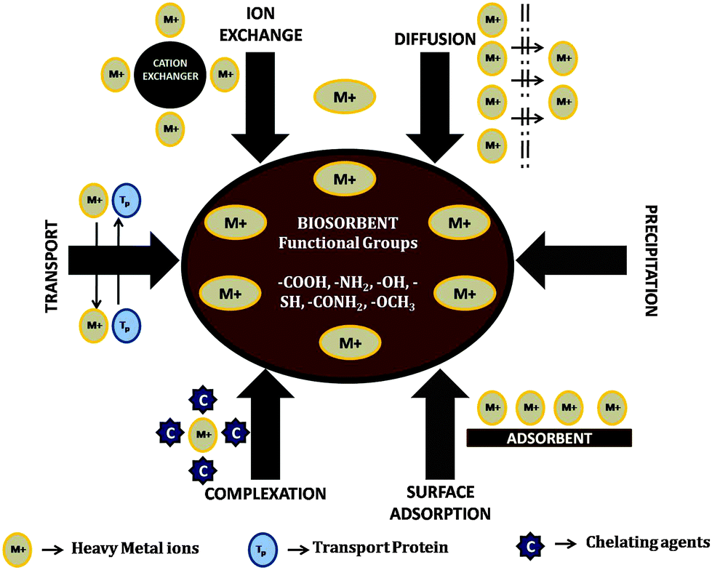

Slide 16
Advantages
Competitive performance.
Pollutant selectivity.
Cost effectiveness.
Pollutant recovery.
No sludge generation.

Slide 17
Our adsorbents
Why? High content of functional organic groups such as alcohol (fiber and carbohydrates), carboxylic acids and amines (structural polysaccharides).
Why? Easy preparation and massive collection.
Massive collection from tea industries (i.e. Arizona and other bottled tea-based drinks). Algae line up shores of beaches representing an extra expense.

Slide 18
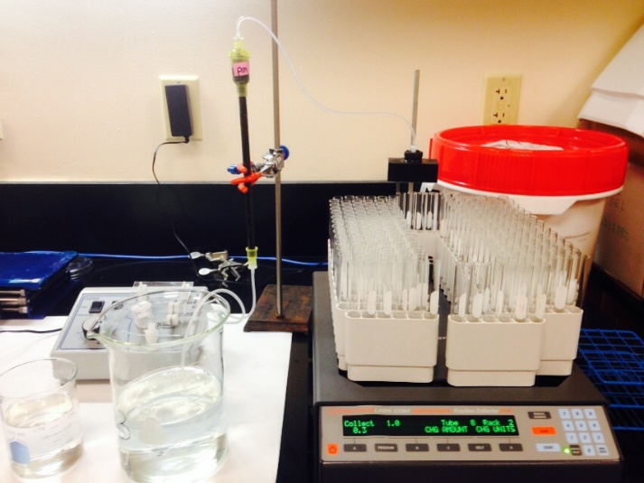
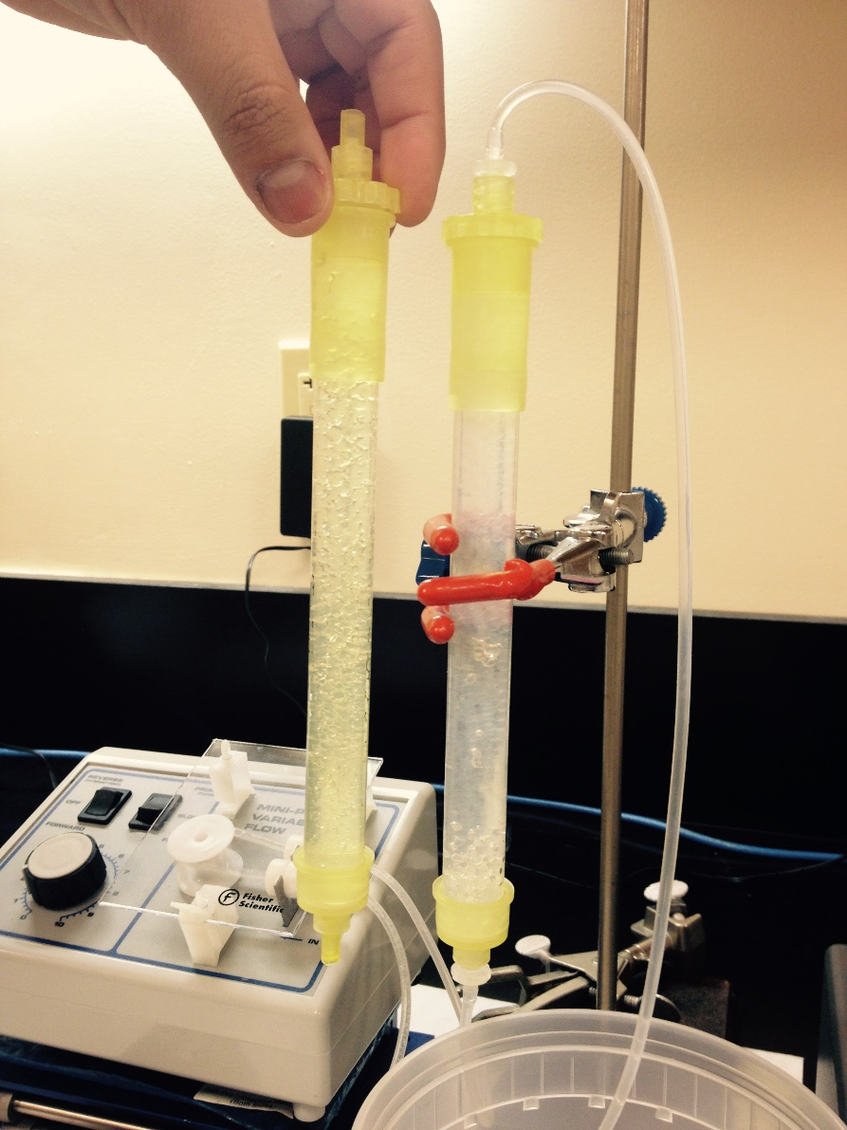
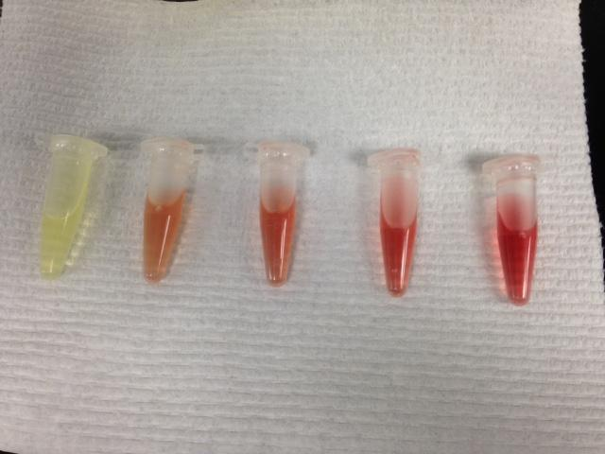
Methodology

Slide 19
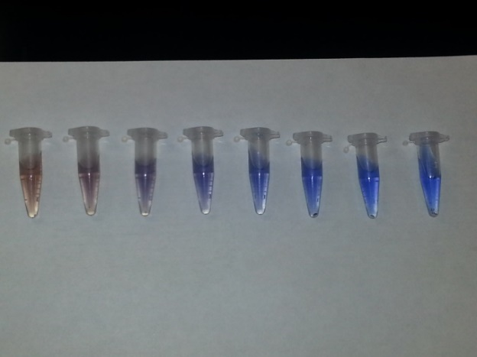
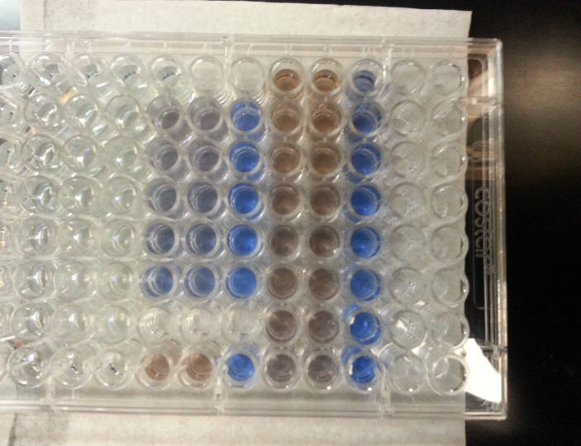
Methodology

