Slide 1
Dog Breed Analyzer
Bollenmiller, Wilhelm
Hochschule München
25. Januar 2018
Notes:
1

Slide 2
Projektziel
Native Android Application
Use of Deep Learning Frameworks
Classify Dog Breeds live
Challenge between performance and accuracy
Notes:
1

Slide 3
Methods
ImageNet Stanford Dog Dataset, Udacity Dog Project Dataset
Framework Tensorflow Lite & Mobile
Mobilenet 0.50, 1.0, InceptionV3
Python, Bazel
Android Studio
Notes:
1

Slide 4
Realization
Installation of required software
Retraining the pre-trained model
Optimizing the model
Realization of the Android app
Notes:
1

Slide 5
Conclusion
Tensorflow Lite
Mobilenet vs InceptionV3
 | Mobilenet_0.5 LR0.007_700 | Mobilenet_1.0 LR0.01_500 | InceptionV3 LR0.03_4000
Accuracy (20 images) | 0,4838197125 | 0,4584744525 | 0,700055786
classification time in app | 246,8 ms | 320,55 | 1108,2 ms
model size | 1.8 MB | 4.8 MB | 24.1 MB
Notes:
1

Slide 6
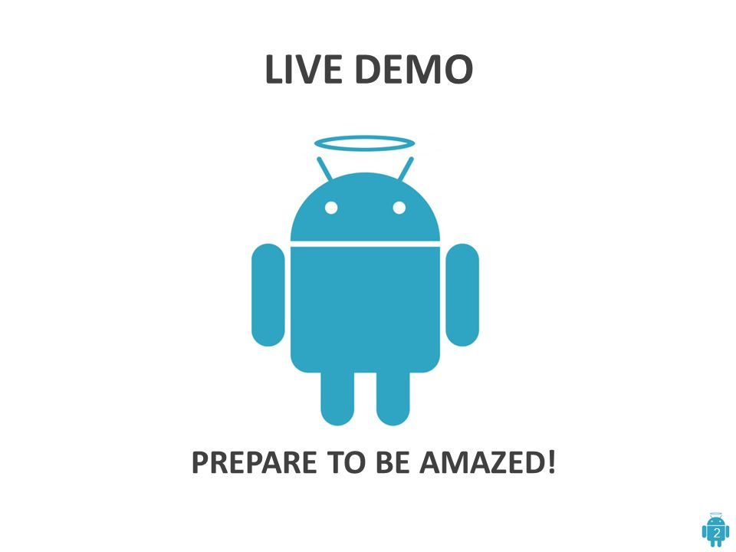

Slide 7
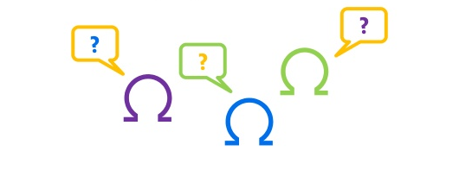
Vielen Dank für Ihre Aufmerksamkeit!
Fragen?
Vielen Dank!
Notes:
1

