Slide 1
Dog Breed Analyzer
Bollenmiller, Wilhelm
University of Applied Science Munich
25. Januar 2018
Notes:
1

Slide 2
Scope
Native Android application
Use of Deep Learning frameworks
Classify Dog Breeds live
Challenge between performance and accuracy
Notes:
2

Slide 3
Methods
ImageNet Stanford dog dataset, Udacity dog project dataset
Framework Tensorflow Lite & Mobile
Mobilenet 0.50, 1.0, InceptionV3
Python, C++ (Bazel)
Android Studio
Notes:
3

Slide 4
Realization
Installation of required software
Retraining the pre-trained model
Optimizing the model
Realization of the Android app
Notes:
4

Slide 5
Conclusion
Tensorflow Lite
MobileNet vs InceptionV3
 | MobileNet_0.5 LR0.007_700 | MobileNet_1.0 LR0.01_500 | InceptionV3 LR0.03_4000
accuracy (20 images) | 0,4838 | 0,4584 | 0,7001
classification time in app | 246,8 ms | 320,55 | 1108,2 ms
model size | 1.8 MB | 4.8 MB | 24.1 MB
Notes:
5

Slide 6
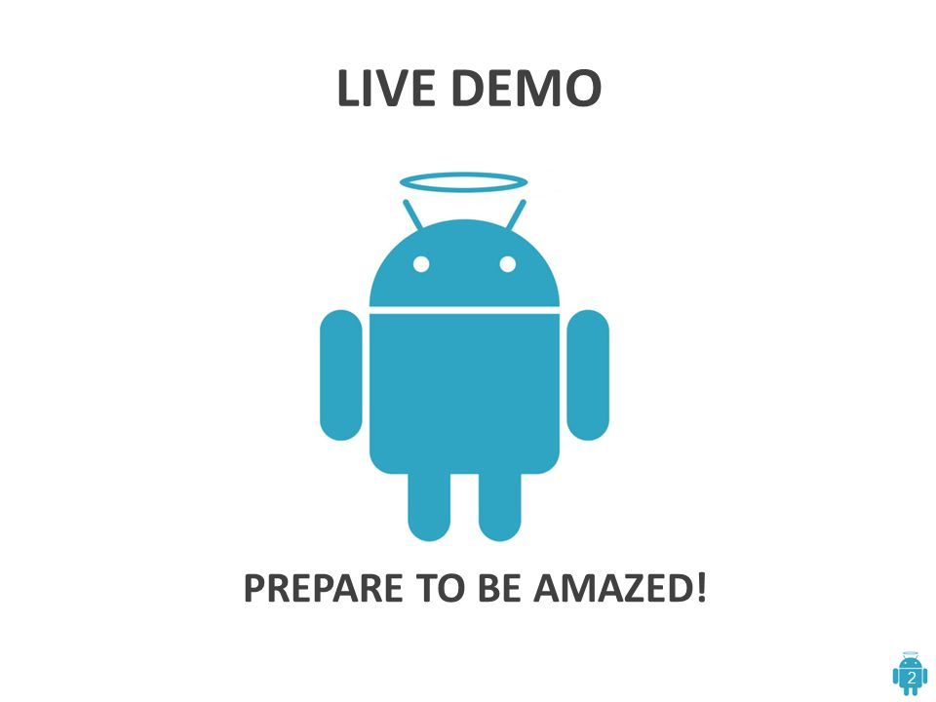

Slide 7
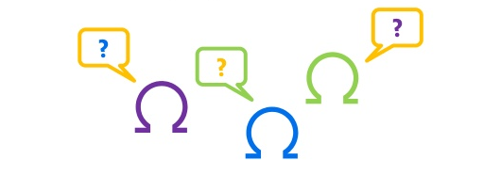
Thanks for your attention!
Questions?
Notes:
7

