Slide 1
Dog Breed Analyzer
Bollenmiller, Wilhelm
Hochschule München
25. Januar 2018
Notes:
1

Slide 2
Projektziel
Native Android Application
Use of Deep Learning Frameworks
Classify Dog Breeds live
Challenge between performance and accuracy
Notes:
1

Slide 3
Methods
ImageNet Stanford Dog Dataset, Udacity Dog Project Dataset
Framework Tensorflow Lite & Mobile
Mobilenet 0.50, 1.0, InceptionV3
Python, Bazel
Android Studio
Notes:
1

Slide 4
Realization
Installation of required software
Retraining the pre-trained model
Optimizing the model
Building the Android app
Notes:
1

Slide 5
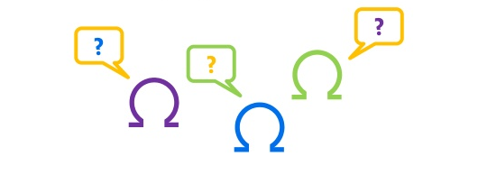
Vielen Dank für Ihre Aufmerksamkeit!
Fragen?
Vielen Dank!
Notes:
<Foliennummer>

